Slide 1

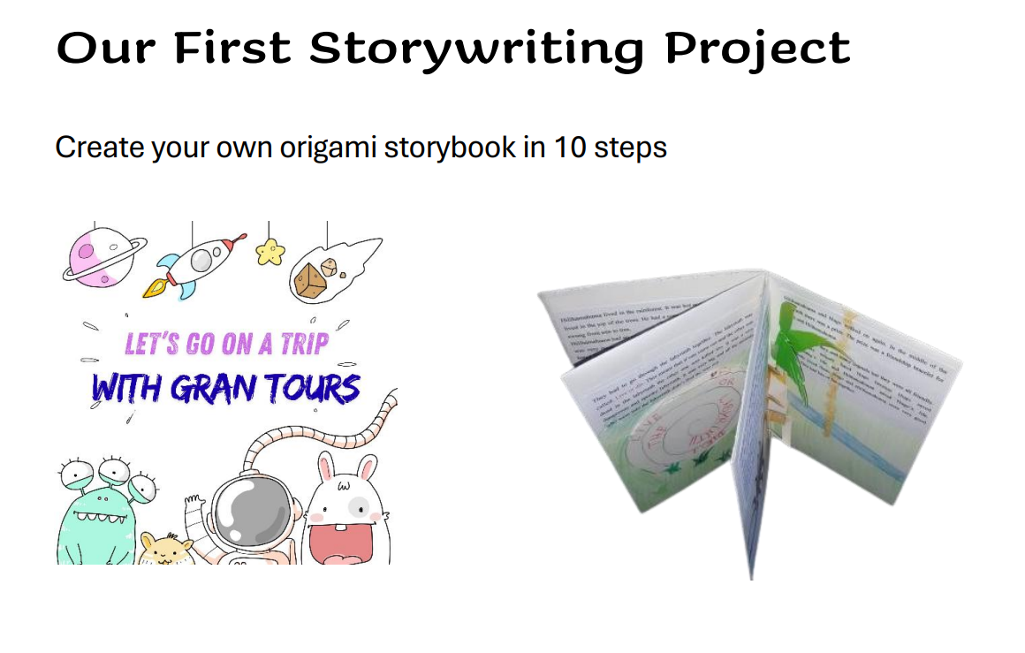

Storywriting with the Help of AI
Écrire des histoires
à l'aide de l'IA
A first storywriting project for young learners
ESL, A2
By Elisabeth Pölzleitner

Slide 2
The Setting
Le Cadre
12 year old ESL students in Austria
Low A2 level
A high percentage of students from educationally disadvantaged backgrounds, and limited language exposure and language awareness
Des élèves de 12 ans suivant des cours d'anglais langue seconde en Autriche
niveau A2 faible
un pourcentage élevé d'élèves issus de milieux défavorisés sur le plan scolaire, avec une exposition limitée à la langue et une conscience linguistique restreinte

Slide 3
My Teaching Goals
Mes objectifs pédagogiques
Make the reading of picture books interesting and fun, especially for students with little reading experience.
Practice top-down reading and listening strategies.
Practice writing stories and expand vocabulary
Provide students with an opportunity to produce a piece of writing they can be proud of.
Maintain high levels of student engagement and agency.
Rendre la lecture d'albums attrayante et ludique, en particulier pour les élèves ayant peu d'expérience en lecture.
Mettre en pratique des stratégies de lecture et d'écoute de haut en bas.
S'exercer à écrire des histoires et enrichir son vocabulaire.
Offrir aux élèves l'occasion de produire un texte dont ils peuvent être fiers.
Maintenir un niveau élevé d'implication et d'autonomie chez les élèves.

Slide 4


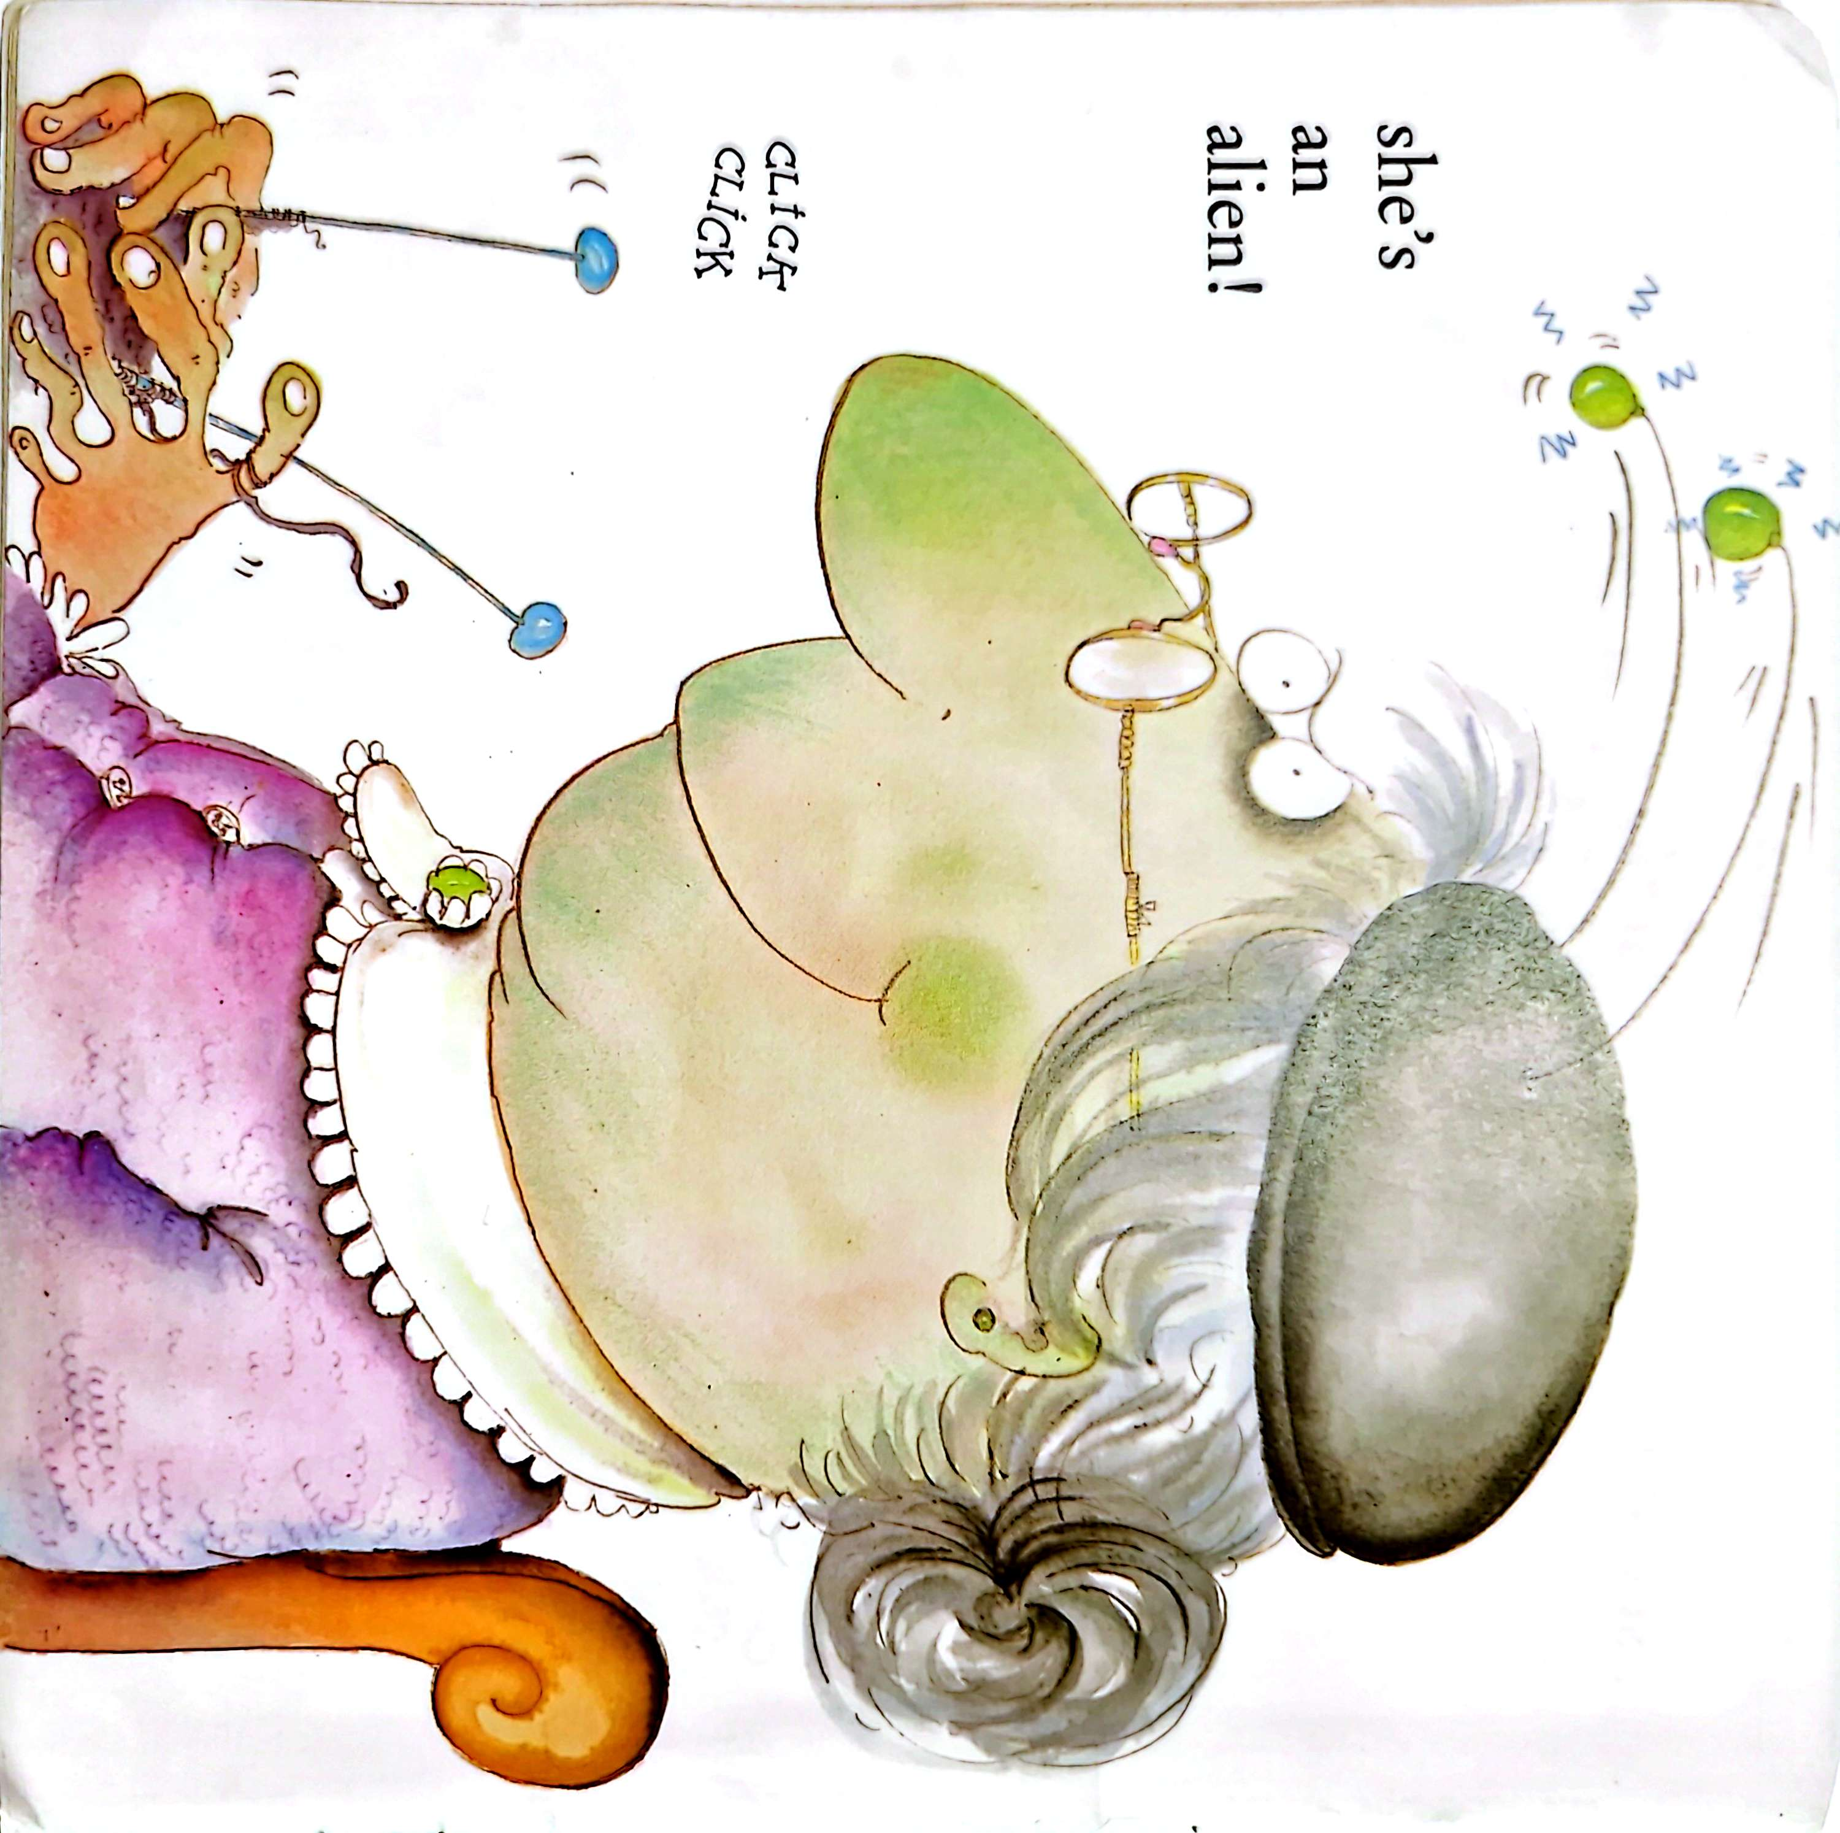
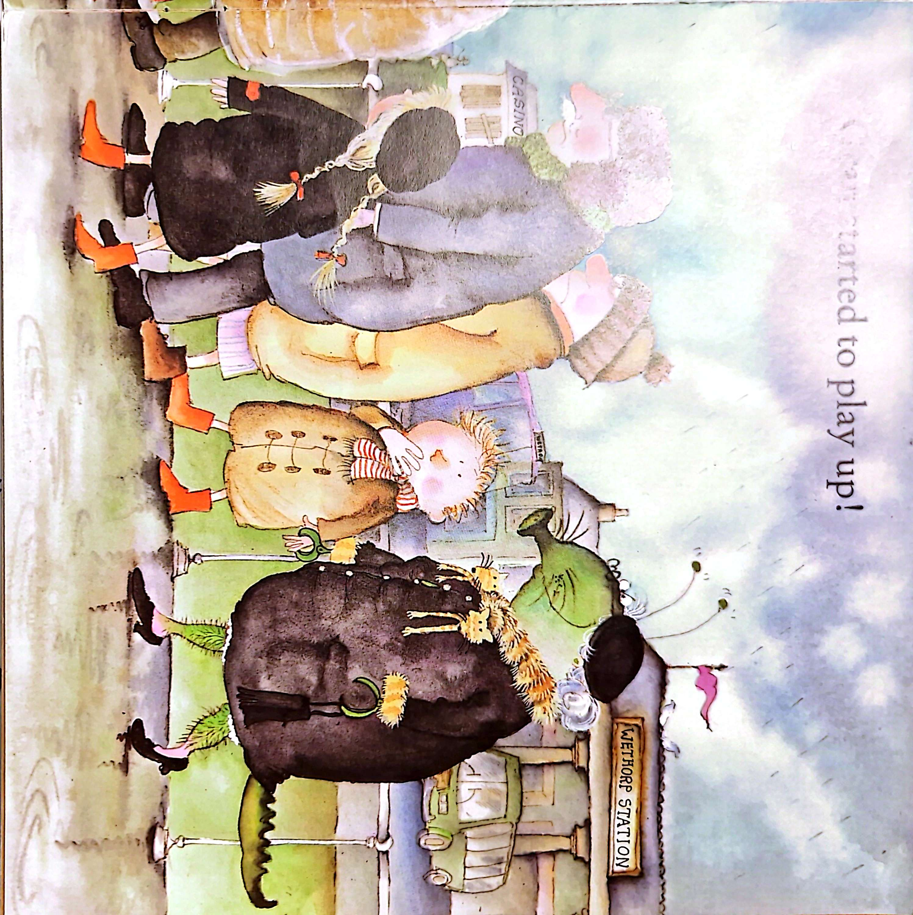
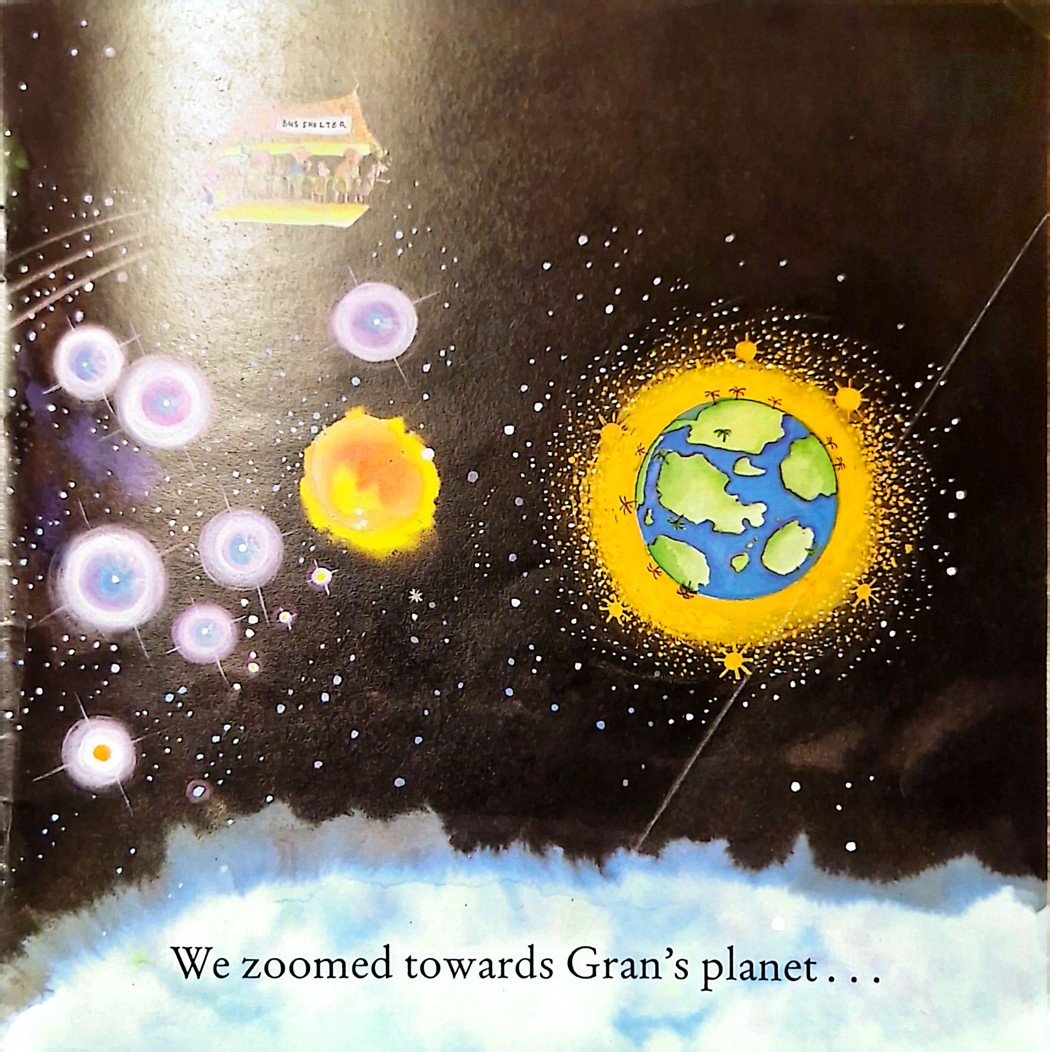
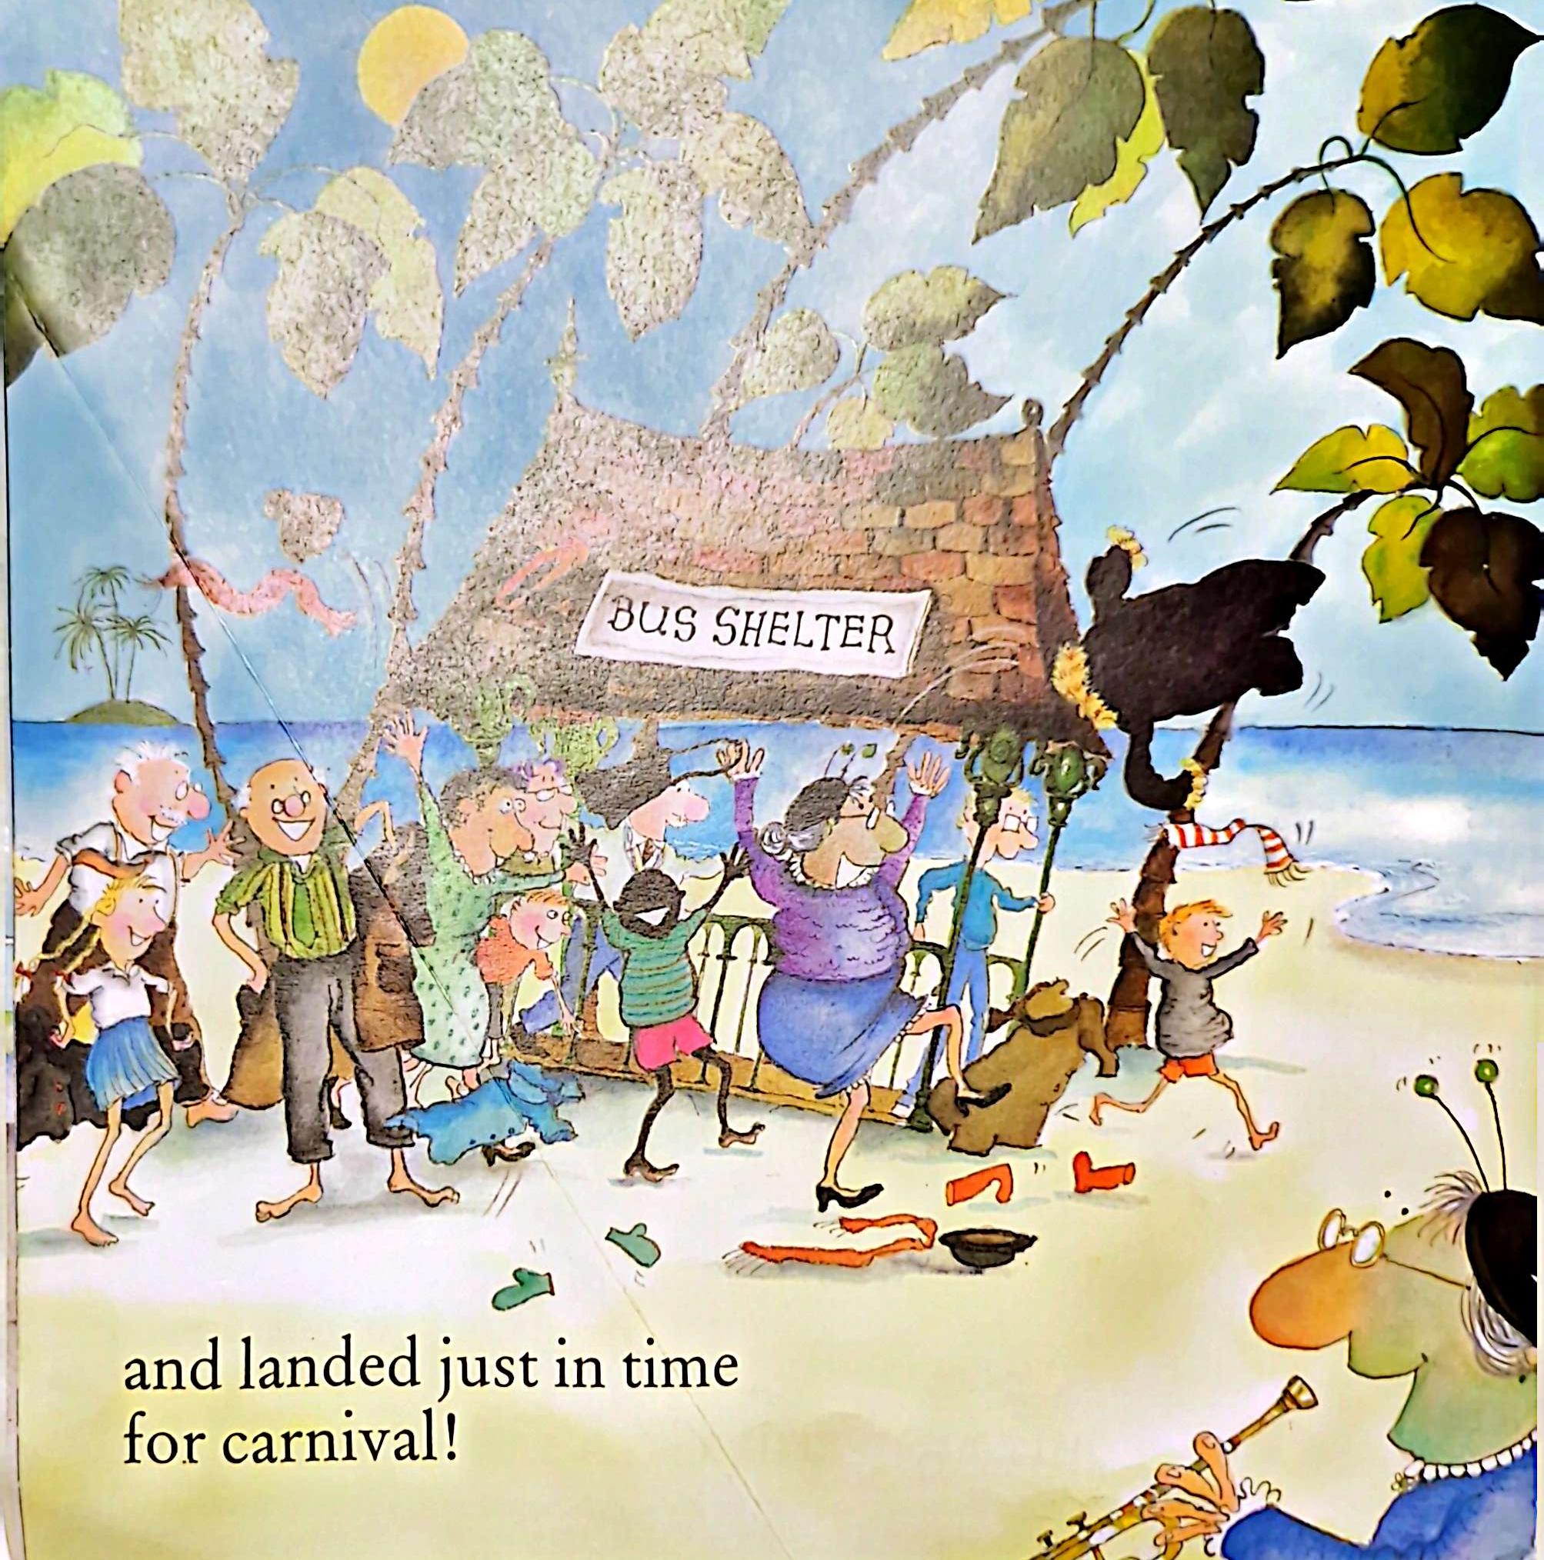
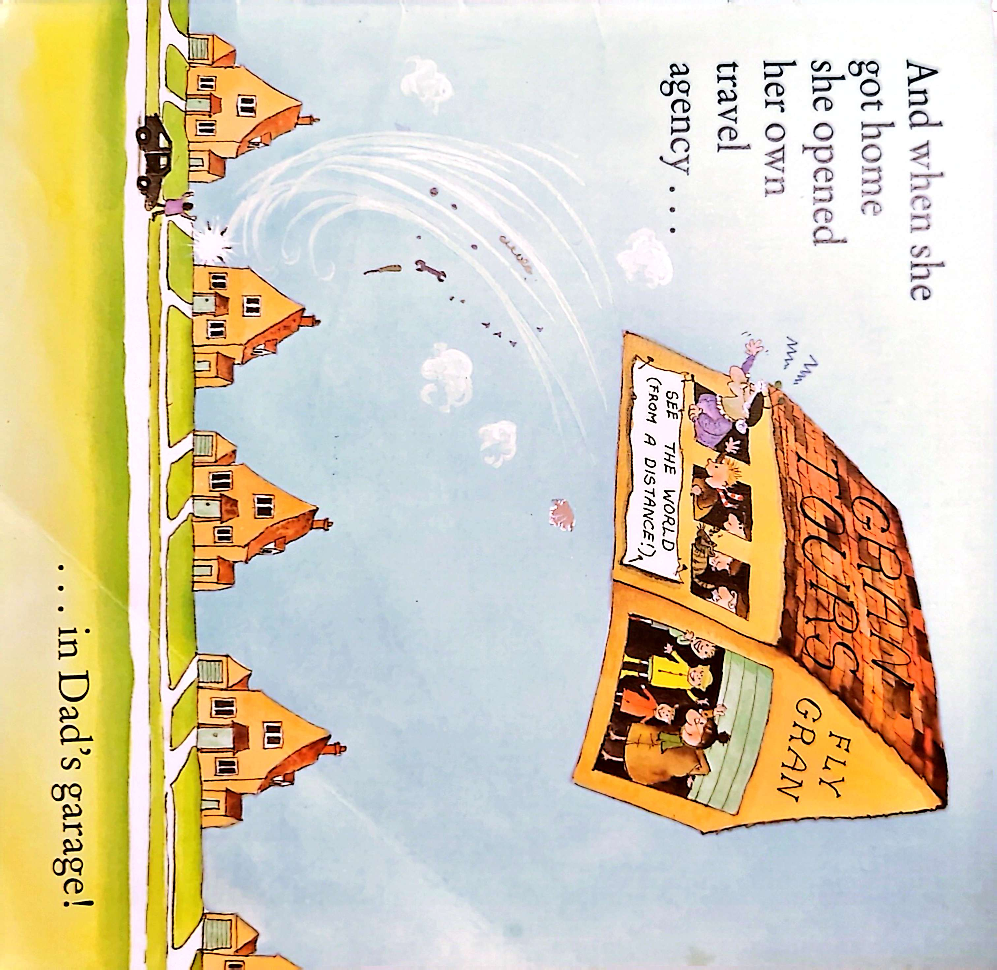
Step 1: Reading / Listening to the Story
Étape 1 : Lire / Écouter l'histoire

Slide 5
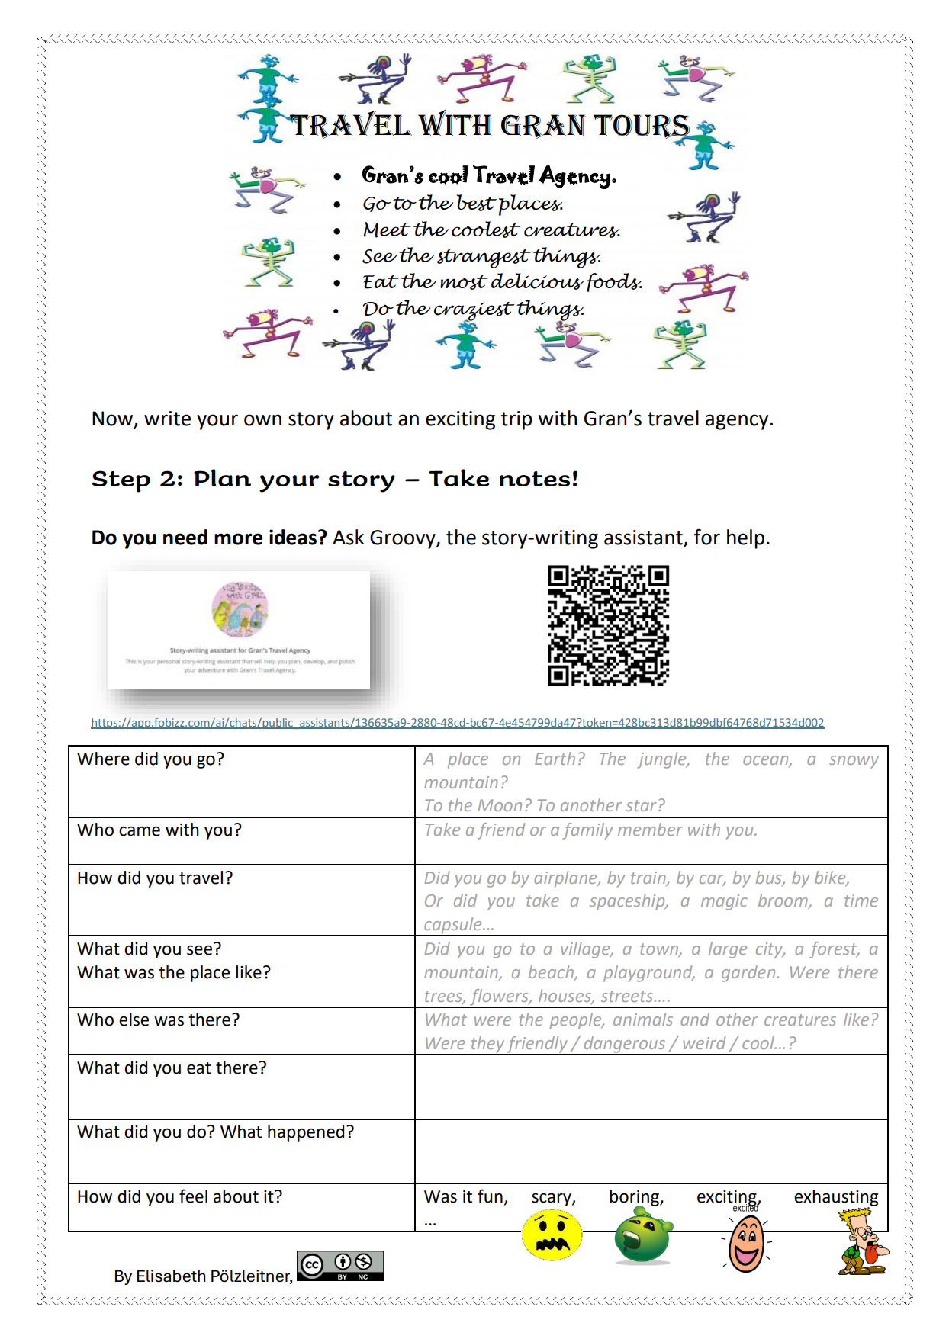
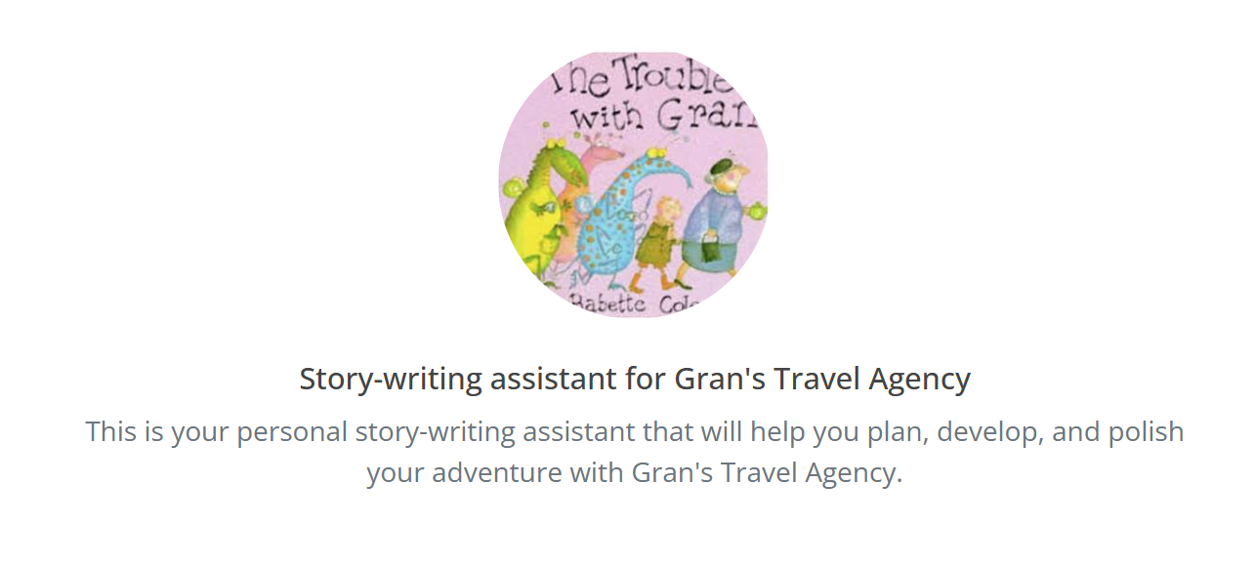
Step 2:
Planning the story
Étape 2 : Planification de l’histoire
Without AI sans IA
With AI avec IA

Slide 6
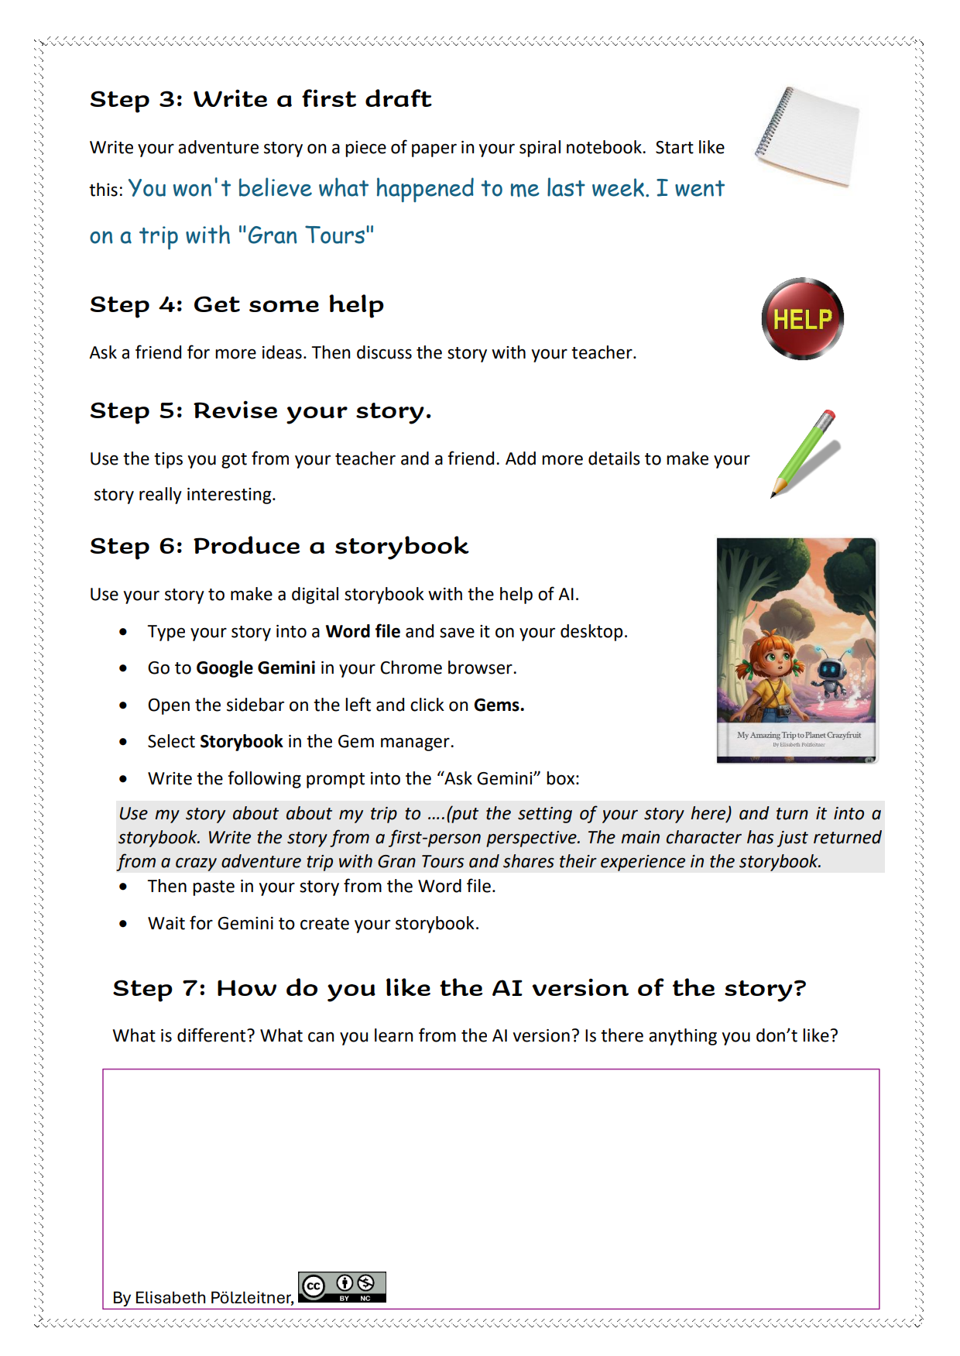
3. Writing a first draft
Rédaction d'un premier jet de l’histoire
4. Getting human feedback
Recueillir des commentaires humains
5. Revising the story Réviser l'histoire
6. Producing an AI storybook
Créer un livre illustré généré par l'IA
7. Critical reading of the AI version Lecture critique de la version générée par l'IA

Slide 7
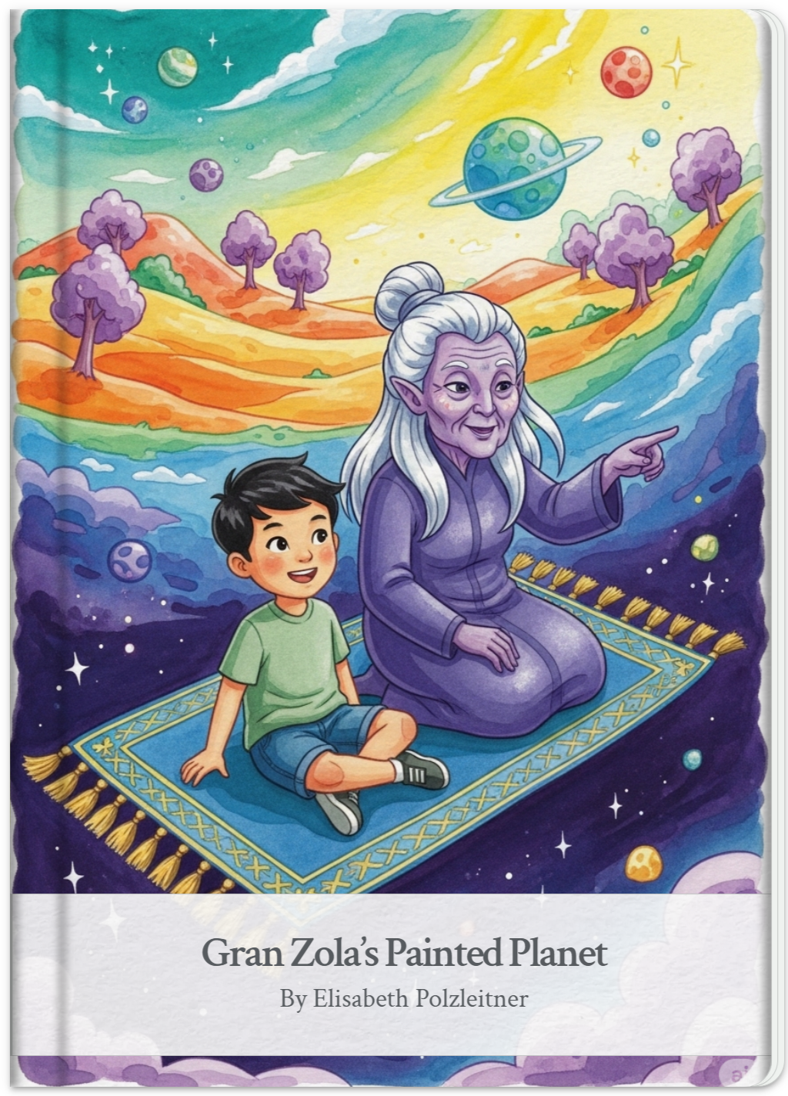
Comparing the two versions comparer les deux versions
Student Example: A2
Gemini Storybook
You won’t believe what happened to me last week. On a nice day I sat with my gran in the park. Gran is an alien. She told me that we could travel to a cool fantasy planet. She gave me a travel ticket. The next day we flew to this planet with a flying carpet. We only took water with us, because the trip only took two hours. We visited the moon and all the other planets and then we landed on my fantasy planet.
My fantasy planet was white, but gran painted it in lots of colors. We landed in front of a castle. The castle was made of crystal. Lots of animals sat in front of the castle and greeted us. One animal was half bear and half lion and had wings. It gave me a feather from its wings.
My brother said “I am hungry”. Gran said, “Just go up the stairs and get some food.”
We both ran to the steps and when I put my foot on the first step, I heard some music. Each step made a different sound. There were about 1000 steps. On top of the stairs we found lots of food: strange fruits, pink and green cakes and blue sausages. Everything was really good.
Then gran took us to the beach. The water was pink and the sand was green. We screamed and played in the water until we were tired. Then gran clapped her hands and we flew back home.
This was the coolest trip in my life.

Slide 8
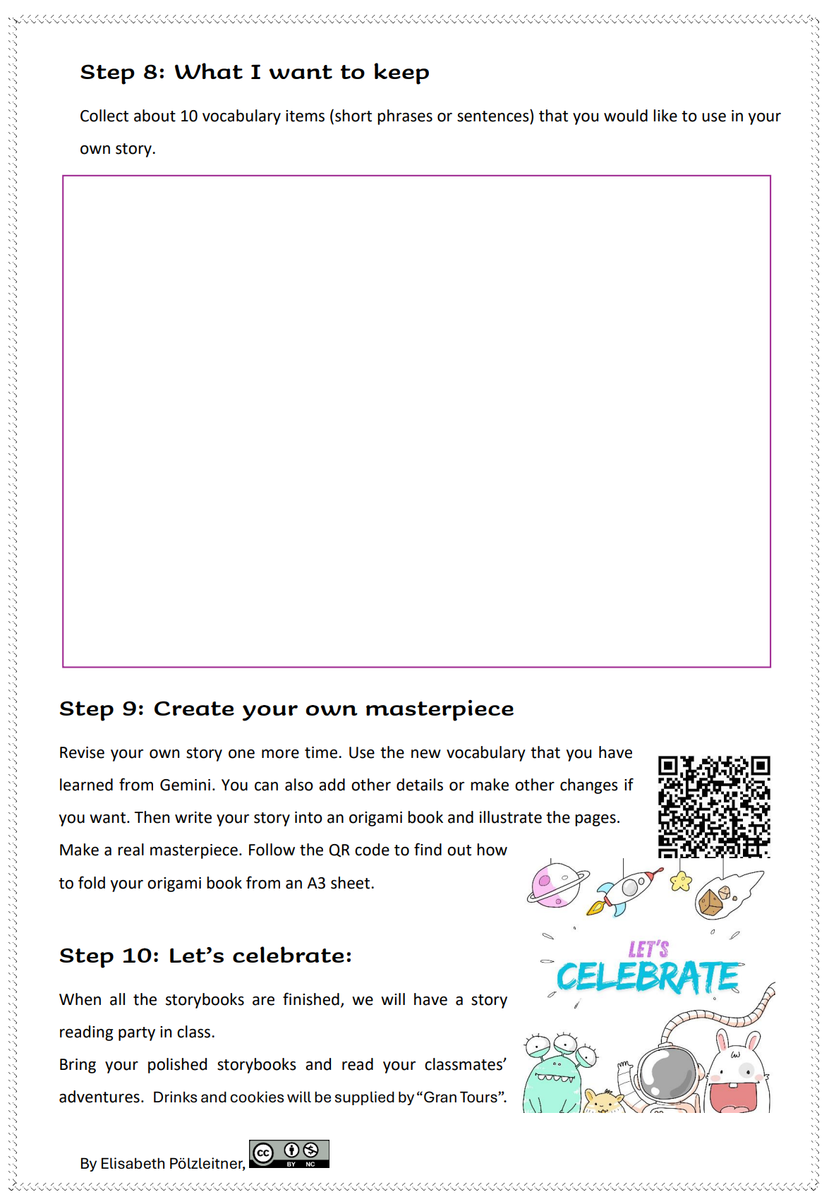
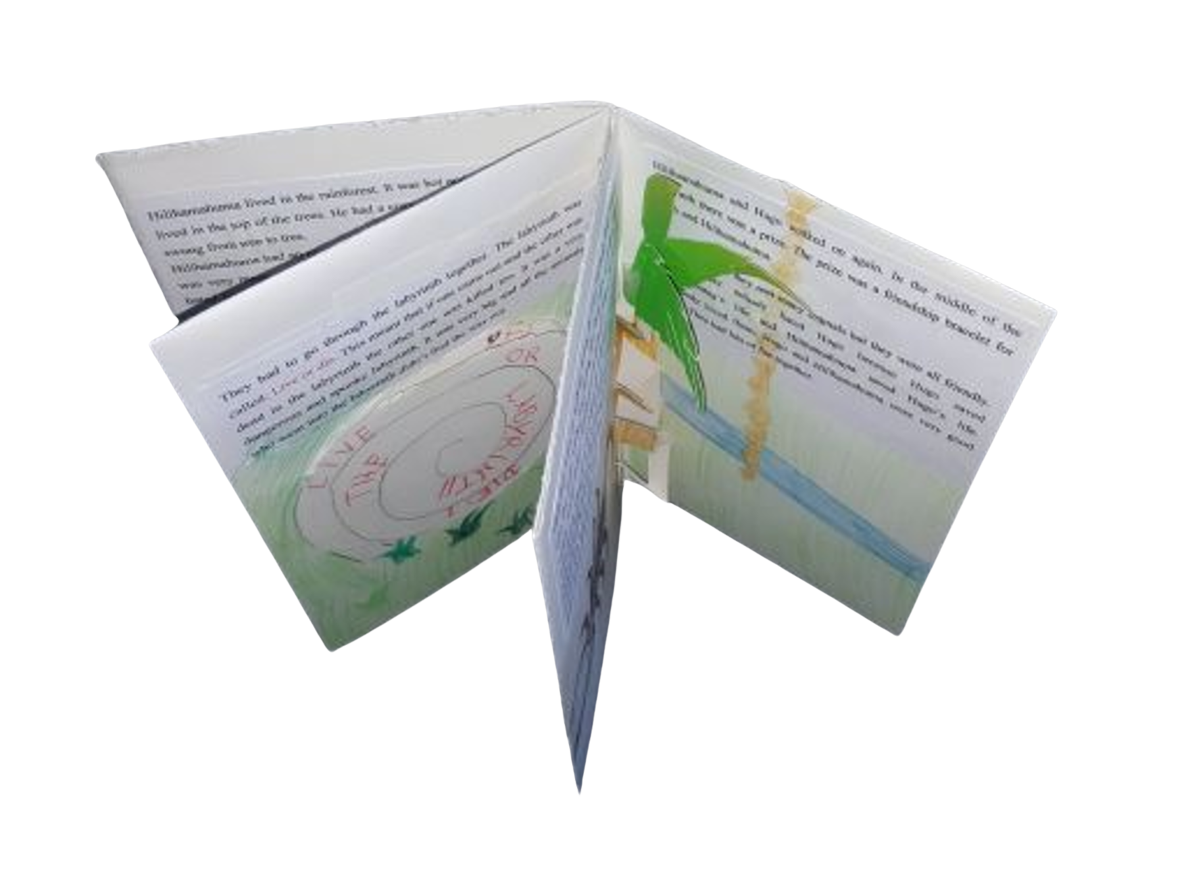
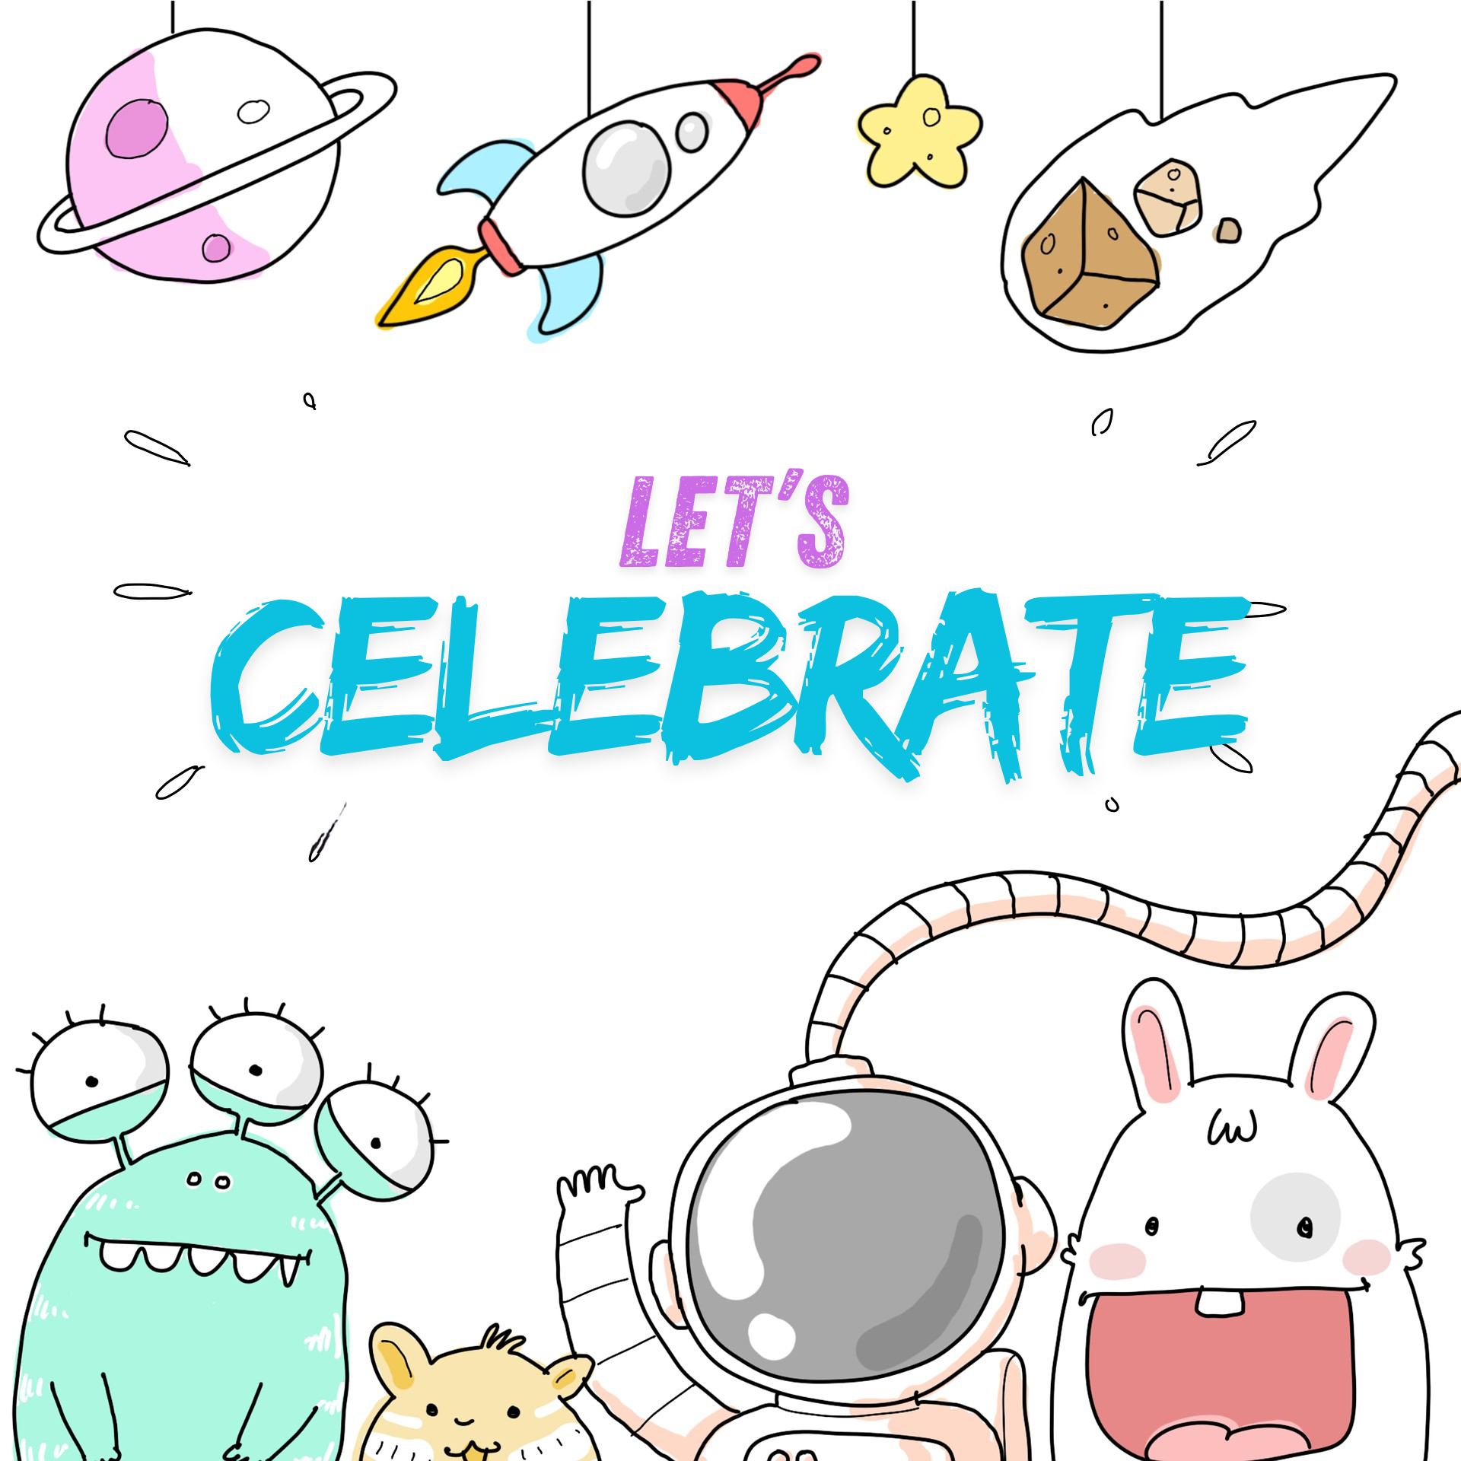
8. Learning from the AI Example
Tirer les leçons de l'exemple de l'IA
9. Creating an Origami Masterpiece
Créer un chef-d'œuvre d'origami
Celebrating achievement
Célébrer les réussites

Slide 9
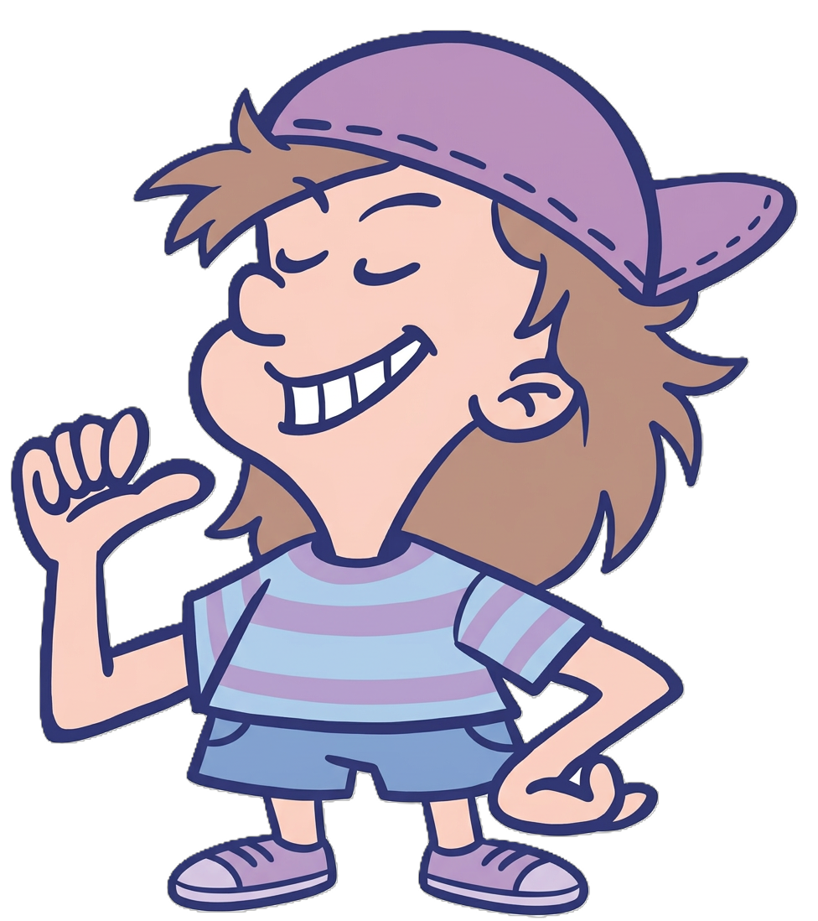


My Main Concerns about Using AI in this Context
Mes principales préoccupations concernant l'utilisation de l'IA dans ce contexte
Maintaining student agency and authorship
Préserver l'autonomie et la responsabilité des élèves
Safe and age-appropriate use of AI
Une utilisation sûre et adaptée à l'âge de l'IA
Easy access and use of the AI tools
Facilité d'accès et d'utilisation des outils d'IA

Slide 10
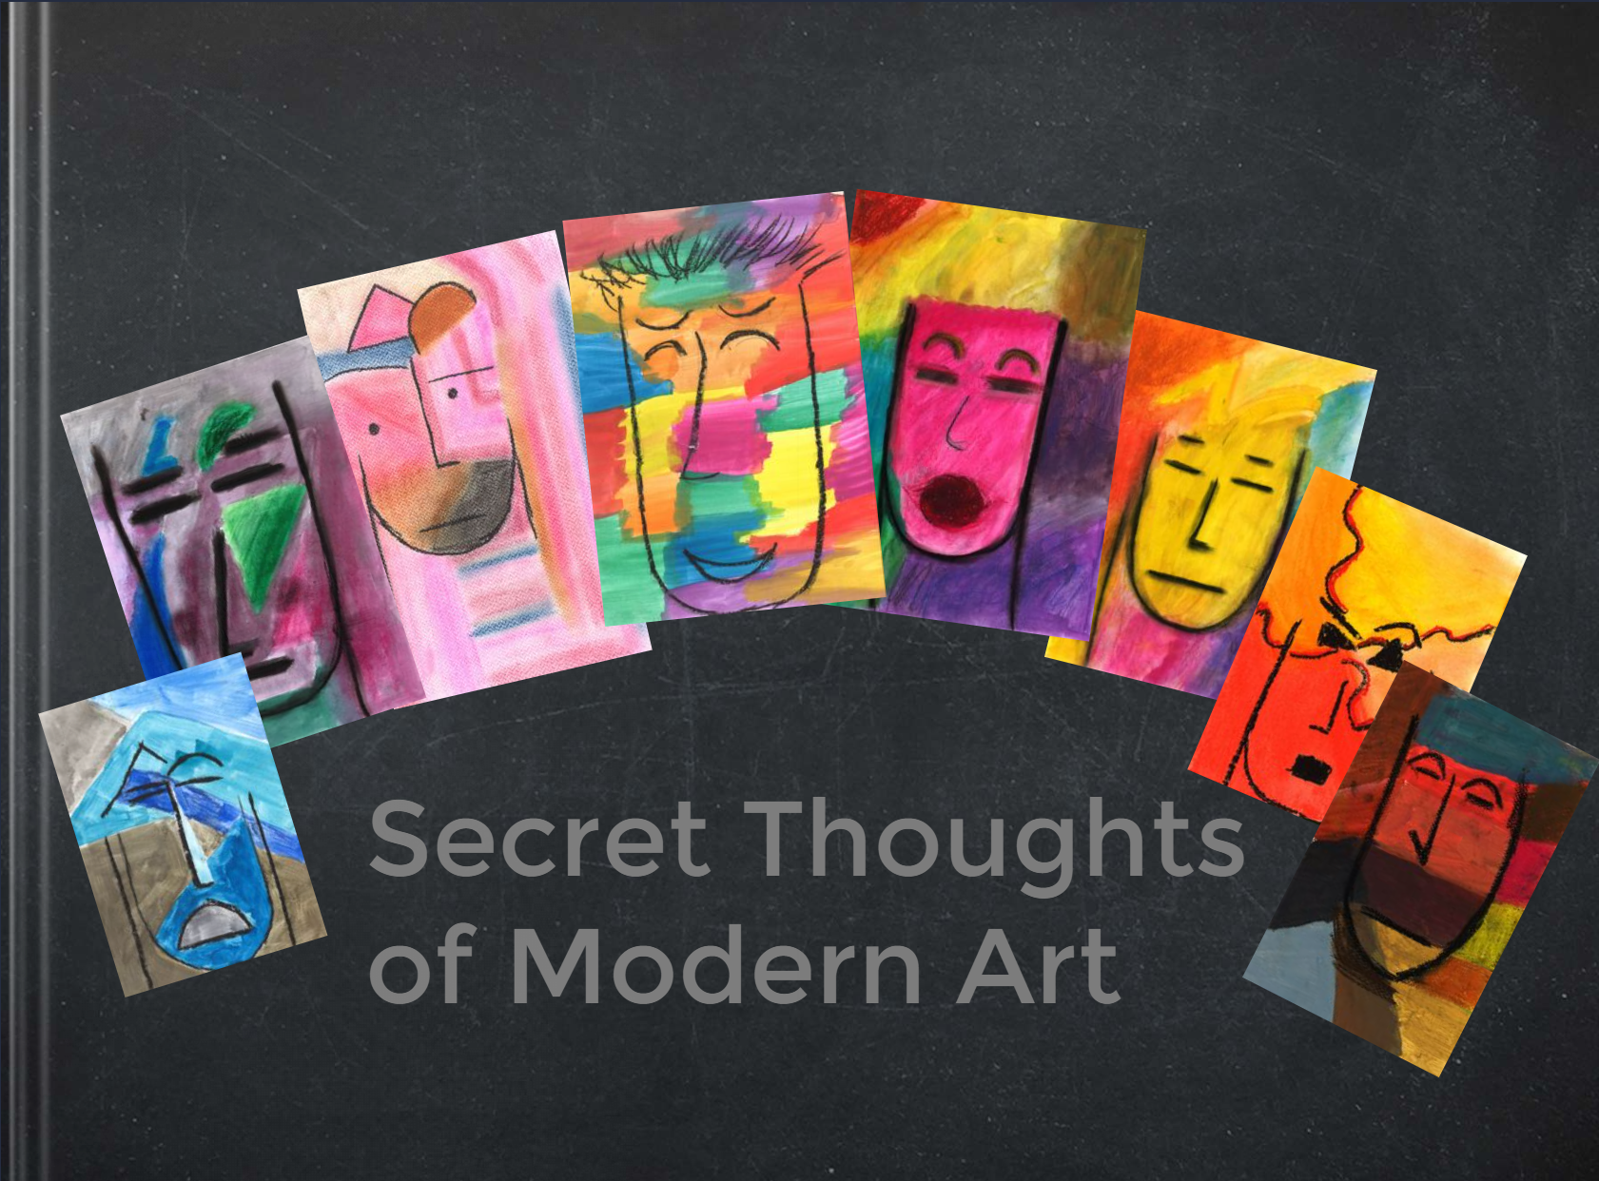
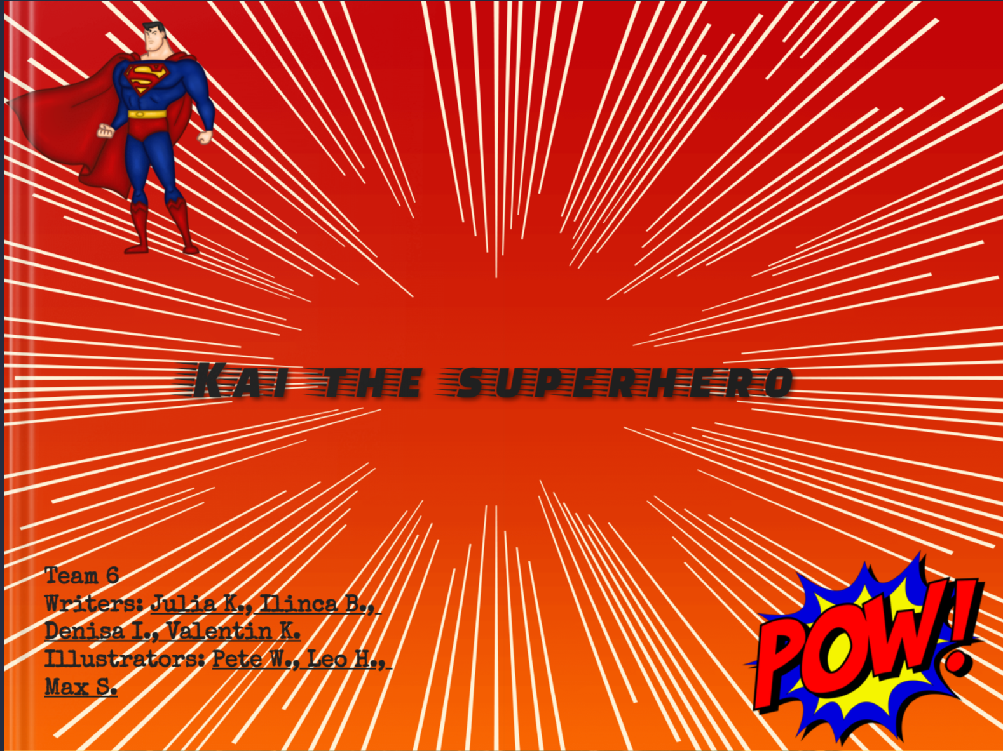
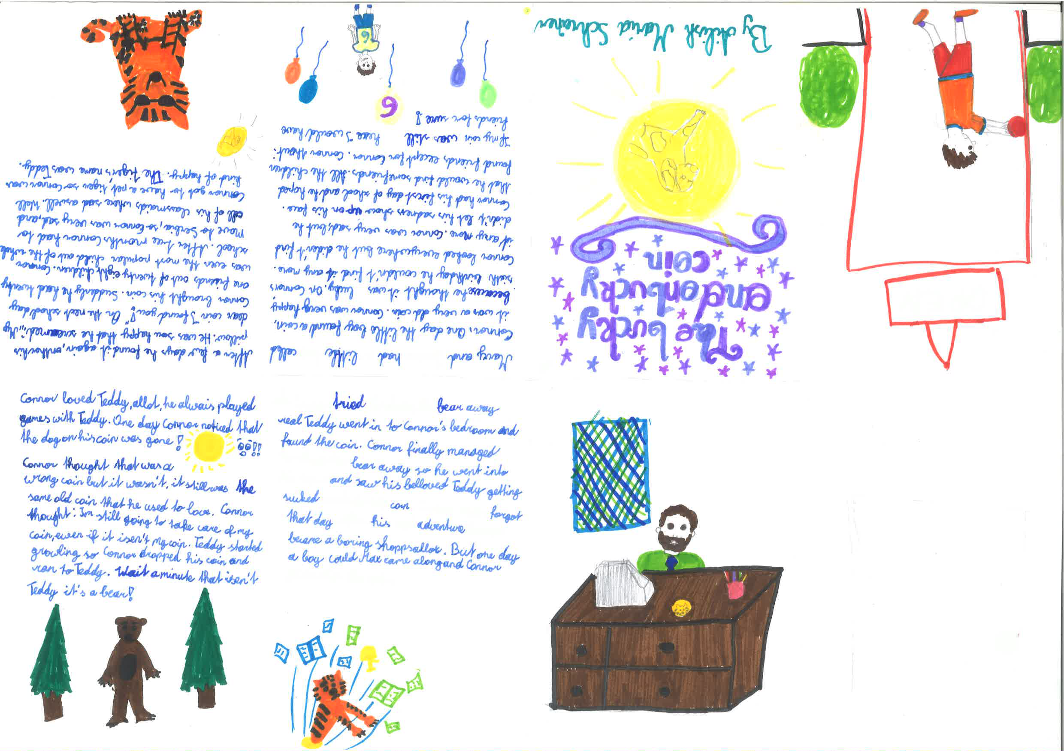
AI in Writing: Knowing When to Step Back
L'IA dans l'écriture : savoir quand prendre du recul

