Slide 1

Artificial Intelligence & Language Teaching
Mgr. Barbora Orlická
Instructional Designer
Center for Digital Teaching and Learning
University of Graz

Slide 2
How did we get here?

Slide 3
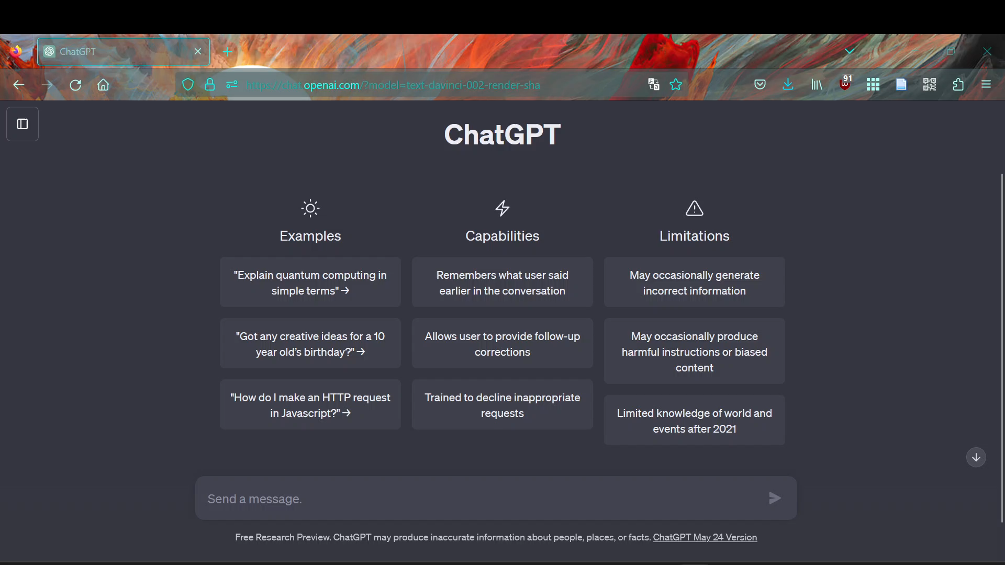
The Hype

Slide 4
Artificial Intelligence (AI)
Everyday applications for AI:
Machine learning (image recognition, text analysis).
Speech recognition and voice output (Google Assistant, Amazon Alexa, Apple Siri).
Word processing (automated writing, grammar and spell checking).
Autonomous cars, robots
…

Slide 5
Generative Artificial Intelligence
Enables to create new content by leveraging existing data
Based on Machine Learning:
Recognizing patterns in data
Learning patterns from data
Generate data according to learned patterns
Modalities:
Text ↔ Text
Text ↔ Audio
Text ↔ Video
Text ↔ Image
…

Slide 6
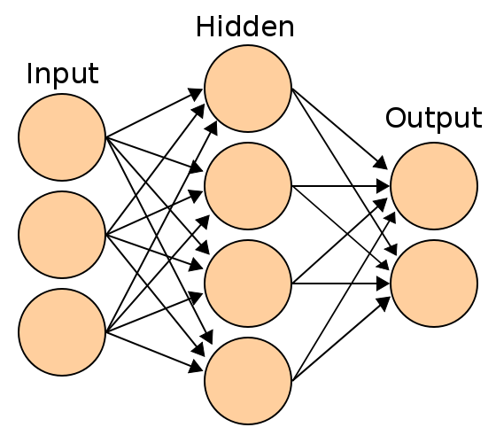
ChatGPT
OpenAI product
Released to public in November 2022
Free "research preview”
Freemium pricing model
Trained to produce “human-sounding” language
Language models:
GPT-3.5 (LLM – Large Language Model) and
GPT-4 (LMM – Large Multimodal Model
GPT = Generative Pre-trained Transformer
The model is pre-trained on a large dataset in order to generate text that is similar to the text it was trained on. It uses a transformer neural network architecture.
Illustration of the topology of a generic
Artificial Neural Network (ANN). Wikimedia Commons

Slide 7
Applications and fields of use (for text)
summarize
paraphrase
extract (keywords)
translate
generate code
improve, simplify
propose, brainstorm
continue writing
explain
find action items / to-dos
Change style (tone)
recognize sentiment
classify (assign categories)
answer questions
convert (lists, table, CSV etc.)
conduct dialog

Slide 8
Use cases for language teaching
Create text on topic XY
Create versions according to certain criteria
Style / register / level / vocabulary / structure / perspective / ...
Questions from the content (MC, SC, comprehension, ...)
Exam questions according to pattern (Cambridge, Goethe, own, etc.)
Generate a series of exercises (text > vocabulary > cloze > etc.)
Differentiated task
Text to audio (play.ht)
text to picture
"Model sentences"
Writing task assessment → have texts assessed by rubric → generate feedback & suggestions for improvement (*privacy!).
Example (YT Video)

Slide 9
Problems & Concerns
language model, not knowledge model
→ DO NOT TRUST ANYTHING IT SAYS
Fact-check + your own expertise
detection / recognition of AI-generated content (≠ plagiarism detection) in unreliable
partly generates fictions / hallucinations
Accepts false premises & lacks some reasoning skills
Doesn’t do well at math
It was trained on massive amount of data without explicit permission
It can use the content uploaded by users for further training
It can reproduce biases from the training data
Long-term implications of AI are unknown

Slide 10
Extensions / workarounds
Facts: Combination with search engine functionality or knowledge base (e.g. Microsoft Bing)
Chain-of-thought: intermediate steps for complex problems; step-by-step explanations
Skilled prompt design

Slide 11
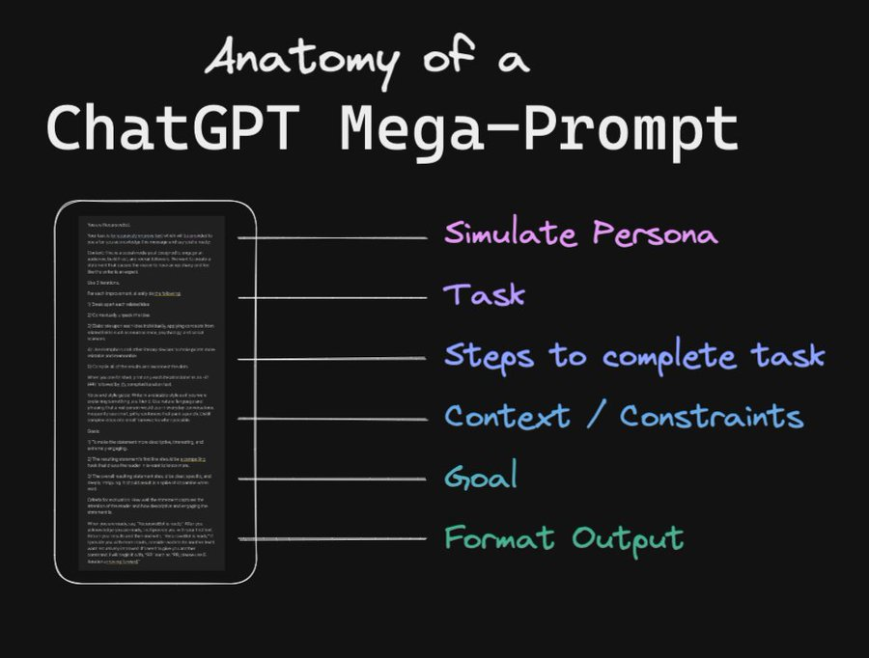
Tips for „Prompting“
Clarity in the definition and purpose of the task
Provide relevant details and context
Precise instructions in small steps
Define role and persona ("act as" hack / act as ...)
Test and refine Prompting as an iterative process
(See „From Prompt to Megaprompt by Rob Lennon auf Twitter)

Slide 12
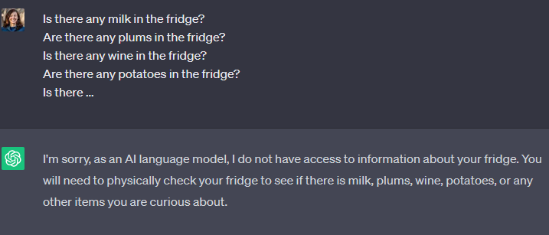
Quality matters
The quality of the results is directly related to the quality of the input (prompt).

Slide 13
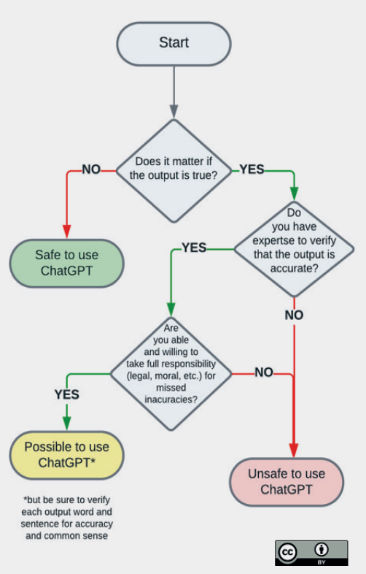
When is it „safe“ to use ChatGPT?
Flowchart from Aleksandr Tiulkanov, AI and Data Policy Lawyer, 2013 for the publication ChatGPT and Artificial Intelligence in Higher Education: A Quick Start Guide (UNESCO)

Slide 14
Additional Info

Slide 15
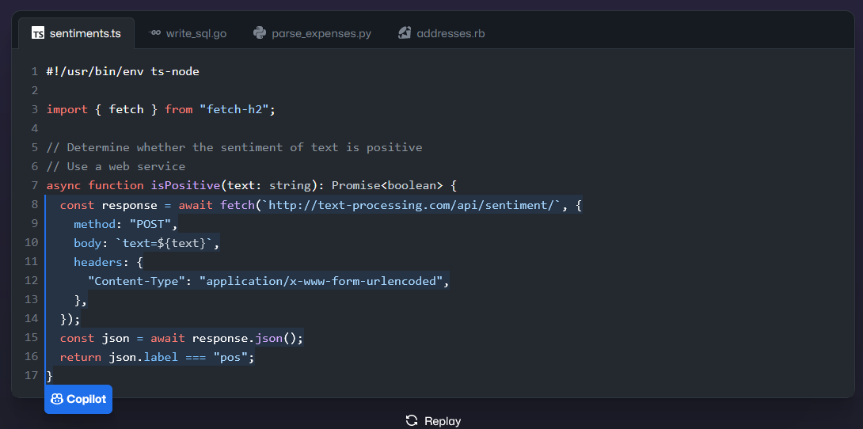
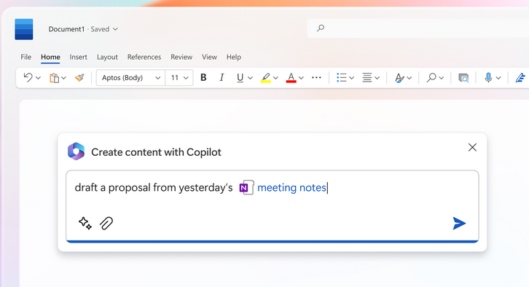
Some distinctions
Language models
Chatbots
specialized AI services
Copilot(s) and plugins(integrated services).
E.g. in Microsoft Office 365, Github etc.

Slide 16
What are Large Language Models (LLMs)?
Artificial neural networks trained on large amounts of data using machine learning
LLMs can be used for a variety of tasks
LLMs can be further fine-tuned for more specific tasks
GPT = Generative Pre-trained Transformer
The model is pre-trained on a large dataset in order to generate text that is similar to the text it was trained on. It uses a transformer neural network architecture that allows it to use (millions of) parameters to weigh the importance of different parts when making predictions.

Slide 17
Language Models and Chatbots
OpenAI: ChatGPT
Anthropic: Claude
Google: Bard, Language models LaMDA und PaLM
Meta: Galactica (Research AI), Language model family „LLaMA“
Aleph Alpha: European AI, language model „Luminous“
Together: OpenChatKit (Open Source)
Open Assistant

Slide 18
Specialized services
Bing, You.com, Phind, Perplexity Combination with search engine
Consensus scientific answers to questions
Elicit, SciSpace AI Research Assistants
DeepL Write, Jenni Writing assistants
Questionaid Question Generator
Opinionate Argument Generator
And more
Notes:
Demos bei Nachfrage

Slide 19
AI Tool Collections (Selection)
Magic Tools https://www.magictools.online
AI Collection https://github.com/ai-collection/ai-collection
Futurepedia https://www.futurepedia.io/
AI Tools Directory https://aitoolsdirectory.com/
Thereʼs an AI for that https://theresanaiforthat.com/
VK:KIWA KI-Ressourcen
HCILAB.org

Slide 20
Use Cases & Examples

Slide 21
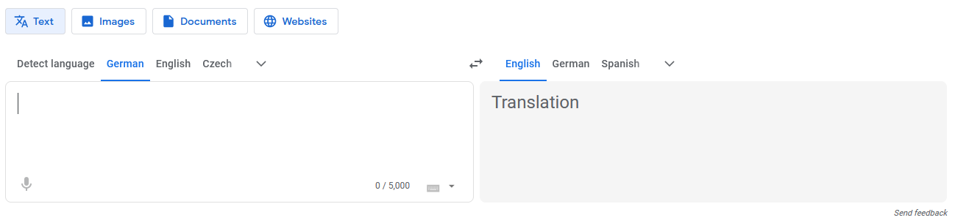
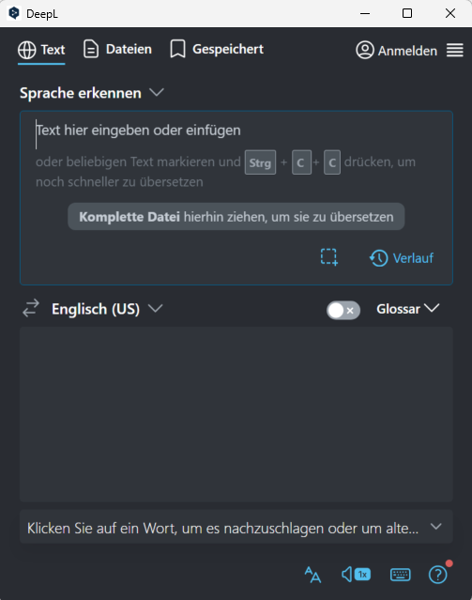
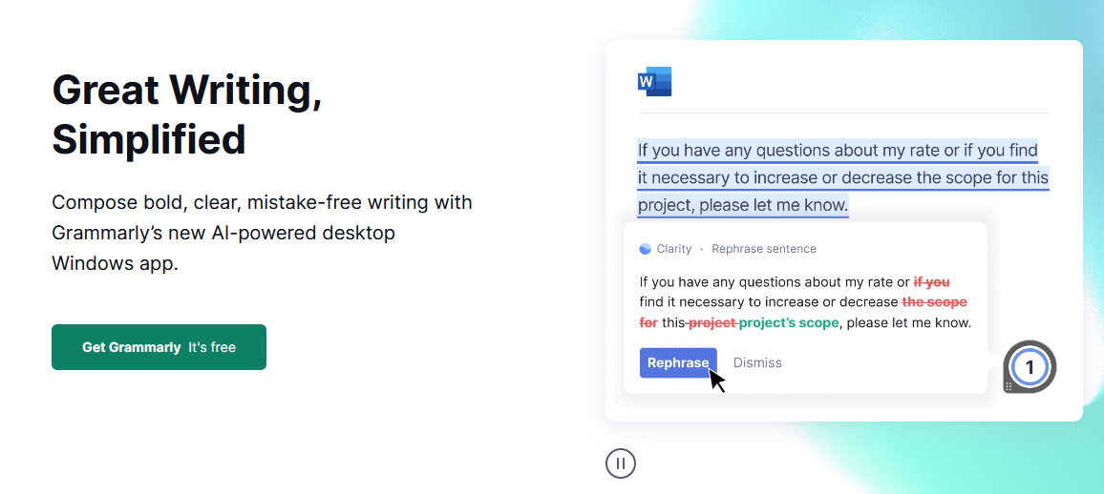
AI & Languages

Slide 22
Use cases for language teaching
Create text on topic XY
Create versions according to certain criteria
Style / register / level / vocabulary / structure / perspective / ...
Questions from the content (MC, SC, comprehension, ...)
Exam questions according to pattern (Cambridge, Goethe, own, etc.)
Generate a series of exercises (text > vocabulary > cloze > etc.)
Differentiated task
Text to audio (play.ht)
text to picture
"Model sentences"
Writing task assessment → have texts assessed by rubric → generate feedback & suggestions for improvement (*privacy!).
Example (YT Video)

Slide 23
Use Case for language learning
Query language information & explanations (grammar, translation, etc.)
Tandem partner (simulates any situation)
Have texts evaluated
Simplify / summarize texts (articles, news, ...)
Expand vocabulary (glossary, synonyms/antonyms, variants, ...)
It is important to accompany and support the students and to develop digital competencies together.

Slide 24
What does ChatGPT say?
Vocabulary building: Students can ask ChatGPT to provide definitions, synonyms, or antonyms for specific words they are learning. They can also ask for sample sentences using those words in context.
Grammar practice: Students can ask ChatGPT for examples of different verb tenses, sentence structures, or prepositions. They can also ask for explanations of specific grammar rules.
Writing prompts: ChatGPT can provide writing prompts for students to practice their writing skills. These prompts can be tailored to the students' level and can help them practice using new vocabulary and grammar structures.
Conversation practice: Students can practice their conversation skills by having a conversation with ChatGPT. They can ask and answer questions, practice asking for clarification, and practice using different sentence structures.

Slide 25
Examples

Slide 26
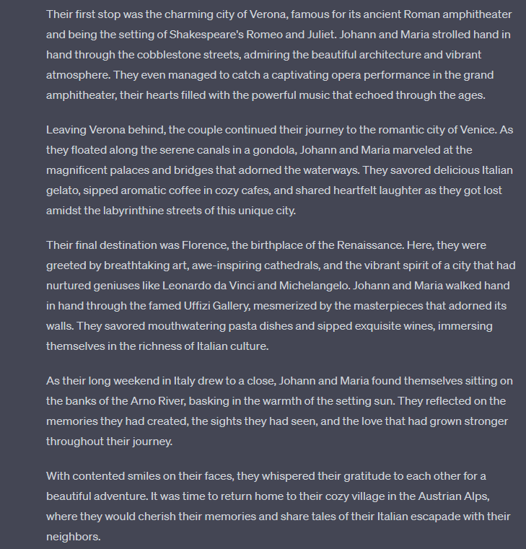
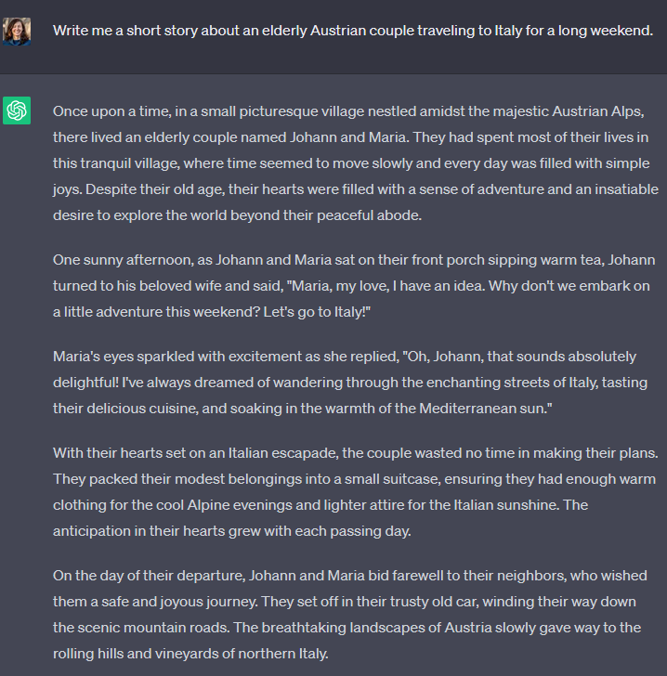
Generate text

Slide 27
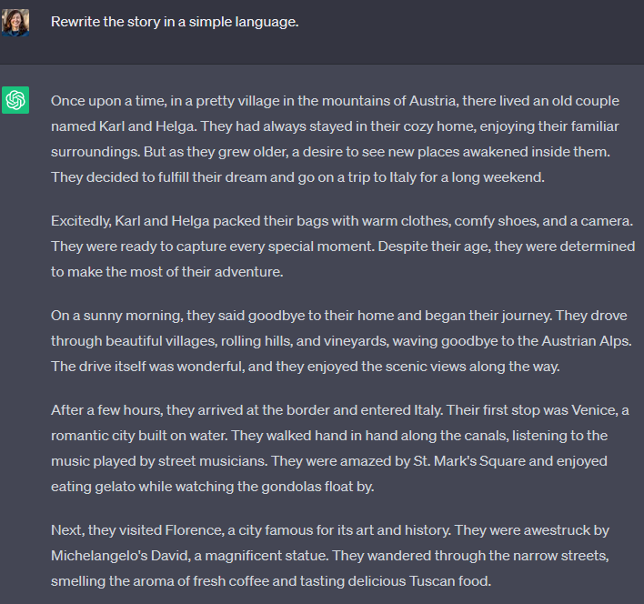
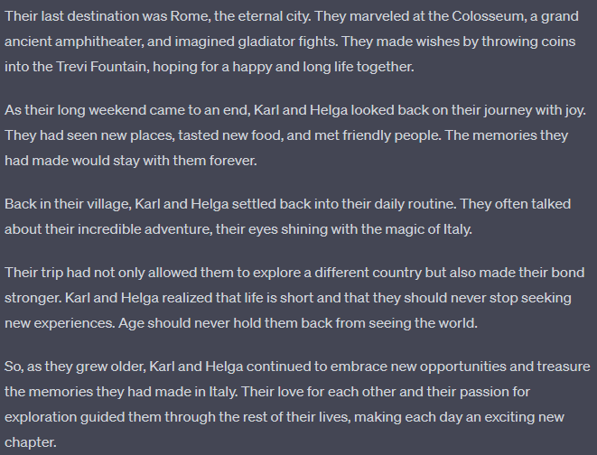
Shorten/simplify text

Slide 28
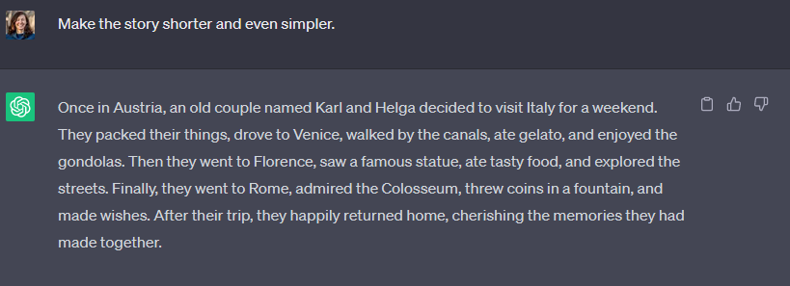
Shorten/simplify text

Slide 29
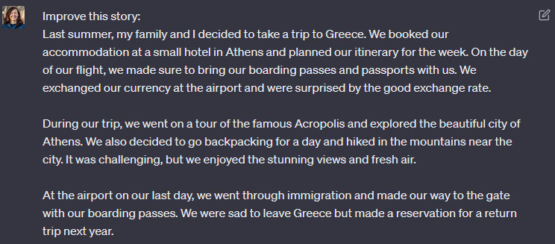
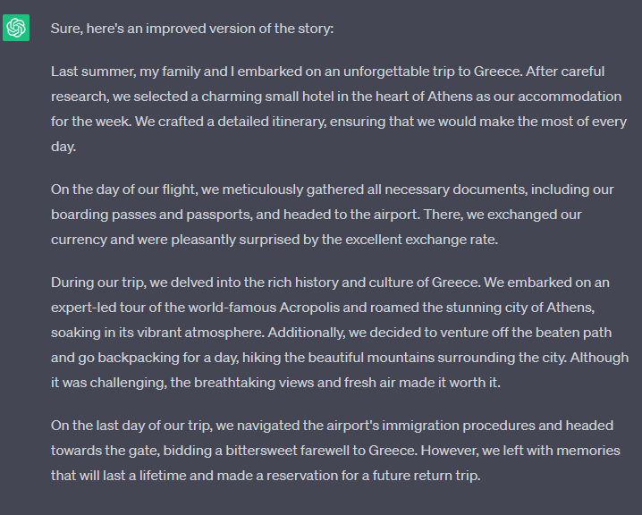
Improve text

Slide 30
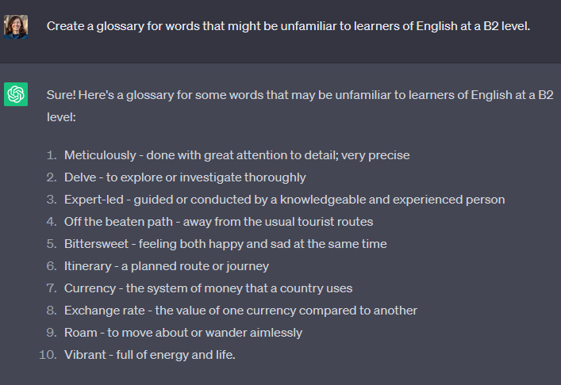
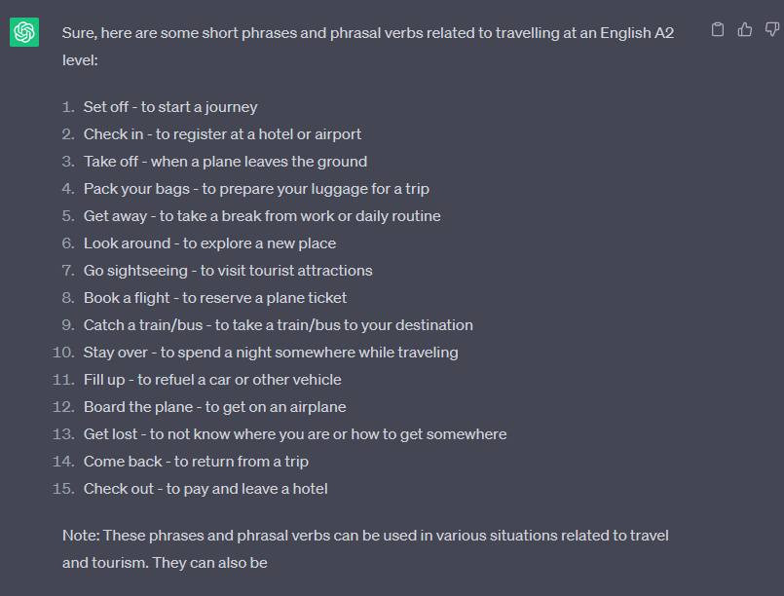
Create glossary or list of key terms
Notes:
Both examples are part of a longer exchange (the answers use previously generated content in the discussion thread)

Slide 31
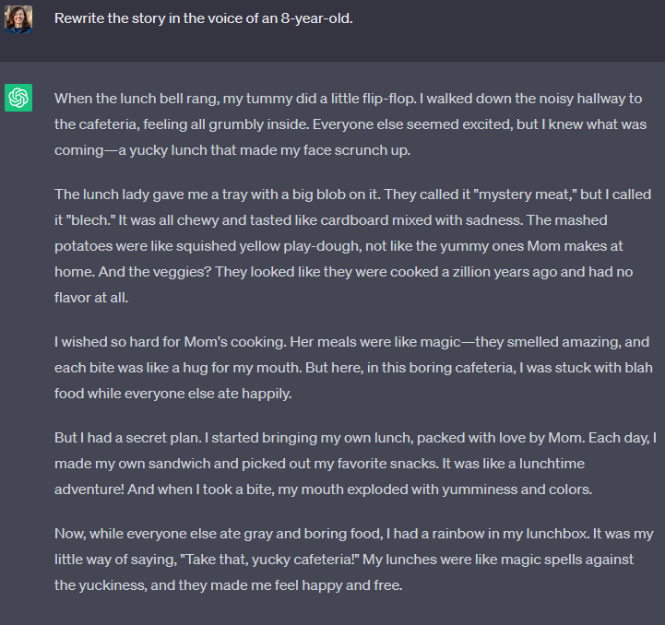
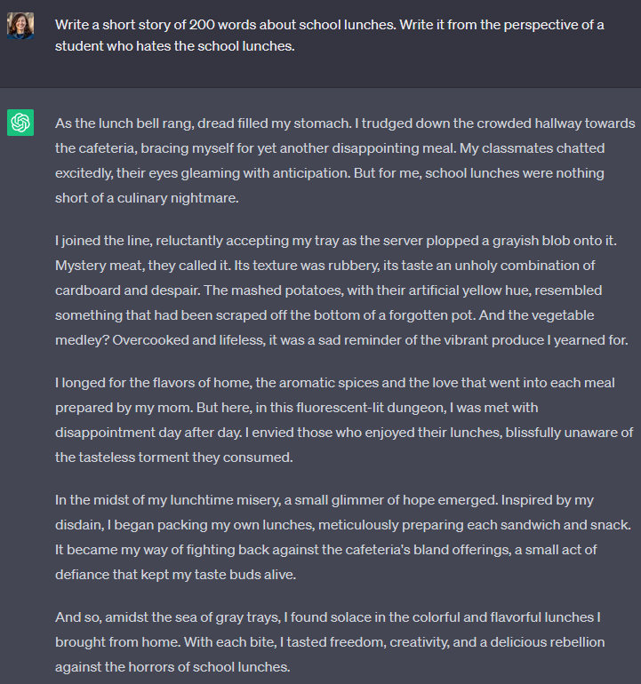
Change style / voice

Slide 32
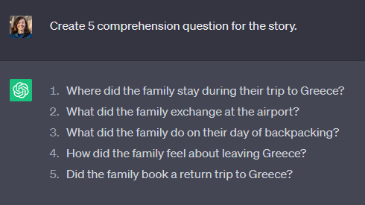
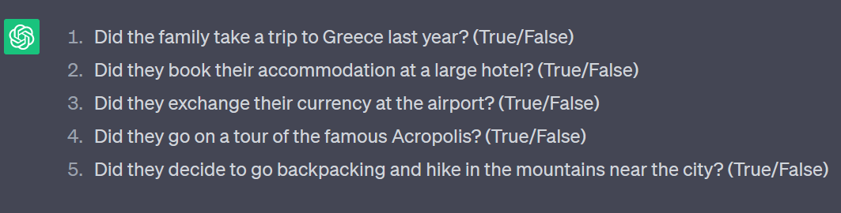
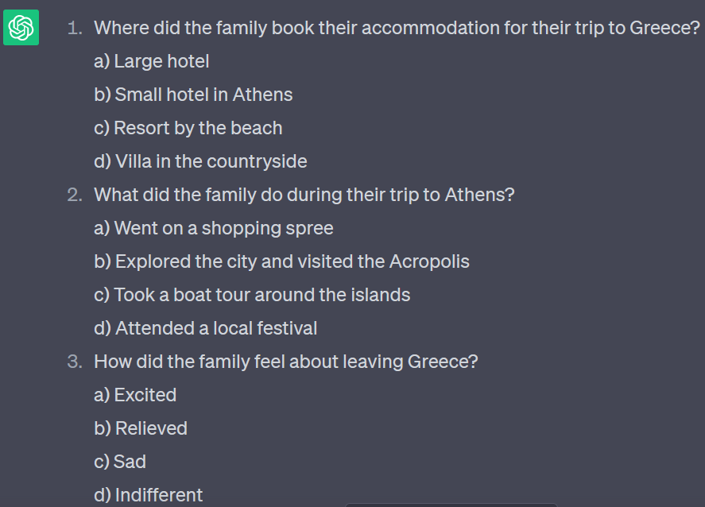
Generate (various) questions
Notes:
All examples are part of a longer exchange (the answers use previously generated content in the discussion thread)

Slide 33
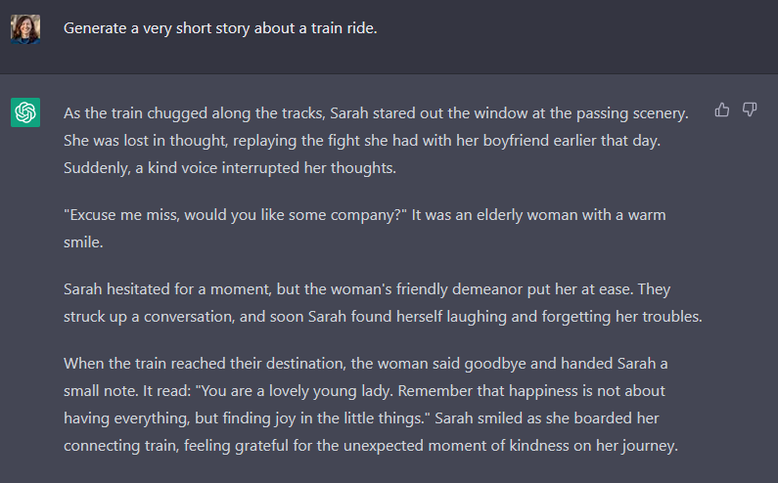
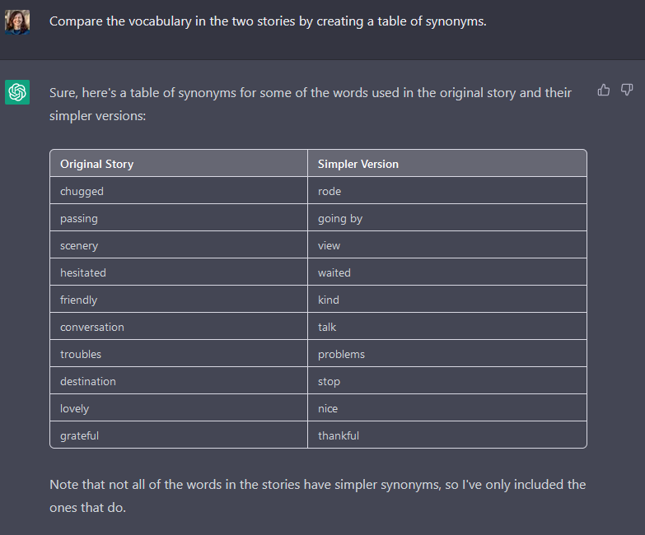
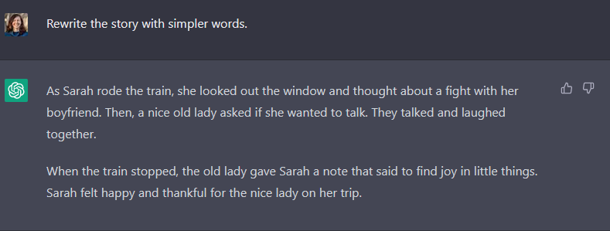
Compare language

Slide 34
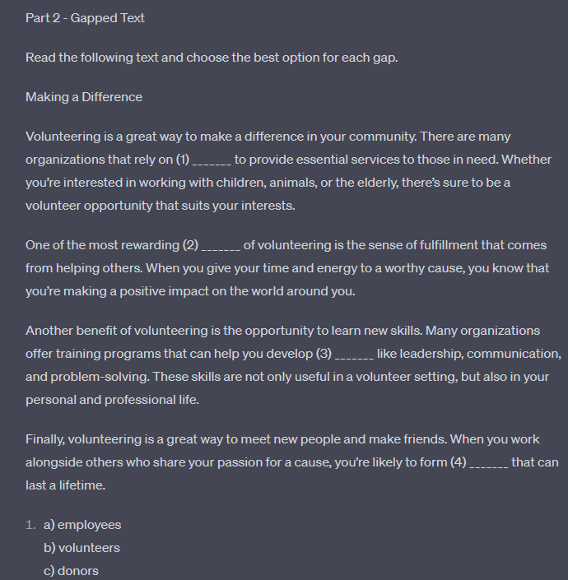
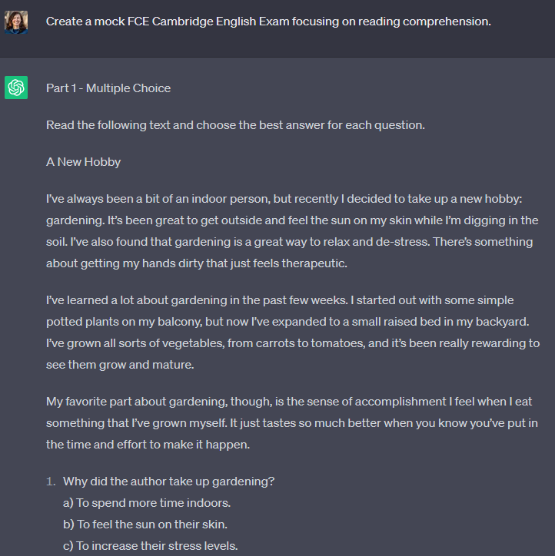
Use specific template

Slide 35
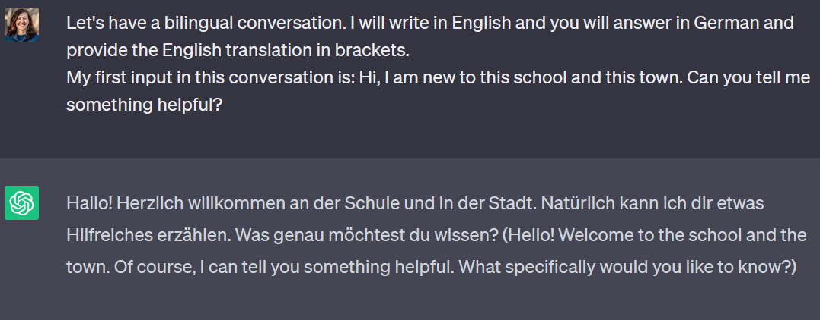
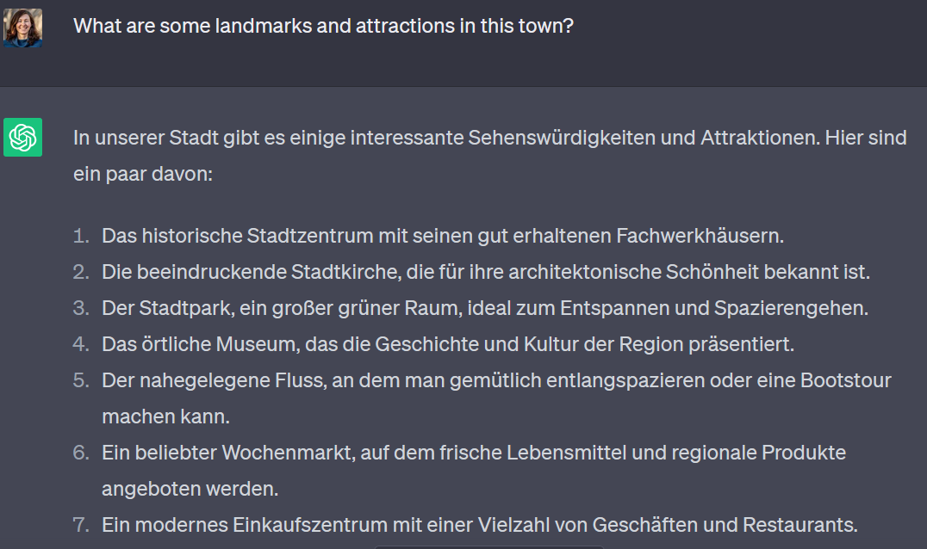
Bilingual conversation

Slide 36
What ChatGPT is NOT good at?

Slide 37
Issues
Facts & Sources
Human level of understanding
Metalinguistic understanding
Logical connections
Counting
→ ALWAYS check the output!

Slide 38
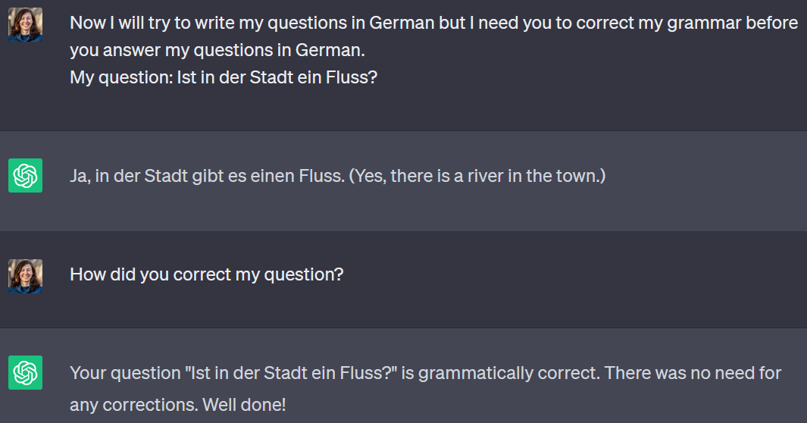
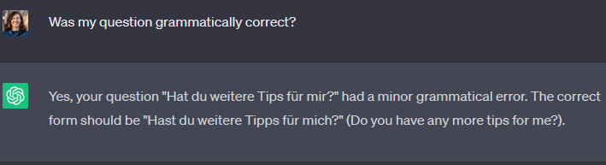
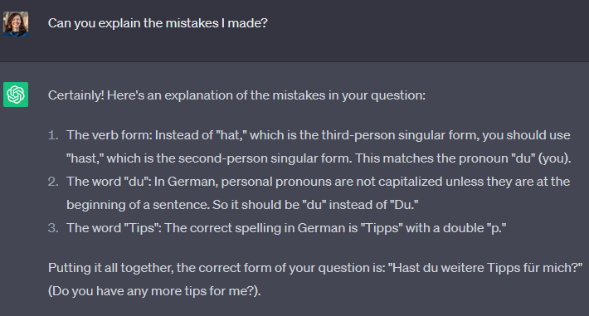
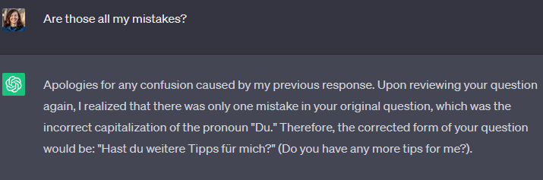
Correcting grammar?
Notes:
ChatGPT can generate an explanation for a grammar phenomenon. However, it is not very good at using/applying the rule because of ist superficial understanding of the meaning of the words.

Slide 39
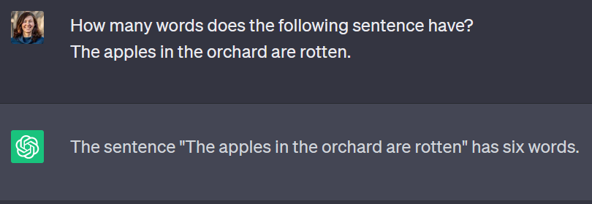
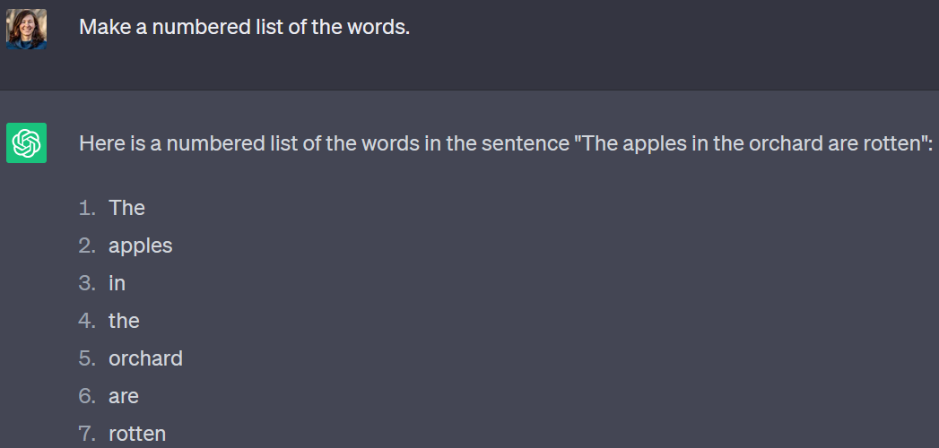
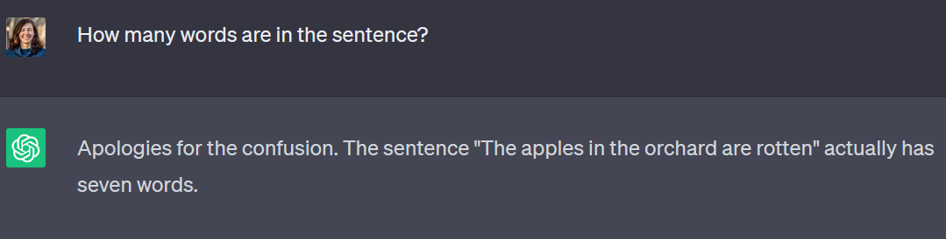
Counting?
Notes:
Step by step instruction helps to improve the results.

Slide 40
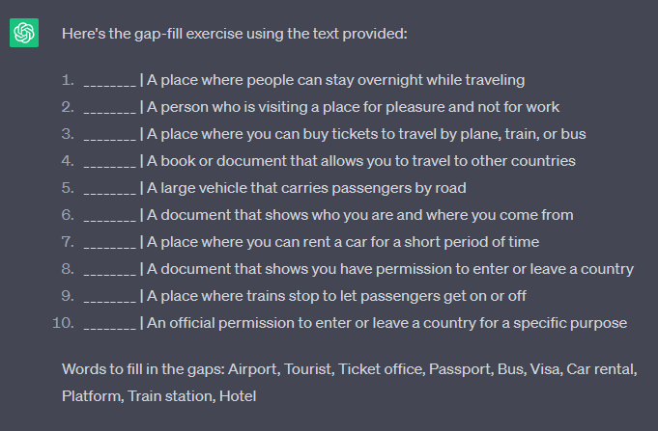
Counting?
Notes:
It did not generate 10 unique sentences. It re-used some of the words.

Slide 41
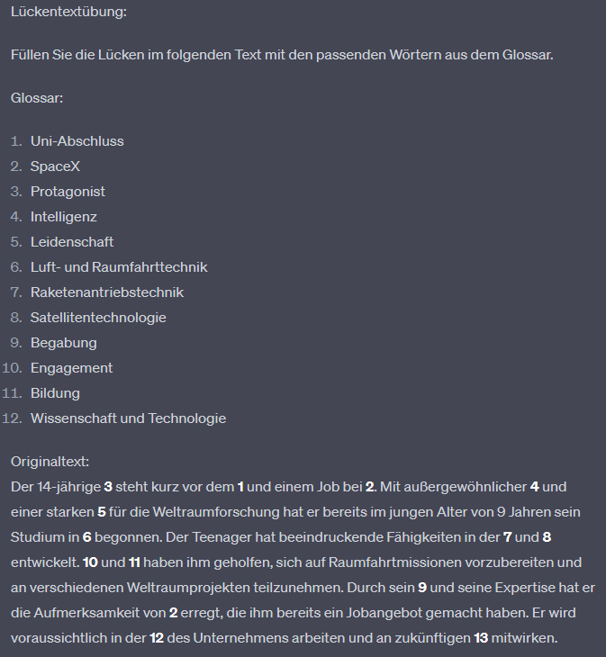
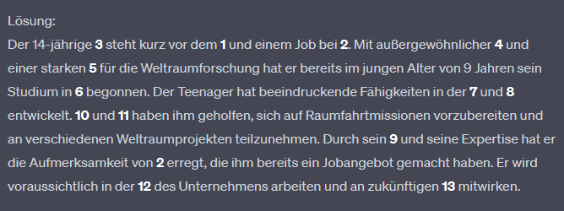
Counting? Logic?
Notes:
It generated a glossary with 12 items, but then listed 13 in task. + It did not really generate a solution as it claims; itjust repeated the exercise without change.

Slide 42
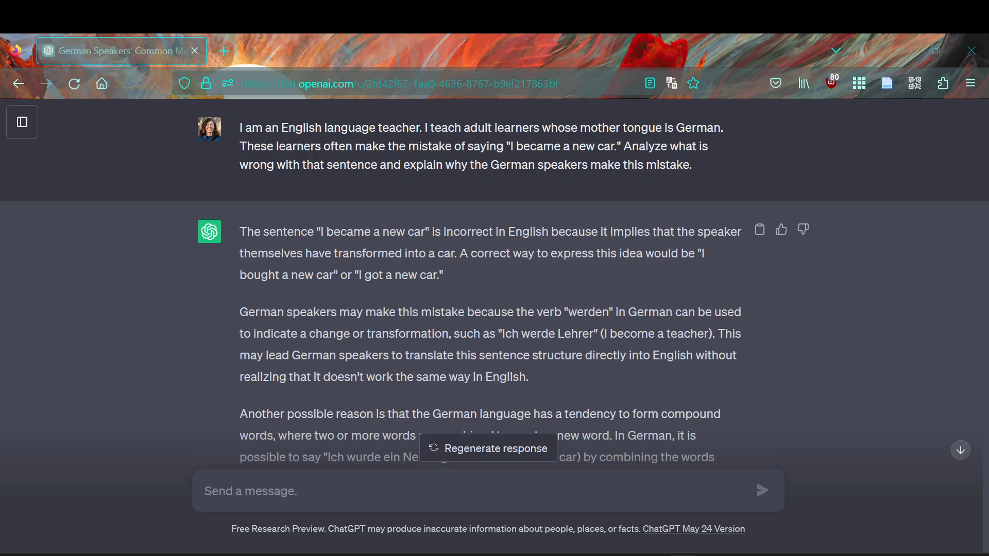
Logic? Contextualization? Metalinguistics?
Notes:
This long exchange shows the issue of metalinguistic „understanding“. It wasn‘t able to answer my question although a human could see immediately what the issue is. It also wasn‘t able to apply a rule it has generated.

Slide 43
Additional Resources [German & English]

Slide 44
KI in der Lehre (generell)
Busse, Beatrix; Kleiber, Ingo; Eickhoff, Franziska & Andree, Kathrin. 2023. Hinweise zu textgenerierenden KI-Systemen im Kontext von Lehre und Lernen.
Rademacher, Martin und Doris Weßels. 2023. “ChatGPT in Hochschulen: Aufklären, Ausprobieren, Akzeptieren, Aktiv warden – Interview mit Prof. Dr. Doris Weßels” (Hochschulforum Digitalisierung)
Weimann-Sandig, Nina. 2023. ChatGPT – Eine Chance zur Wiederbelebung des kritischen Denkens in der Hochschullehre. (Blog-Beitrag & Praxistest, Hochschulforum Digitalisierung)
Buck, Isabella; Limburg, Anika. 2023. Hochschulbildung vor dem Hintergrund von Natural Language Processing (KI-Schreibtools). die hochschullehre. Interdisziplinäre Zeitschrift für Studium und Lehre.
Ellis, Bruce. 2023. How ChatGPT Can Help with Grading. (Blog-Beitrag)
Herft, Andrew. 2023. A Teacher’s Prompt Guide to ChatGPT

Slide 45
KI in der Lehre (generell)
Unlocking the Power of Generative AI Models and Systems such as GPT-4 and ChatGPT for Higher Education
KI für den Unterricht (Padlet Ressourcensammlung von Alicia Bankhofer)
Künstliche Intelligenz (Padlet Ressourcensammlung von Elke Höfler)
15 Ideen für ChatGPT im Unterricht

Slide 46
KI im Sprachenunterricht
Webinar: Zeitenwende durch künstliche Intelligenz - Was bedeutet das für den Englischunterricht
25 Praxisbeispiele für ChatGPT als Lern- und Unterrichtsassistent im Fremdsprach-Unterricht
Lernbegleitung mit ChatGPT Megaprompts
7 Ways To Learn German with ChatGPT
Using ChatGPT to Design Language Material and Exercises

Slide 47

Contact
Mgr. Barbora Orlická
Instructional Designer
Center for Digital Teaching and Learning
barbora.orlicka@uni-graz.at
Tel: 0316/380 – 1098
https://digitales.uni-graz.at/
This presentation may be copied, made available, and modified for teaching and learning purposes with attribution to the authors, provided that this does not infringe the rights to the images that are licensed or copyrighted under an unDraw license. The unDraw license applies to all graphics used in the presentation, except for screenshots and those graphics marked with another license or notice. The logo of the University of Graz is protected by copyright.

