Slide 1

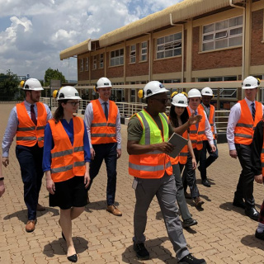
Exploring the World of Work
Jobs, Skills, and Your Future

Slide 2



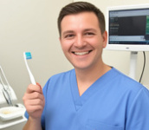

Healthcare Jobs
1
2
3
4
Doctor
Treats patients and prescribes medicine.
Nurse
Cares for sick people in hospitals.
Dentist
Fixes teeth and keeps mouths healthy.
Pharmacist
Prepares and gives out medicine.

Slide 3




Technology Jobs
1
2
3
4
Software Engineer
Writes code to create apps and programs.
Web Designer
Designs how websites look and work.
IT Support
Fixes computer problems and networks.
Data Analyst
Studies numbers and data to find trends.

Slide 4

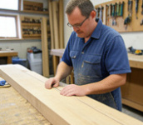

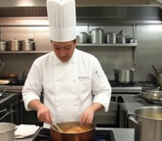
Craft & Trade Jobs
1
2
3
4
Electrician
Installs and repairs electrical wiring.
Carpenter
Builds structures with wood and furniture.
Plumber
Fixes pipes and water systems.
Chef
Cooks delicious food in restaurants.

Slide 5


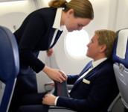

Service Jobs
1
2
3
4
Teacher
Helps students learn new subjects.
Police Officer
Keeps the community safe and enforces laws.
Flight Attendant
Ensures safety on airplanes and serves passengers.
Receptionist
Greets visitors and answers phone calls.

Slide 6

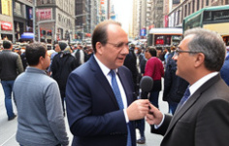

Creative & Media Jobs
1
2
3
Graphic Designer
Designs visuals to communicate ideas, inspiring, informing, or captivating consumers.
Journalist
Researches, writes, and reports news for media.
Architect
Plans and designs houses, office buildings, and other structures.

Slide 7


activities.discussion.title 🤷‍♀️​ 💁‍♂️​ 💬​
Dream Jobs
What other jobs do you know that sound interesting to you?

Slide 8
✅​
Maybe you mentioned jobs like: Video Game Designer, Architect, Vet, Pilot, Scientist, Artist, YouTuber, or Astronaut. These jobs often require specific skills like creativity, technical knowledge, or bravery!

Slide 9

Discuss! 🤷‍♀️​ 💁‍♂️​ 💬​
Your Perfect Match
Considering the different jobs and traits we discussed, what makes a career feel rewarding to you, and how does your personality fit that choice?

Slide 10
Match the words with the definitions 🎯​
✅​
1.
Creative
b)
Describes using imagination to create new ideas or things.
2.
Reliable
d)
Describes a person who can be trusted to do their job well.
3.
Lehre
a)
A training system combining work with school for a trade.
4.
Matura
c)
Formal education needed to attend university or higher colleges.

Slide 11
Discuss! 🤷‍♀️​ 💁‍♂️​ 💬​
✅​
You might have said...
Chefs find reward in creative dish creation and customer enjoyment. Doctors are fulfilled by healing the sick and serving the community. Software Engineers enjoy logical problem-solving and building useful tools.

Slide 12


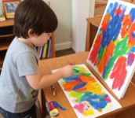

Personality Traits
Organized
You plan well and keep things tidy.
Reliable
People can trust you to do a good job.
Creative
You use your imagination to make new things.
Helpful
You enjoy supporting and assisting others.

Slide 13
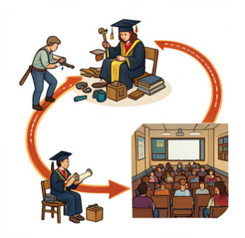
Austrian Training Paths
Lehre (Apprenticeship)
Learn a trade 3-4 days/week on the job, 1-2 days in school. Ideal for hands-on careers like carpenter or chef.
Matura (High School Diploma)
Complete secondary school (Gymnasium/BHS) for broader university or higher training options.
University Study
Post-Matura, study 3+ years to become an expert (e.g., doctor, architect).

Slide 14
Match the words with the definitions 🎯​
1.
Nurse
a)
Requires a degree or specialized technical college after Matura.
2.
Software Engineer
b)
Often starts with a Lehre (apprenticeship) to learn styling.
3.
Electrician
c)
Usually needs a Lehre (apprenticeship) to learn skills.
4.
Hairdresser
d)
Requires a university degree or specialized medical school.

Slide 15
Match the words with the definitions 🎯​
✅​
1.
Nurse
d)
Requires a university degree or specialized medical school.
2.
Software Engineer
c)
Usually needs a Lehre (apprenticeship) to learn skills.
3.
Electrician
a)
Requires a degree or specialized technical college after Matura.
4.
Hairdresser
b)
Often starts with a Lehre (apprenticeship) to learn styling.

Slide 16
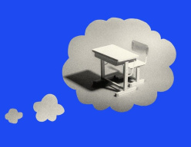
Discuss! 🤷‍♀️​ 💁‍♂️​ 💬​
Dream Job Discussion
Which job from today sounds most interesting to you? Why? Which personality traits do you have that would help you?

Slide 17
Discuss! 🤷‍♀️​ 💁‍♂️​ 💬​
✅​
You might have said...
Helpful & patient: teacher. Creative & problem-solver: engineer. Organized & loves cooking: chef.

Slide 18

Summary
We explored jobs in Healthcare, Technology, Crafts, and Services. We learned personality traits like creative and organized. We also looked at Austrian paths like Lehre, Matura, and University. What is your next step?

