Slide 1

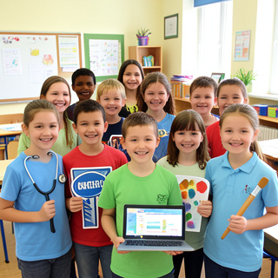
My Strengths and My Dream Job
Discovering the Perfect Career for You

Slide 2

Recap: Jobs and Traits
Job Sectors
Healthcare: Doctor, Nurse, Vet
Technology: Programmer, Web Designer
Crafts: Carpenter, Electrician, Chef
Personality Traits
What are you like?
Creative: Good at art and ideas
Organized: Tidy and on time
Helpful: Likes supporting others
Curious: Wants to learn new things
Patient: Calm when waiting

Slide 3
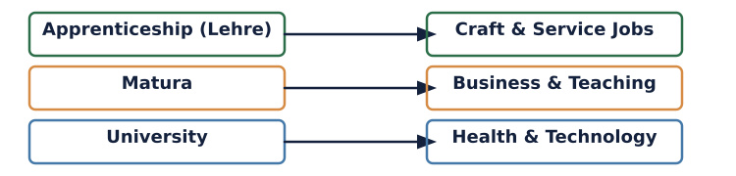
Training Paths in Austria
How do you get the job?
Different careers need different types of schooling.
Remember
Lehre: Learn by working.
Matura: High school diploma.
University: Academic degree study.

Slide 4
Job Knowledge Check
Answers on the next slide...
Which training path is best for a Carpenter?
1.
University
2.
Apprenticeship (Lehre)
3.
Medical School
4.
Art School

Slide 5
Job Knowledge Check
✅​
Which training path is best for a Carpenter?
1.
University
2.
Apprenticeship (Lehre)
👍​
3.
Medical School
4.
Art School

Slide 6

True or False ✅​ ❌​
A Nurse needs to be 'patient' and 'helpful'.
👍​
👎​
TRUE
FALSE
Answers on the next slide...

Slide 7
True or False ✅​ ❌​
✅​
A Nurse needs to be 'patient' and 'helpful'.
👍​
TRUE
Nurses care for sick people, so they must be kind and willing to wait.

Slide 8
Match the words with the definitions 🎯​
1.
Creative
a)
Keeps things tidy and plans ahead
2.
Strong
b)
Asks questions and likes learning
3.
Organized
c)
Good at making art or new ideas
4.
Curious
d)
Has physical power for heavy lifting

Slide 9
Match the words with the definitions 🎯​
✅​
1.
Creative
c)
Good at making art or new ideas
2.
Strong
d)
Has physical power for heavy lifting
3.
Organized
a)
Keeps things tidy and plans ahead
4.
Curious
b)
Asks questions and likes learning

Slide 10

Fill in the blanks 🧩​
If you want to be a Doctor, you usually need to go to ____. If you want to be a Chef, an ____ is the best choice.
Word bank 🏦​
university, apprenticeship, office, library
Answers on the next slide...

Slide 11
Fill in the blanks 🧩​
✅​
If you want to be a Doctor, you usually need to go to university. If you want to be a Chef, an apprenticeship is the best choice.
Word bank 🏦​
university, apprenticeship, office, library

Slide 12

Self-Reflection Workshop
What are your strengths?
Think about these questions:
What is your favorite school subject?
What do you do in your free time?
Are you more active or do you like sitting still?
Do you prefer working alone or in a team?
Your answers help you find the right job!

Slide 13


Discuss! 🤷‍♀️​ 💁‍♂️​ 💬​
Class Discussion
Based on your personality, which job sector fits you best: Healthcare, Technology, Craft, or Services?

Slide 14
Discuss! 🤷‍♀️​ 💁‍♂️​ 💬​
✅​
You might have said...
Healthcare: I am helpful and kind.
Technology: I am curious and good at computers.
Craft: I am active and like building things.
Services: I am organized and like talking to people.

Slide 15

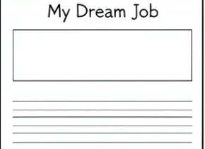
Get creative 🖼️​
Dream Job Poster
Job Title: [Your Dream Job Title]
Required Skills:
Skill 1
Skill 2
Skill 3
Why I Fit: [Briefly explain your relevant qualities]
What you'll need: 🎨​ 🖌️​
Paper, Colored pencils, Markers

