Slide 1












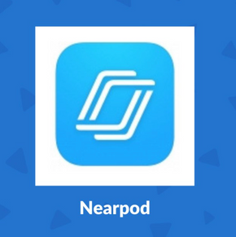

Free Generative AI Tools for Teachers
Gamma
Canva
SLIDES.AI
Enter prompts and Gamma will create a presentation or website for you, including pictures.
Visually appealing
Design presentations, infographics, worksheets or posters using prompts
Use templates and ready-made lessons
Transform pdfs to slides
Translate into any language
Export in various formats
This is a plug in for Google slides
Text or topic to presentation: give prompts AI will to the rest
Supports 100+ languages
SLIDES
& PRESENTATIONS
Eduaide.ai
EDUAIDE assists in creating lesson plans, teaching resources, and assessments.
The platform harnesses artificial intelligence to streamline the lesson planning process.
It does a lot!
Chat GPT
Generate creative prompts and brainstorm ideas for lesson activities.
Get instant explanations and examples
Generate questions for quizzes
Create lesson plan outlines
Magic School
LESSON PLANNING
60+ AI tools to help you lesson plan, differentiate, write assessments, write IEPs, communicate clearly, and more.
Question
Well
Input a Youtube link, website or any text and it will generate multiple choice questions. You can pay for short/long answer.
Export to Kahoot, Quizziz or Canva
Twee
Generate questions for YouTube videos.
Craft dialogues, stories, letters, or articles on any subject and for any proficiency level.
Create questions: true/false, open ended, multiple choice
Blooket
Similar to Quizlet, Kahoot and Gimkit - trivia, quizzes and review games.
You generate a question set, select a game mode, share an ID and the students join on their own devices.
QUIZZES
&
INTERACTIVITY
&
FEEDBACK
Brisk
Teaching
Brisk is a free Chrome extension
It creates instructional materials, shares feedback, evaluates student writing, and adjust or translate texts
Near
Pod
Interactive lesson, videos, gamification, assessment, polls, quizzes.
Almanack
AI
This is a platform that generates curriculum-aligned lesson plans, worksheets, group activities, video recommendations and assessments.
It integrates with kahoot, Quizziz, Google and a various platforms.
www.TutorAlexandra.co.uk

Slide 2


For more resources Google: Tutor Alexandra’s Shop
If you like my resources leave me a review on TES and feel free to email me if you have any feedback: TutorAlexandraABC@gmail.com

