Slide 1
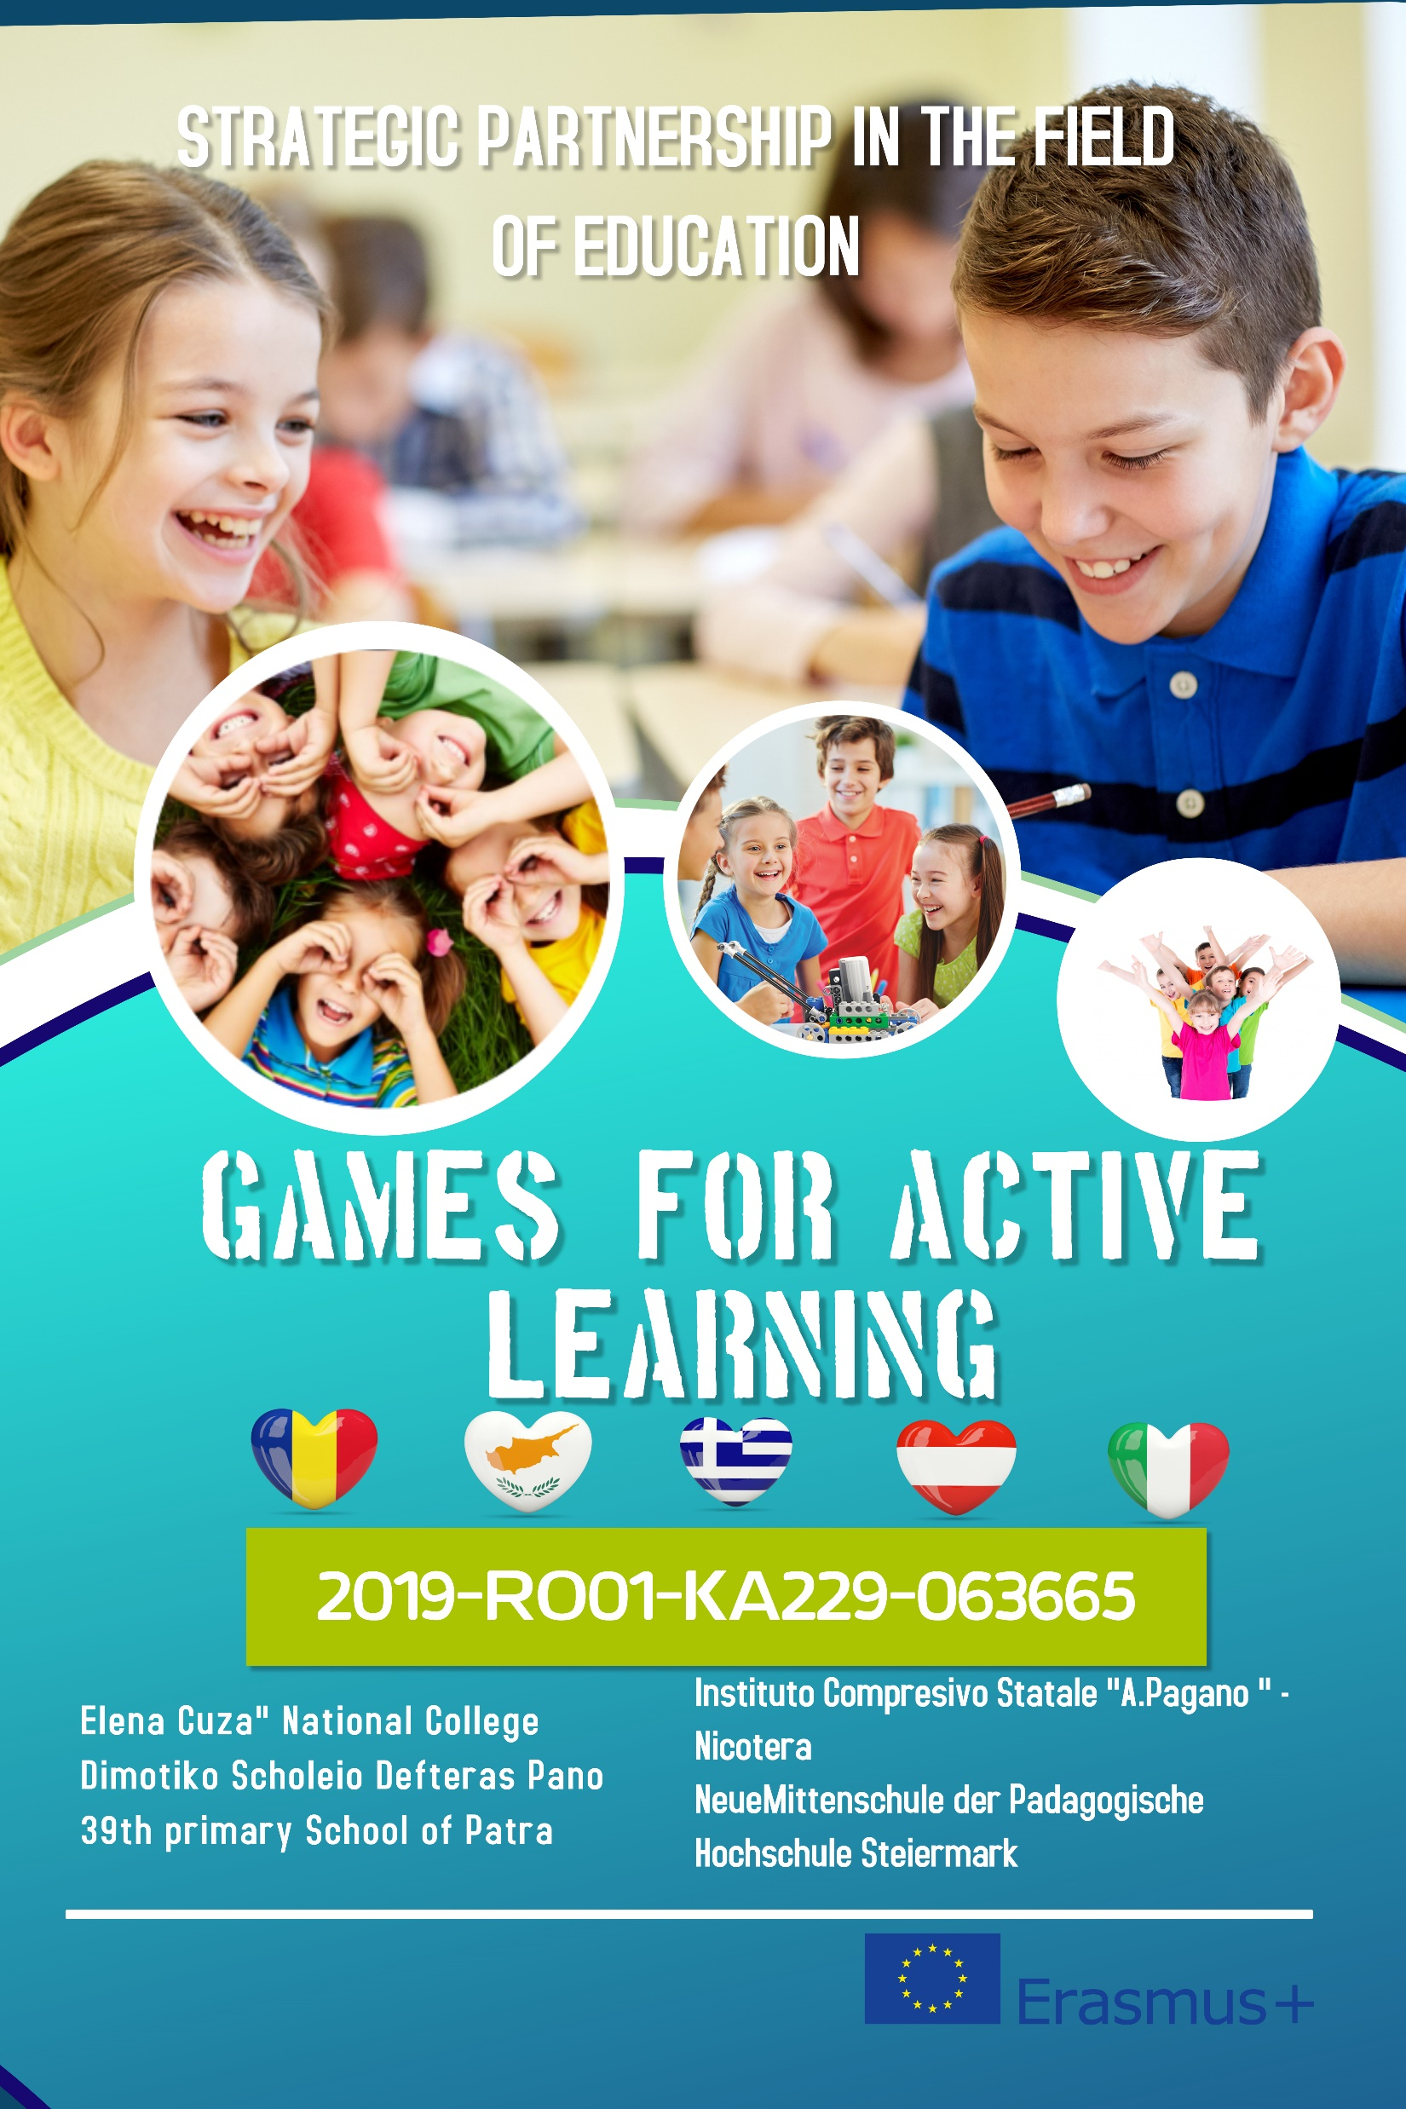


GAME BASED LEARNING WORKSHOP
25th -29th November 2019
1st LTT
Romania - Bucharest
2019-1-RO01-KA220-063665_1

Slide 2
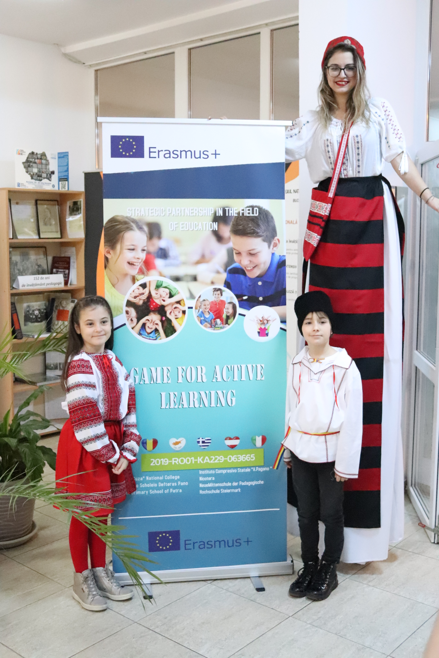
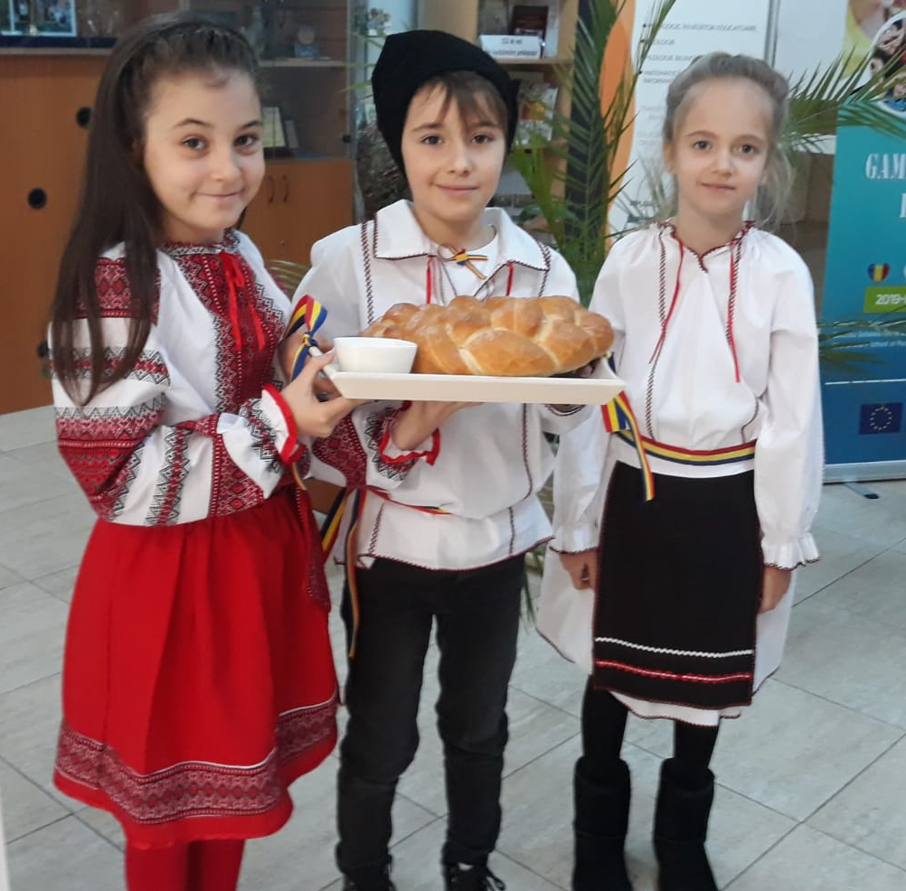
Official welcoming

Slide 3
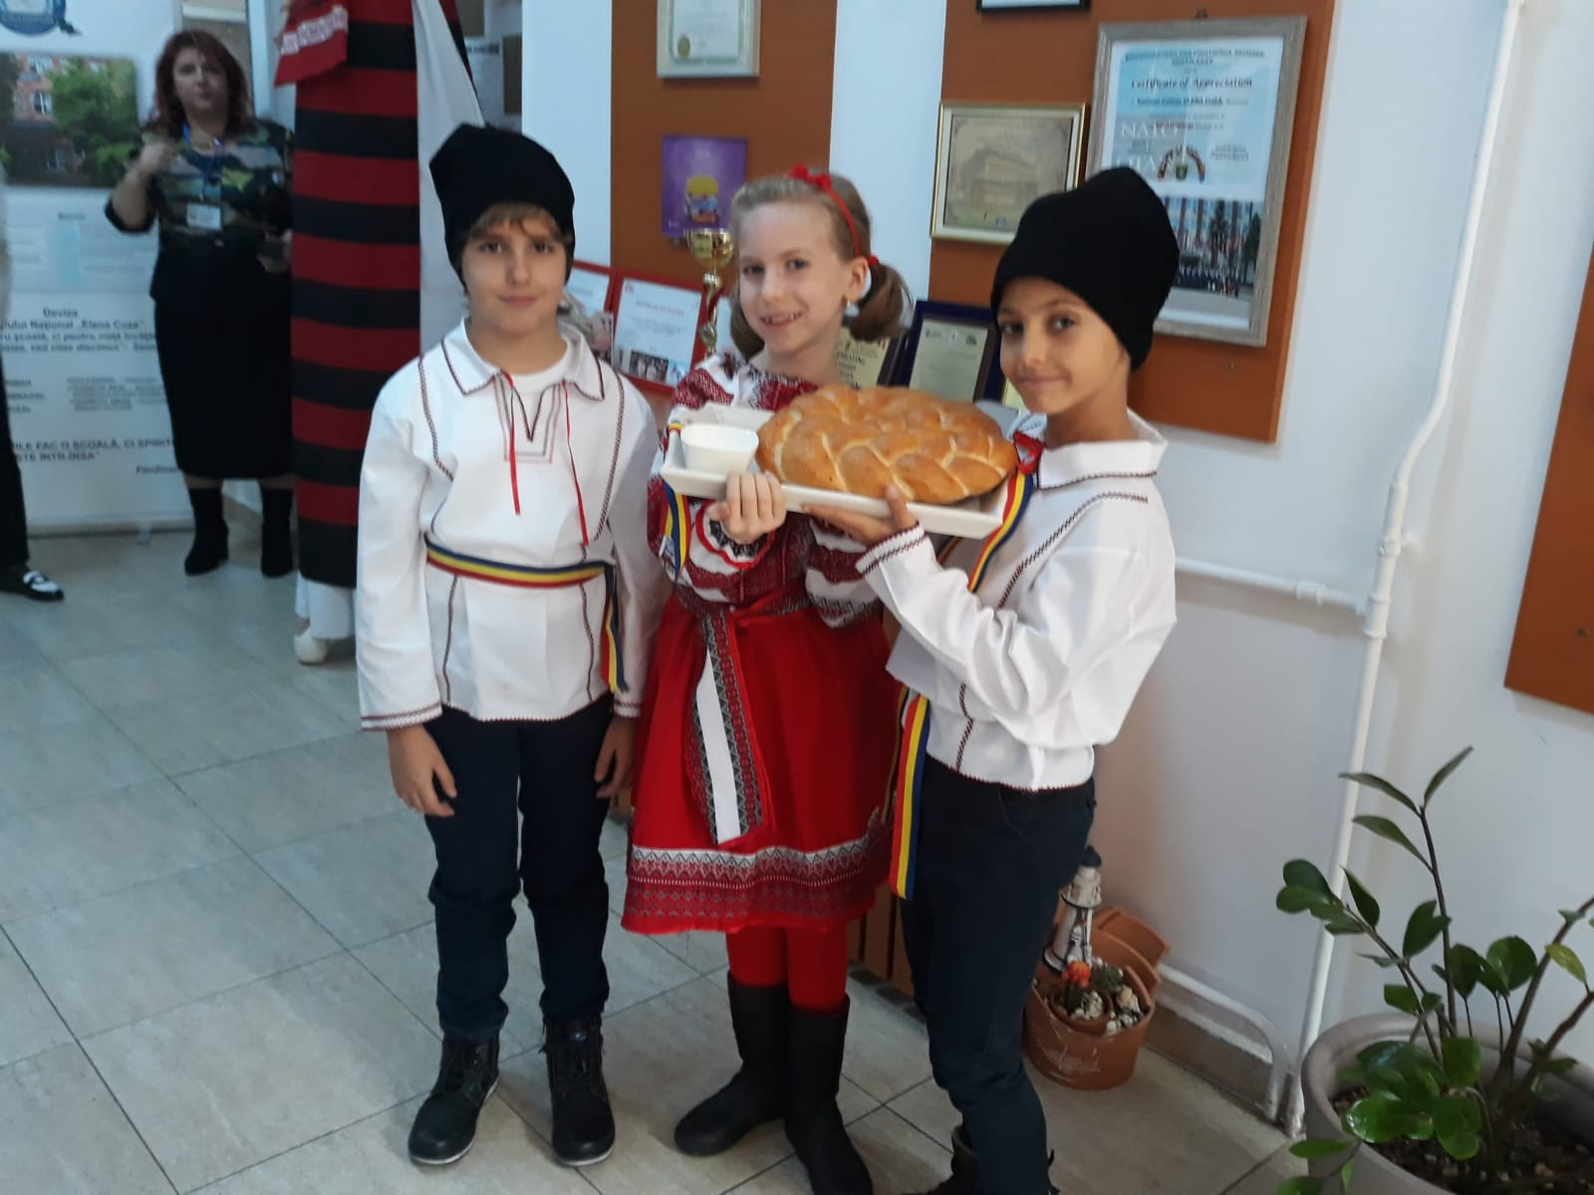
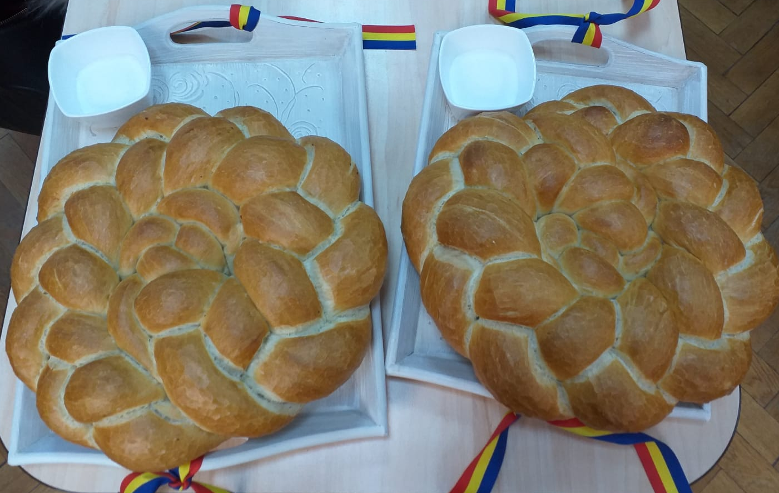
Bread and salt is a traditional Romanian custom expressing hospitality, showing that the guest is welcomed.

Slide 4
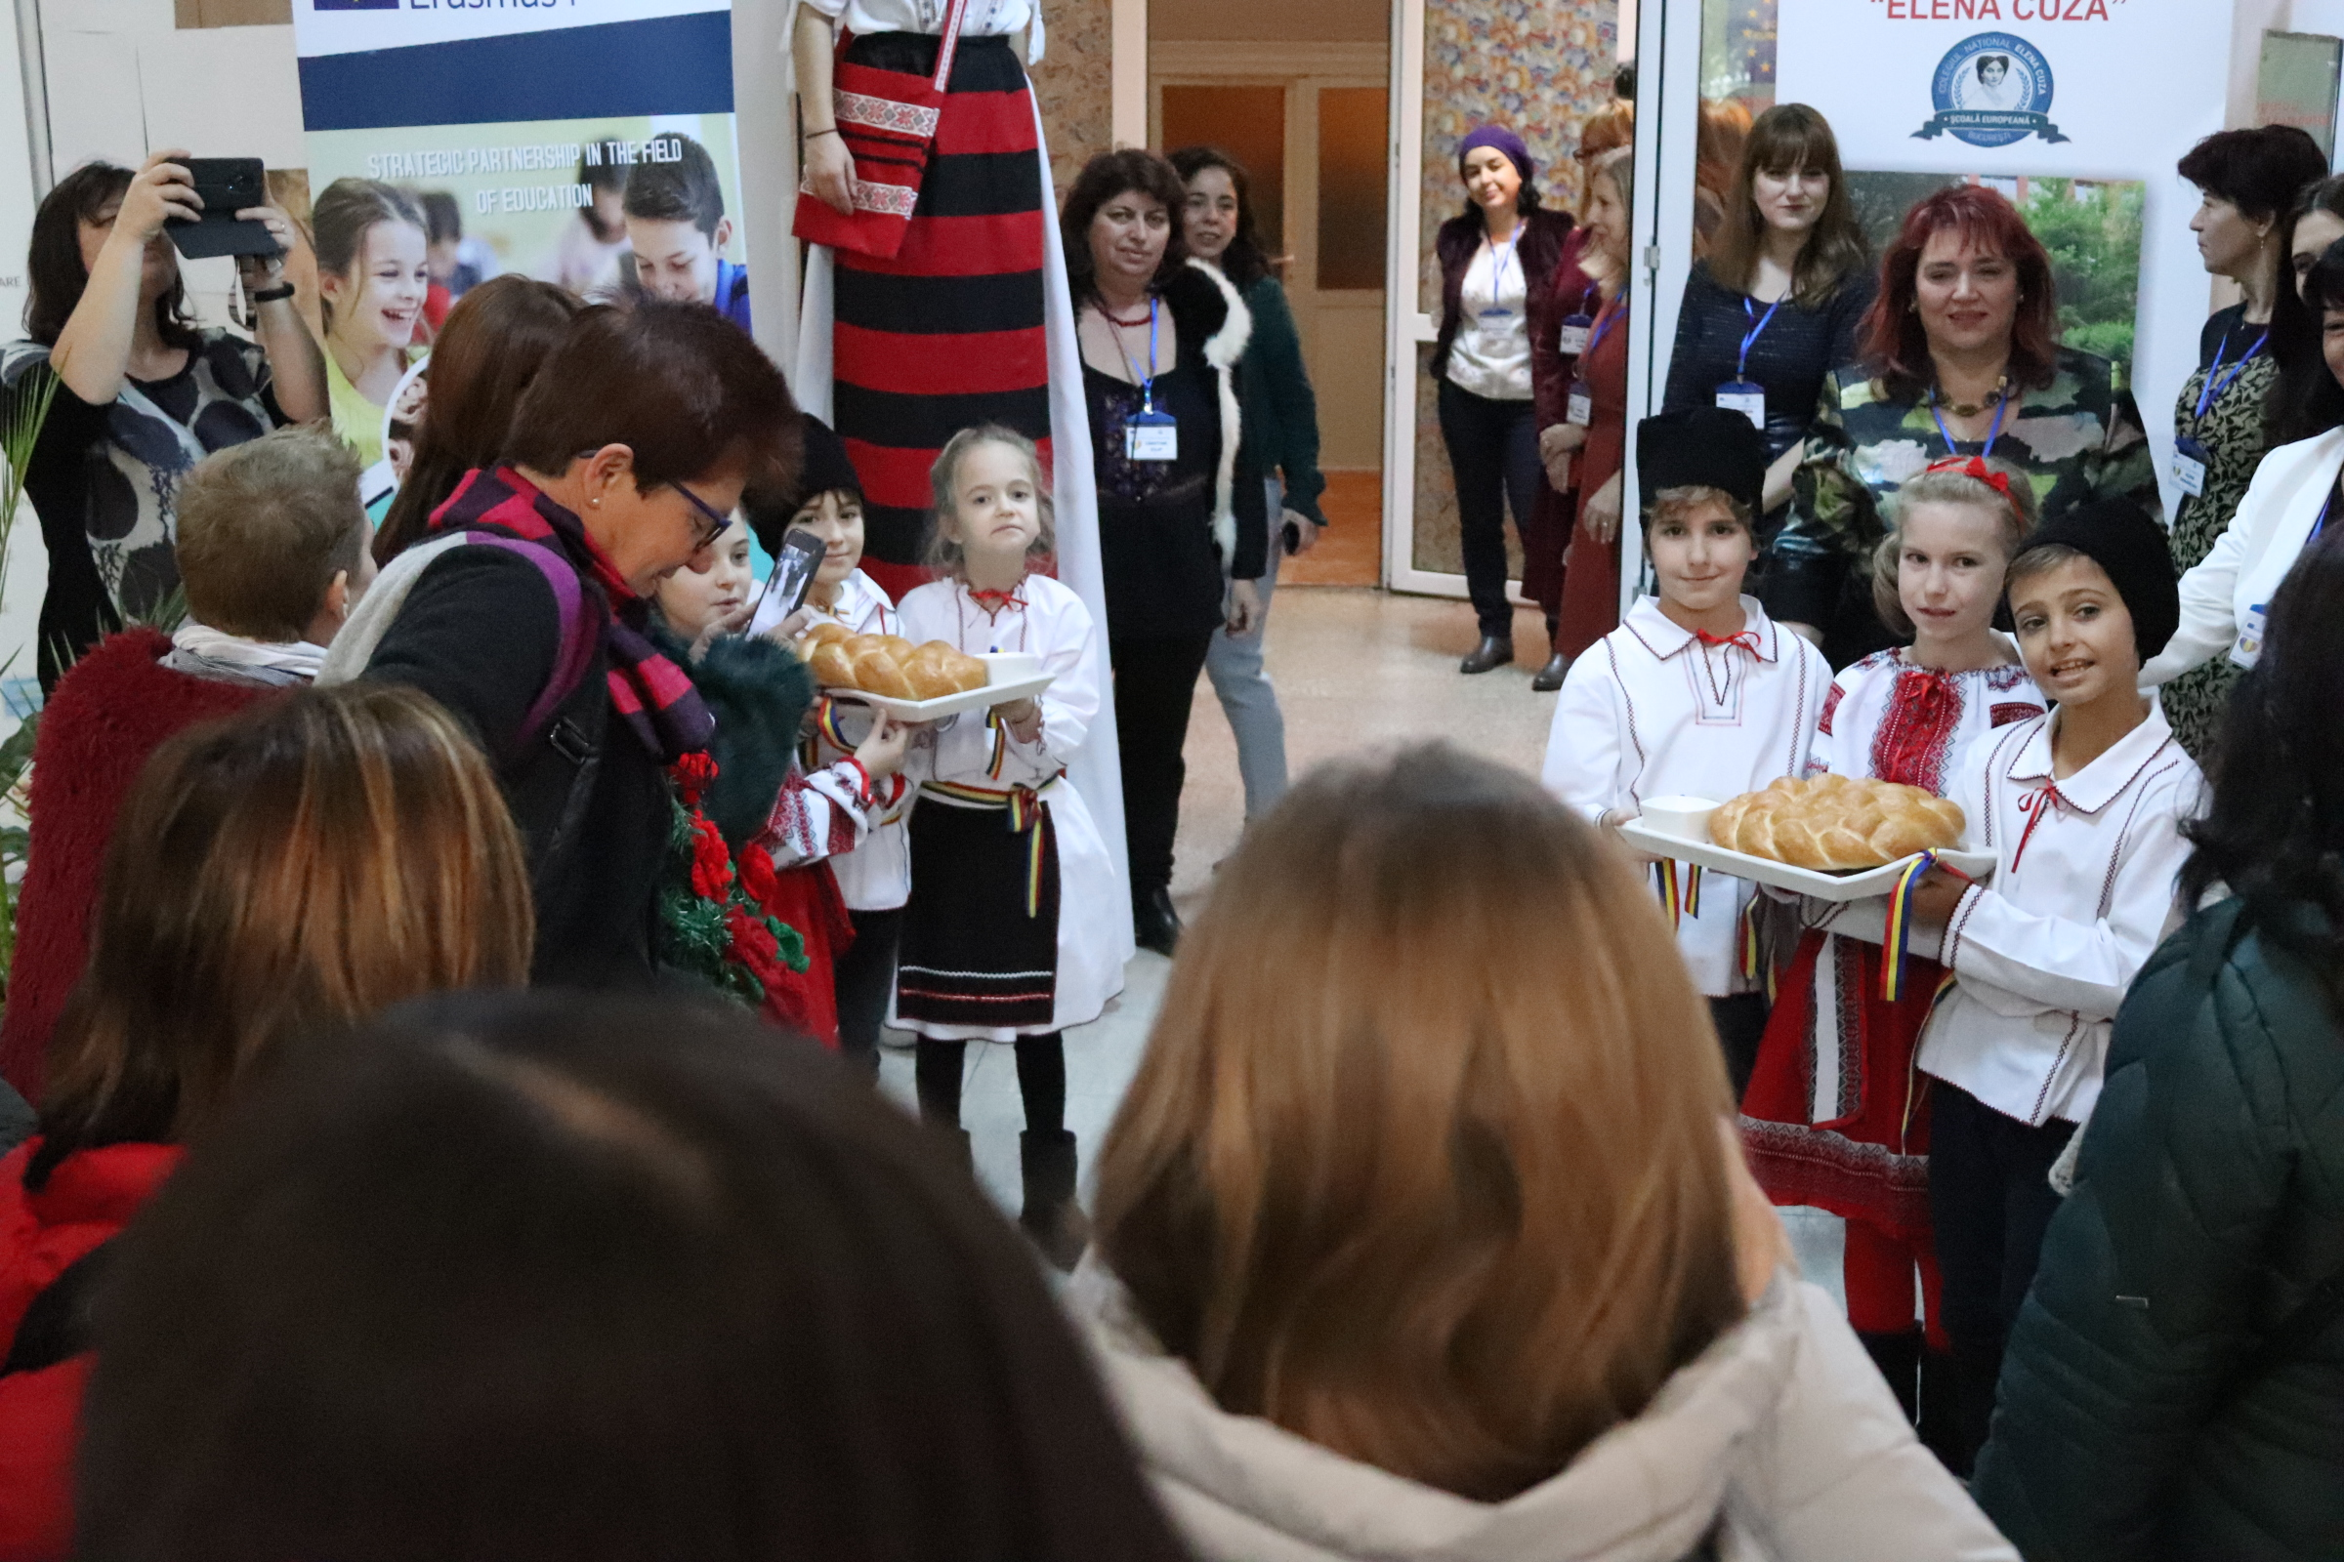

Slide 5
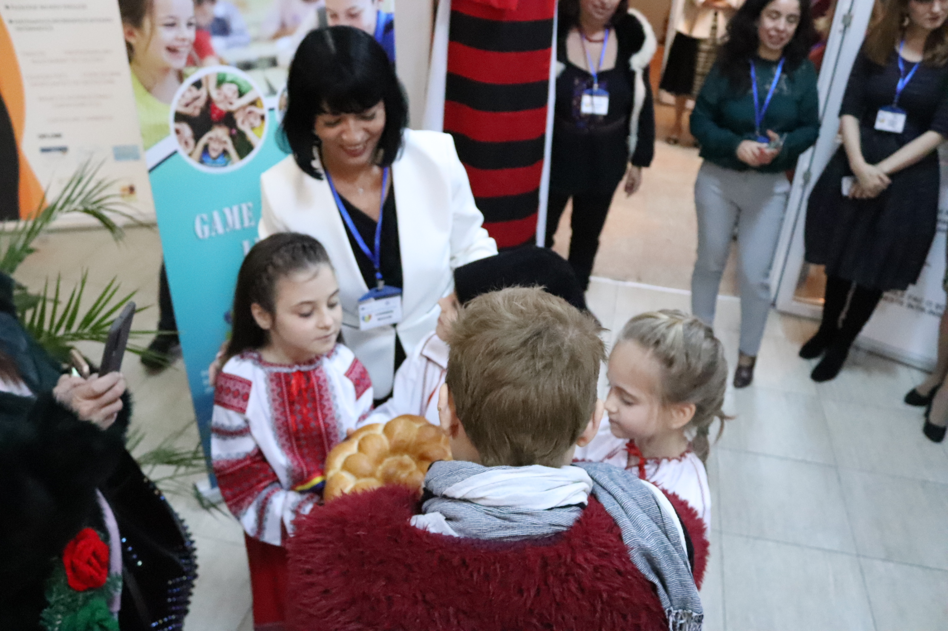

Slide 6
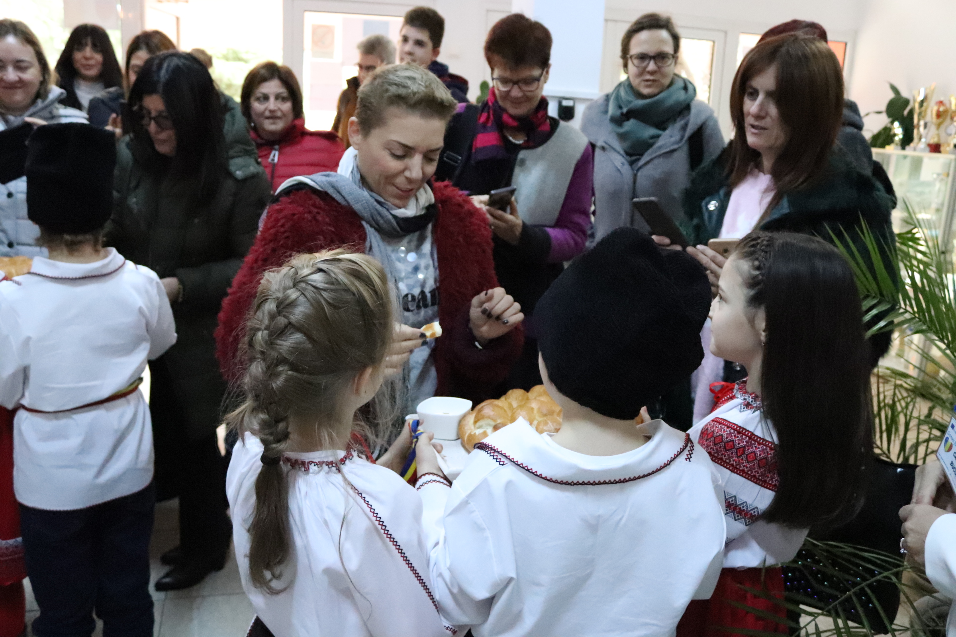

Slide 7
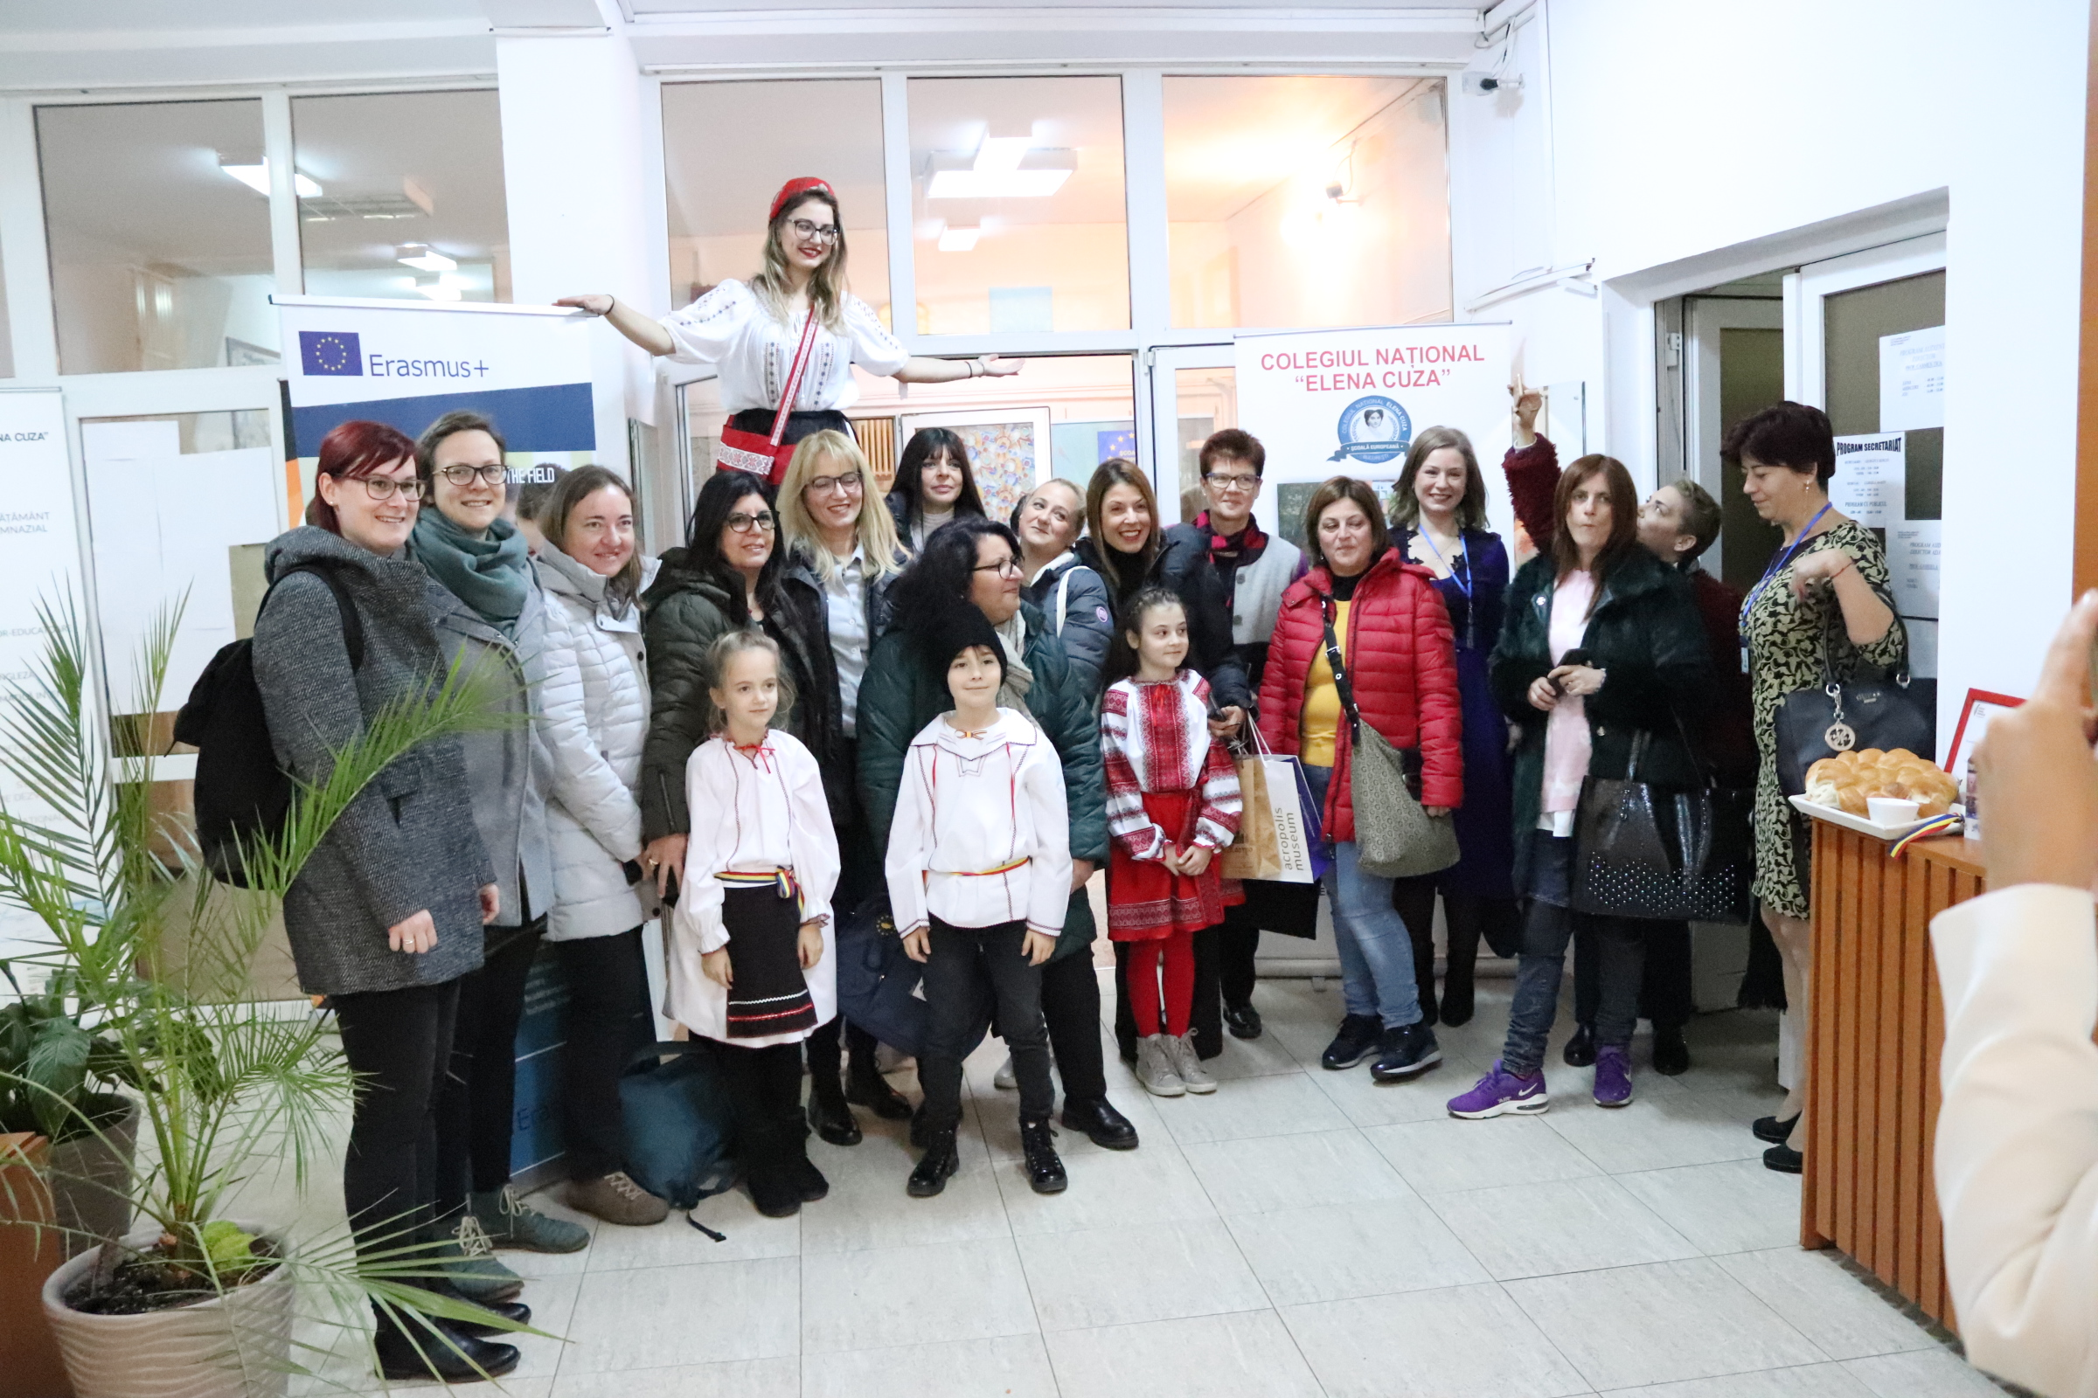

Slide 8
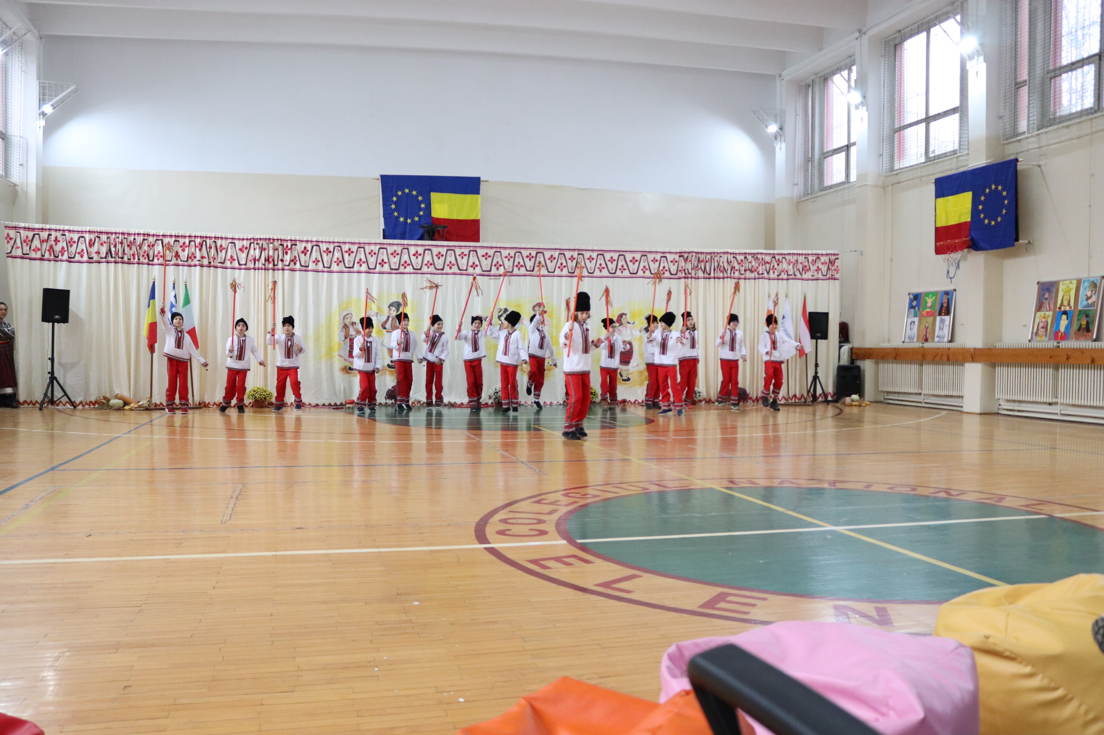
ROMANIAN SEATING -TRADITIONAL CELEBRATION
THE SEATING was one of the most important customs in the social life of the Romanian village.
It was organized in the winter, after the field work stopped and until Easter began. There were more people gathering at a house in the evening. The elders of the village told stories about their childhood and the women worked: they were weaving, knitting, handcrafting. The men who attended helped. The atmosphere was cheerful: it was singing, dancing, stories, jokes and riddles.

Slide 9
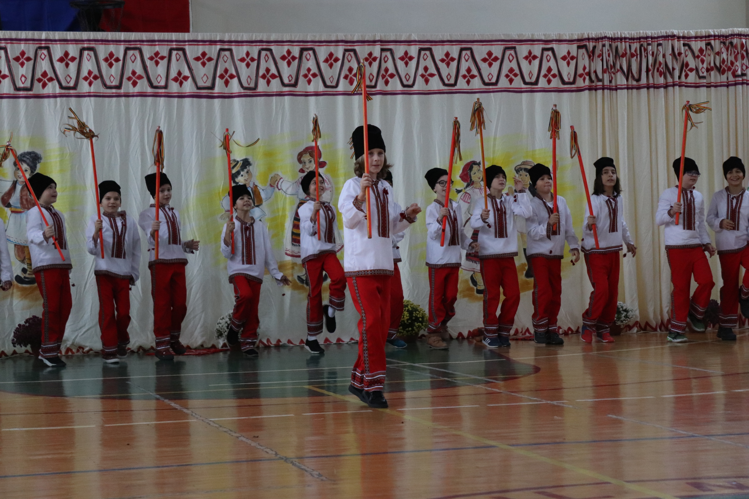
The calus tradition is part of the UNESCO Intangible Cultural Heritage List. Their origins are unknown, but they were mentioned for the first time sometimes during the 17th century. Old custom involves a ritual of healing diseases.

Slide 10
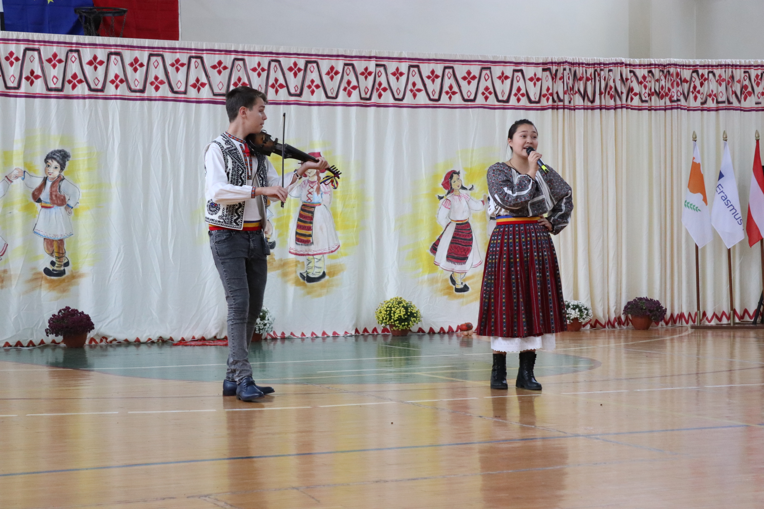
Romanians consider the Doina to be the essence of all its music, and, indeed, the best of the entire artistic expression of all its culture. Romanian form the Doina is usually freeform – no steady beat. It is traditionally improvised, often sung in solitude, having an important psychological action: to “ease one’s soul”.

Slide 11
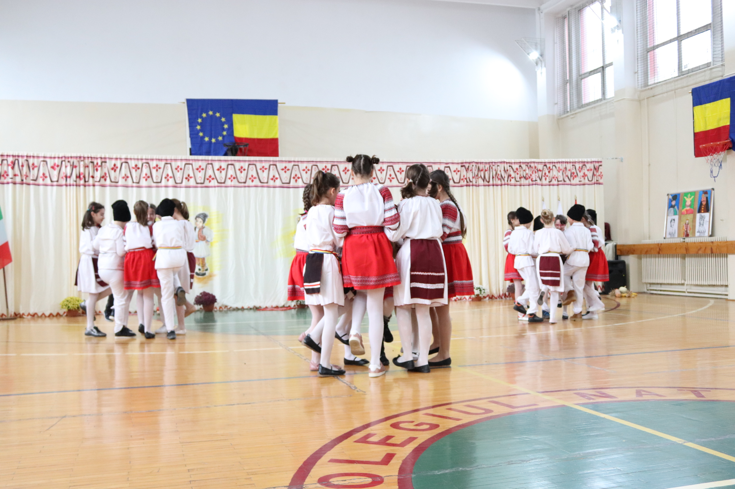
Hora is the most popular folk dance of Romania, performed in a linked circle. It is danced both on special occasions such as weddings and for relaxation.
It is a metaphor for the community: the circle opens to admit nubile women, adolescent boys entering manhood, and those ending mourning; conversely, it shuts out anyone who has violated local moral standards.

Slide 12
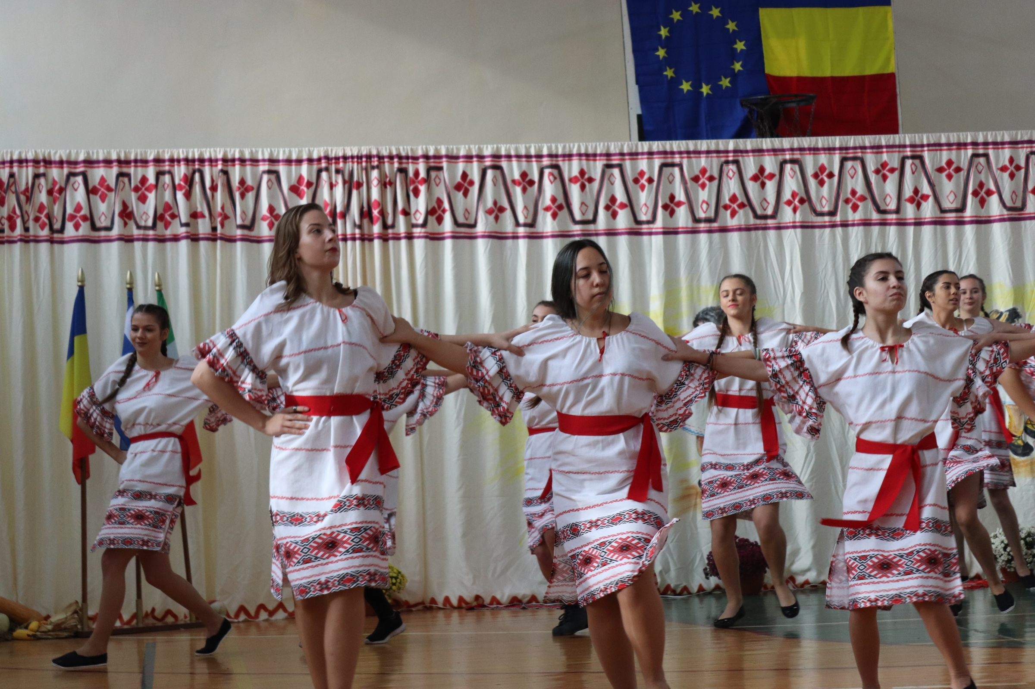
It is a popular old folk dance from Muntenia, the southern region of Romania, dedicated to the solar cult. The dance involves a circle dance of accelerating rhythm. It starts ponderously and gradually accelerates.

Slide 13
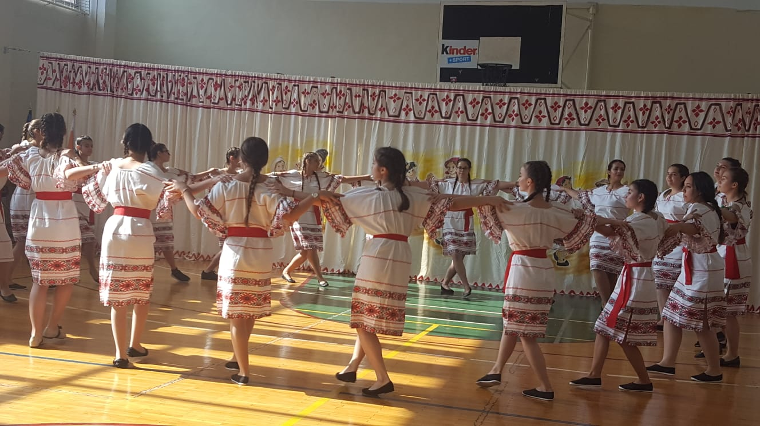

Slide 14
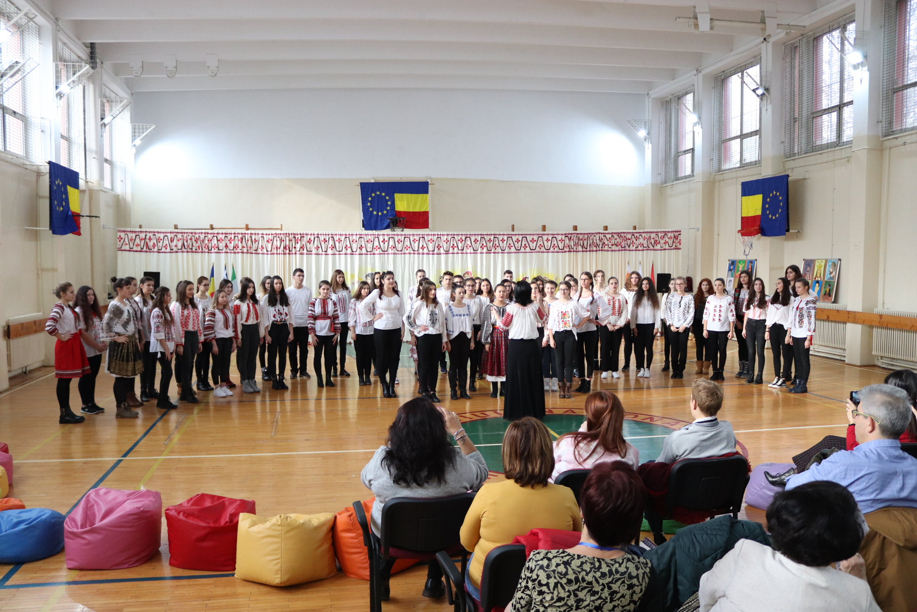

Slide 15
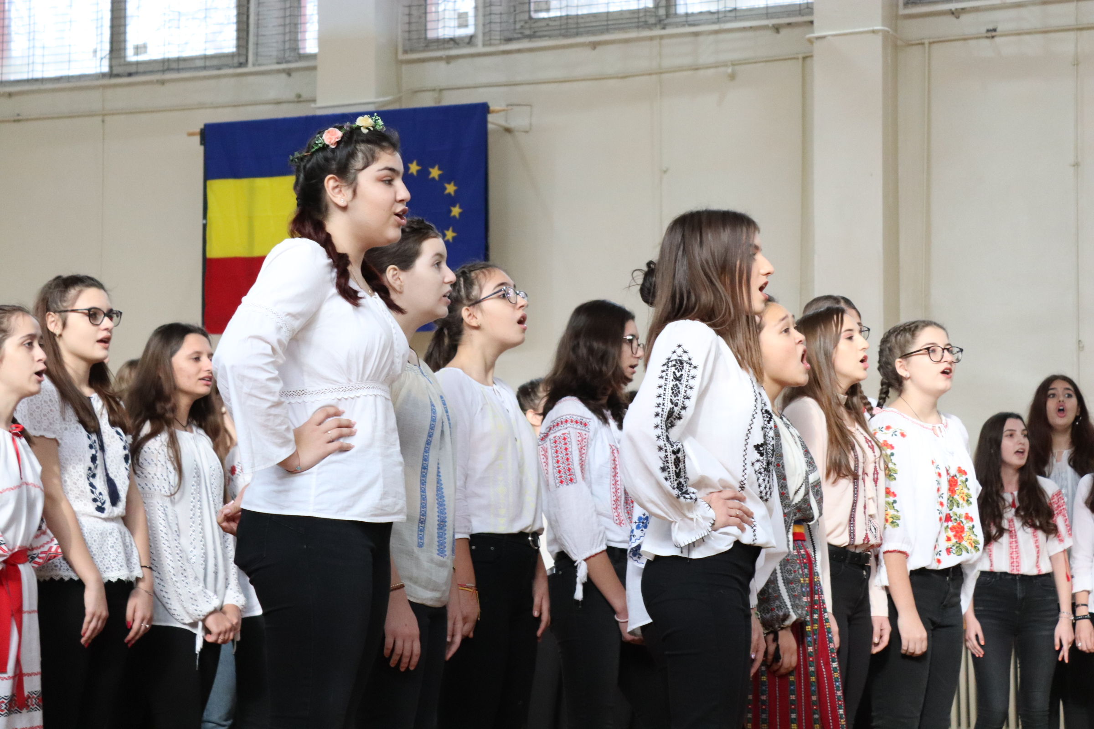

Slide 16
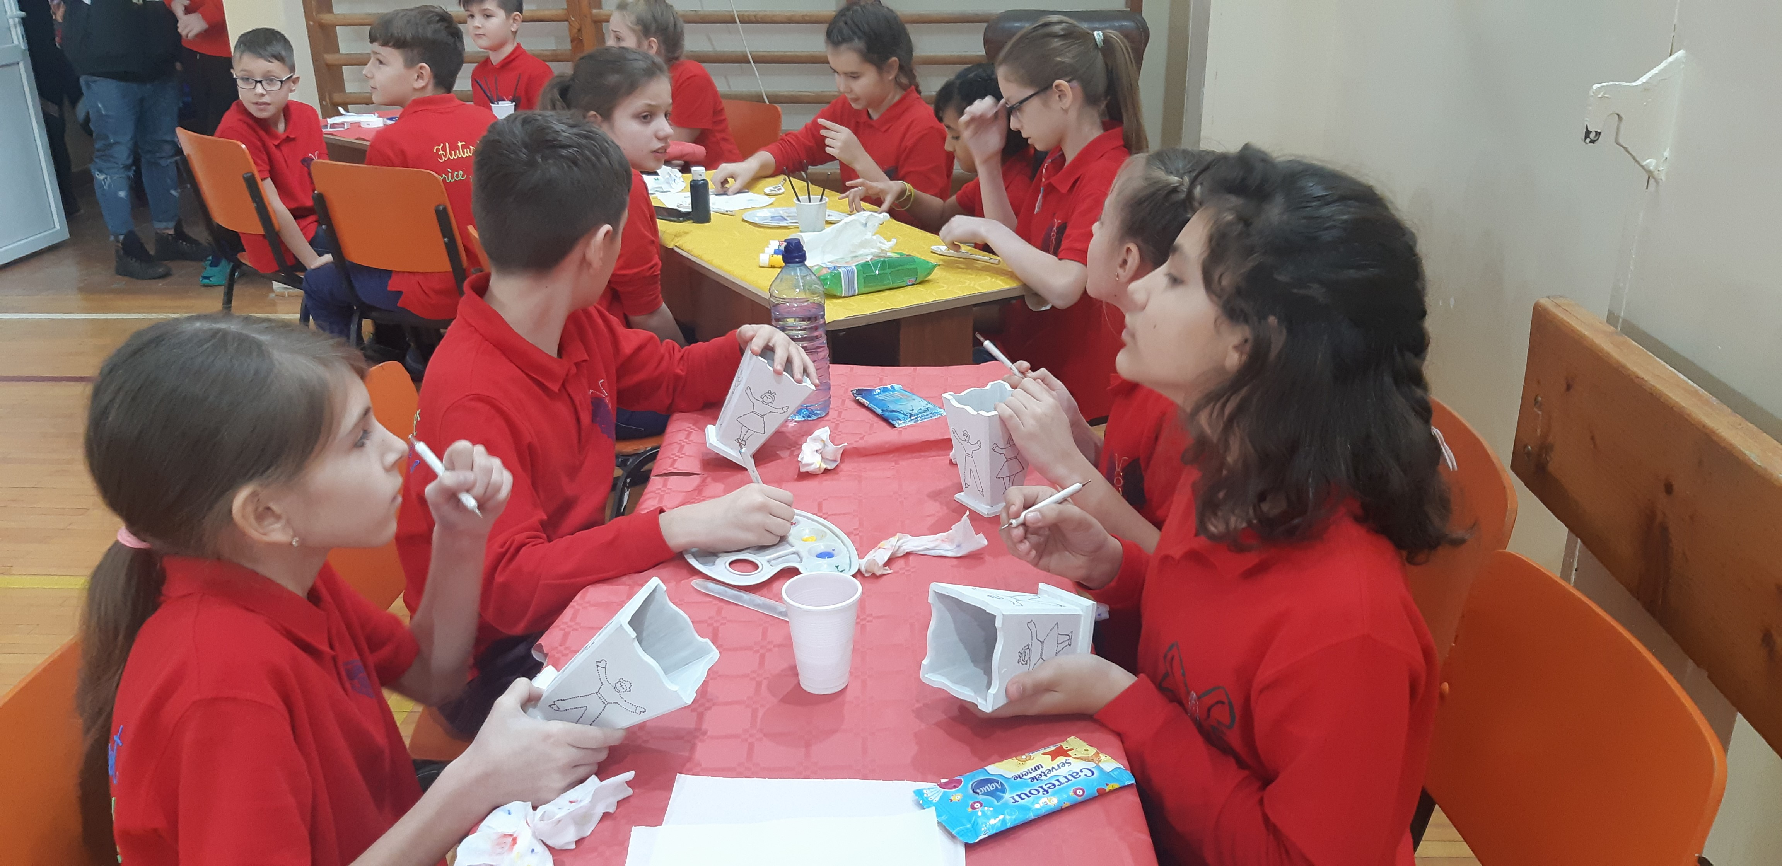
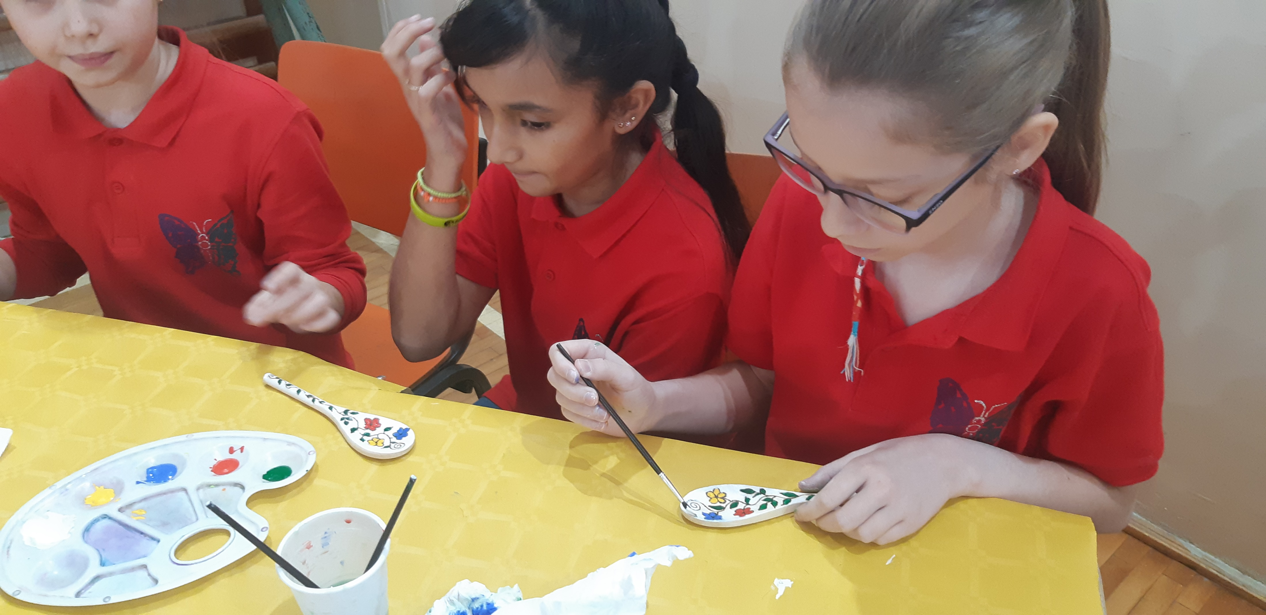
During the ceremony, the pupils prepared gifts for our guests .

Slide 17
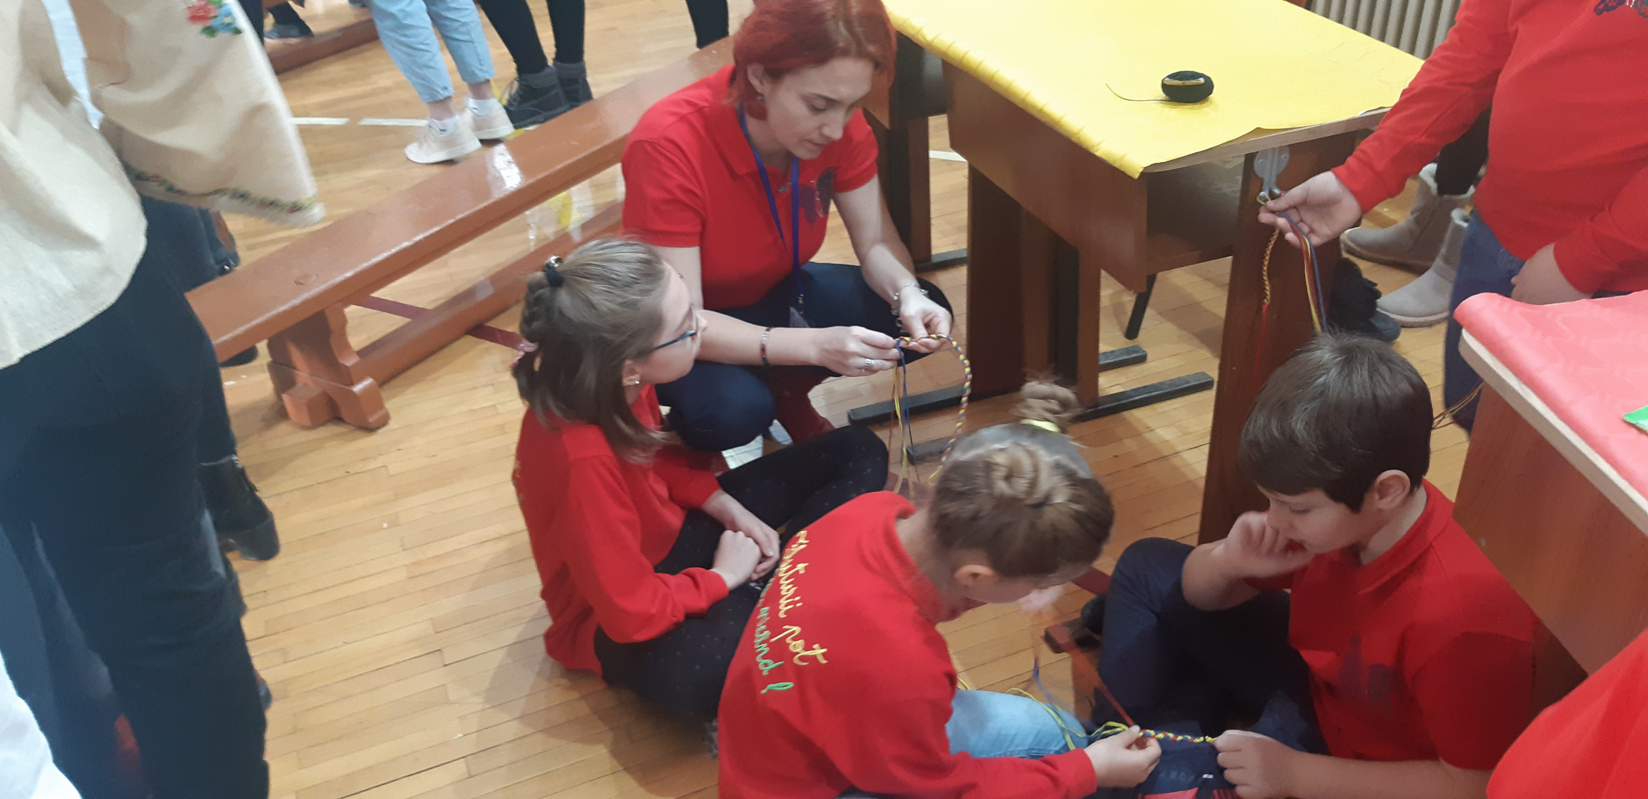
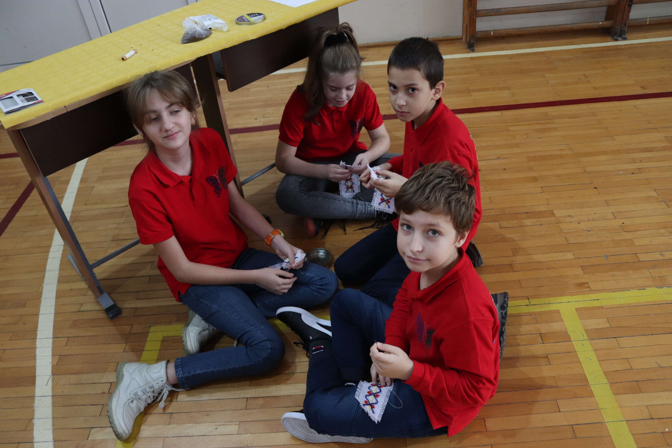
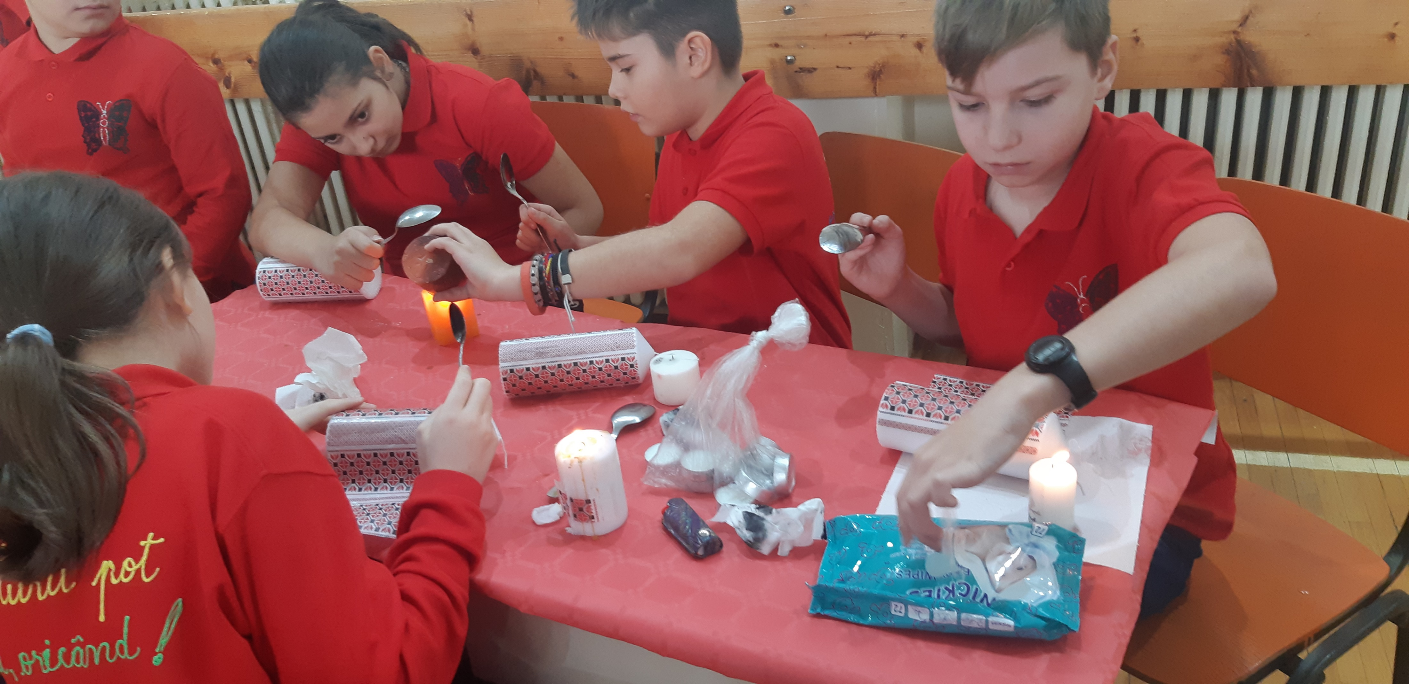
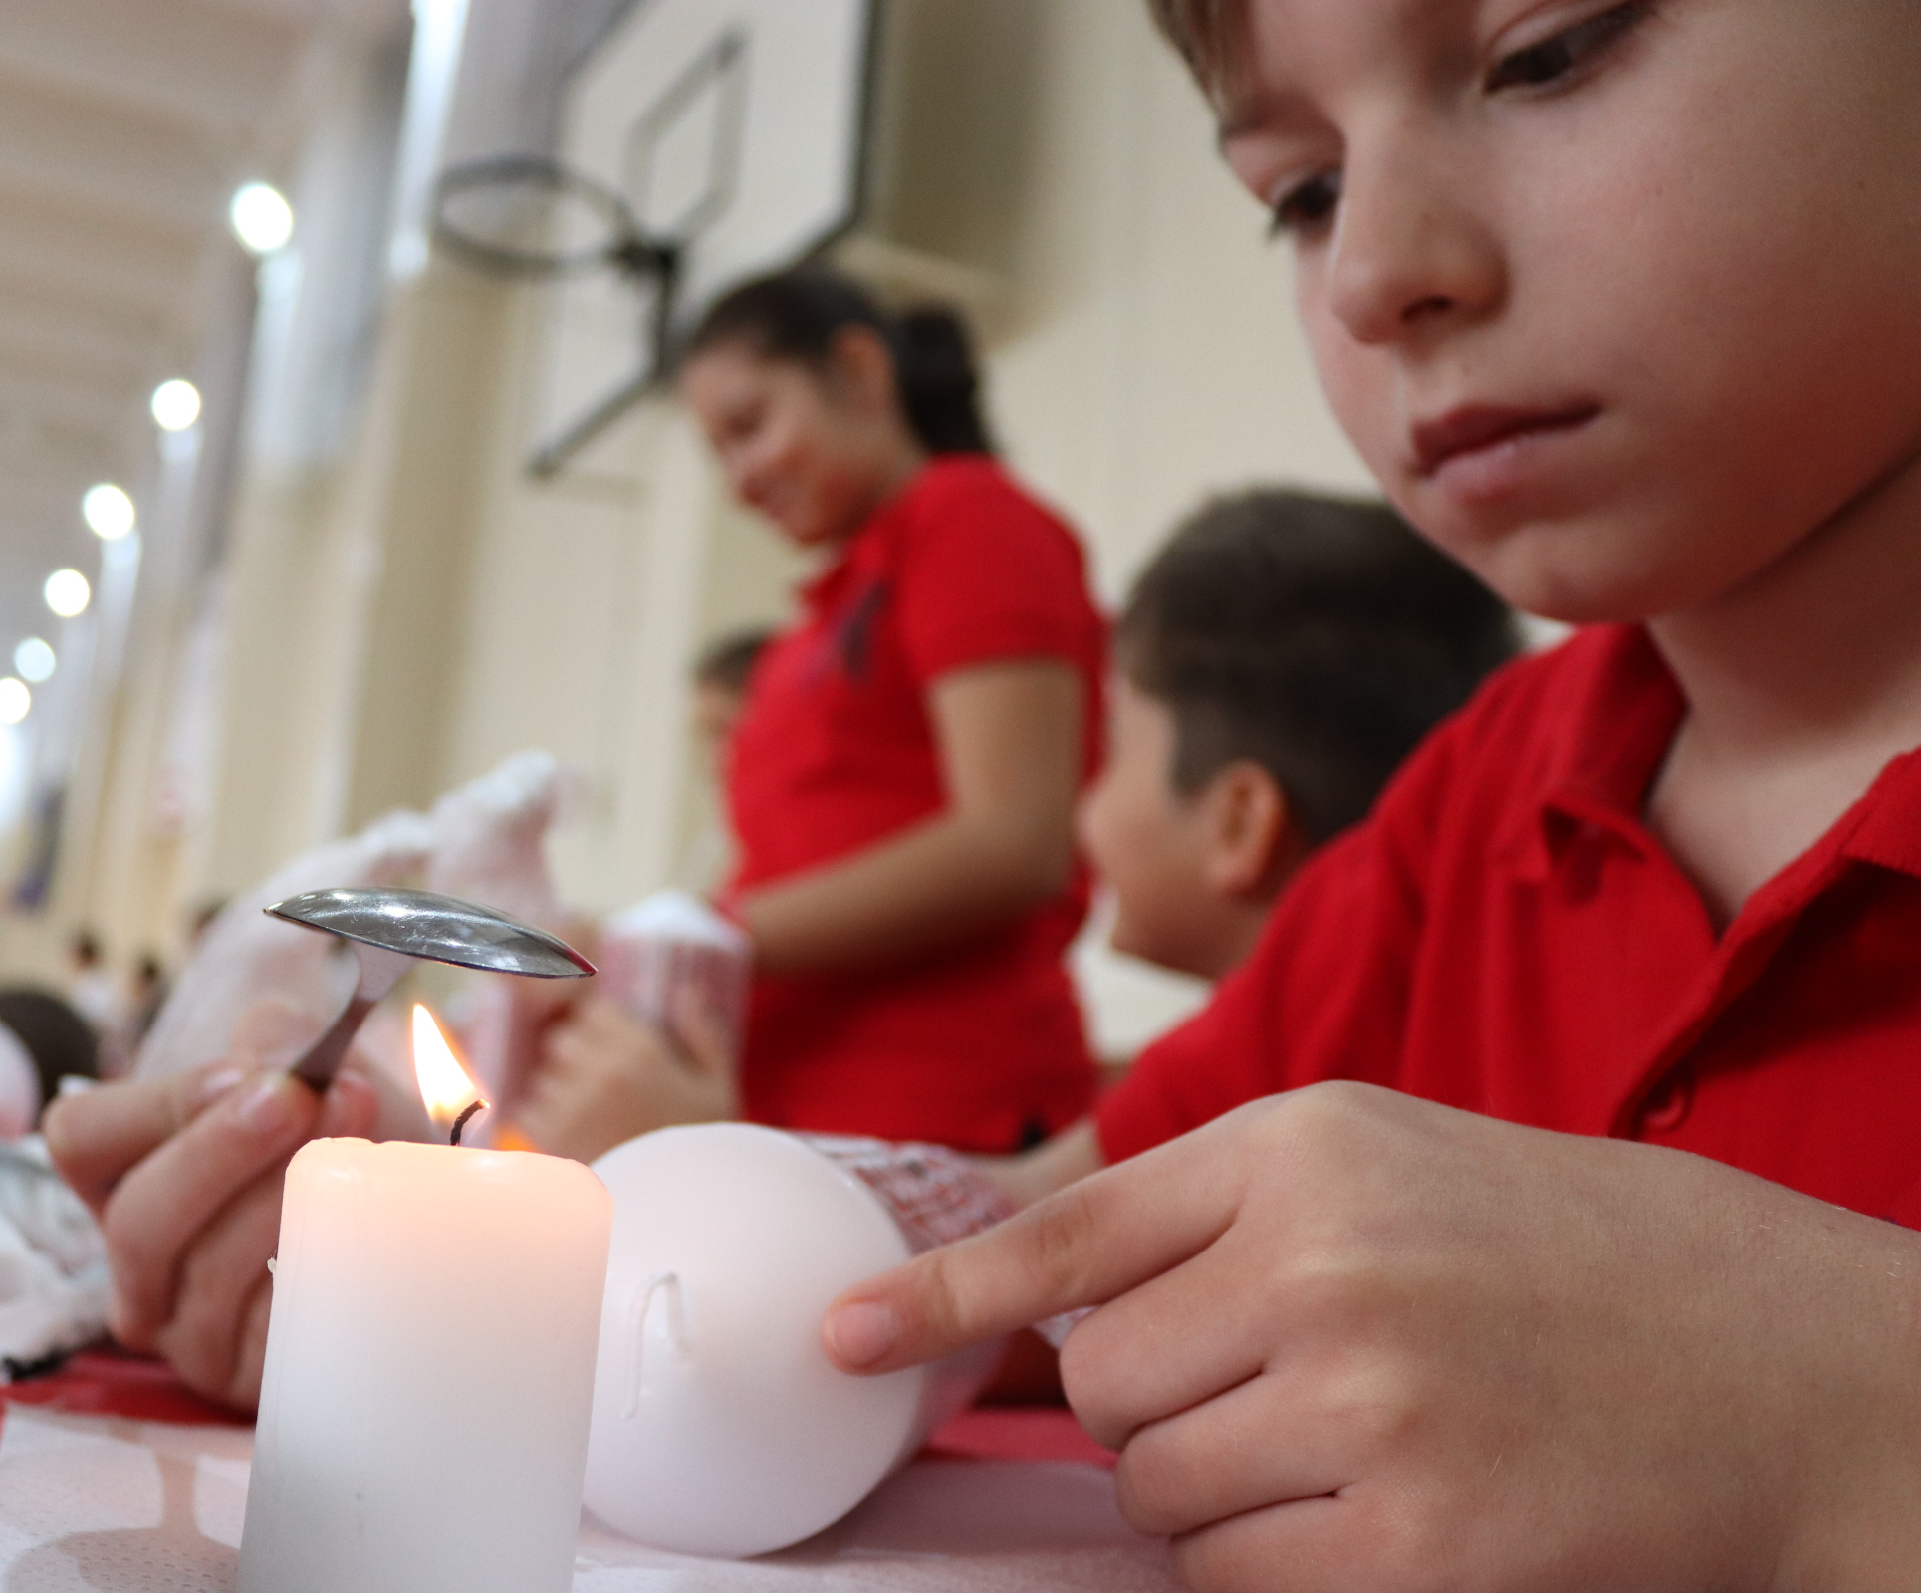

Slide 18
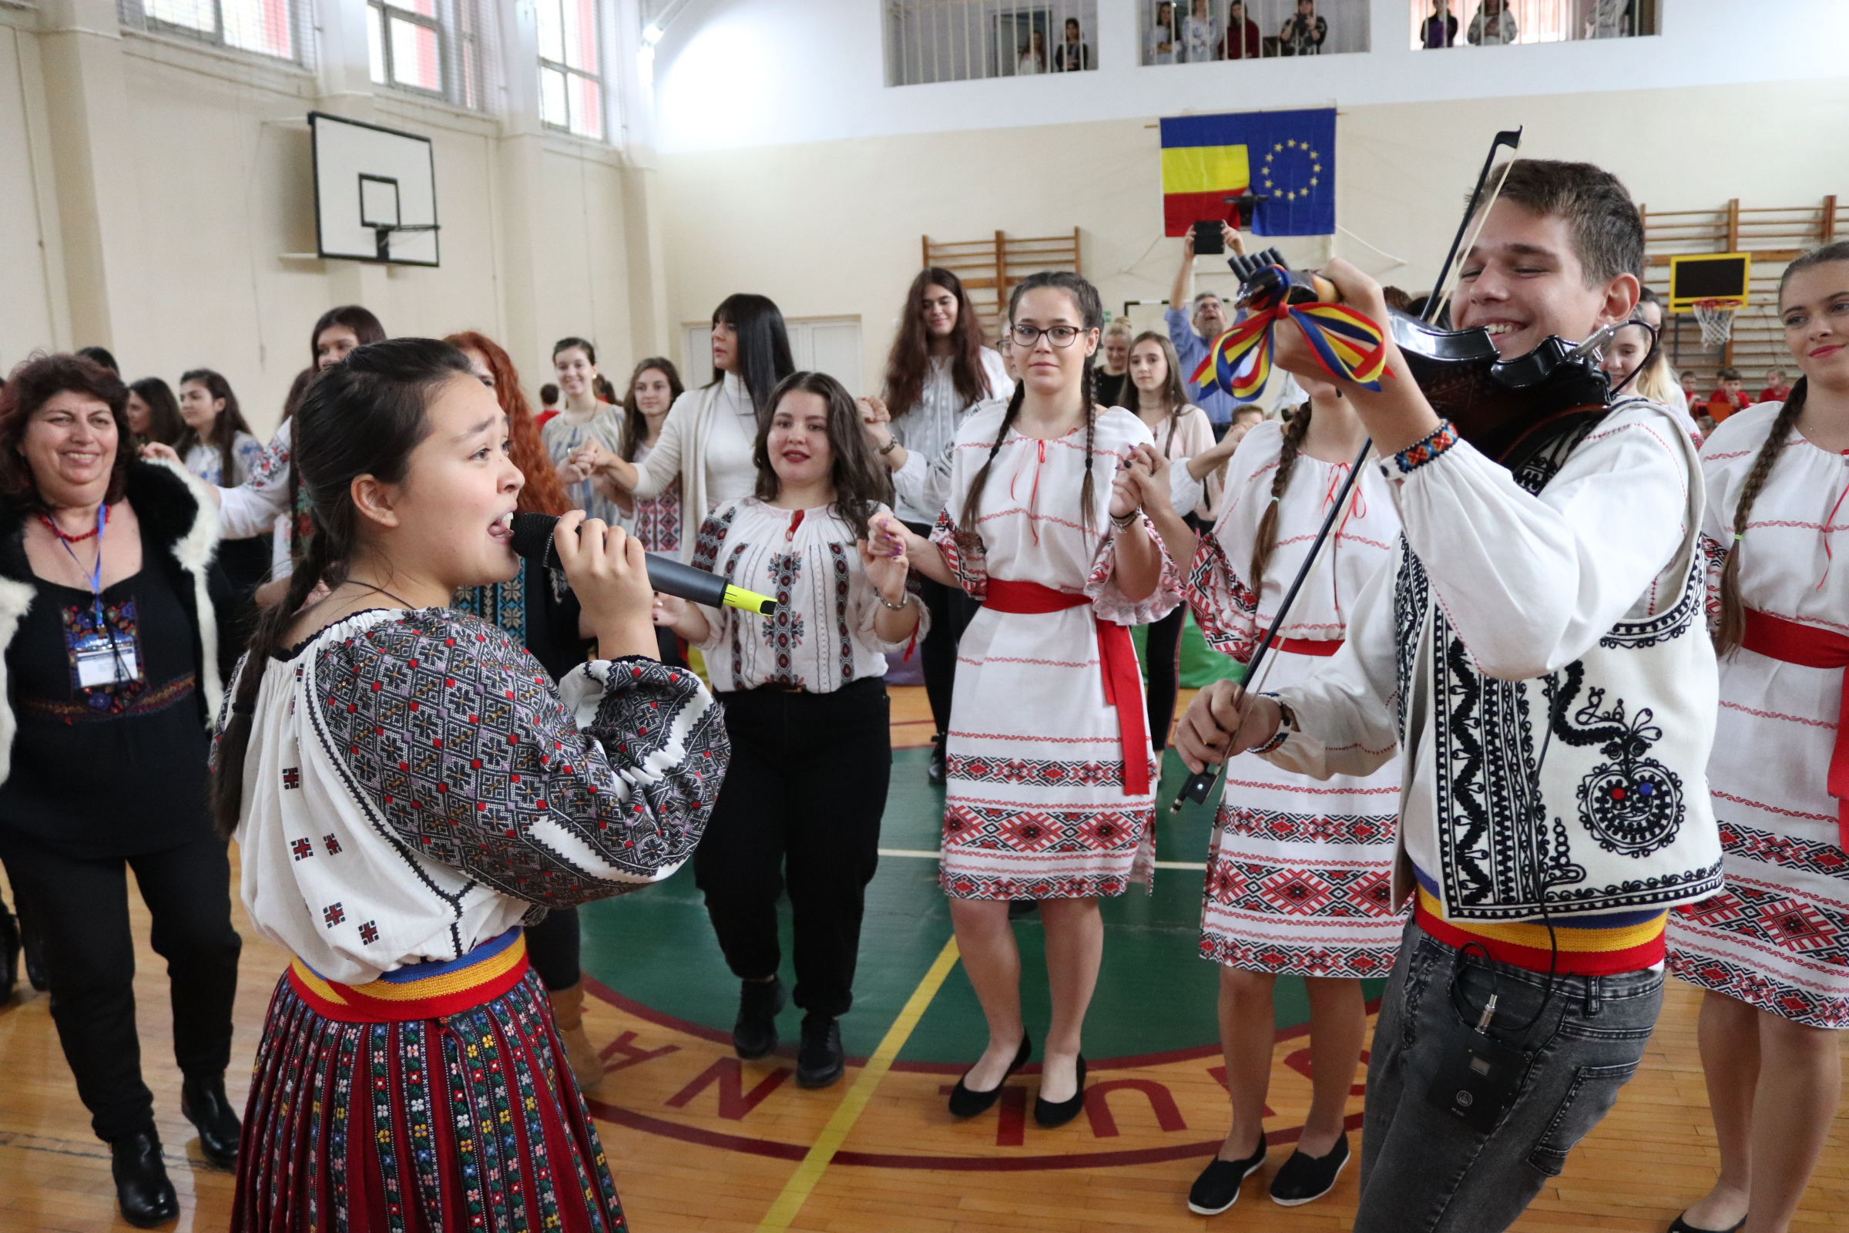

Slide 19
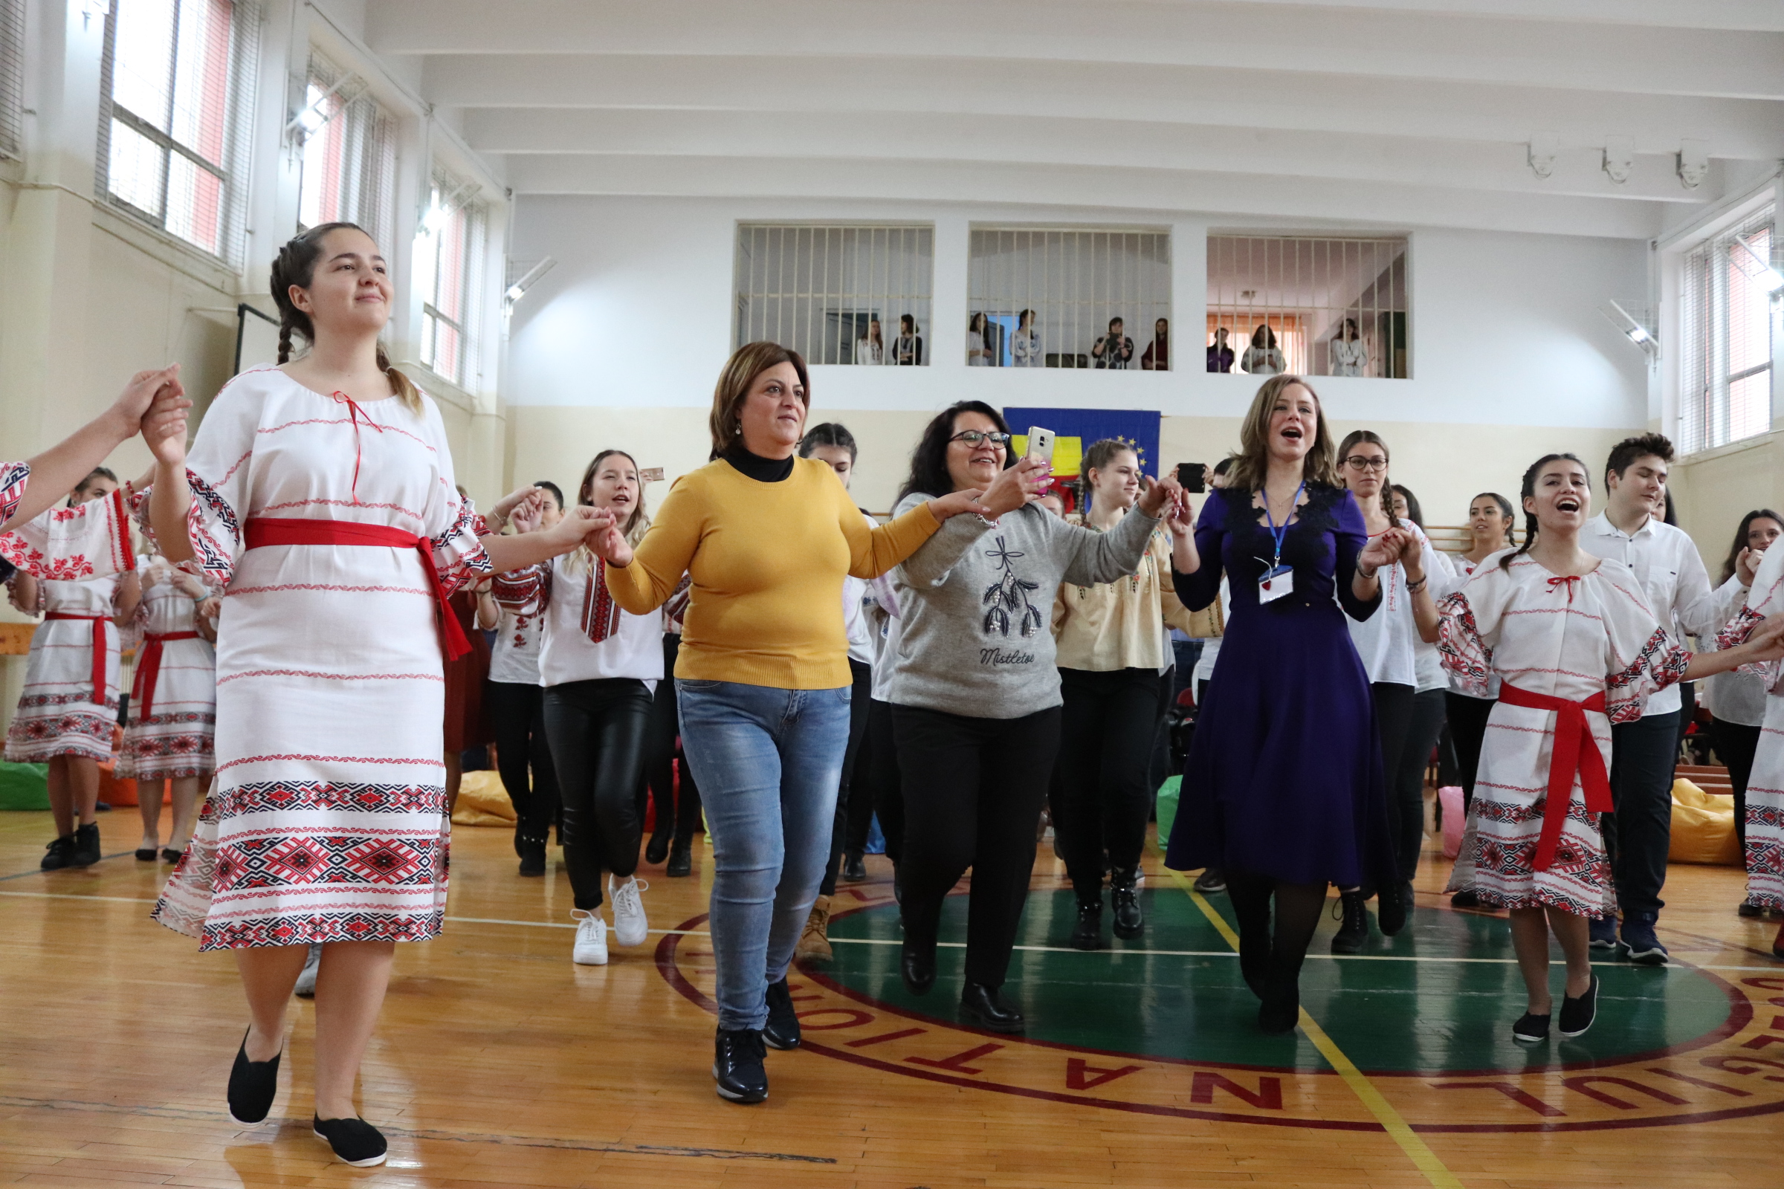

Slide 20
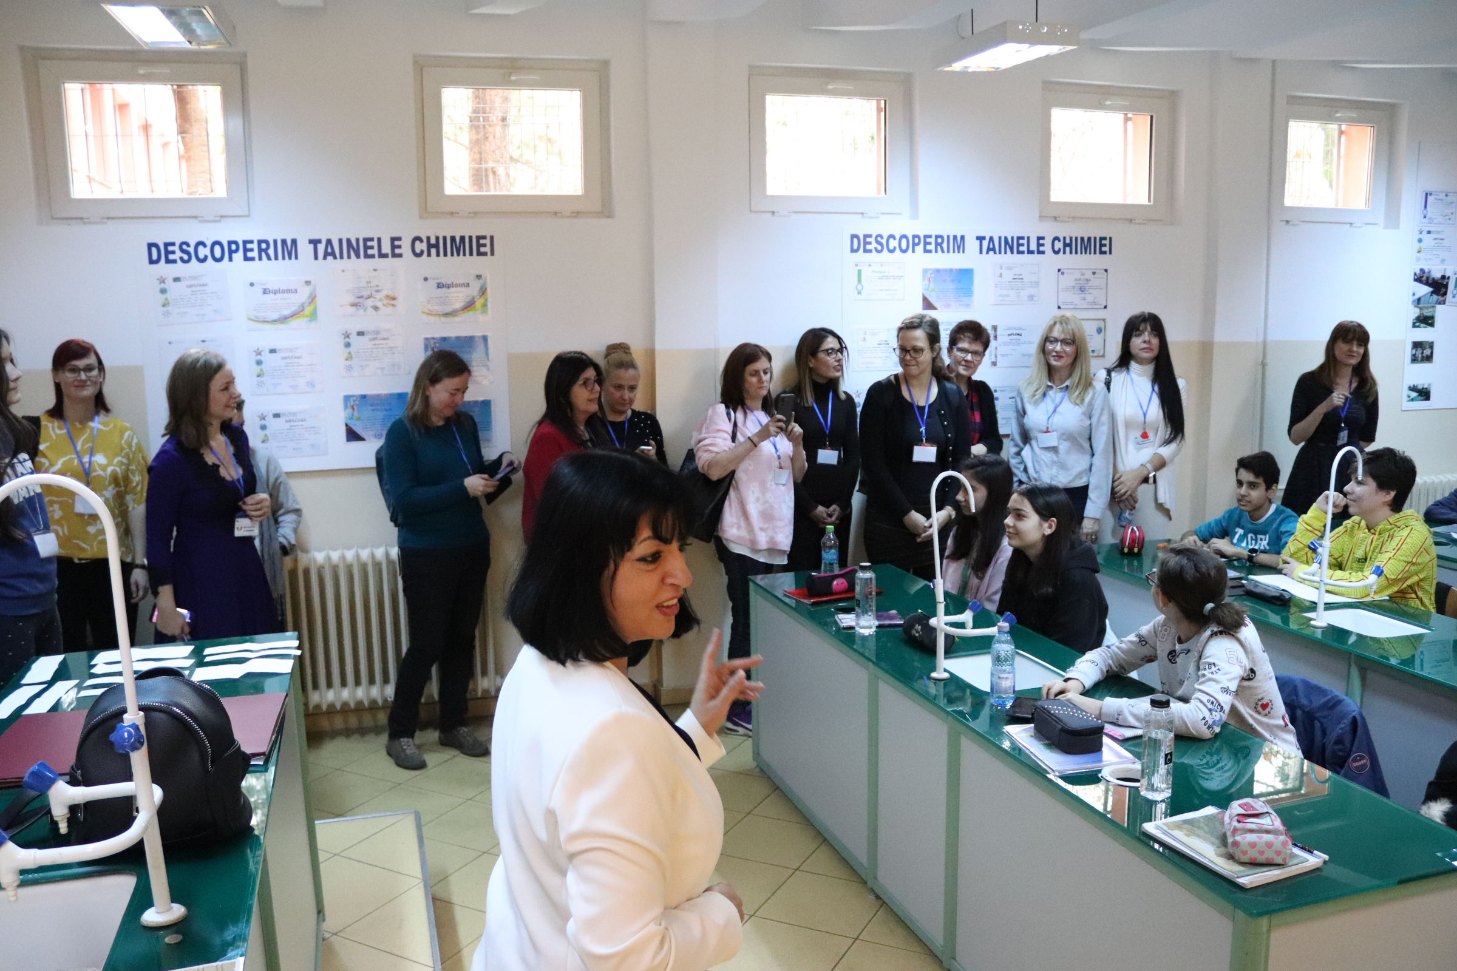
SCHOOL
VISIT

Slide 21
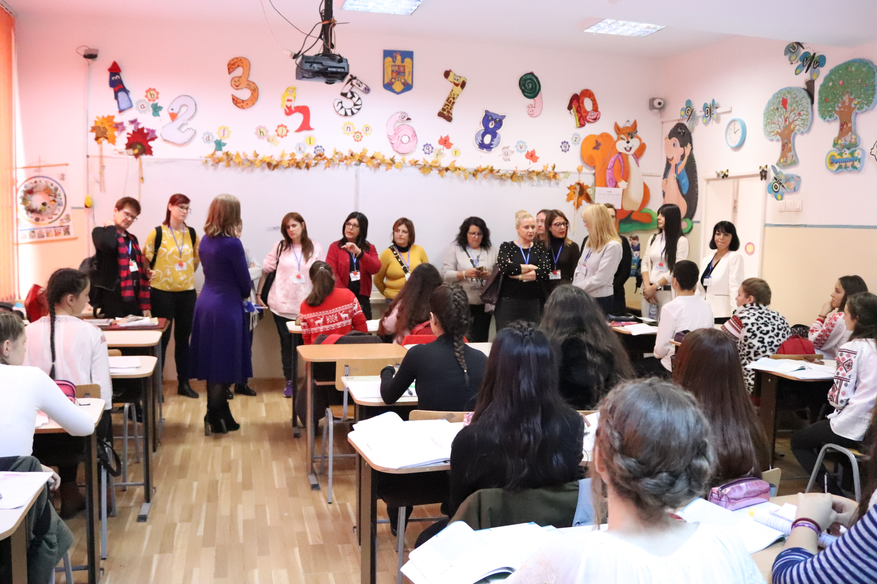

Slide 22
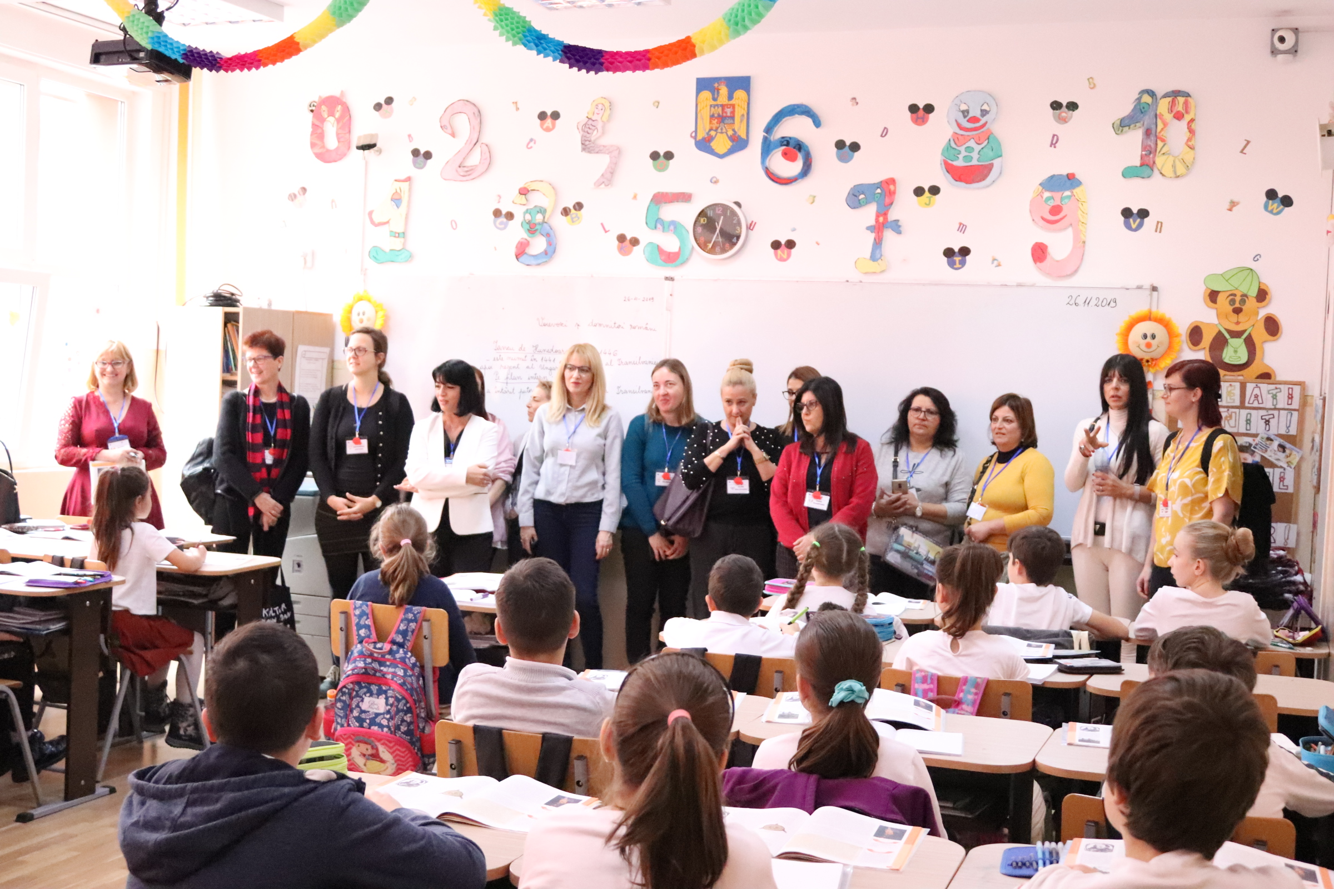

Slide 23
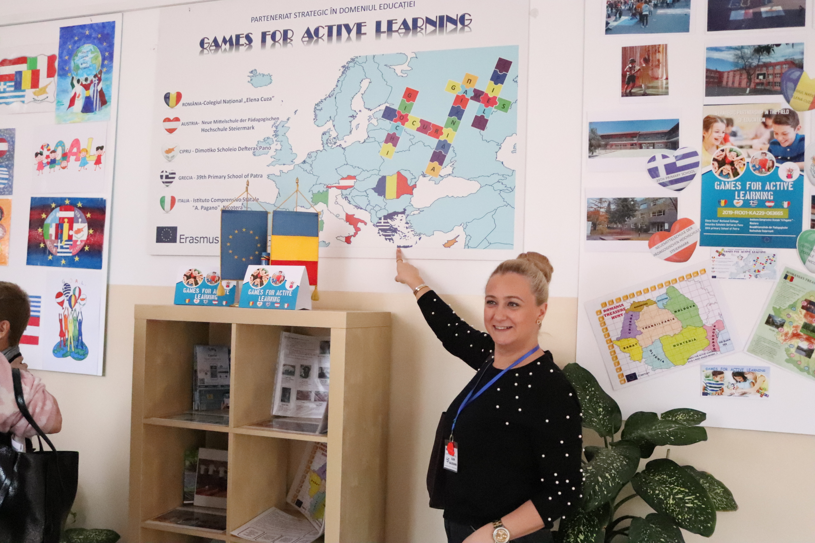
ERASMUS
BILBOARD
ERASMUS
LOGOS

Slide 24
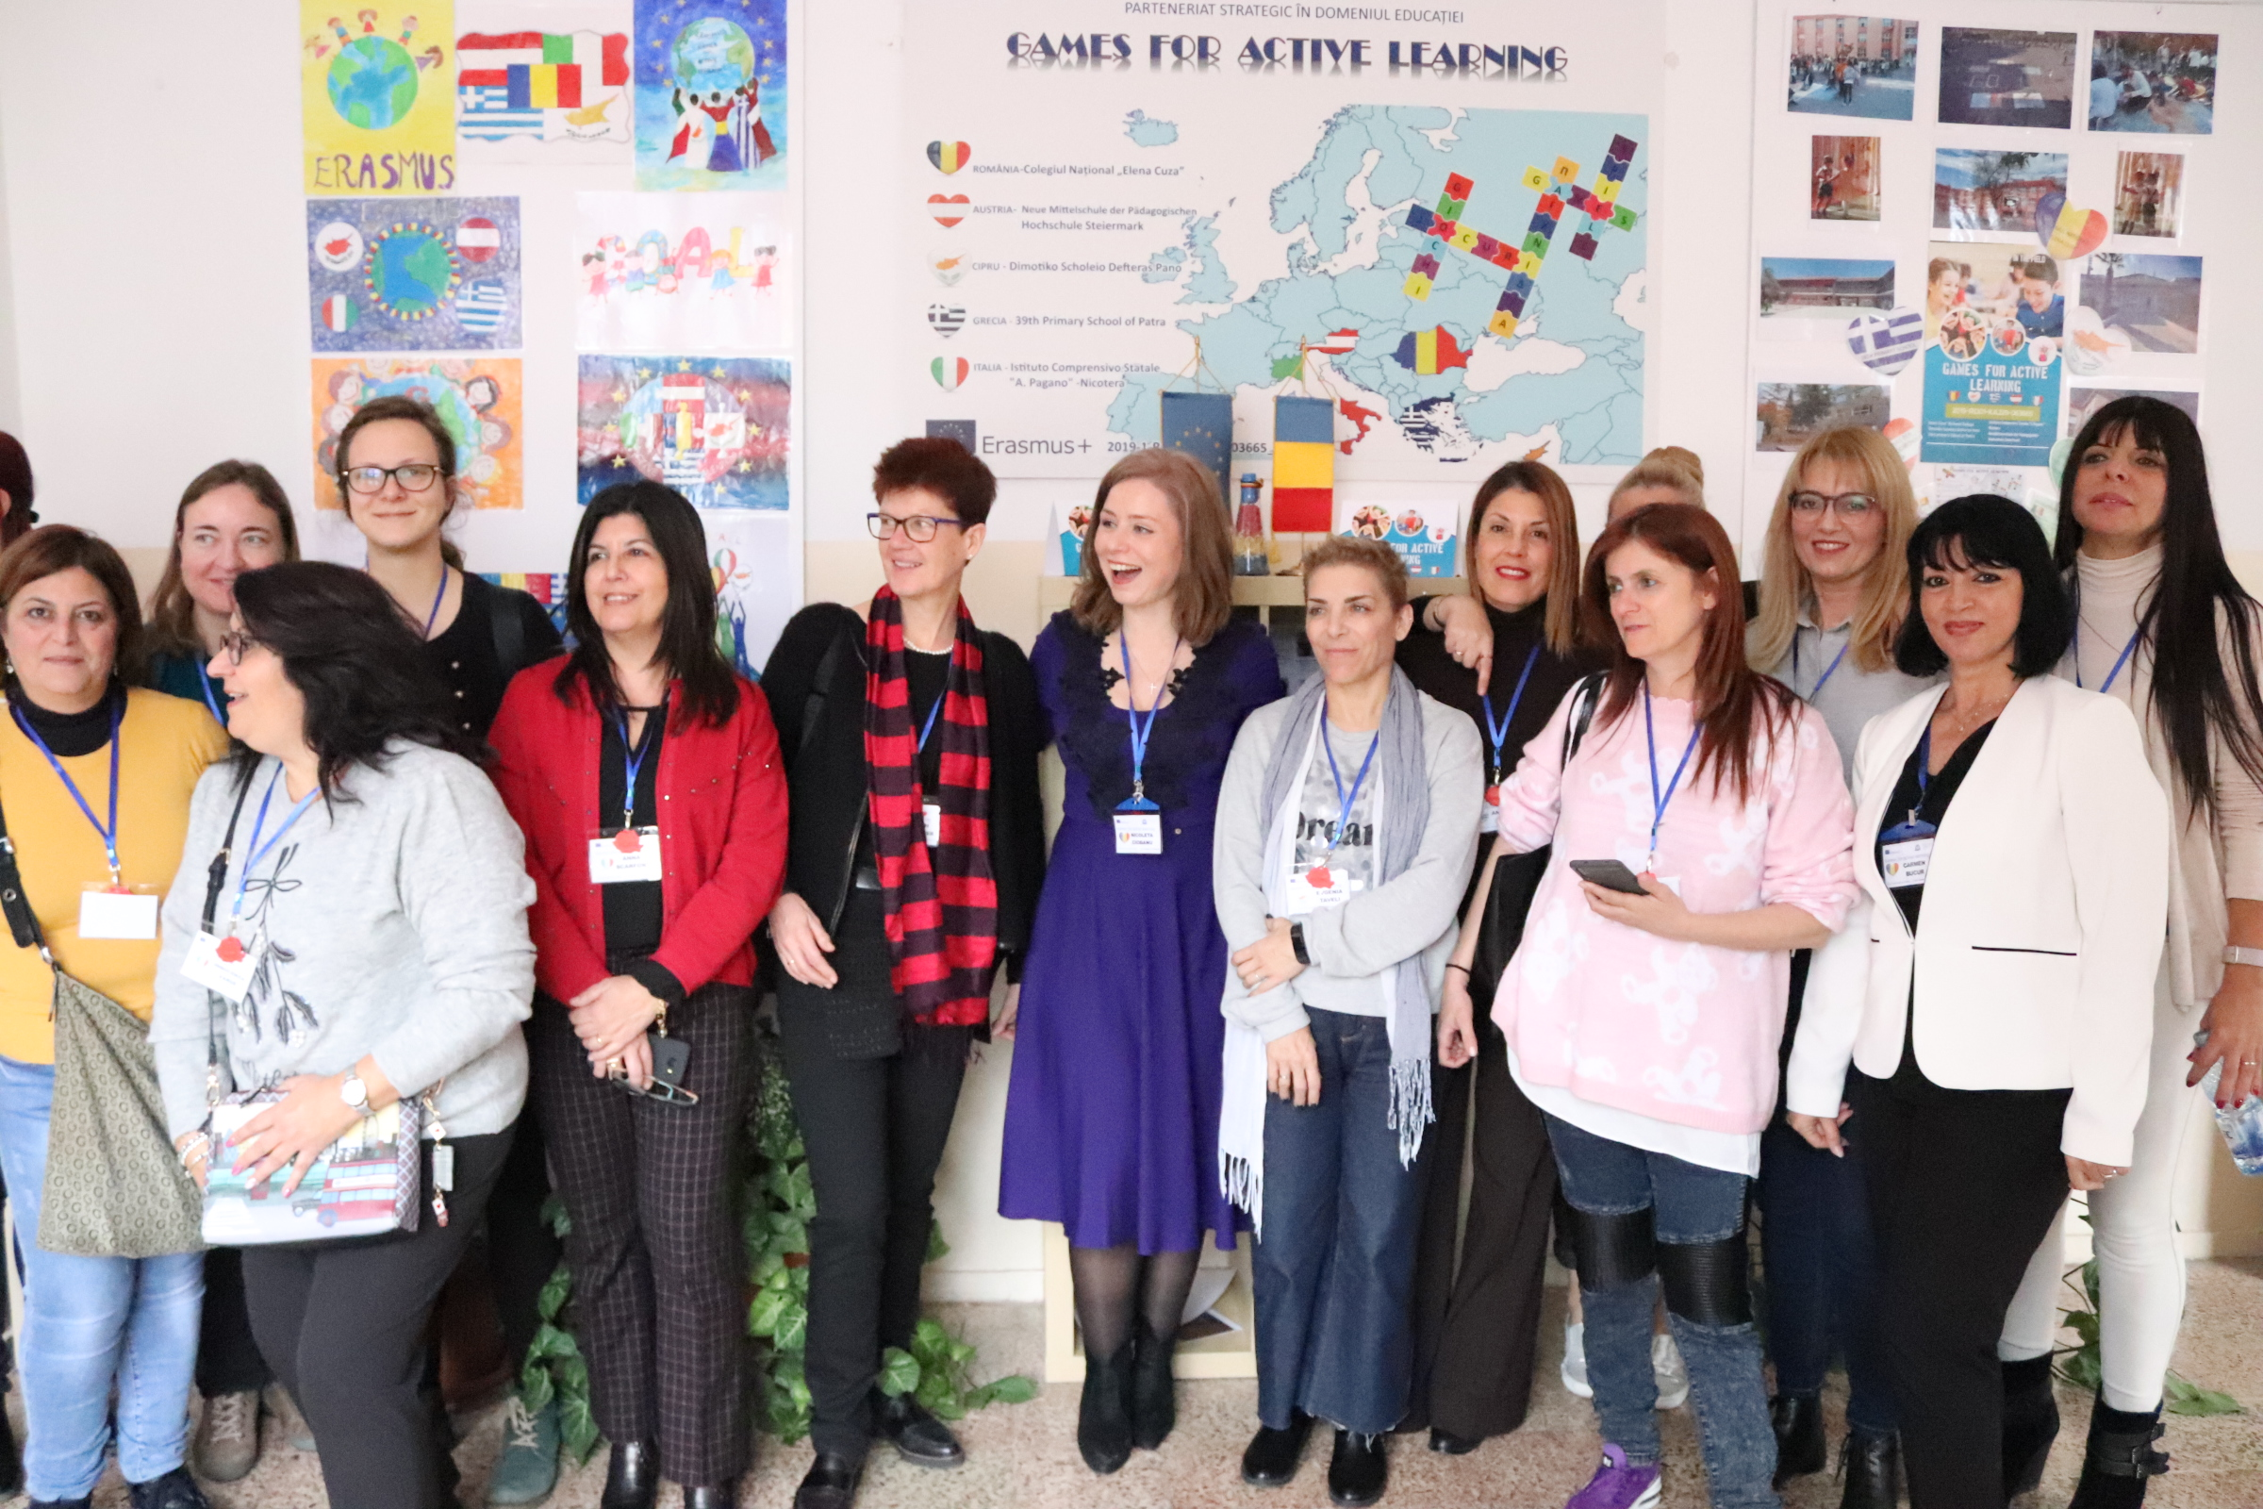

Slide 25
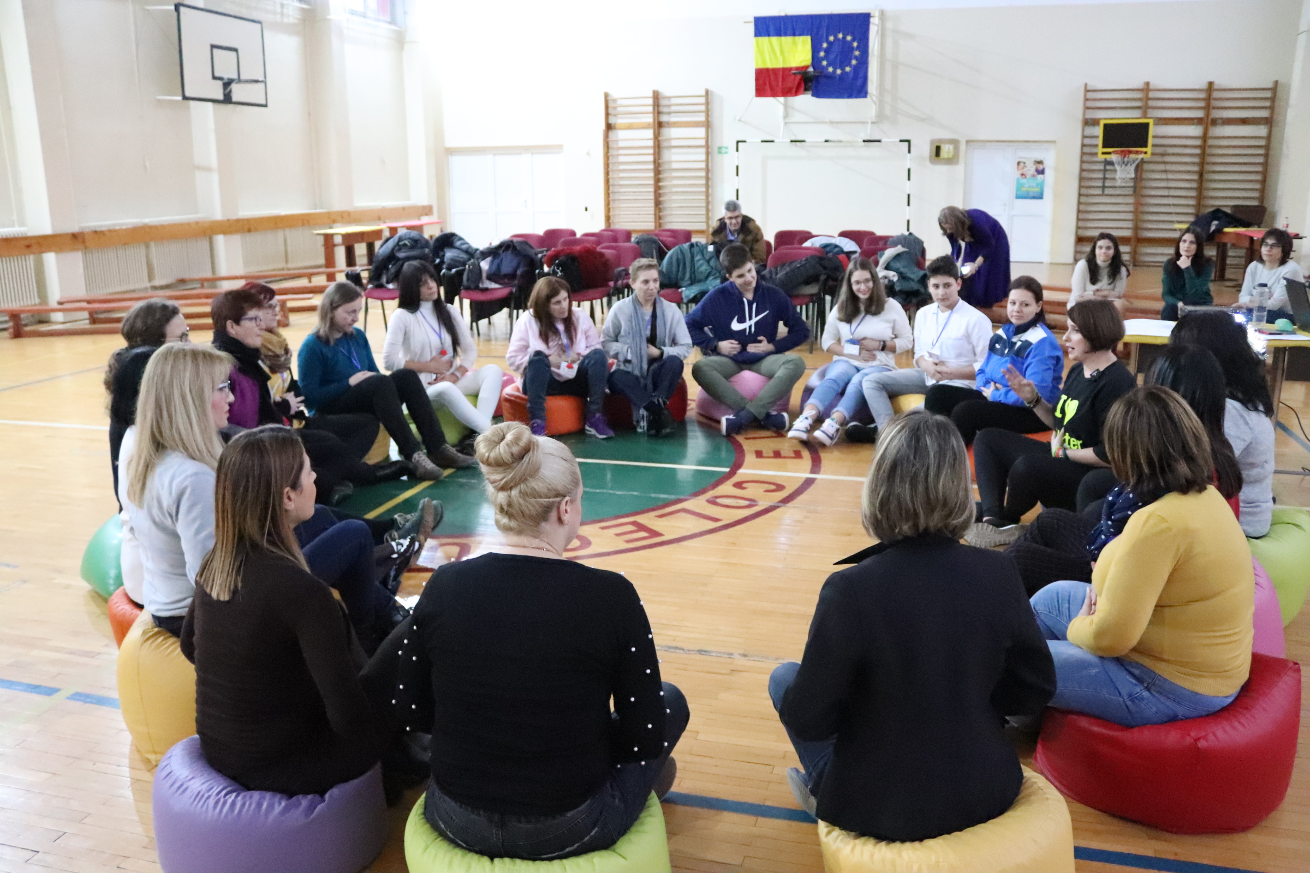
LAUGHTER YOGA
WORKSHOP
Laughing is an easy way to strengthen all immune functions, bring more oxygen to the body and brain, foster positive feelings and improve interpersonal skills.

Slide 26
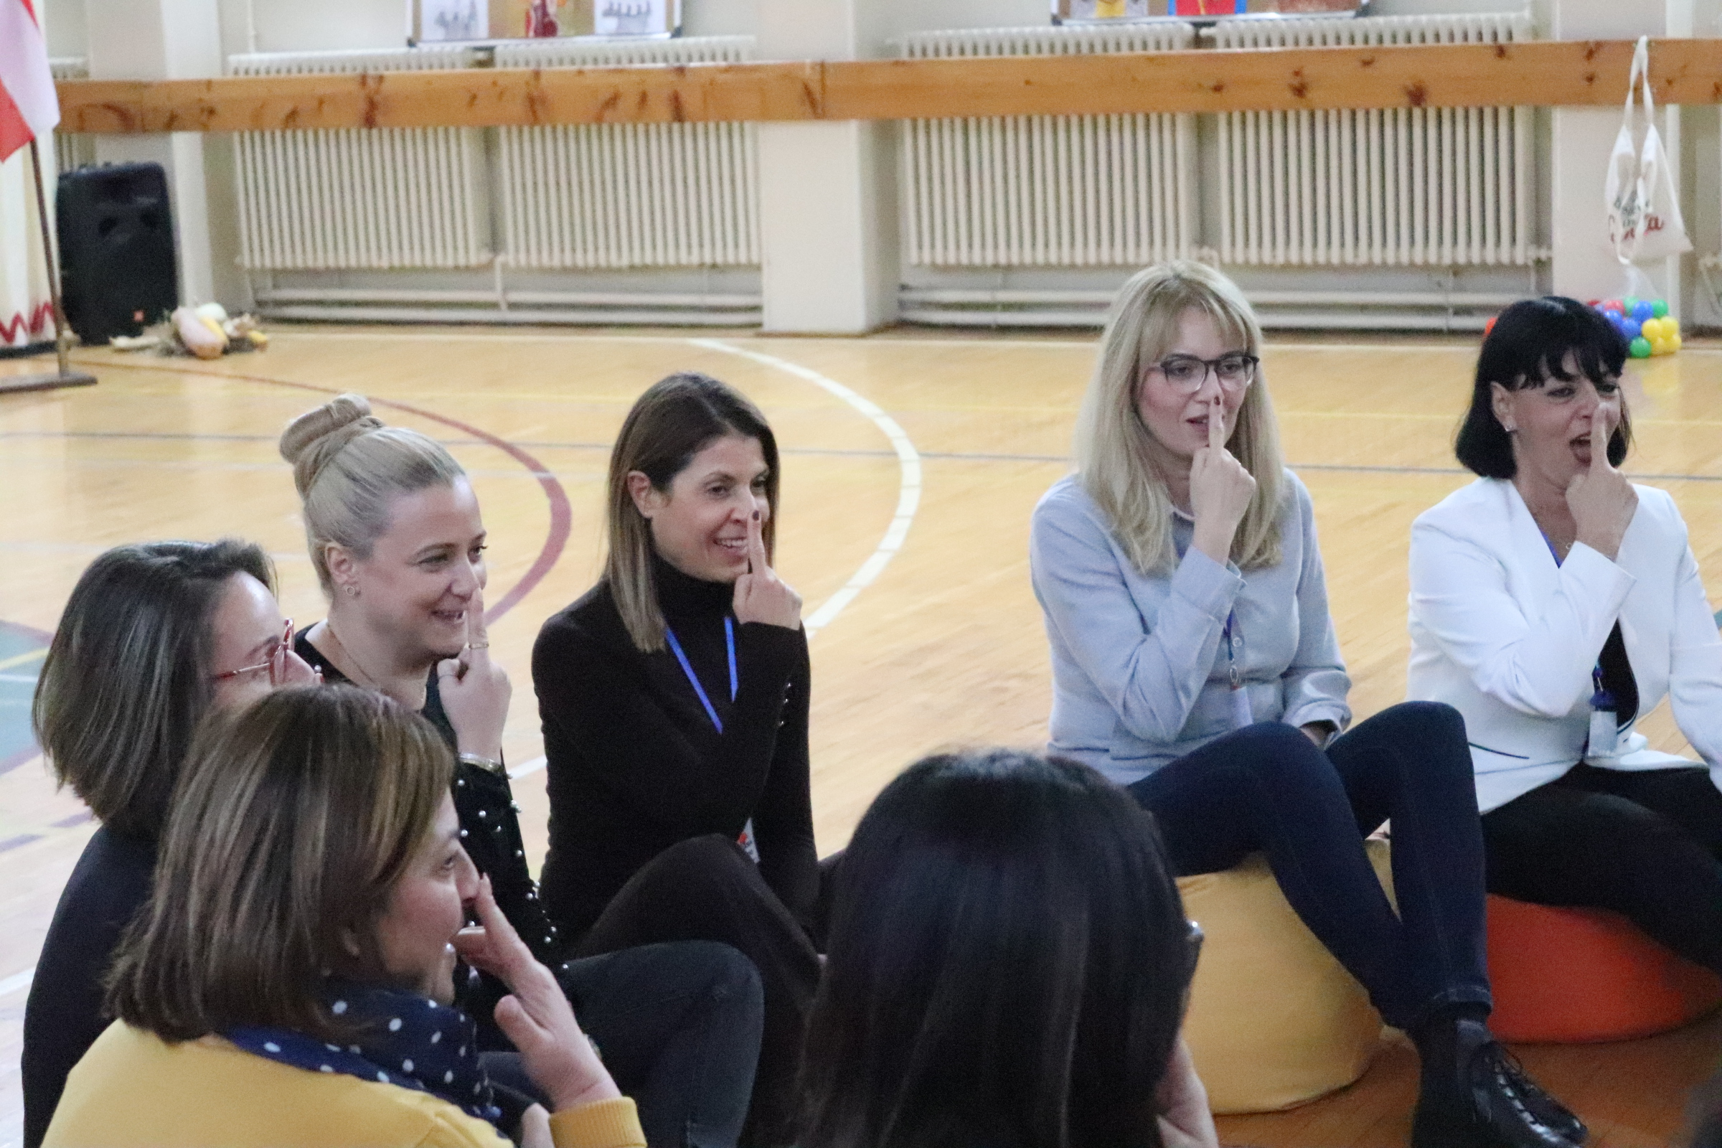

Slide 27
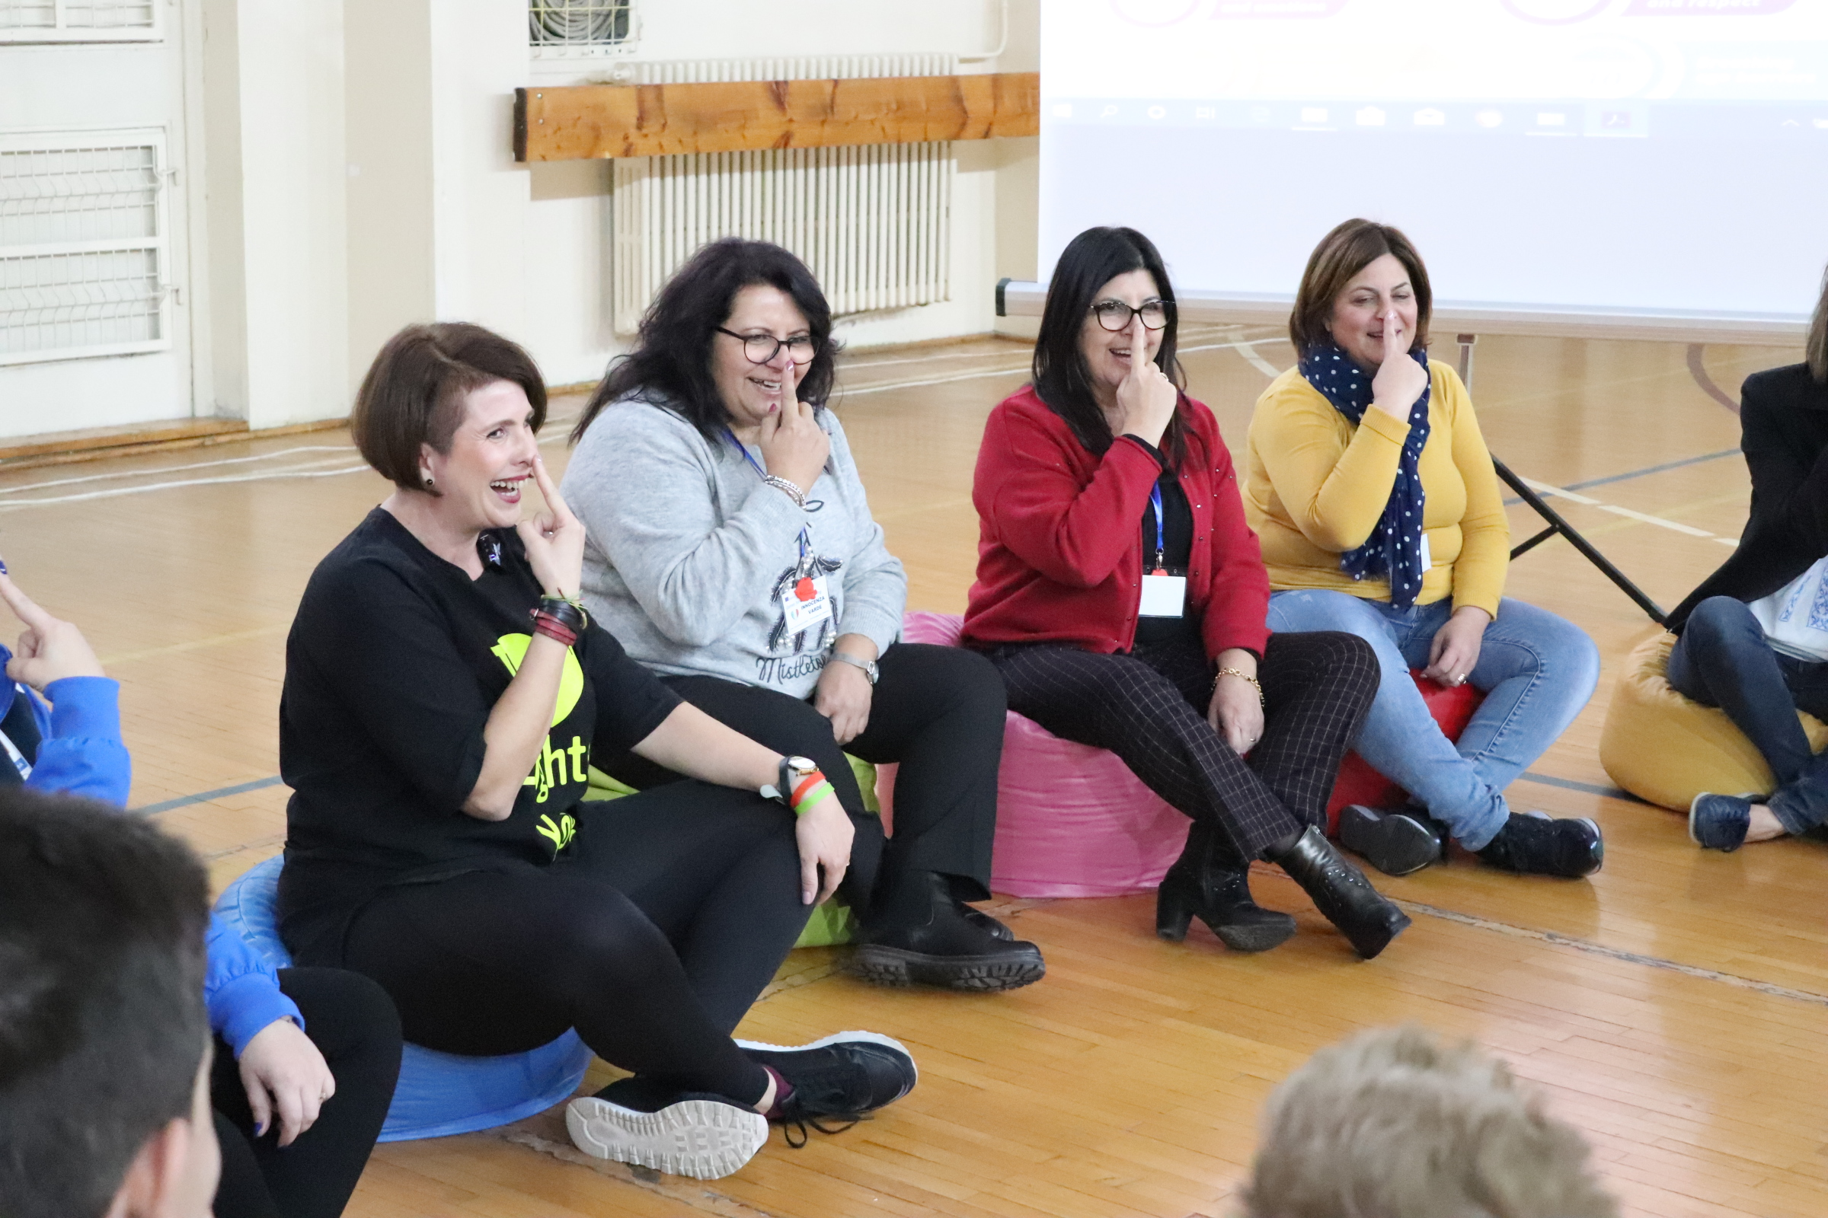

Slide 28
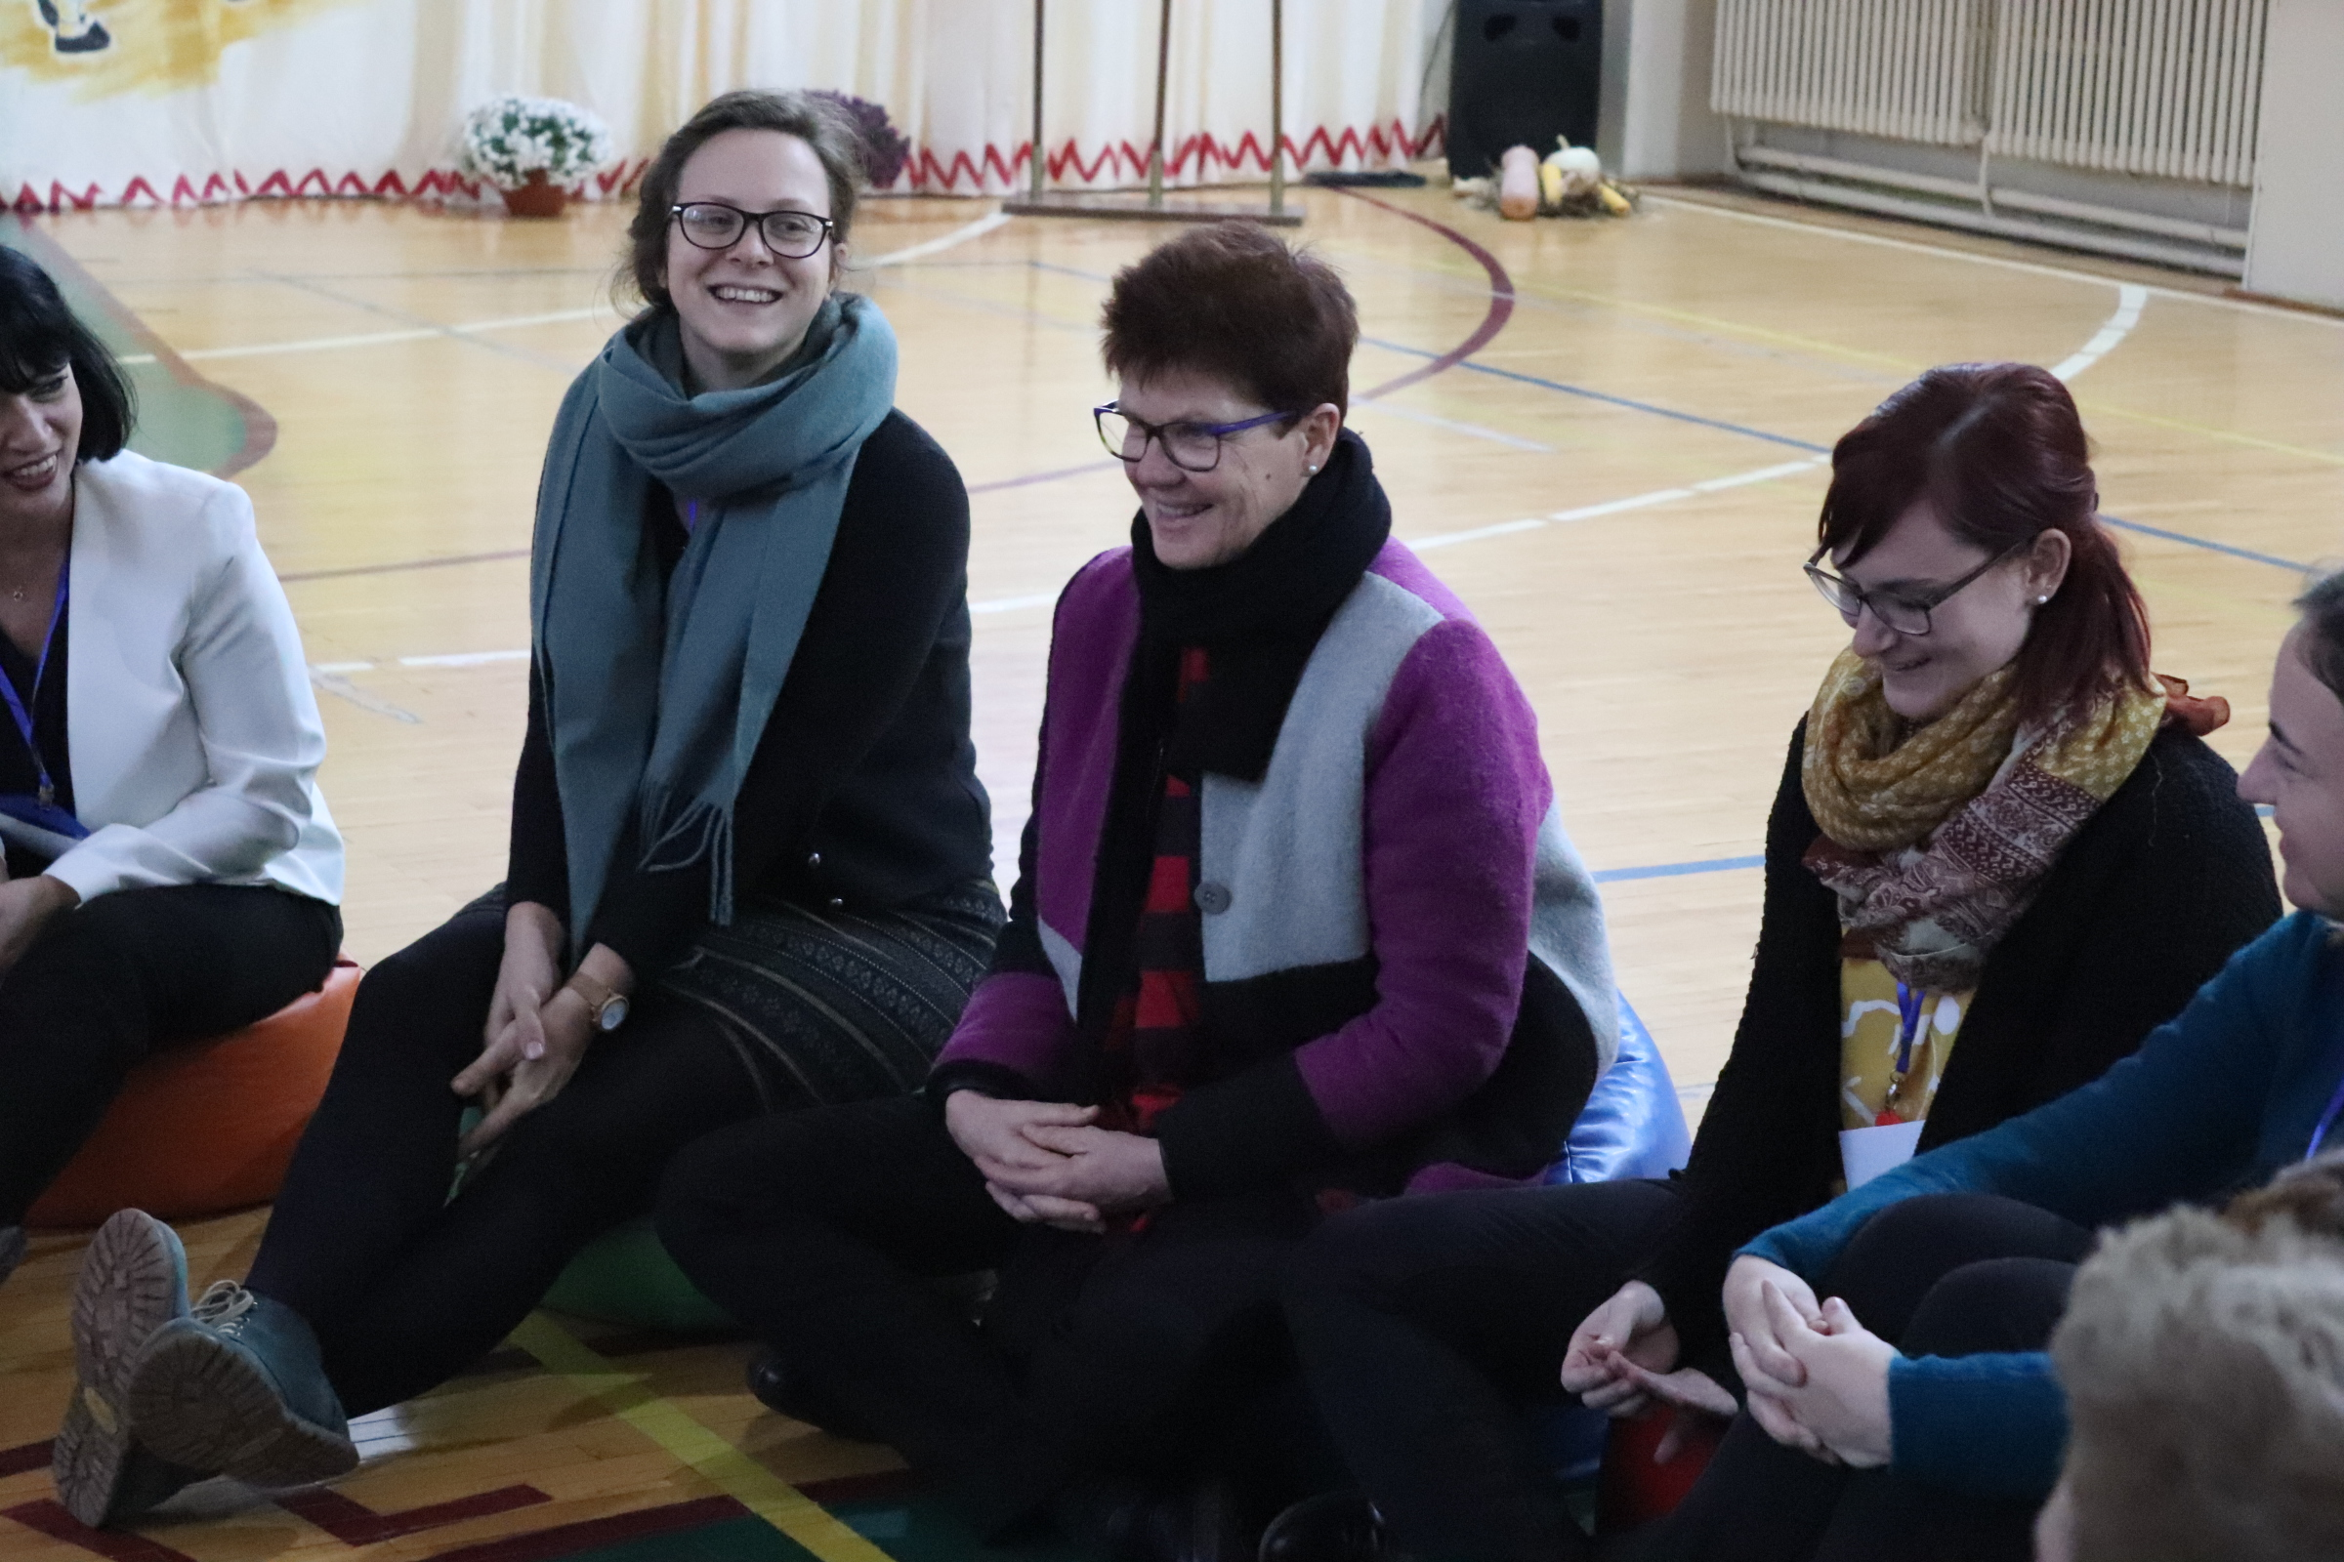

Slide 29
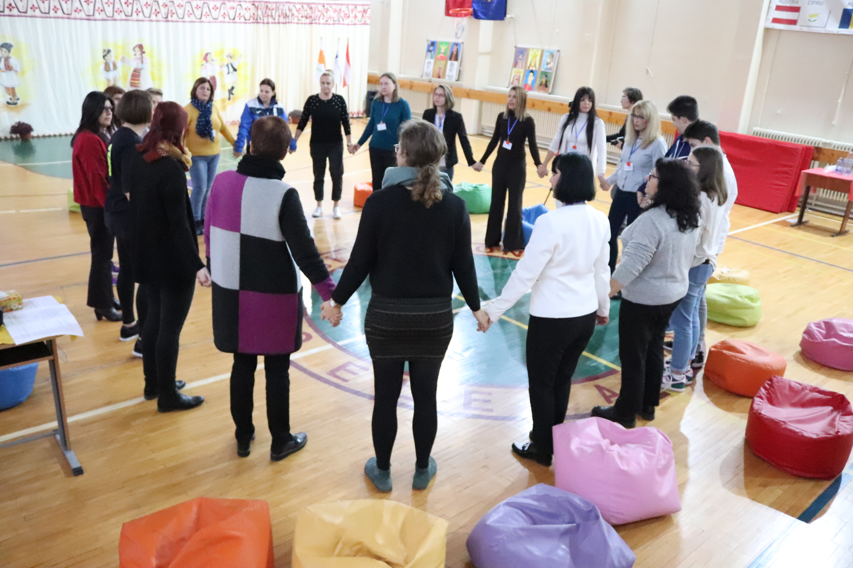

Slide 30
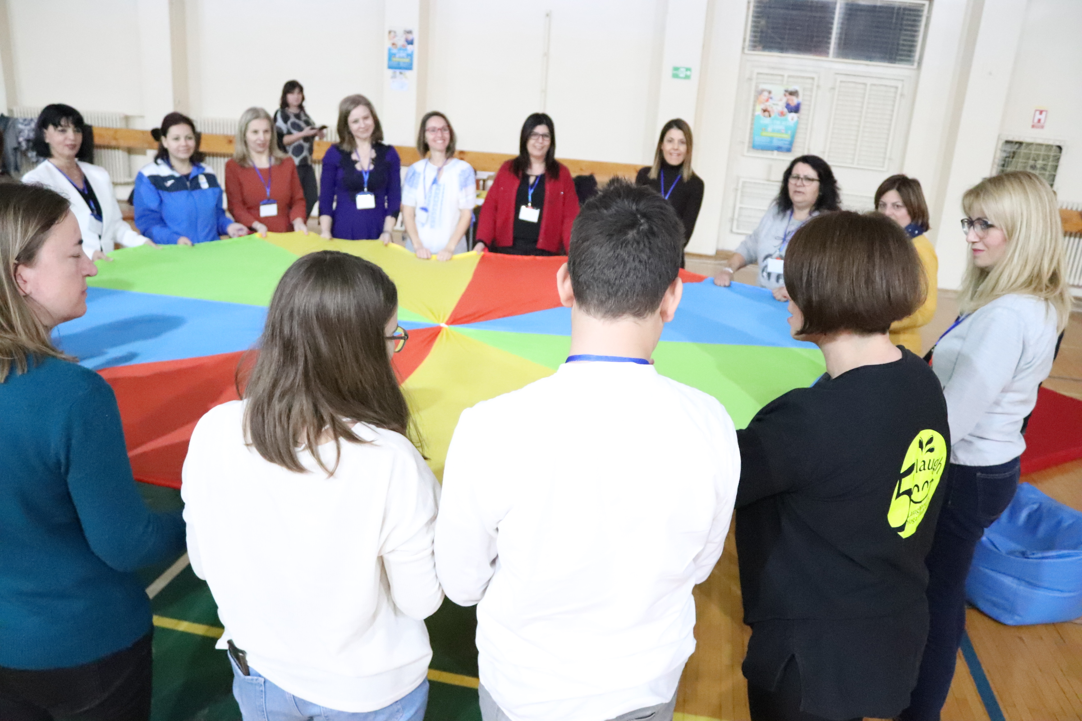

Slide 31
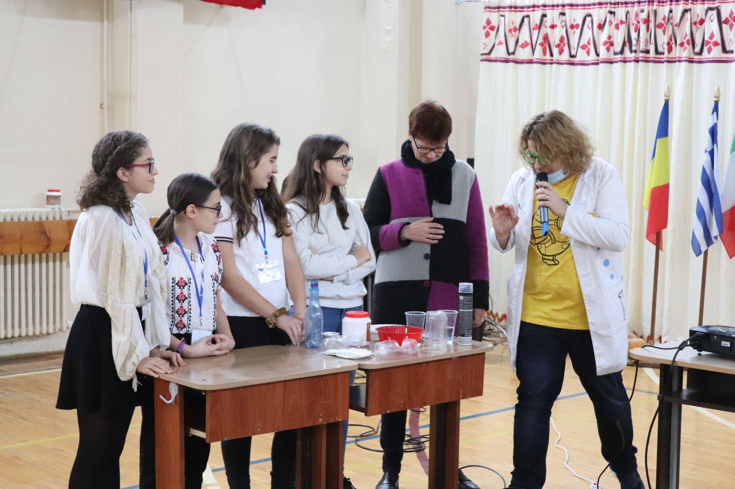
FUN SCIENCE

Slide 32
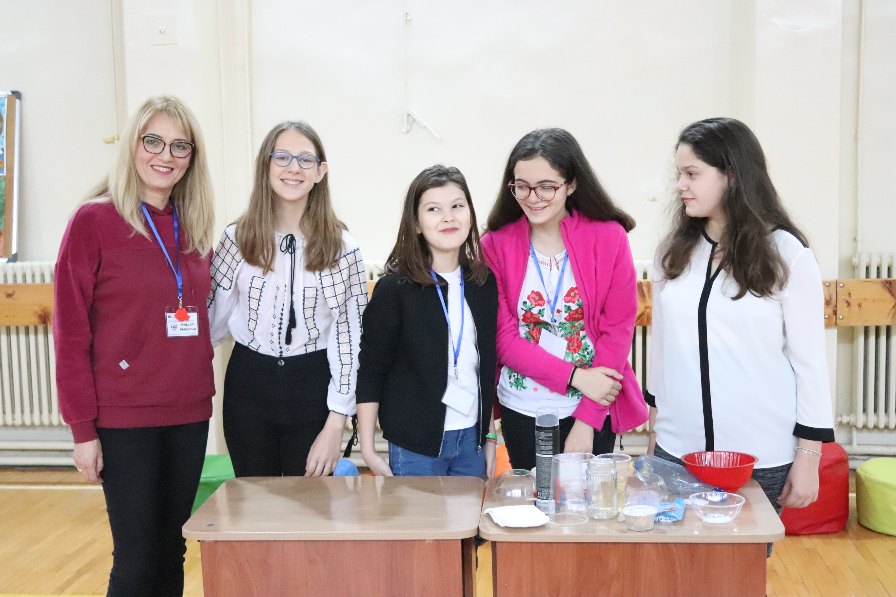

Slide 33
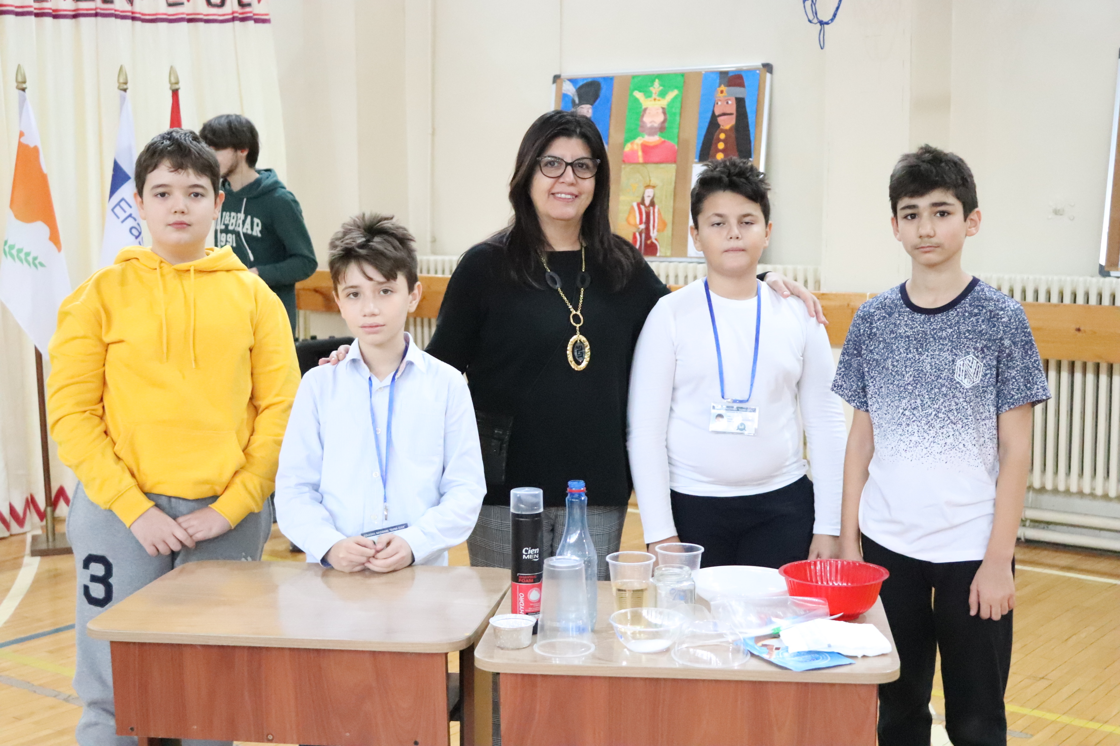

Slide 34
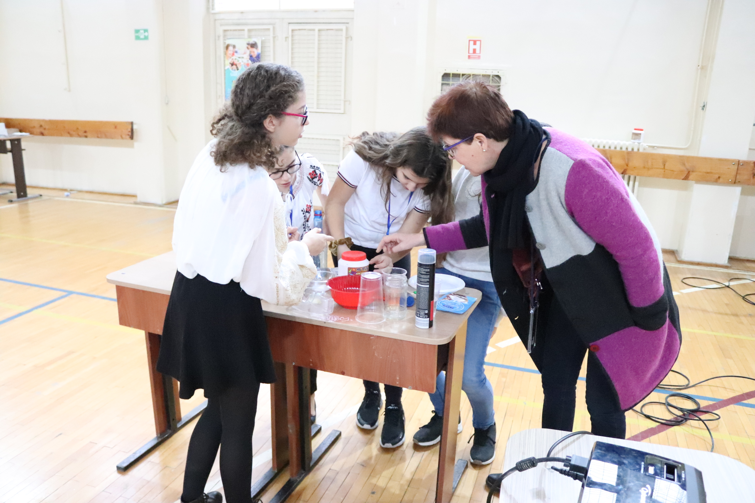

Slide 35
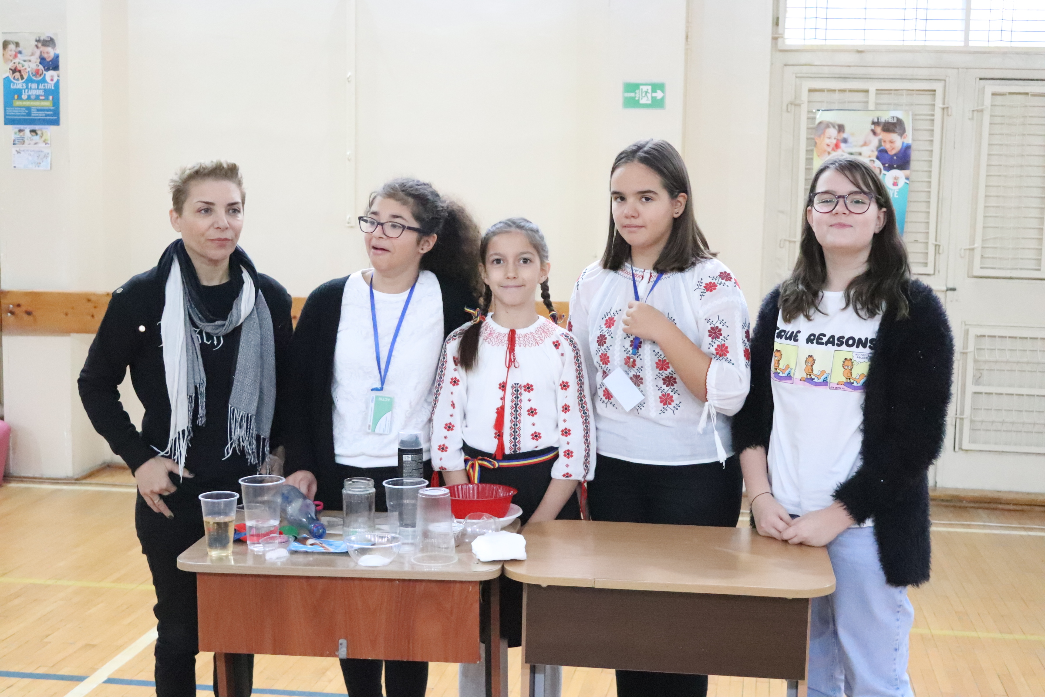

Slide 36
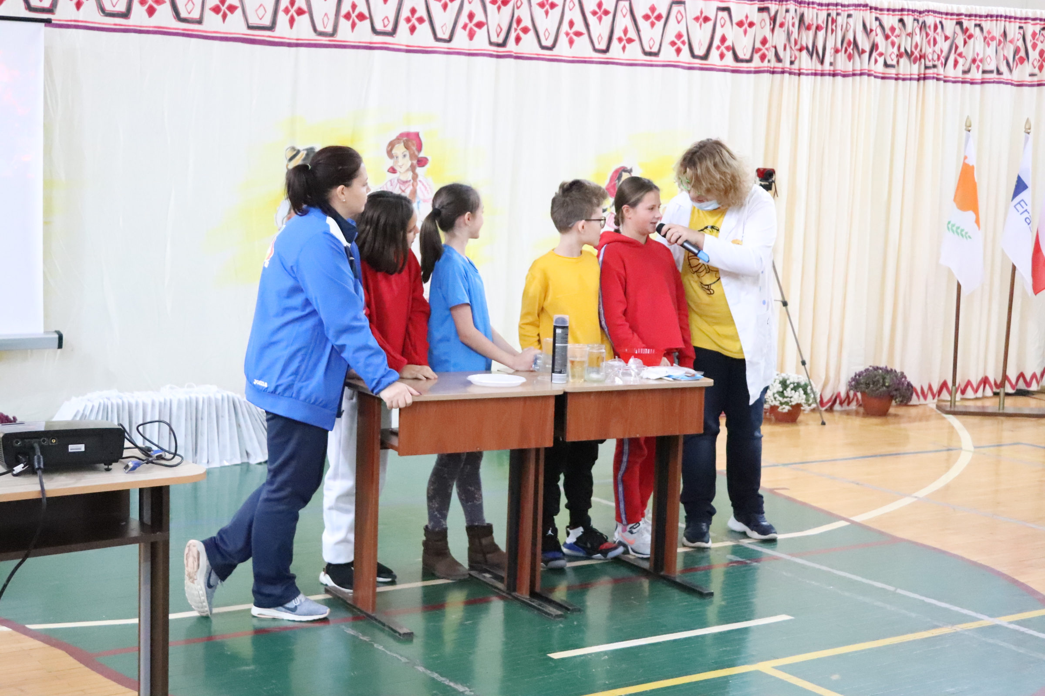

Slide 37
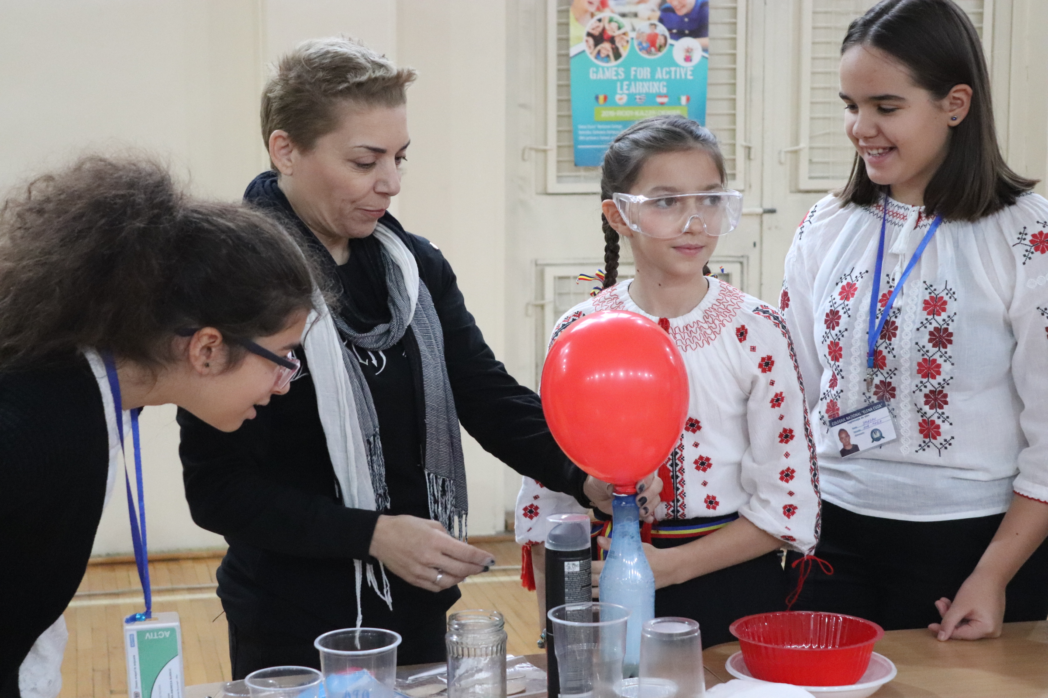

Slide 38
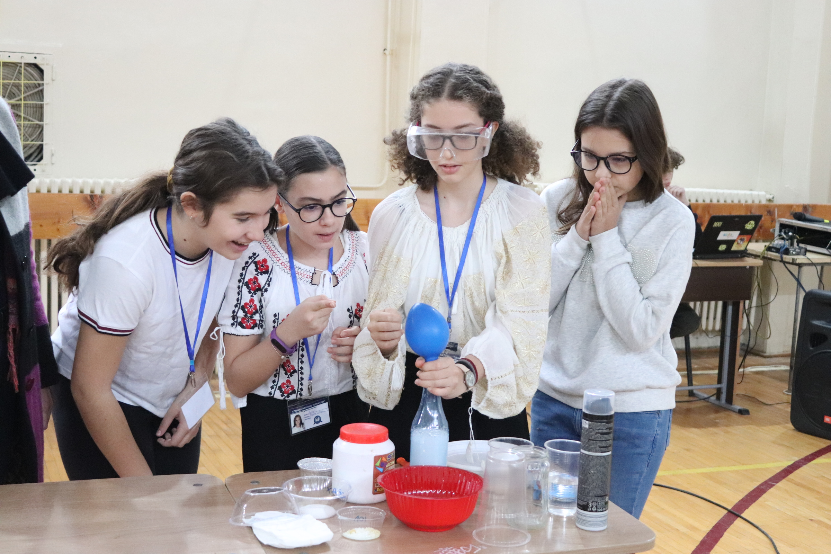

Slide 39
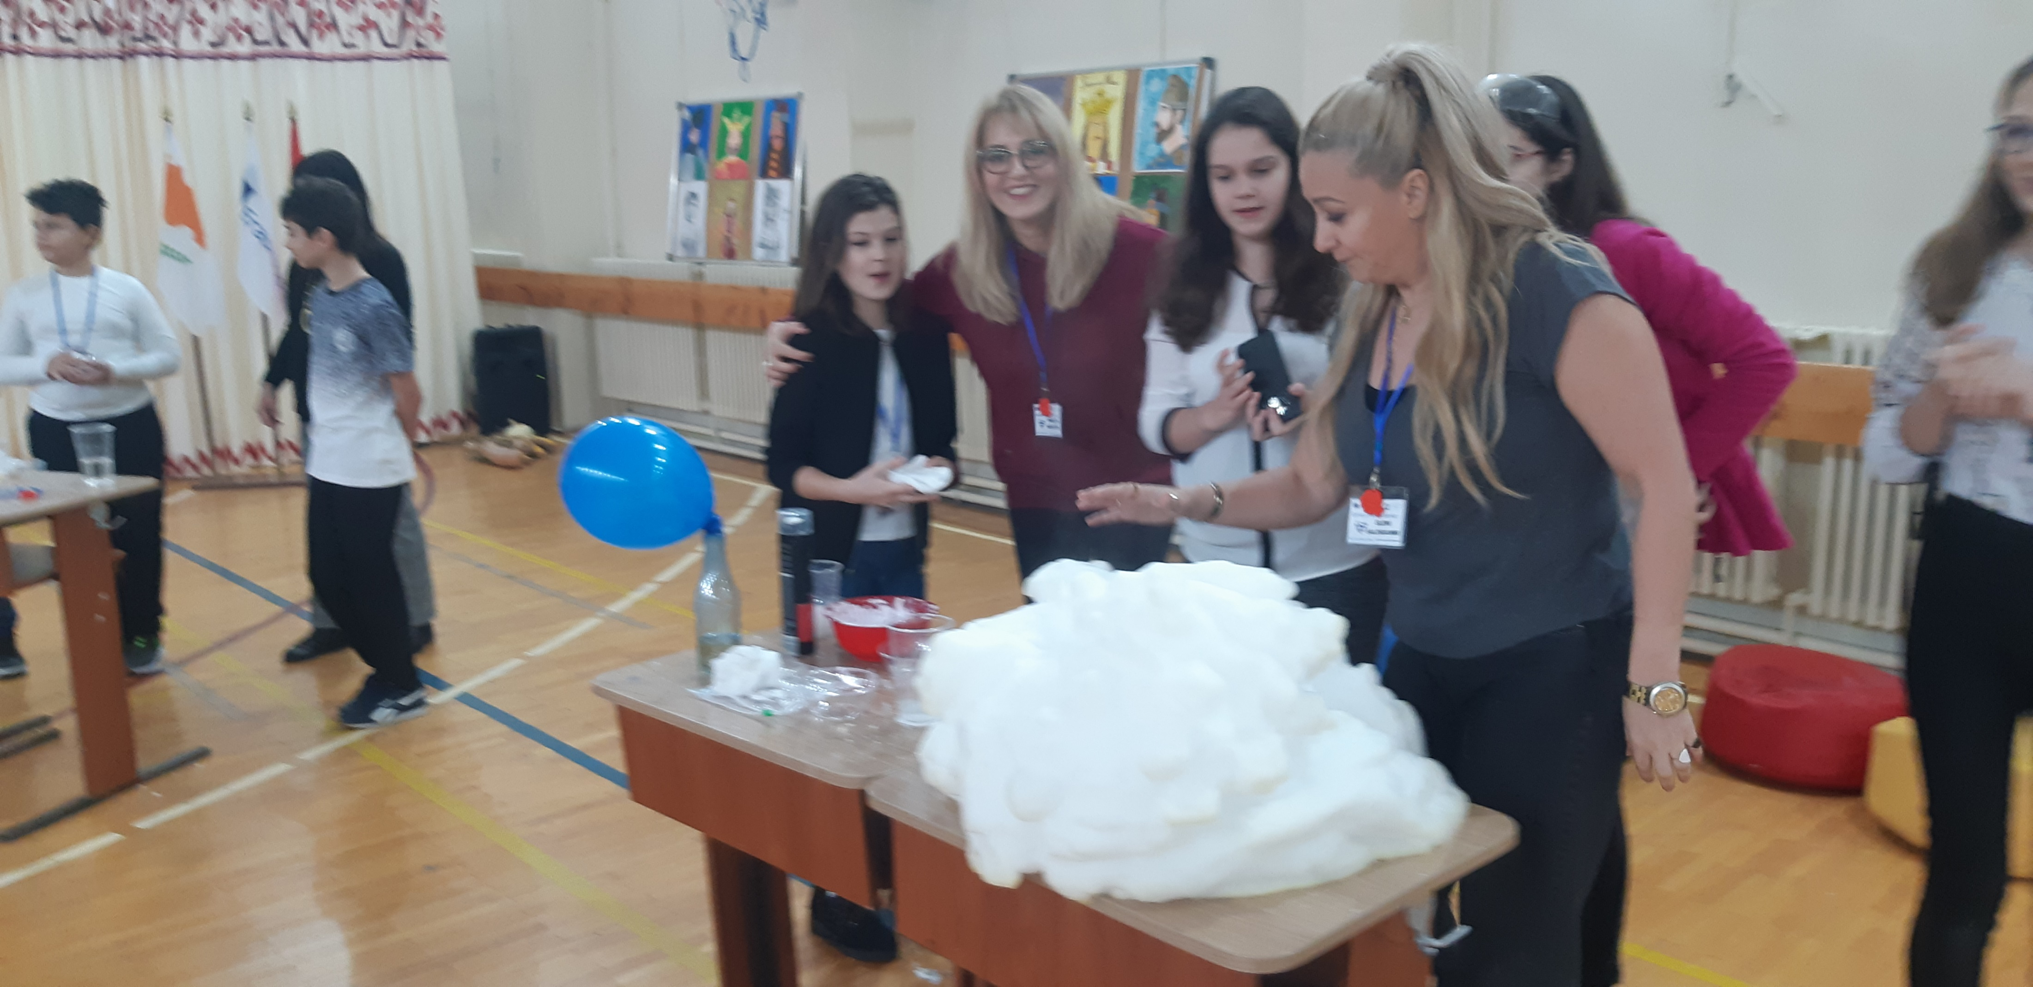

Slide 40
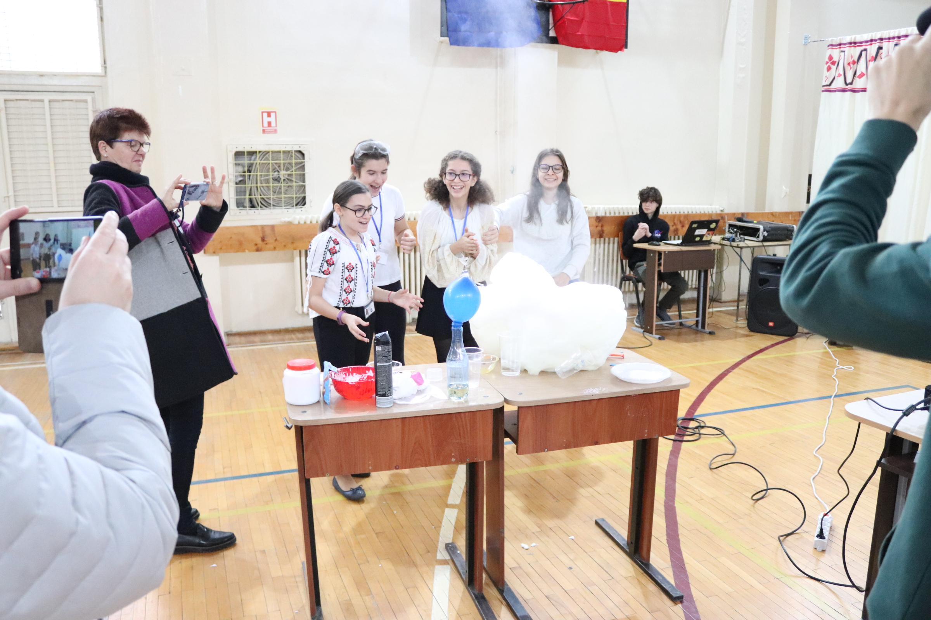

Slide 41
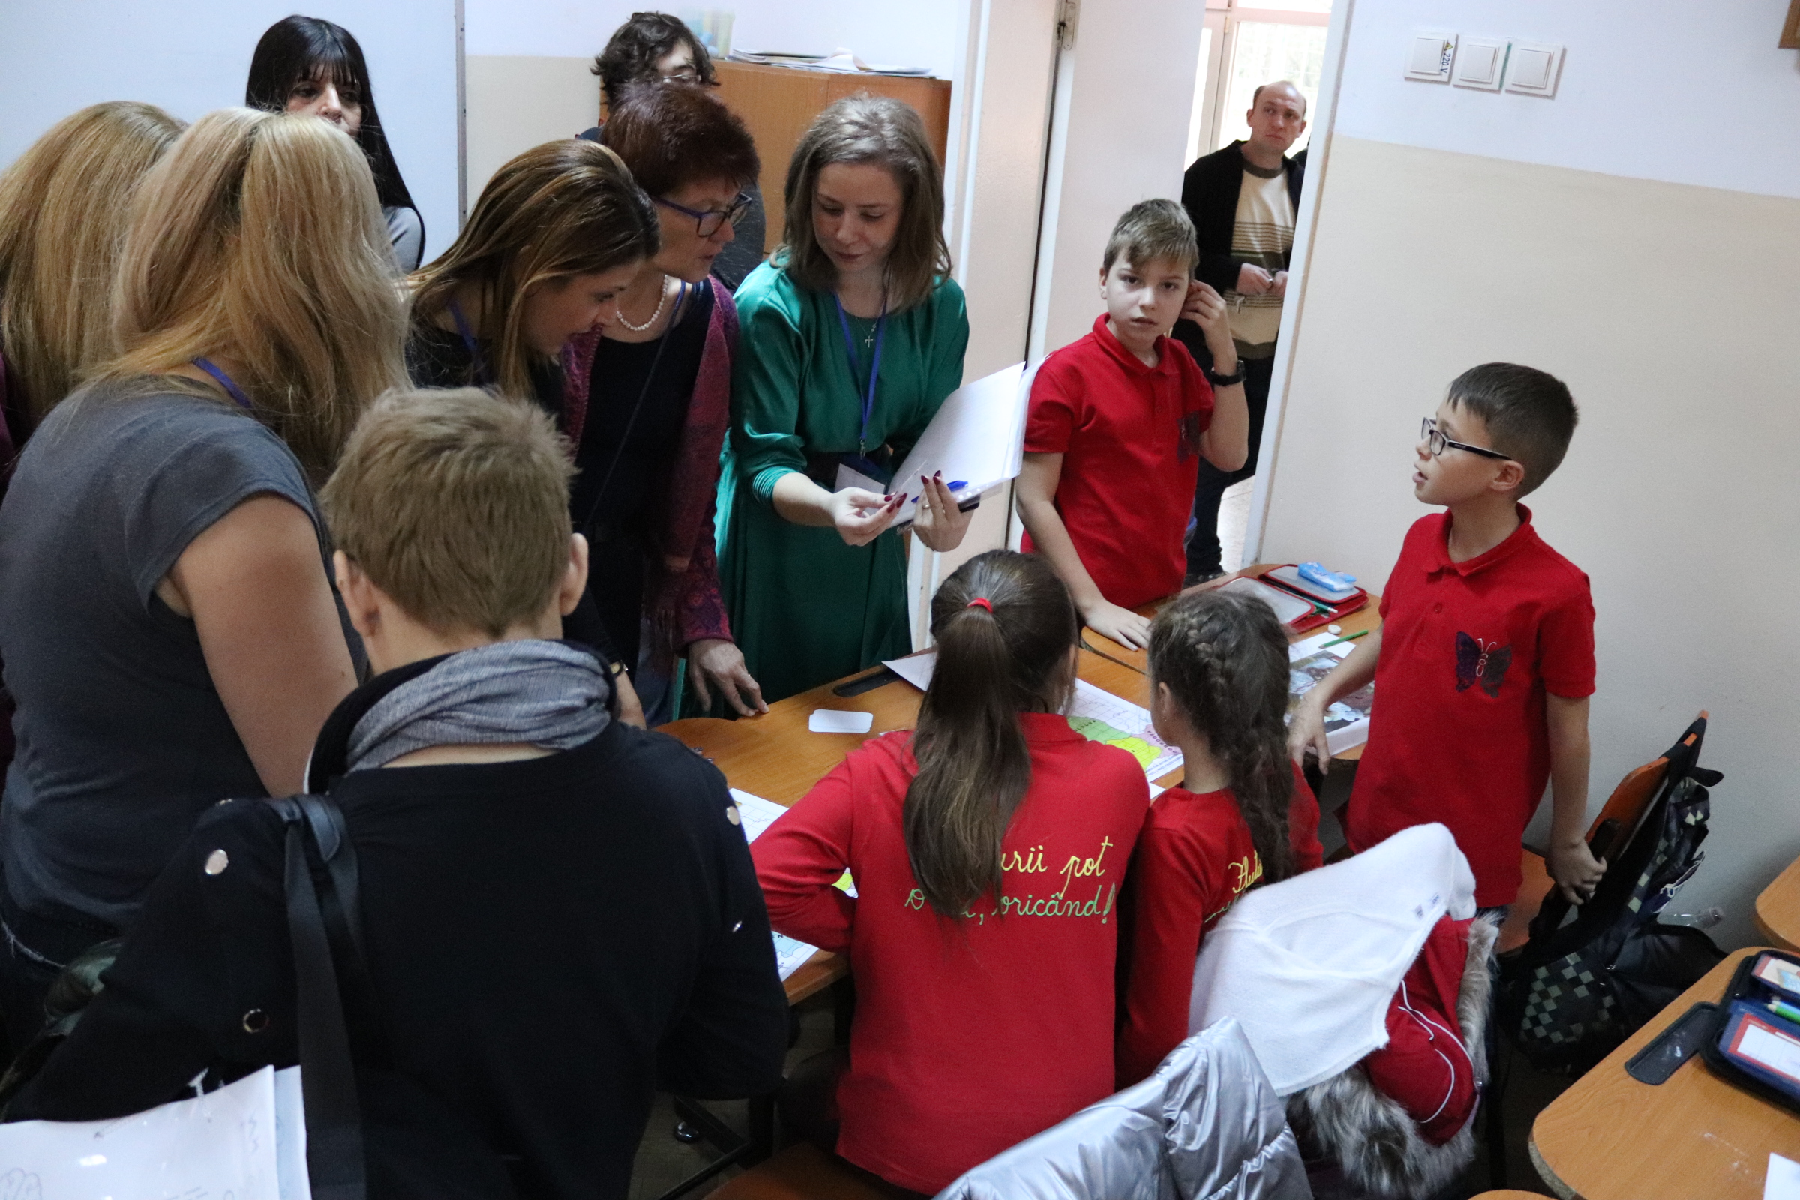
PLAYING WITH
ROMANIAN
PUPILS

Slide 42
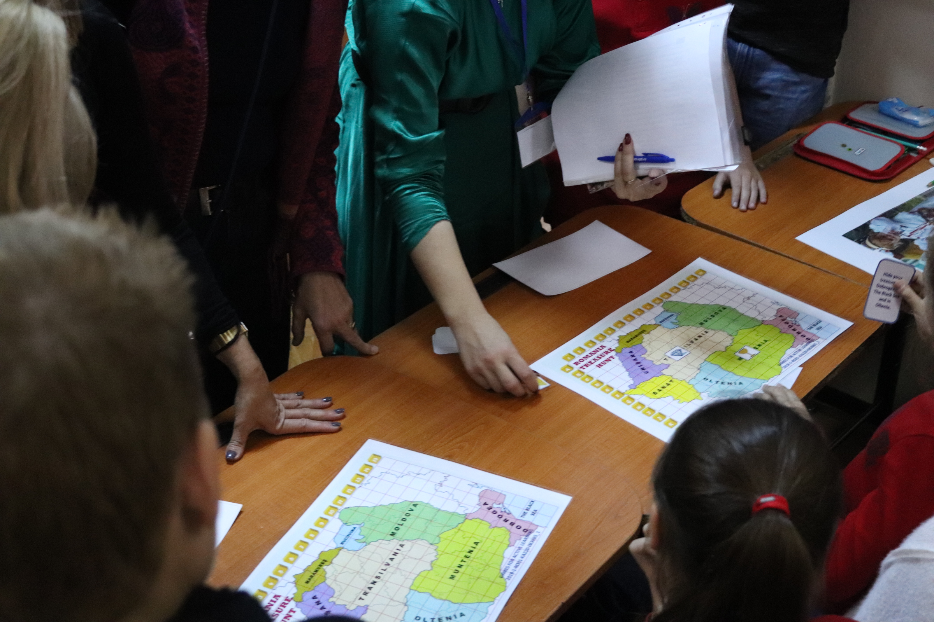

Slide 43
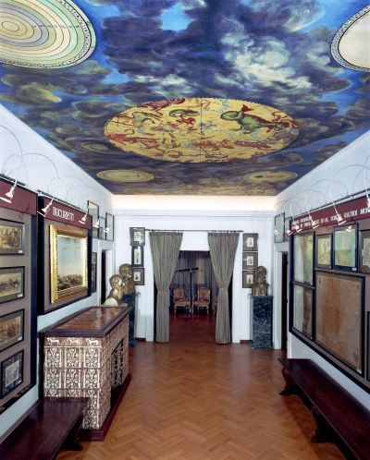
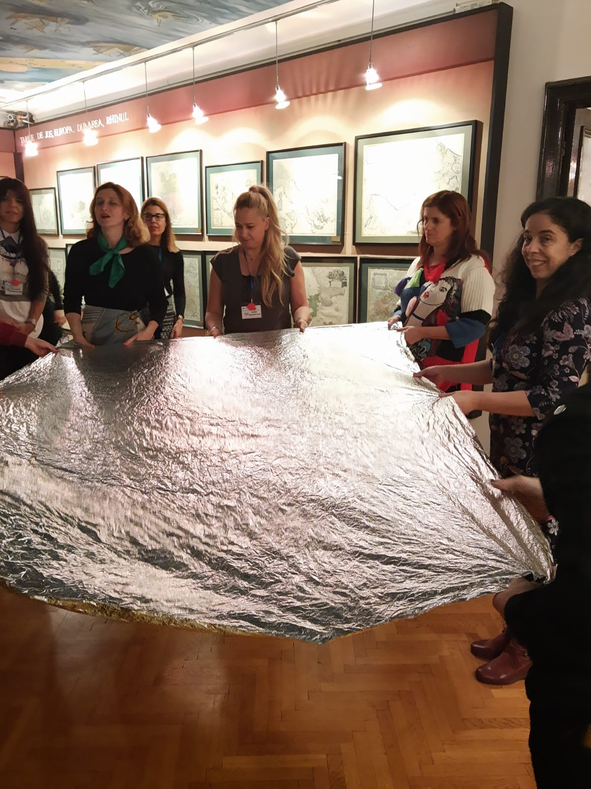
MAPS AND OLD BOOKS
MUSEUM
BOARD GAMES

Slide 44



Slide 45


DOCUMENTARY VISIT

Slide 46

ROLE-PLAY WORKSHOP

Slide 47


Slide 48


Slide 49


Slide 50


