Slide 1
Workshop for Writers
Superheroes Project

Slide 2



Let‘s Recap What are the 10 Rules for Superheroes?

Slide 3

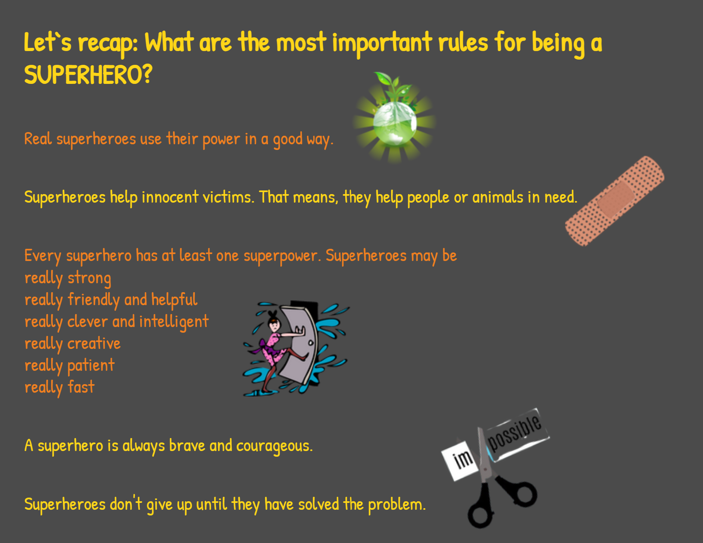

Slide 4

Let‘s start with the problems
What are the problems that we want to solve?
Let‘s collect our ideas: https://answergarden.ch/1956698

Slide 5
Places: where does it happen?
Where do these problems happen?
What could be the settings (places) for our stories?
Let‘s collect our ideas here: https://answergarden.ch/1956704

Slide 6

What superpowers do heroes need to solve the problems?
Let‘s collect our ideas
https://answergarden.ch/1956709deas:

Slide 7
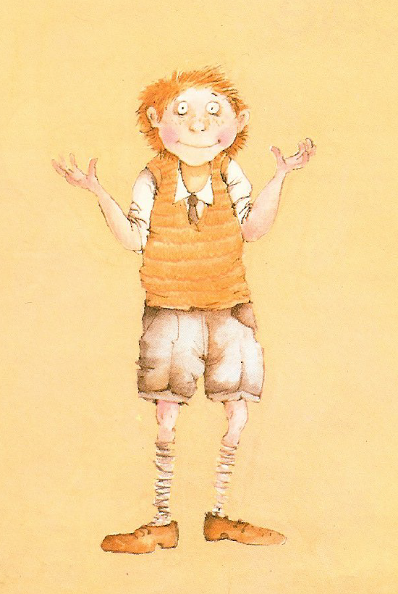
Let‘s look at an example
The trouble with mom

