Slide 1


GAMES FOR ACTIVE LEARNING
2019-1-RO01-KA229-063665_1
2019 - 2021
FIRST TRANSNATIONAL MEETING
CYPRUS – 29-31 OCTOBER 2019
Conţinutul prezentului material reprezintă responsabilitatea exclusivă a autorilor, iar Agenţia Naţională şi Comisia Europeană nu sunt responsabile pentru modul în care vor fi folosite informaţiile conţinute.

Slide 2





PARTNERS
CIPRU
Dimotiko Scholeio Defteras Pano
GRECIA
39th Primary School of Patra
COORDONATOR - ROMÂNIA
Colegiul Național “Elena Cuza”
ITALIA
Istituto Comprensivo Statale
"A. Pagano"
AUSTRIA
NeueMittelschule der Pädagogischen Hochschule Steiermark
Conţinutul prezentului material reprezintă responsabilitatea exclusivă a autorilor, iar Agenţia Naţională şi Comisia Europeană nu sunt responsabile pentru modul în care vor fi folosite informaţiile conţinute.

Slide 3

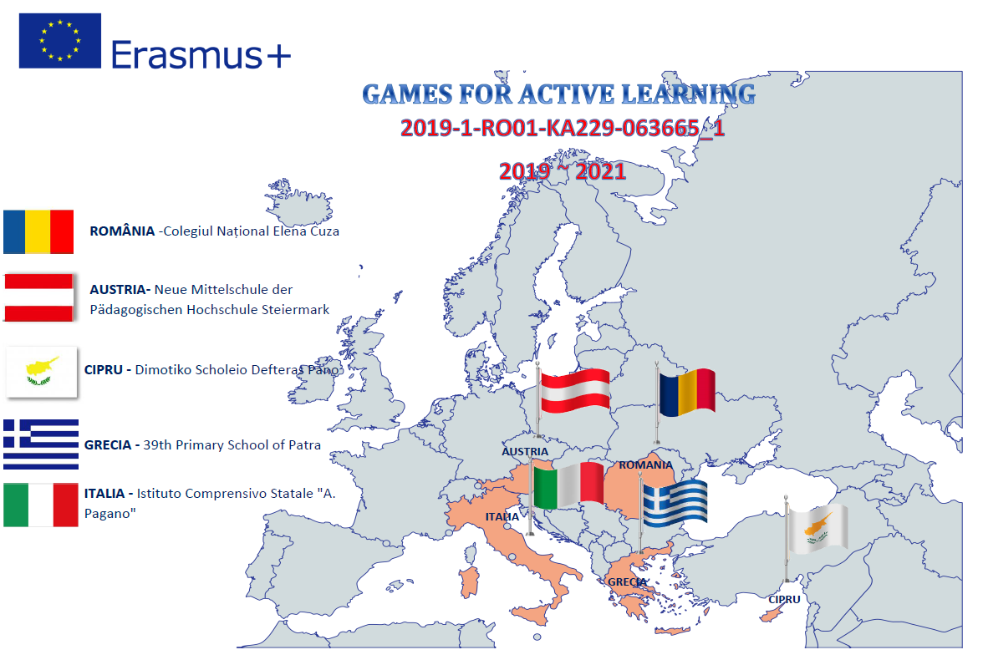

Slide 4
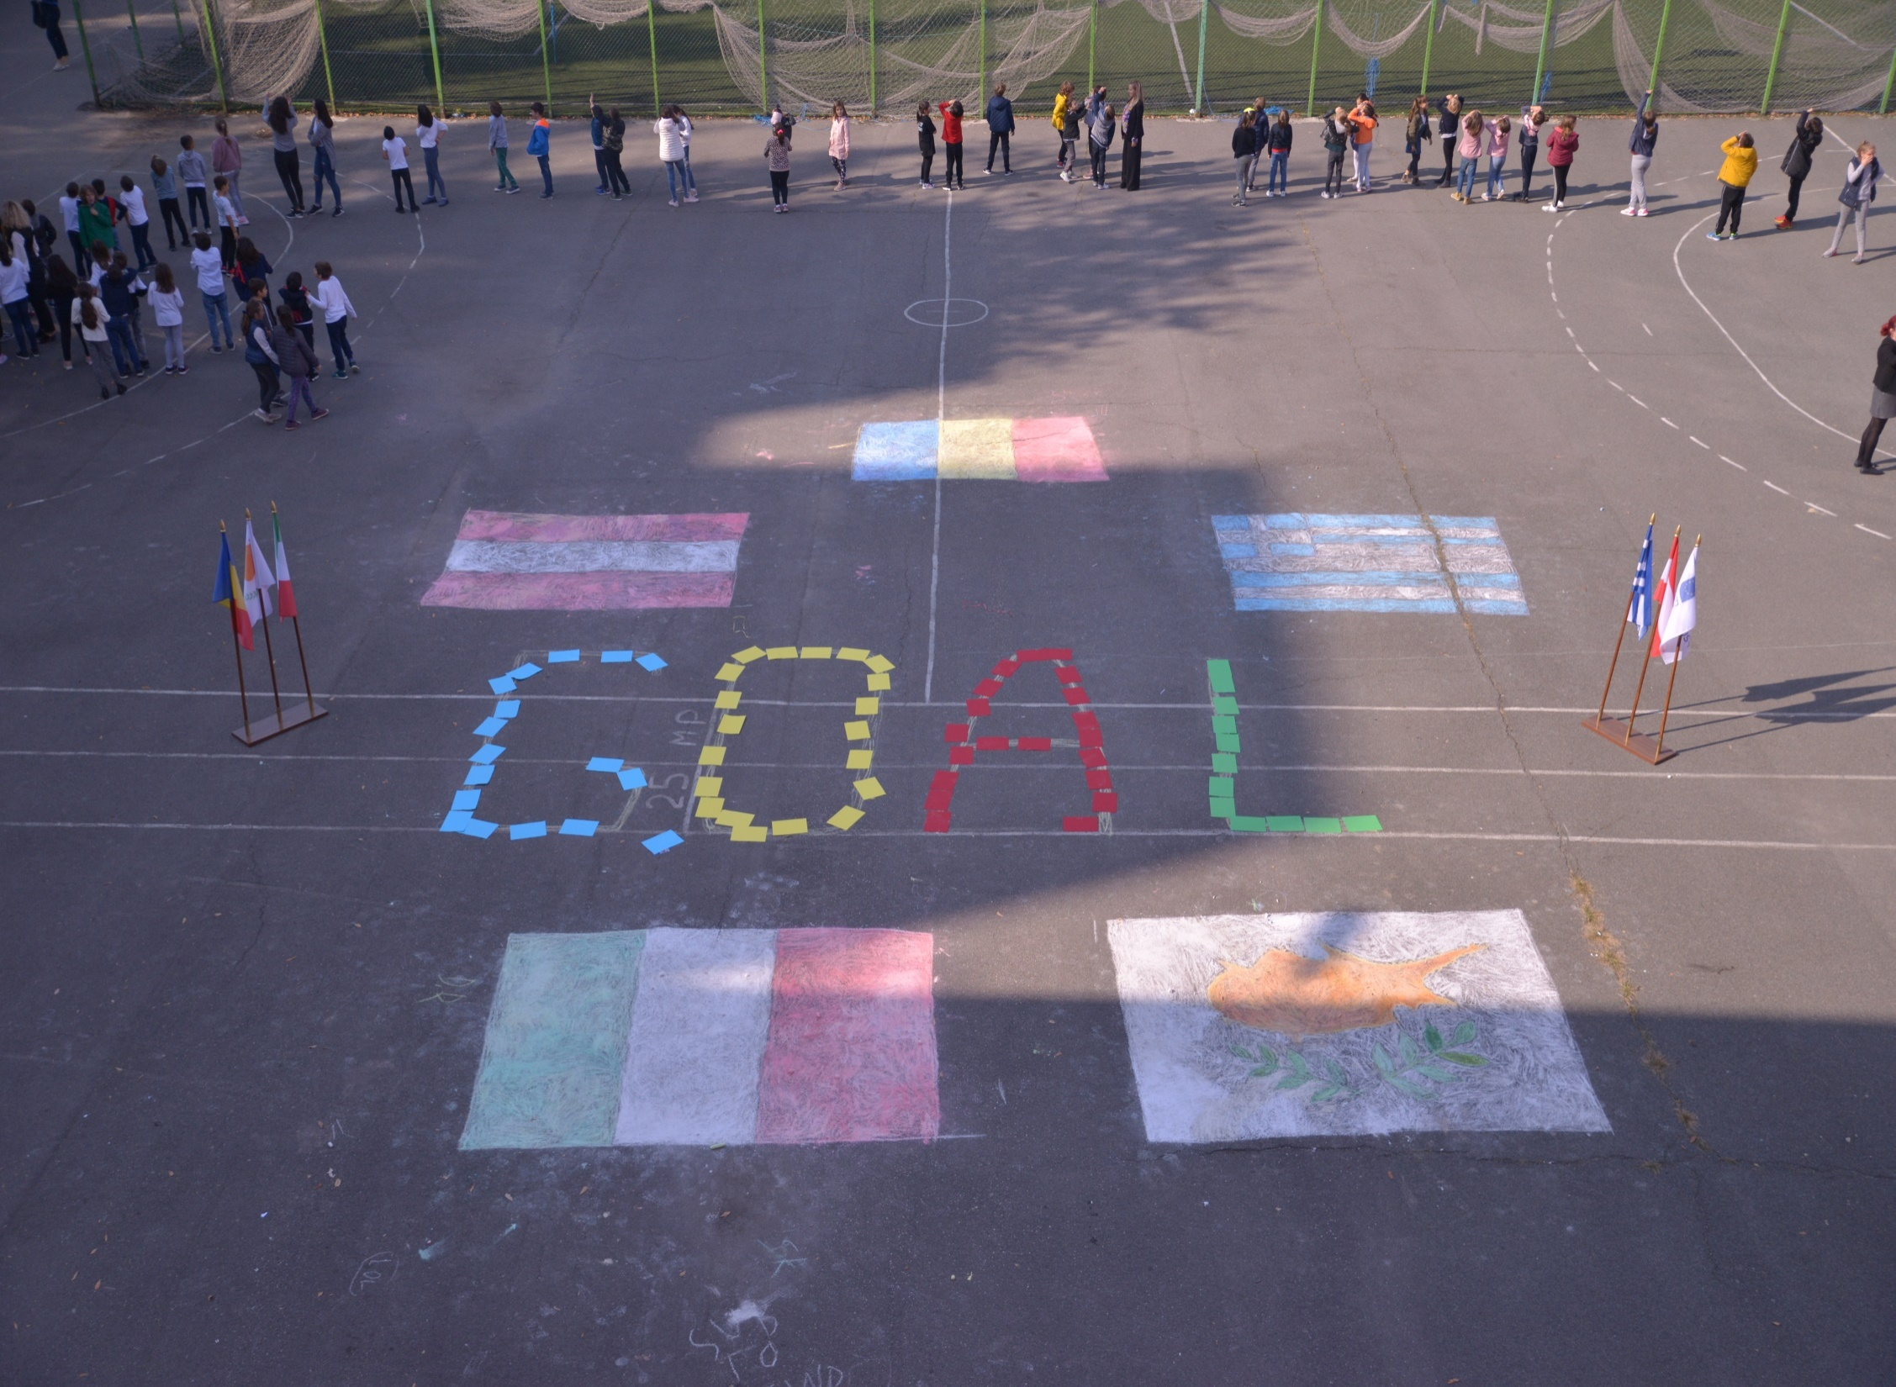

Slide 5

INTERNAL PROCEDURES FOR THE
PROJECT MANAGEMENT
EVALUATION WORKSHEET OF THE APPLICATION
BUDGET APPROVED
PROJECT ACTIVITIES
PROJECT TIMETABLE
TASKS
IMPLEMENTATION PLAN
DISSEMINATION PLAN
COMMUNICATION PLAN
EVALUATION PLAN
OFFICIAL TEMPLATES

Slide 6
EVALUATION WORKSHEET OF THE APPLICATION
Areas of improvement
More information is needed regarding: the training methodology, the trainers’ profile.
It is not sufficiently described the measures for the protection and safety of the participants.
There are no details regarding the periodicity of the communication, stages.
The description of the monitoring and evaluation of the project requires concretization.

Slide 7
EVALUATION WORKSHEET OF THE APPLICATION
Areas of improvement
More information needs to be added regarding the impact on the students involved in mobility and local activities.
There is no sharing of dissemination activities between the five partner organizations.
There are no detailed measures to ensure the sustainability of the project.

Slide 8
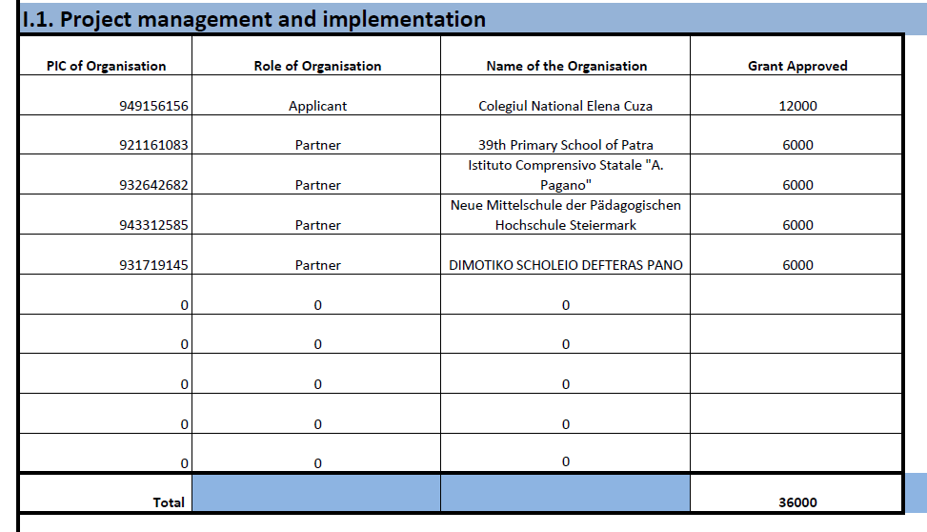
BUDGET APPROVED

Slide 9
ACTIVITIES
WELCOME TO ERASMUS – INTRODUCTORY EVENTS
ROMANIA creates the website ,a Facebook page
CYPRUS creates an E-twinning platform:
All the schools register the pupils and familiarise them with the platform so that they can use it to communicate with each other using the e-mail and the forum in a children safe way.
ERASMUS BILLBOARD
Each school will set up a billboard with the inscription "Erasmus partnership program, funded by the National Agency of the European Commission - 2019-2021".
Partners will share 2-3 photos of their town and school that can be printed and added to the maps.
LAUNCHING THE PROJECT -MEETING WITH PARENTS and LOCAL AUTHORITIES
There will be opening ceremonies and exhibitions about the partners and the project in the partner schools.Each school throws balloons in the national flag colours to start the project.Photos are taken and loaded on the website. Articles are written on school website and/or school magazine.

Slide 10


Slide 11
OCTOBER 2019
Topic 1 - WHERE WE LIVE AND WORK: PRESENTATIONS
Each country creates a presentation answering the question: "Where do we live and work": Country,Town, School.
WHERE WE LIVE AND WORK: GAMES
Every school will create 3-5 games that help their partners learn about their country, region and town and school. The games can be card games / board games or digital games.
MANAGEMENT AND IMPLEMENTATION PROJECT- CYPRUS- 29-31 OCTOBER
During this first meeting the procedures of the project and the project plans will be discussed: implementing plan, monitoring and auto-evaluation plan, dissemination plan, communicating procedure;
* Discussing the form of questionnaires; elaborating instruments to evaluate pupil's satisfaction and their learning results.
* Sharing first ideas about the Goal methodology; each partner will have as a task to think and elaborate a section in the methodology. Their work will be presented during the first workshop, in November, in Romania. Articles in the school magazines or websites.

Slide 12





TASKS

Slide 13
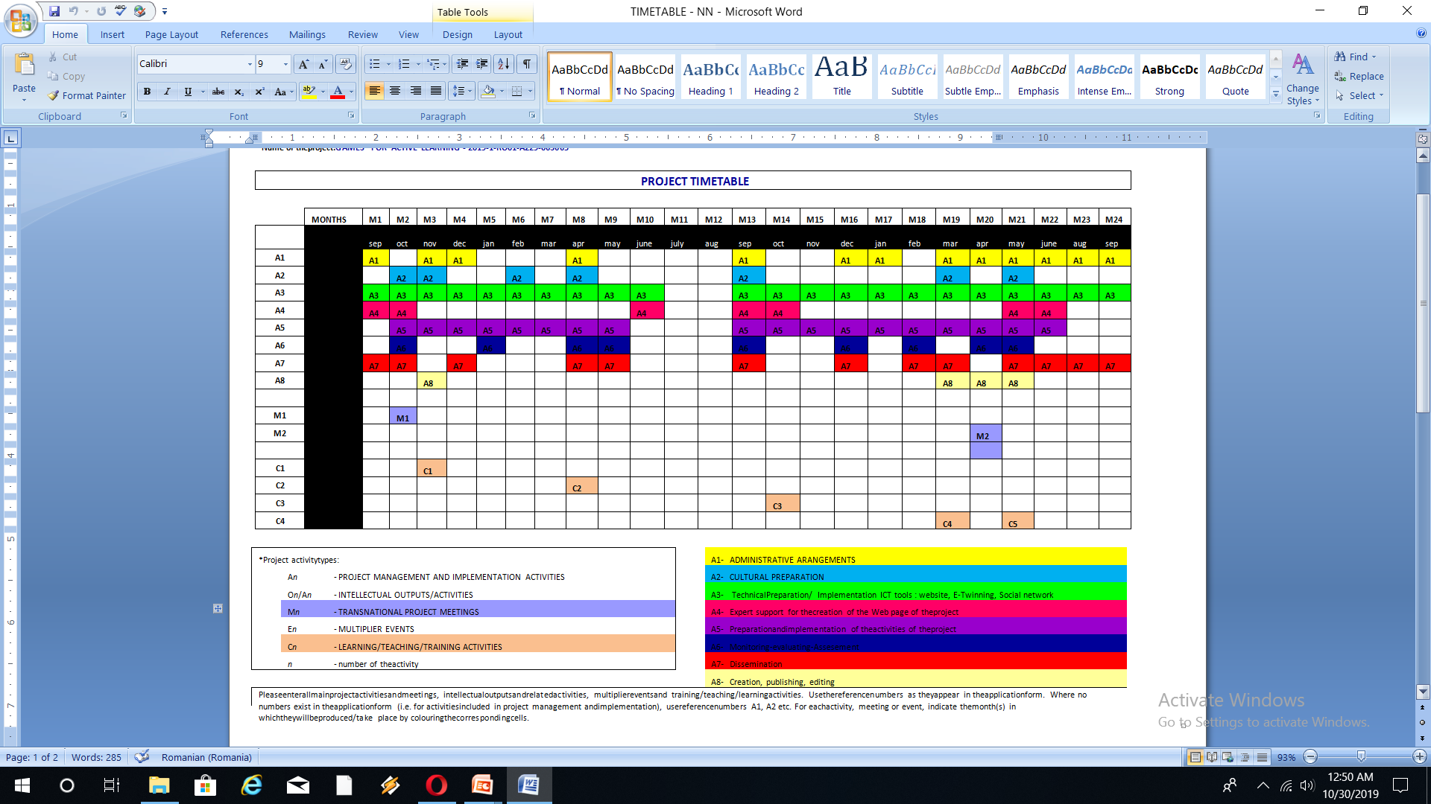
TIMETABLE

Slide 14
IMPLEMENTATION PLAN
Nr/ Month | ACTIVITY | PARTICIANTS | RESPONSIBLE | Assessment / outcomes
M1 Sept 2019 | Presentations of the project toTeacher’s Council in each school | Teachers in each partner school | Coordinators | PPT
 | Selection of the project team in eachschool | Teachers in each partner school | Coordinators | Selection procedure
 | Creation of project website, facebook and e –Twinning account | Project team from 0rganizing school | Romanian coordinating school | Website and facebook page
 | Launching the project-meeting with parents and local authorities-opening ceremonies | Project team from patner schools | Partner schools coordinators | Opening ceremnies, photos, press articles, videos
 | SettingErasmus+ board with the inscription "Erasmus partnership program, funded by the National Agency of the European Commission - 2019-2021" in eachschool | Pupilsandteachersfromeachpartnerschool | Partner schools coordinators | Erasmus bilboard, photos , ppt
M2 Oct 2019 | Project Logo Contest in eachschool on transnational level | pupils | People assigned from every partner teams | Project Logo
 | Topic 1 - Wherewe live andwork: presentations | pupils | People assigned from every partner teams | PPT uploaded on the website

Slide 15
DISSEMINATION PLAN
The aim of the Dissemination plan is to establish and run the visibility of the project, so that all activities that will be carried out during the project lifetime will be widely known with the highest possible visibility, in EU countries.

Slide 16
COMMUNICATION PLAN
In order to ensure constant flow of information among partner institutions the project communication will be structured in three levels:
-at the project management level
-at project activity level
-stakeholder meetings.

Slide 17
EVALUATION PLAN
The aim of the plan is to stipulate evaluation moments and tools concerning the level of the project’s development and generate information gathering fields that allow us to introduce the pertinent changes for a continuous improvement.

Slide 18
OFFICIAL TEMPLATES

Slide 19
G.O.A.L METHODOLOGY
QUESTIONAIRES

