Slide 1


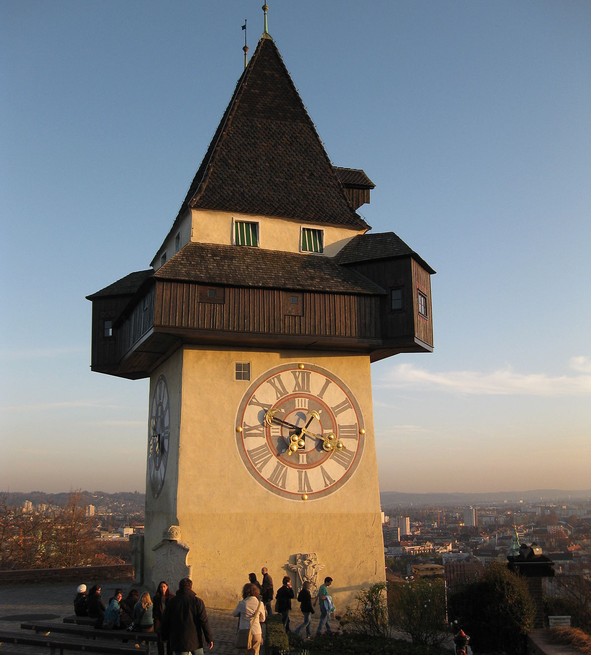
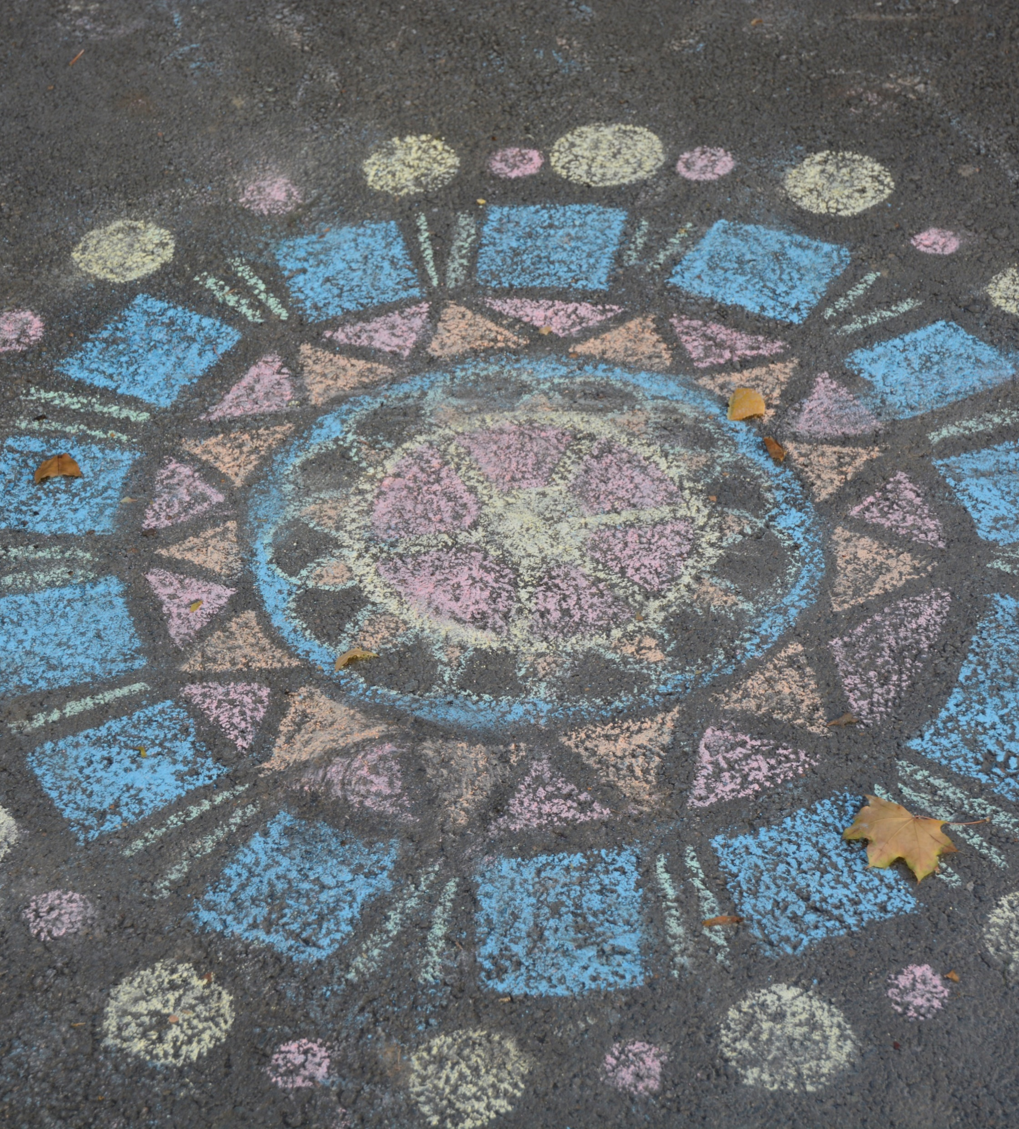
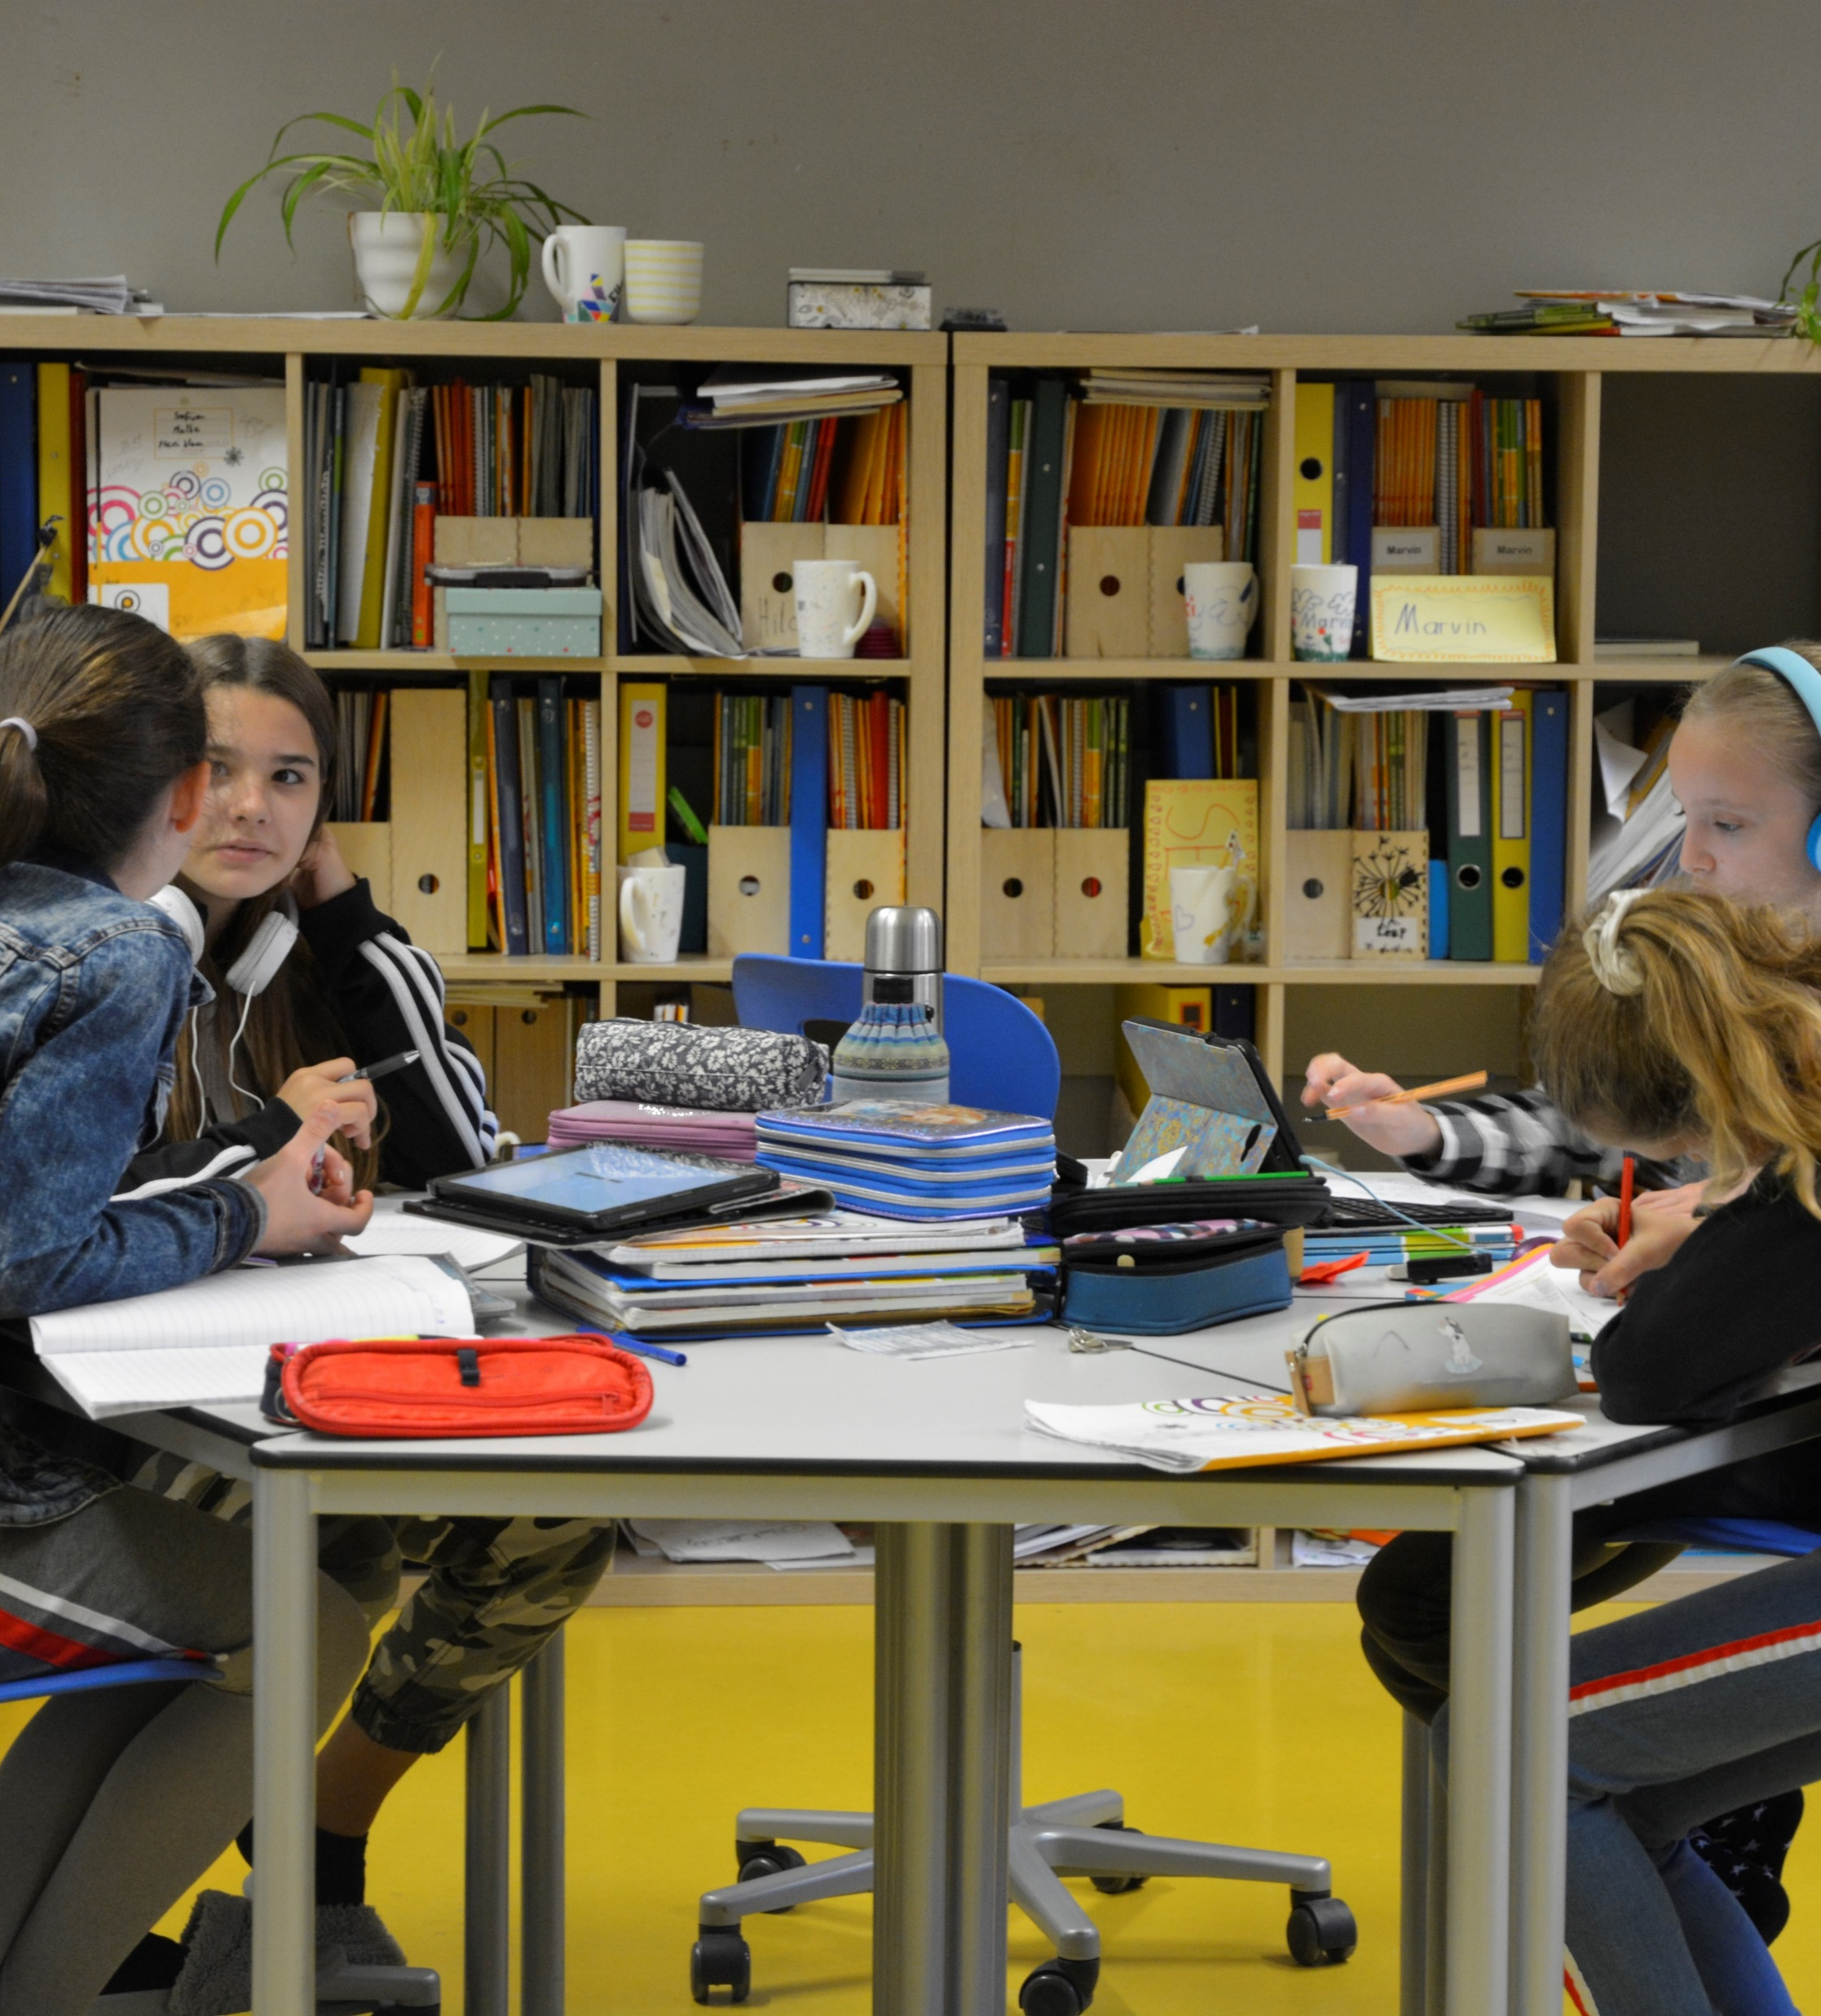

How we live and work in Graz, Austria
This Photo by Unknown Author is licensed under CC BY-SA

Slide 2
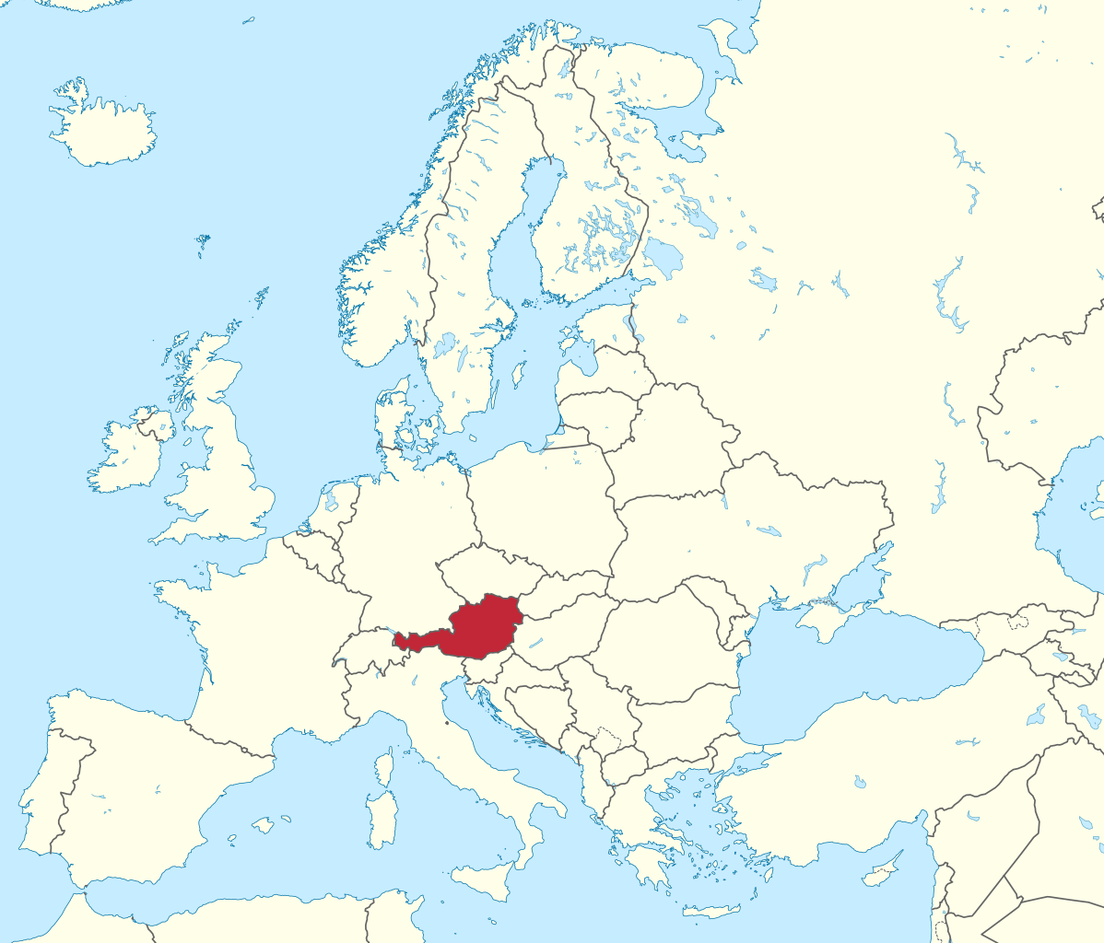
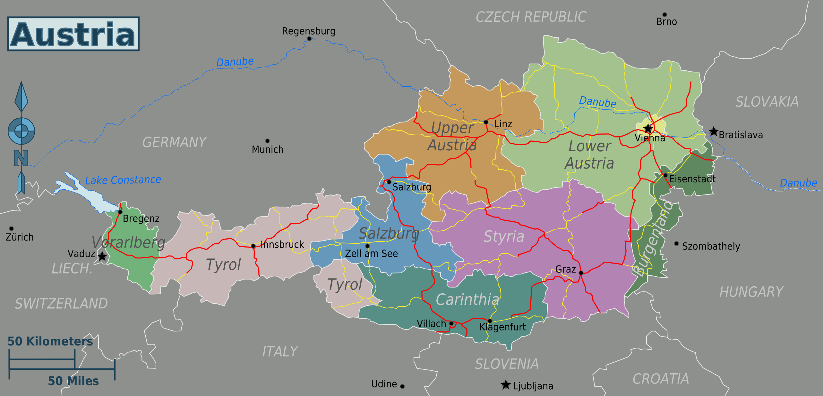
This Photo by Unknown Author is licensed under CC BY-SA
Austria has 9 provinces, we live in Styria. That is the province that is colored pink on this map. Graz is the capital of Styria.
This Photo by Unknown Author is licensed under CC BY-SA
Austria is a small country in the center of Europe.

Slide 3
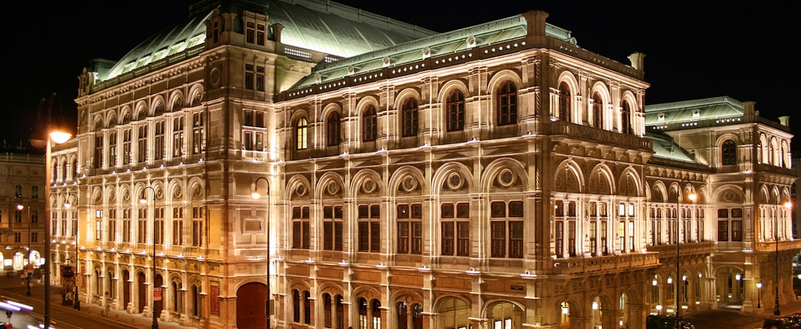
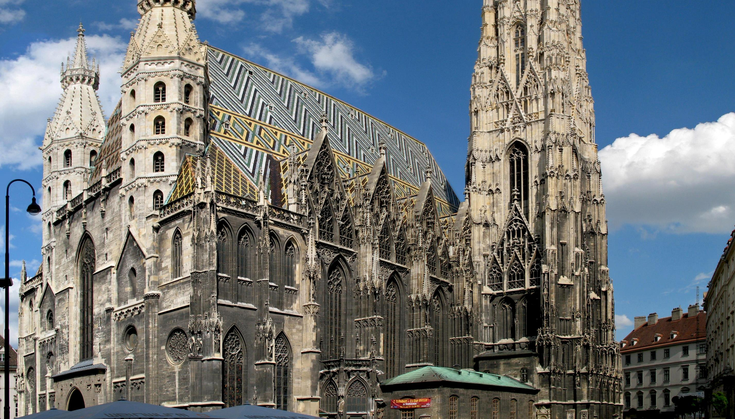
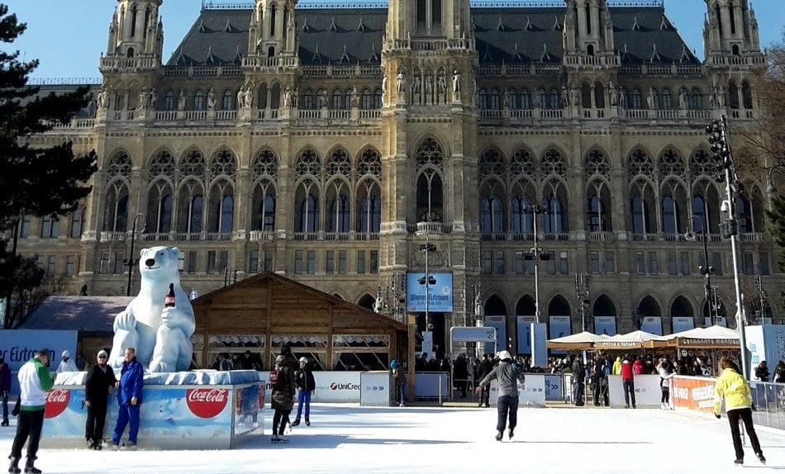
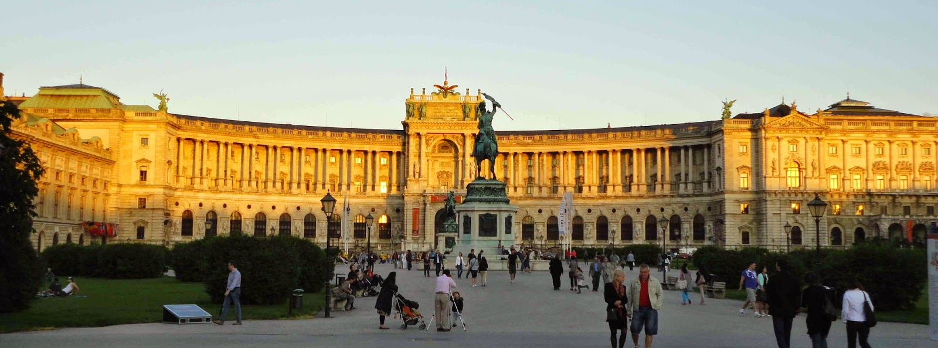
The capital of Austria is VIENNA. Vienna is a very big city with lots of beautiful old buildings. We cannot show them all here. Let‘s rather go to Graz and look around there.
This Photo by Unknown Author is licensed under CC BY-SA-NC
This Photo by Unknown Author is licensed under CC BY-SA-NC
This Photo by Unknown Author is licensed under CC BY-SA
This Photo by Unknown Author is licensed under CC BY-SA

Slide 4
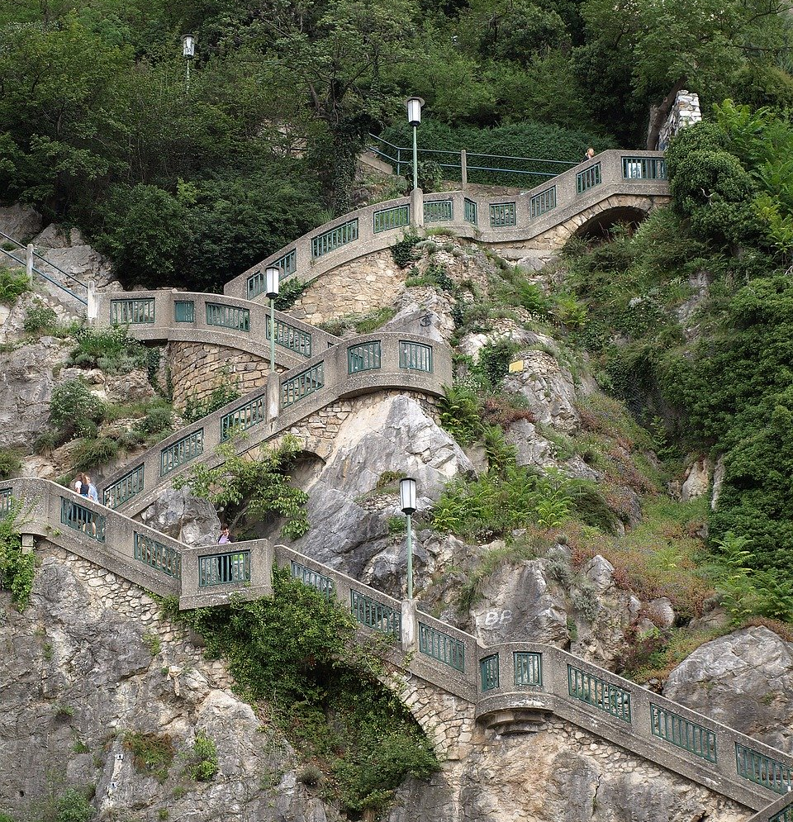
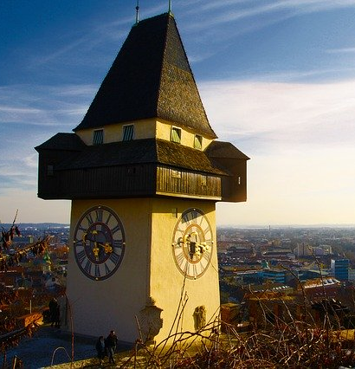
Here you see the stairs that lead up to our Schlossberg – or Castle Mountain. The clocktower is the landmark of our city. You can see it from everywhere in town.

Slide 5
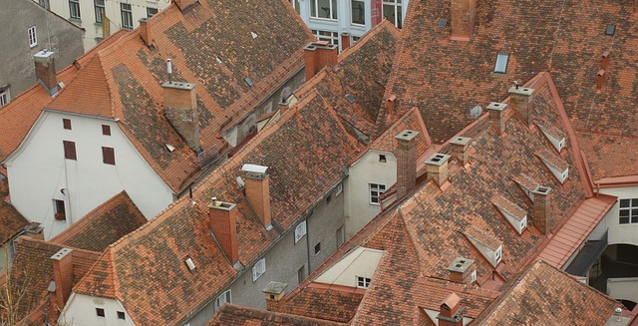
Graz is a very old town. The red brick roofs are very beautiful.

Slide 6
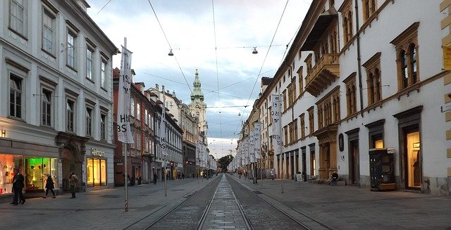
This is the main shopping street in the town center. You can find beautiful old buildings and lots of interesting shops.

Slide 7
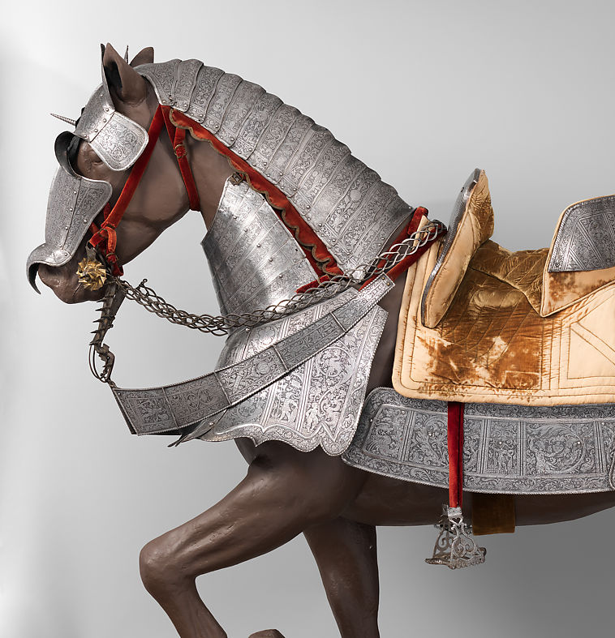
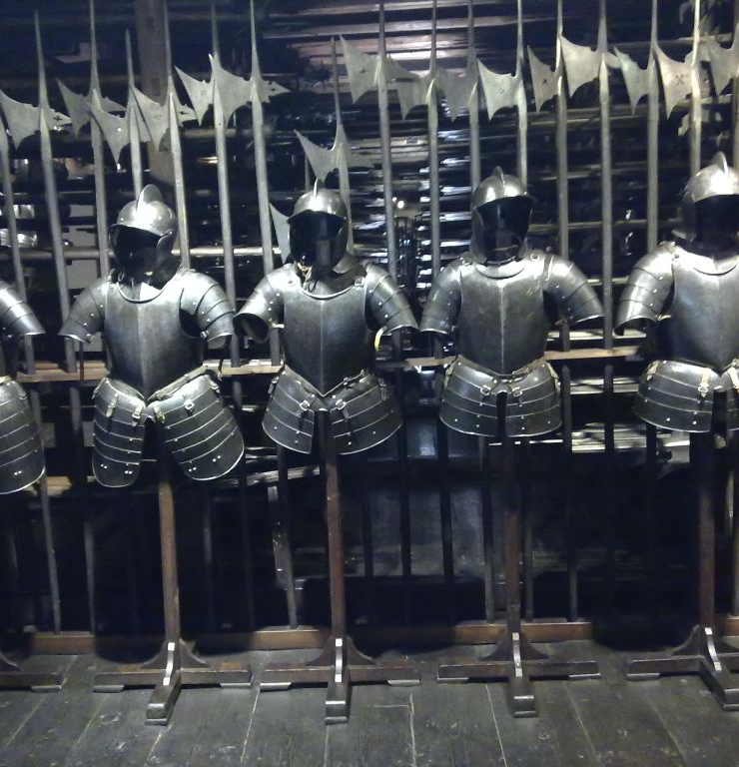
The armory of Graz is very famous. They have Europ‘s largest collection of armory from the 18th century.

Slide 8
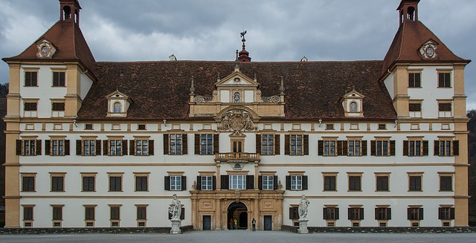
Graz has many beautiful old buildings. This is Eggenberg castle. It is a very interesting place to visit.

Slide 9
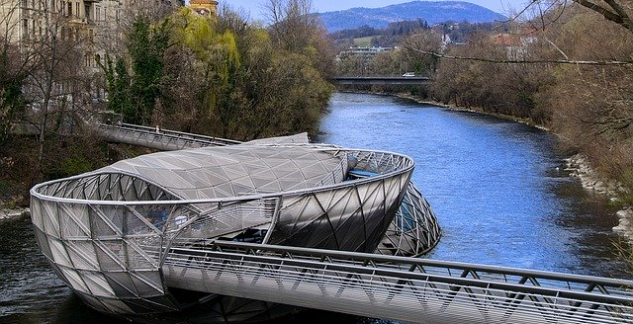
Graz has also got some interesting modern sights. This is the island in the river Mur. It is right in the center of our town, not far from our school.

Slide 10
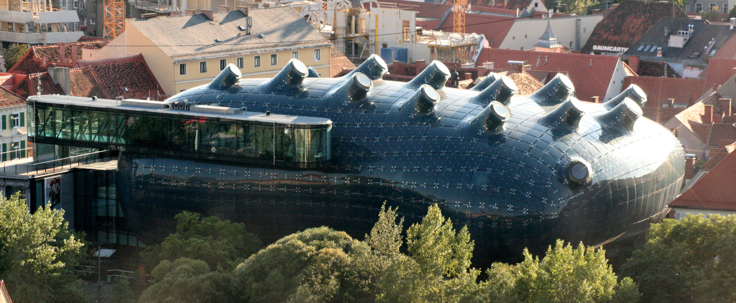
This is the new Arts Center of Graz. Some people call it „the friendly alien“. It is also very close to our school and you can find all kinds of modern art there.

Slide 11
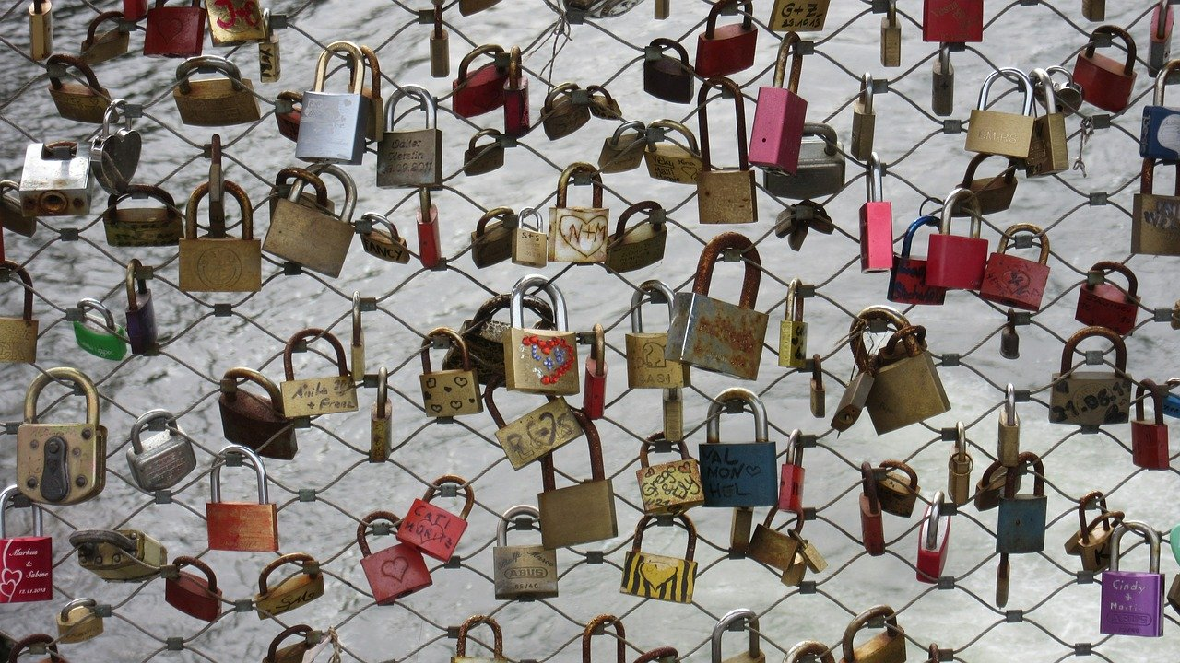
Lots of people fix padlocks on the main bridge across the river Mur. They say that as long as their padlocks are fixed to the bridge, they will be in love with their partners.

Slide 12
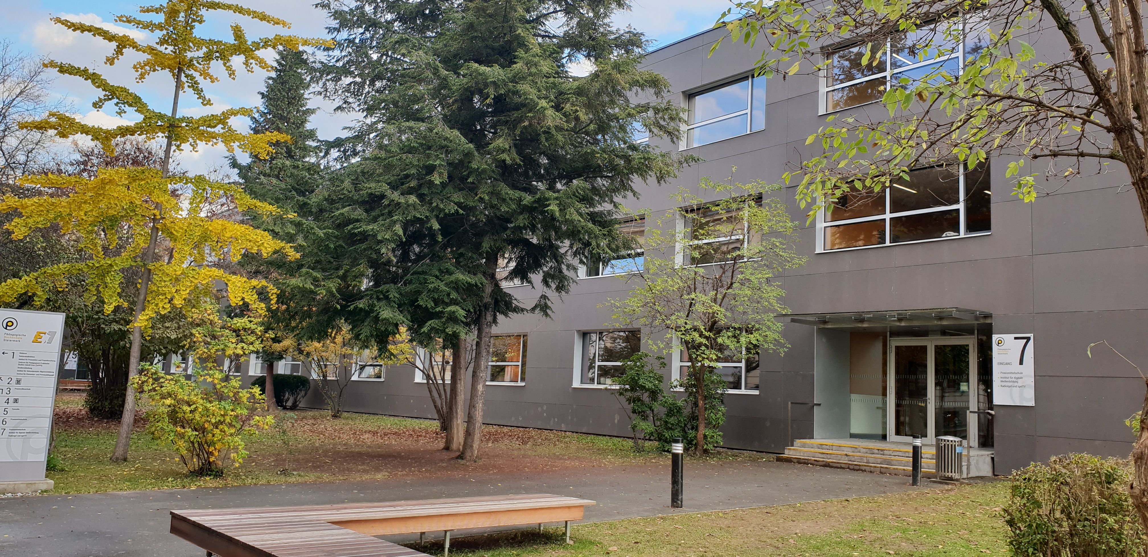
This is our school. We are a lower secondary school with 8 classes – or about 180 students.

Slide 13
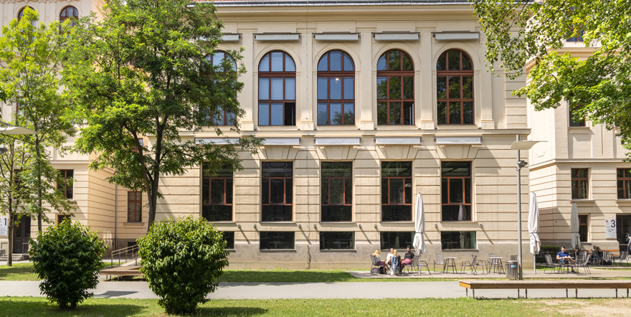
Opposite our school building is the university of teacher training. Here the students study to become teachers. The primary school schildren also have their classrooms in this building.

Slide 14
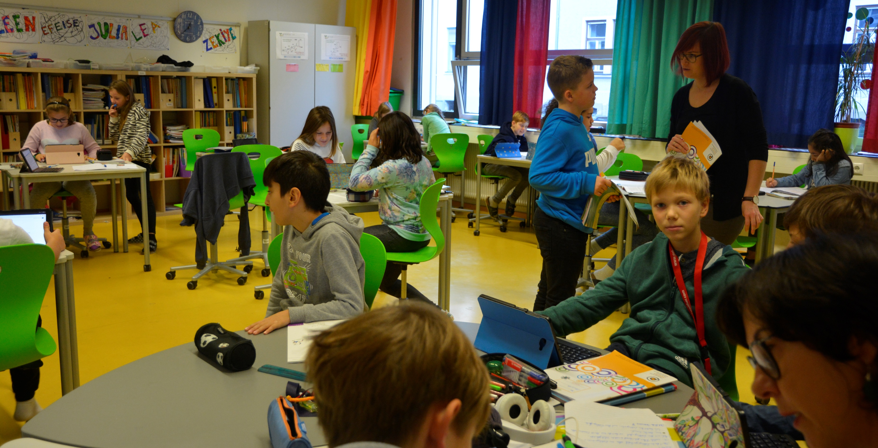
This is one of our classrooms. We usually work in small groups or on our own. The teachers help us when we get stuck.

Slide 15
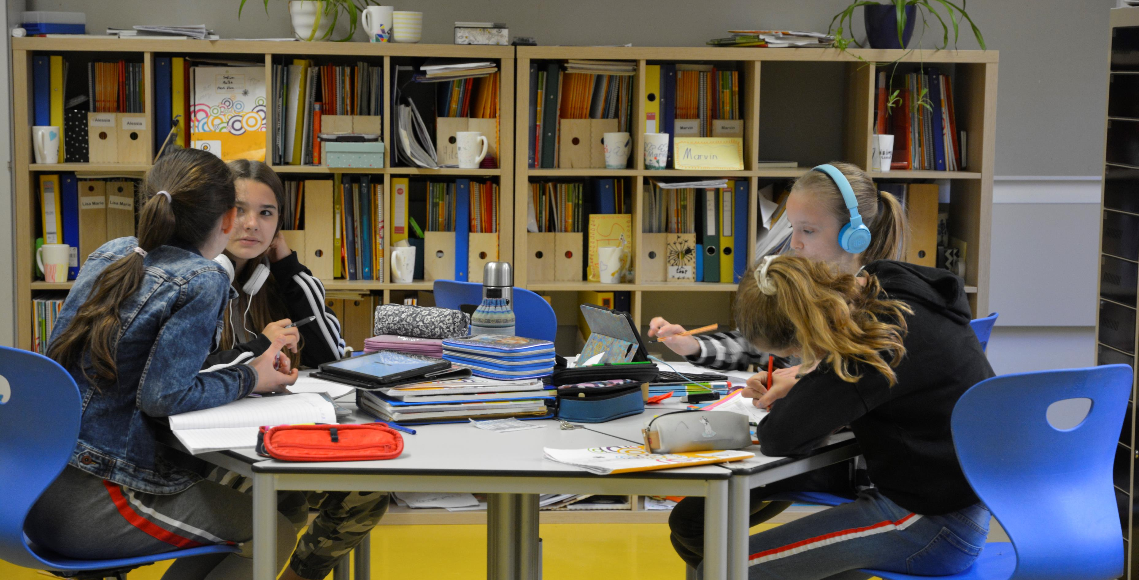

Slide 17
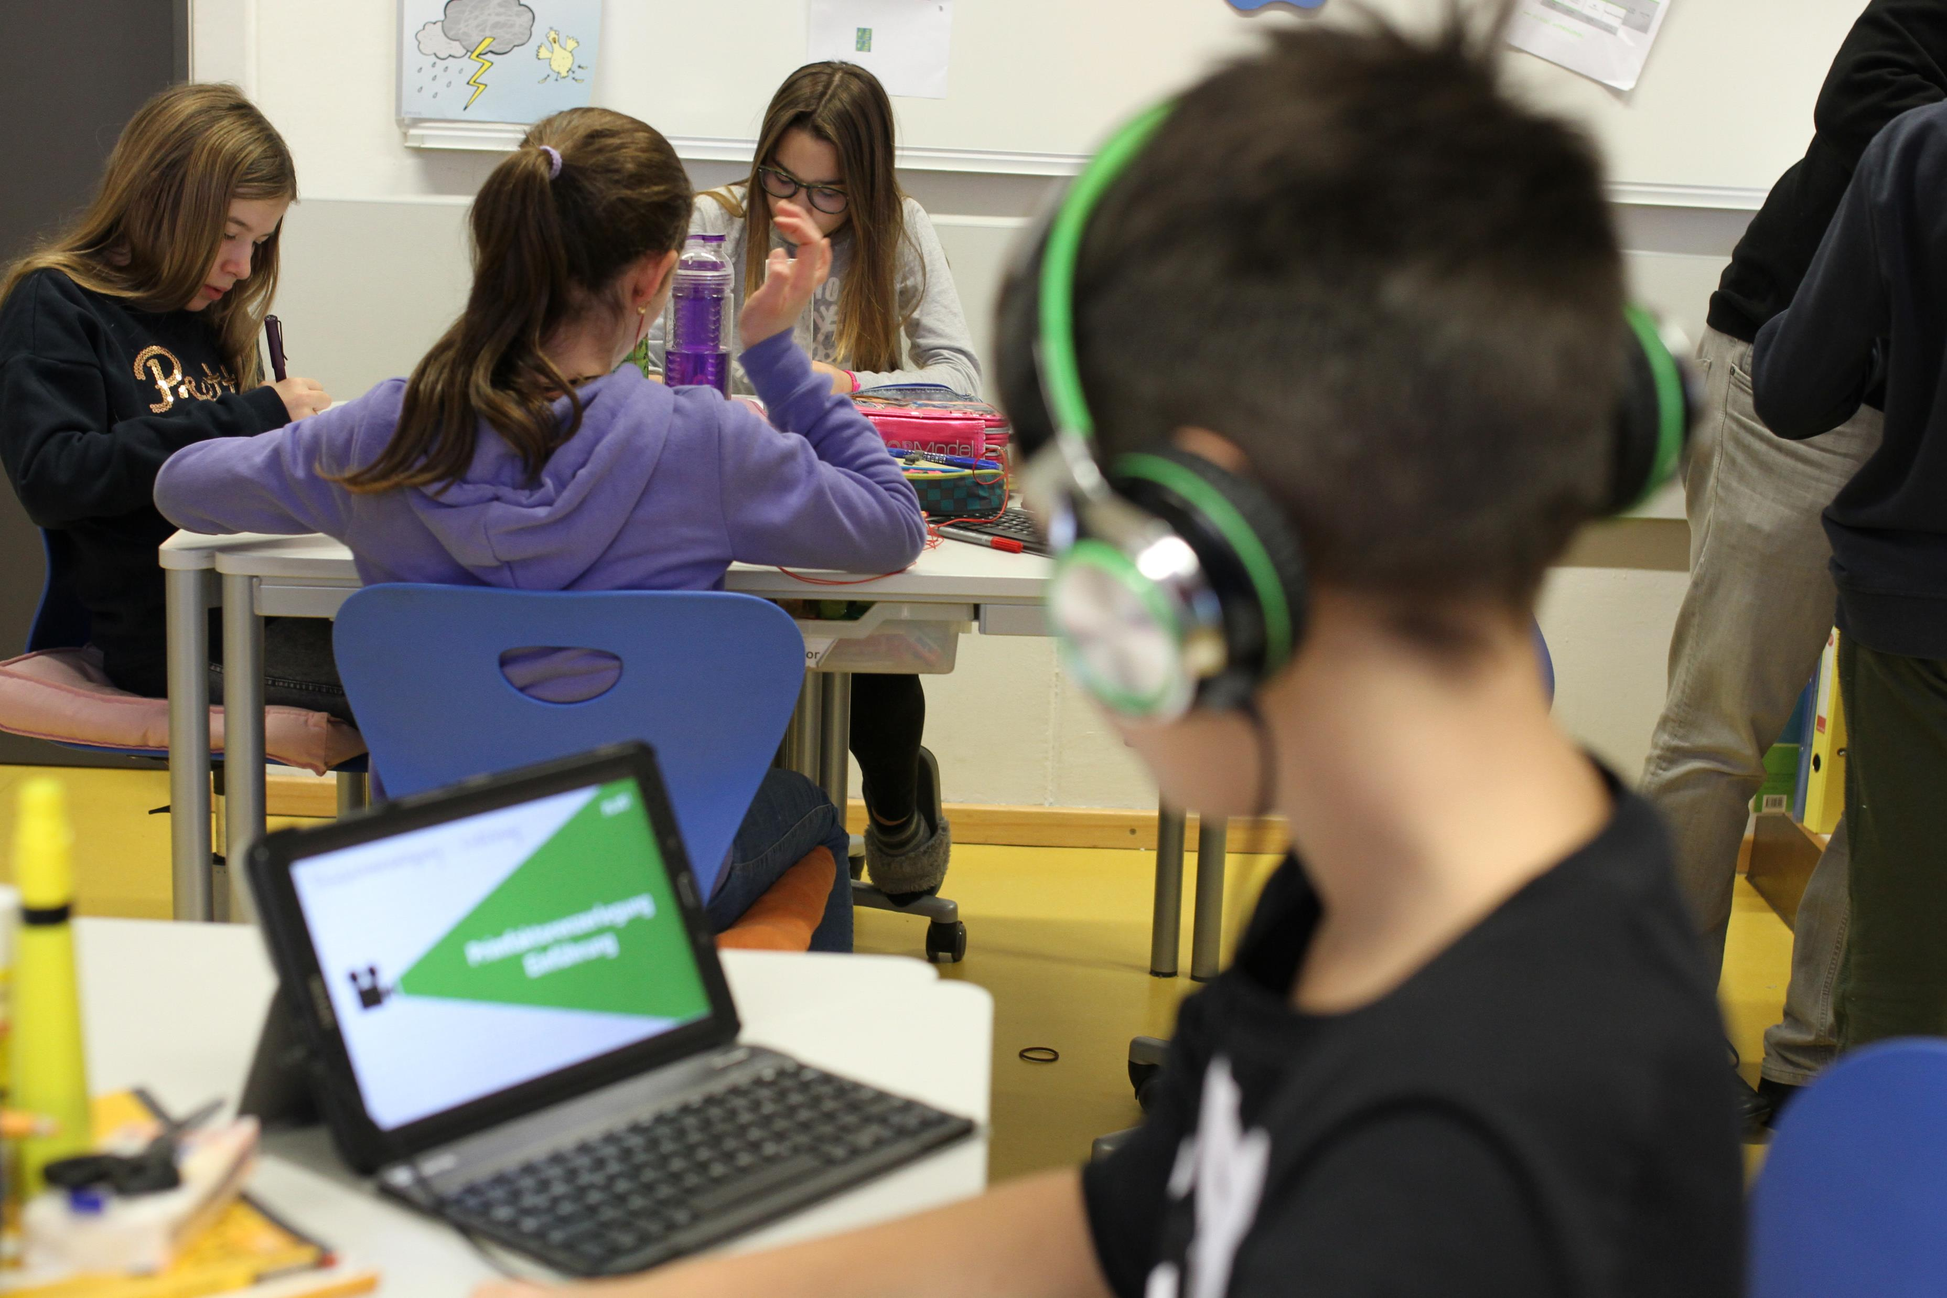
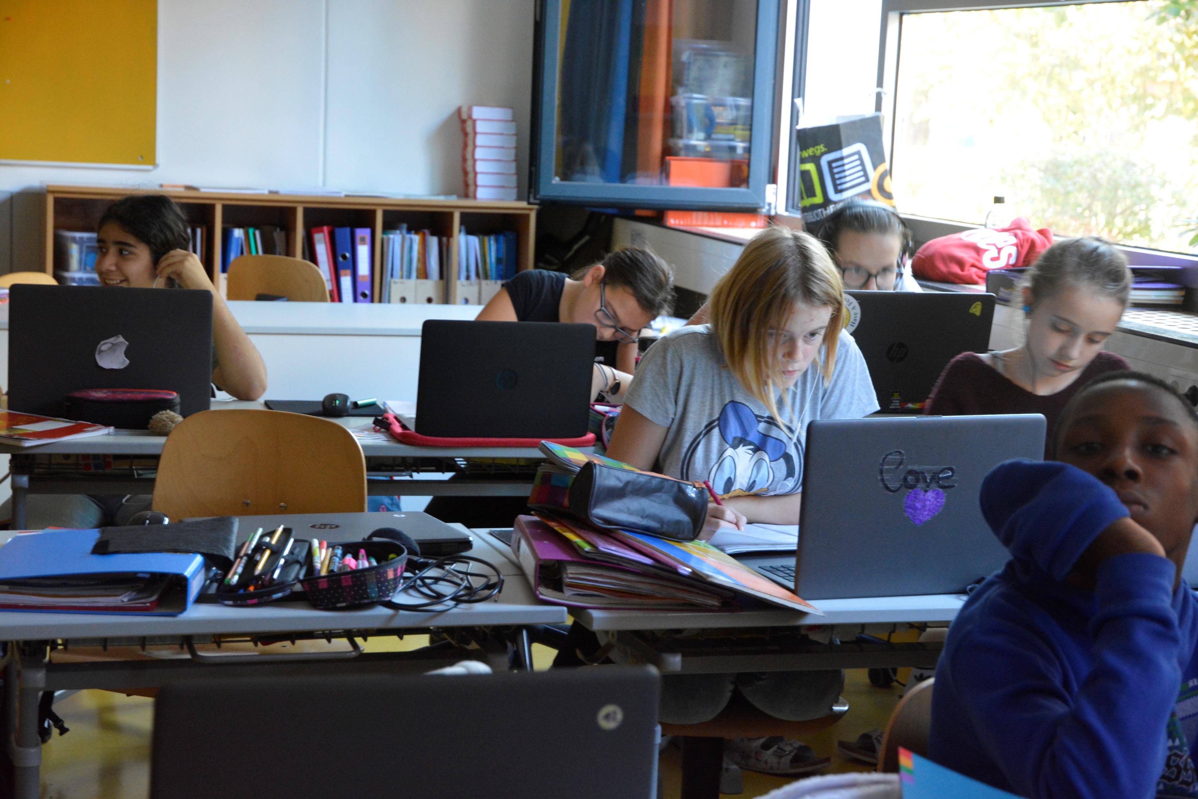
These students are also working in the workshop area. They are trying to solve a tricky math problem.
We often work with computers or tablets and we find all our tasks on our online Moodle platform.

Slide 18
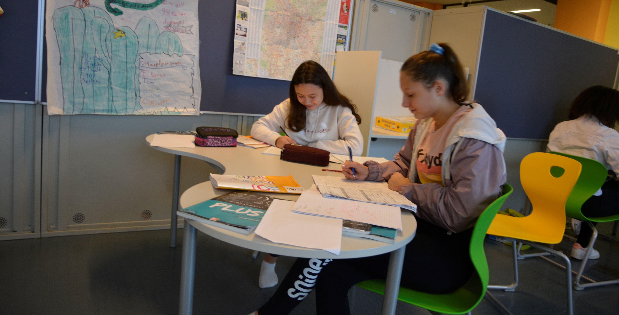
This is our workshop area. We can go there to work with our partners. Most students really like to work in this area.

Slide 19
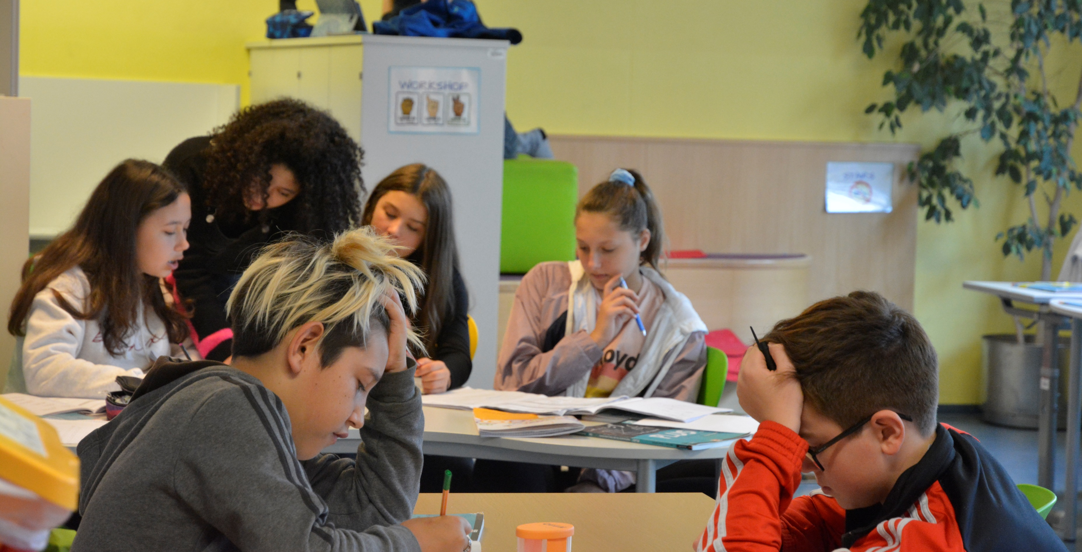
These students are also working in the workshop area. They are trying to solve a tricky math problem.

Slide 20
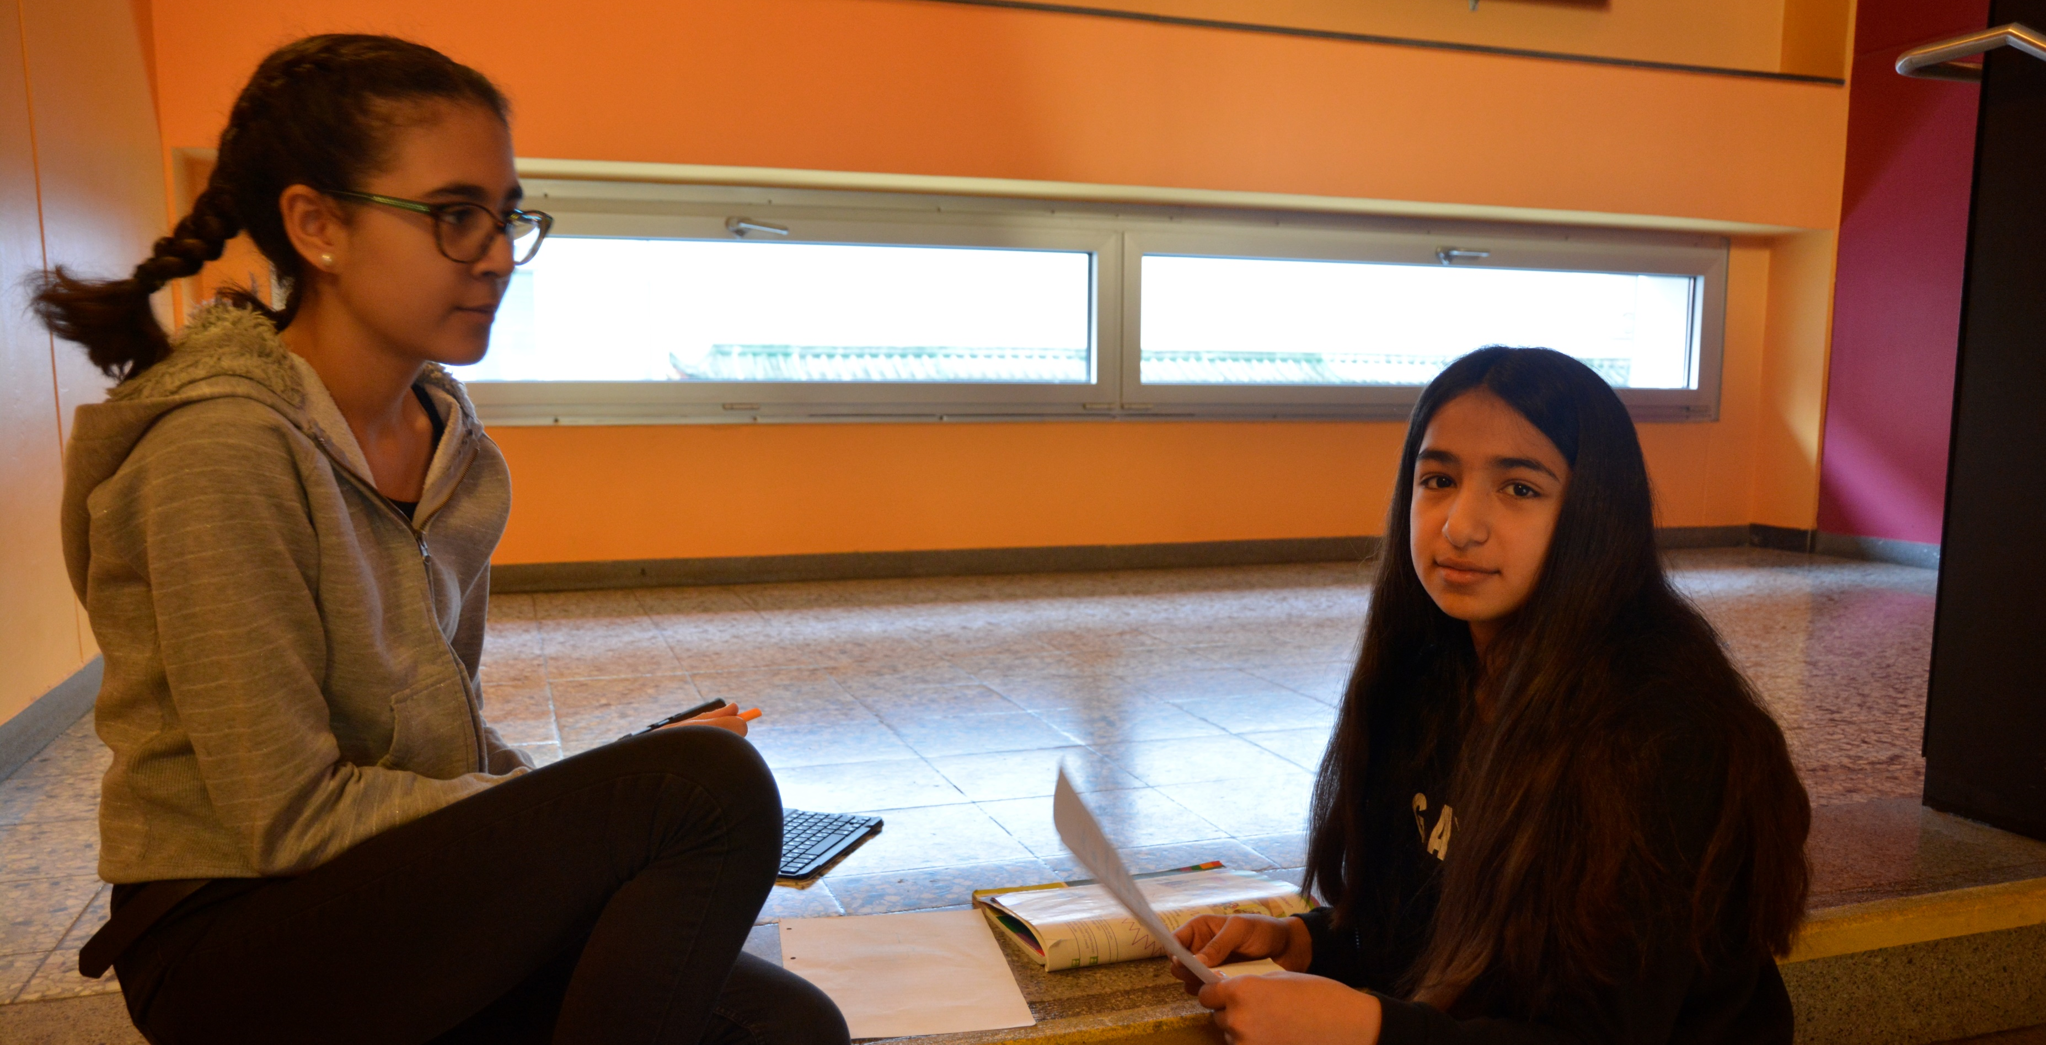
Sometimes we like to work in the hallways or on the stairs. We can choose the places ourselves, as long as we get our work done.

Slide 21
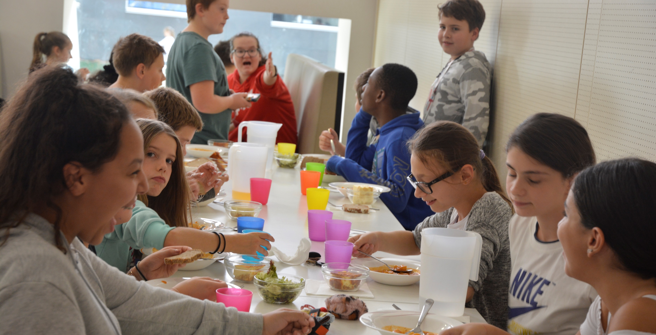
We are in school from 7.40 to 4.05. That‘s a long day. We always eat our lunch in the cafeteria.

Slide 22
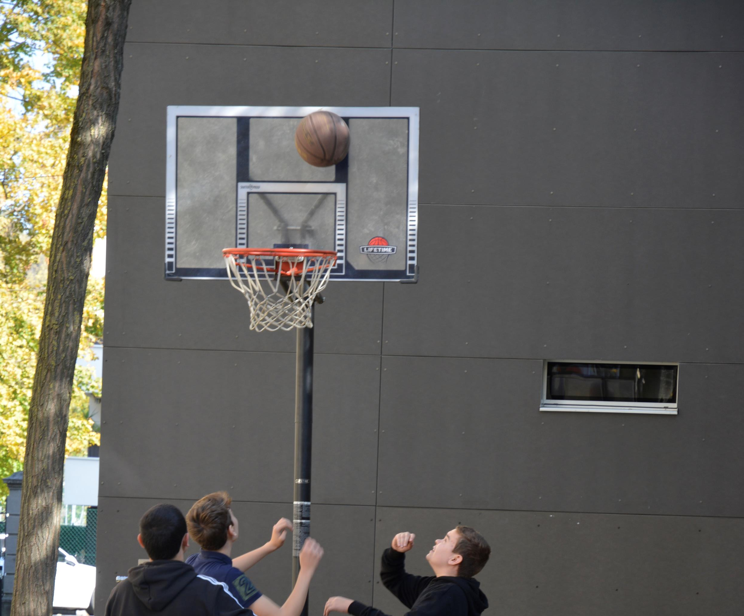
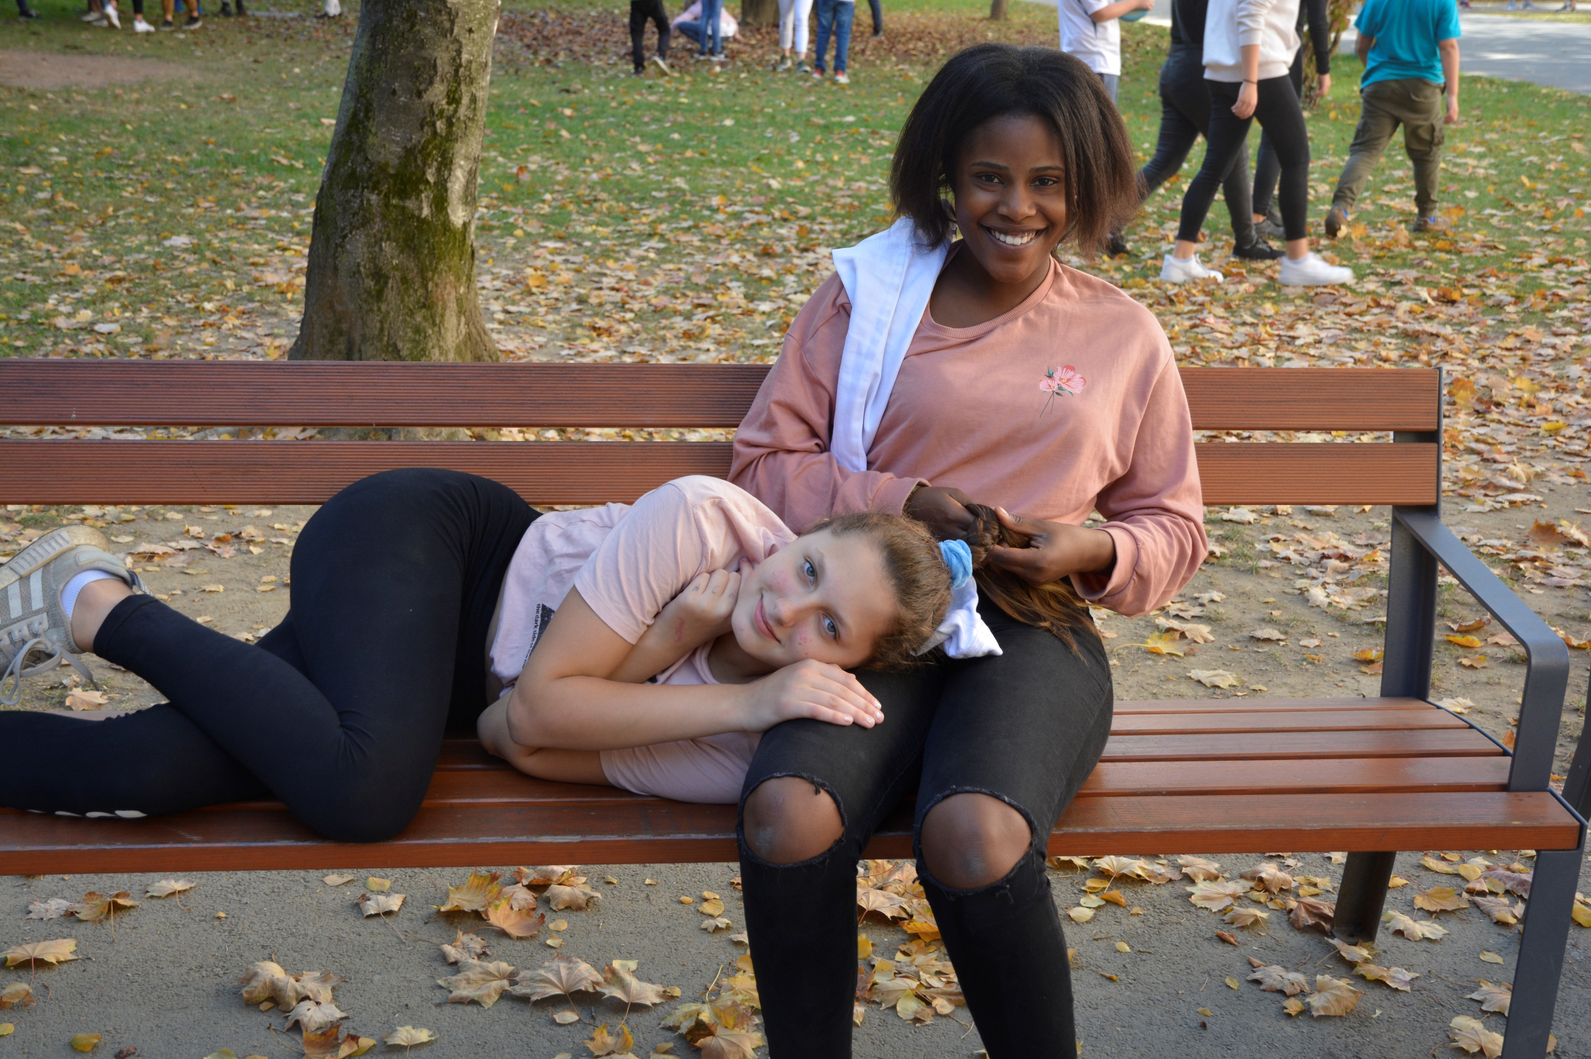
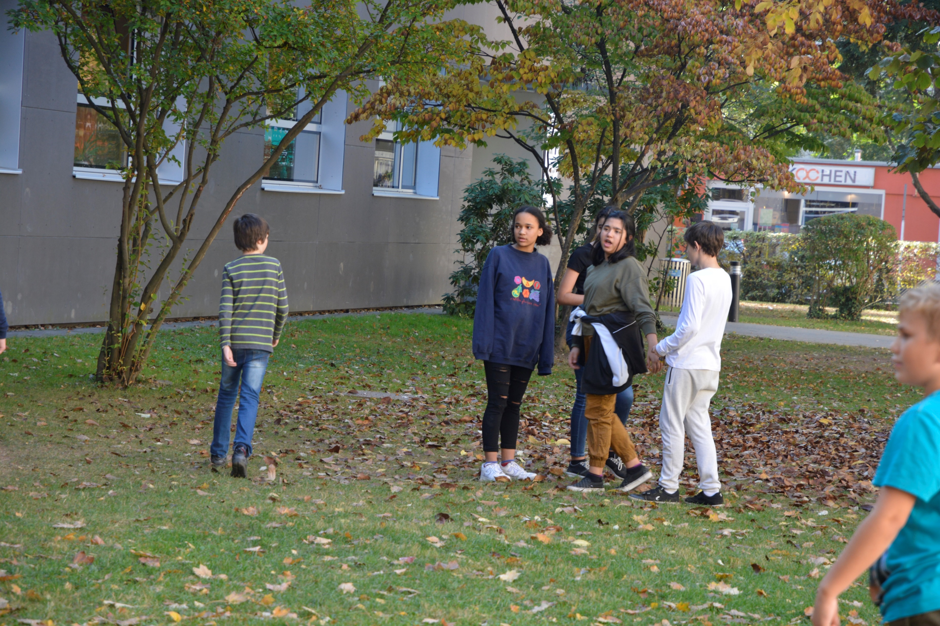
After lunch we have free time. We usually play outside in the yard.

Slide 23
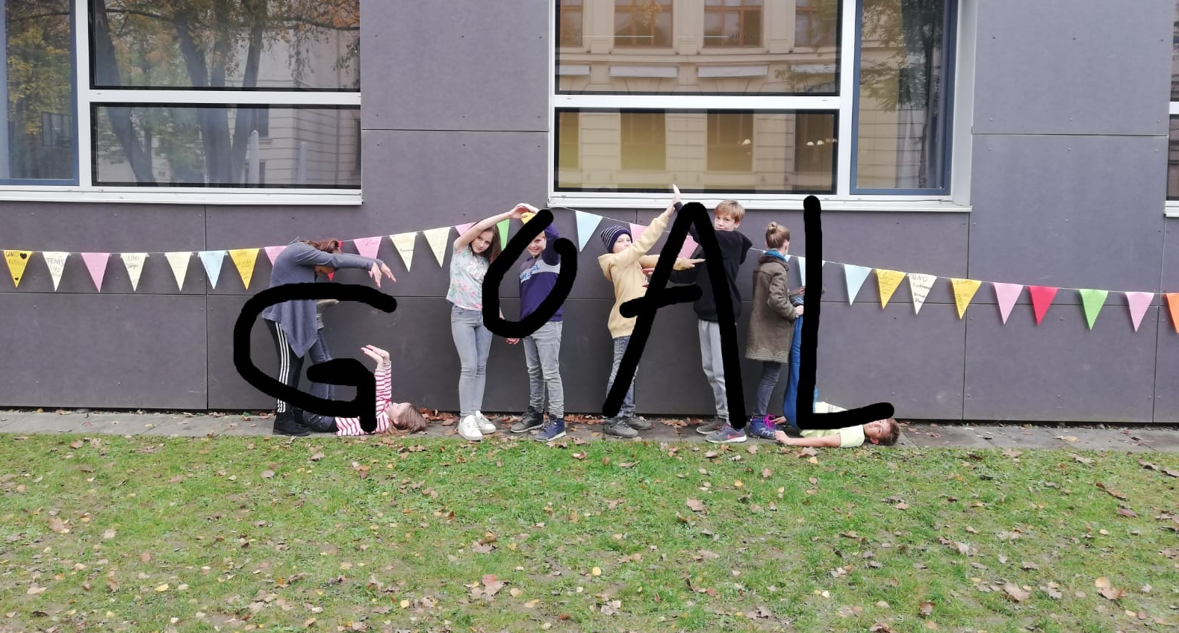
We really like our school and we are looking forward to the new GOAL project.
We would like to get to know our partners from Cyprus, Greece, Italy and Romania and find out where they live and go to school.

Slide 24


"The European Commission's support for the production of this publication does not constitute an endorsement of the contents, which reflect the views only of the authors, and the Commission cannot be held responsible for any use which may be made of the information contained therein."

