Slide 1





GOAL Project Week Feb. 10th-13th 2020

Slide 2
1440 min
of creating and playing games

Slide 3
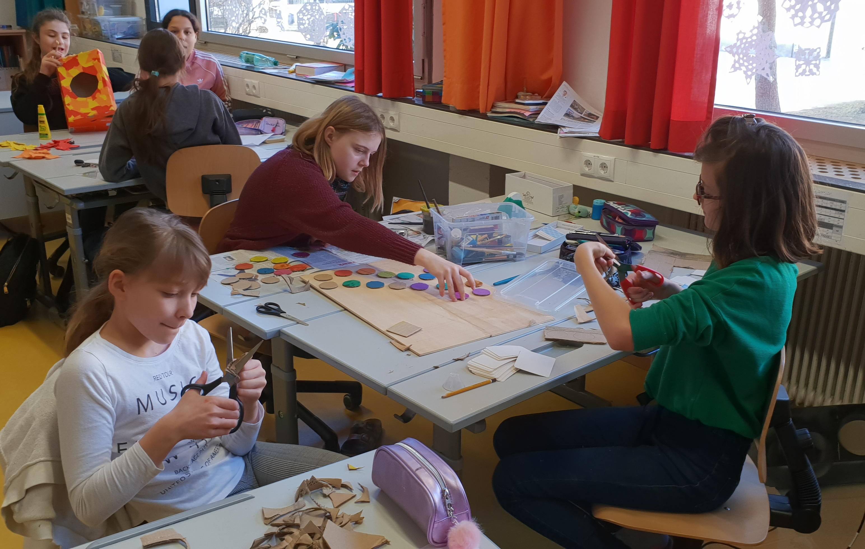
A holistic approach to games
Subjects involved
German
Maths
English
Geography
History
Sports
IT
Art
Crafts
Drama
Music
Nutrition
...

Slide 4
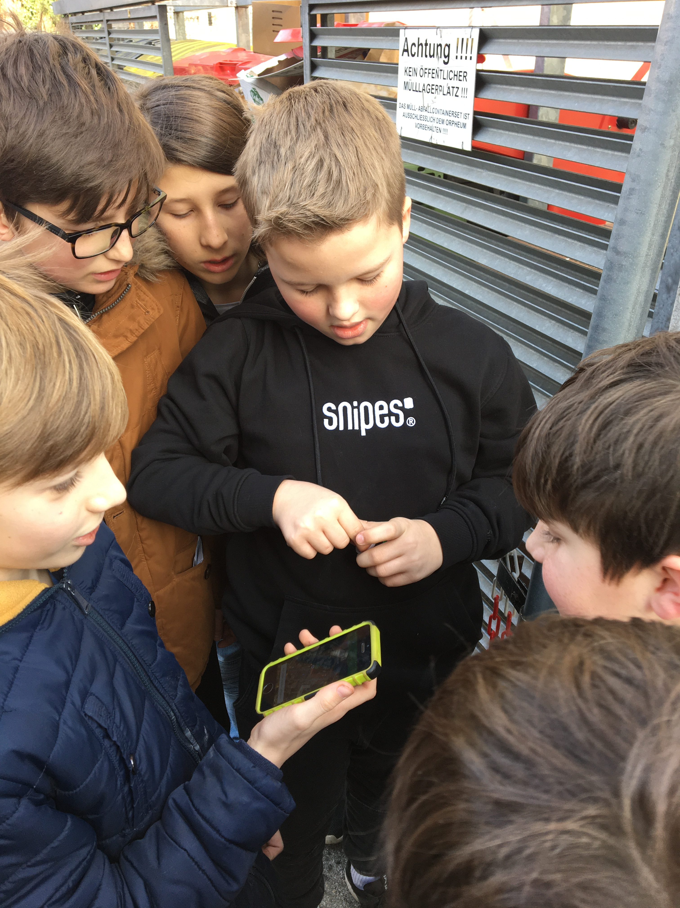
Actionbound tour
The kids prepared a scavenger hunt through our school using an app called “Actionbound”

Slide 5
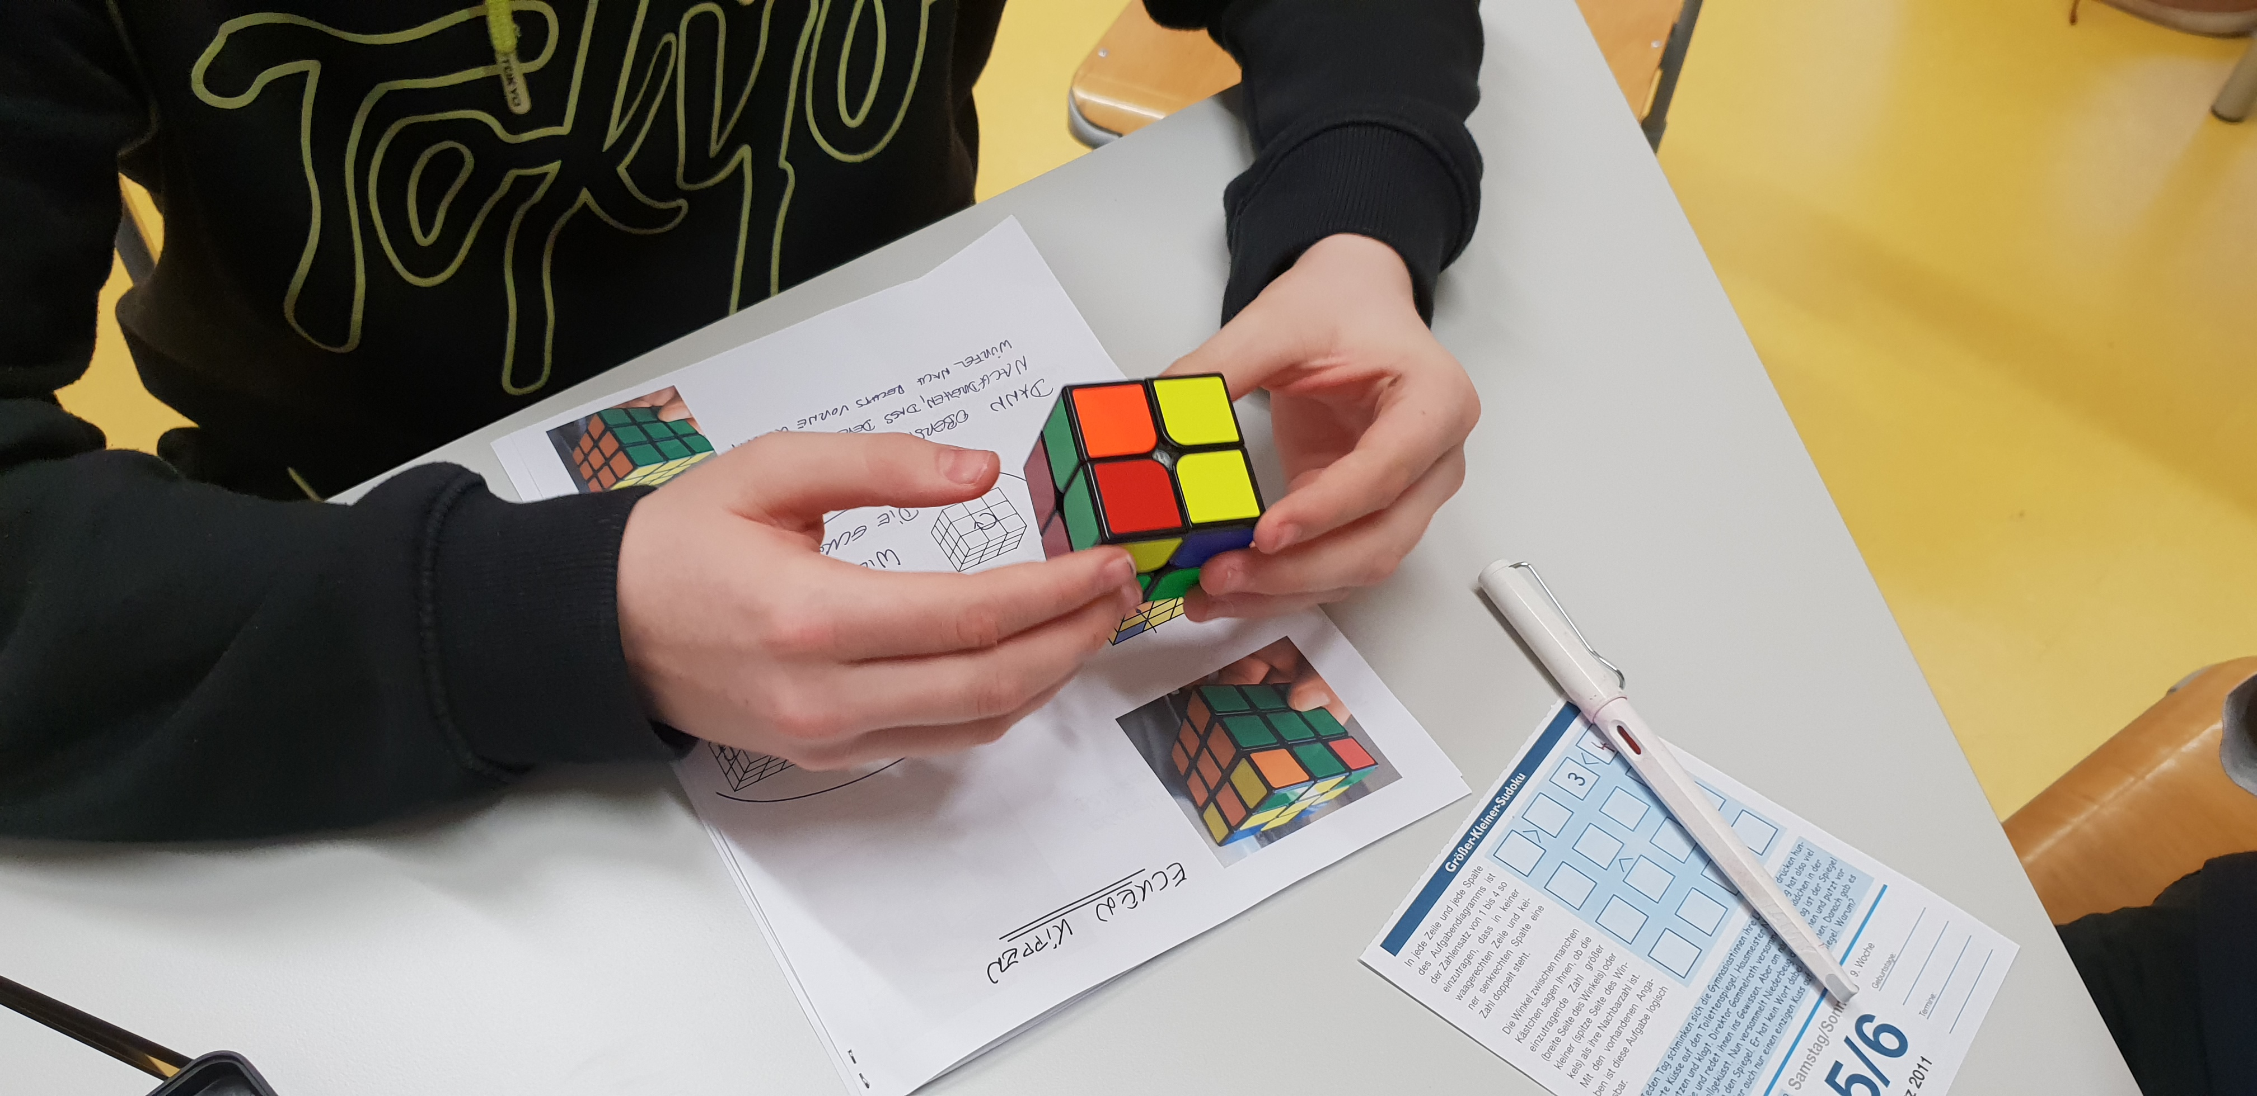
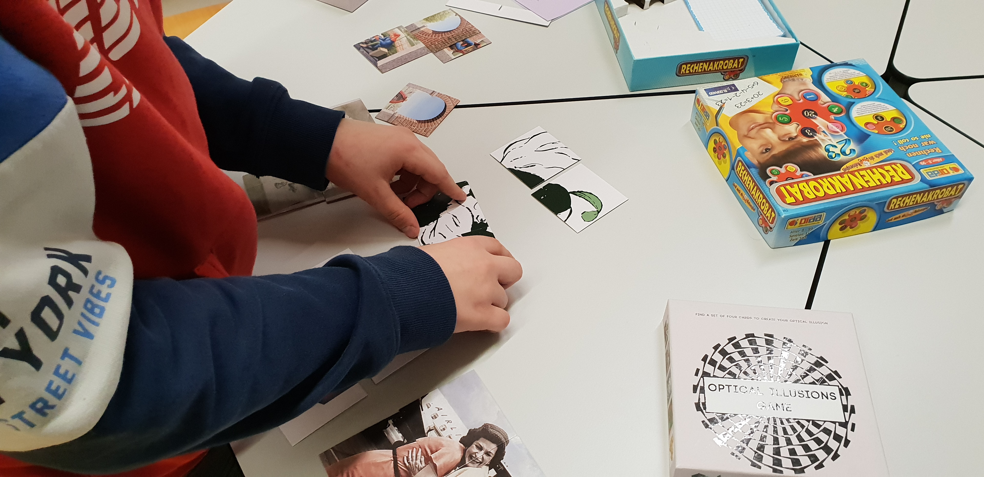
Maths Games
´

Slide 6
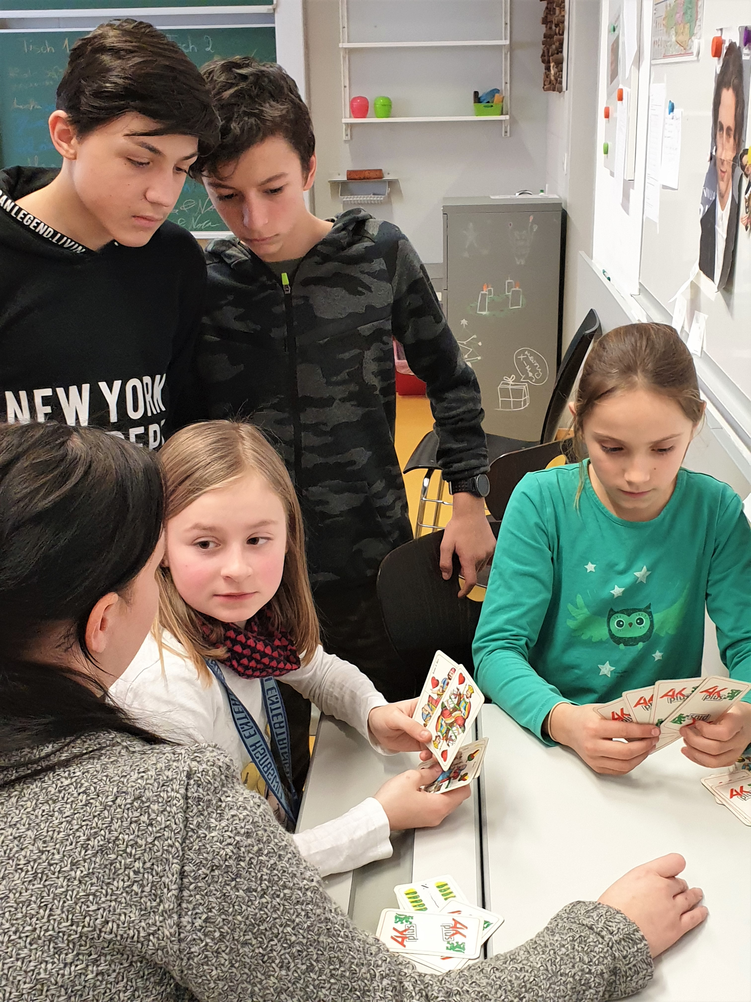
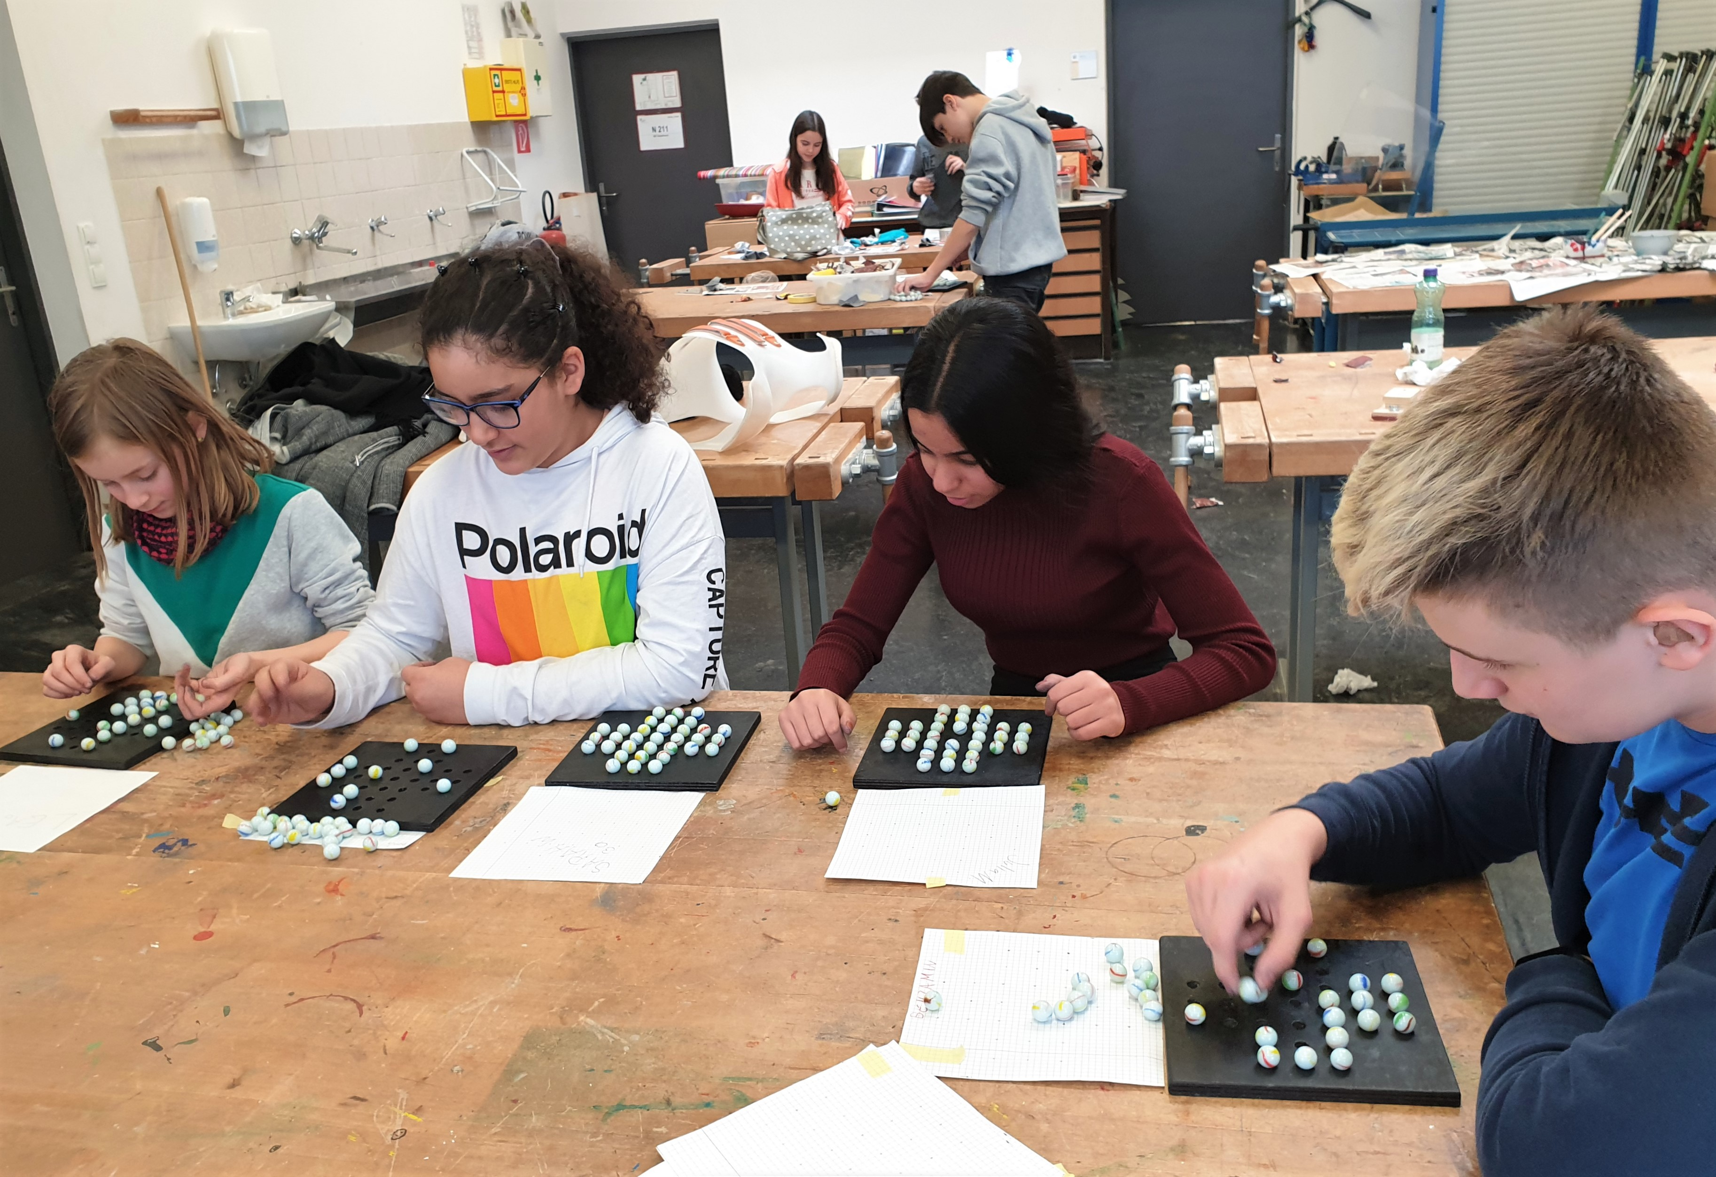
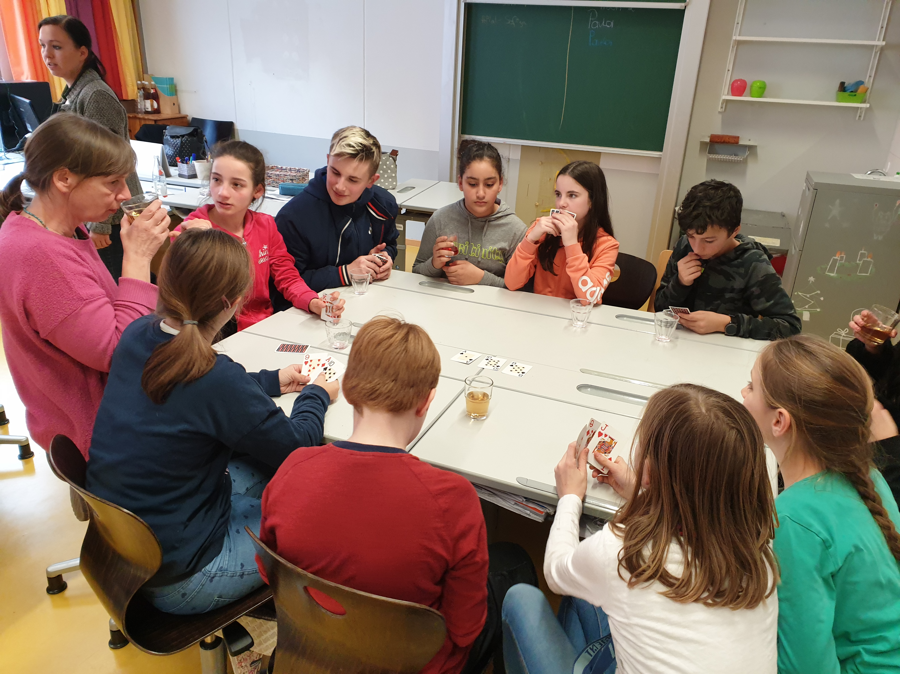
Traditional Games
´
“Solitär“
Schnapsen

Slide 7
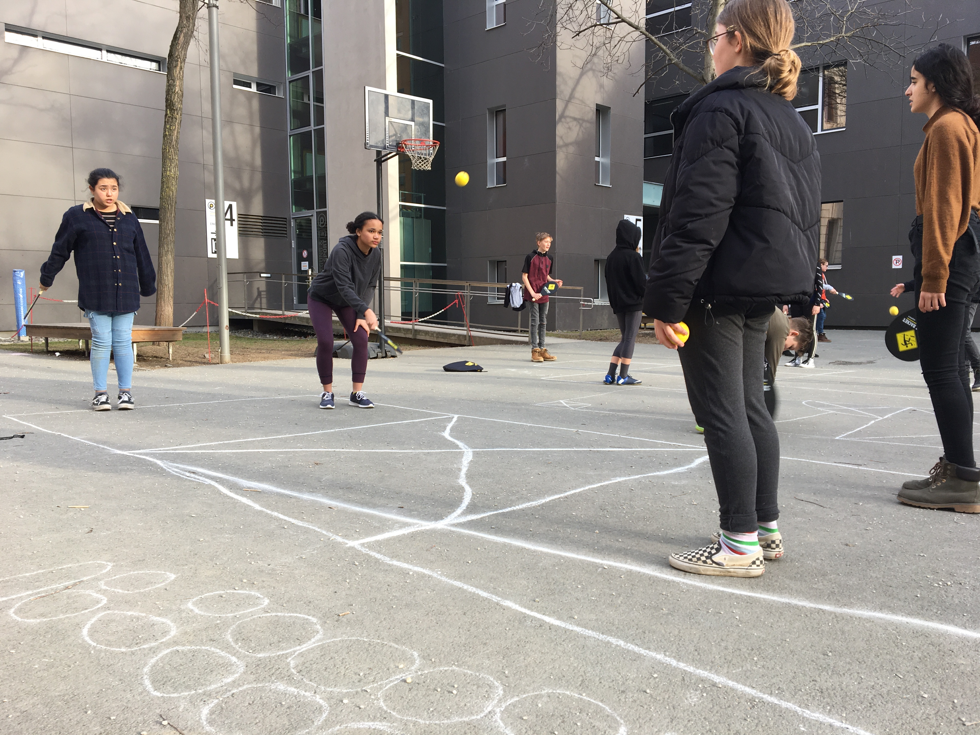
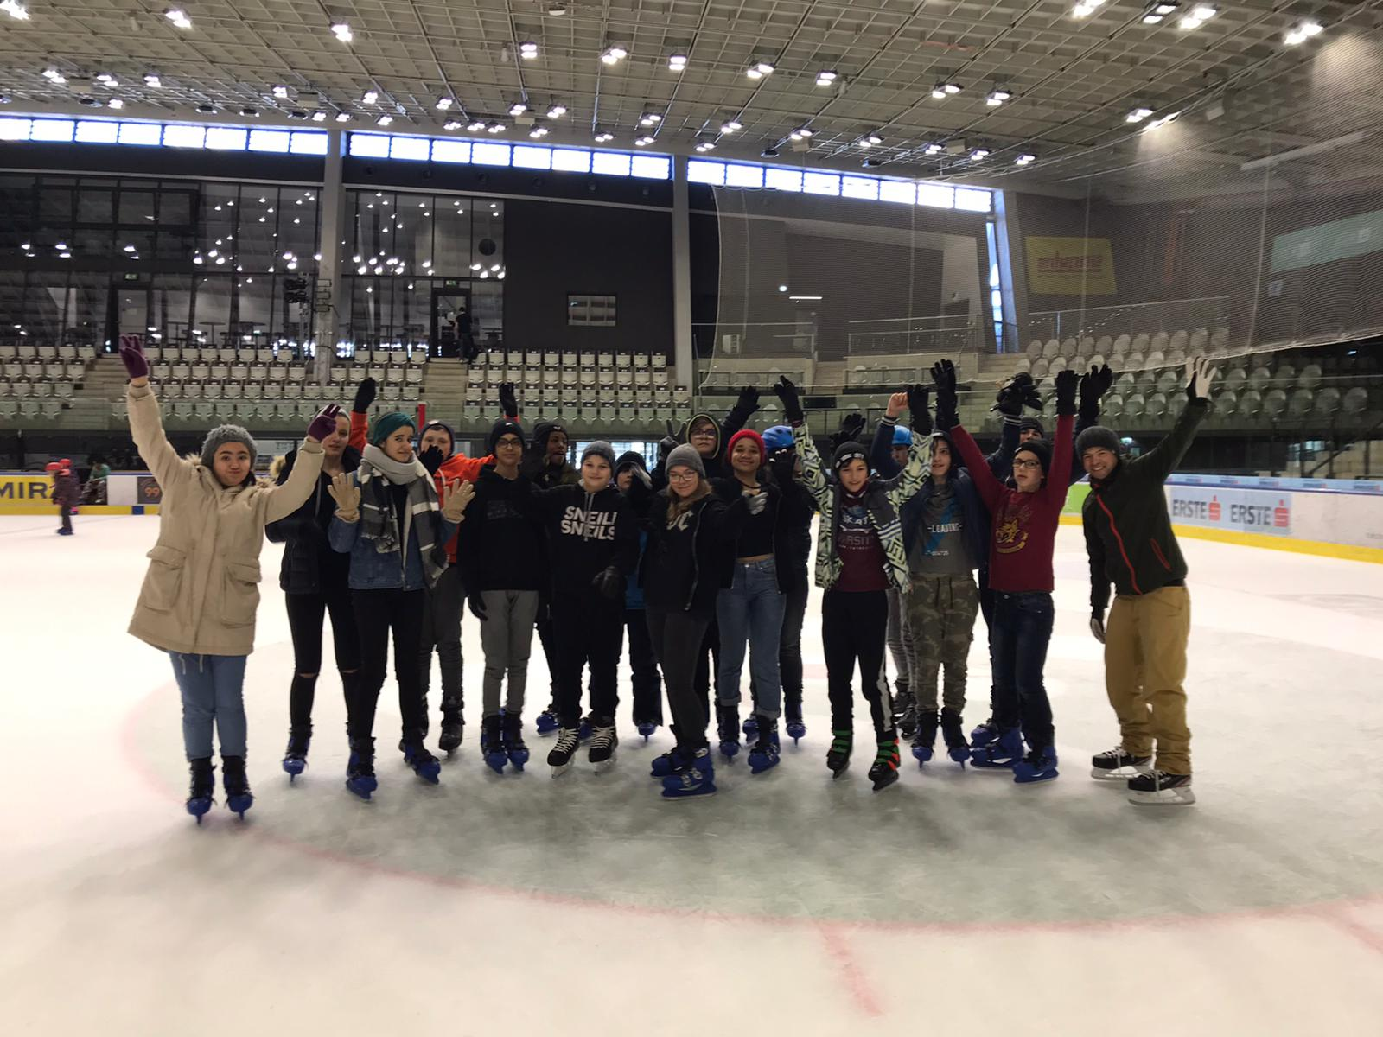
Sports Games/Winter Games
´
Street Racket
Ice Hockey

Slide 8
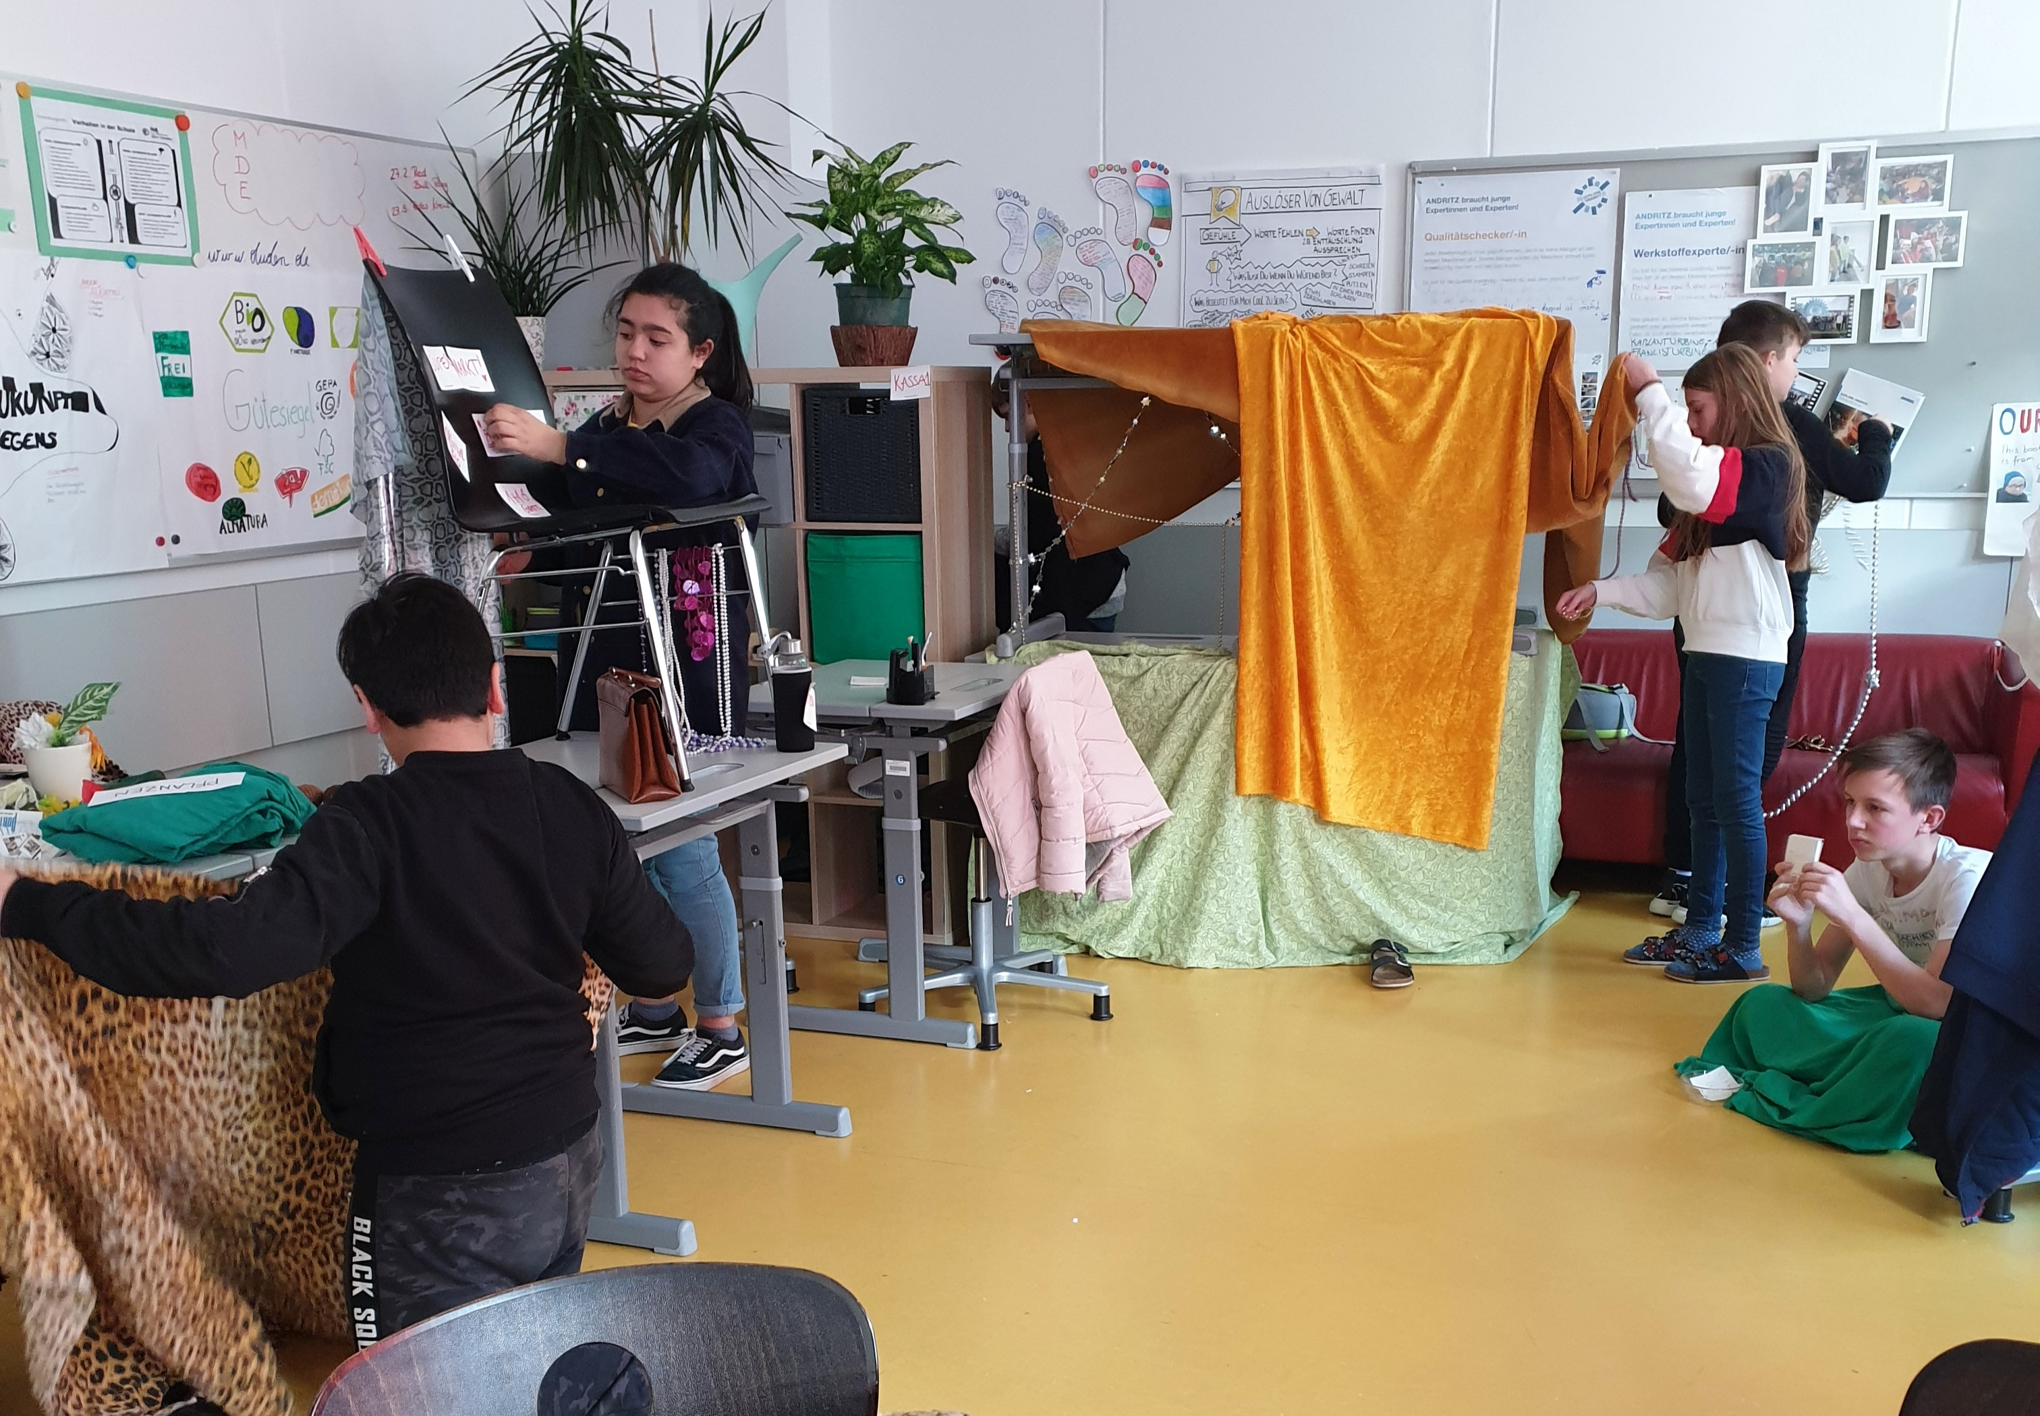
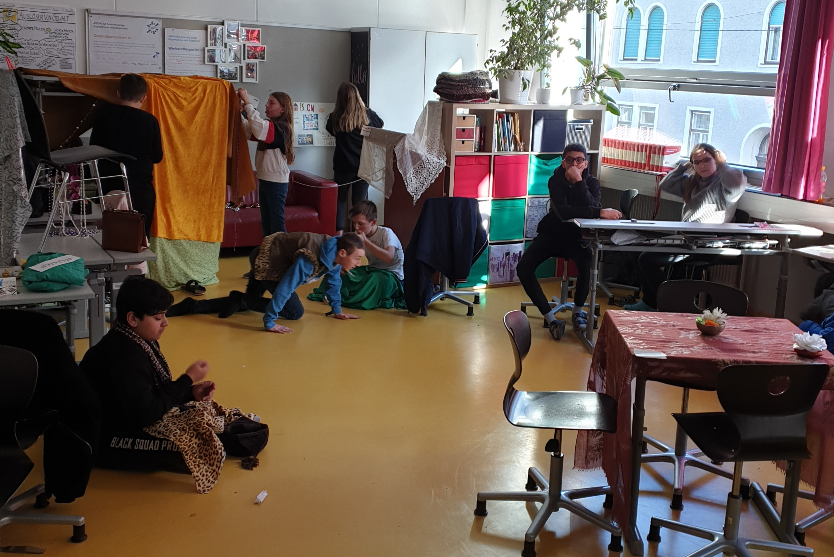
Drama
´

Slide 9
Escape the Room
´
The kids created a game, where a group of people gets locked into a room. By solving puzzles and riddles, they have to find their way out.
ESCAPE

Slide 10
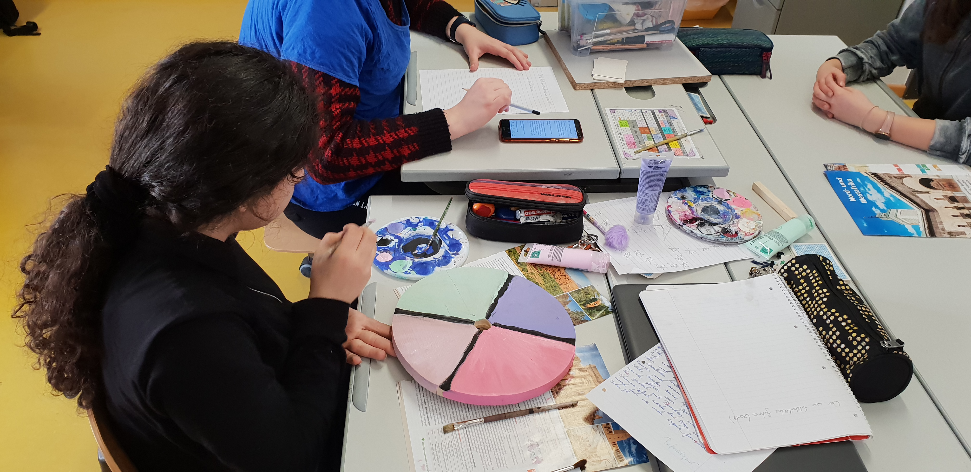
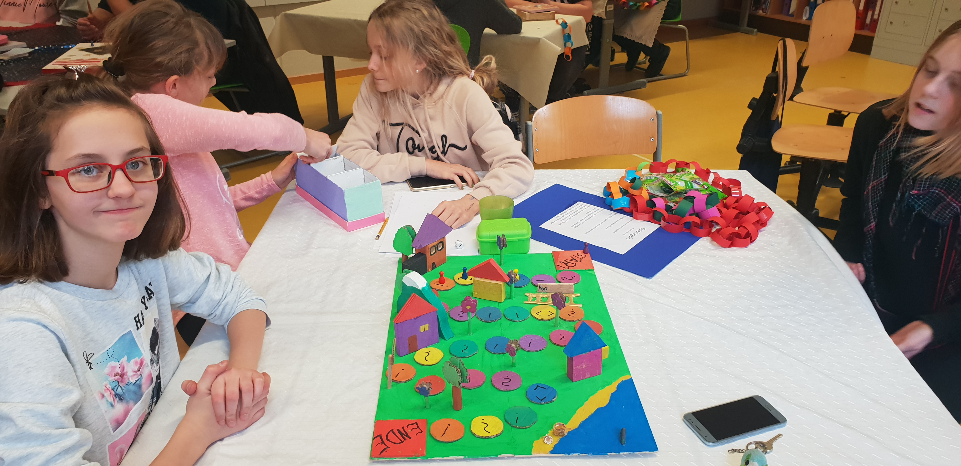
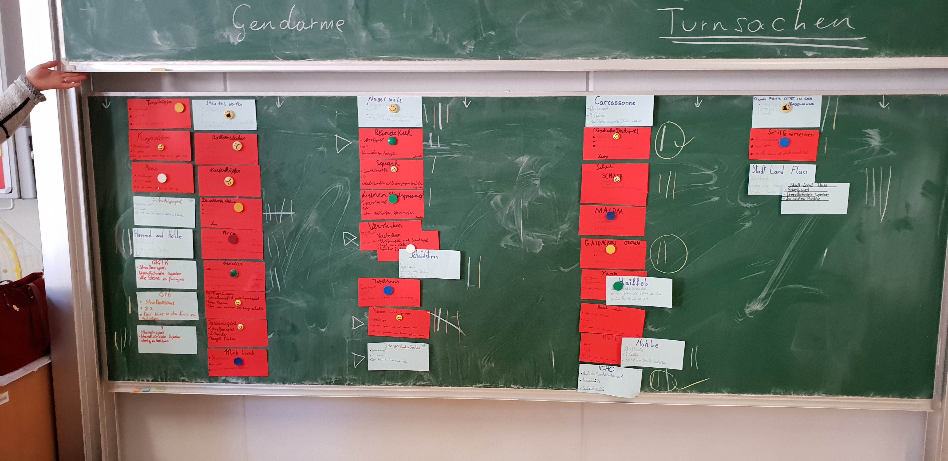
Creating Boardgames

Slide 11
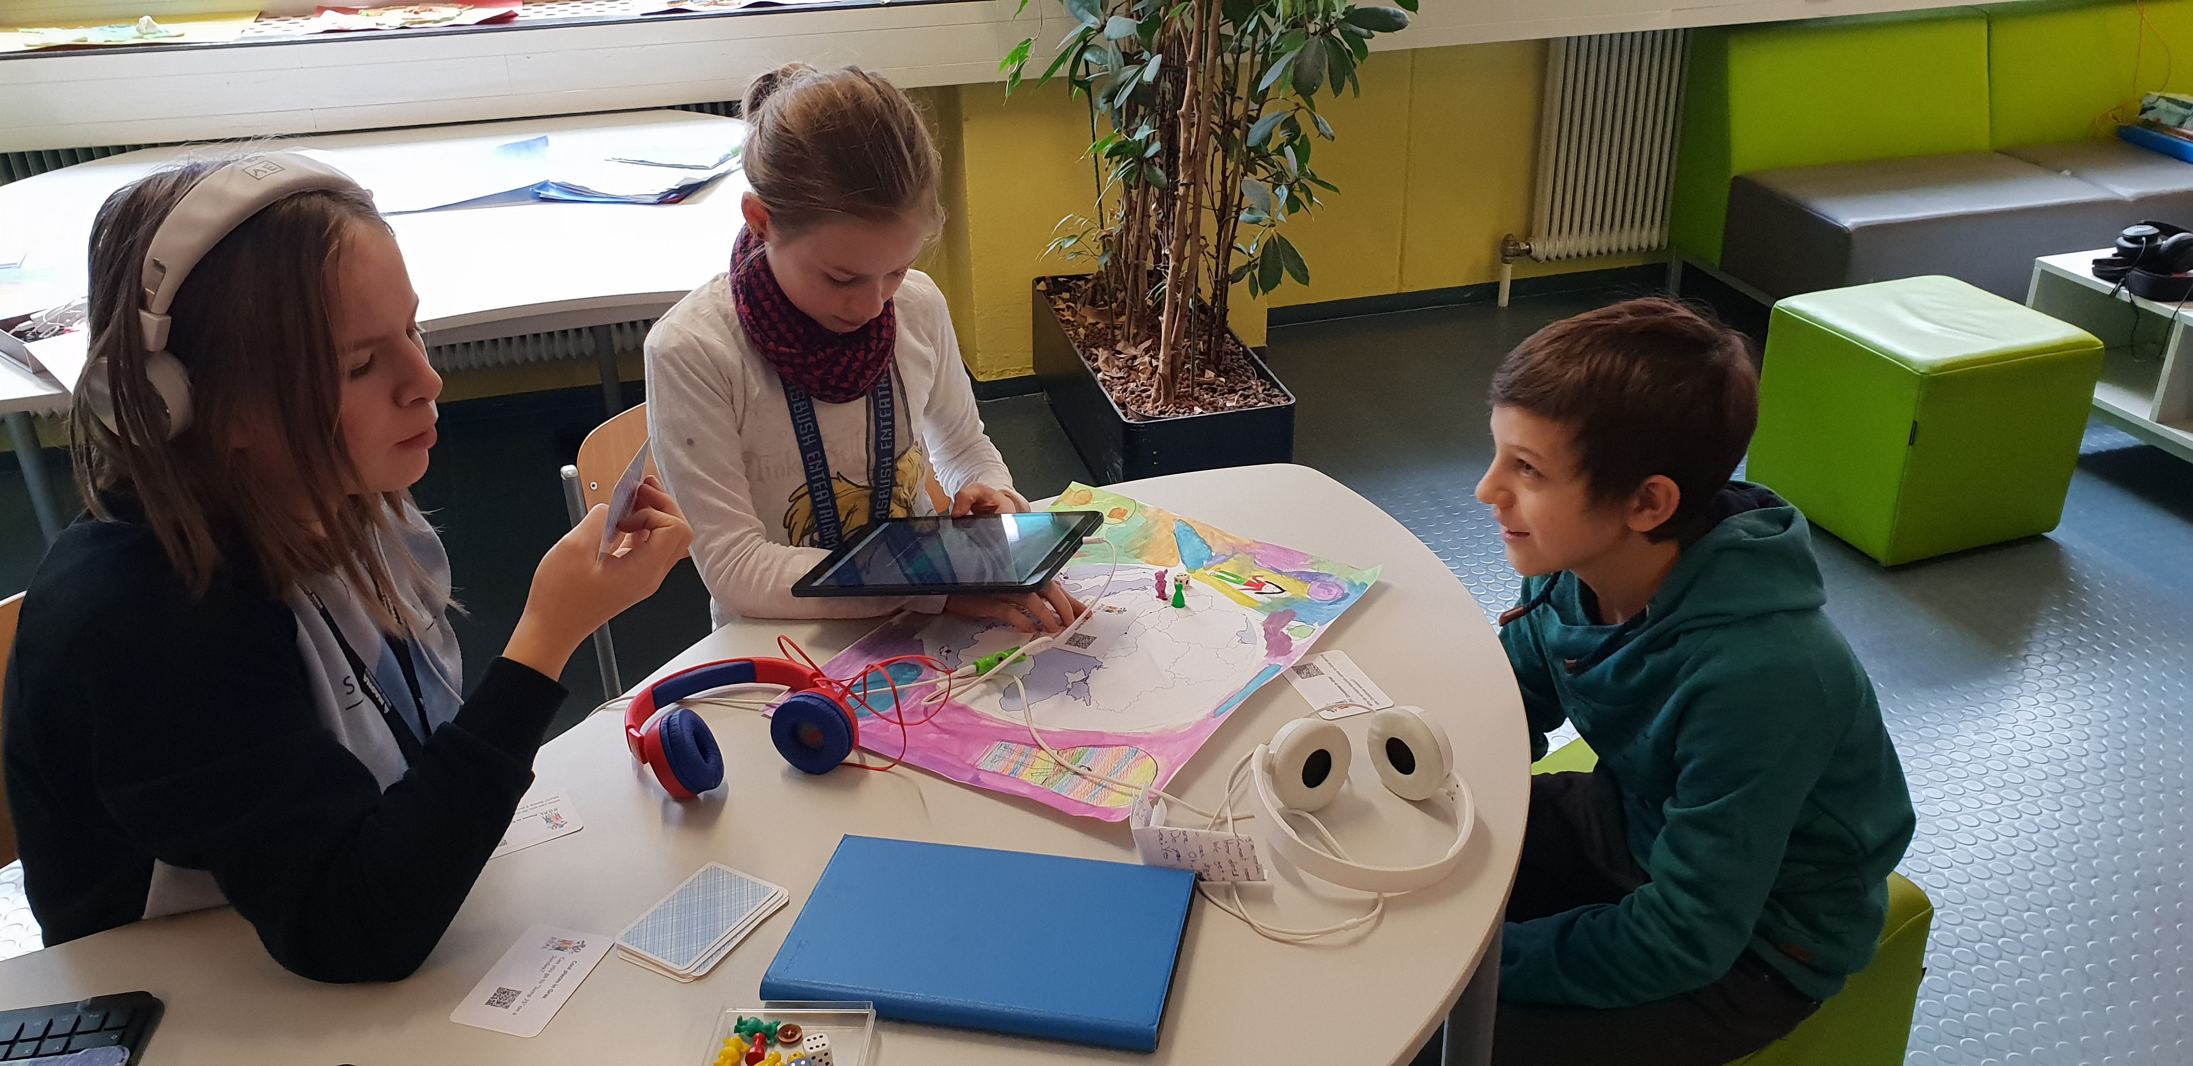
Journey across Europe
Aim
Creating a game the kids could share with our project partners
creating an extendable game
thinking about Austrian culture and traditions
thinking about our school and our daily lives
´

Slide 12
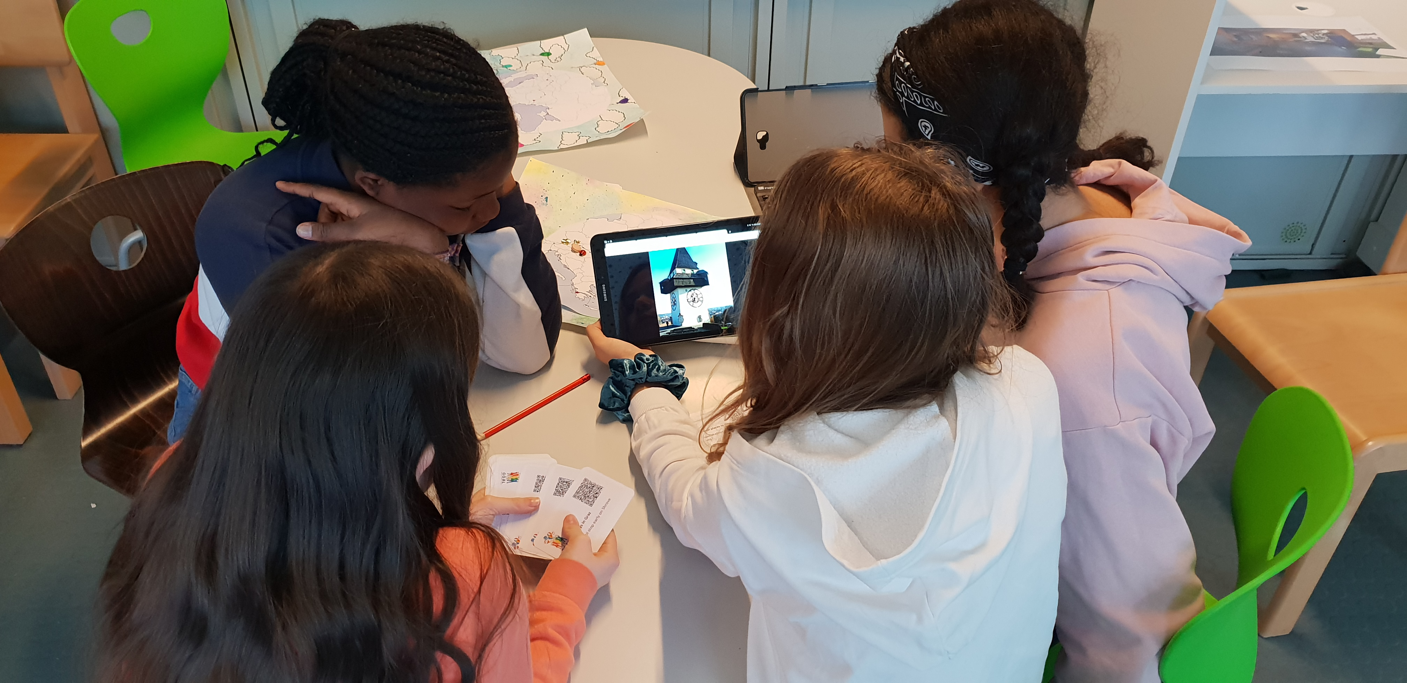
Journey across Europe
Skills involved
English: writing, reading, listening, speaking
IT:
Creating short videos and photo stories on tablets
Text-editing on tablets
Using QR codes
Art: creating a gameboard
Geography/History: learning about Austrian customs; learning about sights in Graz
´

Slide 13
Tell me and I‘ll forget. Teach me and I remember. Involve me and I‘ll learn. – Ben Franklin

Slide 14
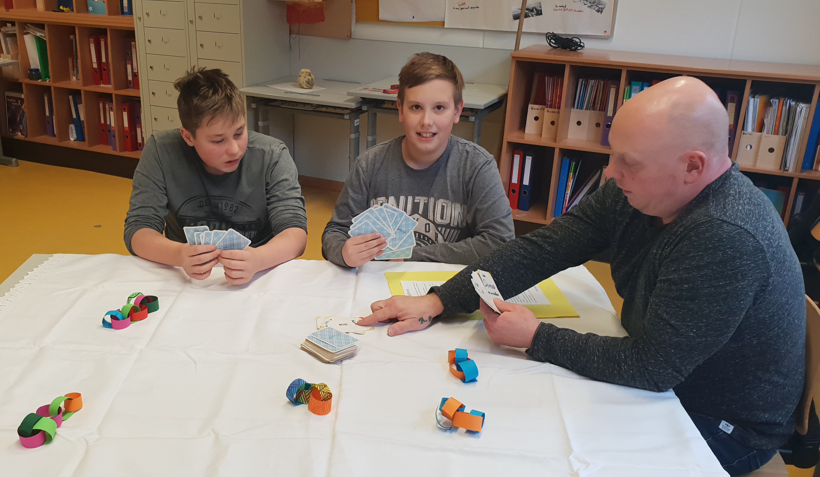
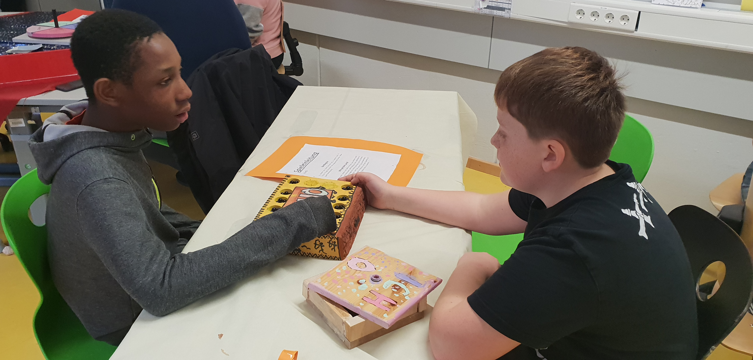
An afternoon of games
an event for students, teachers and parents

Slide 15
>20 workshops
around 170 kids
100%
That’s a lot of choice!
many brains!
Total success!

Slide 16
Thanks!
Feel like playing a game now?

