Slide 1

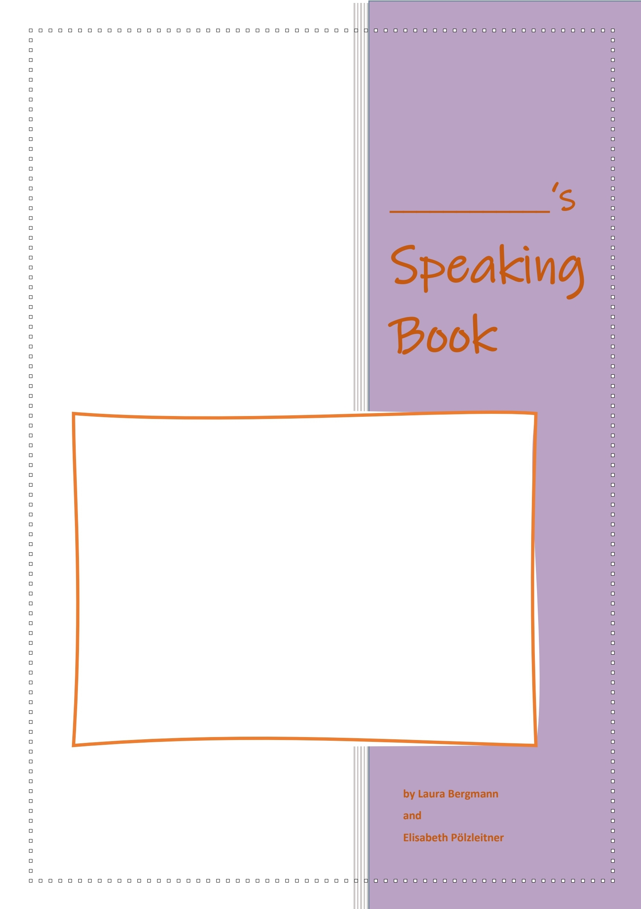

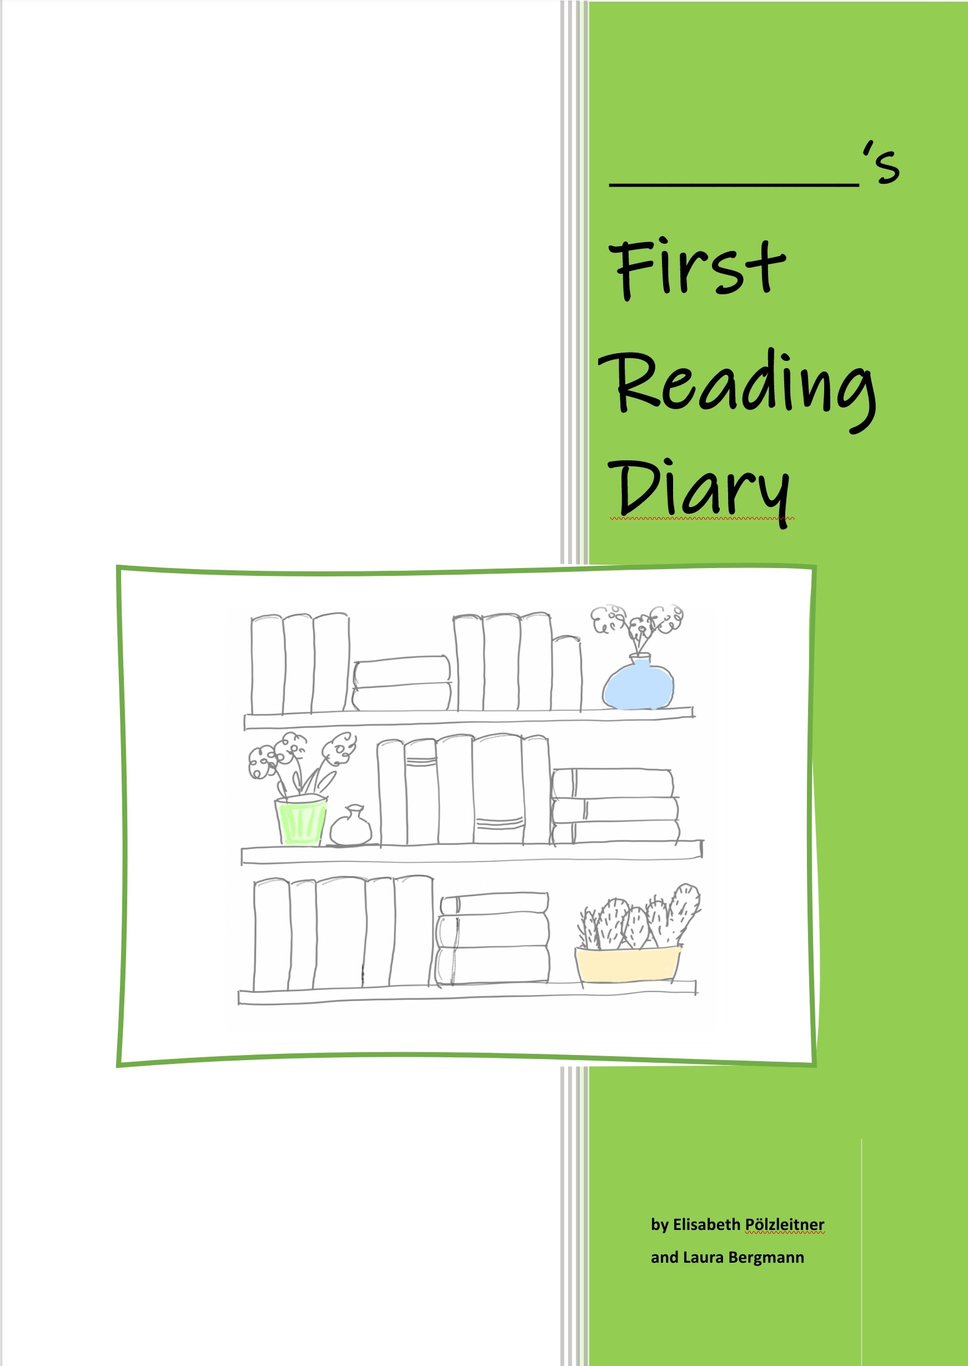




Creative Language Teachers GesbR

Slide 2
Creative Language Teachers GesbR

