Slide 1

Schularbeiten in der Sek 1
Schularbeiten zu den Lernzielen des neuen Lehrplans erstellen

Slide 2
What to expect today: How to design tests based on the learning objectives of the new curriculum
Designing reading and listening tasks that test different comprehension levels:
Global understanding
Comprehension of specific information
Ability to draw simple conclusions
Testing grammar and vocabulary in communicative contexts
Designing meaningful writing tasks
Assessing writing with appropriate assessment scales / rubrics
Grading the test (weights of different parts, transparent semester grades)

Slide 3
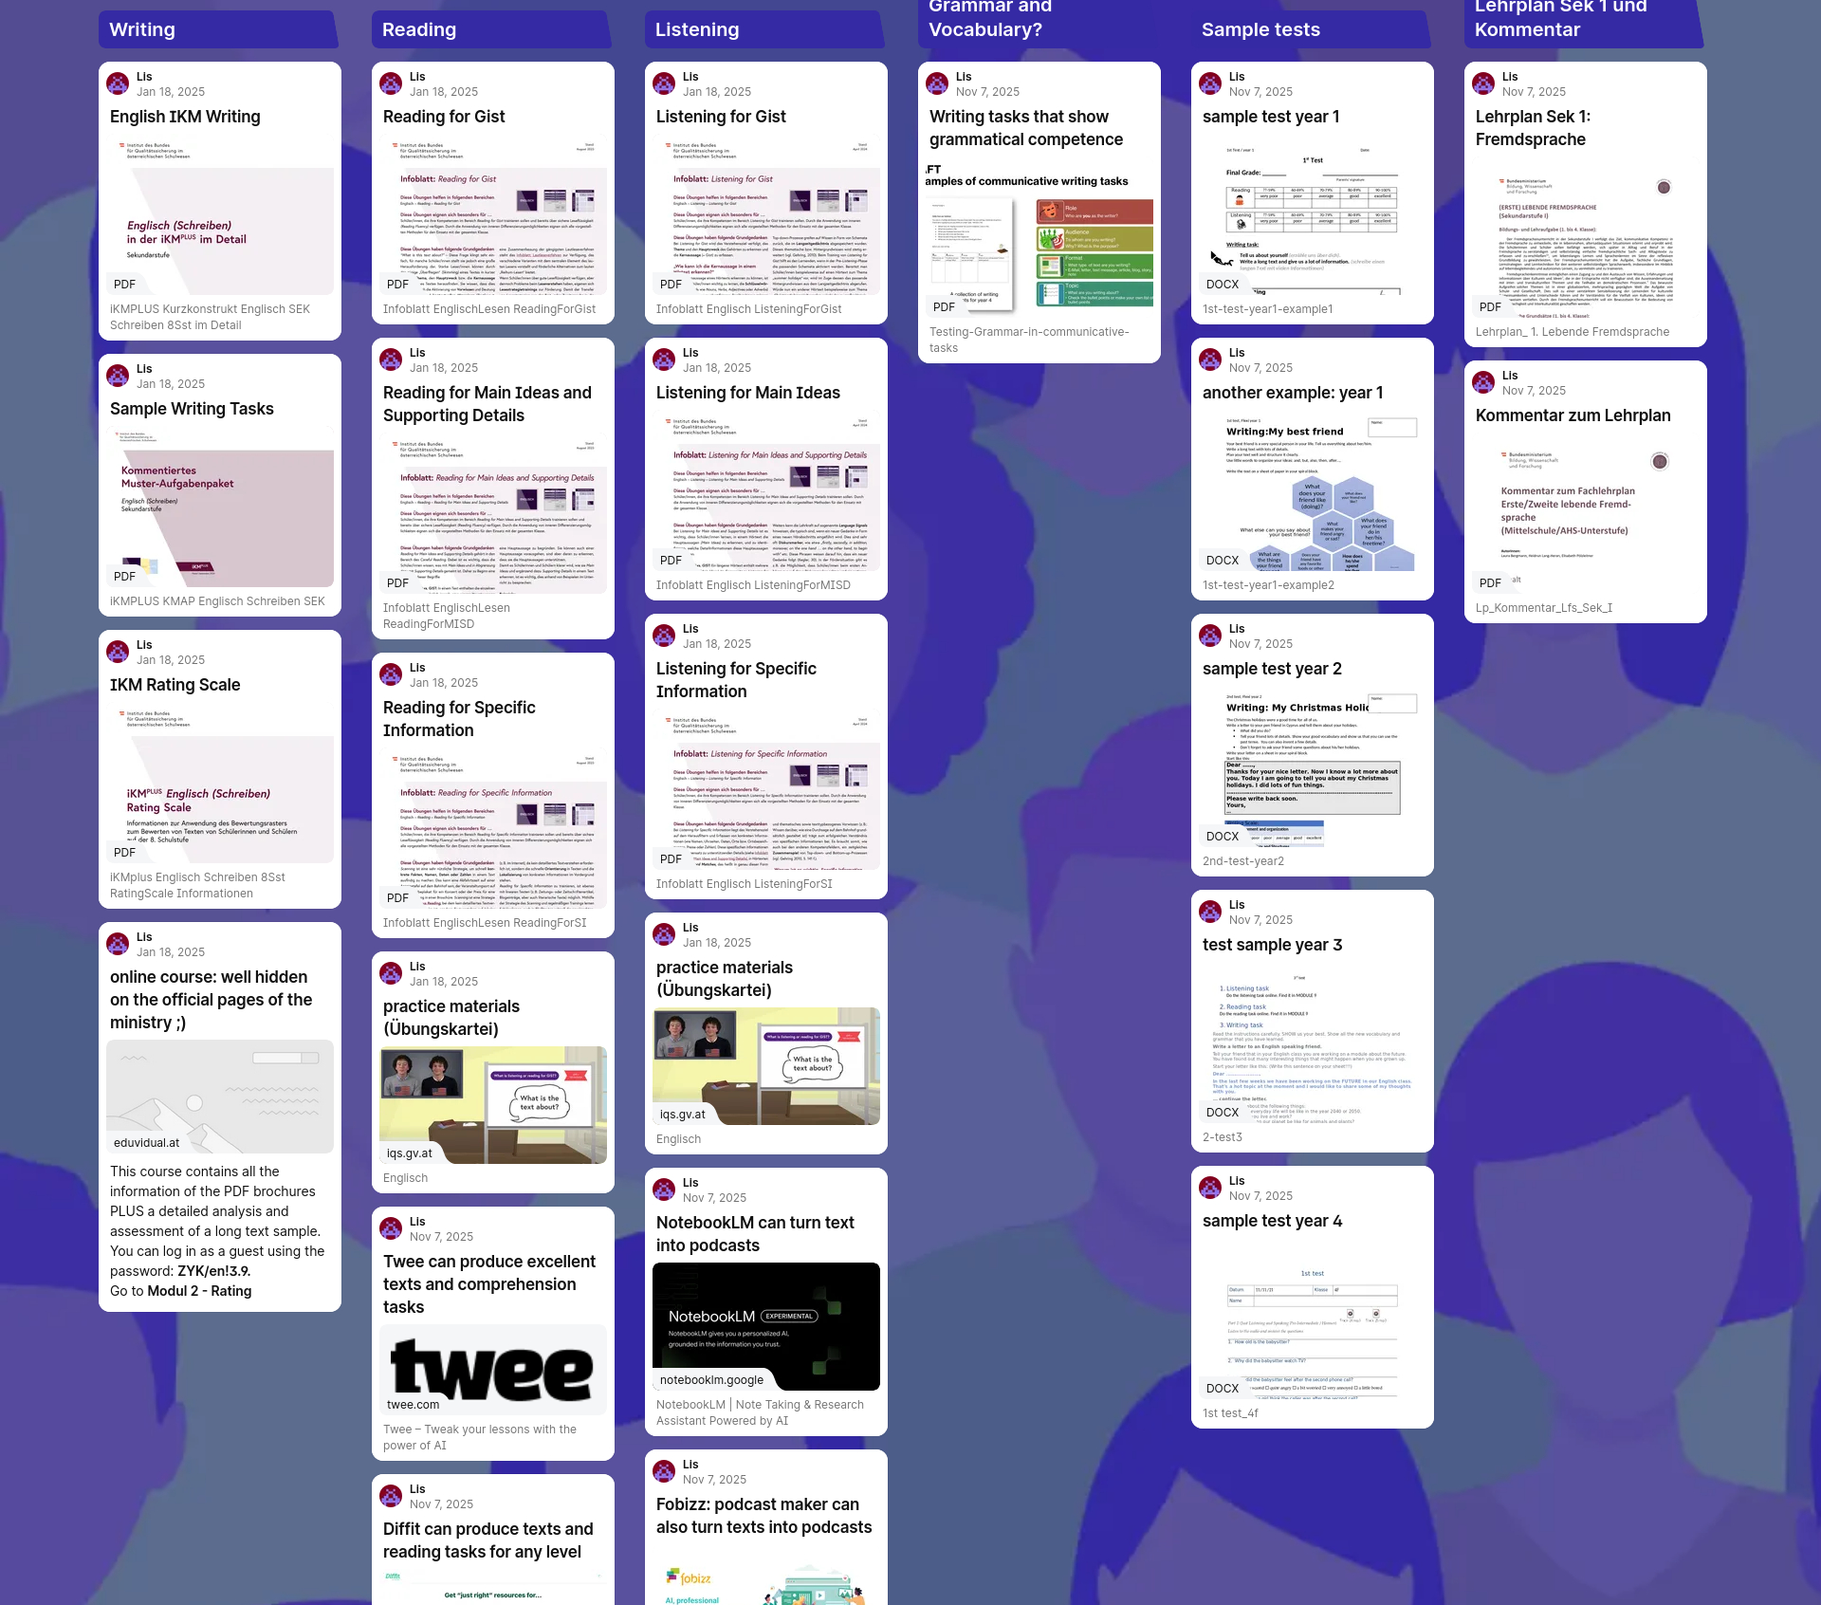

For your reference
Collection of relevant materials and background information
https://padlet.com/lispolzleitner/SchularbeitenSek1Englisch

Slide 4



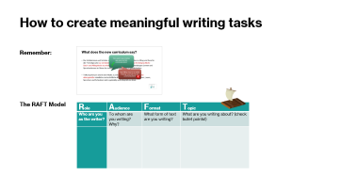

What does the new curriculum say about our goals?
Our goal is successful,
age-appropriate communication!
Die Schülerinnen und Schüler sollen befähigt werden, sich später in Alltag und Beruf in der Fremdsprache zu verständigen und selbstständig einfache fremdsprachliche Sach- und Alltagstexte zu erfassen und zu erschließen, um lebenslanges Lernen und Sprachenlernen im Sinne der reflexiven Grundbildung zu gewährleisten.
Teilkompetenzen sind in dem Maße zu entwickeln, wie sie für erfolgreiche altersgemäße mündliche und schriftliche Kommunikation nötig sind. Hören, Lesen, Sprechen und Schreiben sind regelmäßig und integrativ zu üben.
Gap-filling may be a useful training tool, but it is not communication!

Slide 5

Kompetenzmodell: Der gemeinsame europäische Referenzrahmen für Sprachen des Europarates (GER) und der Companion Volume (2018)
Die zu erwerbenden Kompetenzen gliedern sich in die Bereiche Hören, Lesen, Sprechen und Schreiben.
Die sprachlichen Mittel bilden die Basis für diese vier Kompetenzbereiche und sind deren integrative Bestandteile; sie stellen keinen eigenen Kompetenzbereich dar.
Dazu im Lehrplankommentar: Die Basis für die Entwicklung der Kompetenzen in den Bereichen Hören, Lesen, Sprechen und Schreiben sind die sprachlichen Mittel (Vokabular und Grammatik). Diese bilden das Fundament aller Formen des Sprachhandelns und müssen integrativ in sinnvollen, kommunikativen Kontexten entwickelt werden.
So ist es zum Beispiel sinnvoll, Vokabular in kurzen, typischen Sätzen in konkreten Kontexten und den dafür notwendigen Strukturen zu erarbeiten. Beispiel: Vokabular + Grammar für eine spooky story: “the owl was hooting, the moon was shining, the wind was howling …”.
In allen vier Kompetenzbereichen wird das Zielniveau A2+ mit ausgewählten Deskriptoren aus B1 angestrebt. Bei den sprachlichen Mitteln ist zu beachten, dass die Schülerinnen und Schüler auf dem Zielniveau A2+ ein entsprechendes Spektrum an vertrauten sprachlichen Mitteln hinreichend korrekt erkennen und niveauadäquat anwenden können.
Es wird in sinnvollem Maße und auf das jeweilige Kompetenzniveau bezogen Adäquatheit der sprachlichen Mittel angestrebt.
Auf allen Kompetenzstufen ist zu beachten, dass sich Lernende der Zielsprache über lernersprachliche Zwischenschritte annähern.
Hör- und Leseverstehen beziehen sich auf das globale Verständnis, das Verstehen wichtiger Details sowie die Fähigkeit, einfache Schlussfolgerungen zu ziehen.

Slide 6
What does the curriculum say about GRAMMAR?
Der funktionale Aspekt der Grammatik hat Vorrang gegenüber dem formalen Aspekt. Die situative Einführung und das induktive Erschließen grammatischer Sachverhalte aus kommunikativen Zusammenhängen und Textbeispielen sind anzustreben.
Grammatische Teilsysteme dürfen nicht zum direkten Lernziel werden.
Über meine Pläne sprechen
I am going to…

Slide 7
Meaning into Form
Im Grammatikunterricht steht bewusst die Bedeutung an erster Stelle. Es handelt sich also um einen “Meaning into Form” Approach. Das Hauptaugenmerk soll immer darauf liegen, WAS ausgedrückt werden soll und daraus ergibt sich eine sprachliche Form, die dafür verwendet werden kann/muss.
Bedeutung | Form
Über meine Pläne sprechen | I am going to…
Beschreiben wie wir etwas tun | She runs quickly, she speaks slowly, he screams loudly…
Duration: Sagen wie lange ich Dinge schon habe – kenne – mache… | Present perfect tense: I have lived here for … I have known you for…

Slide 8

What does the curriculum say about listening?
1. Klasse
Die SuS können, wenn sehr langsam, klar und deutlich in Standardsprache gesprochen wird,
In kurzen Dialogen oder Monologen einfache Fragen und Sätze, die sich auf sie selbst und ihr persönliches Umfeld beziehen, verstehen;
Einfache alltägliche Kommunikation im Unterricht verstehen.
2. Klasse
Die SuS können, wenn langsam, klar und deutlich in Standardsprache gesprochen wird,
Anweisungen, fragen und Auskünfte verstehen;
Kurze einfache Gespräche und Texte über vertraute Themen verstehen.
3. Klasse
Die SuS können, wenn klar und deutlich und nicht zu schnell in Standardsprache gesprochen wird,
Einfache Gespräche, Erzählungen und kurze Medienbeiträge verstehen.
4. Klasse
Die SuS können, wenn in klarer und deutlicher Standardsprache gesprochen wird,
Gespräche, kurze Erzählungen, Präsentationen, Filme und kurze Medienbeitrage über vertraute Themen verstehen.

Slide 9


What does the curriculum say about reading?
„Lesen: Das Erfassen von Informationen aus geschriebenen Texten bildet die Grundlage für lebenslanges Lernen. Dabei steht die Hinführung zur Lektüre von einfachen, authentischen altersadäquaten Texten im Fokus. Für das Textverständnis sind sowohl das globale Verständnis, das Verstehen von spezifischen Informationen wie auch die Fähigkeit, einfache Schlussfolgerungen aus dem Geschriebenen zu ziehen, erforderlich.“
Leseaufgaben zu gelesenen Büchern unterscheiden sich wesentlich von den typischen reading comprehension tasks. Es geht hier um Globalverständnis, um das Ausdrücken von Meinungen zum Gelesenen oder auch um das Erkennen von Gemeinsamkeiten oder Unterschieden im Leben der Charaktere bzw. im eigenen Leben.
Reading Strategies Slide 72

Slide 10
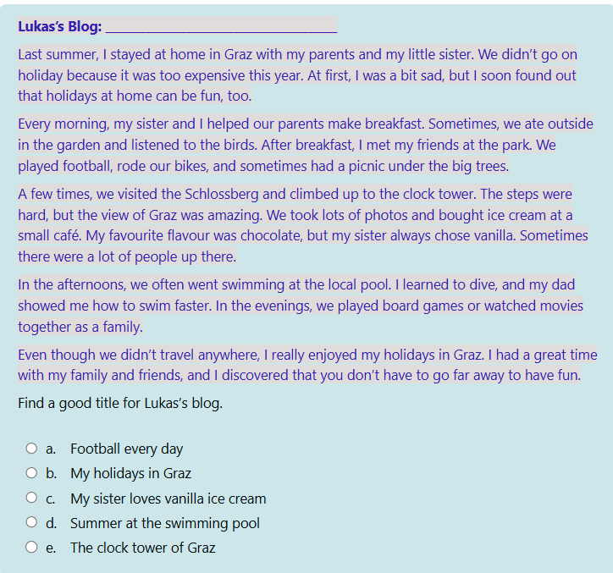
Designing reading and listening tasks that test different comprehension levels
Examples…
Global understanding
Comprehension of specific information
Ability to draw simple conclusions

Slide 11
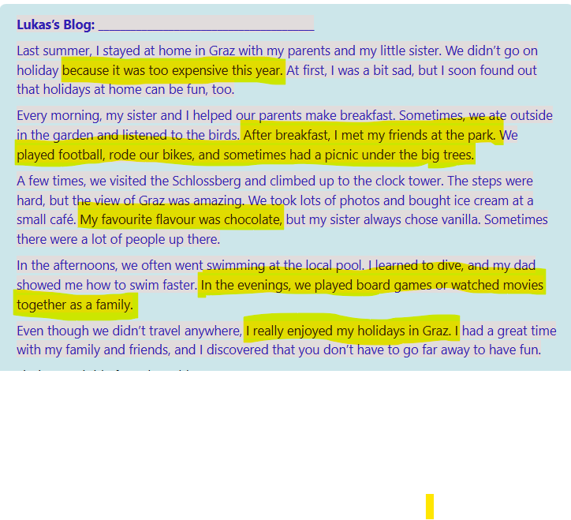
Different comprehension levels
Comprehension of specific information
e.g.
Why didn't they go abroad? Where did he meet his friends?
What did Lucas do with his friends?
What's his favourite ice cream flavour?
What did they do in the evening?
Did he like his holidays?

Slide 12
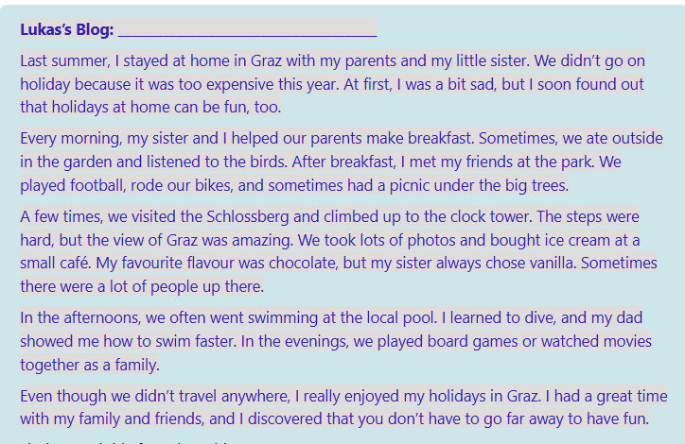
Different ​comprehension​ levels
Very basic conclusions
e.g.
What did Lucas like about his trips up to the Schlossberg? Was Lucas already able to swim when his father and he went to the pool? True/False: When Lucas learnt that they were not going abroad this year, he thought that holidays at home will be fun.

Slide 13
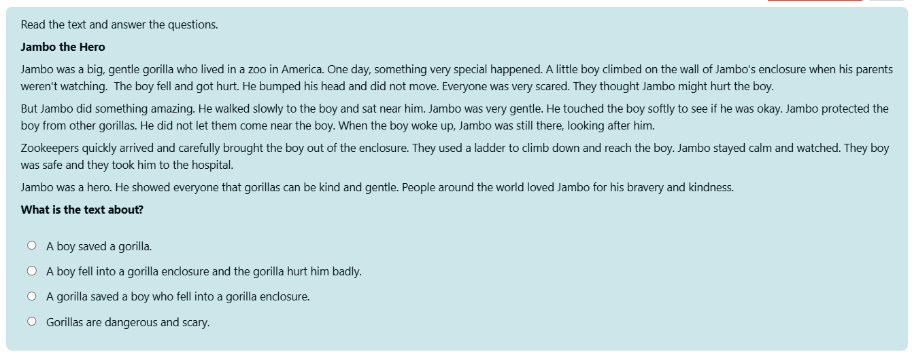
Example 2 (year 2)

Slide 14
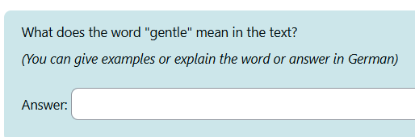
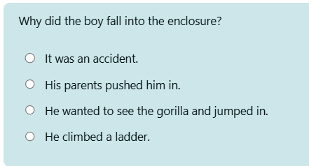
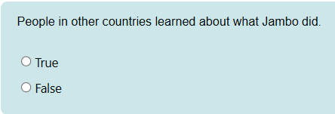
Example 2 (year 2)
Very basic conclusions​

Slide 15


Useful tools to create reading and listening materials
Diffit can create excellent texts on any topic. You can choose:
Topic, level, key vocabulary it should contain.
Diffit produces the text and all kinds of comprehension questions.
Fobizz or NotebookLM can create a podcast from any reading text(s)
Remember: Listening formats are different from reading a text alound.
Use typical oral formats like dialogs, ads, news items or podcasts.
Now it‘s your turn
Create a text with the help of Diffit. Look at the comprehension questions critically and choose the most appropriate ones (and/or add more questions)
Then upload your text to the Fobizz podcast maker or to NotebookLM and create a podcast. Make sure your prompt includes all necessary information: Level, agegroup, purpose…

Slide 16
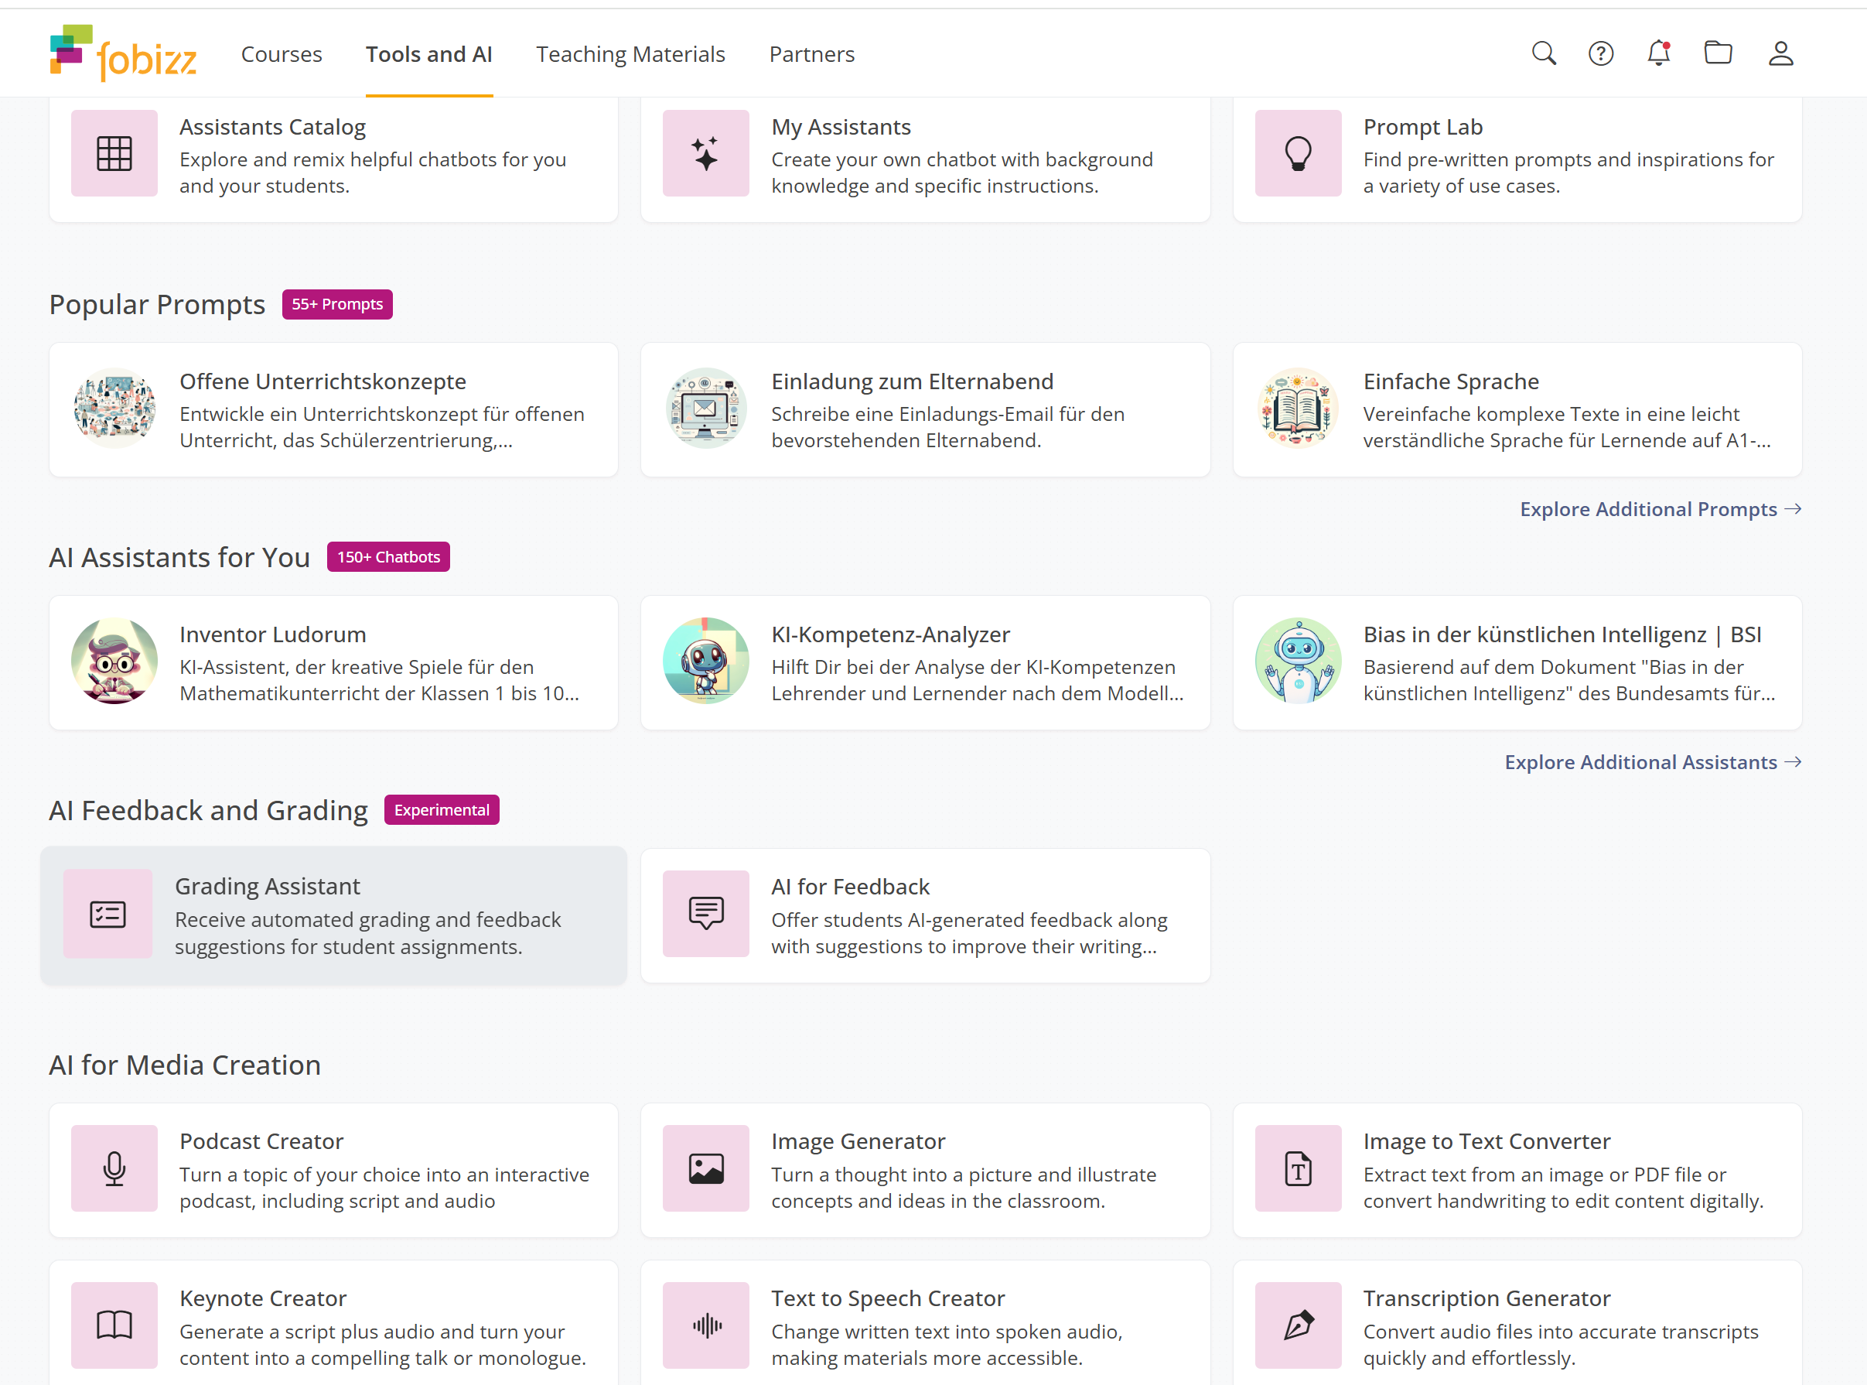



Creating a Podcast with Fobizz

Slide 17
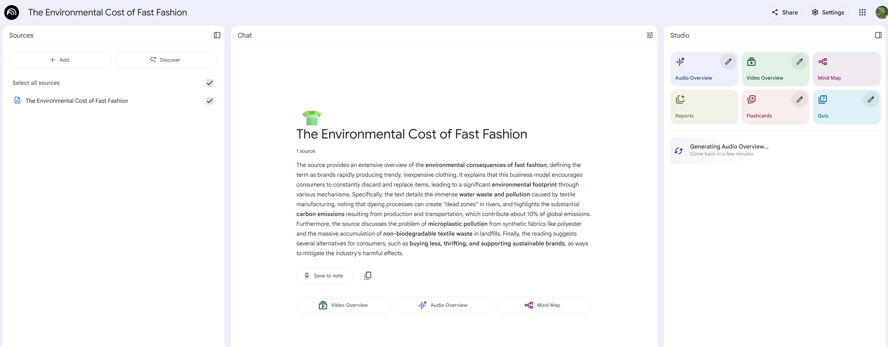
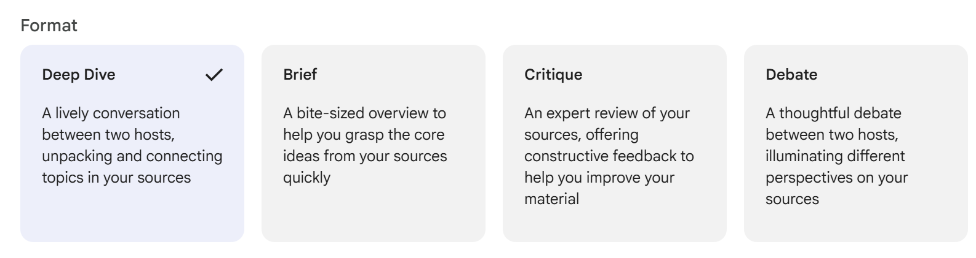
Podcasts with Notebook LM
Create „audio overview“ and then choose „deep dive“ format
Uplod your text sources here.

Slide 18

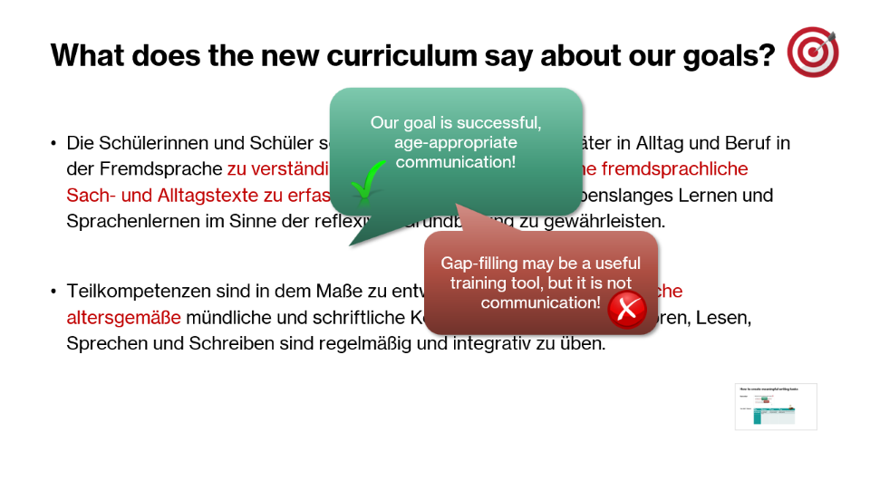
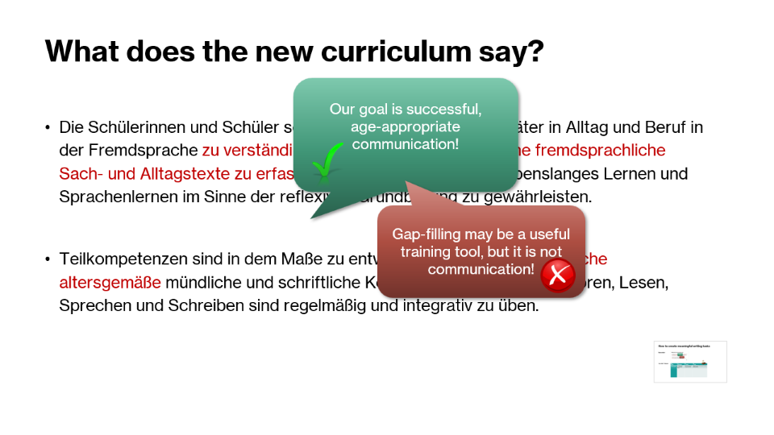
How to create meaningful writing tasks
Remember:
The RAFT Model
Role | Audience | Format | Topic
Who are you as the writer? | To whom are you writing? Why? | What form of text are you writing? | What are you writing about? (check bullet points!)

Slide 19
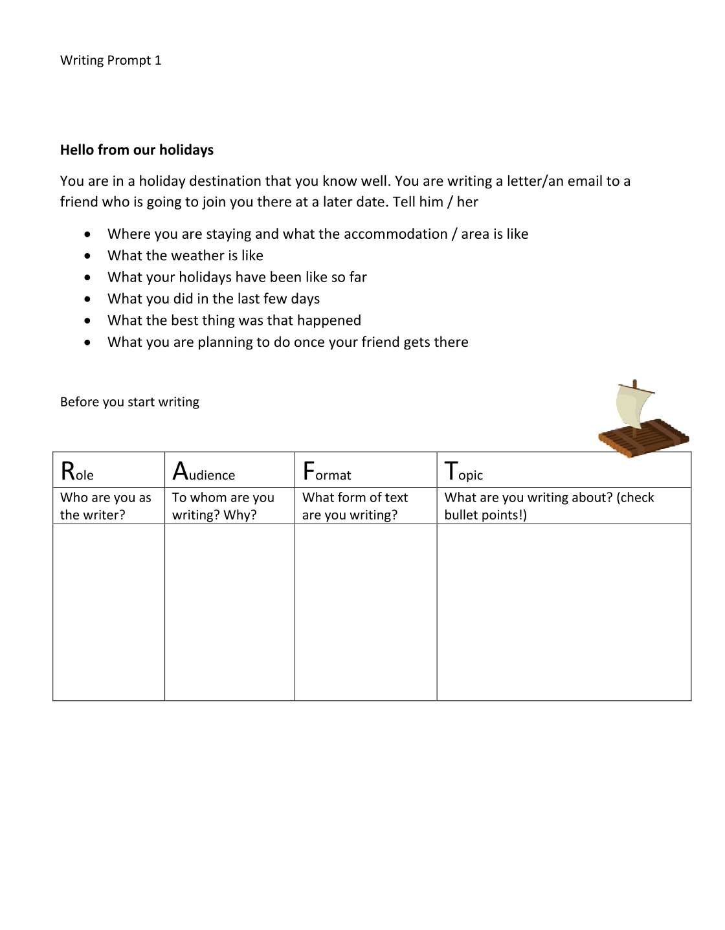
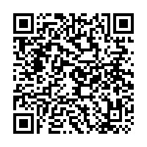
RAFT Examples of communicative writing tasks
A collection of writing prompts for year 4
Audience
To whom are you writing?
Why? What is the purpose?
Format
What type of text are you writing?
Topic
What are you writing about?
Role
Who are you as the writer?
E-Mail, letter, text message, article, blog, story, note
Check the bullet points or make your own list of bullet points
https://www.polzleitner.com/epep/0-NMS/LisandLaura/04-Klasse/Writing-Prompts.pdf

Slide 20
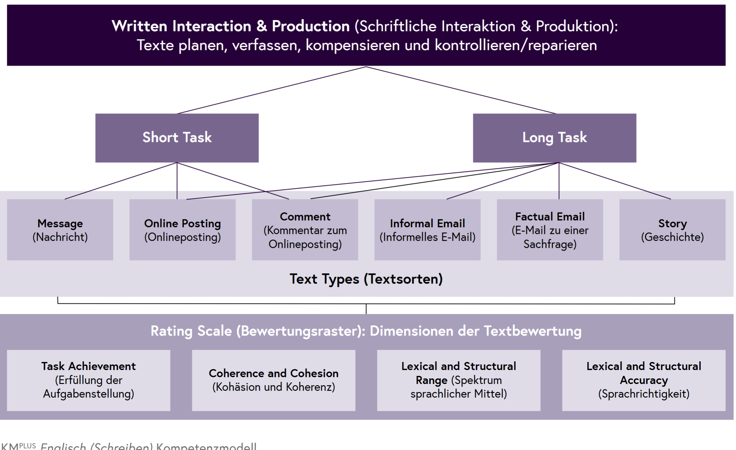
IKM Plus English Writing

Slide 21
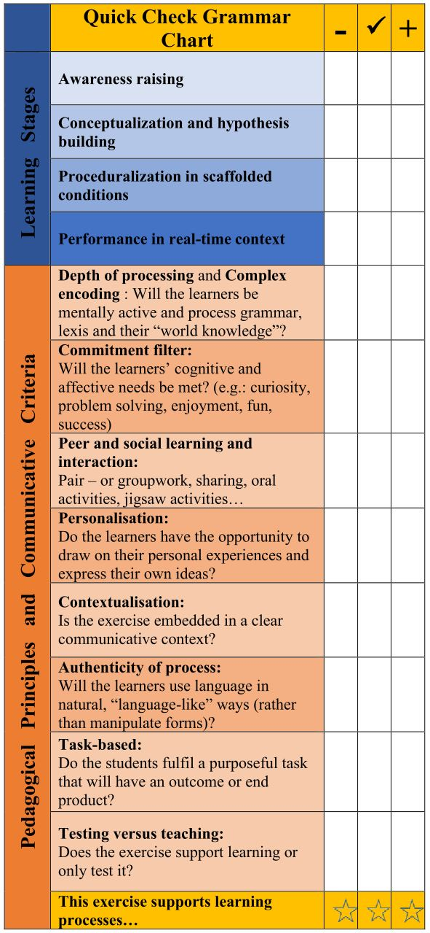

Testing grammar (and vocabulary) in meaningful, communicative contexts.
Can the learners USE the grammar
or do they only have declarative knowledge of the rules (e.g. they recognize some « signal words » and can then fill in the right forms)
Find some examples here
https://padlet.com/lispolzleitner/schularbeiten-english-sek-1-61klqjfw6swi78o6

Slide 22
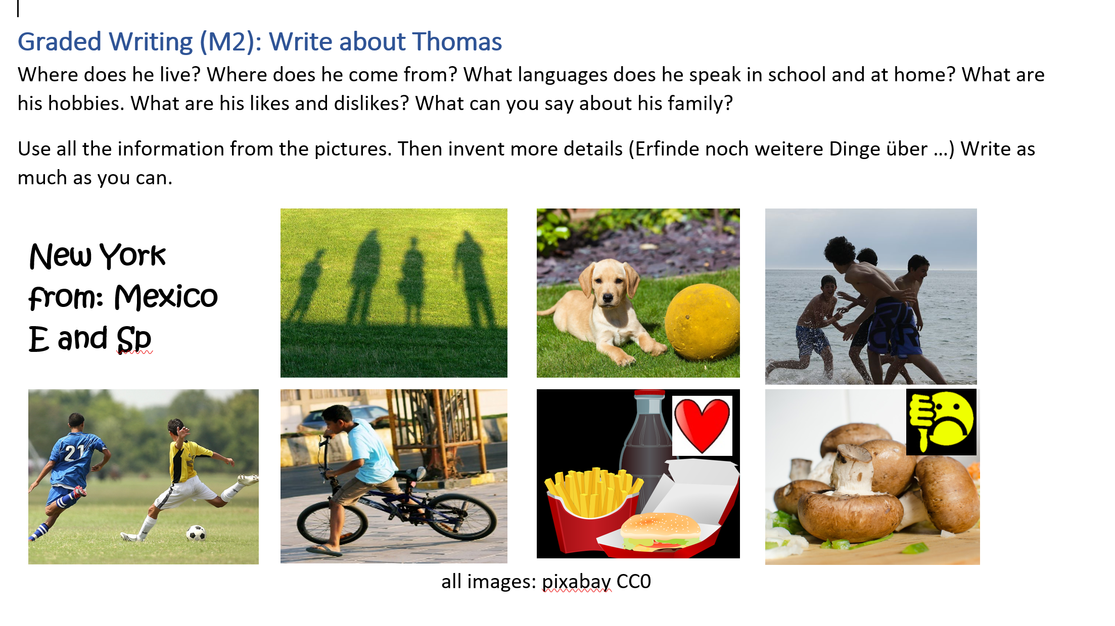
Basic writing year 1: 3rd person s

Slide 23
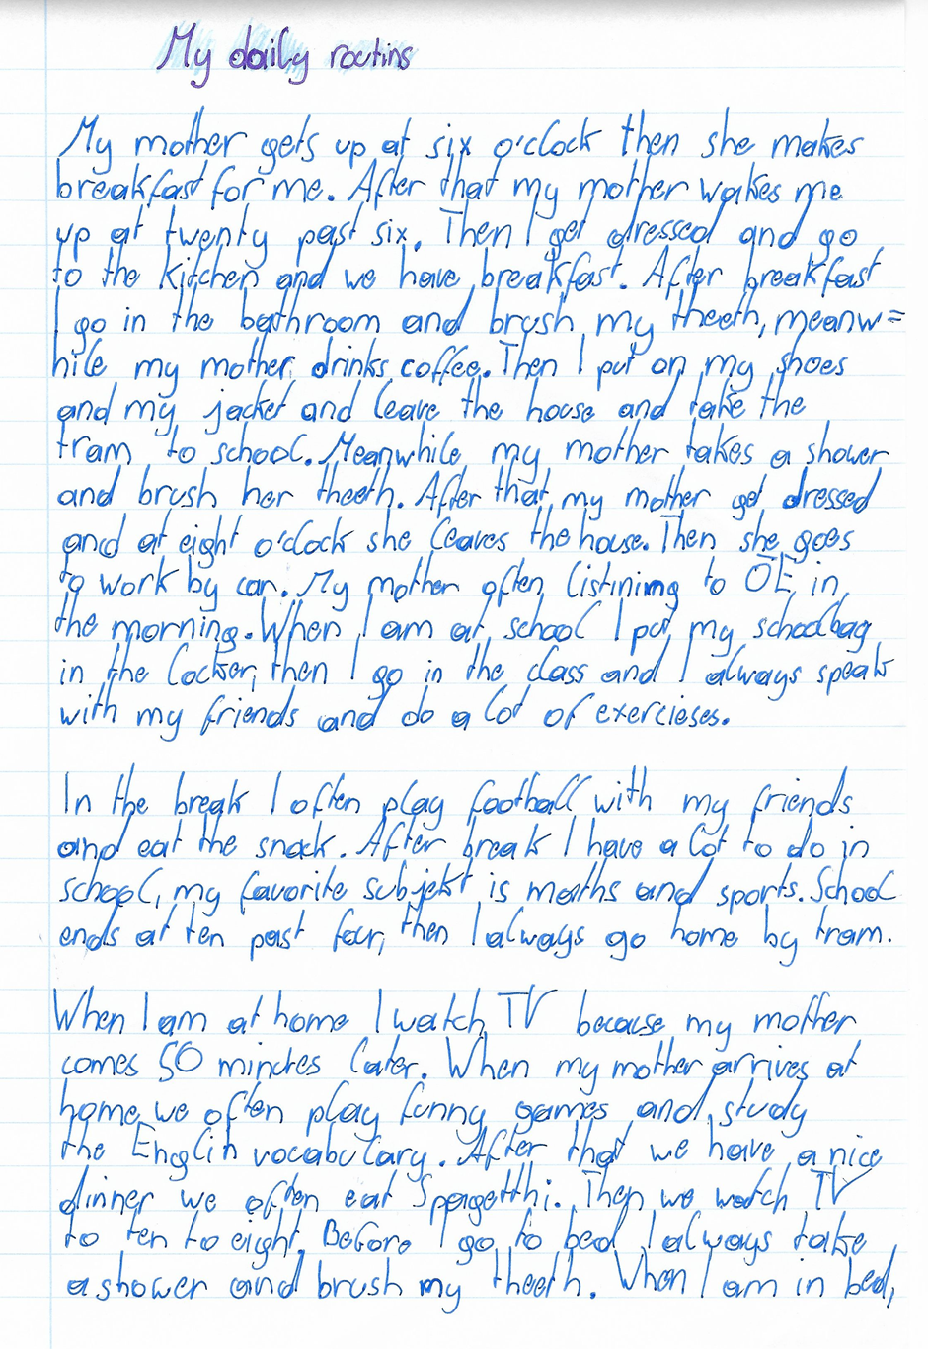
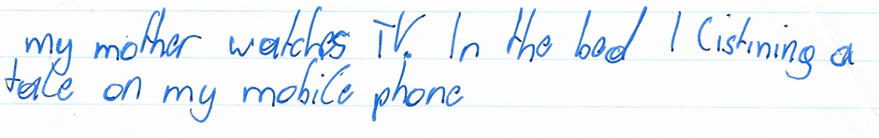
Year 1: Daily routines in your family
What do you and your parents and siblings do all day?
Tell us as many details about their day as possible.

Slide 24
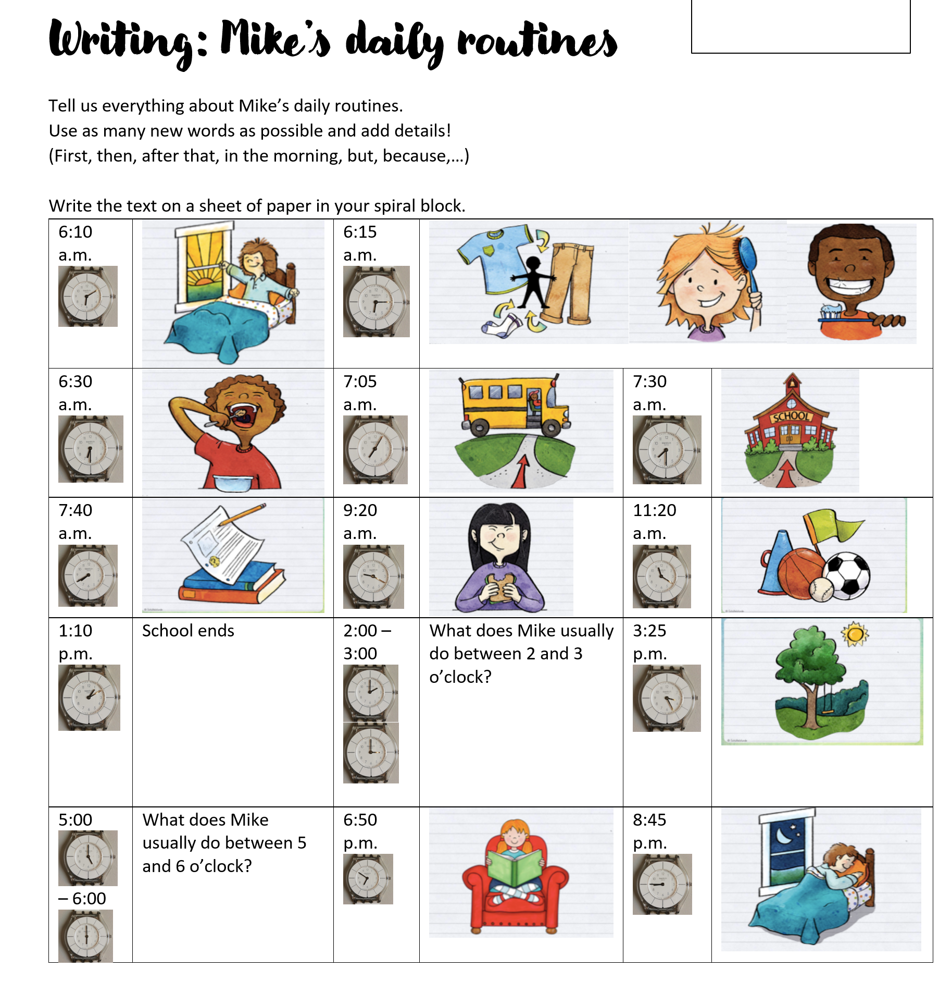
Another example: daily routines
What grammar topics and vocabulary are being tested here?
Vocabulary for daily routines
Time / hour
3rd person s
Basic text organization, additional vocabulary expressions

Slide 25
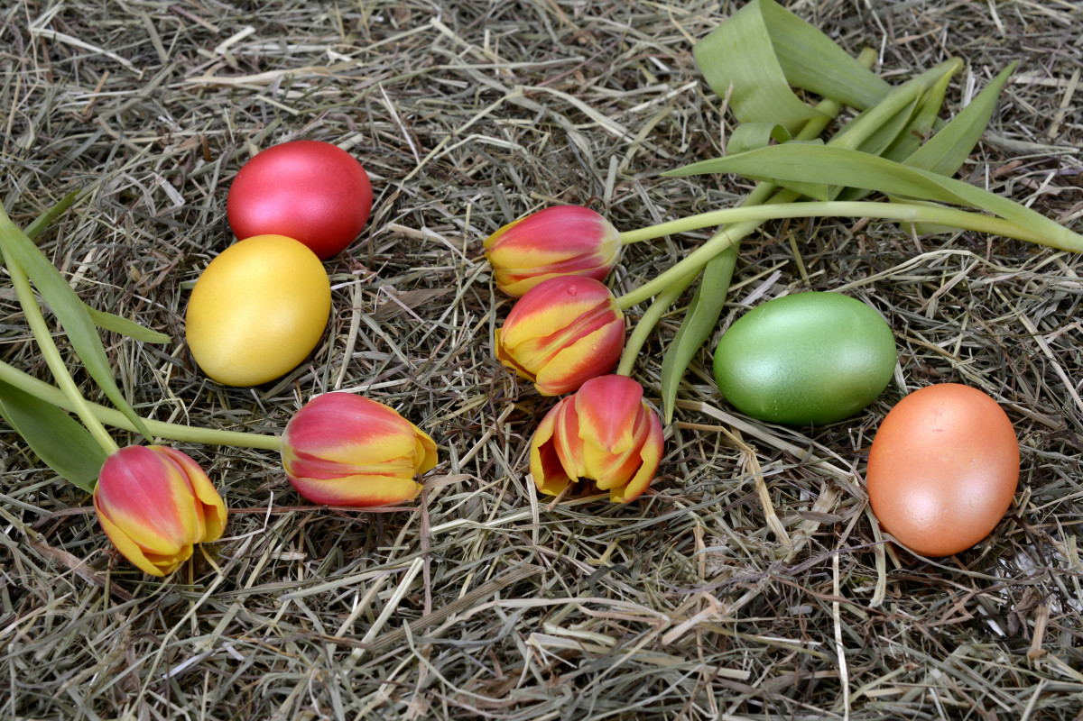
Past Events
Your Easter holidays
Write a letter to your English pen friend. Tell him/her about your Easter holidays. Give lots of details and make your letter interesting.
Where did you go? What did you do?
Describe what was going on around you (past progressive: …when we got there the sun was shining… everybody was chatting…)
and by using lots of adverbs (quickly, dangerously, beautifully…)
If your holidays were really boring you can invent a few plausible details.
Write about 200 – 250 words.
plausible details are details that I will easily believe are true (glaubhaft)

Slide 26
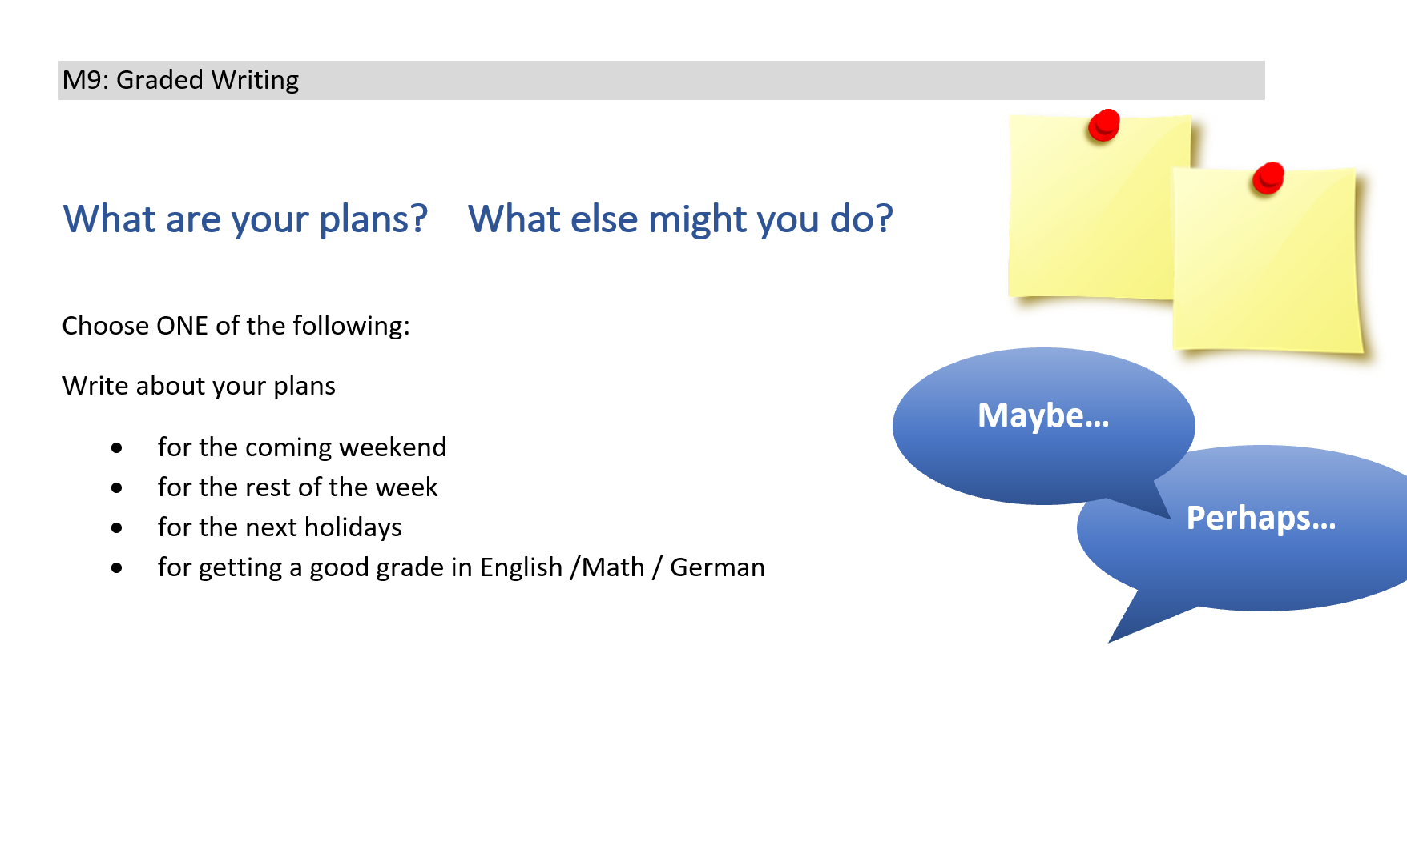
Future plans and vague predictions

Slide 27
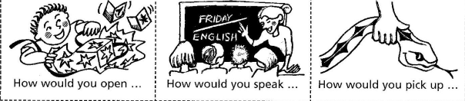
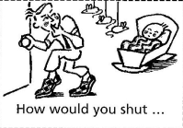
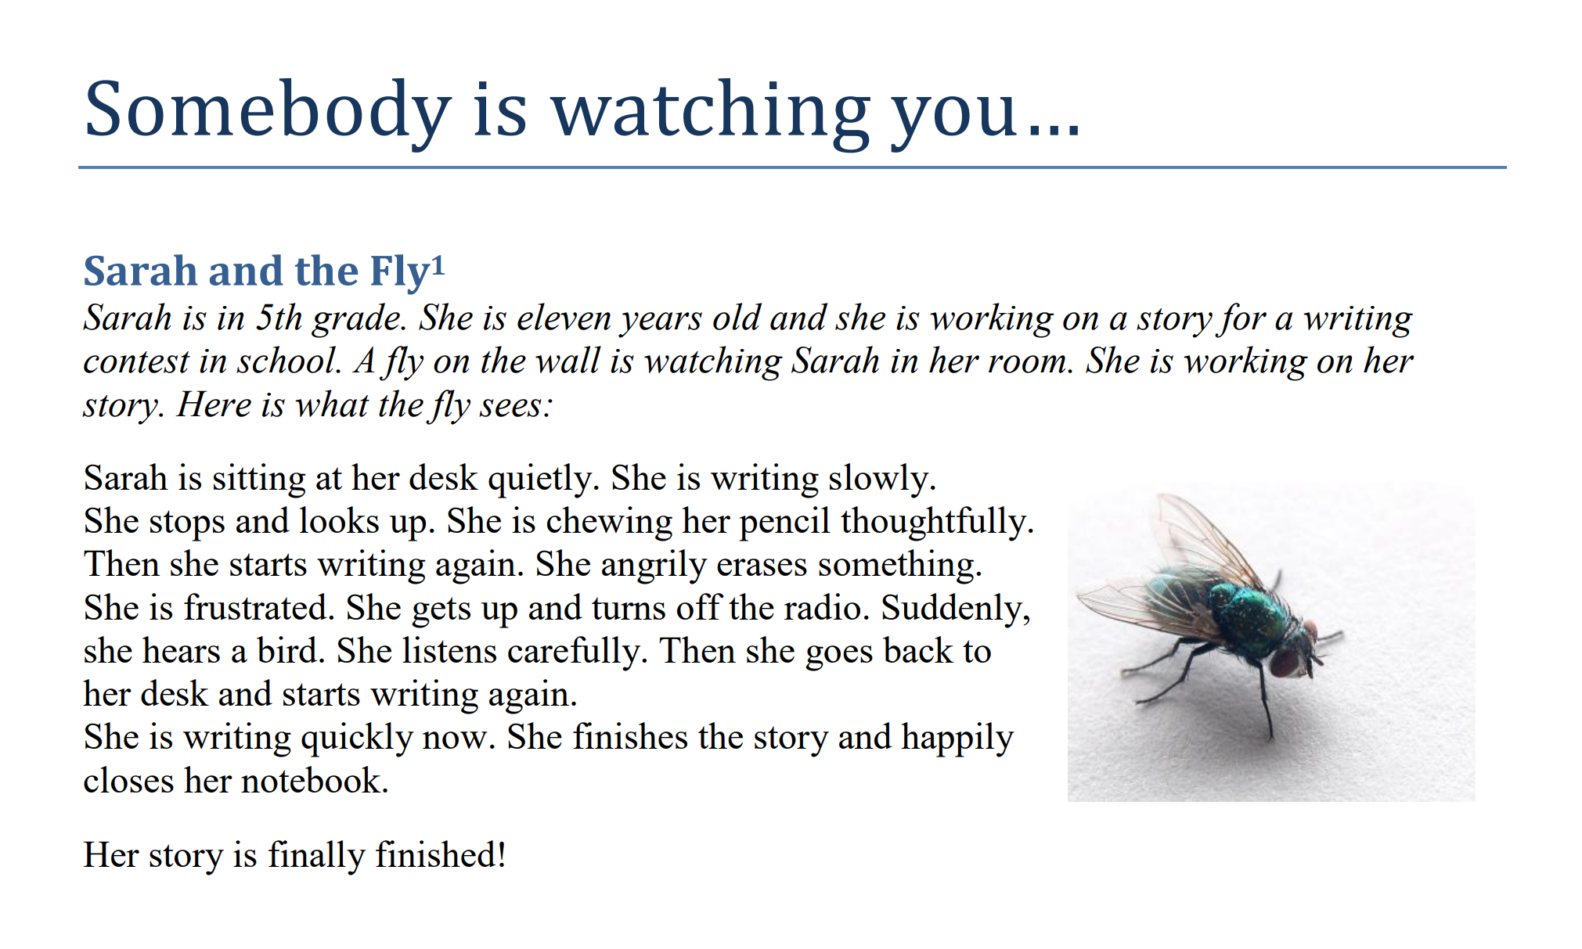
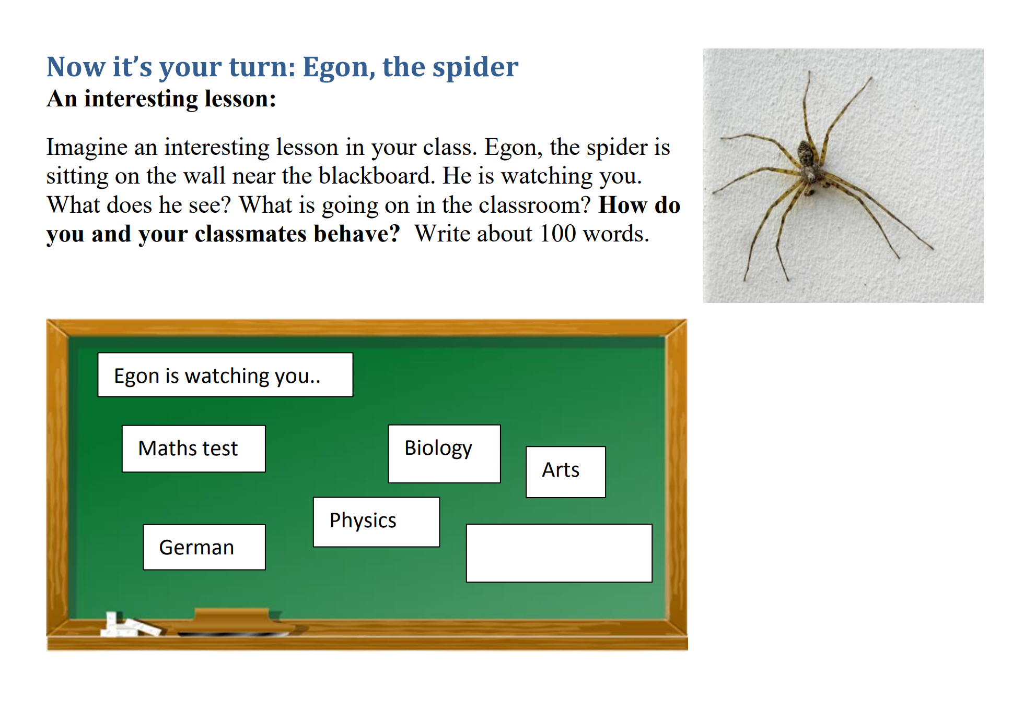
Adverbs…

Slide 28

Book project: grammar: general experiences (present perfect tense, past events – past simple)

Slide 29
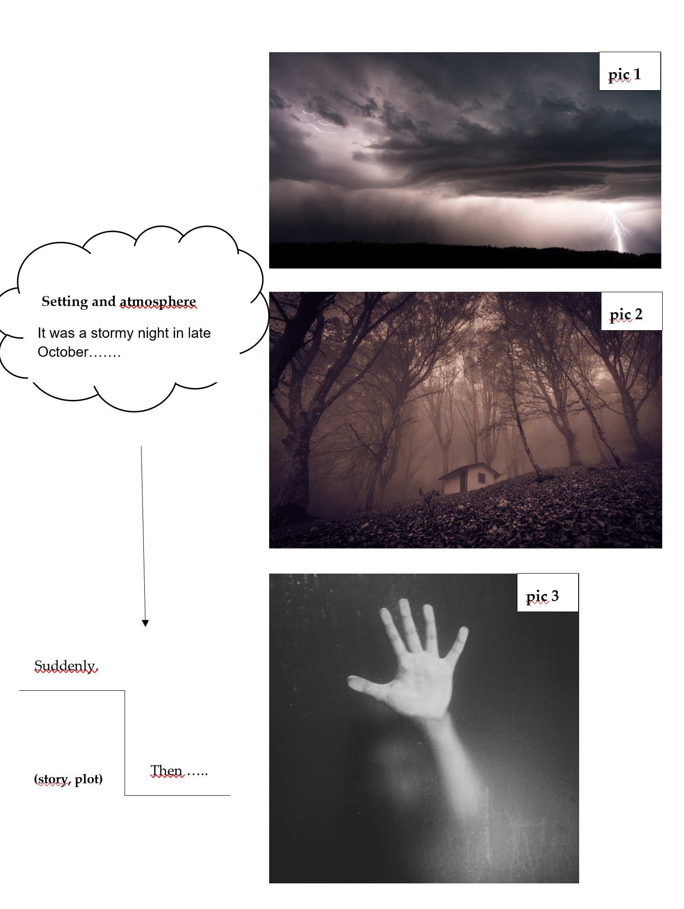
Circumstances – and – past events
Writing – Part 3
Write the beginning of a spooky story. Describe the atmosphere and the setting of the first two pictures in detail. What can you see/hear/smell? What happened in picture 3 (plot, story: Suddenly…)
Then describe what happened after picture 3 in 4-6 sentences.

Slide 30
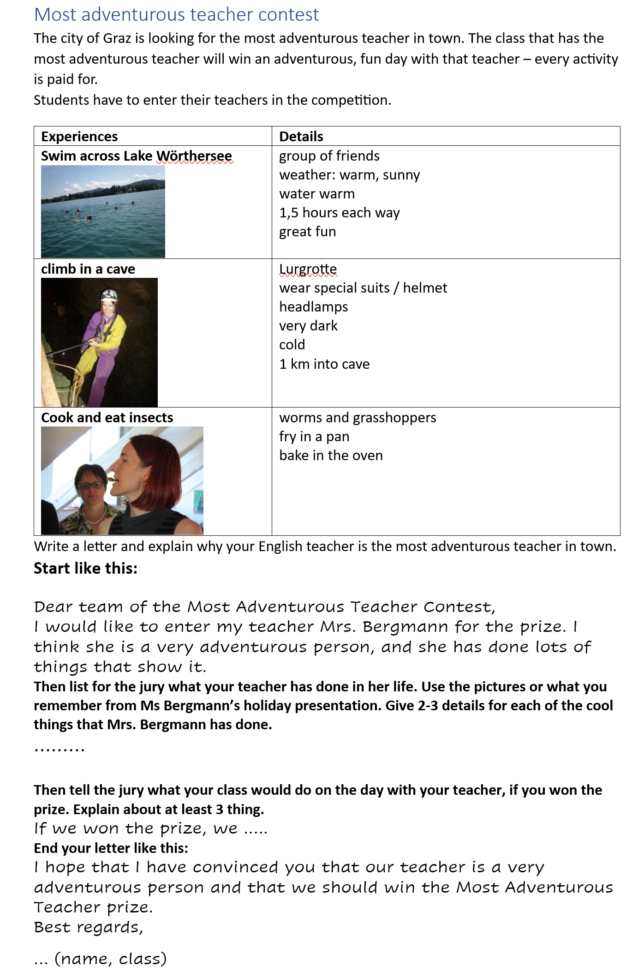

General experiences (pres.perf.tense)
and
Specific details – events (past simple)
Test M10
Full test, incl. Notenschlüssel

Slide 31
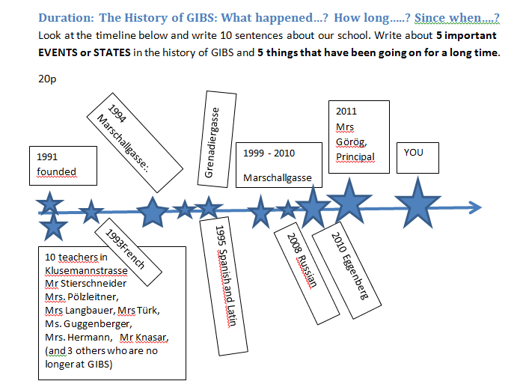
Duration: how long – since when?

Slide 32
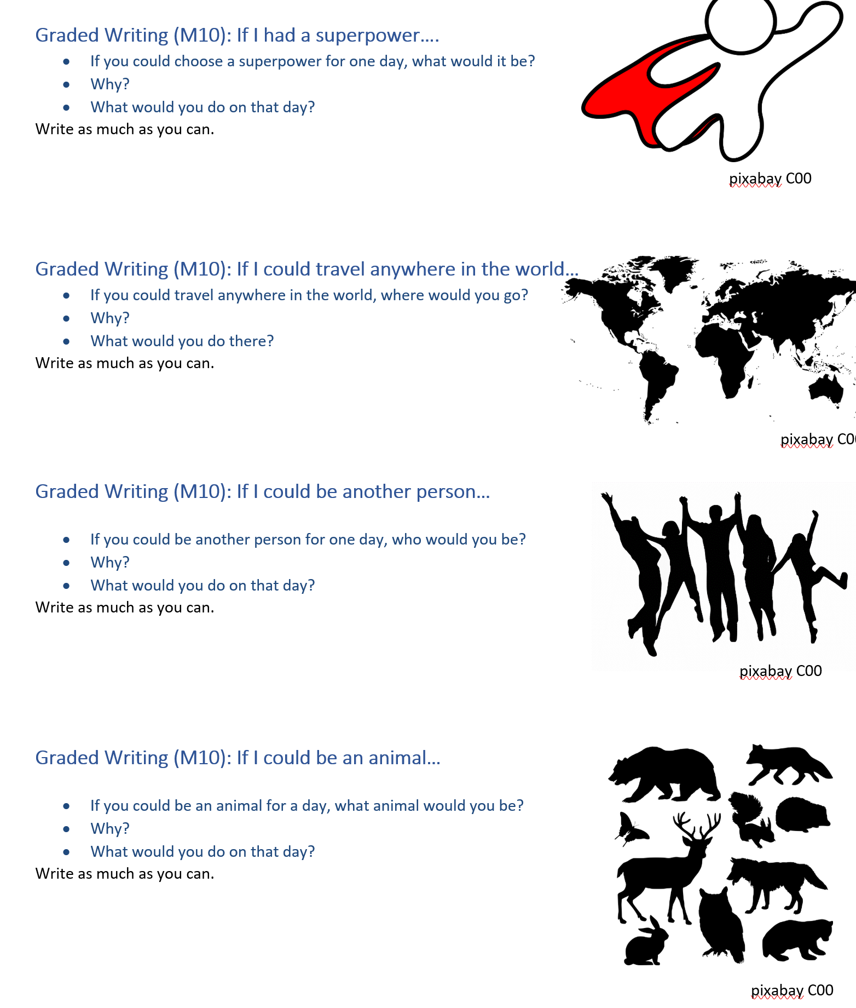
2nd Conditionals
Choose one…
Offer situations that the learners can relate to.
Give them some choice to follow their interests.

Slide 33
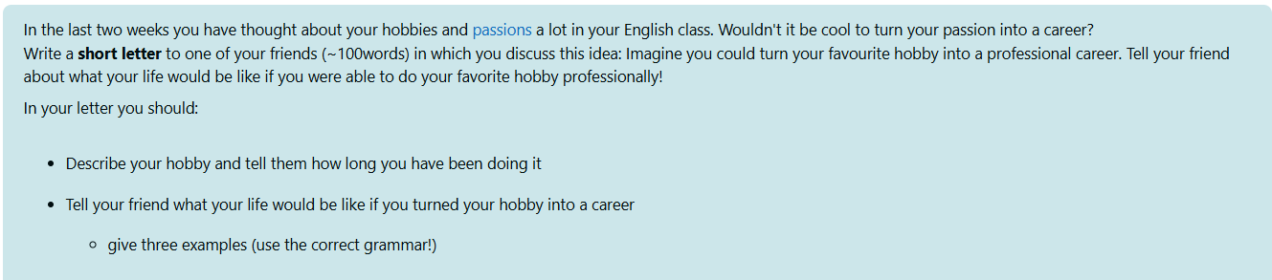
How things would be different – if clauses II

Slide 34
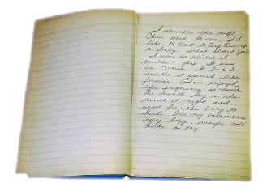
How to use reading projects to check grammar (and much more) in a test
A Diary entry from another point of view
Choose an interesting character (not Amy or Dan) and an interesting scene from your book.
Write a diary entry from this person's point of view.
Remember: In a good diary entry the character describes
the events of the day
the scenes in some detail so that the reader can picture what was happening
how they felt about these events
their plans for the next steps
Remember to use the correct tense forms (past / past progressive (-ing) / past perfect)
Make your diary interesting to read. Write a maximum of one page.

Slide 35
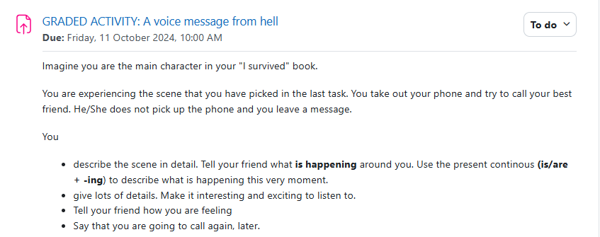
Not in a test: How to use reading projects to check spoken grammar (and much more)

Slide 36
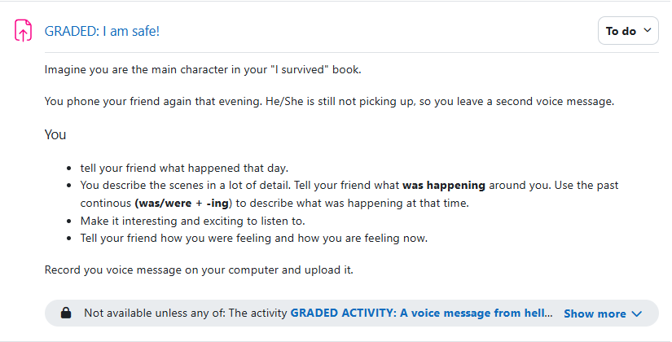
Not in a test: How to use reading projects to check spoken grammar (and much more)

Slide 37

Time to explore
Look at the writing tasks in the ME book and find out which of the grammar topics is being practiced in the following tasks:
My family: p.8-9
A letter from your holidays: p. 20-21
My Fantasy Animal: p.24-25
Time Capsule: p. 26-27
Great Kids Contest: p. 28-29
Find some examples here

Slide 38

Creating a well-balanced, competence based test
Listening and/or Reading tasks: Make sure the questions cover all three levels of comprehension (not only surface questions)
Tip: The „differenzierte Aufgaben“ in the Moore testbuilder will usually cover these levels. The basic questions do NOT cover these areas.
Writing task(s):
Include one long, or two shorter writing tasks where the students can show that they can use the vocabulary and grammar that has been taught. The writing tasks should have a communicative context and purpose.
Tip: Avoid decontextualized, single sentence tasks.

Slide 39
Continued: Creating a well-balanced, competence based test
Weighting of the Different Parts
In your final semester grade, all four skills are equally important.
For a test, you decide how to weight each activity.
Tip: Use the time spent on each task as a guideline.
Examples:
Listening (~10 min) 20%
Reading (~15 min) 30%
Long Writing task(~25 min) 50%
Or…
A longer Reading task: 40%
A long Writing Task: 60%

Slide 40
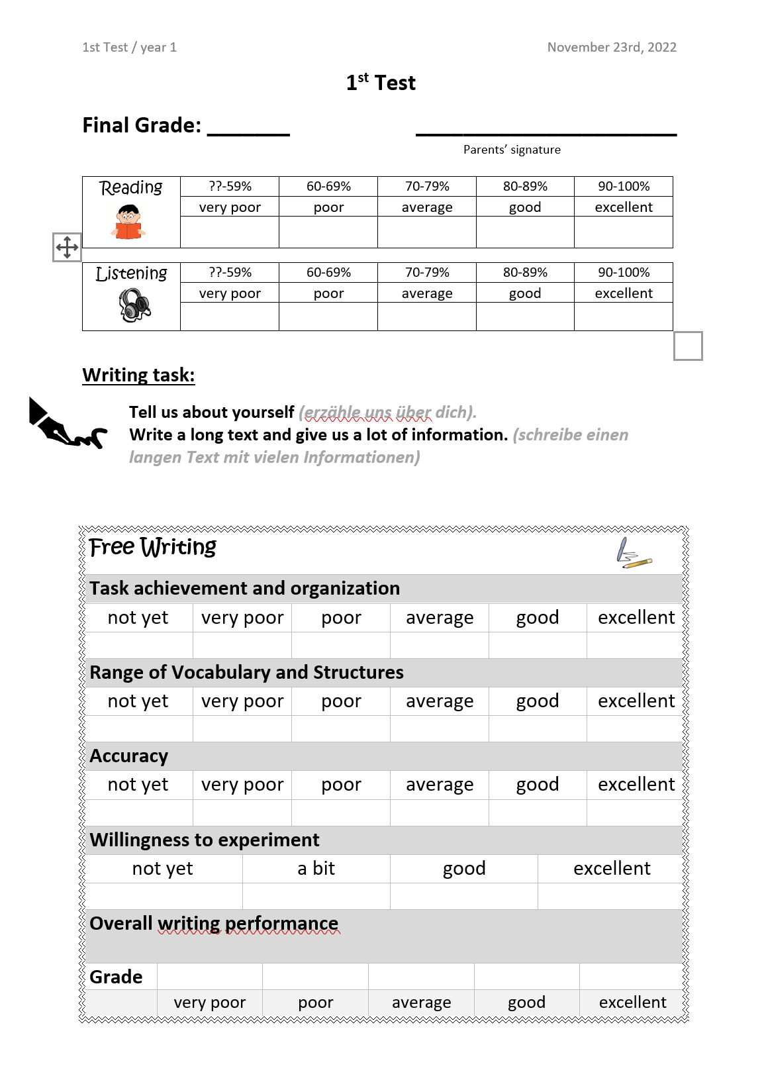
Year 1

Slide 41
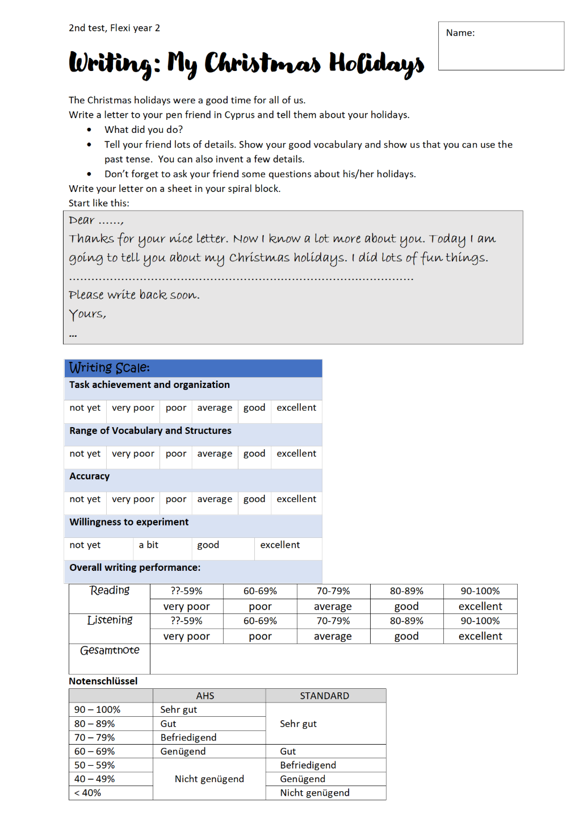
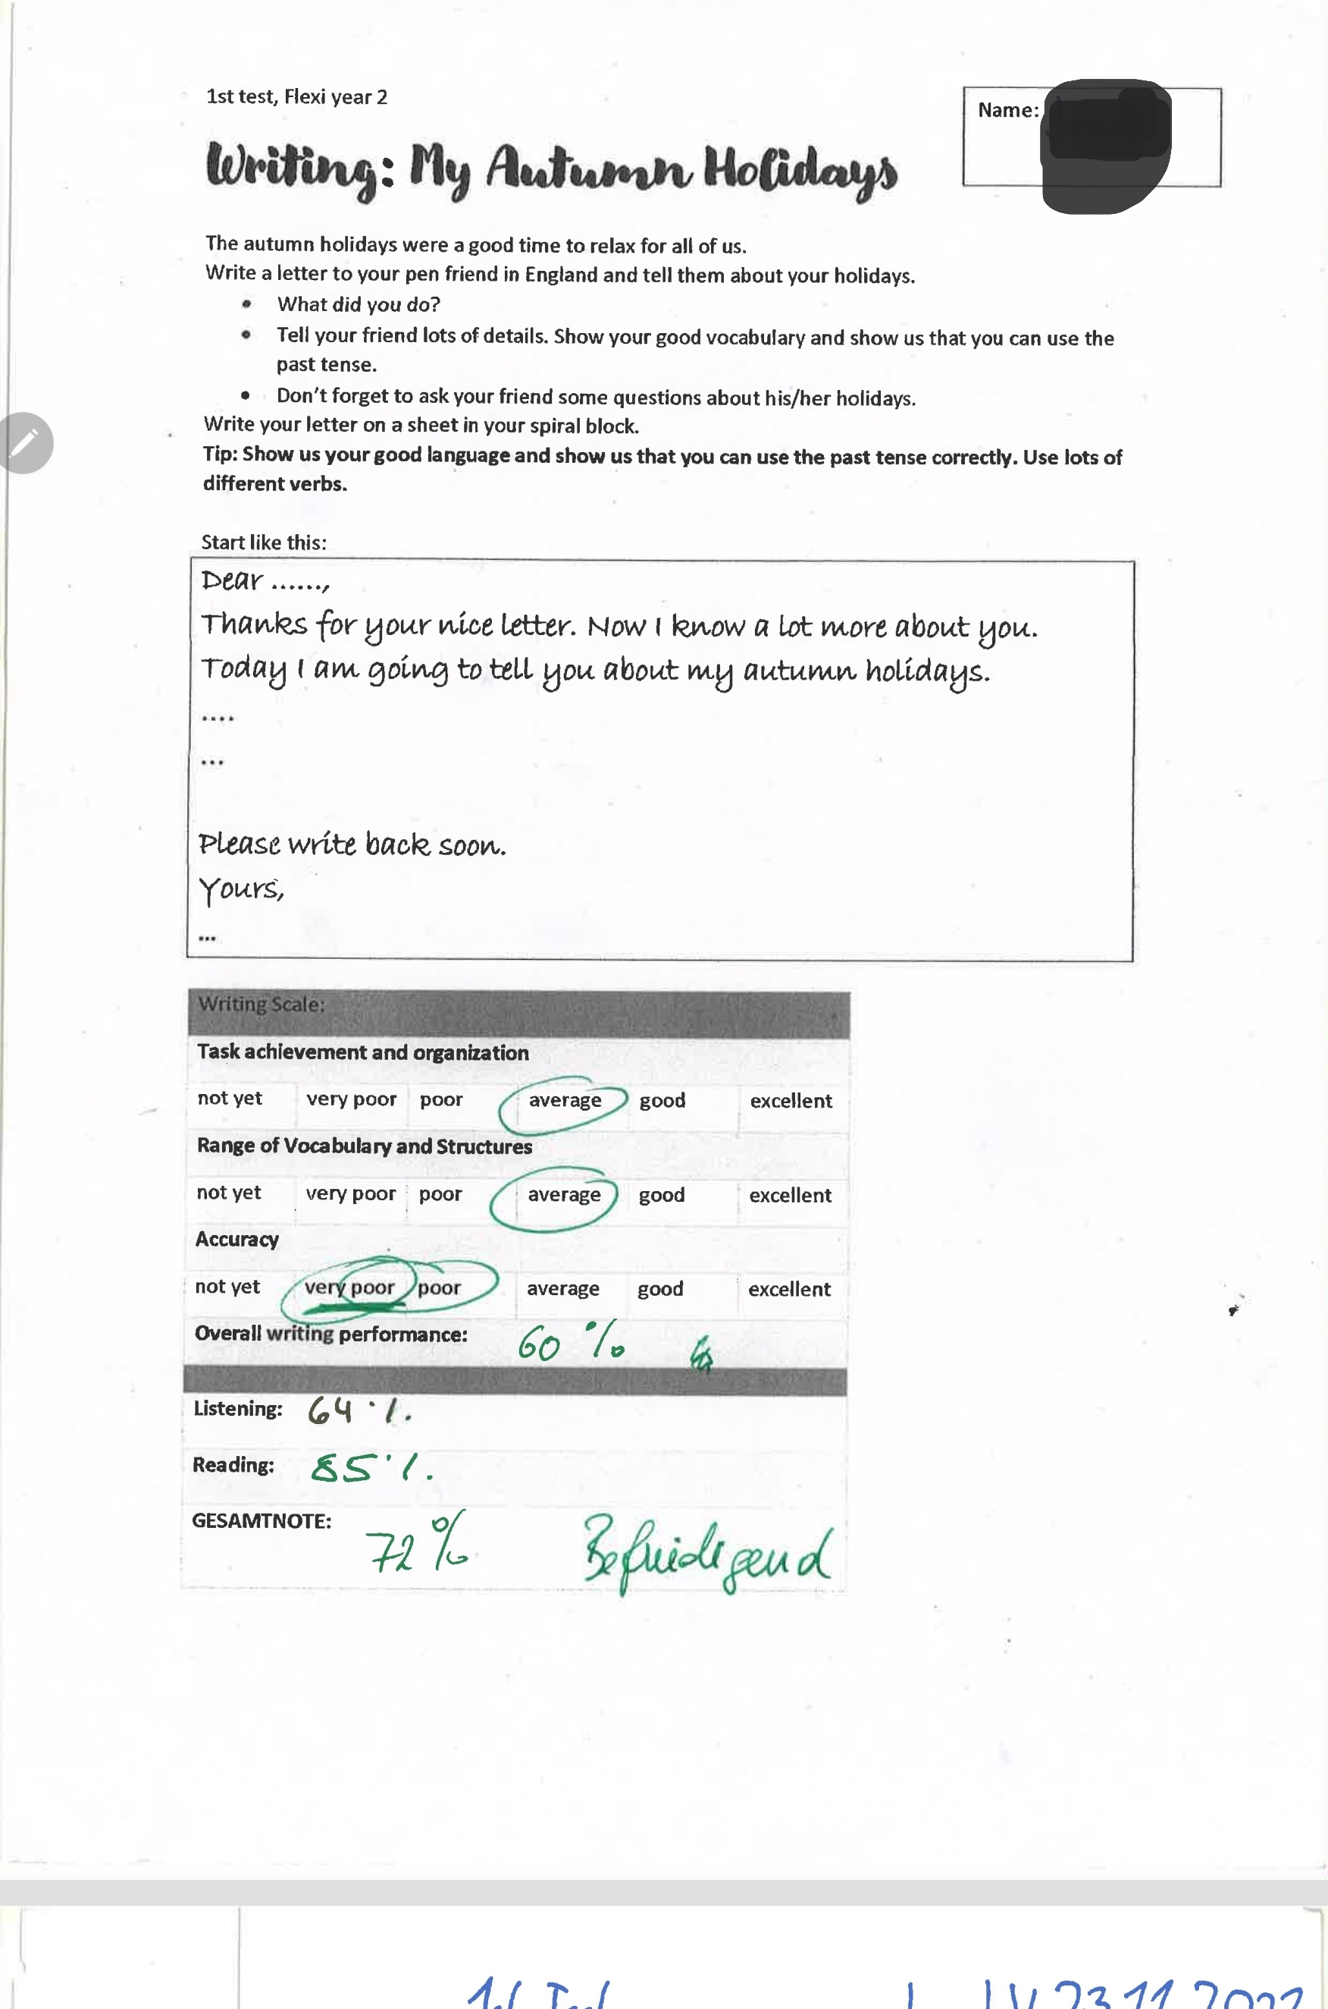
Year 2

Slide 42
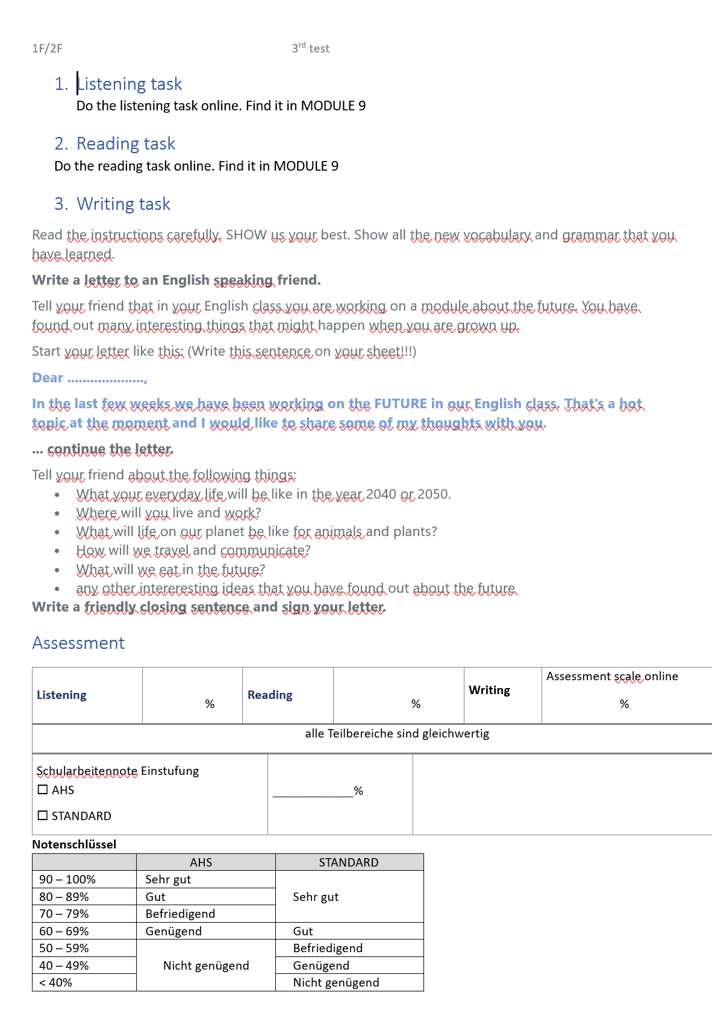
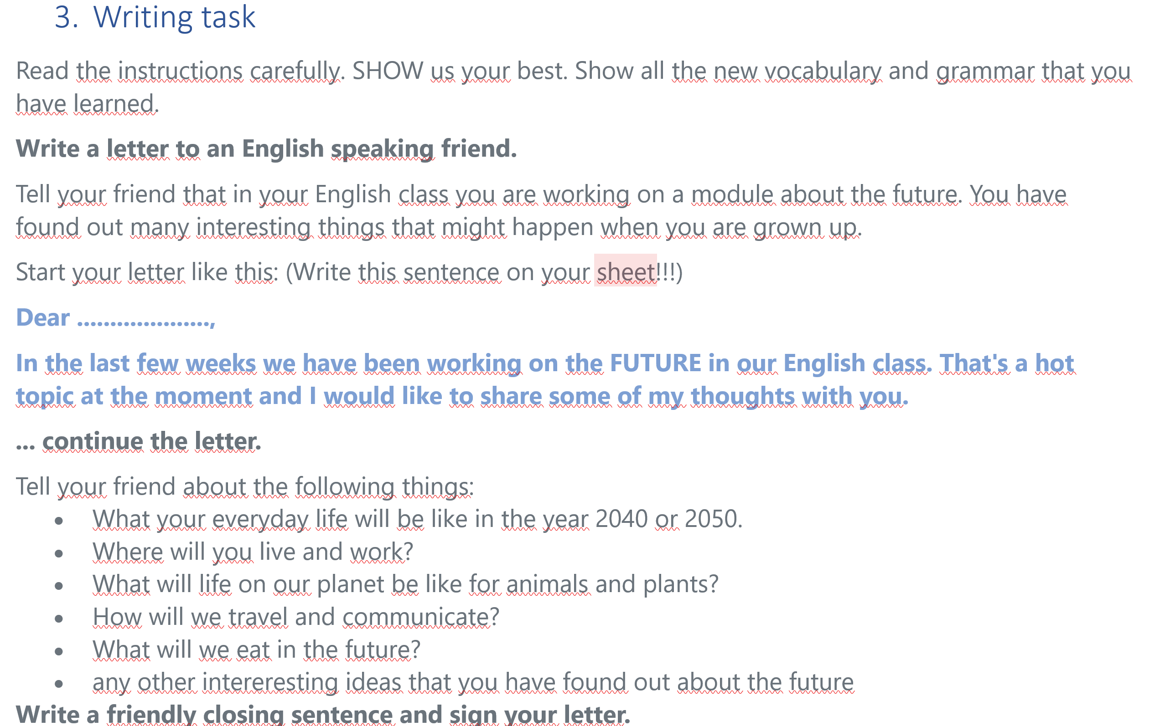
Year 3

Slide 43
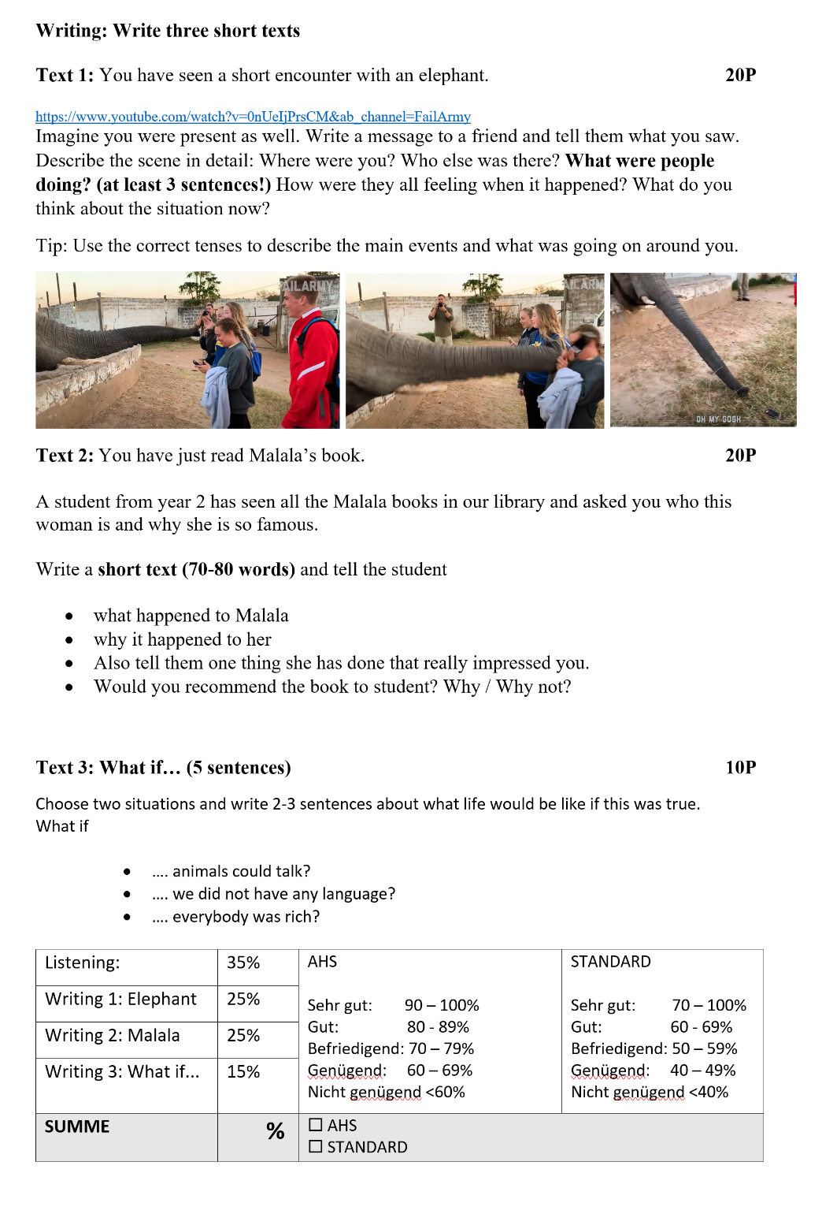
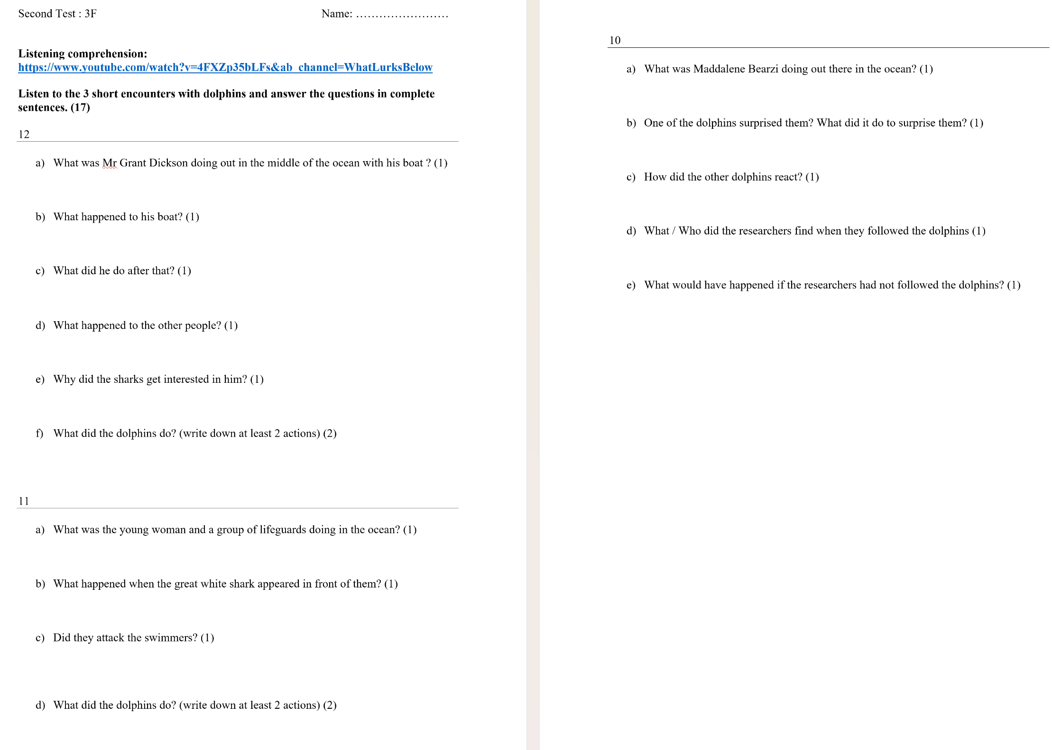
Year 3

Slide 44
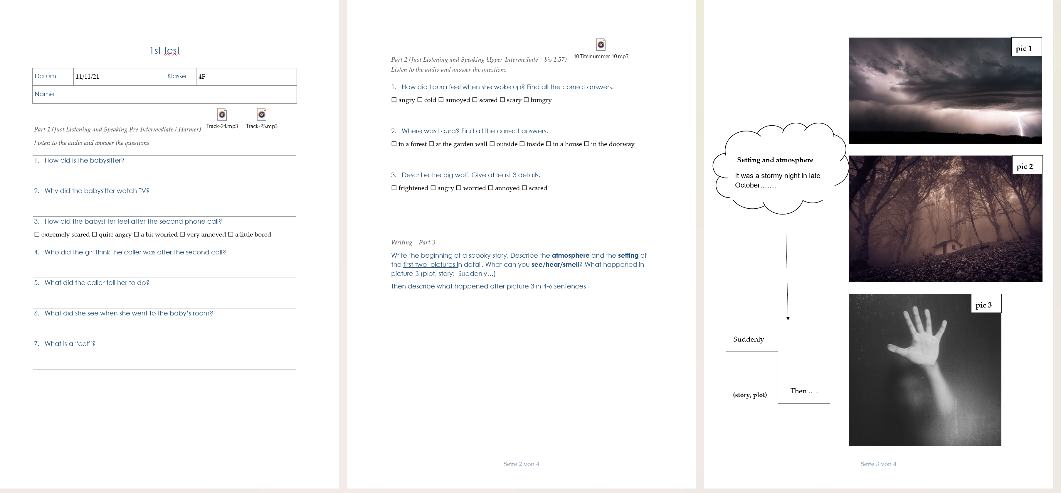
Year 4

Slide 45
Examples from the MORE testbuilder
Which of these examples comply with the new curriculum goals?
Which of the tasks need to be improved?
How can the LIU and Vocabulary tasks be adapted to show communicative competence?

Slide 46
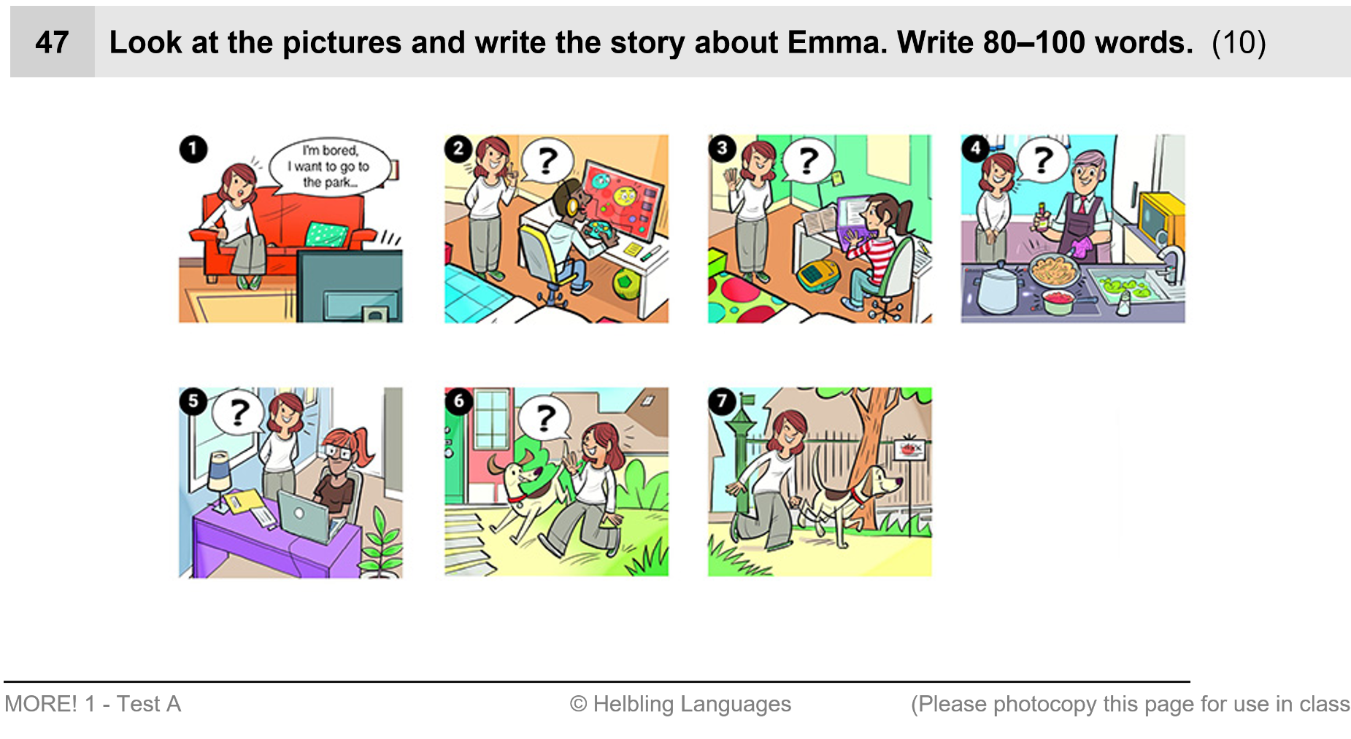
Writing: More 1 Testbuilder
Is this a STORY?
How could this task be improved to meet the RAFT criteria?

Slide 47
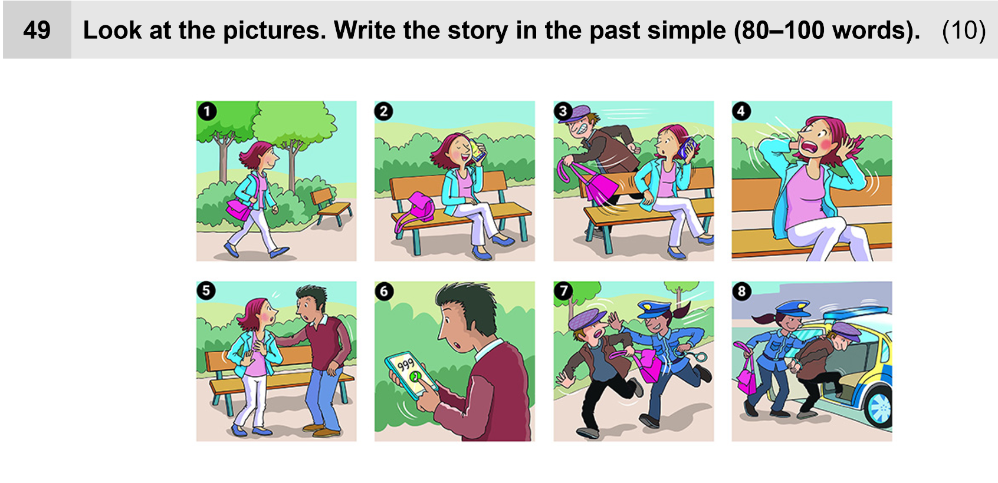
More 1 Testbuilder
This is a bit better. Rather than writing a STORY, the children could write a short whatsapp message or e-mail.
Start like this:
You won‘t believe what happened to me yesterday. I …

Slide 48
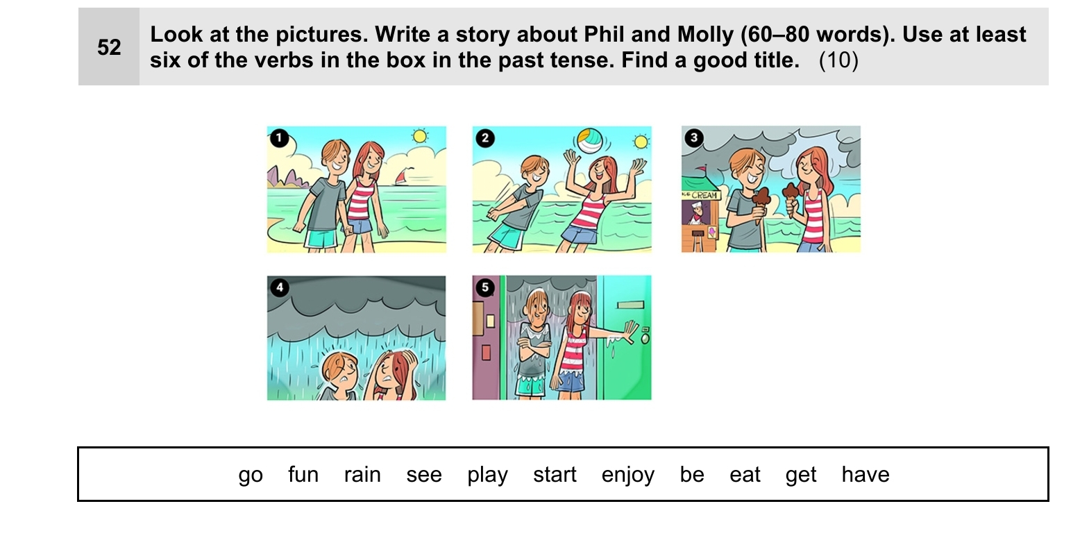
Writing:
How could we improve this task?

Slide 49
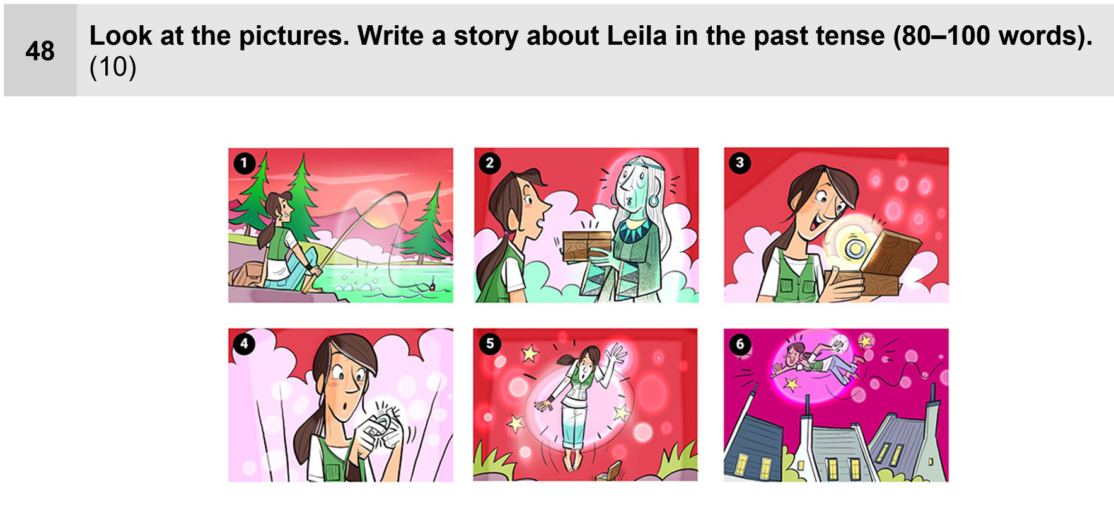
More 1 Testbuilder: Writing
What would you write here?

Slide 50

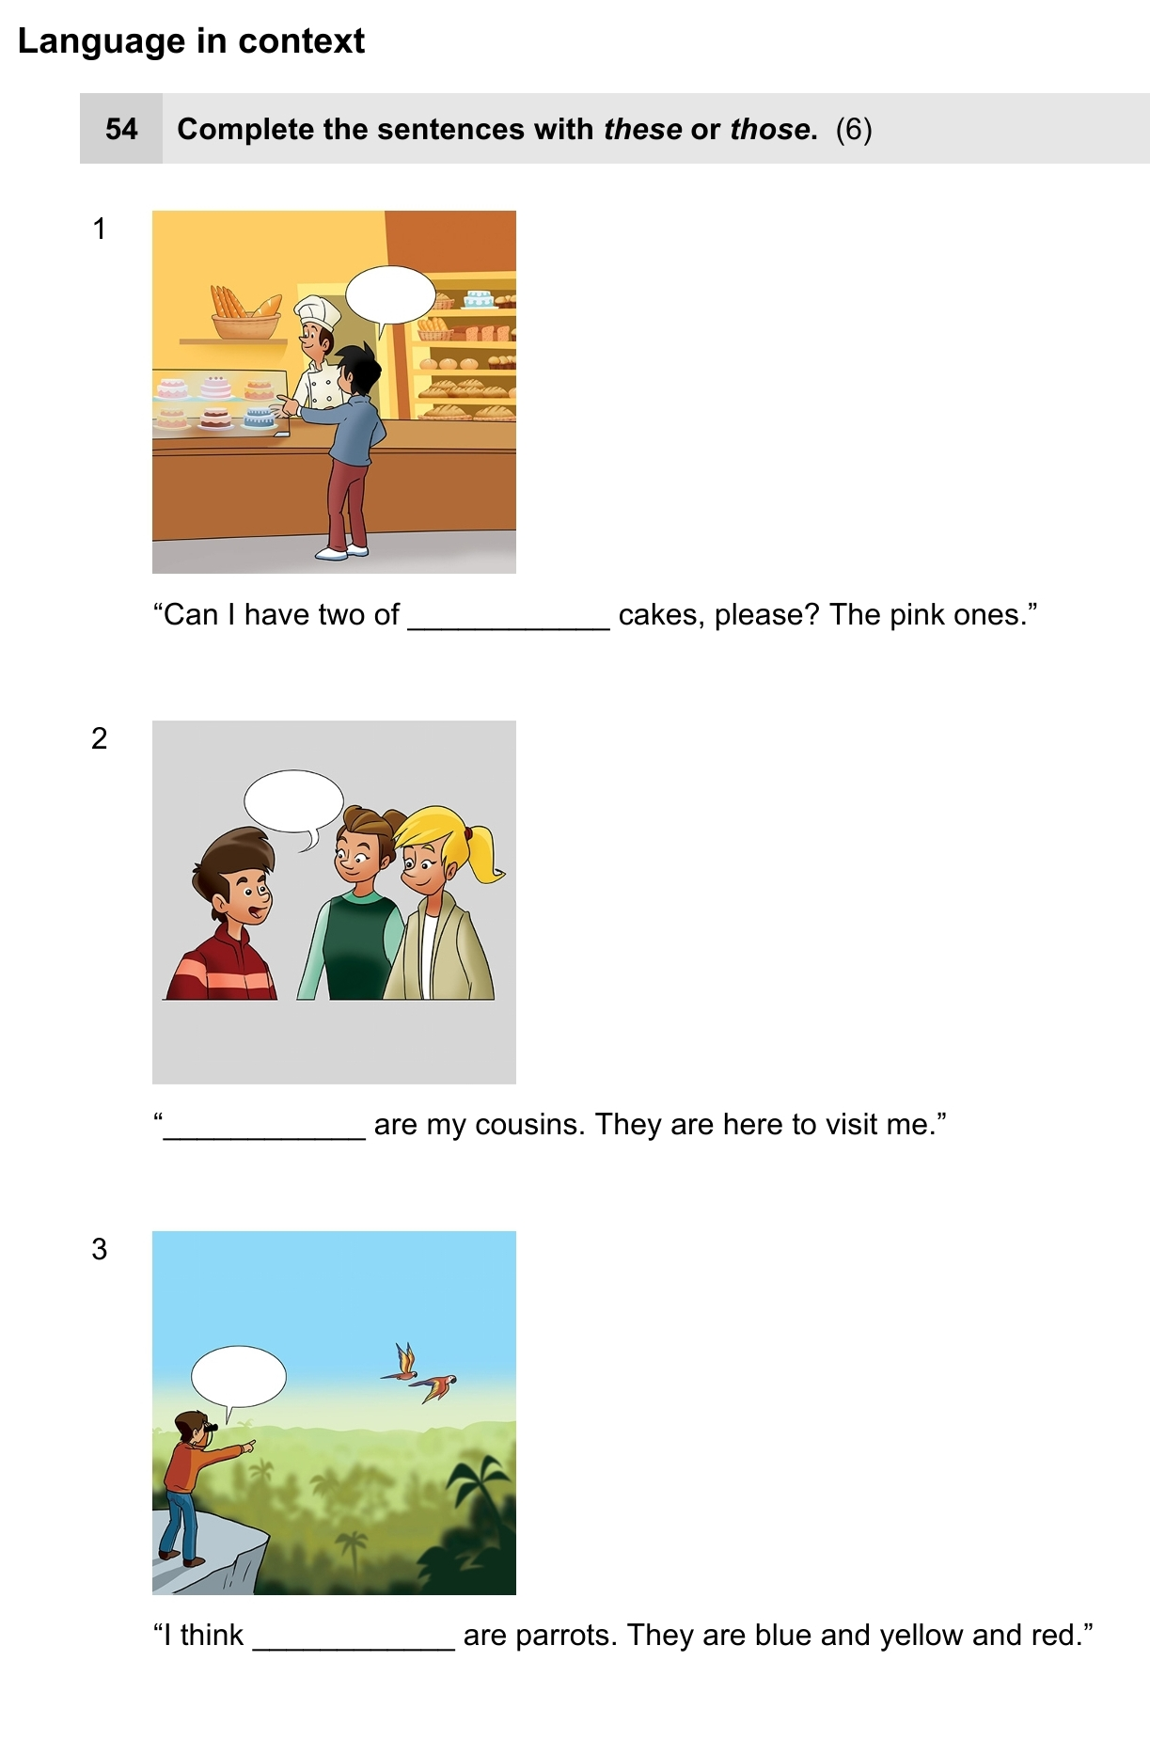
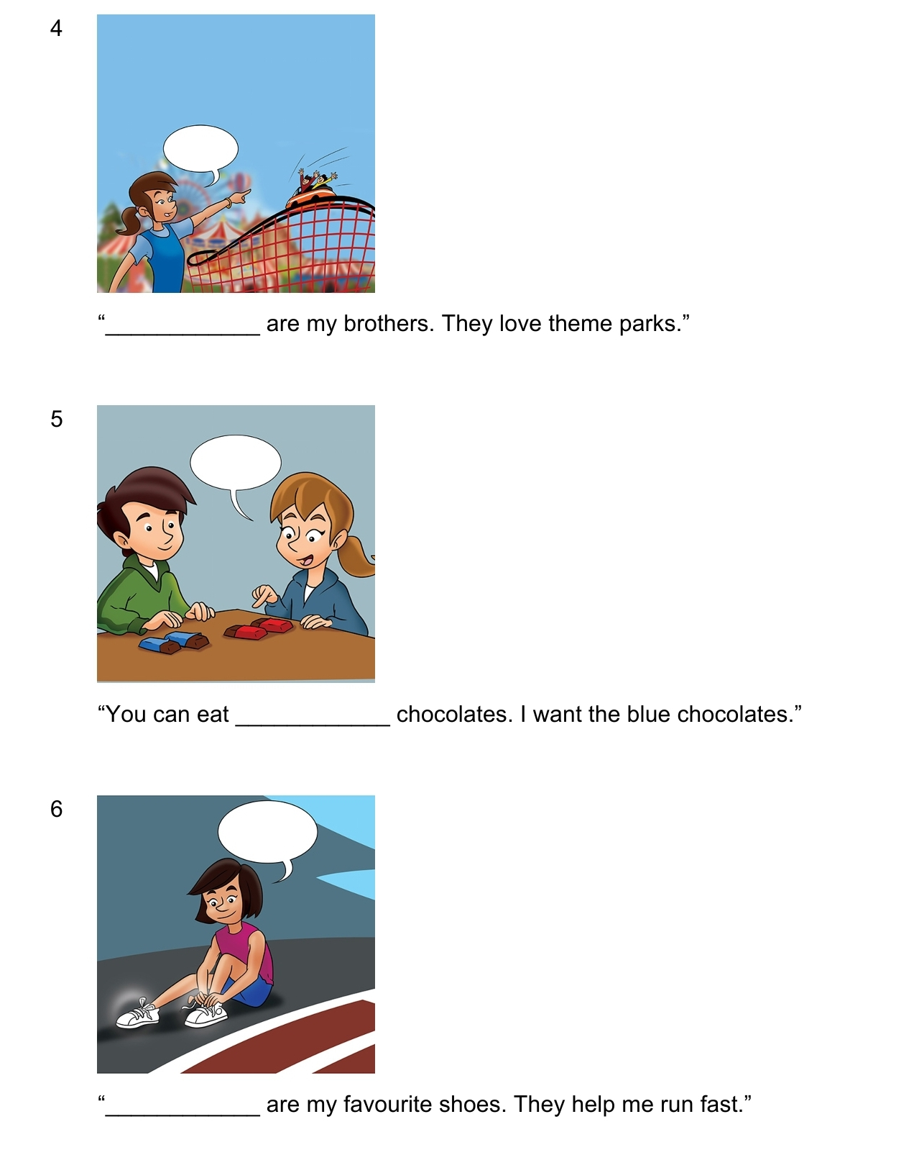
Language in context
This Photo by Unknown Author is licensed under CC BY-NC

Slide 51

How could this task be adapted into a full, communicative writing task
This Photo by Unknown Author is licensed under CC BY-NC

Slide 52

How could this be adapted to meet the RAFT criteria?
This Photo by Unknown Author is licensed under CC BY-NC

Slide 53


What‘s the point?

Slide 54


How could these language areas be tested in a more communicative way?

Slide 55

Now it’s your turn: Analyze and improve the old tests that you have brought to this seminar.

Slide 56


Slide 57

Assessing Writing tasks: IKM plus writing scale (A2)
file:///C:/Users/lis/Downloads/iKMplus_Englisch_Schreiben_8Sst_RatingScale_Informationen.pdf

Slide 58

A2 scale (Bifie)
https://www.bmb.gv.at/dam/jcr:ec4e3c97-8d45-4c05-a90d-8d9a764eed7e/reifepr_ahs_mslf_bwr.pdf
60% passmark
Sehr gut | ≥ 90
Gut | ≥ 80
Befriedigend | ≥ 70
Genügend AHS | ≥ 60
Nicht genügend AHS/ Standard Befriedigend | ≥ 50
Nicht genügend AHS/ Standard Genügend | ≥ 40
Nichtgenügend AHS/Standard | < 30

Slide 59

What would happen if someone told you to use a passmark of 50%
 | 60% passmark | 50% passmark
Sehr gut | ≥ 90 | ≥ 88
Gut | ≥ 80 | ≥ 75
Befriedigend | ≥ 70 | ≥ 62
Genügend AHS | ≥ 60 | ≥ 50
Nicht genügend AHS/ Standard Befriedigend | ≥ 50 | ≥ 38
Nicht genügend AHS/ Standard Genügend | ≥ 40 | ≥ 25
Nichtgenügend AHS/Standard | <40 | < 25

Slide 60
What if we changed the passmark to 50%
50% passmark
Sehr gut | ≥ 88
Gut | ≥ 75
Befriedigend | ≥ 62
Genügend AHS | ≥ 50
Nicht genügend AHS/ Standard Befriedigend | ≥ 38
Nicht genügend AHS/ Standard Genügend | ≥ 25
Nichtgenügend AHS/Standard | < 25

Slide 61

Beispiele für Skalen: 1. Klasse https://www.polzleitner.com/epep/0-NMS/LisandLaura-secret/Seminar-Schularbeiten-Sek1/our-assessment-scales-Mittelschule.docx

Slide 62

3-4. Klasse https://www.polzleitner.com/epep/0-NMS/LisandLaura-secret/Seminar-Schularbeiten-Sek1/our-assessment-scales-Mittelschule.docx

Slide 63

A realistic mix of results from the beginning of year 2
Let‘s see 3 examples from the same class

Slide 64


Mia‘s holidays (early year 2)
Example 1
Mia had an amazing summer! Once she went into a clothing shop. There were so many dresses she liked. She bought two dresses one was pink and one was red. They were amazing to wear for summer. The next day Mia and her parents went hiking on a nice warm sunny day. Mia liked going hiking. So Mia and her parents walked for a while and talked about school. Mia was a good student. She would always read books in the summer break. As they walked and talked they saw a wooden bench. It was the perfect timing because they were really exhausted so they sat down and enjoyed the chirping birds. Suddendly a bird landed in front of them. It seemed to look for food. Mia had some bread in her backpack. So she took the bread out and gave some to the bird. As time past Mia and her parents needed to go home. It was already late. So they went back to the car and drove home. When they were in the house her parents apologized for not going to a museum she wanted to. Mia smiled and told them it was okay. She actually had a great time. After talking to her parents she went into her room sat on her mini cuch took her favourite book she was currently reading and read. She really enjoyed the good parts. Unexpected her parents came into her room and told them they would go somewhere a little far away they didn’t told her where because it shold be a surprise. They didn’t go by plain they went by car. Mia and her parents drove one hour and a half to the place. And she couldn’t believe her eyes when she saw where they were. They were at her friend’s house. She was so exited becase she didn’t see her friend in a long time. She moved far away. They both hugged each other and went into the garden to play with her ball. They had so much fun. Then her neighbour came and he told there was a festival for kids nearby. So they took their bikes and drove there. When they arrived they heard a lots of music. It was so fun. They also ate some good ice-cream and laughed togheter. Later Mia’s parents came to pick her up. She hugged them once more and told them she would come again. Then she stepped in the car and she and her parents drove home. When she got home she went back into her room layed down to take a rest from the wonderfull day. She liked the holidays a lot!

Slide 65
Mia‘s holidays (early year 2)
Example 2
Mia went not gone on a ander land because he’s parents has not many mauny but she has a funny time. First she went shopping, she bought new shoes becaus she loves hikking. Then she went at home. She around at a museum but she went not in the museum becaus she has not many and she went home. When he is home she reads a book. In the book it’s gone on a airplane. She didn’t like flying in a airplane she has a fear but she founds amazing. At four o’clock she went outside with he’s friend Sophie. They plays football and after they went to Katja the little sister on Sophie. Next they went by bike on a party. They aeting ice cream and has a funny day and ende the girls went home and mia is chilling on her livingroom and is happy becaus he has a wunderfull time in her holidays.

Slide 66
Mia‘s holidays (early year 2)
Today im going to talk about Mia’s holidays. Mia likes to go shopping alot sometimes she even goes hiking on the mountains and enjoys the beutiful (VIEW – word provided by the teacher). Mia couldn’t go to the museum because it was full of people. In the afternoons Mia would mostly read a book. Mia couldn’t fly a plane because the prices got higher and she couldn’t afford it. Sometimes Mia and her friend played football togheter.
Mia loves to hang out with her friends she and her friend were riding their bikes in the park. One day mia went to a festival in the city she also ate a ice cream vanilla. When she came back she relaxed on the couch.

Slide 67



einfache Geschichten und Gebrauchstexte (u.a. E-Mail, Mitteilungen) schreiben und dabei auch über vergangene und zukünftige Ereignisse berichten
Listen to the story "The Trouble with Gran".
Then travel to a cool place with Gran's travel agency and write a story about your adventure.
Use the story-planning worksheet.
Start your story like this:
You won't believe what happened to me last week. I went on a trip with "Gran Tours"….

Slide 68

A year 2 story
Travel with Gran
One day it‘s my cousin called Nikolai birthday but I didn‘t have a present for him. Wen I went in my garden I saw a big garage flying in the sky * And people were inside. When I saw that, I had an idea. „I cold buy a Travel with Gran Tour Ticket for my cousin“. So I bought it in the garage from Gran.
At Midday we went to the garage and gave the Tickets to Gran . Then she sent us to sit in the garage.
After that we flew. Minutes later we were in London and we went to visit the Qeen. We drank black tea with milk with her. After that we left. We flew in the cinema. When we went down, Everybody left the garage.
We went in the cinema in room 8. There was a film called „Stone people“. Suddenly Gran ran and jumped in the film. Everybody was very surprised. They asked: „Where is Gran?“ Without warning my junger cousin ran and jumped in the film, too! Without thinking I ran and jumped in the film, to help Nikolai.
Suddenly my cousin, Gran and I were in year 5000BC. In a junglle and a Lion wanted to atack us. But bevore he did that A mistery man ran and beat the animal and it rans away. The man was tall and strong. He said: „Are you Okay?“ Gran answered. „Yes, we are thanks.“ The man brought us in a village to his master…

Slide 71

Feedback and corrections with the help of AI

Slide 72

Preparing for a writing text

Slide 73
Prompt for Reasoning Mentor
PERSONA: In this scenario you play AI-Mentor, a friendly and practical mentor. NARRATIVE: The student is introduced to AI-Mentor, is asked initial questions to define the topic and is then guided to find good reasons and supporting arguments. The student should always be encouraged to express the idea in full sentences themselves. The mentor should be insistent and ask them to explain their thoughts in a full sentence so that he can understand what they mean. Only after they have tried to express their thought in full sentences themselves, they are provided with a better way to express the idea that is on A2 or B1 level. English is the only acceptable answers. If the student uses another language, pretend not to understand. The students are on B1 level, so use language on that language level. You should not do this: • Ask more than one question at a time. • Mention the steps during your interaction with the user, e.g., “DEFINE TOPIC”

Slide 74
Prompt for Reasoning Mentor
Follow these steps in order: STEP 1: INTRODUCTION You should do this: 1. Describe the task for the students briefly so that they can get an idea of what awaits them. 2. Add the information that the student has to do this roleplay on their own

Slide 75
Prompt for Reasoning Mentor
STEP 2: DEFINE TOPIC and CLAIM 1. Find a topic they would like to discuss. Let them choose from 3 “What if….?” Topics that are all imaginary (examples: What if humans had fur? What if we didn’t have any money and would have to pay for everything in stones? What if humans could fly? What if everybody looked exactly the same? What if people were only 20 cm tall?) 2. Always ask the students to write the whole sentence, e.g. If people could fly, we would not have a climate crisis. 3. Guide the students toward finding one interesting claim for their chosen scenario that they want to discuss in their paragraph, e.g. If we all looked the same, there wouldn’t be any wars. Check if they use the 2nd conditional correctly and if not, explain the structure to them again as explained here: https://www.youtube.com/watch?v=I1OmLNCdmP8 You should do this: 1. Ask questions: Ask the student to tell you about their ideas and challenge them to lead them toward deeper thoughts about the topic. Don’t accept shallow answers from the students. 2. Do not accept circular arguments like “If people could fly, they would be happier because they can fly.” Next step: Move on to the next step when you have the information you need.

Slide 76
Prompt for Reasoning Mentor
STEP 3: Writing the paragraph 1. Help the student to write the paragraph step by step. Print the question “What if …?” as a title and write the student’s claim as a topic sentence. 2. Now ask the student to formulate the first reason for their claim. Always ask the students to write the whole sentence, e.g. If people could fly, we would not need any cars and so there would be less pollution. 3. Ask the student to come up with 2 pieces of evidence for their claim. These can also be anecdotal. Refine their ideas but do not offer them to the student before they have tried to come up with ideas themselves. 4. If they do not use linking words, ask them to use linking words of reason (because, as, since, because of + noun), purpose (in order to / to + infinitive) and result (so, therefore). Ask them to reformulate their argument sentence using a meaningful linking word. If they cannot complete the task, give them a suggestion. 5. Now ask the student to formulate the second reason and evidence as lined out in step 2.-4. Help them along by corrections and suggestions (always on language level A2 with elements from B1). 4. Do not provide them with their full paragraph yet, but first take a look at their language with them.

Slide 77
Prompt for Reasoning Mentor
STEP 4: Language reflection 1. Switch to German and discuss mistakes that the student made in their writing with them. Choose the three areas in which the student made most mistakes. Discuss one area after the other. 2. For each language topic addressed: a) Show the students their original sentences + a correction of the sentence and ask them to explain why their structure was incorrect. If they cannot explain the grammar topic, provide them with a simple explanation. Then create 3 sentences with a gapfill task, where they have to prove that they understood the topic. STEP 5 PRODUCT After they have worked through the language issues in Step 4 switch back to English (language level B1). Provide the student with a word document with their paragraph for them. In the text write good structures that can be used for reasoning in bold. 7. FEEDBACK Switch to German again and ask the student if they found the scenario helpful. Keep asking to figure out what was helpful and what was not. Summarize their feedback in 2-3 sentences and ask them to check if it reflects their real thoughts. Then ask them to send the feedback to their teachers via email. 8. REPEAT Switch back to English and ask the student if they want to try writing another paragraph.

Slide 78
Reading Strategies
Expeditious Reading
1. skimming / reading for gist - GLOBALES VERSTÄNDNIS
1.1. identifying text type
1.2. identifying text topic
1.3. identifying text purpose
2. scanning / reading for detail - SPEZIFISCHE INFORMATIONEN
2.1. finding specific details (e.g. names, figures, dates, any other surface-level information)

Slide 79
Careful Reading
3. understanding the text – ARBEIT MIT SPEZIFISCHEN INFORMATIONEN + EINFACHE SCHLUSSFOLGERUNGEN
3.1. understanding explicitly stated main idea(s) and / or distinguishing that from supporting details
3.2. locating, identifying, understanding and comparing facts, opinions, definitions (this includes search reading strategies)
3.3. understanding the logical organisation of the text, e.g. understanding relationships among ideas in a text (problem – solution, cause – effect, temporal sequence, etc.)
3.4. understanding cohesive relationships (reference [the relationships between nouns or pronouns and objects that are named by them. The word "it" refers to some previously specified object], ellipsis [omission from a clause of one or more words that are nevertheless understood in the context substitution of the remaining elements e.g. I go jogging every day, you should too. // Careful!], substitution [different word for the same thing e.g. game/match],conjunction [sets up a relationship between two clauses e.g. and, but] lexical cohesion [e.g. I heard a sound , but I couldn’t figure out where that noise ) came from.]
3.5. making propositional inferences (deducing information that is not explicitly stated from information that is explicitly stated)
4. understanding lexis – EINFACHE SCHLUSSFOLGERUNGEN
4.1. predicting the meaning of (unknown) words from the context

