Slide 1
Looking back to our holidays

Slide 2
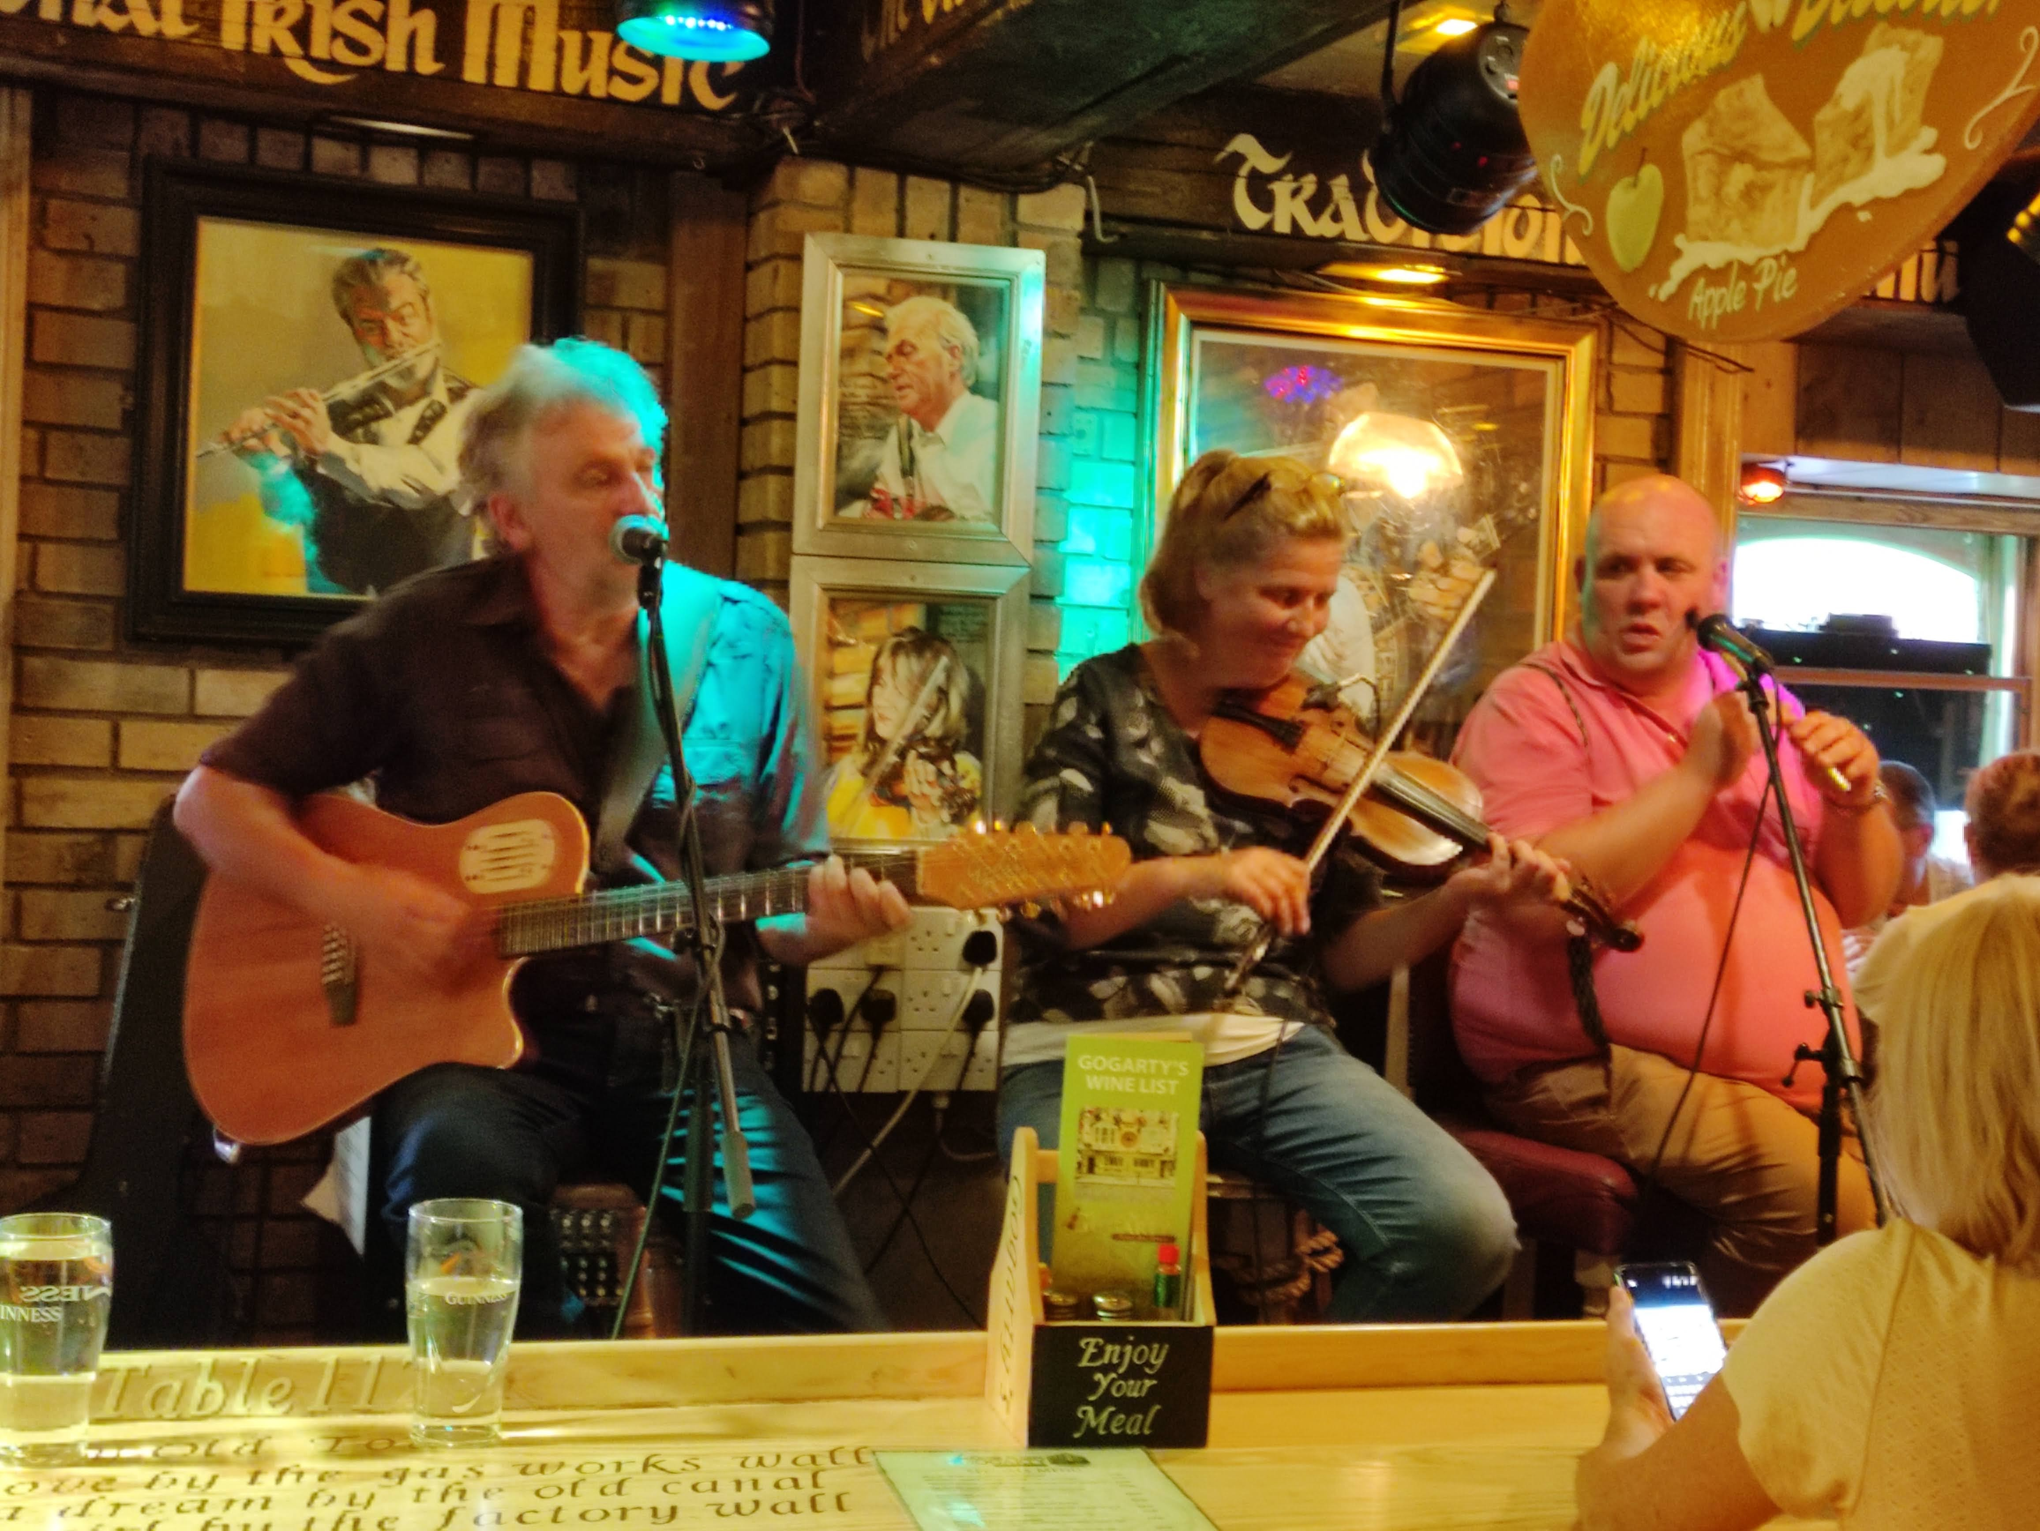
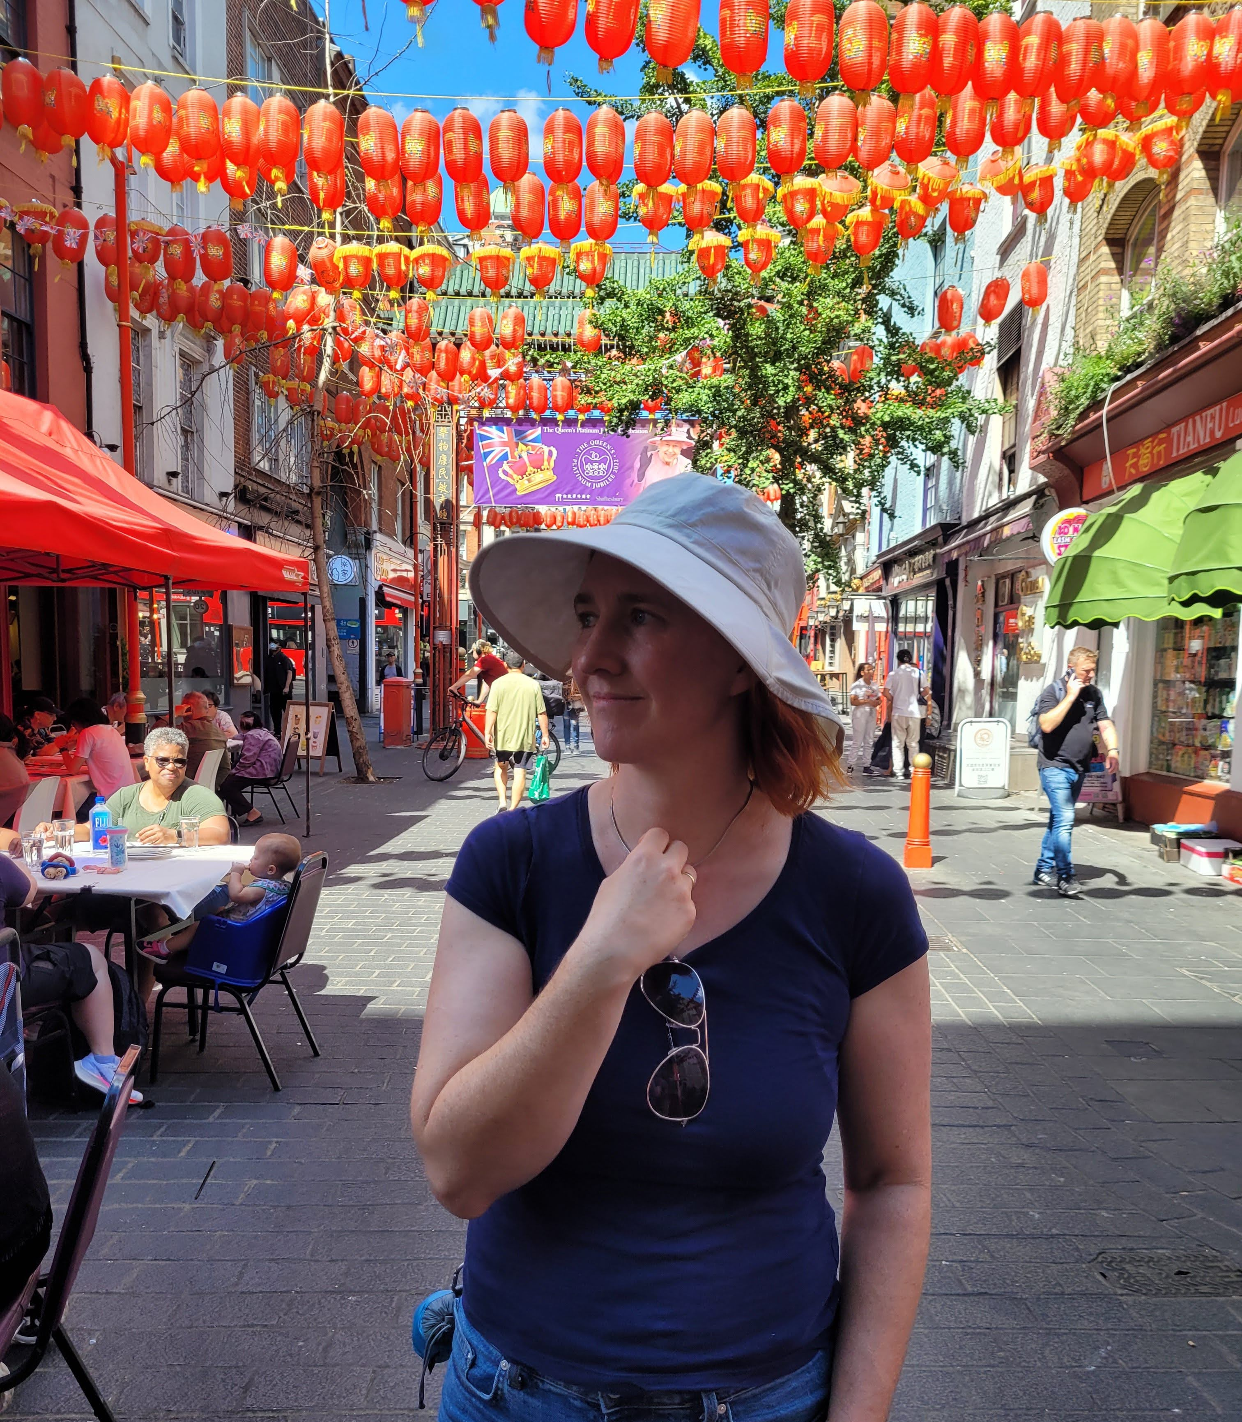
This year I was in two countries. Where do you think I was?

Slide 3
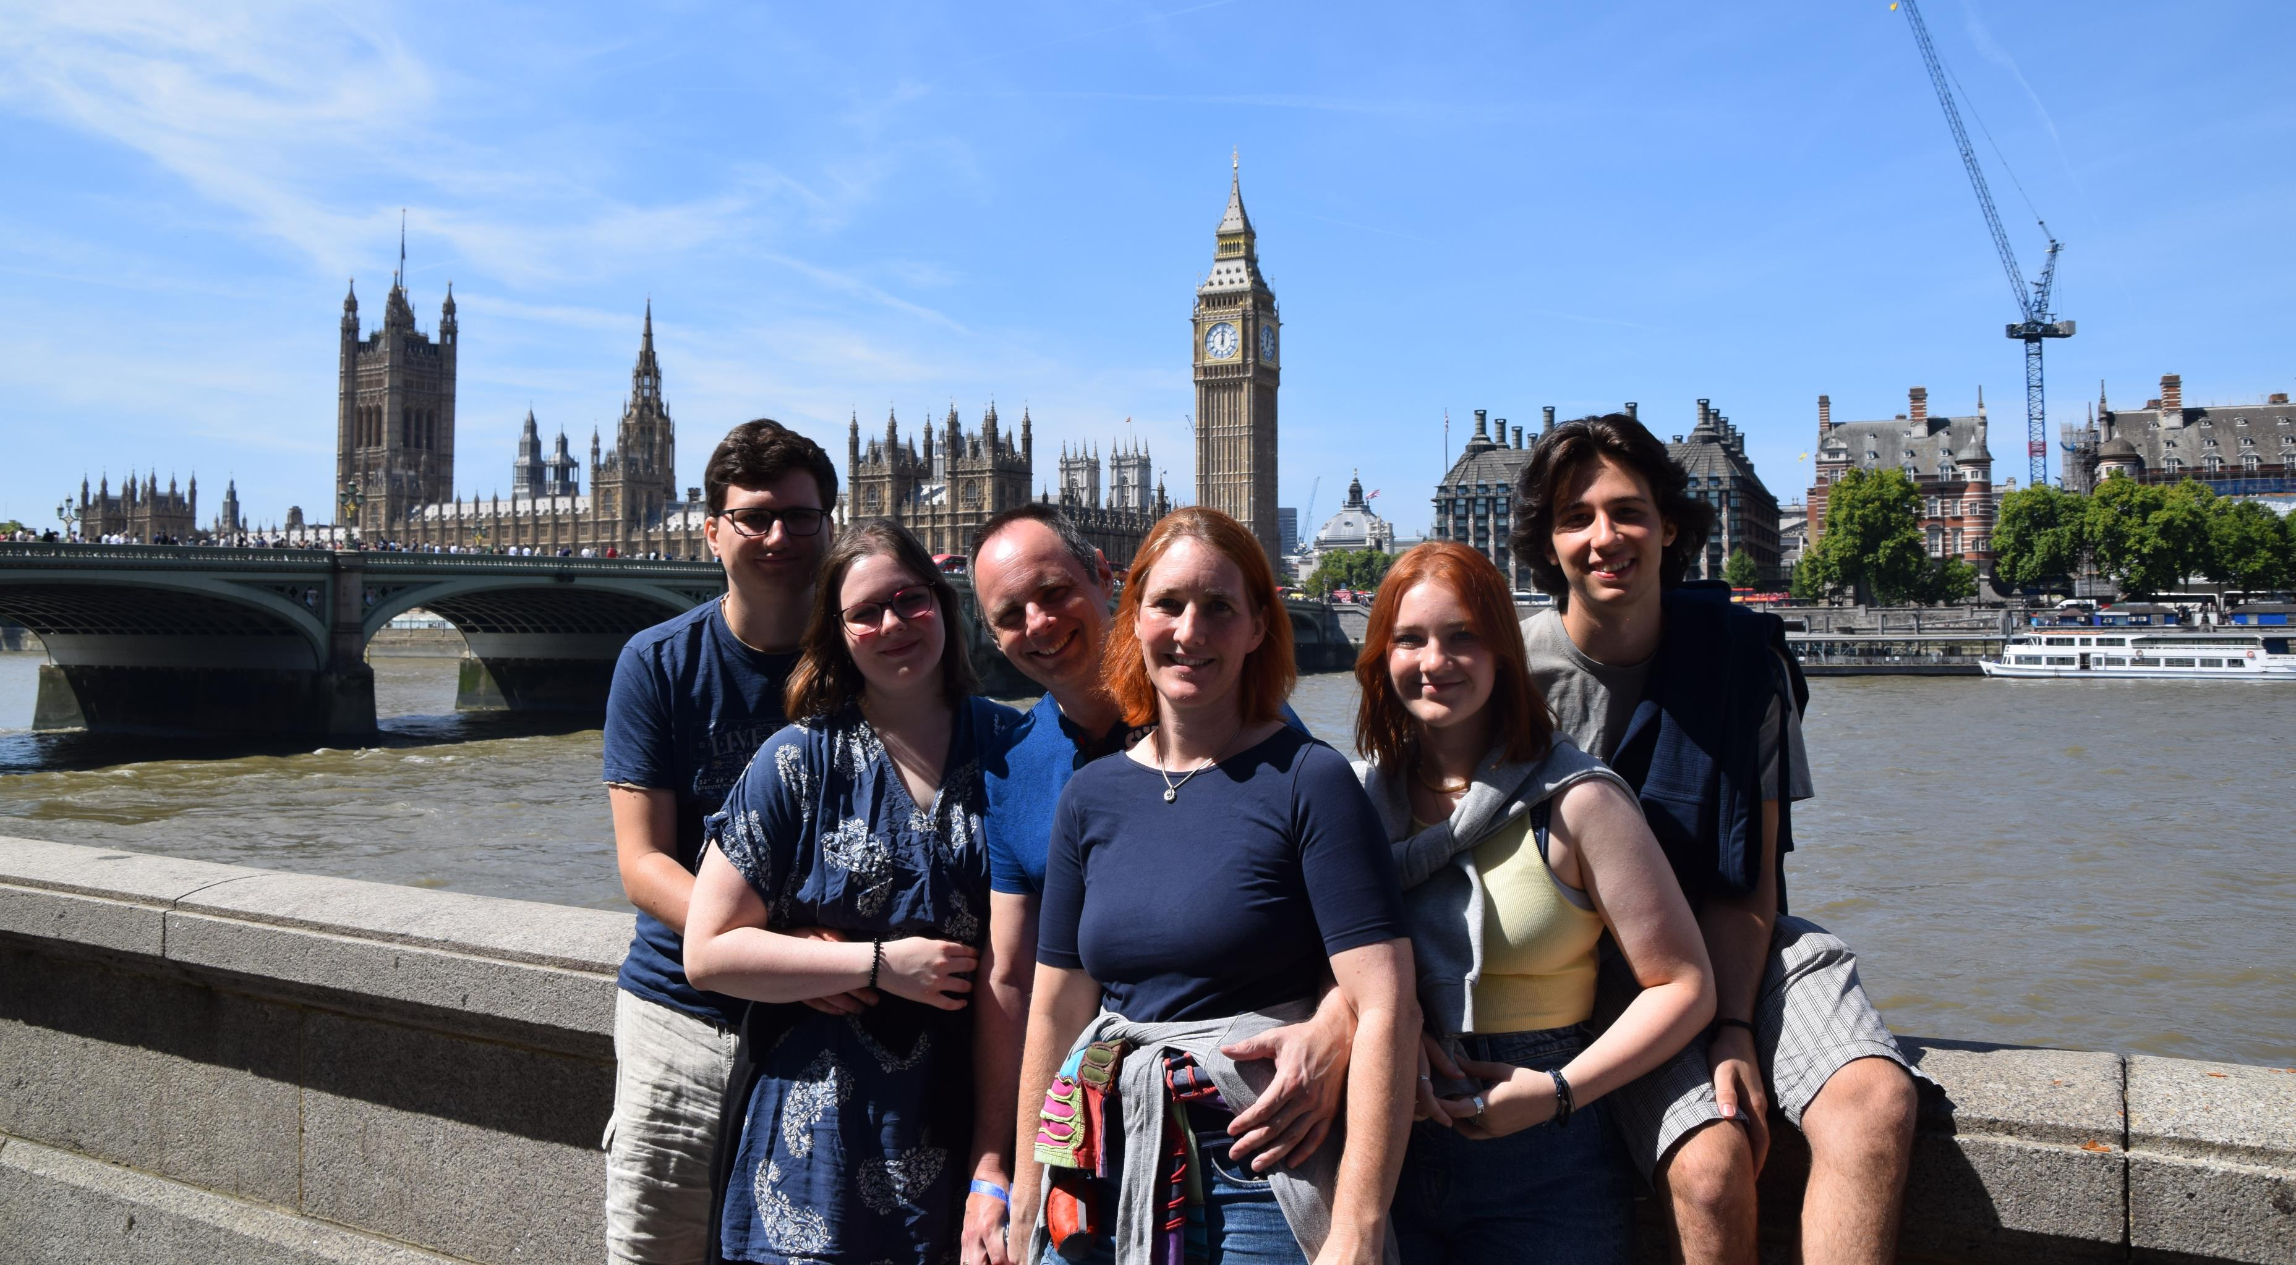

Slide 4
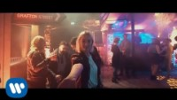
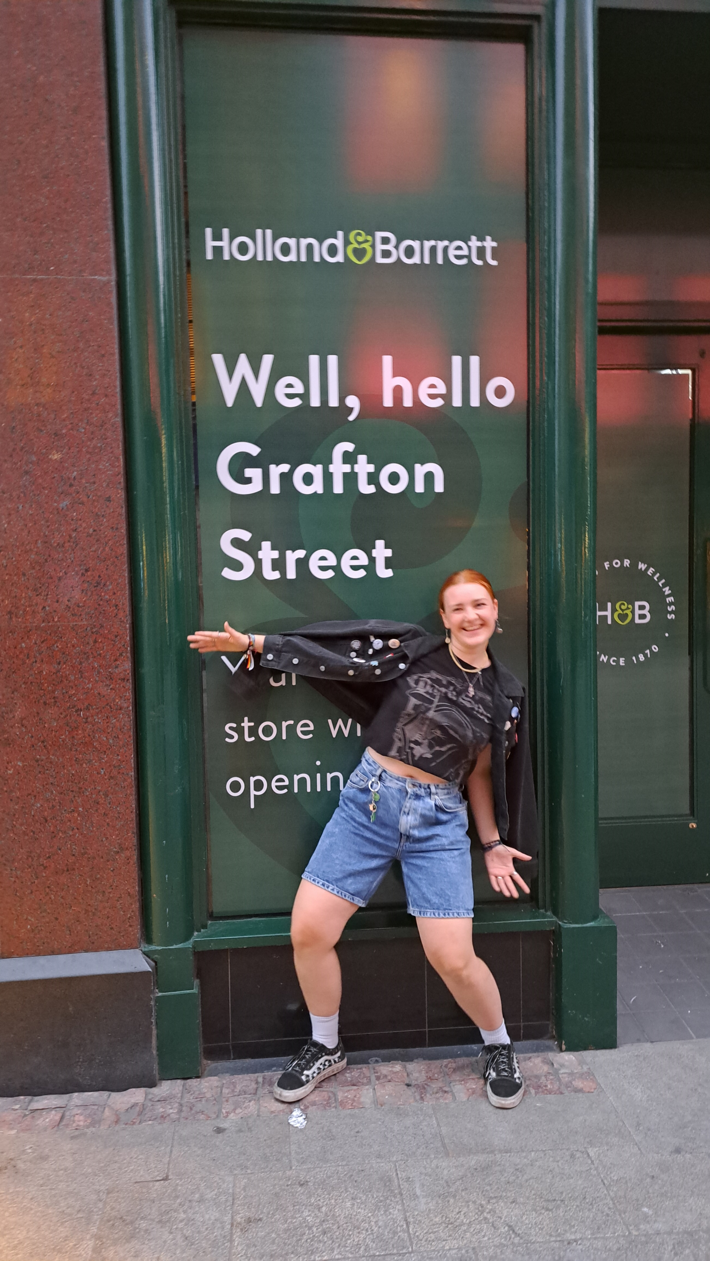
She played the fiddle in an Irish band….
I met her on Grafton street right outside of the bar ….

Slide 5
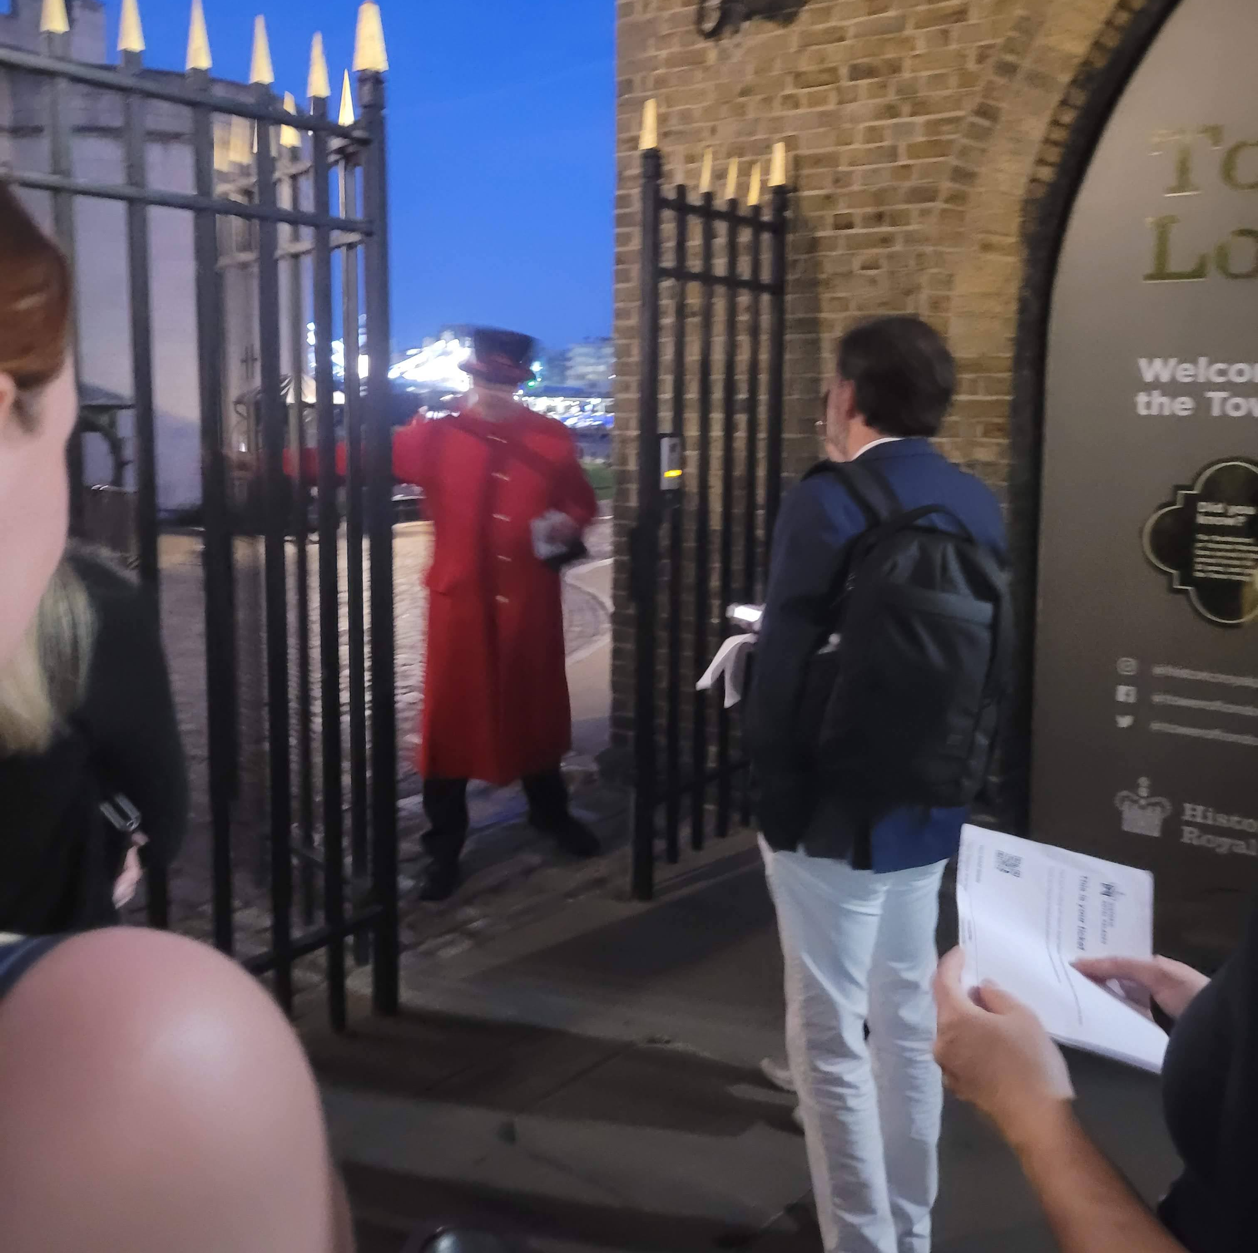
Why did the Beefeater open the gate for us?
Ask questions to find out more….

Slide 6
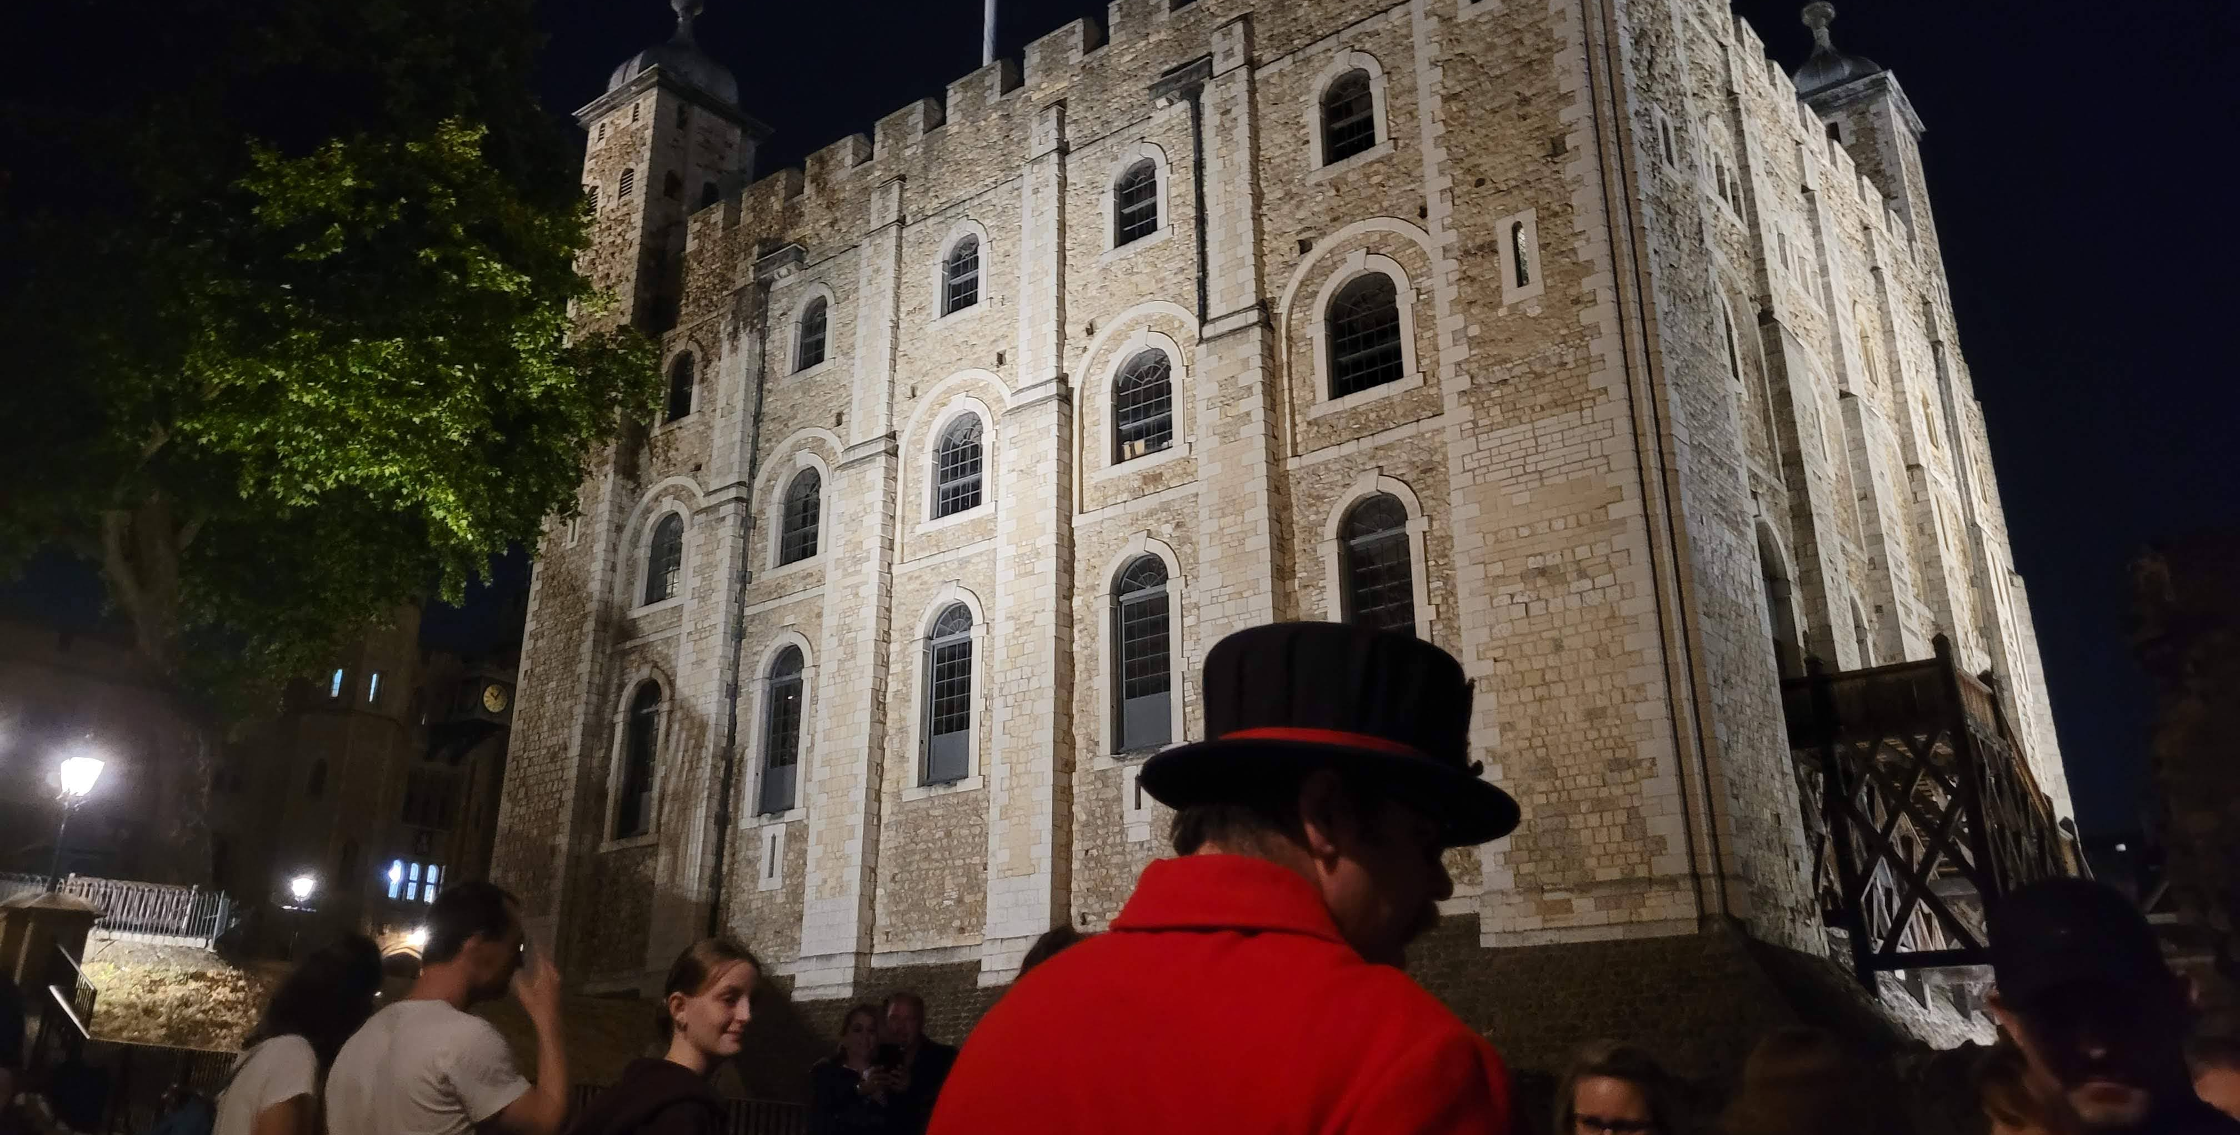
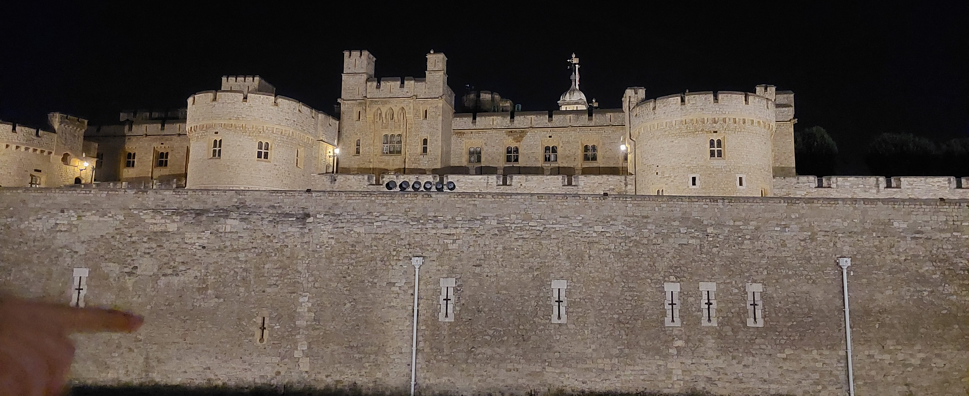
The ceremony of the keys

Slide 7
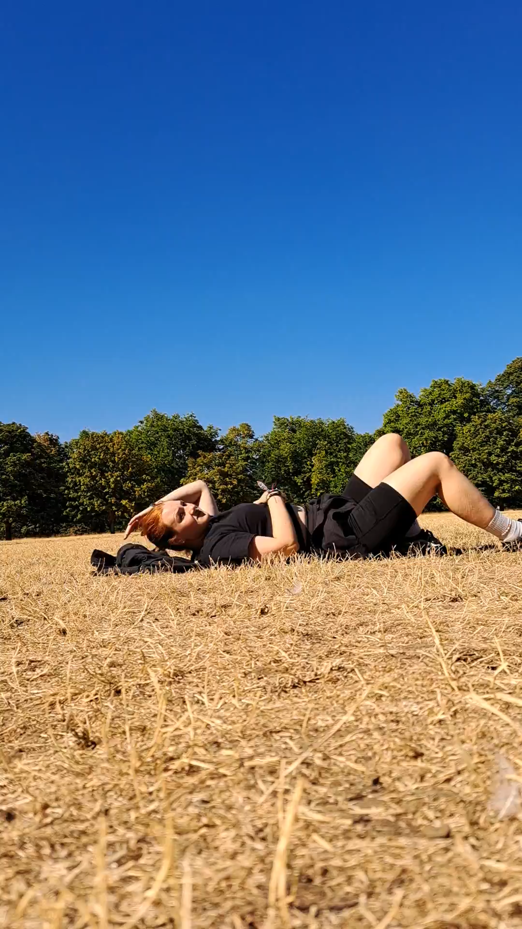
What do you think is going to happen?

Slide 8
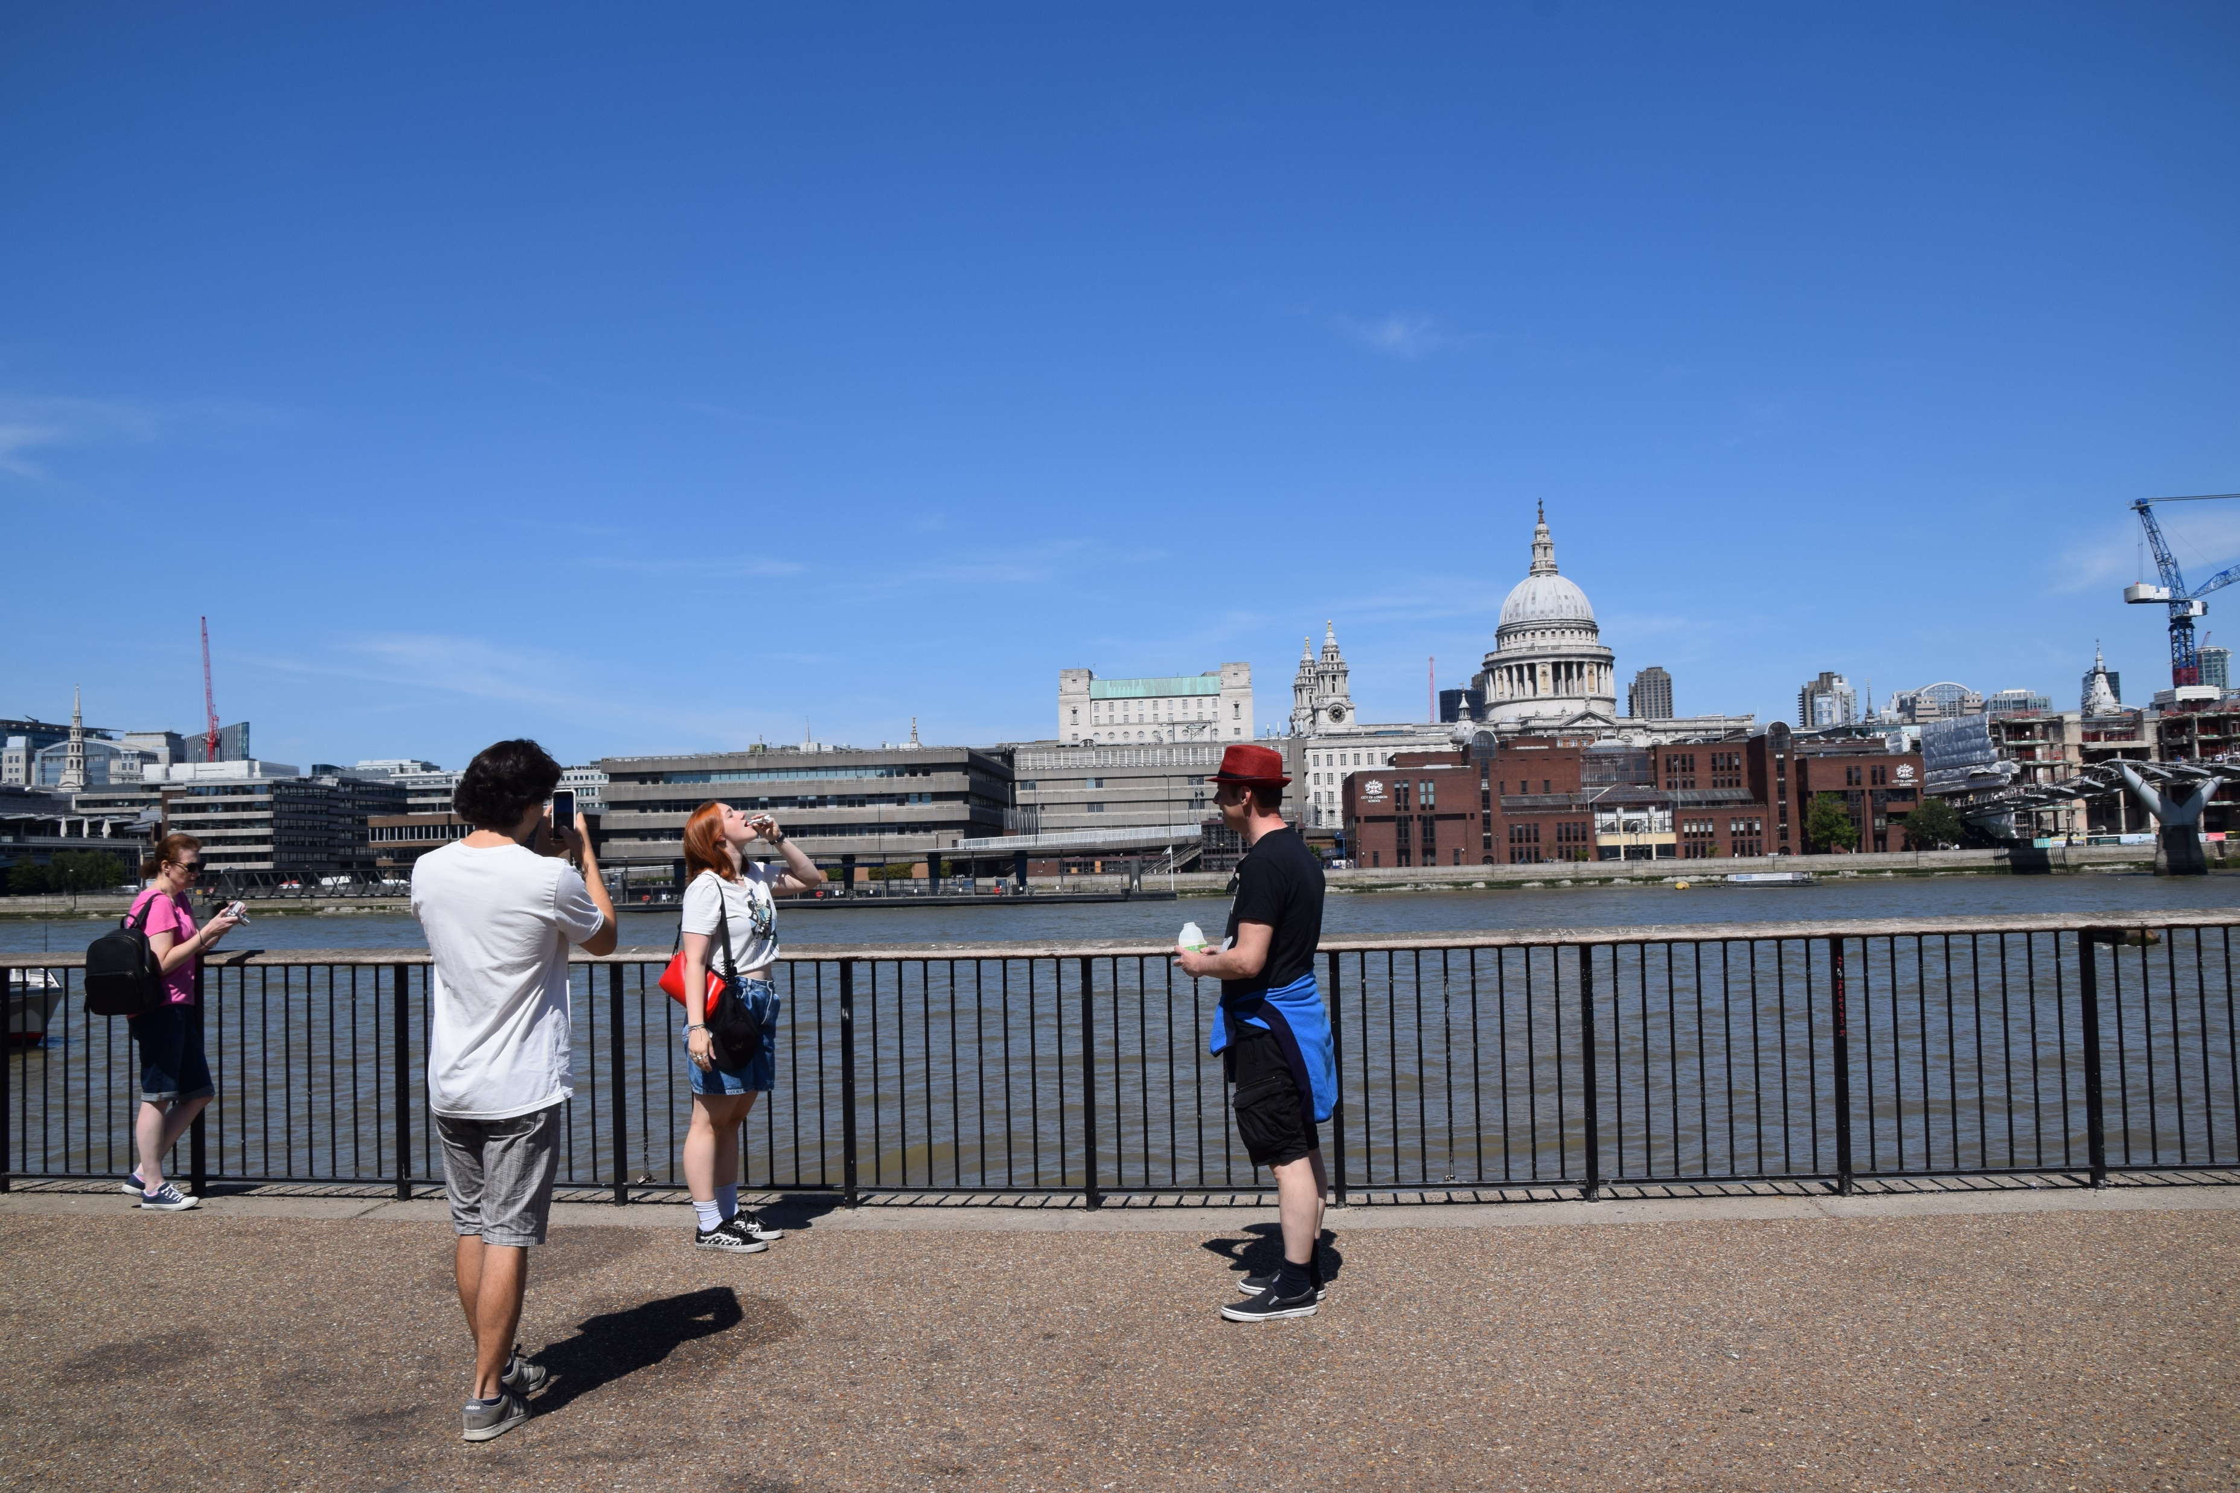
What are these people doing?

Slide 9


Slide 10
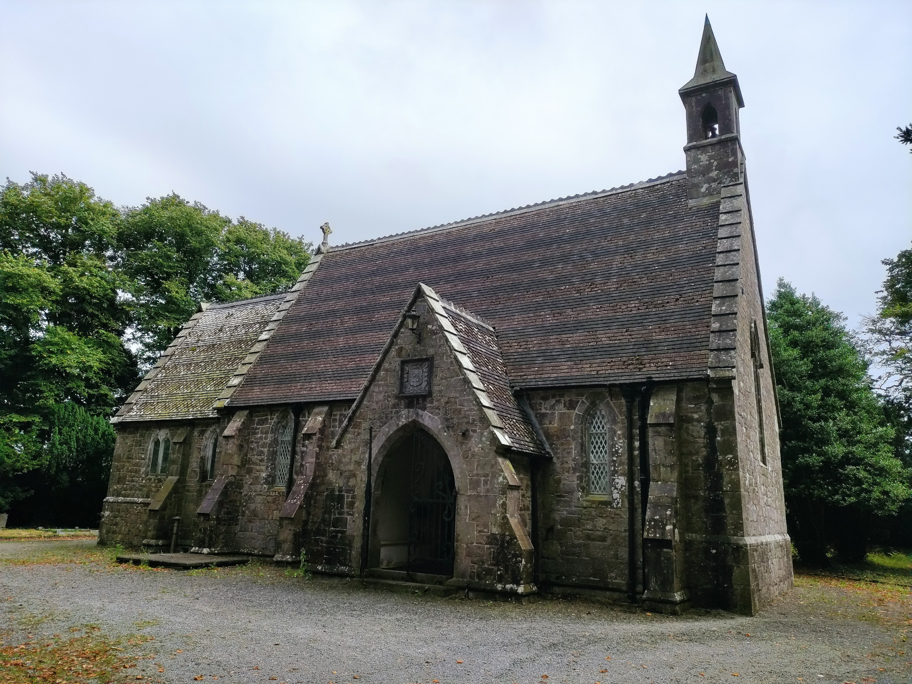
What can you do in this building?

Slide 11
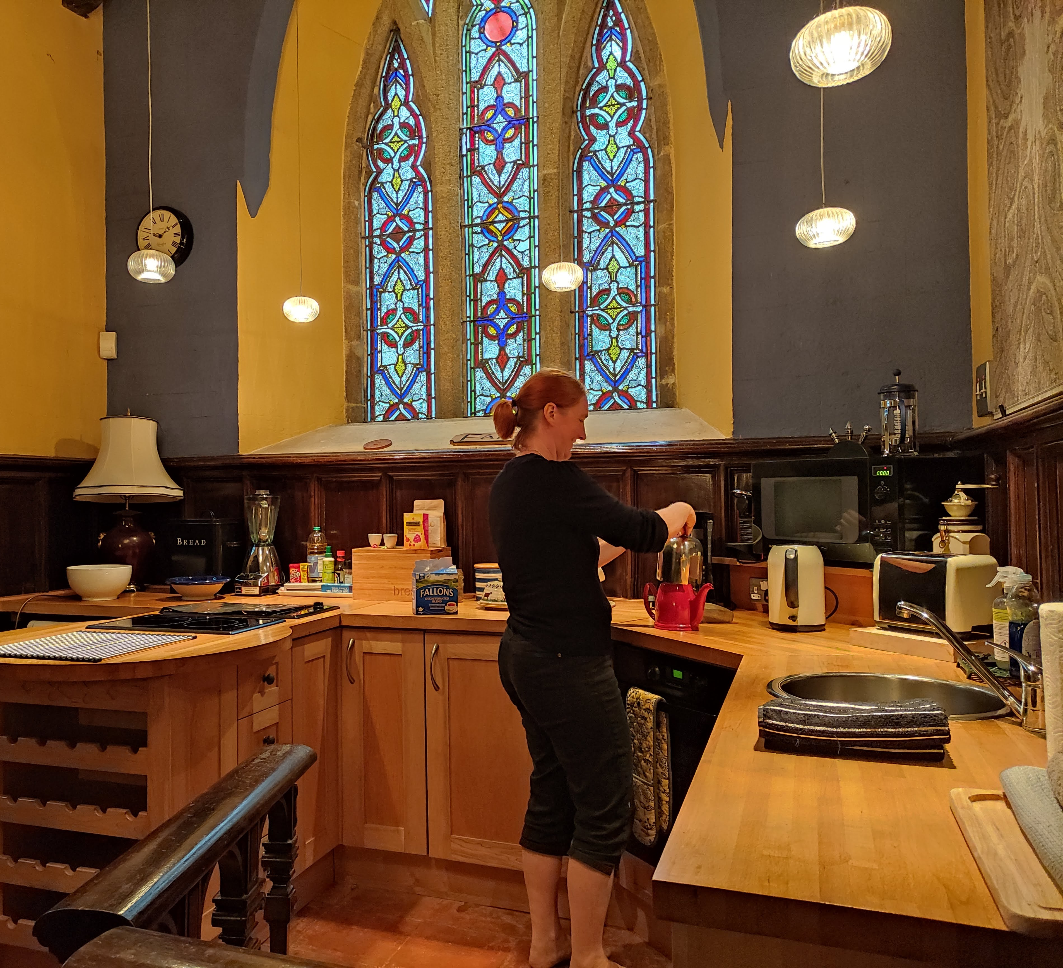
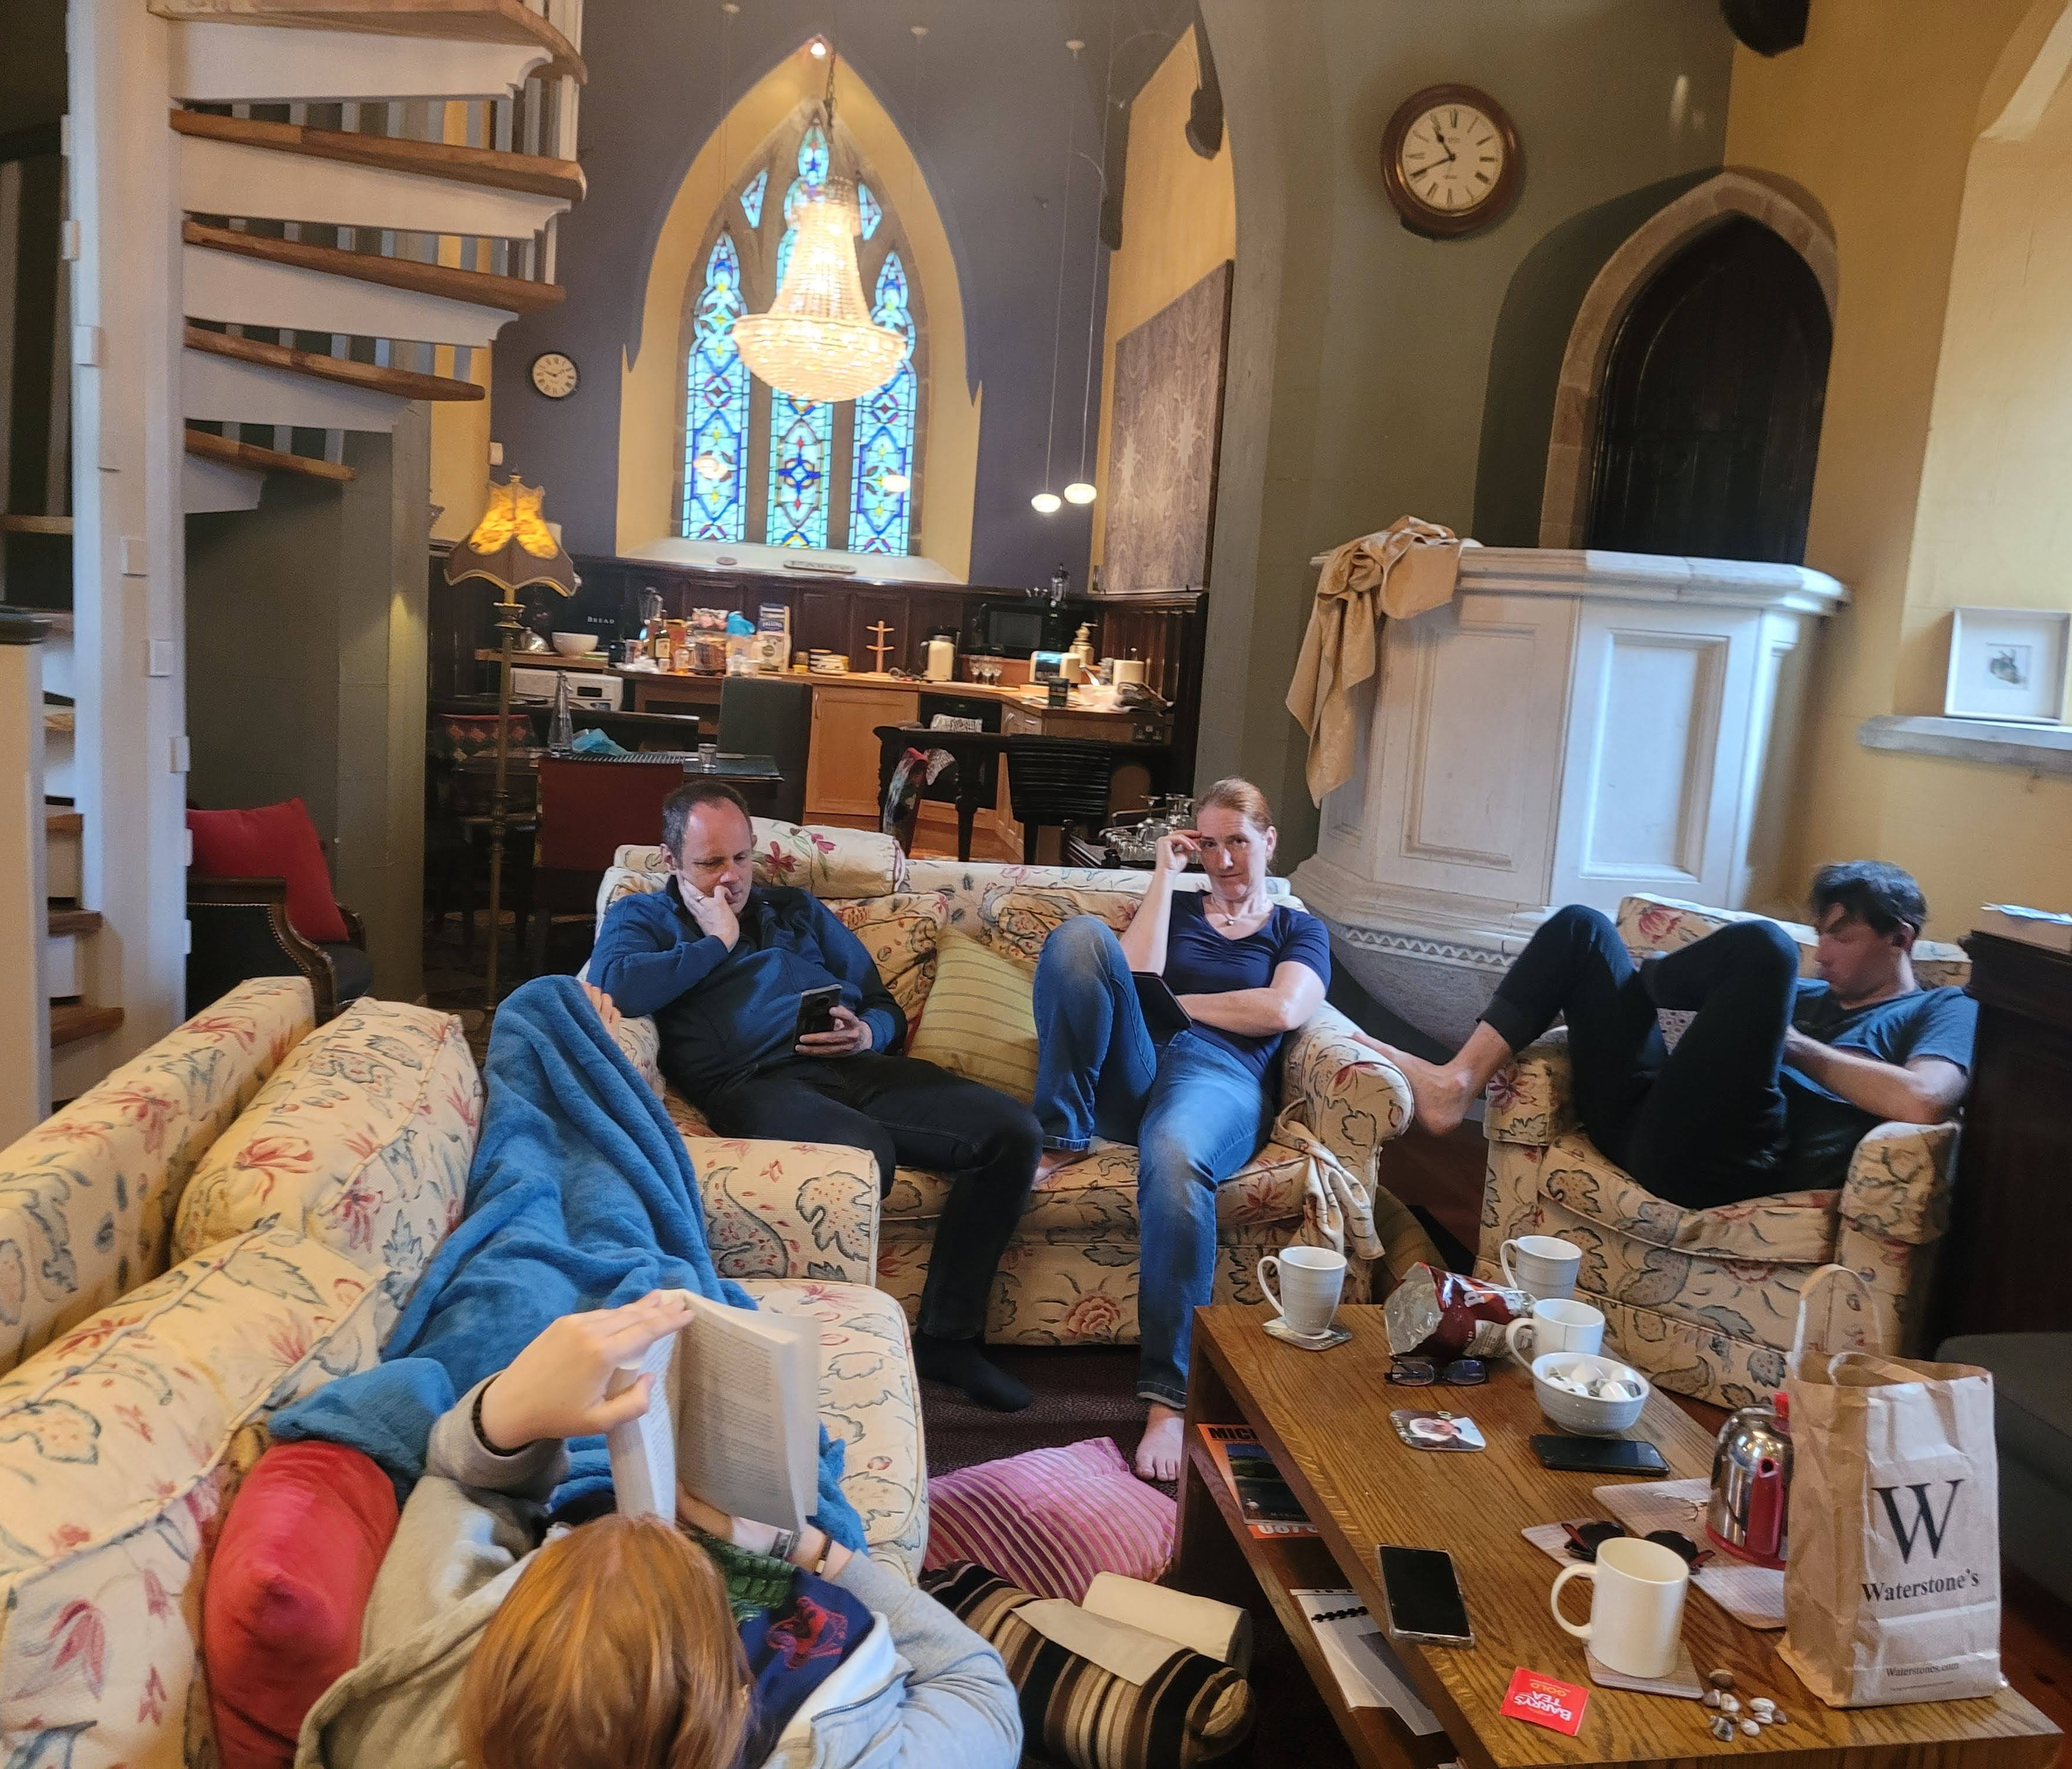
We stayed in a church for two days.
Do you think it is all right to use a church as a hotel?
Would you like to stay there?

Slide 12
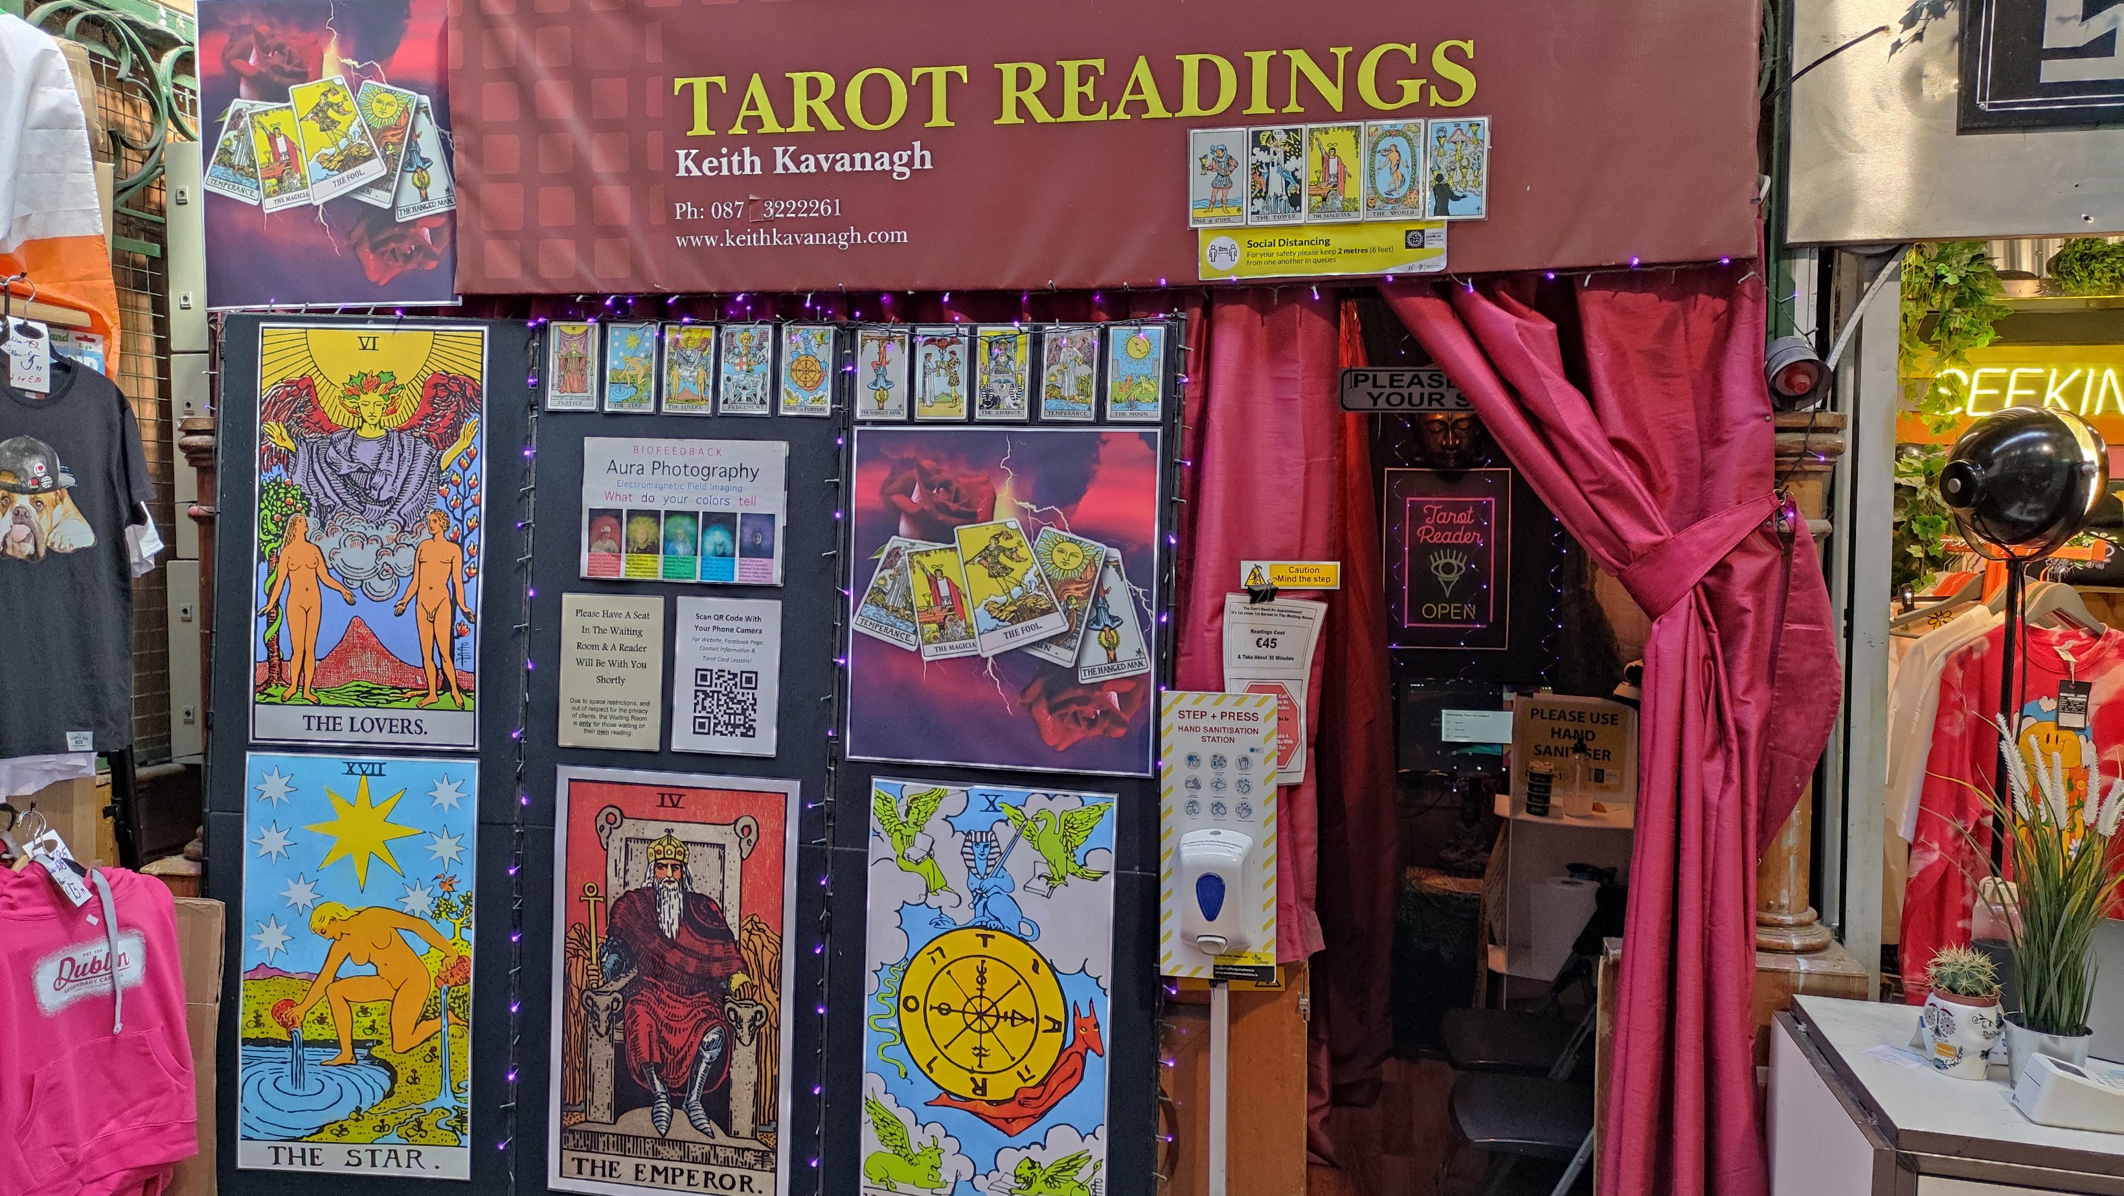
Would you go in?
In Dublin you can have your cards read for you.
Would you do it? Why? Why not?

Slide 13
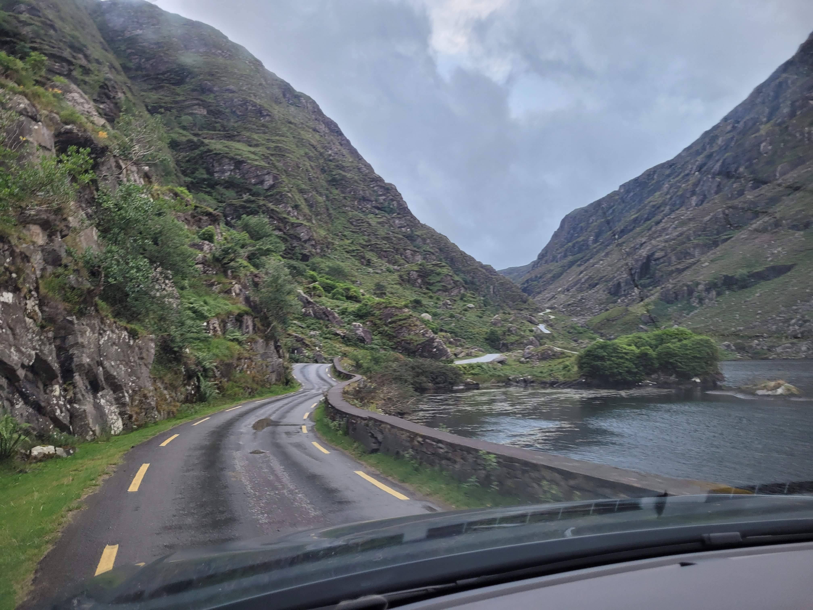
Narrow streets
Would you follow the street into the wilderness or would you go back to a bigger road?

Slide 14
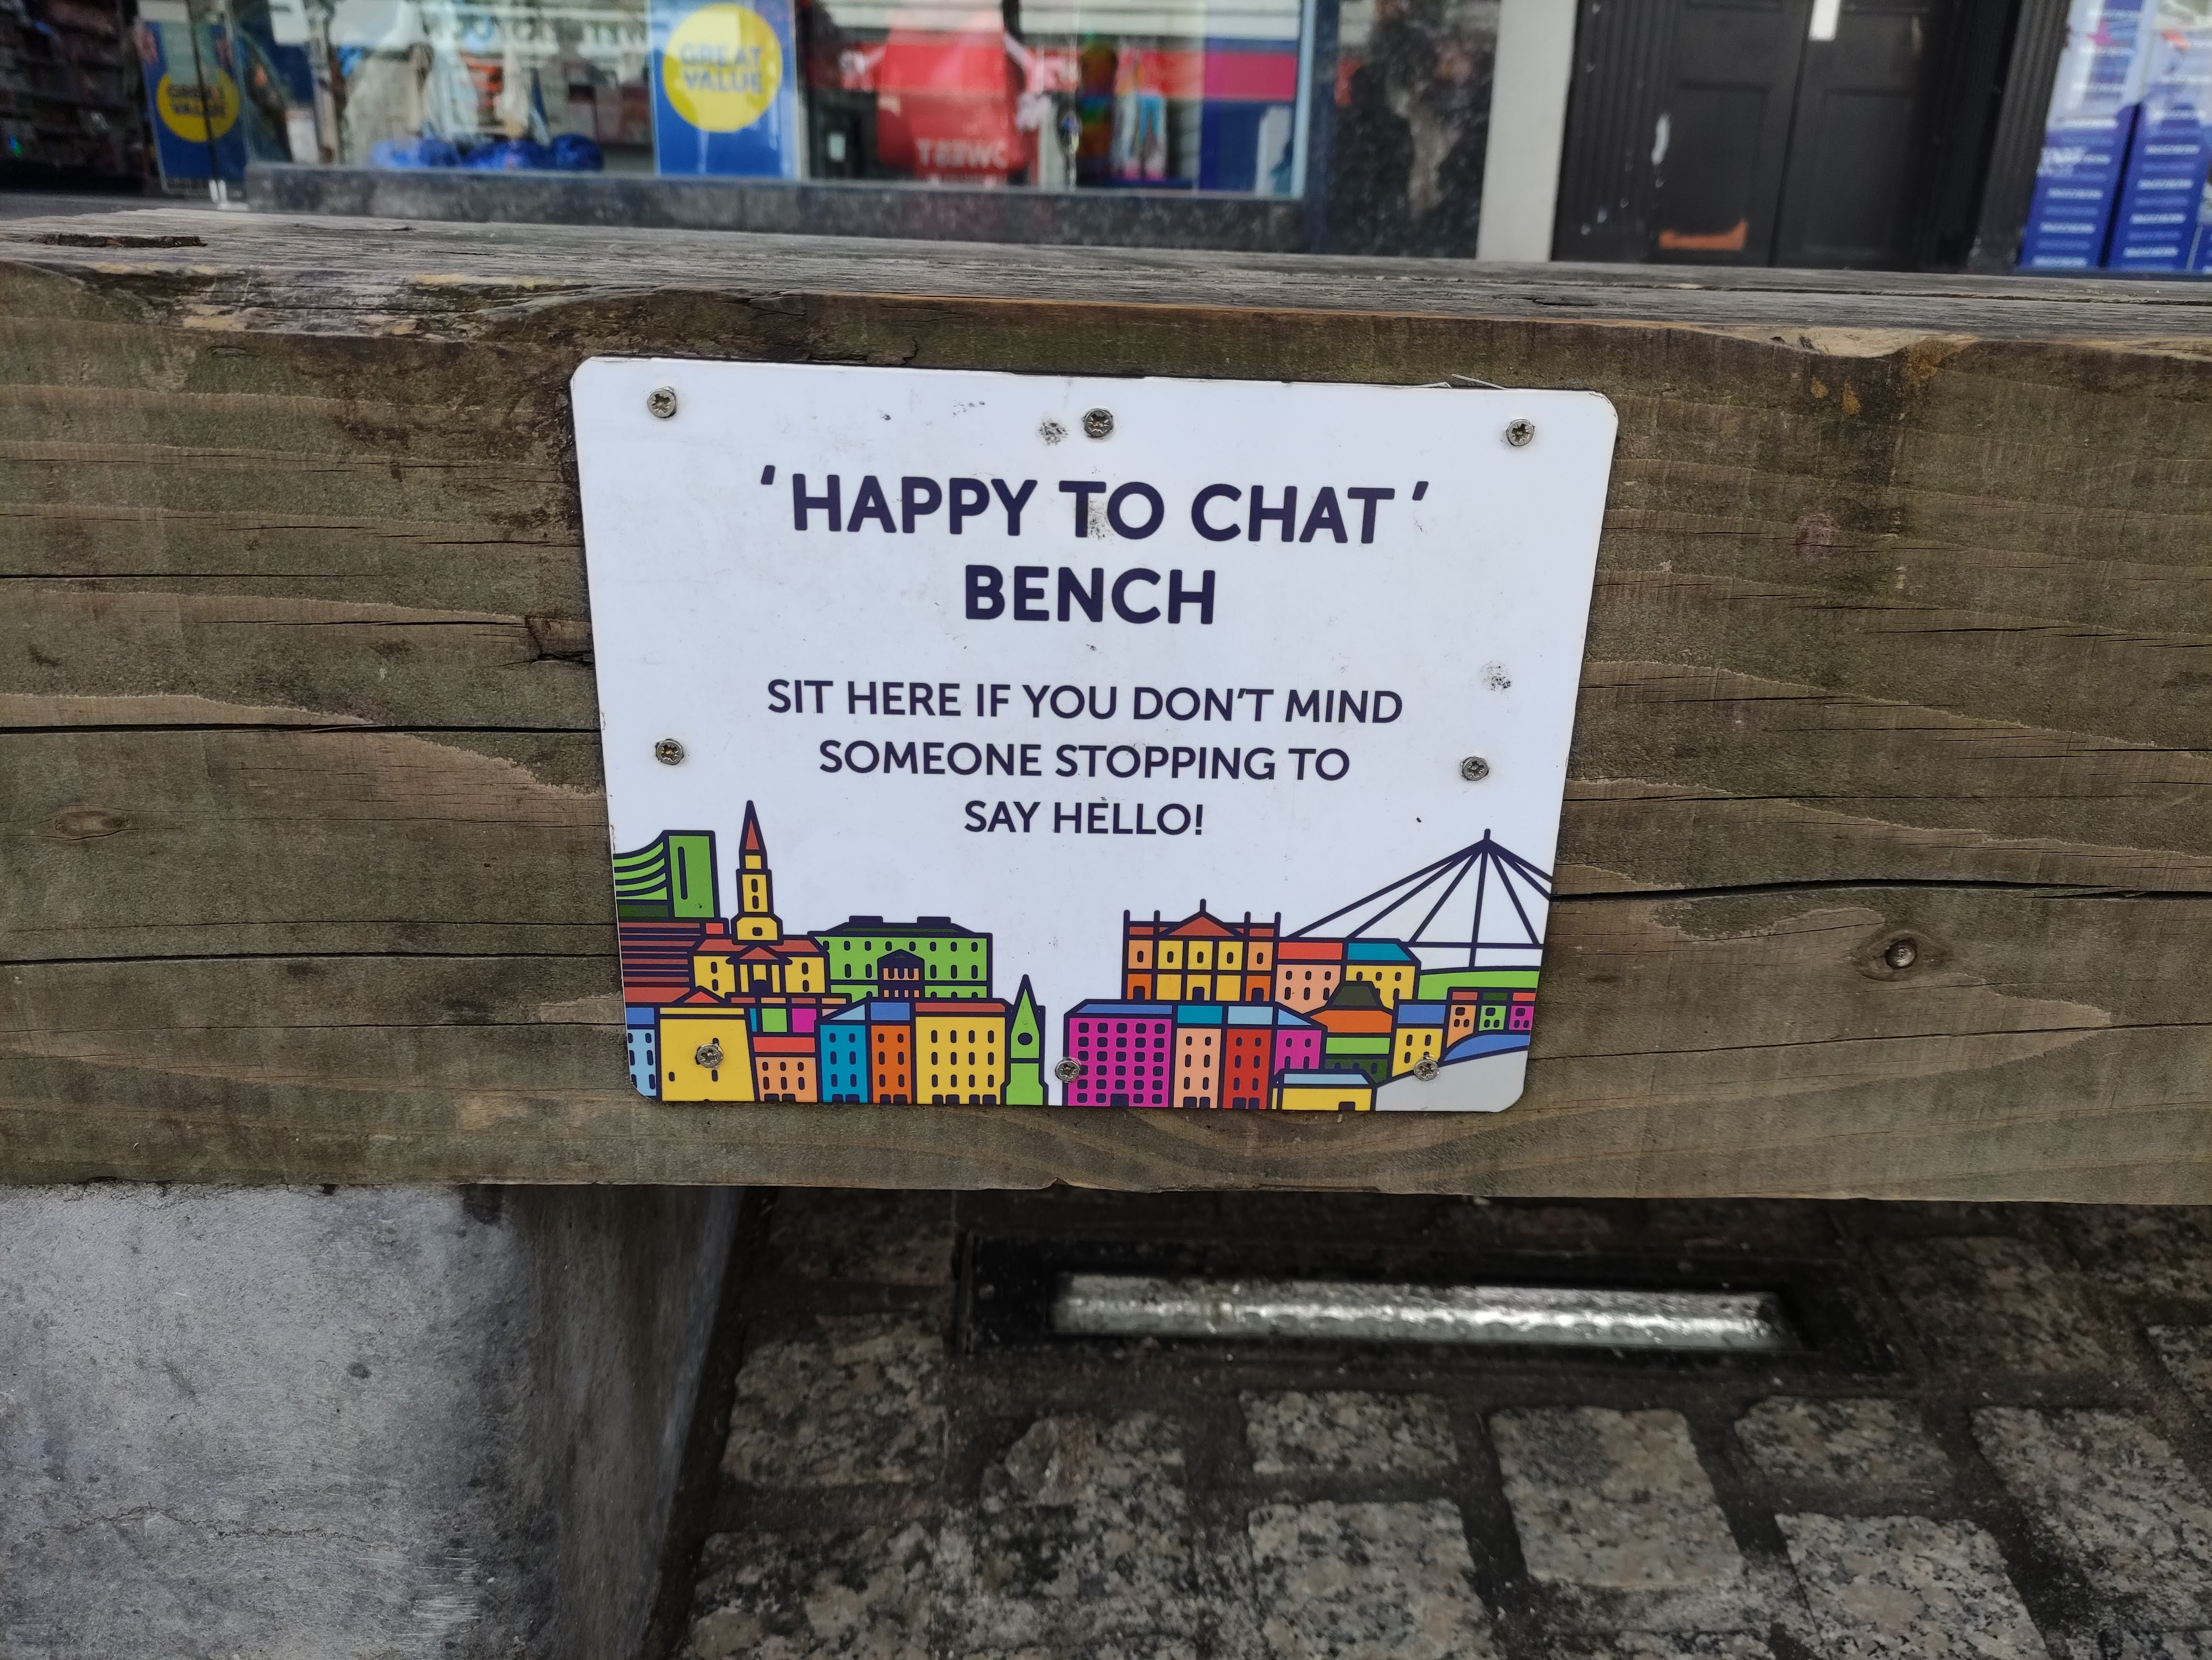
Would you sit down on this bench?
What might happen if you sit down on this bench?
Are such benches a good idea? Who for?

Slide 15
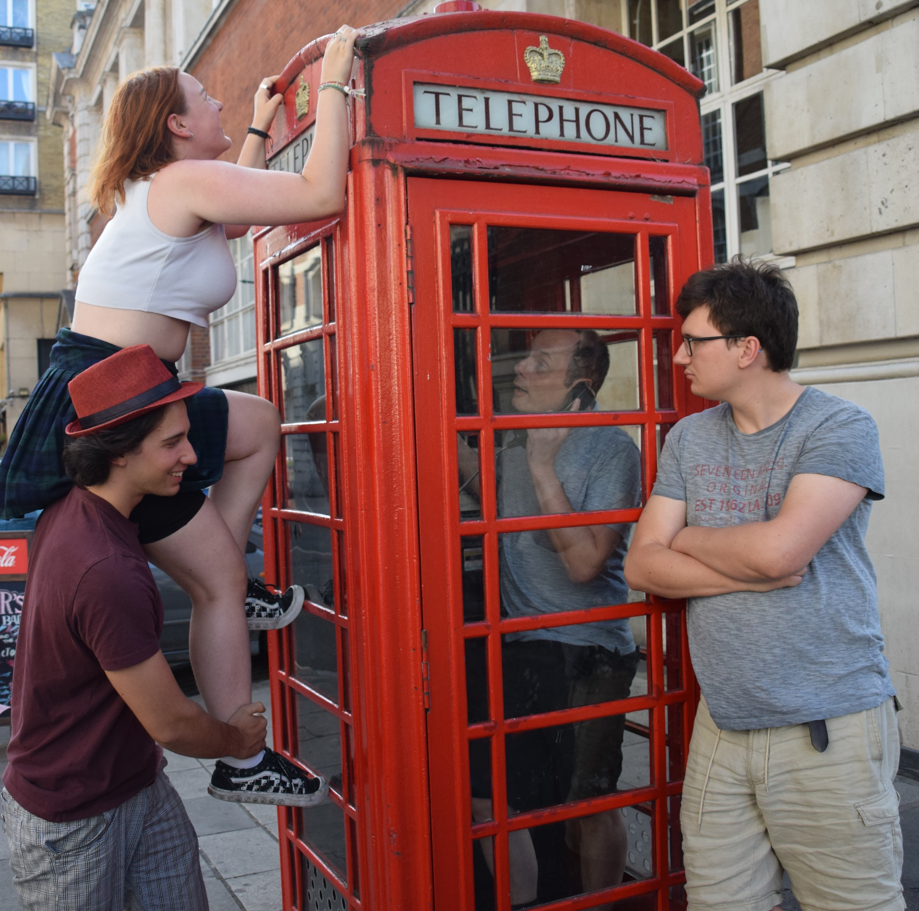
What are these people doing and why?

Slide 16
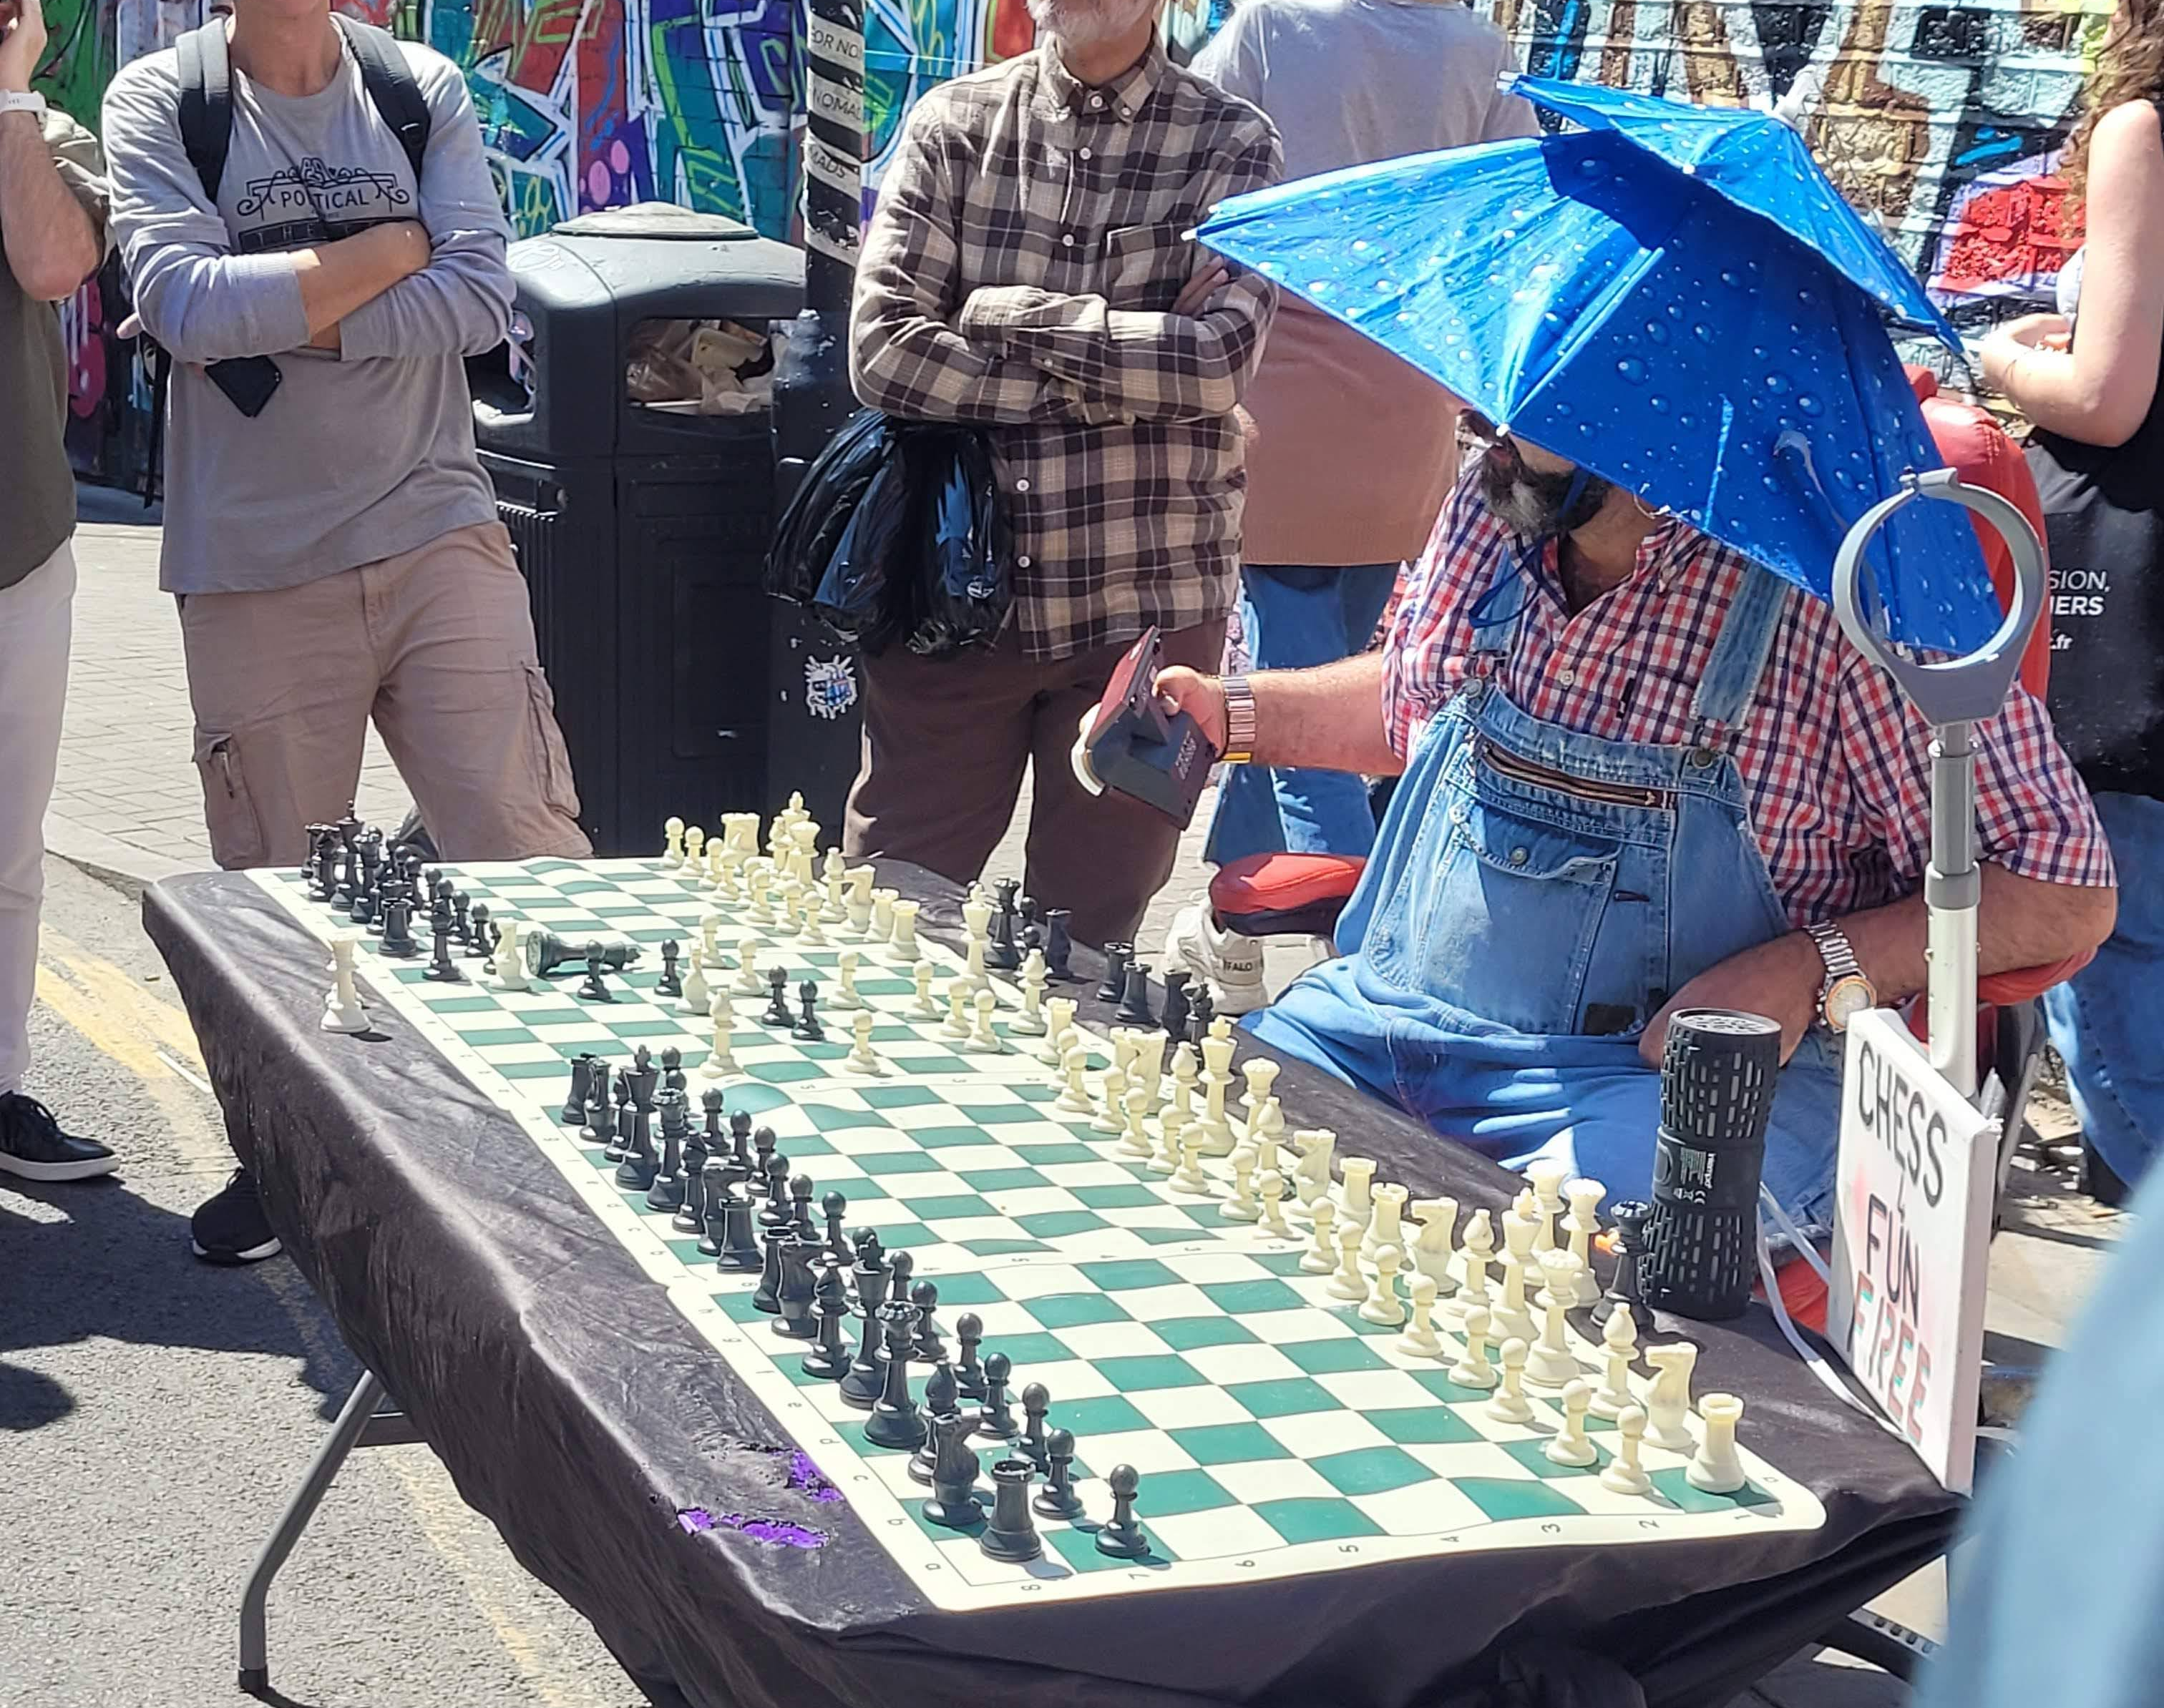
What is this man doing?
Would you play with him?

Slide 17
Now it‘s your turn
Tell your partner about your holidays.
What did you do?
Where did you go?
What was the best day in your holidays and why?
What did you want to do, but did not do in the end?
Did you learn anything new?
What did you do that you would recommend to other people? Why?

