Slide 1
WHAT ARE THEY LIKE ?

Slide 2
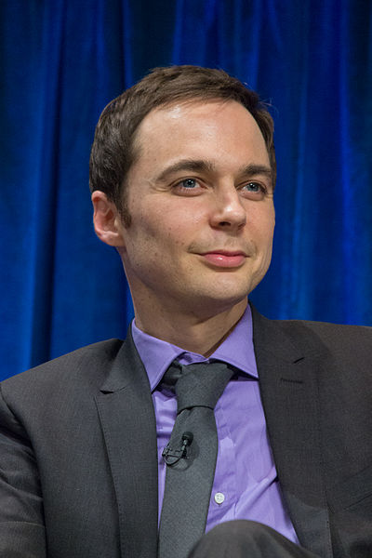
SHELDON COOPER from BIG BANG THEORY - What is he like?
https://www.flickr.com/photos/82924988@N05/15863660249/
By iDominic

Slide 3
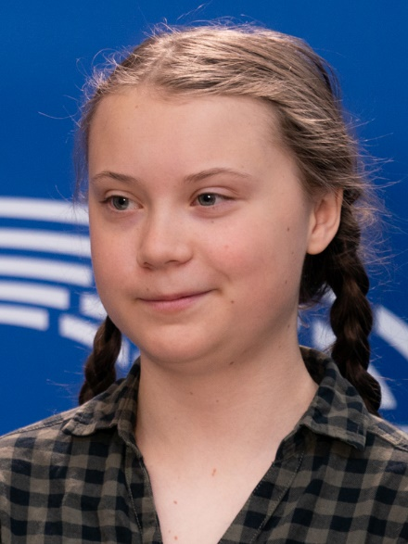
GRETA Thunberg - What is she like?
https://www.flickr.com/photos/36612355@N08/46705842745
CC0-by

Slide 4
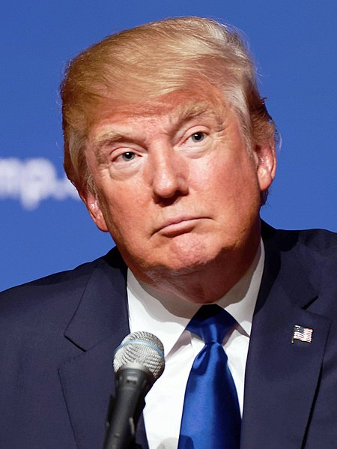
Donald Trump - What is he like?
https://en.wikipedia.org/wiki/File:Donald_Trump_August_19,_2015_(cropped).jpg

Slide 5
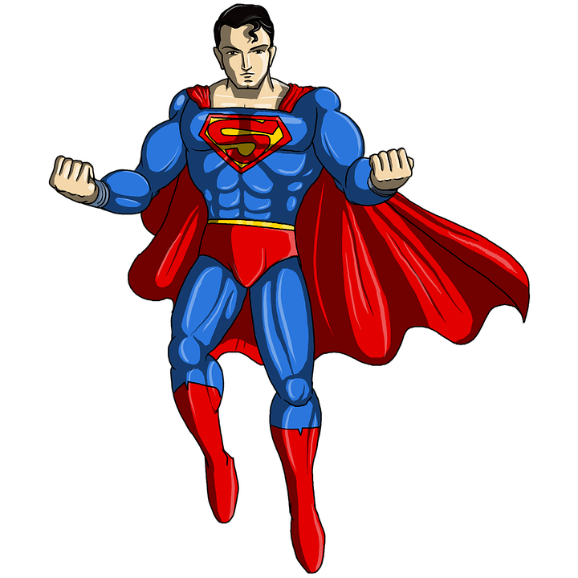
What is he like?
pixabay

