Slide 1
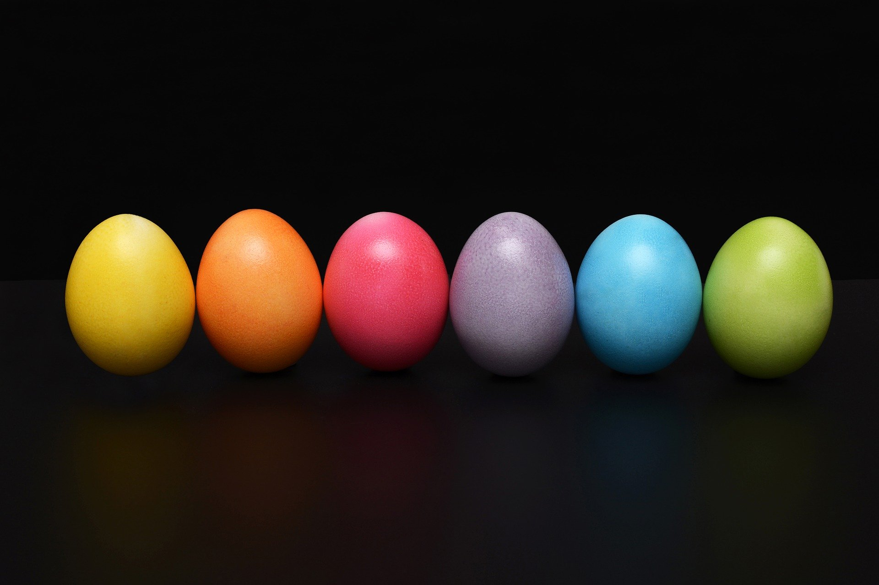
What did you do during the Easter holidays?

Slide 2

How did the Coronavirus change your Easter holidays?

Slide 3

Guess which student it is?
?
A -
B -
C -
D -
F -
G -
If I had not brought a living spider to school, my classmates would not have screamed.
If I had not changed school, I would not be in this class.
My English would not be that good if I had not watched that many YouTube videos.
If I had not come to class today, my grandmother would have been angry.
I would have been able to do more work if I had not broken my finger.
If my ankle had not healed well, I would have had an operation.

Slide 4
When do we use 3rd conditional?
If the Coronavirus had not broken out, I would have spent more time outisde.
If he had studied, he would have passed the exam.
If we had taken the subway, we wouldn’t have missed the plane.
He would not have felt sick if he had not eaten the questionable street food.

Slide 5
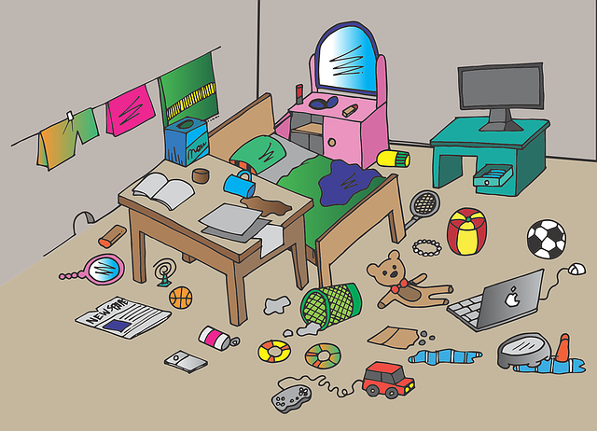
Dream
Reality
If the Coronavirus had not broken out, I would have spent more time outisde.
3rd conditional
The Coronavirus spread across the world, so I spent most of my time in my room.

Slide 6

Can you find a rule?

Slide 7
Let’s practice
Talk about our Easter holidays
What would you have done if the Coronavirus had not spread across the world?
If | the Corona virus | had not broken out | , | I | would have | spent | more time outside.

Slide 8

Activity: Pack your suitcase
Listen carefully what you classmates say – you will have to pack ALL these thing when it is your turn.
If I had gone to Denver, I would have packed…

Slide 9
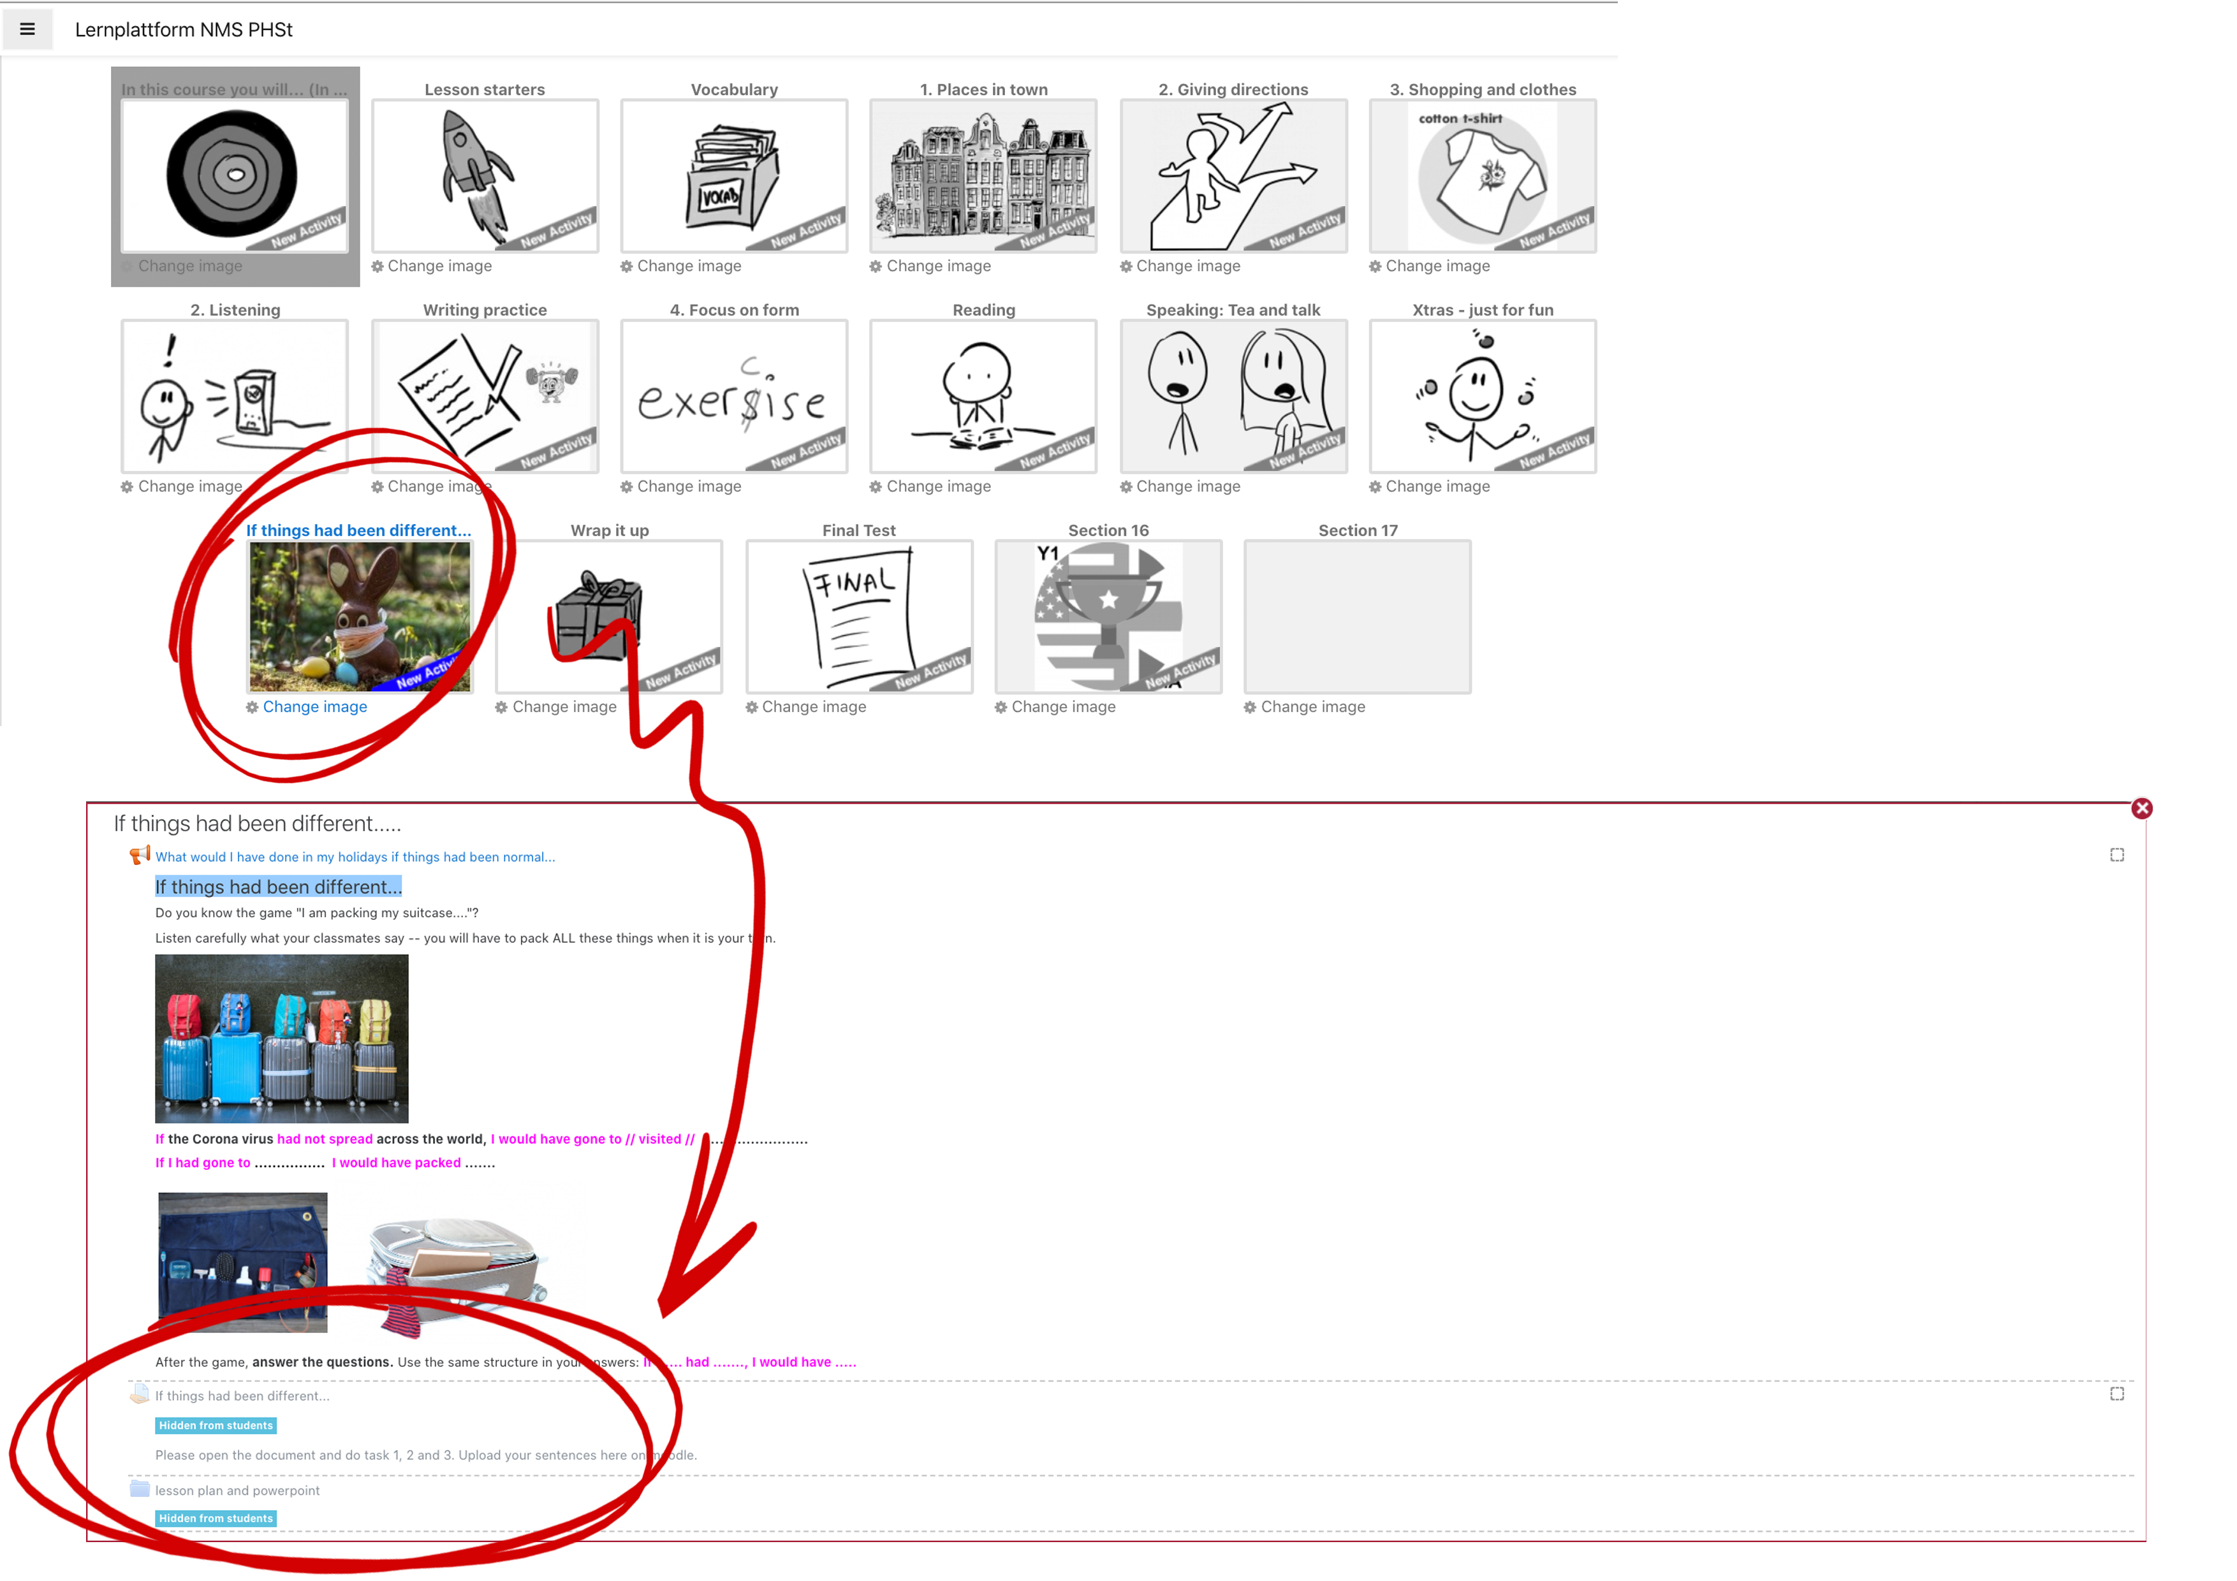
ASSIGNMENT FOR THIS ONLINE CLASS

