Slide 1

How did the
Coronavirus change your life?

Slide 2

Yesterday…..
?
A -
B -
C -
I am in group B so I did not go to school yesterday.
If I had gone to school, I would have met my friends.
If I had gone to school on Monday, I would have been very tired.
If I had gone to school yesterday…..
If + had + last form...., I would + have + last form

Slide 3
This morning
Who had breakfast this morning?
If I had had.....
If I had not had .....
If + had + last form...., I would + have + last form

Slide 4
On Friday it was rainy
If it had not .....
If + had + last form...., I would + have + last form

Slide 5
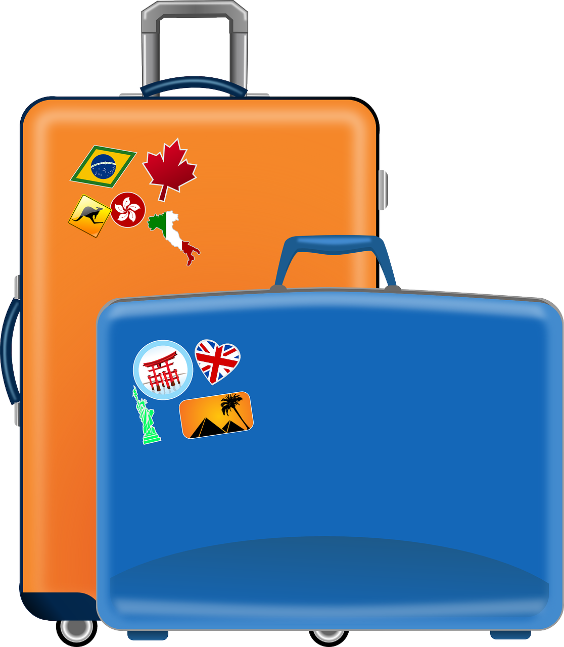
We were not allowed to travel in the Easter holiday
If we had.....
If + had + last form...., I would + have + last form

Slide 6
When do we use this form?
If + had + last form...., I would + have + last form
When we talk about....

Slide 7
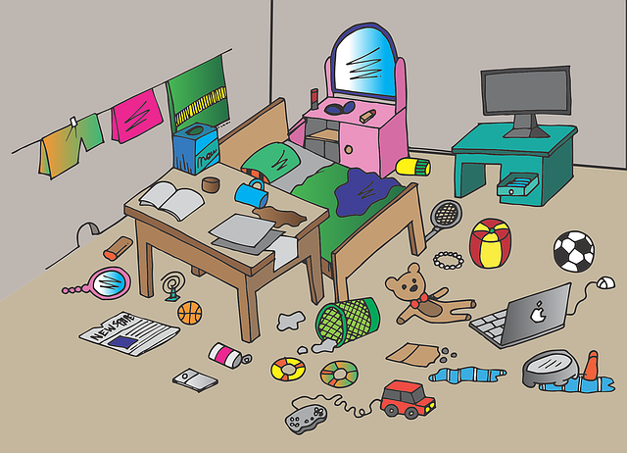
Dream (past)
Reality
If the Coronavirus had not broken out, I would have spent more time outisde.
3rd conditional
The Coronavirus spread across the world, so I spent most of my time in my room.

Slide 8
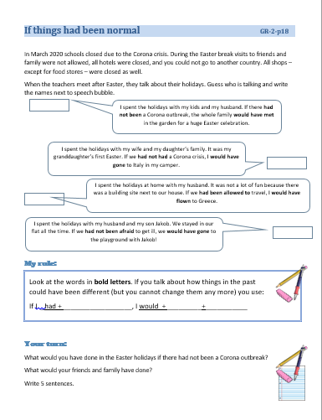
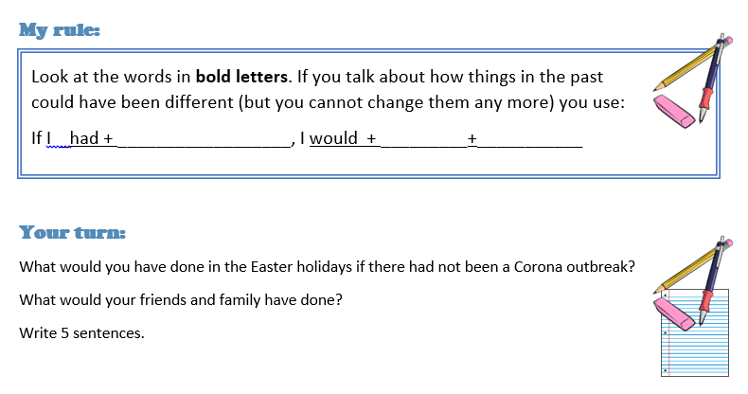
Grammar book page 18
If things had been normal

Slide 9
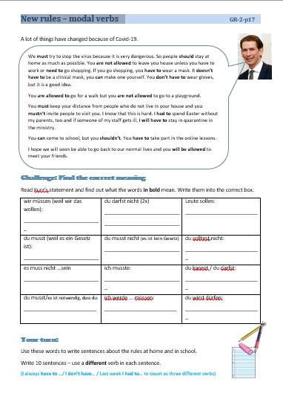

Grammar book page 17
New rules – modal verbs
Read Kurz’s statement and find out what the words in bold mean. Write them into the corret box.
wir müssen (weil wir das wollen): | du darfst nicht (2x) | Leute sollen:
du musst (weil es ein Gesetz ist): | du musst nicht (es ist kein Gesetz) | du solltest nicht:
es muss nicht ...sein | ich musste: | du kannst / du darfst:
du musst/es ist notwendig, dass du: | ich werde ... müssen: | du wirst dürfen:
We must
You are not allowed to
people should
you have to
you don‘t have to
you shouldn‘t
It doesn‘t have to be
I had to
you can
you need to
I will have to
you will be allowed to

Slide 10
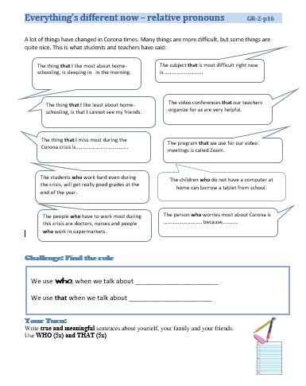
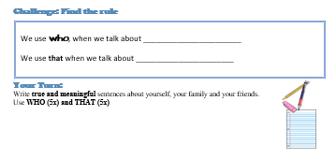
Grammar book page 16
Everything is different now
Write sentences and upload your page on moodle. If you uploaded it and it‘s not ticked off look at the feedback and correct your sentences!

