Slide 1
Imaginary situations of the past

Slide 2
What would have happened if … ?
What would have happened if Kieran/Danilo/Noah had not joined the class?
What would have happened if Mr. Grasser had become your Klassenvorstand?
What would have happened if you had gotten a different classroom on the first floor?
What would have happened if you had had a skiing trip as a class last year? Who would you have chosen as roommates?
Which teachers would have gone with you? Where would you have gone?
What would have happened if the PH had given us a huge playground?
What would have happened if you had had to leave school after the first year?

Slide 3



Imaginary situation of the past
reality
If I had studied more,
I would have passed the exam.
I didn’t study a lot, so I didn't pass the exam.
FAIL

Slide 4
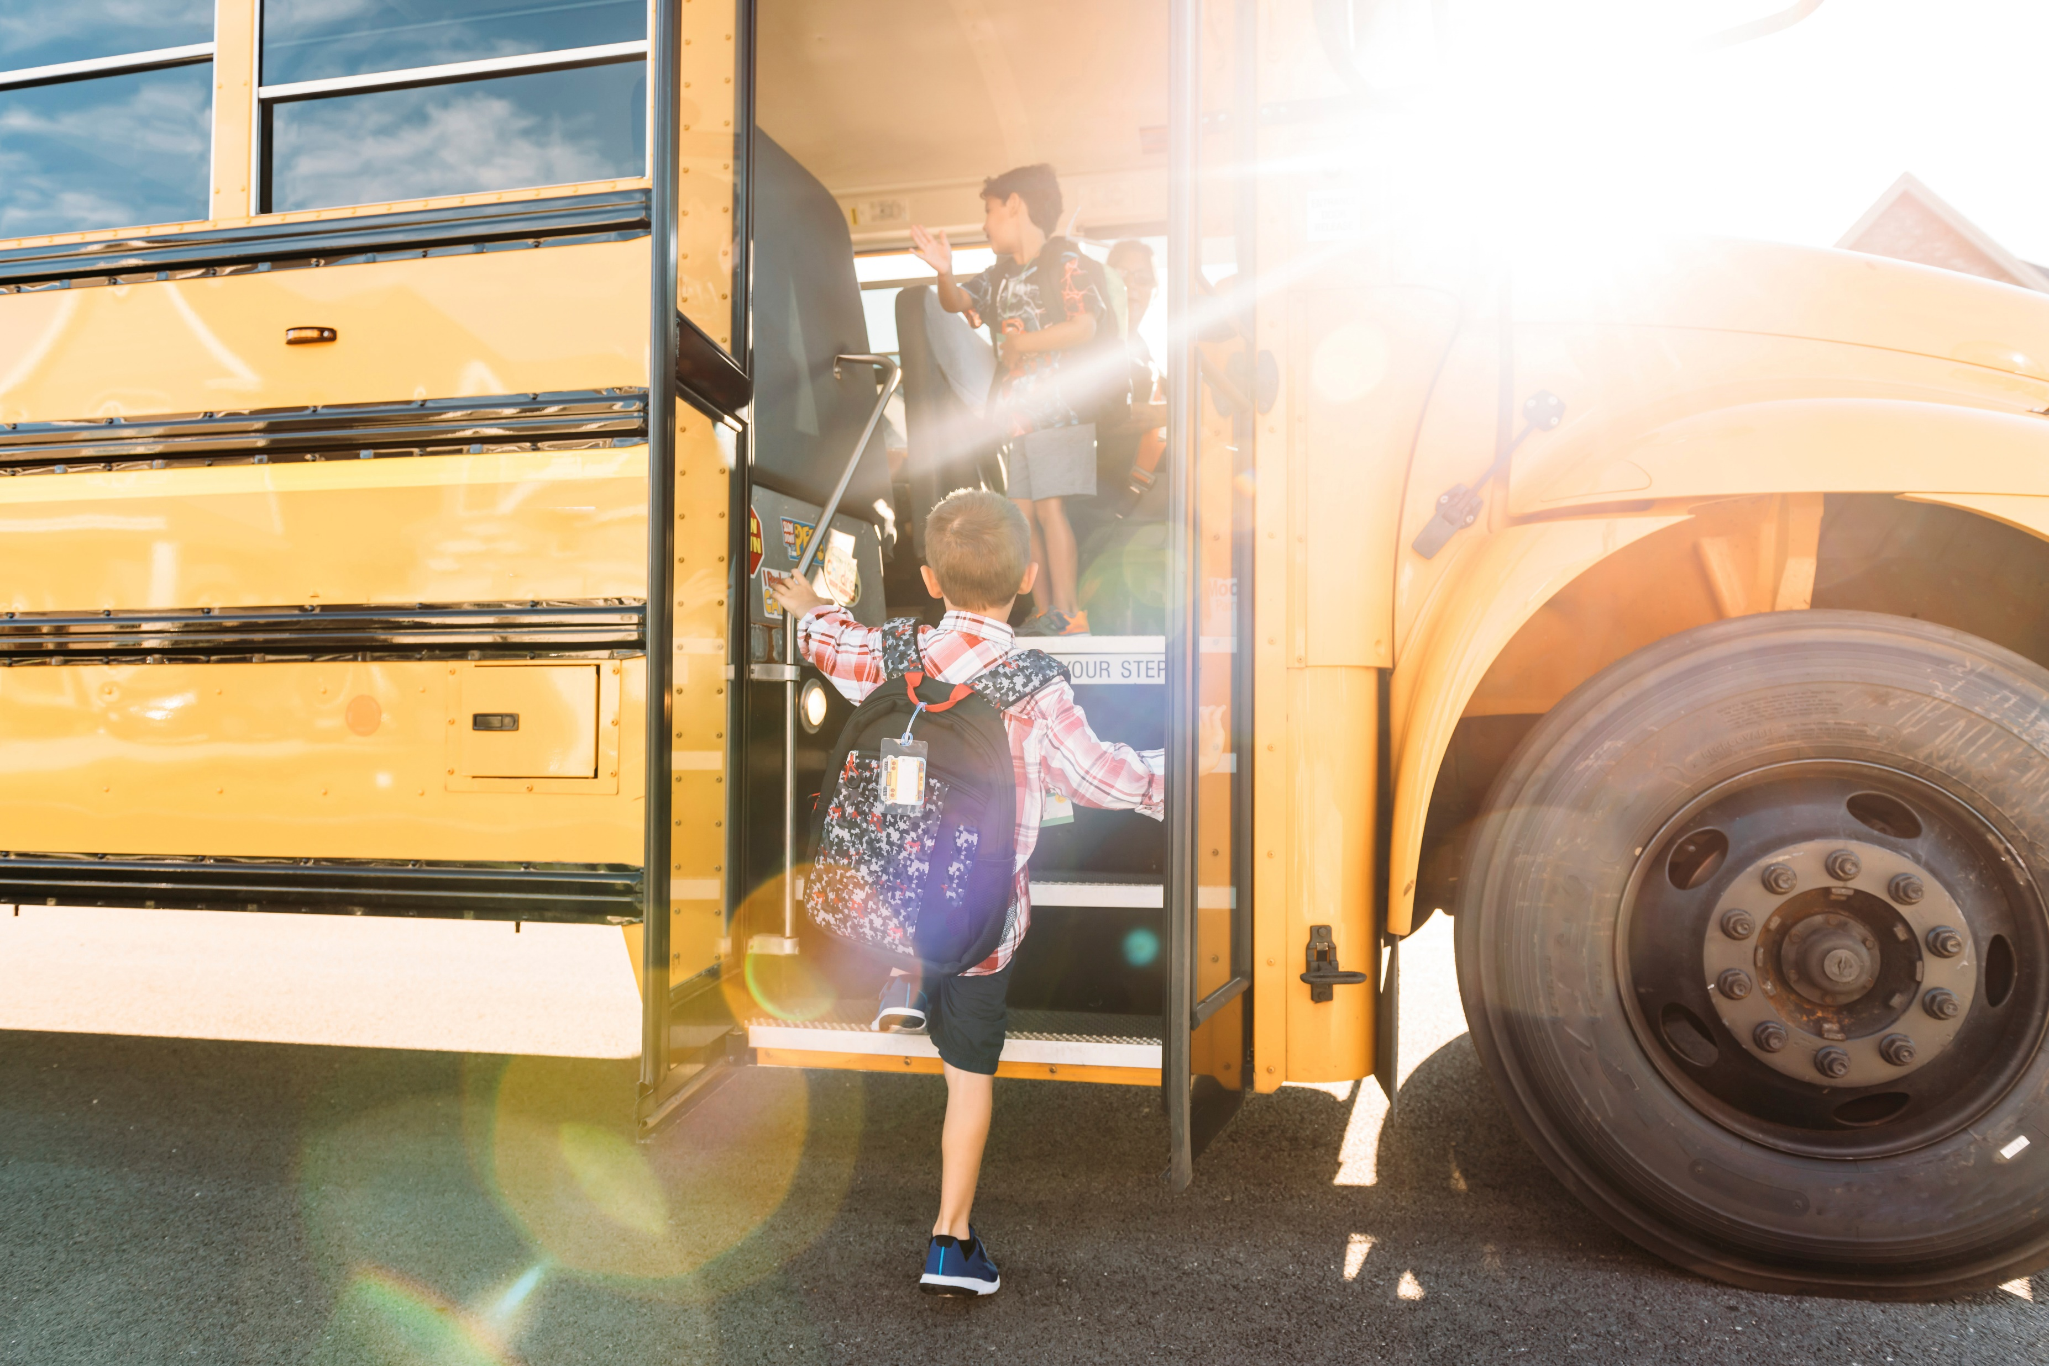

Imaginary situation of the past
reality
If you had caught the bus,
you would have been on time.
You didn’t catch the bus, so you were late.
✓

Slide 5



Imaginary situation of the past
reality
If I had scored the goal,
my team would have won.
I didn’t score, so my team lost.

Slide 6
When do we use this form?
… when we talk about an event that has already happened and the result can‘t be changed anymore!

Slide 7
How can we express an imaginary situation of the past?
If + had + 3rd form ….. , would + have + 3rd form
(condition) (result)
If Michael Jordan had given up, he would not have become such a successful basketball player.

Slide 8
-worksheet and grammar book page 63-

Slide 9
What did you do in your winter holidays?
Tell a real your partner about a real event that happened in your holidays.
Ask your partner: „What would have happened if …..?
Explain to your partner what would have been different and why.

