Slide 1
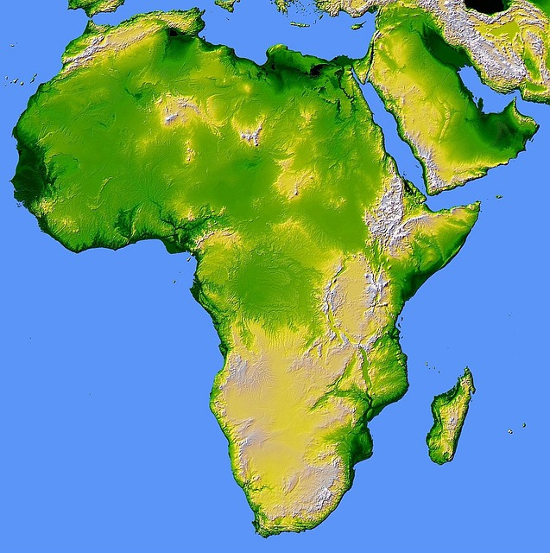
chameleon
scientist
reptile
rainforest
Madagascar
deforestation
Notes:
https://pixabay.com/de/photos/afrika-karte-relief-landkarte-land-11117/

Slide 2
chameleon
scientist
reptile
rainforest
Madagascar
deforestation

Slide 3
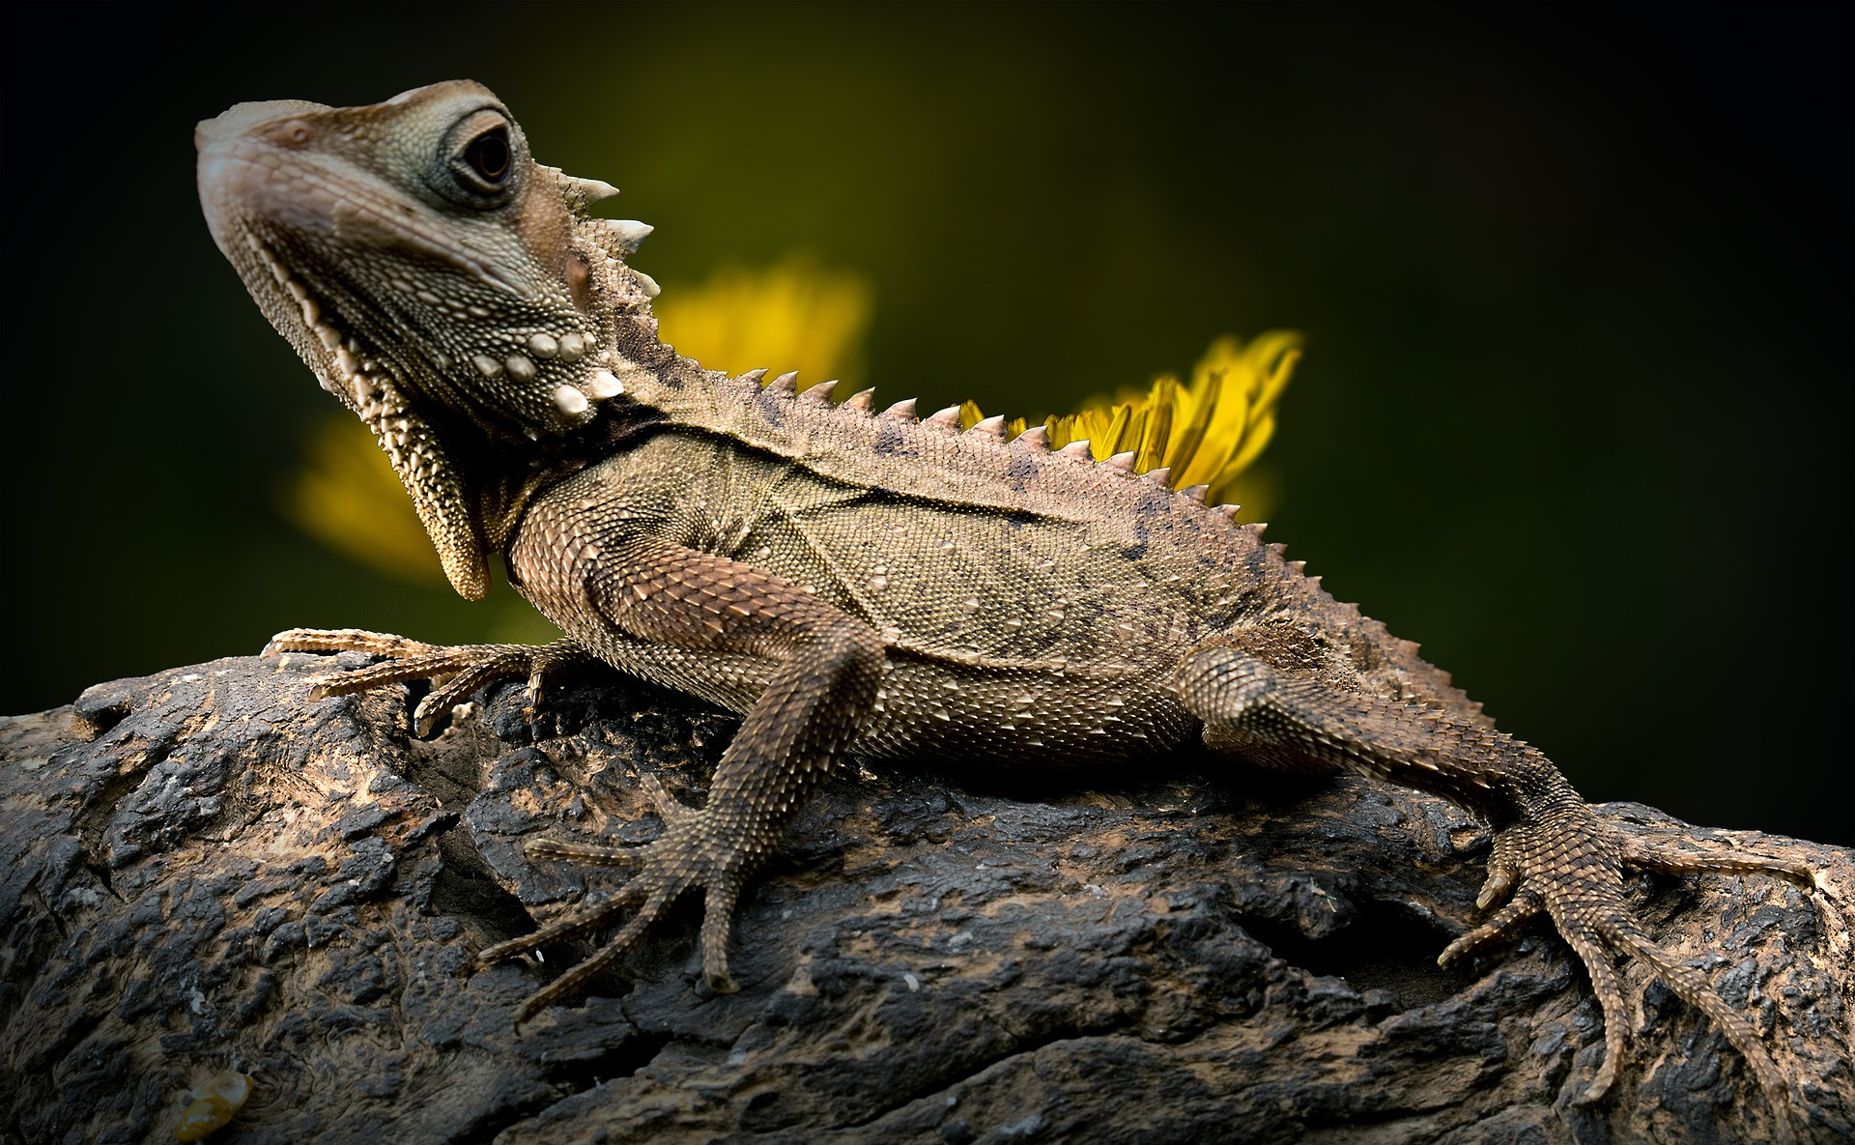
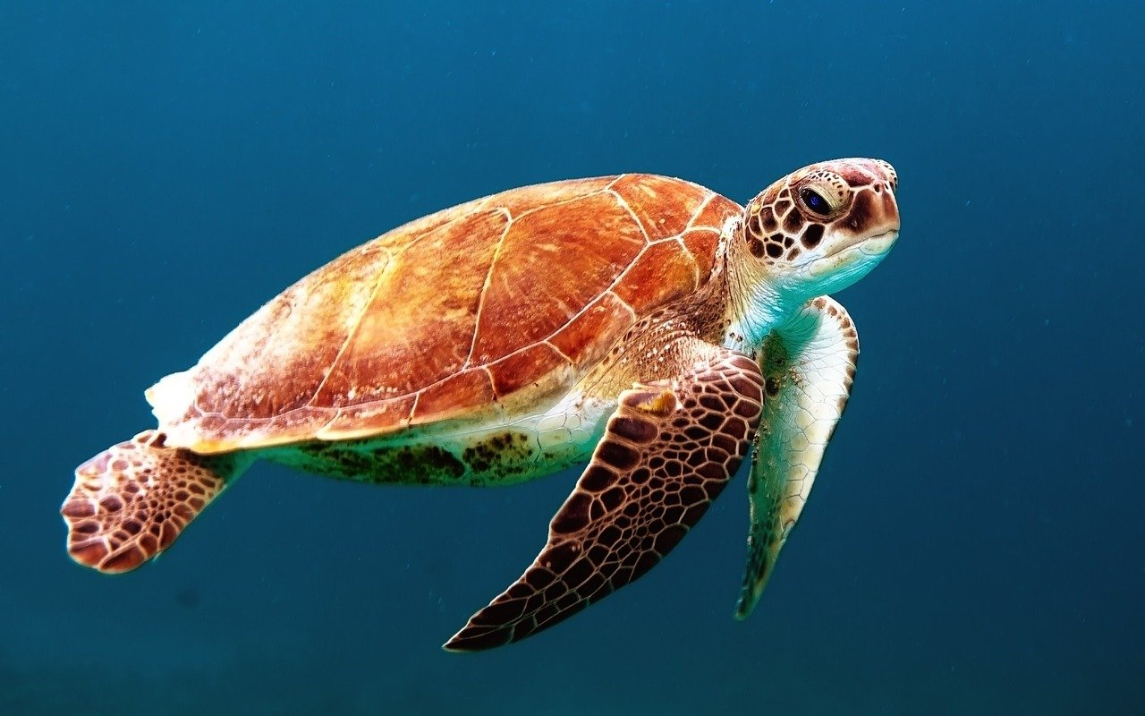
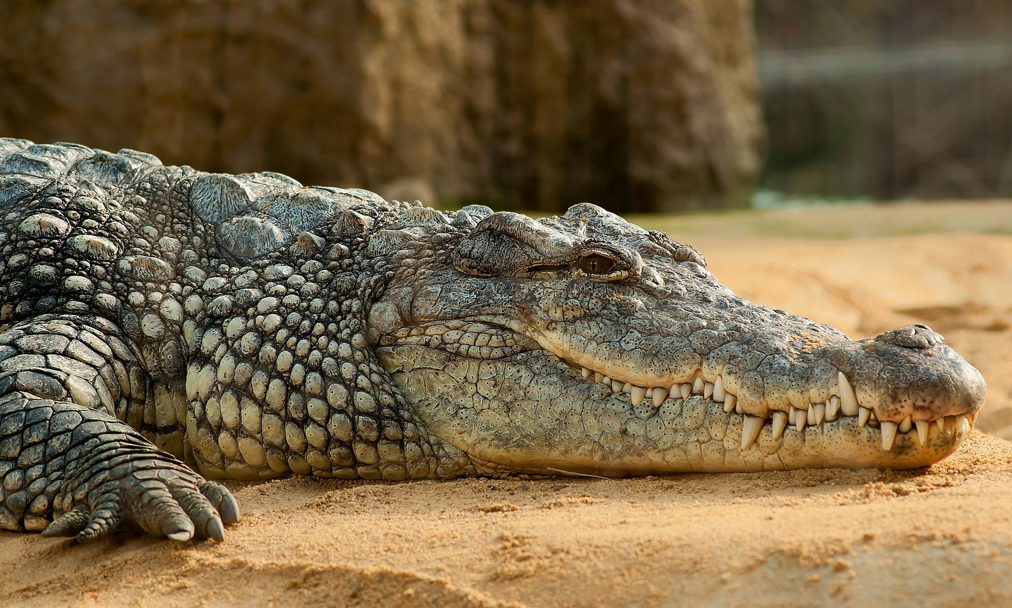
chameleon
scientist
reptile
rainforest
Madagascar
Pictures retreived from: https://pixabay.com/
deforestation

Slide 4
chameleon
scientist
reptile
rainforest
Madagascar
Pictures retreived from: https://pixabay.com/
deforestation

Slide 5
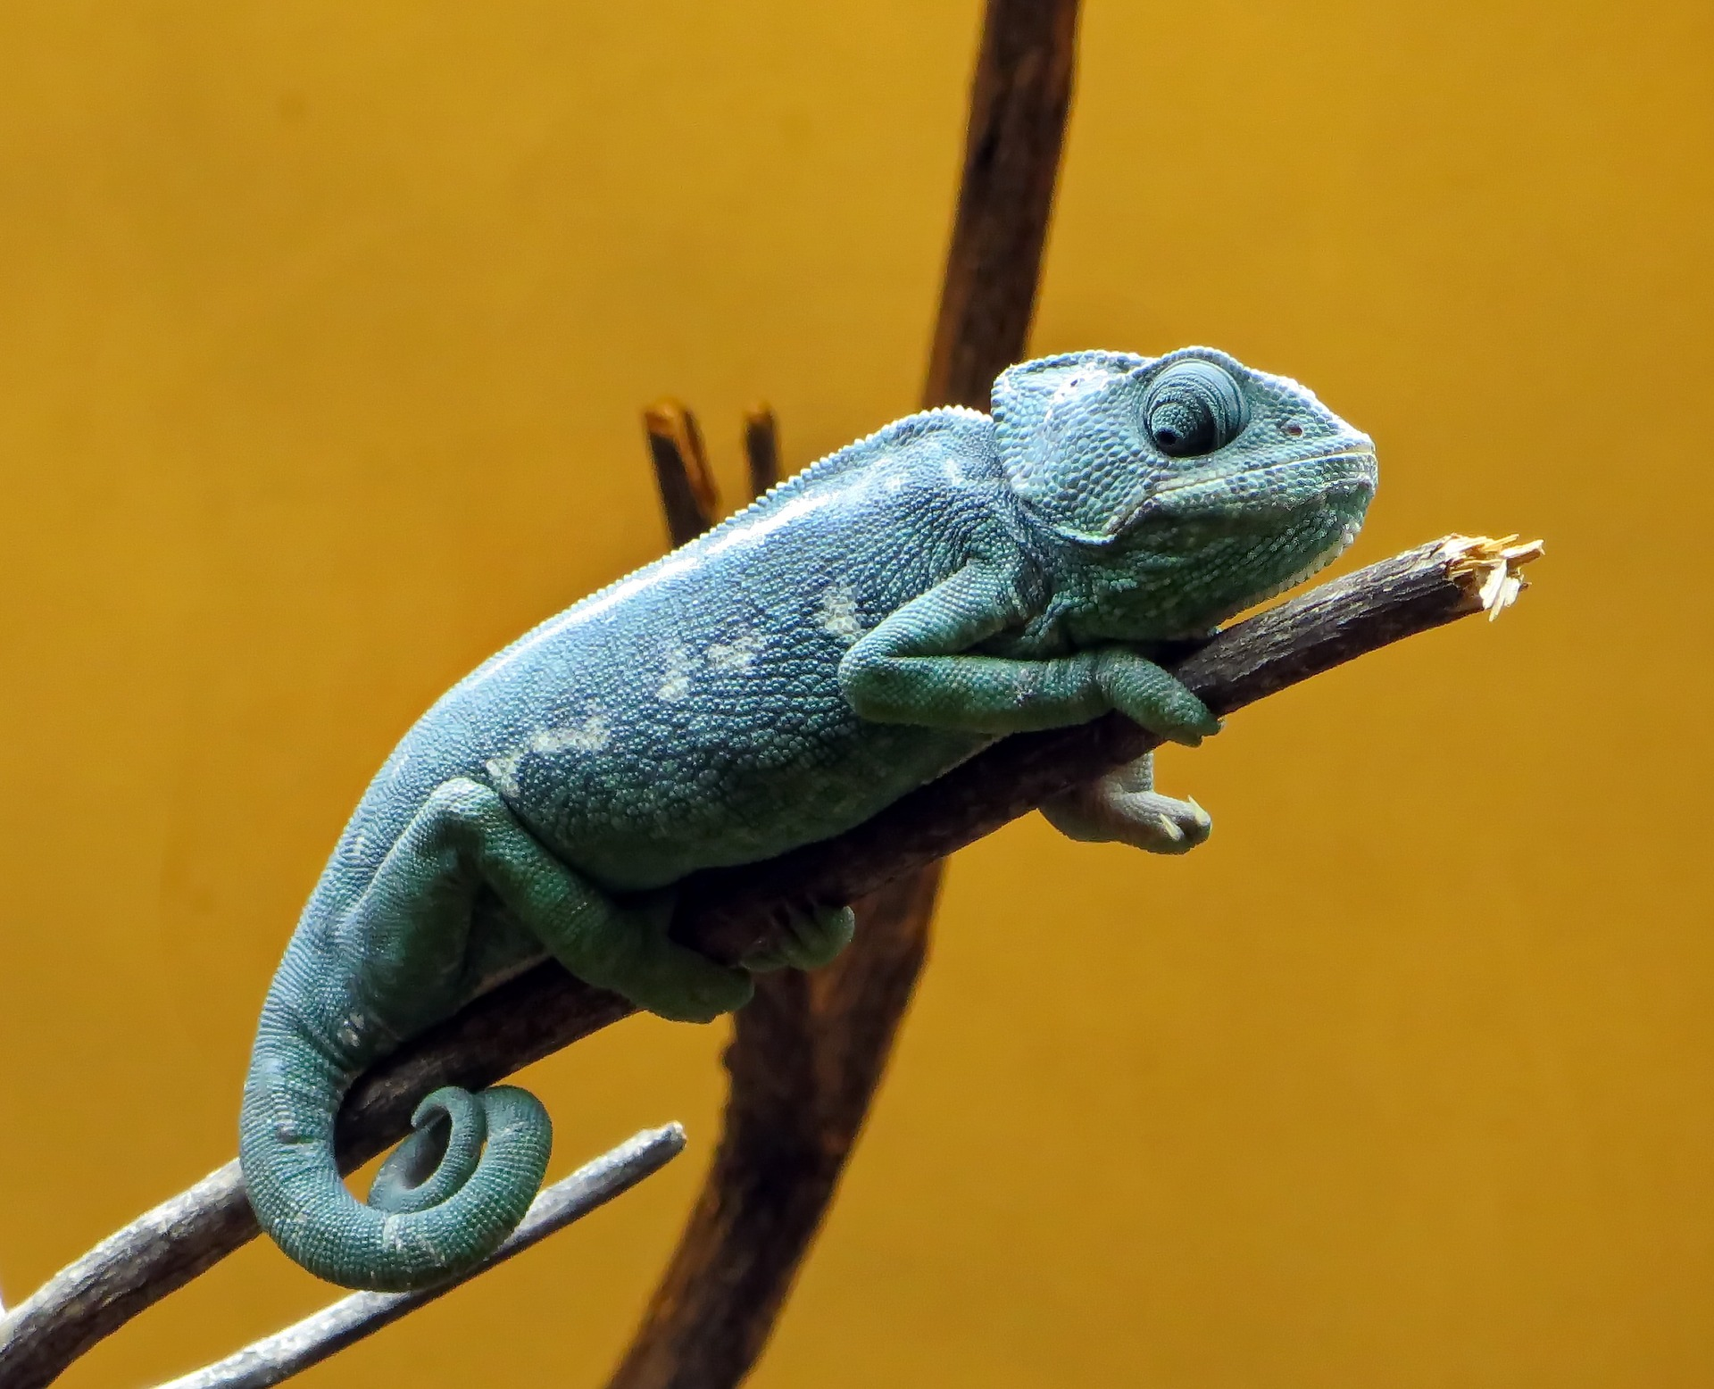
chameleon
scientist
reptile
rainforest
Pictures retreived from: https://pixabay.com/
Madagascar
deforestation

Slide 6
chameleon
scientist
reptile
rainforest
Pictures retreived from: https://pixabay.com/
Madagascar
deforestation

Slide 7
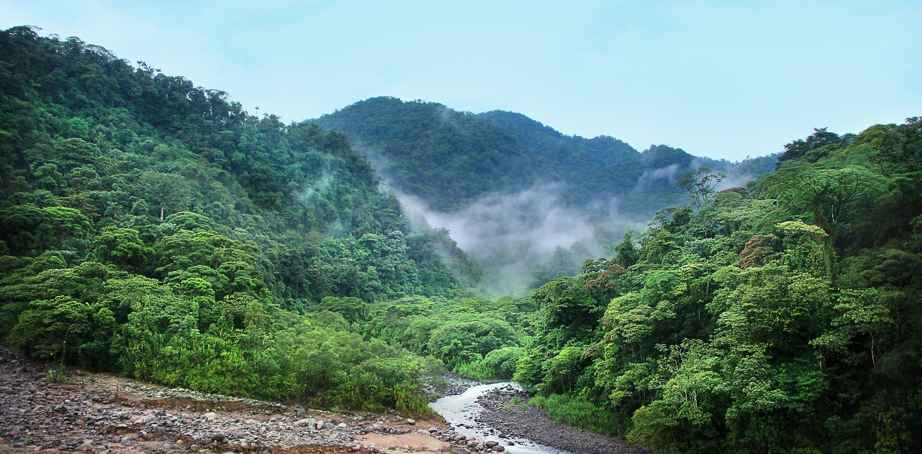
chameleon
scientist
reptile
rainforest
Pictures retreived from: https://pixabay.com/
Madagascar
deforestation

Slide 8
chameleon
scientist
reptile
rainforest
Pictures retreived from: https://pixabay.com/
Madagascar
deforestation

Slide 9

chameleon
scientist
reptile
rainforest
Pictures retreived from: https://pixabay.com/
Madagascar
deforestation

Slide 10
chameleon
scientist
reptile
rainforest
Pictures retreived from: https://pixabay.com/
Madagascar
deforestation

Slide 11
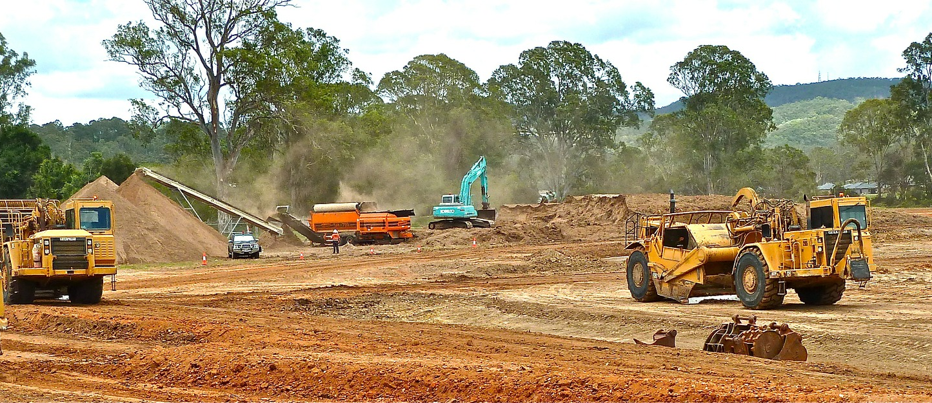
chameleon
scientist
reptile
rainforest
Pictures retreived from: https://pixabay.com/
Madagascar
deforestation

Slide 12
chameleon
scientist
reptile
rainforest
Pictures retreived from: https://pixabay.com/
Madagascar
deforestation

