Slide 1

What do you see?
Describe the people you see – who could they be and what are they doing?
Describe the images and the background.
Describe the text you see – Look up the meaning of any words you don‘t know. What could the text refer to?
What do you think this picture is used for?

Slide 2
This is a movie poster:
Based on your observations (people, images, text), what do you think this movie could be about?
Useful phrases:
I think …
I believe …
Maybe …
Probably …
It could be that …
The characters might be…
The movie could be about …
Because of …, I think/ believe …
Notes:
https://www.youtube.com/watch?v=D6HUv2eFdLg

Slide 3
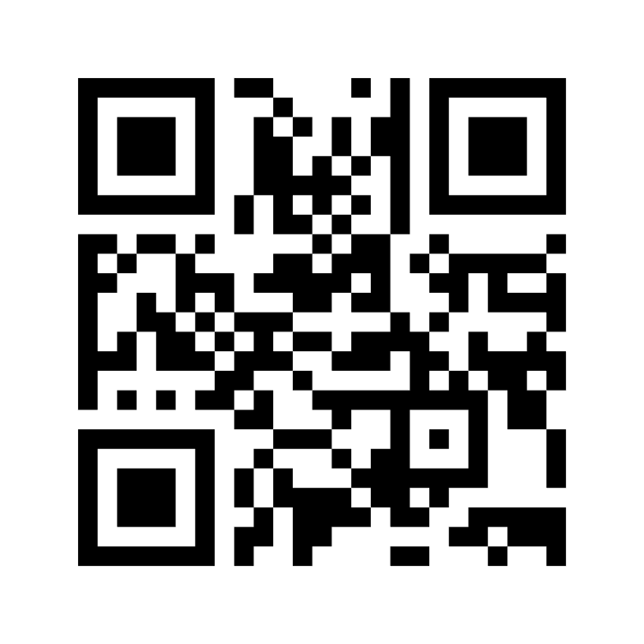
Go to this link and share how the video made you feel!
www.menti.com – Code: 3563 3416

Slide 4
After having watched the video, talk to your partner:
Were your predictions true or false?
Prepare one statement to share with your class!
Useful phrases:
We thought …, but …
We were right about …
We were wrong about …
We assumed that …, but …
It seemed like …
In reality, …
The movie was really about …
Like we thought, the characters were…

Slide 5

Role Play
It‘s the next day and you are in math class again. Moises is still struggling because of his English. Play out the scene and try to end it with a positive resolution for the situation!

Slide 6
Situation 1: You have a new classmate, who just came to Austria from the Ukraine. They are struggling to adapt to the new situation. Especially because they know almost no German, they have difficulties following class and making friends.
Situation 2: Your friend is very passionate about climate change, and they want to live as environmentally friendly as possible. However, they struggle to do so because their parents aren’t very aware or interested in the issue.
Situation 3: Your friend is very passionate about animal rights and would like to go vegan. However, their family is very worried about it because they don’t know much about veganism and think it’s unhealthy, complicated and expensive.
Situation 4: You have a classmate, who moved to Austria from Mexico a few years ago. When speaking German, they sometimes make mistakes and have a strong accent. Because of this, a few kids in your class make fun of them, which makes them feel discouraged and unwelcome.

Slide 7
Now it’s your turn: write a letter of advice to one of these people! (~250 words)
Your letter should…
… be a response to an e-mail from your friend asking you for advice and refer to their e-mail.
… express your understanding for your friend’s problem and try to cheer them up.
… include at least three pieces of advice and say why they could be helpful for your friend.
… be well-structured such as the model-text and include connecting words and phrases.
Situation 1: You have a new classmate, who just came to Austria from the Ukraine. They are struggling to adapt to the new situation. Especially because they know almost no German, they have difficulties following class and making friends.
Situation 2: Your friend is very passionate about climate change, and they want to live as environmentally friendly as possible. However, they struggle to do so because their parents aren’t very aware or interested in the issue.
Situation 3: Your friend is very passionate about animal rights and would like to go vegan. However, their family is very worried about it because they don’t know much about veganism and think it is unhealthy, complicated and expensive.
Situation 4: You have a classmate, who moved to Austria from Mexico a few years ago. When speaking German, they sometimes make mistakes and have a strong accent. Because of this, a few kids in your class make fun of them, which makes them feel discouraged and unwelcome.

Slide 8
Talk to someone you haven‘t talked to today!
Have you ever had a similar experience as Moises? Have you ever struggled to understand/ learn a foreign language? Have you ever been surrounded by a language you did not speak? How did you deal with it?
Have you ever had a positive language learning experience? What made it so positive?
When you have finished, move on to another person!

