Slide 1
In the CHRISTMAS HOLIDAYS, I ....

Slide 2
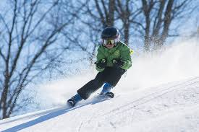
In the christmas holidays ...
I went skiing.
Me too!
Really?

Slide 3
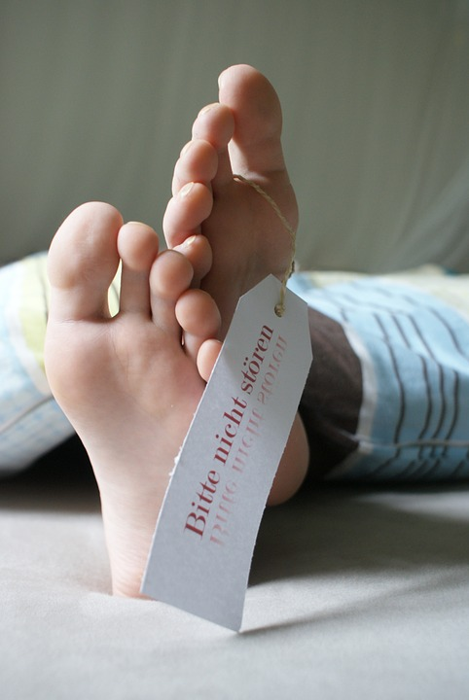
In the christmas holidays ...
I slept till ten o‘clock.
Me too!
Really?
http://maxpixel.freegreatpicture.com/Rest-Bed-Tired-Pension-Sleep-Relax-Feet-Hotel-449159
Notes:
http://maxpixel.freegreatpicture.com/Rest-Bed-Tired-Pension-Sleep-Relax-Feet-Hotel-449159

Slide 4

In the christmas holidays ...
I read a book.
Me too!
Really?
http://maxpixel.freegreatpicture.com/Rest-Bed-Tired-Pension-Sleep-Relax-Feet-Hotel-449159
Notes:
http://maxpixel.freegreatpicture.com/Rest-Bed-Tired-Pension-Sleep-Relax-Feet-Hotel-449159

Slide 5
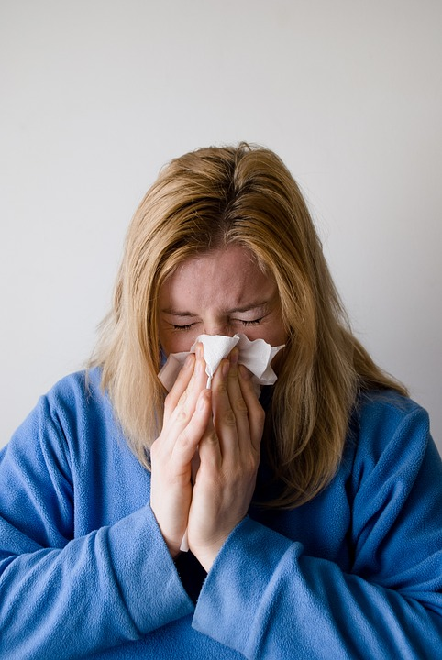
In the christmas holidays ...
I was ill.
Me too!
Oh dear!
That‘s a shame.
http://maxpixel.freegreatpicture.com/Nose-Grey-Blow-Hand-Chief-Woman-Blond-Blowing-698964
Notes:
http://maxpixel.freegreatpicture.com/Nose-Grey-Blow-Hand-Chief-Woman-Blond-Blowing-698964

Slide 6
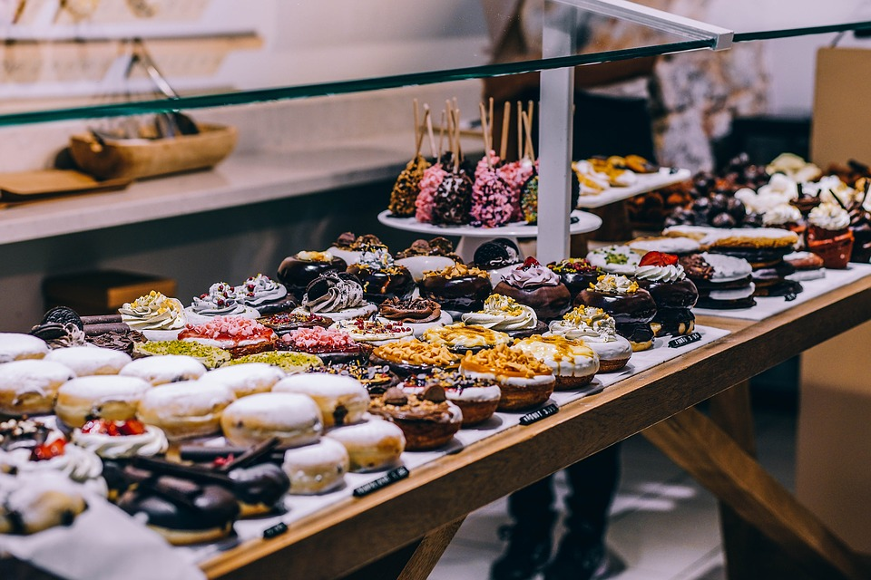
In the christmas holidays ...
I had a lot to eat.
Me too!
Really?
http://maxpixel.freegreatpicture.com/Bread-Chocolate-Buffet-Baked-Bakery-Abundance-1868573
Notes:
http://http://maxpixel.freegreatpicture.com/Bread-Chocolate-Buffet-Baked-Bakery-Abundance-1868573

Slide 7
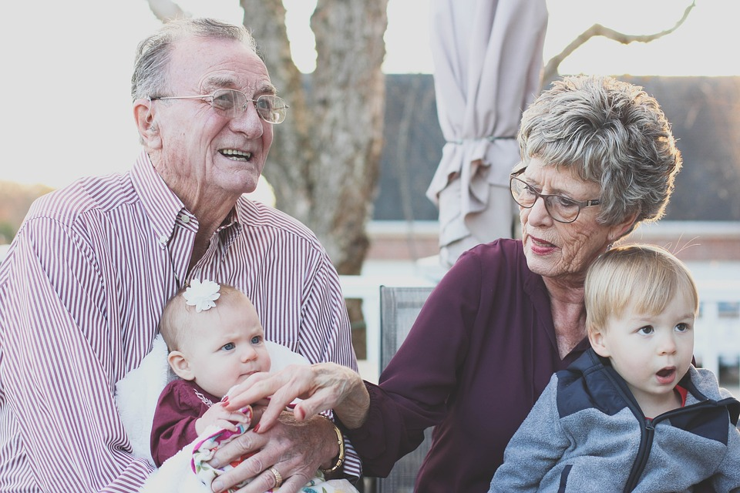
In the christmas holidays ...
I visited my grandparents.
Me too!
Really?
http://maxpixel.freegreatpicture.com/Happy-Grandmother-Family-People-Grandparents-1969824
Notes:
http://maxpixel.freegreatpicture.com/Happy-Grandmother-Family-People-Grandparents-1969824

Slide 8
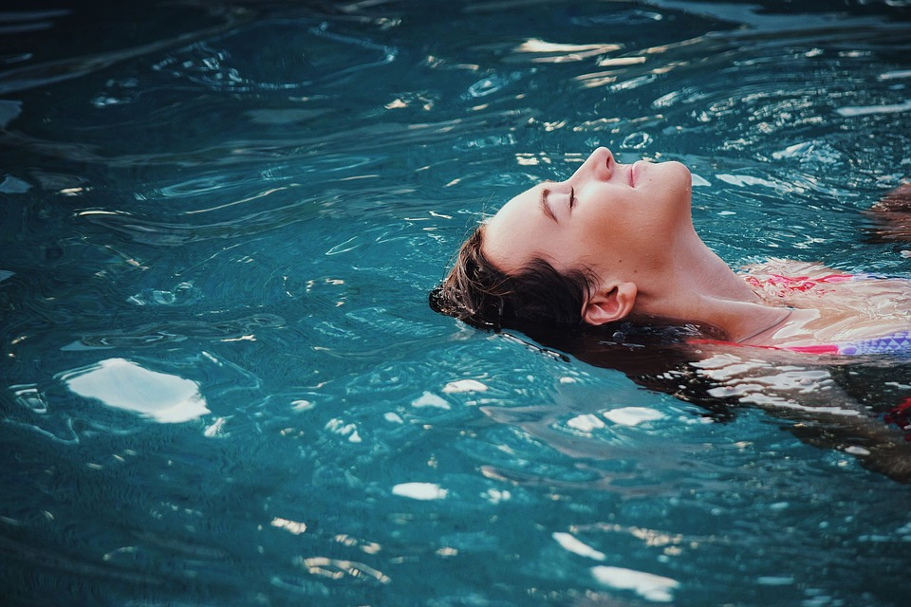
In the christmas holidays ...
I went swimming.
Me too!
Really?
http://maxpixel.freegreatpicture.com/Person-Relaxing-Ripples-Fun-Leisure-Recreation-1850709
Notes:
http://maxpixel.freegreatpicture.com/Person-Relaxing-Ripples-Fun-Leisure-Recreation-1850709

Slide 9
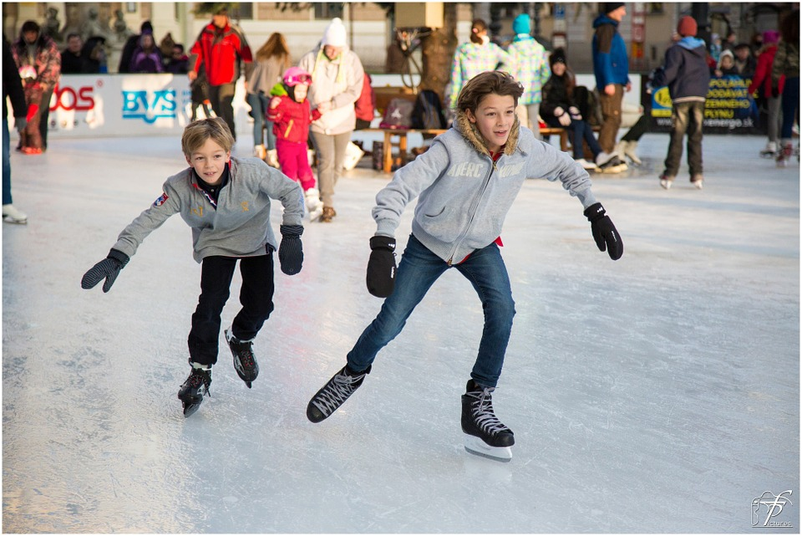
In the christmas holidays ...
I went ice skating.
Me too!
Really?
http://maxpixel.freegreatpicture.com/Skating-Ice-skating-Figure-Skating-Ice-Skating-235547
Notes:
http://maxpixel.freegreatpicture.com/Skating-Ice-skating-Figure-Skating-Ice-Skating-235547

Slide 10
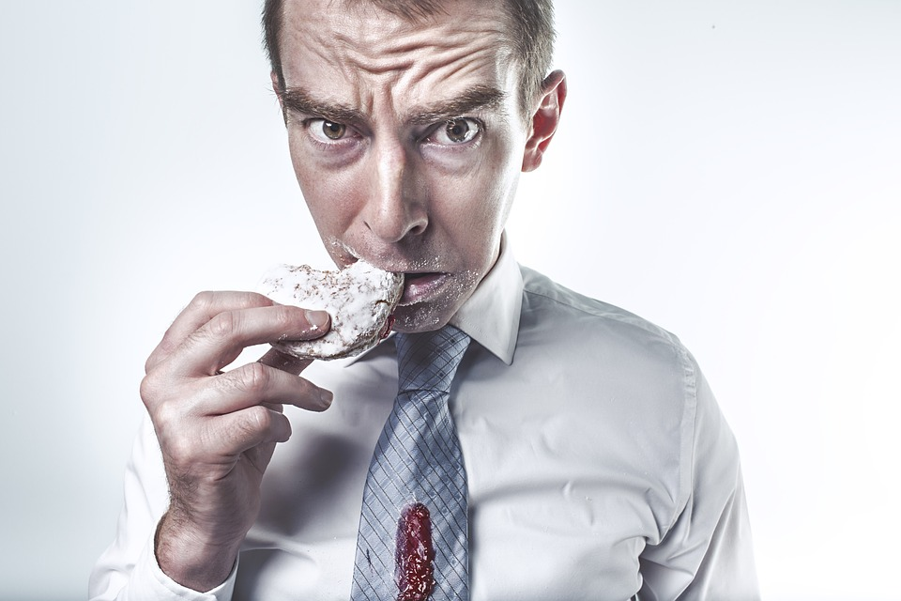
In the christmas holidays ...
I ate Christmas cookies.
Me too!
Really?
http://maxpixel.freegreatpicture.com/Hungry-Eating-Biscuit-Cookie-Hunger-Cracker-413685
Notes:
http://maxpixel.freegreatpicture.com/Hungry-Eating-Biscuit-Cookie-Hunger-Cracker-413685

Slide 11

In the christmas holidays ...
I played computer games.
Me too!
Really?
http://maxpixel.freegreatpicture.com/Win-Success-Happy-Children-Play-Video-Game-593313
Notes:
http://maxpixel.freegreatpicture.com/Win-Success-Happy-Children-Play-Video-Game-593313

Slide 12
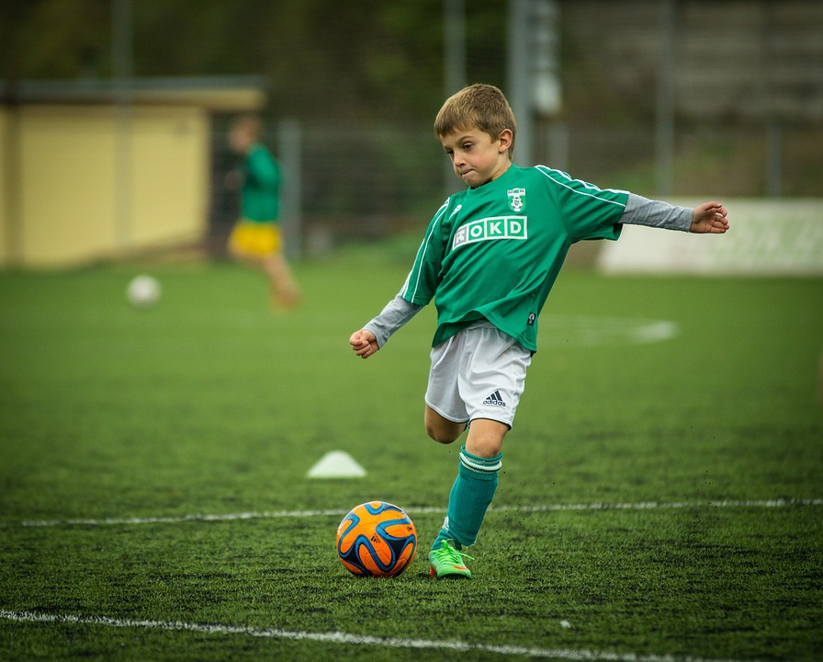
In the christmas holidays ...
I played football.
Me too!
Really?
http://maxpixel.freegreatpicture.com/Football-Child-Sphere-Backswing-Footballer-Kick-613199
Notes:
http://maxpixel.freegreatpicture.com/Football-Child-Sphere-Backswing-Footballer-Kick-613199

Slide 13
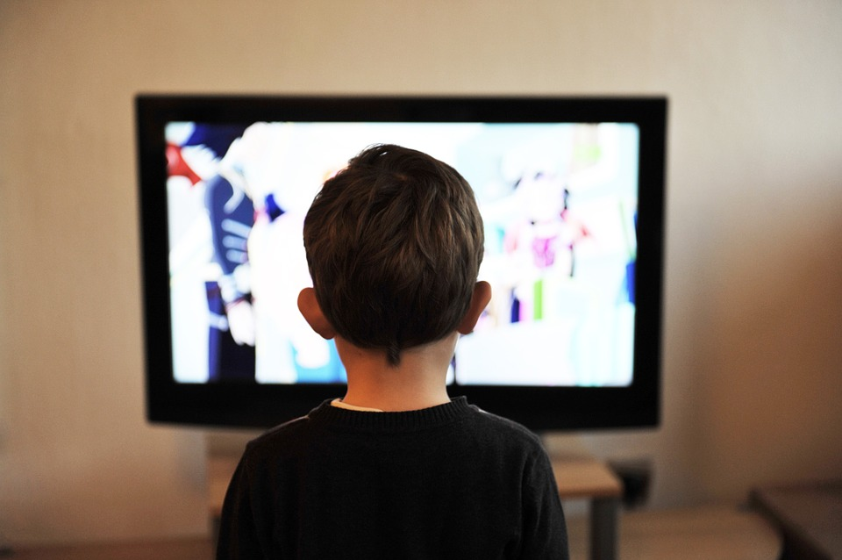
In the christmas holidays ...
I watched TV.
Me too!
Really?
http://maxpixel.freegreatpicture.com/Television-Children-Boy-People-Child-Home-Tv-403582
Notes:
http://maxpixel.freegreatpicture.com/Television-Children-Boy-People-Child-Home-Tv-403582

Slide 14

What did you do in the Christmas Holidays?
Notes:
http://maxpixel.freegreatpicture.com/Group-Clouds-Balloons-Team-Question-Mark-Problems-464644

