Slide 1
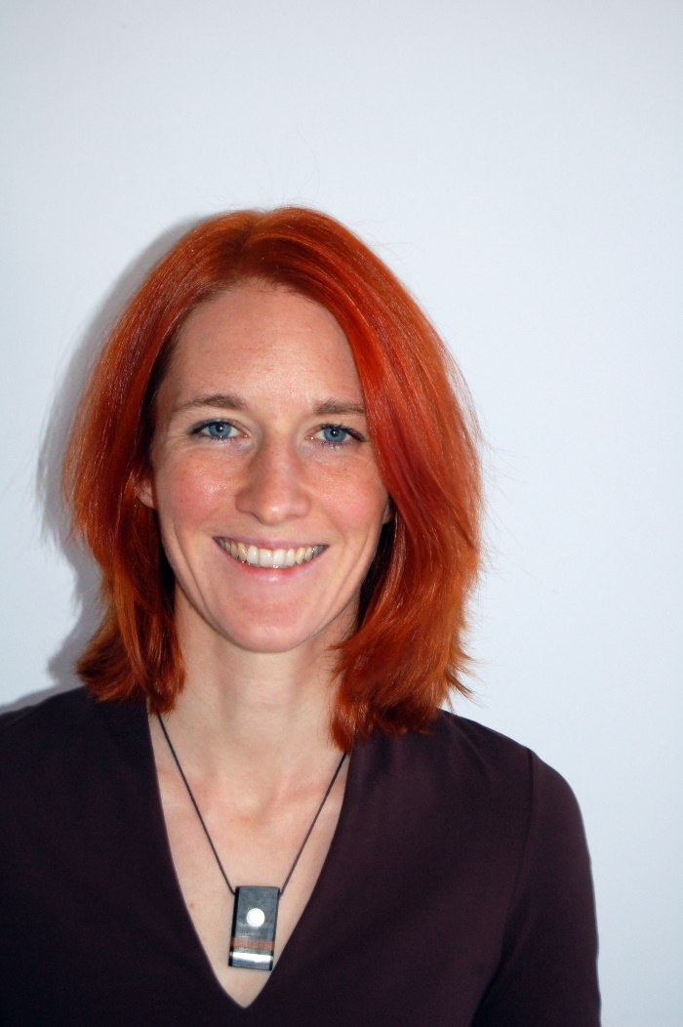
Hello, I’m your new English teacher and I’m going to introduce myself That’s me.

Slide 2
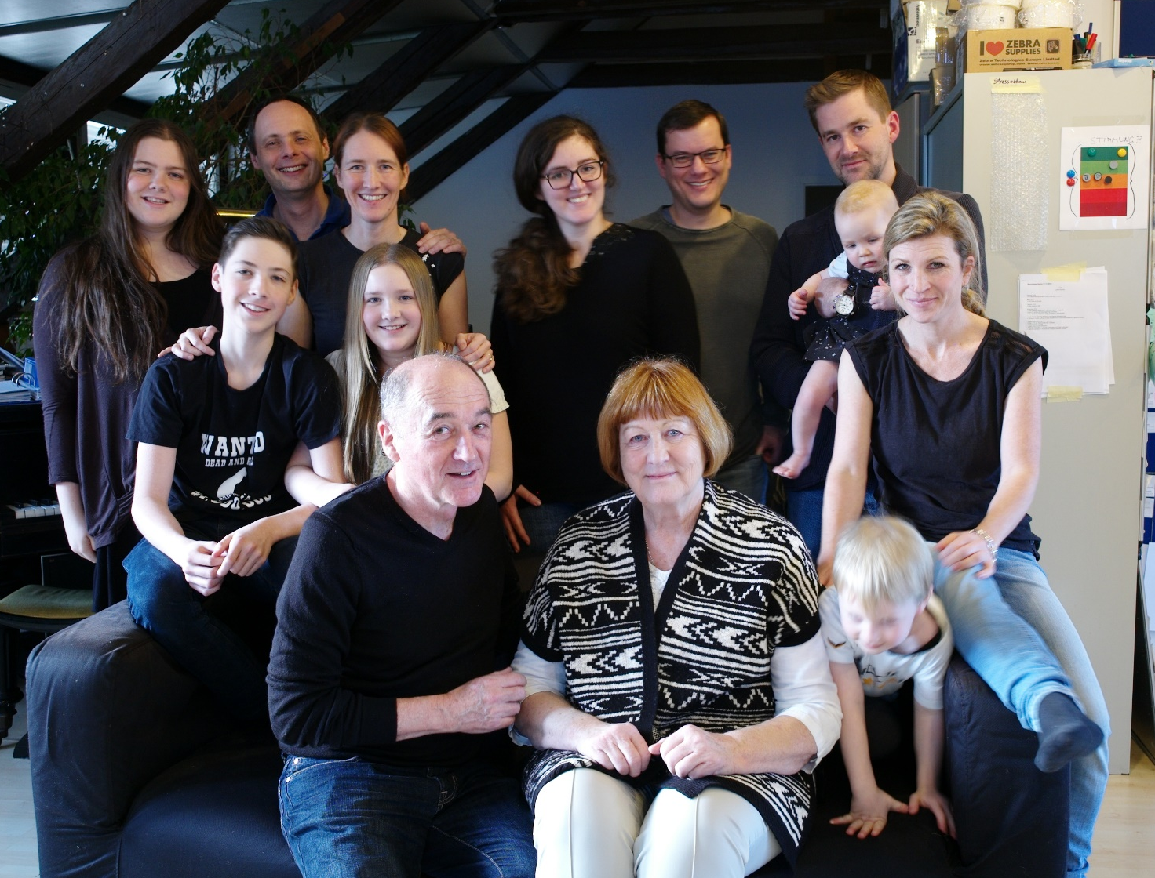
I have got a big family and I love my family.

Slide 3
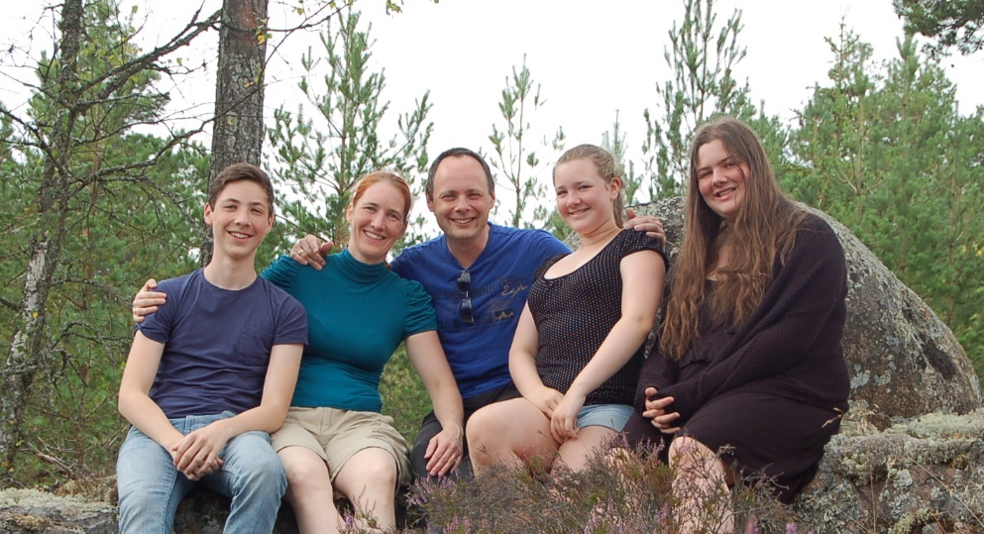
This is my husband, Andreas.

Slide 4
3
2
1
We have got three kids,
two daughters and one son.

Slide 5
This is Julia. She is the oldest.

Slide 6
This is Martina,
she is the youngest.

Slide 7
And this is Matthias.

Slide 8
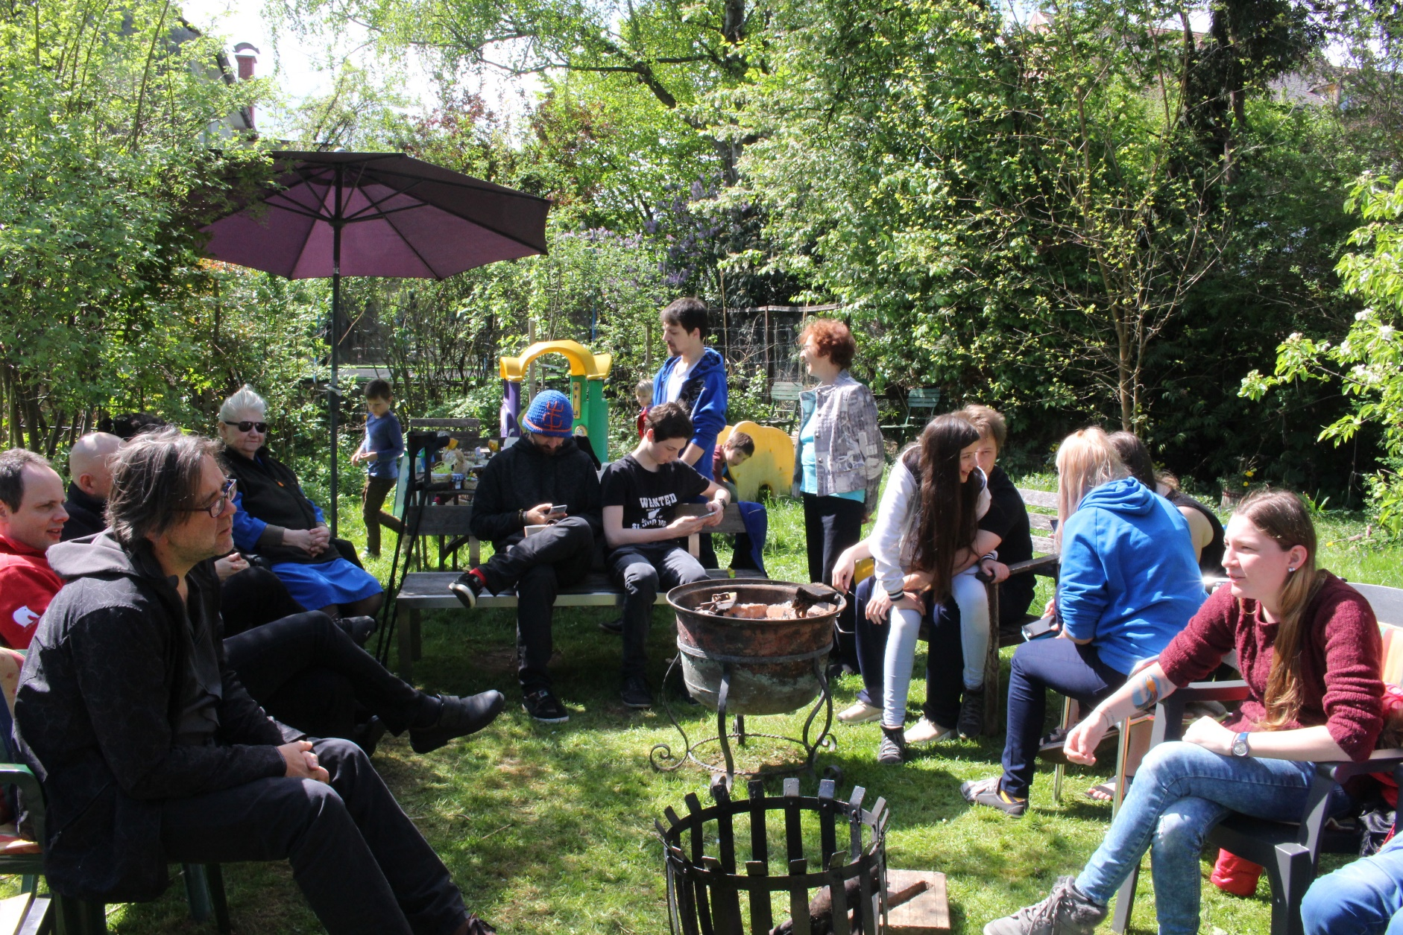
We live in a house with many other family members. Grandparents, uncles, aunts and many, many cousins. I love my big family.

Slide 9
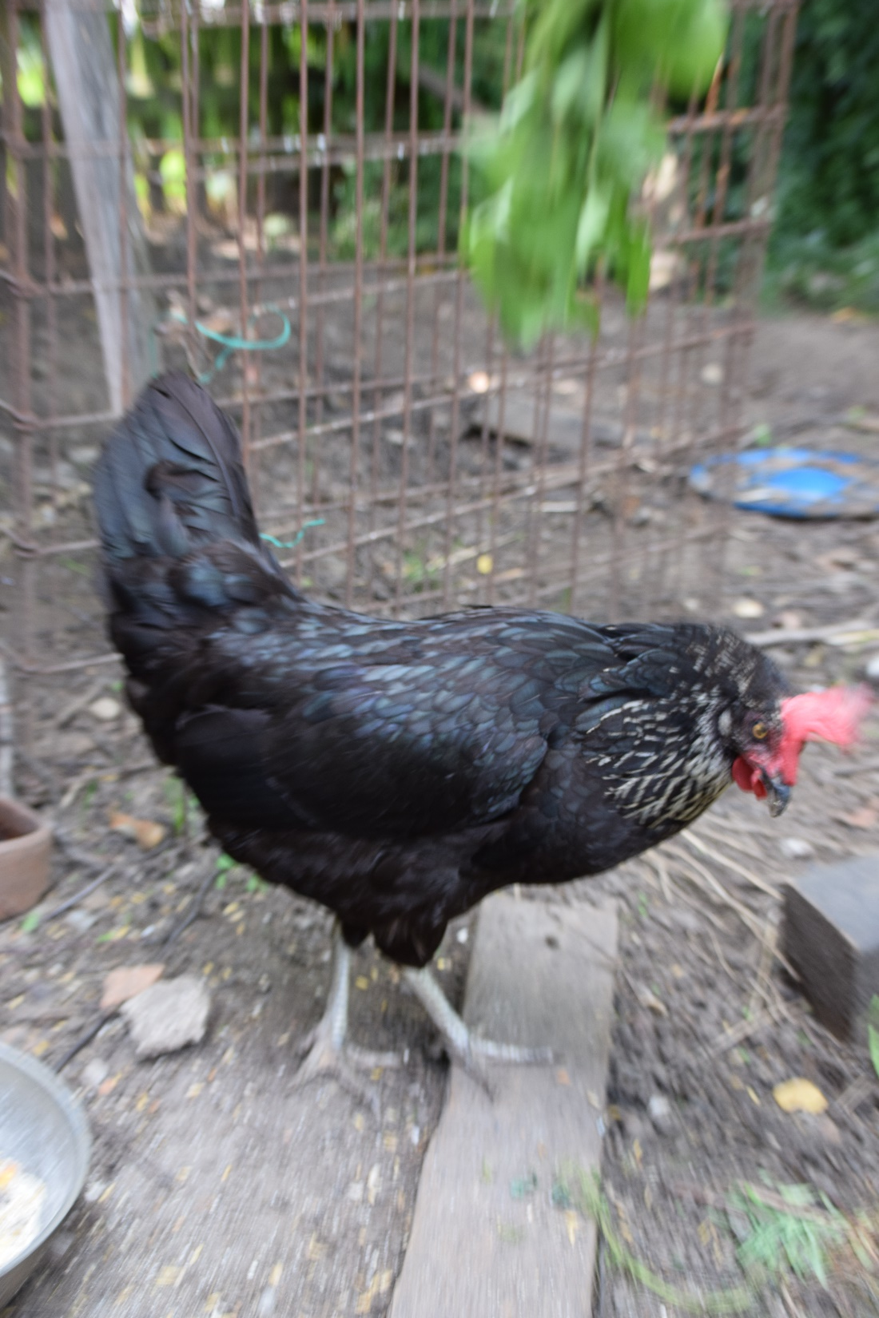
I like animals.
This is our chicken.
It lives in the garden.

Slide 10
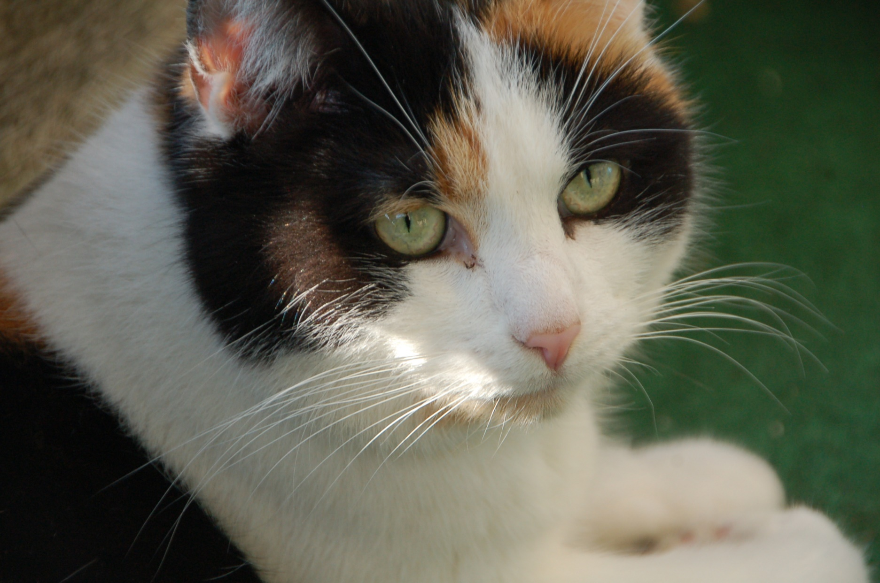
This is my cat, Kuschel. She is beautiful because she has got three colours – black, white and brown.
I really love Kuschel.

Slide 11
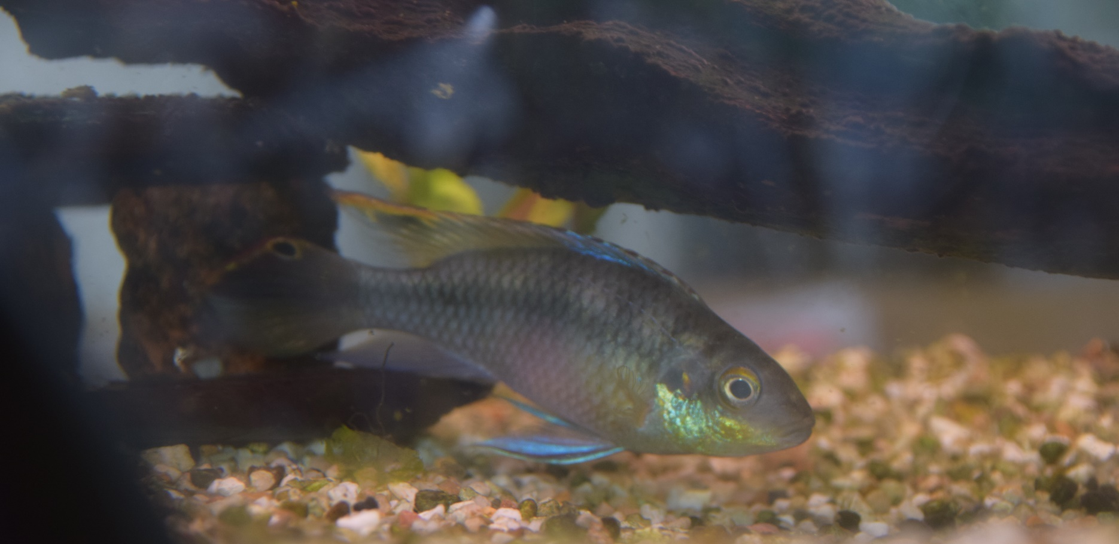
I also like our fish. They are beautiful.

Slide 12
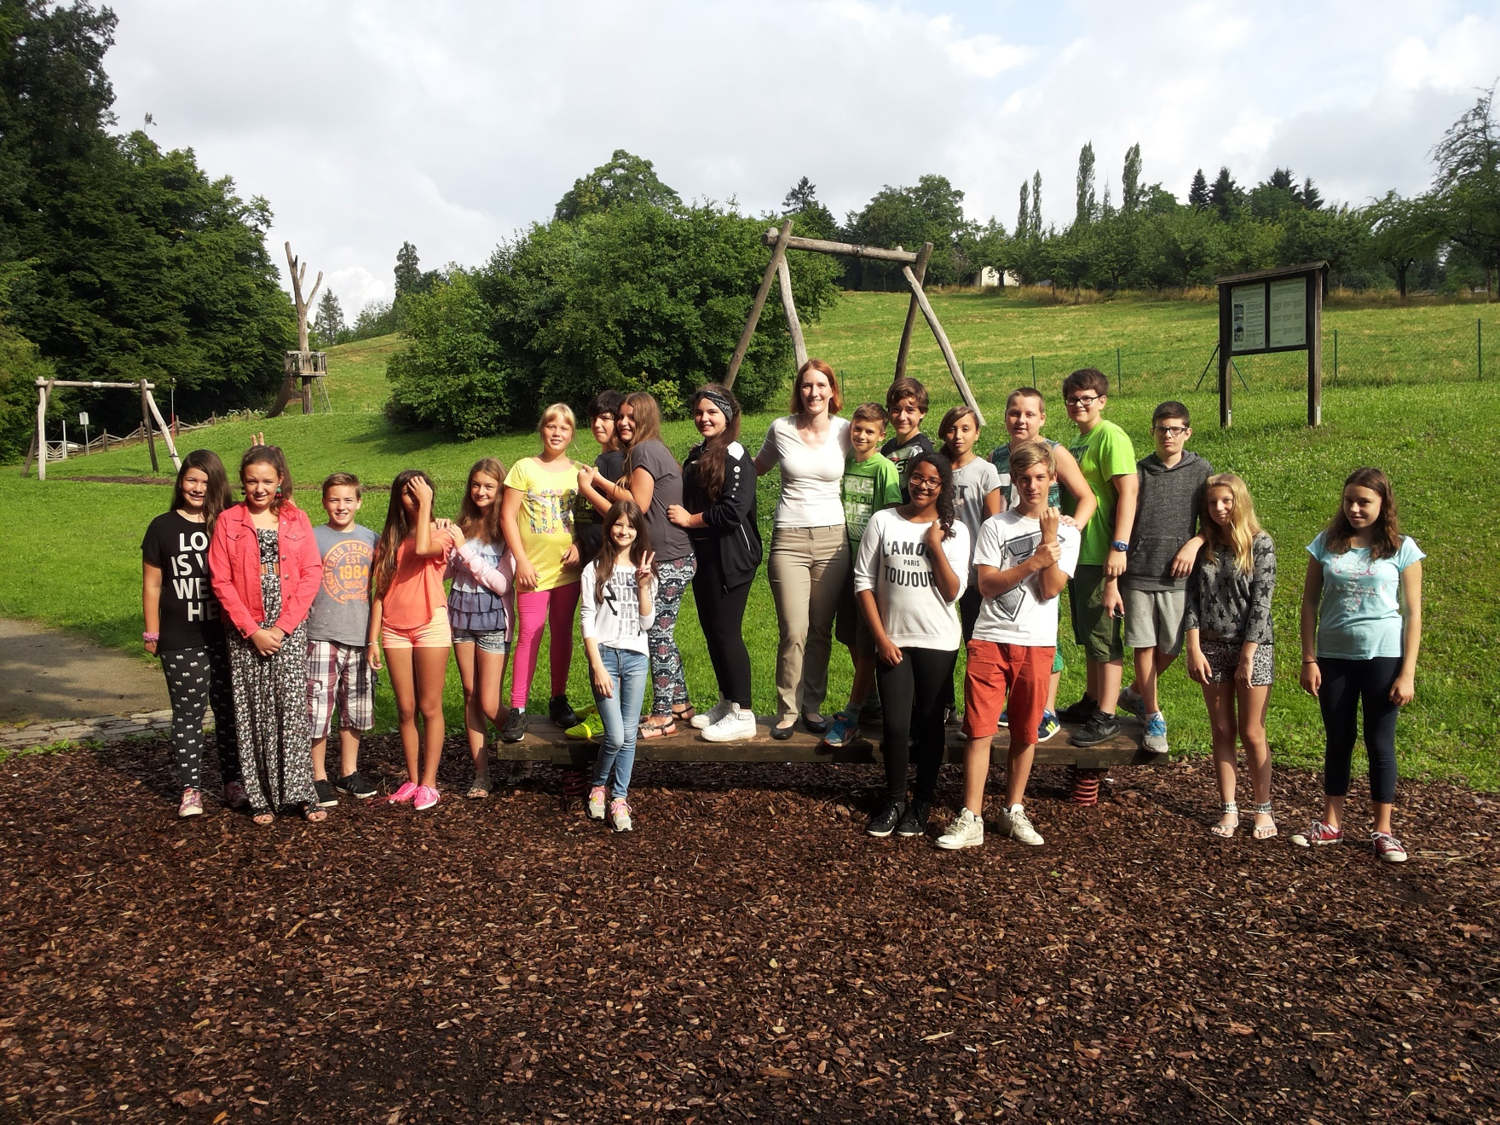
I like school a lot and I love speaking English. These are my old students. They are in a new school now.

Slide 13
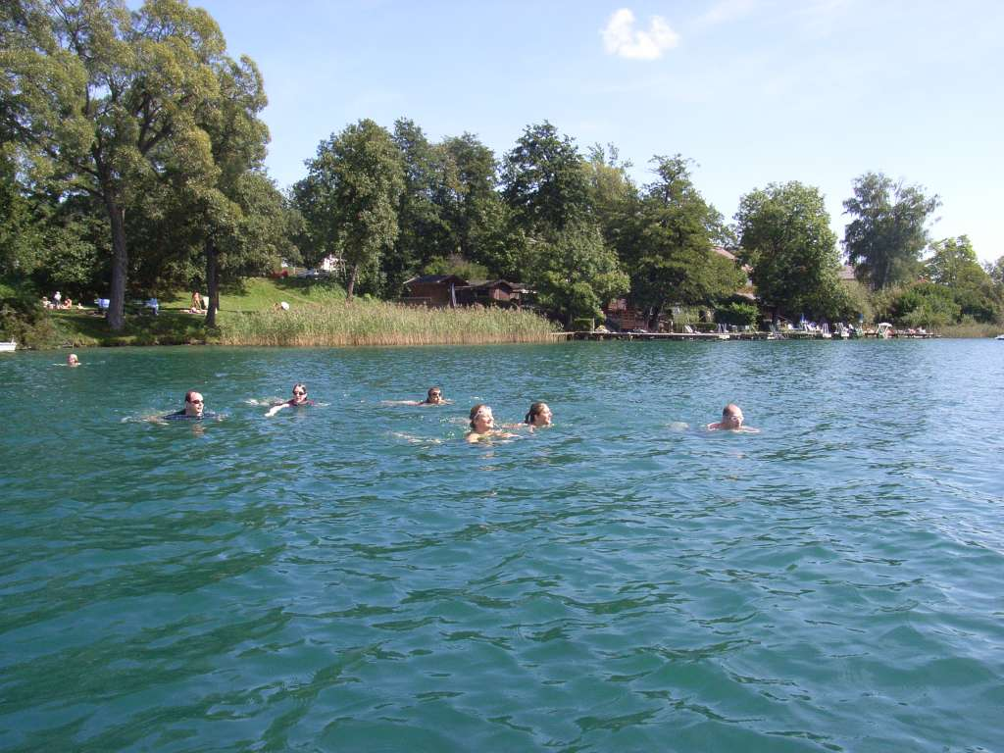
I like sports. In summer I go swimming a lot. I love swimming and I love lake Wörthersee. It’s my favourite lake.

Slide 14
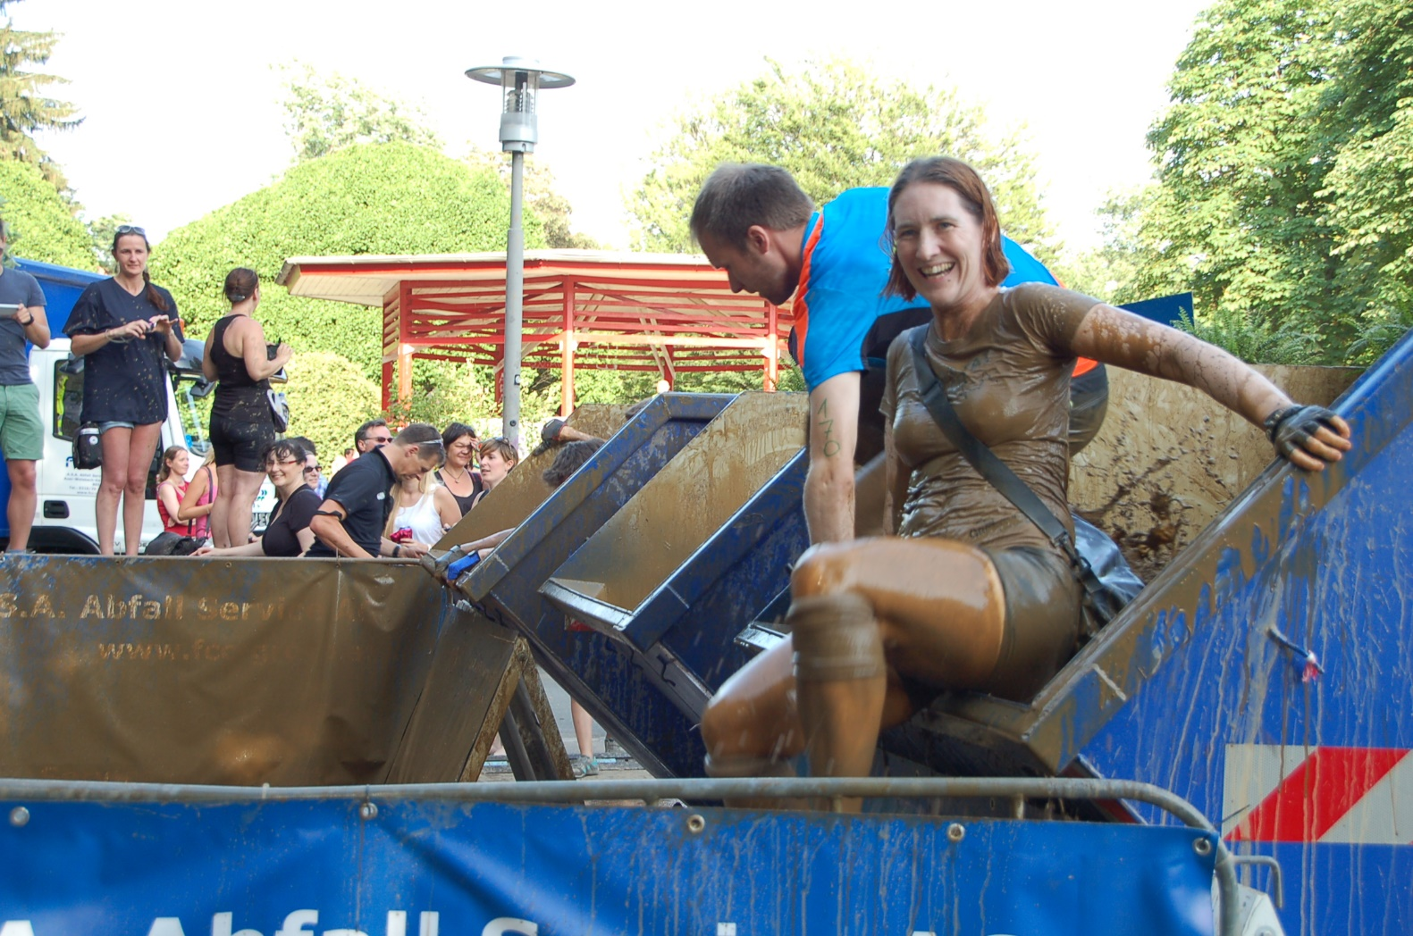
I also like jogging and in June I take part in the Grazathlon. It is a crazy run through Graz. You get very dirty. I like the Grazathlon. It’s a lot of fun.

Slide 15
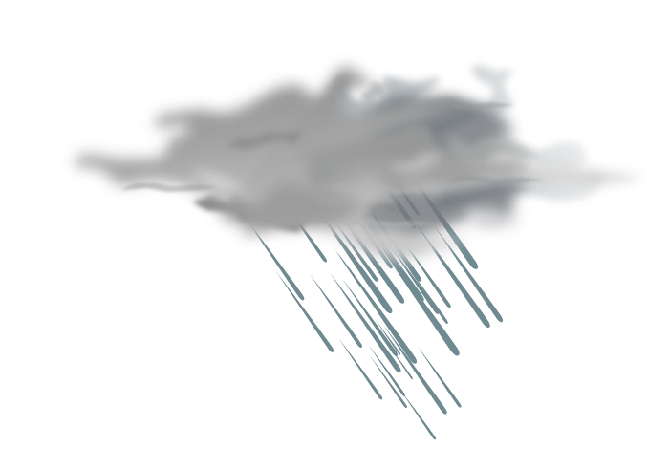

I like riding my bike.
I always ride my bike to school, even if it rains.

Slide 16

I love dancing. I go dancing every week with my husband Andreas.
Dancing is a lot of fun.

Slide 17
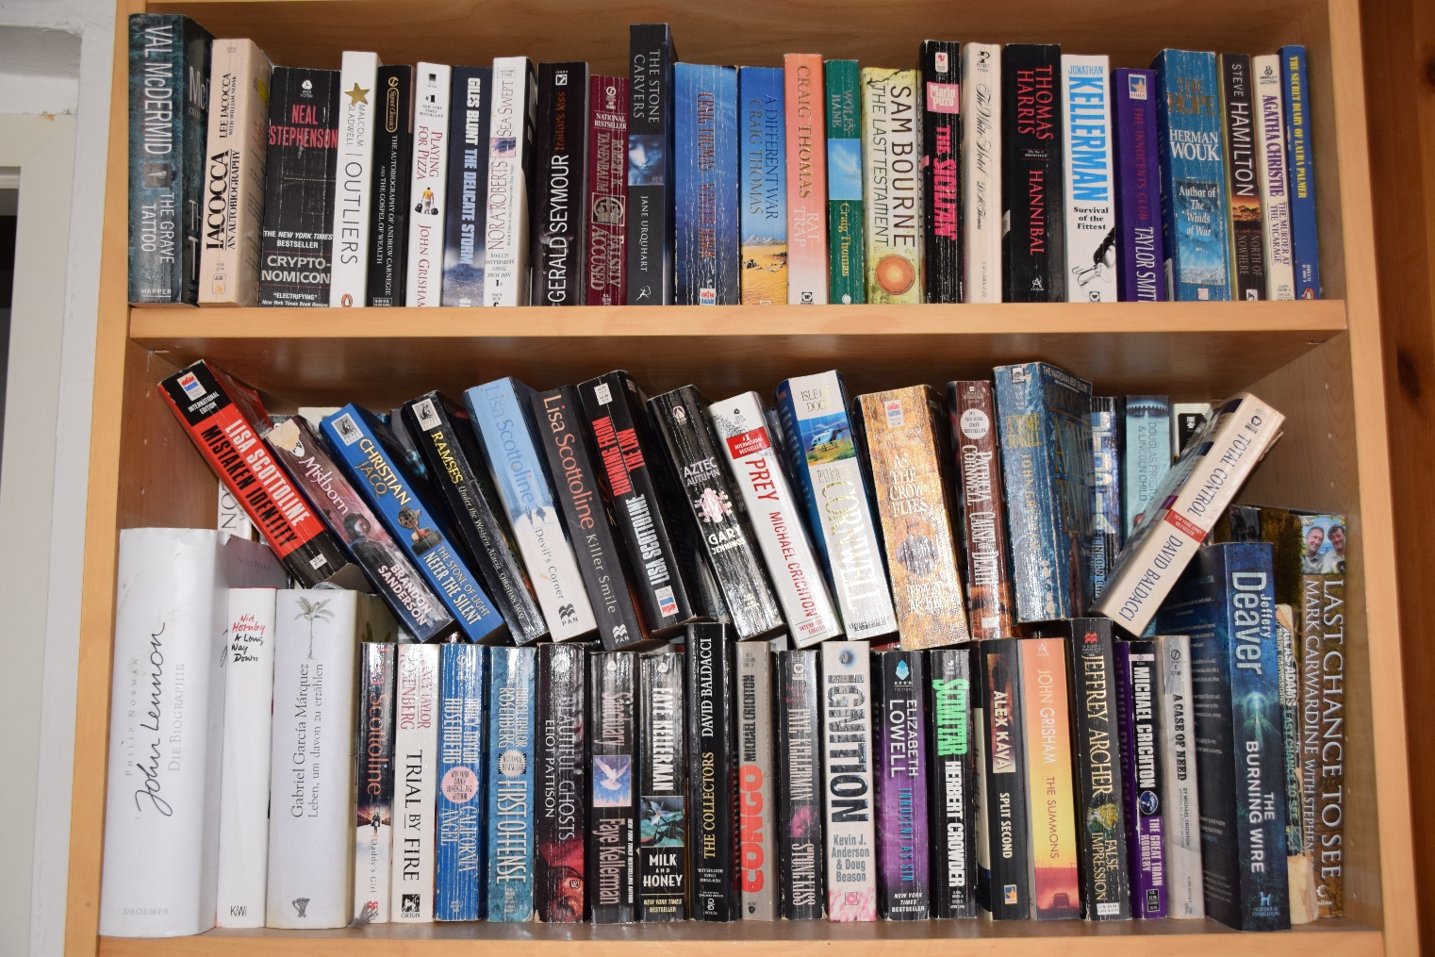
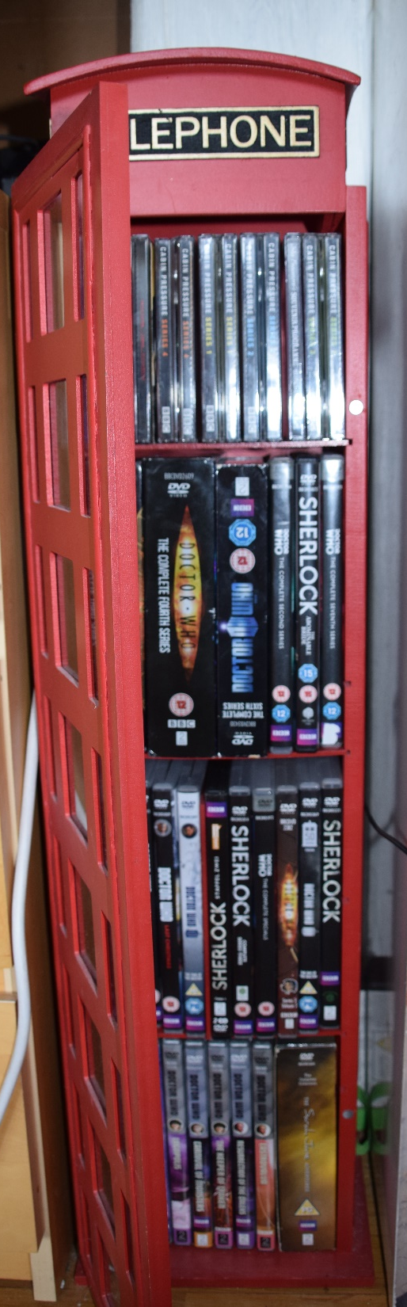
In my free time I like reading books and I love watching English TV-series.

Slide 18
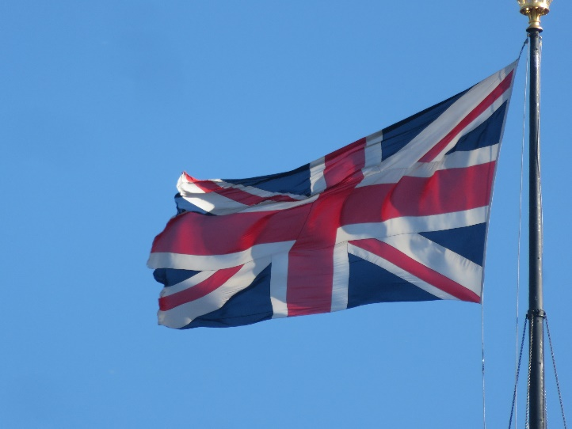
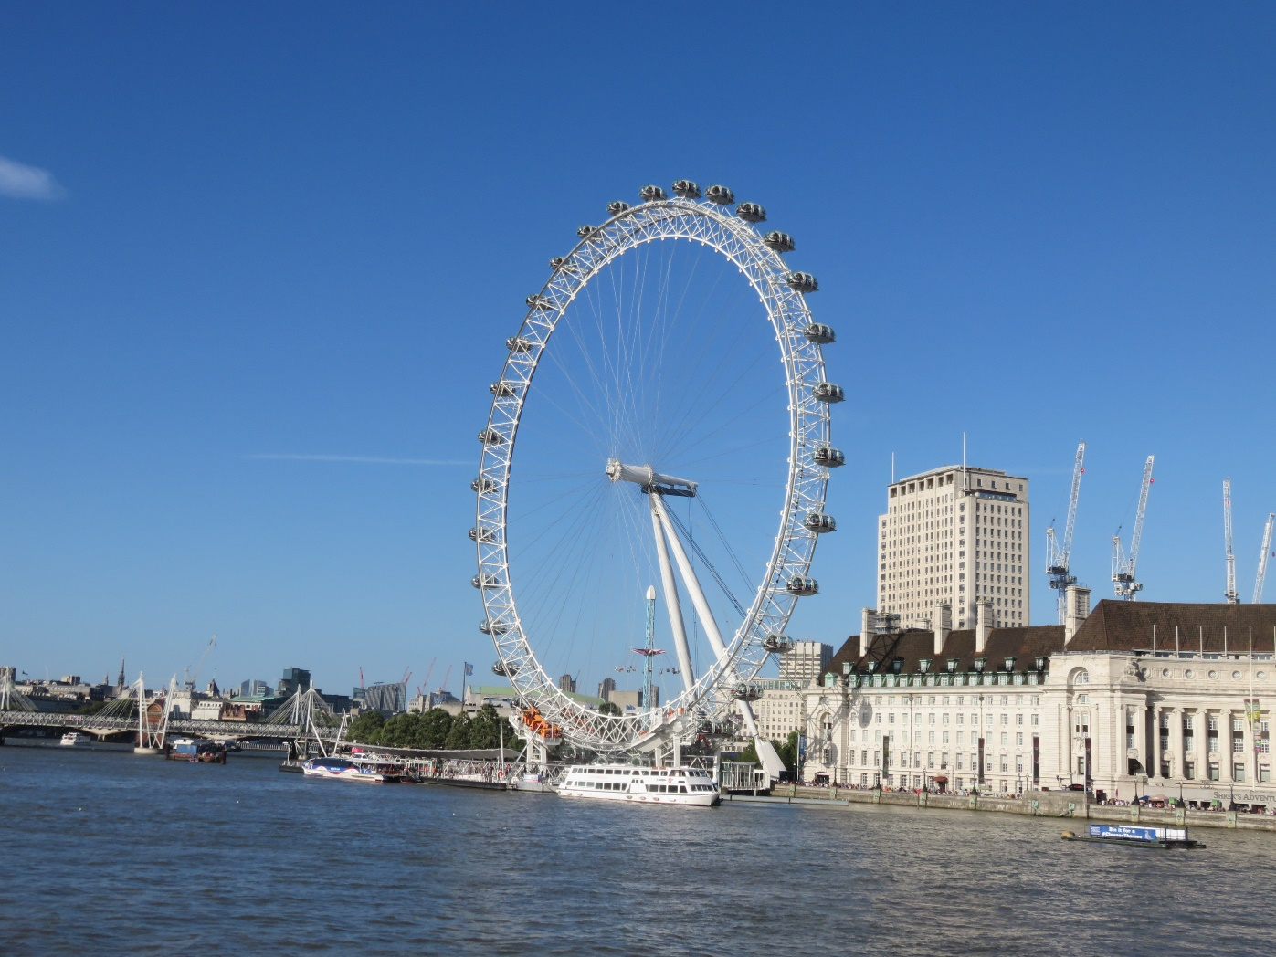
I love England.
This is London. I love London. It’s my favourite city and I go there every year. They speak English there, of course.

Slide 19
That’s me. Now it’s your turn to tell me about yourself. Who are you and what do you like?

