Slide 1
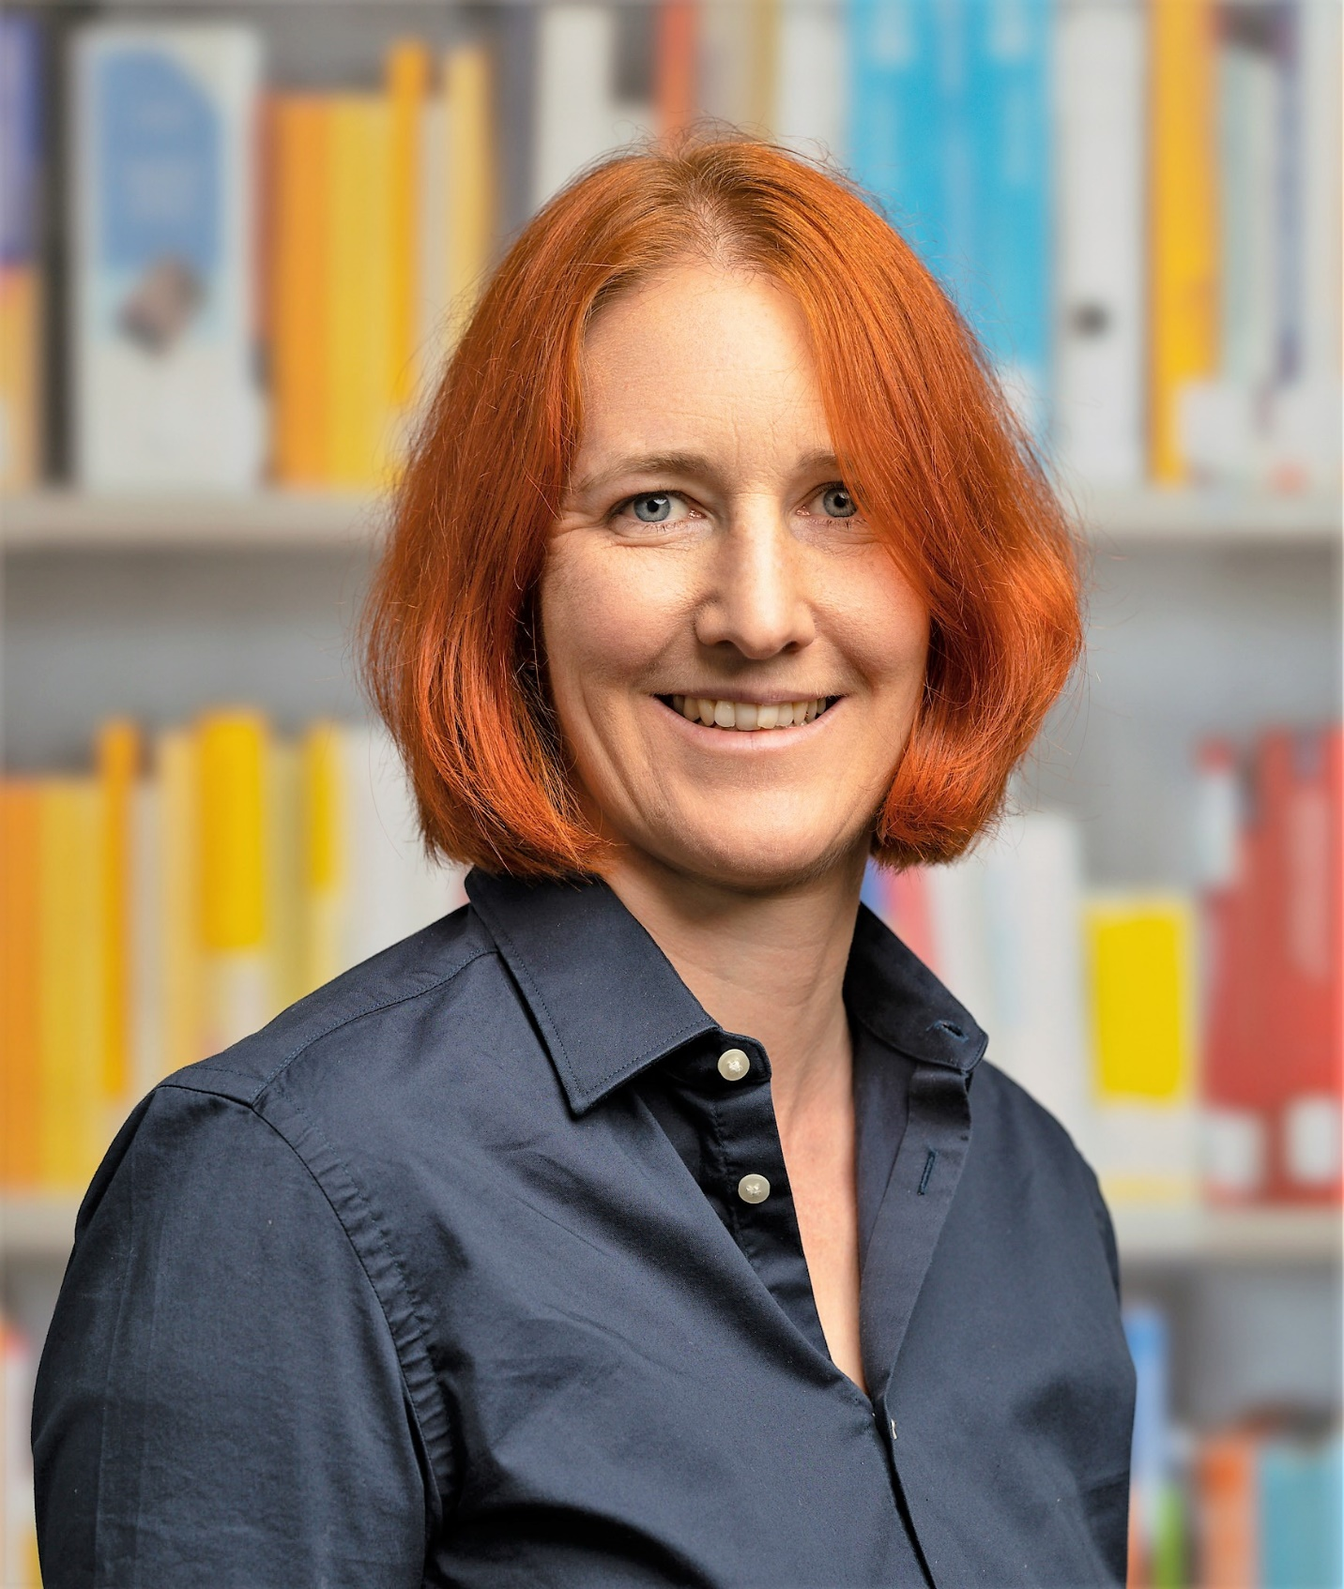

Hello, my name is Ms Bergmann and I’m your new English teacher. I’m going to introduce myself: That’s me.

Slide 2
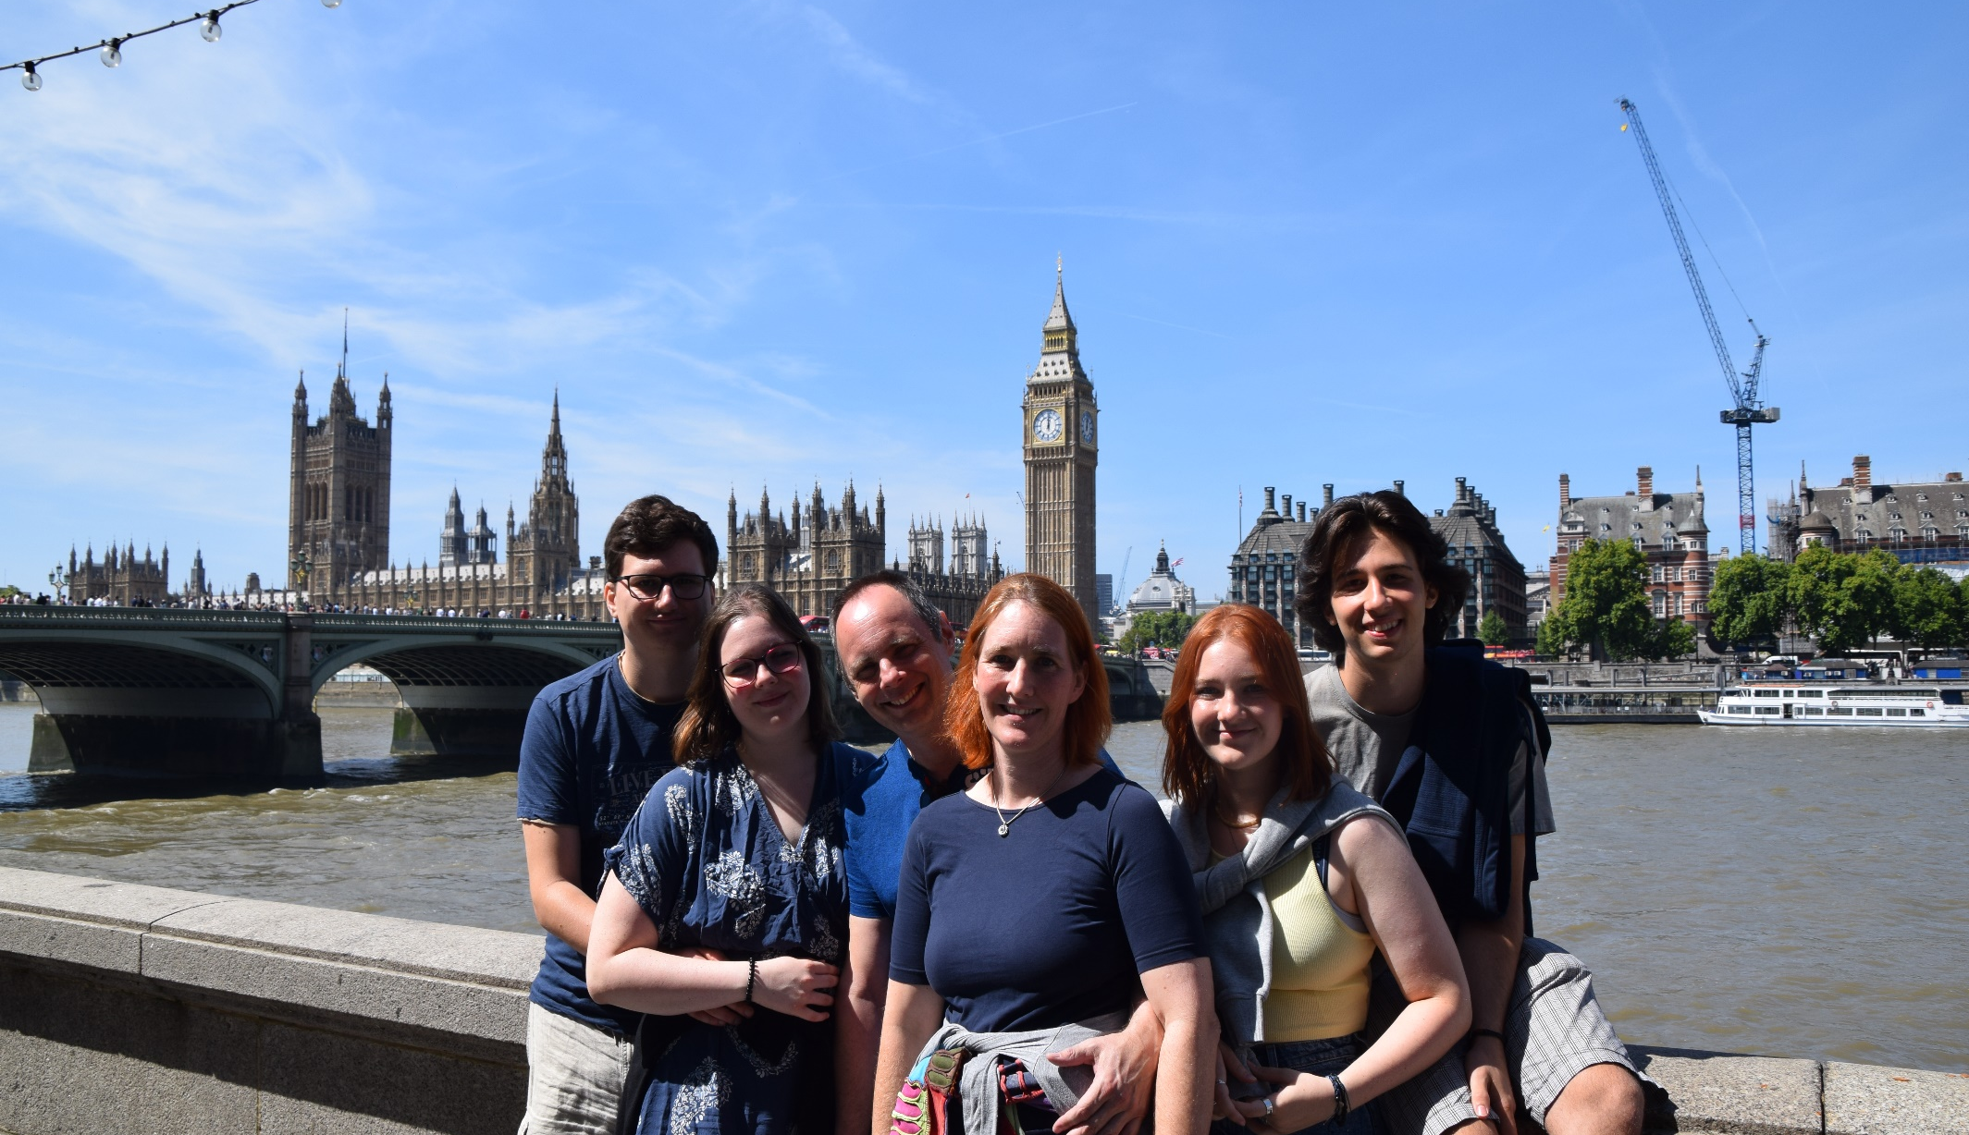
And this is my husband, Andreas.

Slide 3

1
2
We have two daughters,
Julia and Martina.

Slide 4
1
2
Julia is the oldest.
This is Julia with her
boyfriend Valentin.

Slide 5
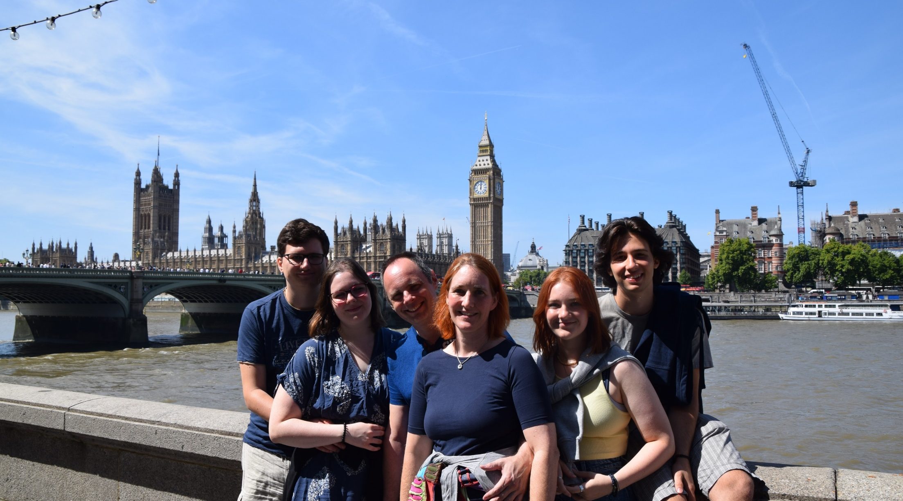
1
2
Martina is the youngest.
This is Martina with her
boyfriend Johannes.

Slide 6
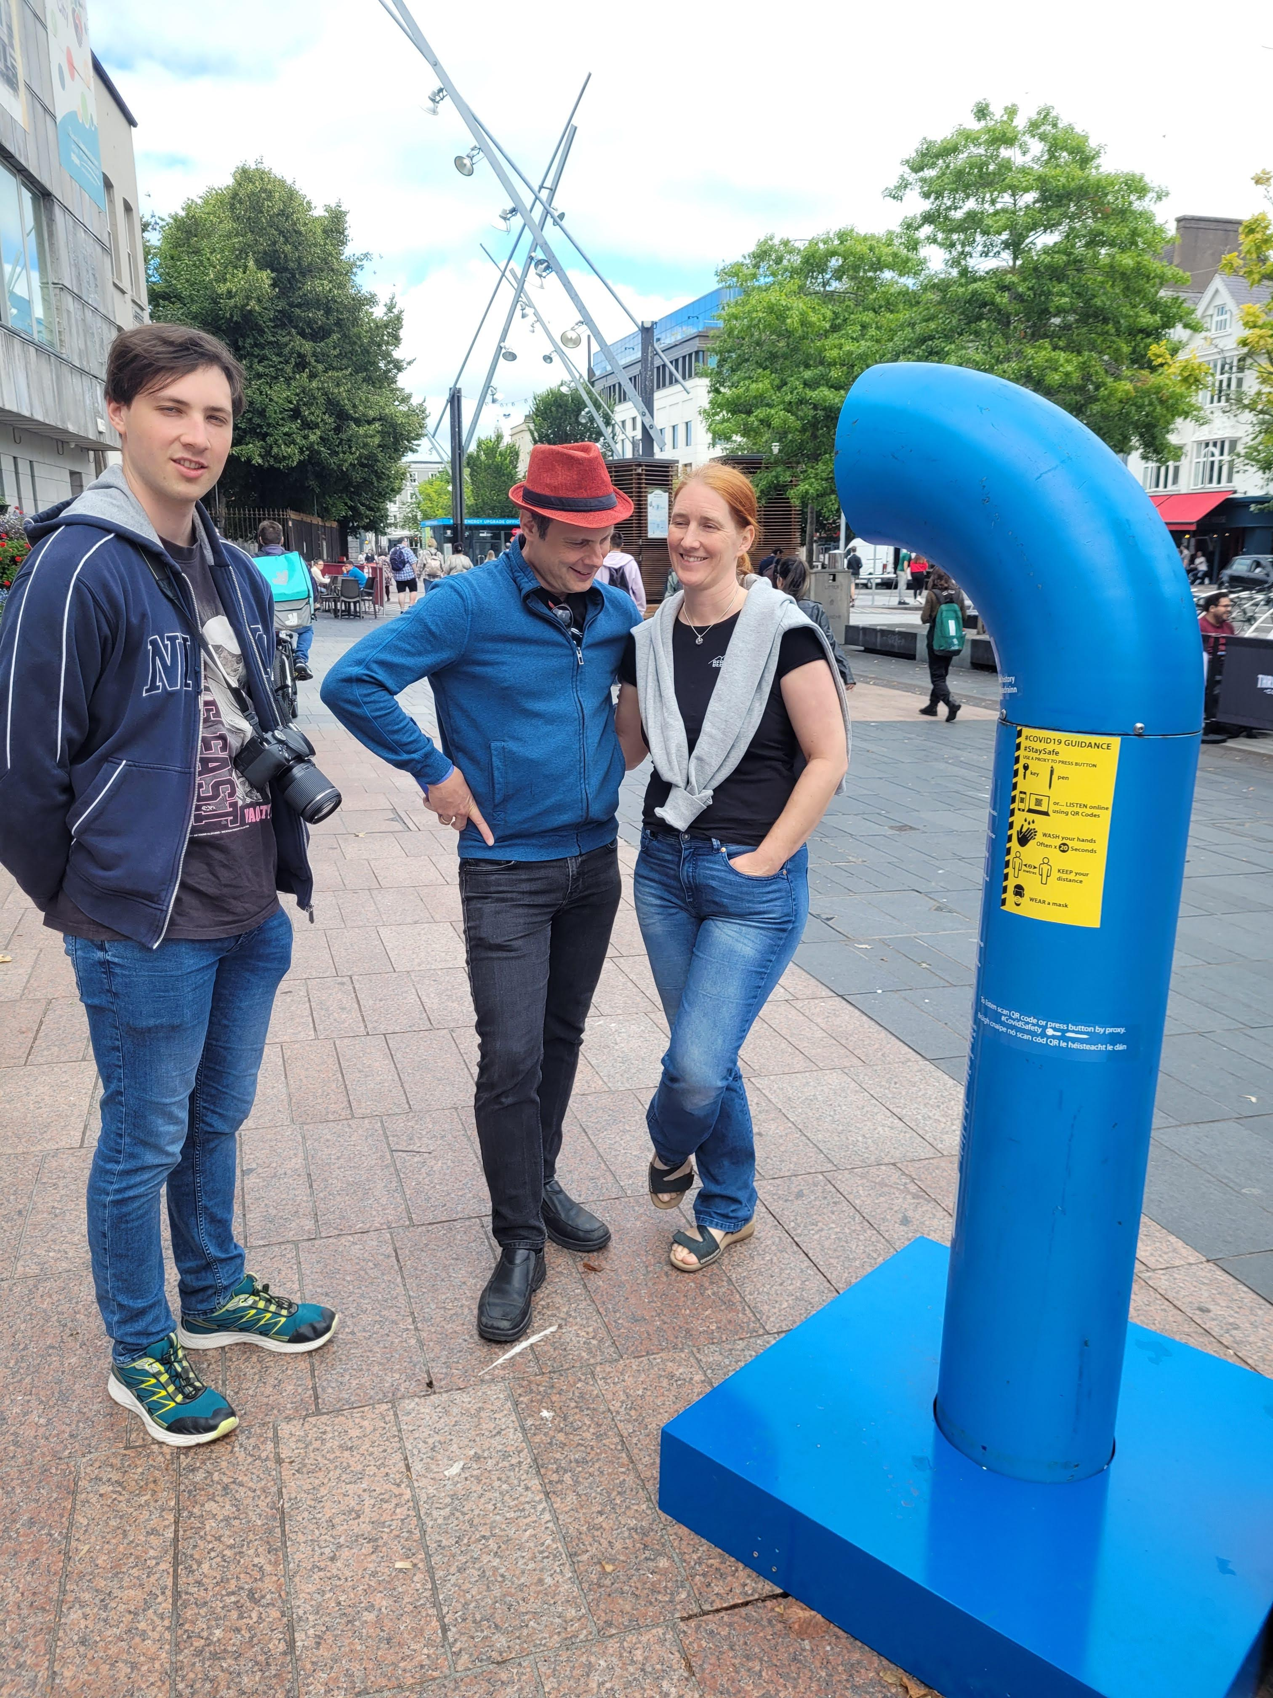
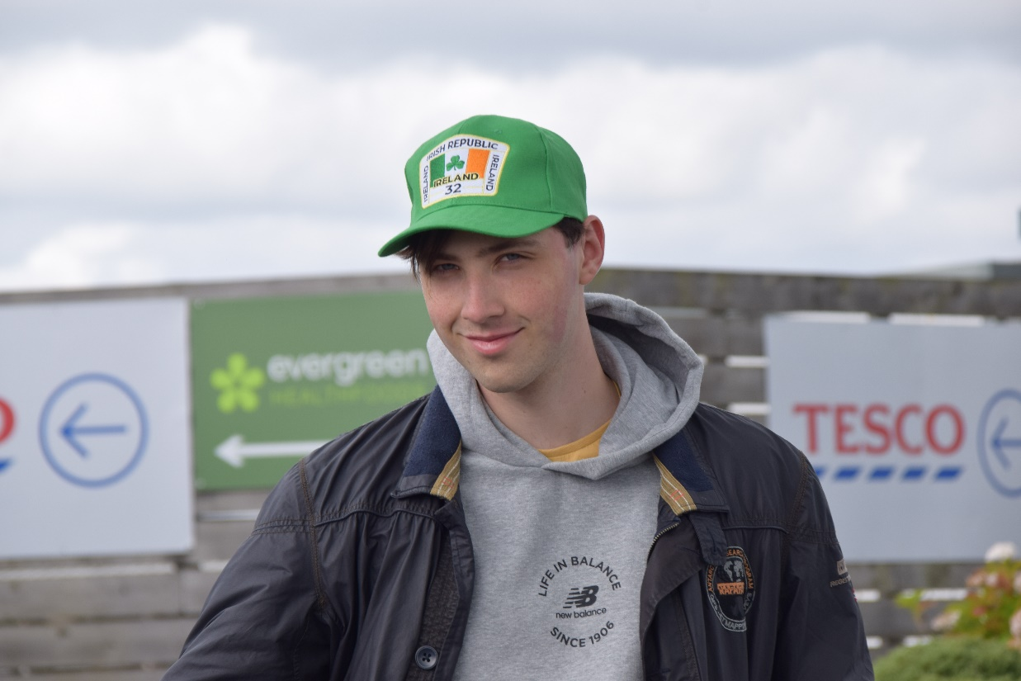
We also have a son. His name is Matthias. He is
20 years old. He is younger than Julia but older than Martina.
He is the middle child.

Slide 7
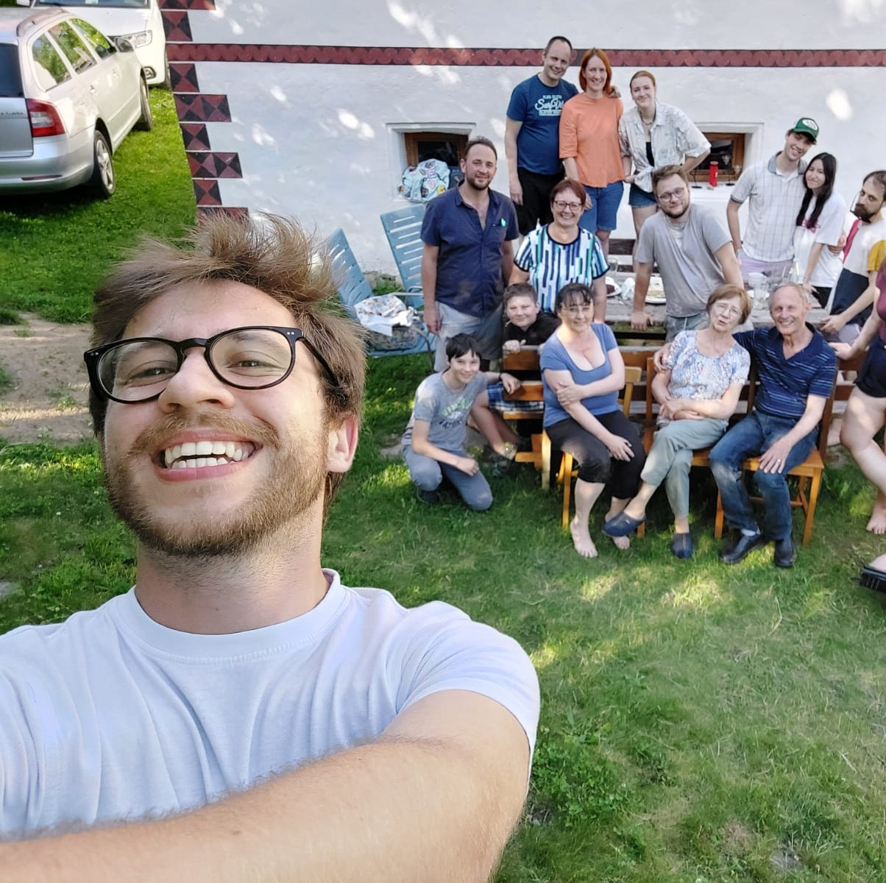
We live in a house with many
other family members. Grandparents, uncles, aunts
and many, many cousins.
I love my big family.

Slide 8
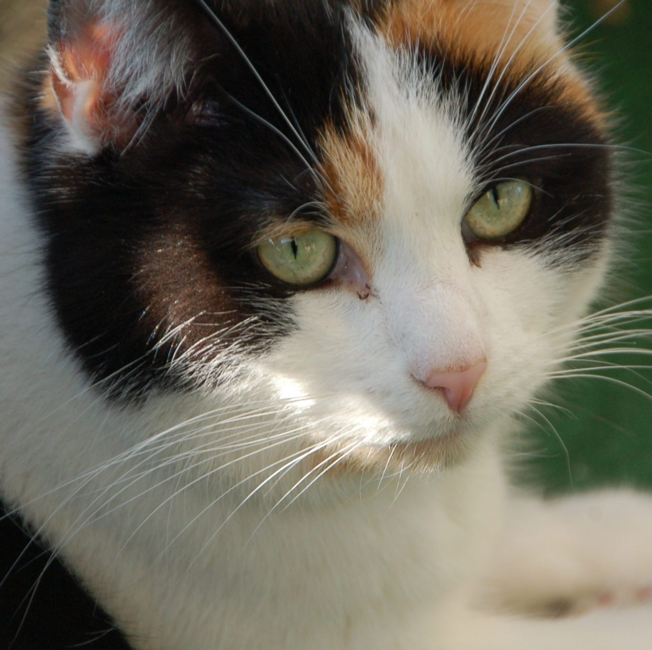
I like animals. This is my cat, Kuschel. She is beautiful because she has got three colours – black, white and brown.

Slide 9
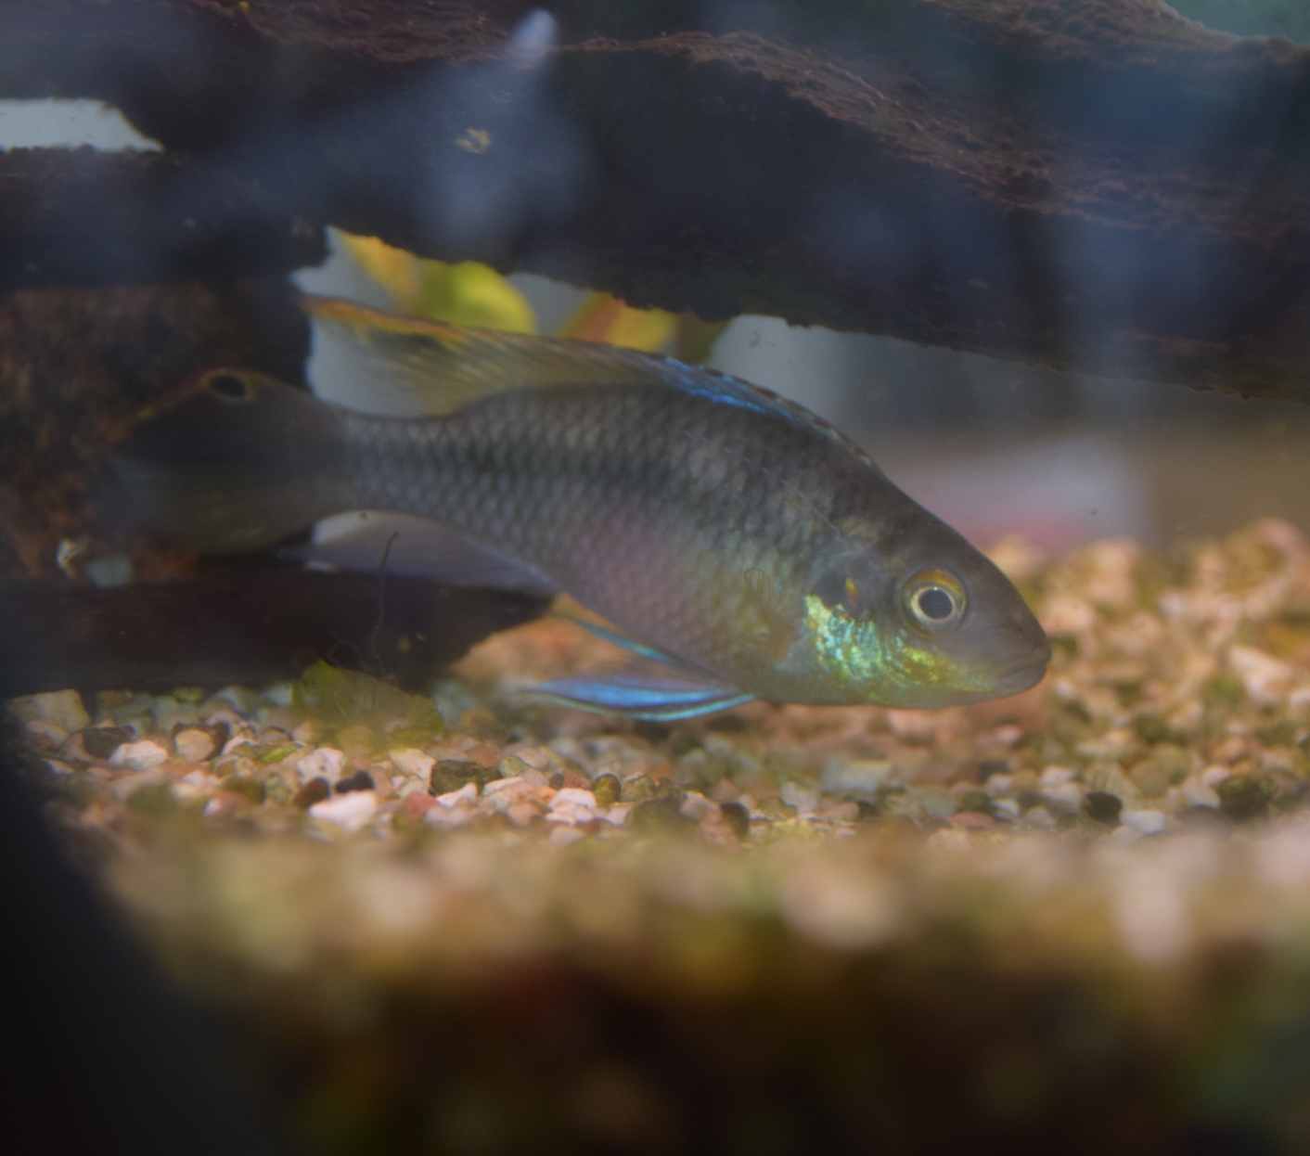
I also like our fish. They are beautiful.

Slide 10
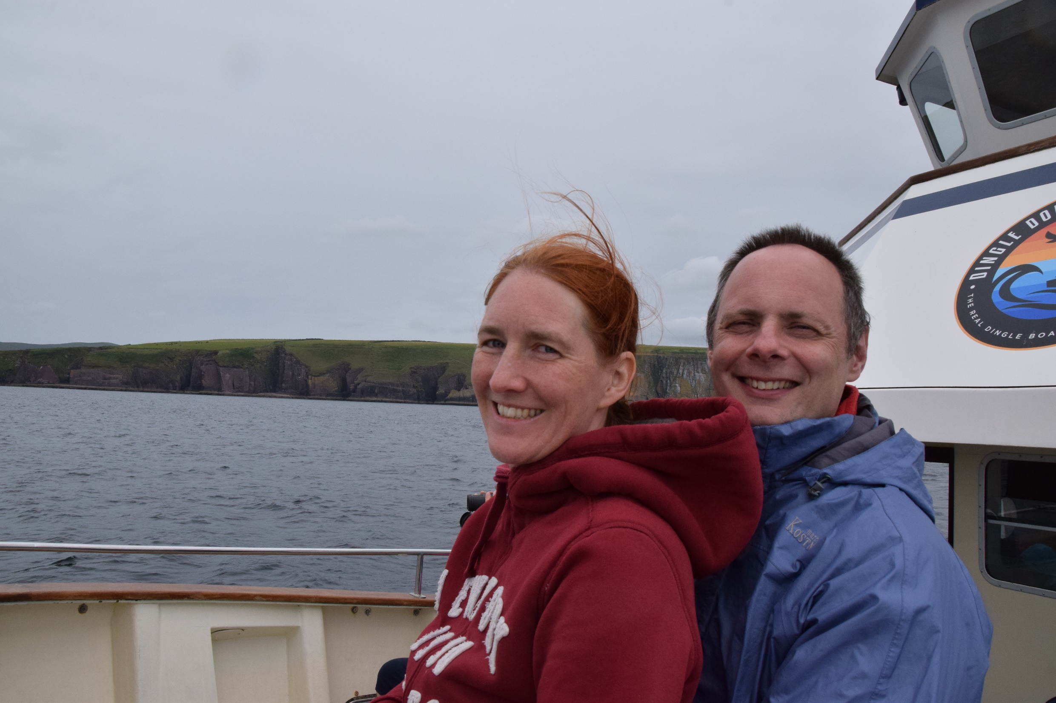
I like travelling but I don’t like hot weather.
I like going north and I love England, Scotland and Ireland. This is me and my husband in Ireland this August.

Slide 11


I like riding my bike.
I always ride my bike to school, even if it is raining.

Slide 12

I love dancing. I go dancing every week with my husband Andreas.
Dancing is a lot of fun.

Slide 13
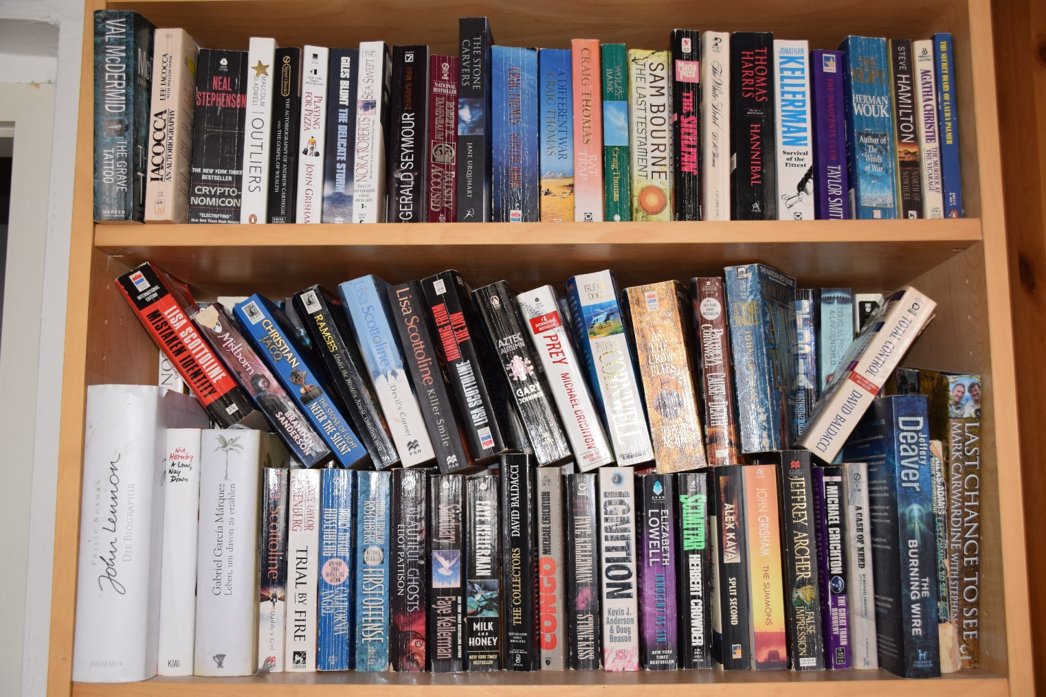
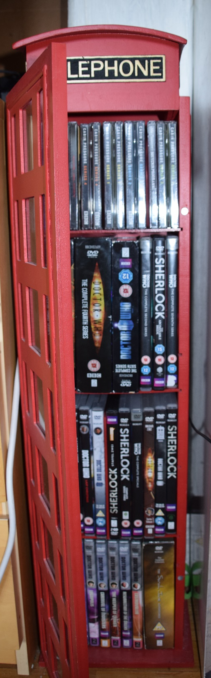
In my free time I like reading books and I love watching English TV-series.

Slide 14
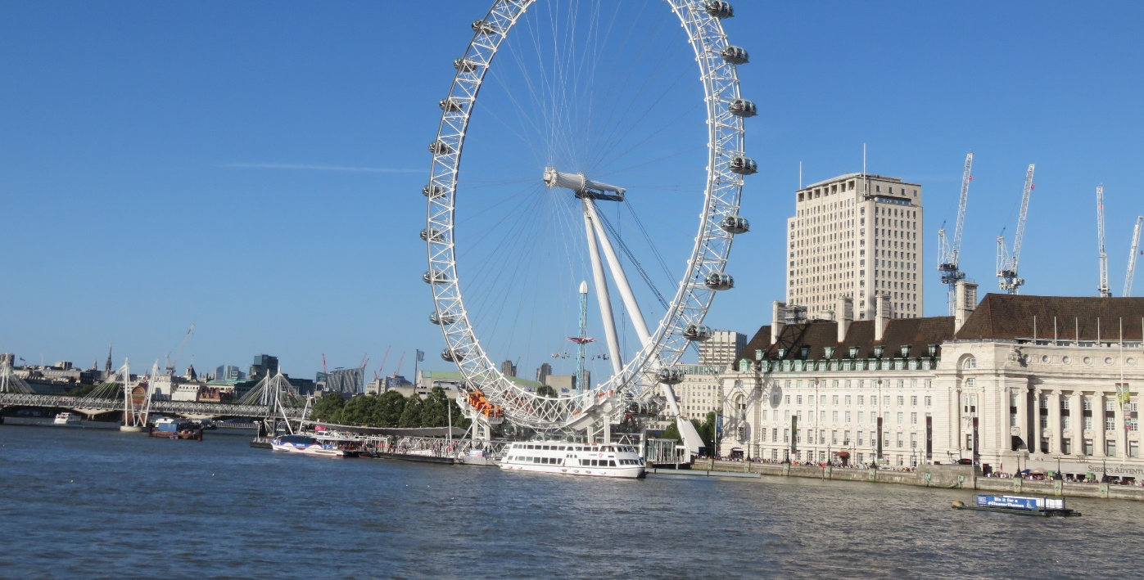
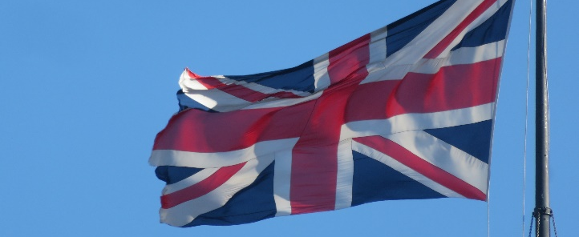
I love England.
This is London. I love London. It’s my favourite city and I go there almost every year. They speak English there, of course.

Slide 15
That’s me. Now it’s your turn to tell me about yourself. Who are you and what do you like?

