Slide 1

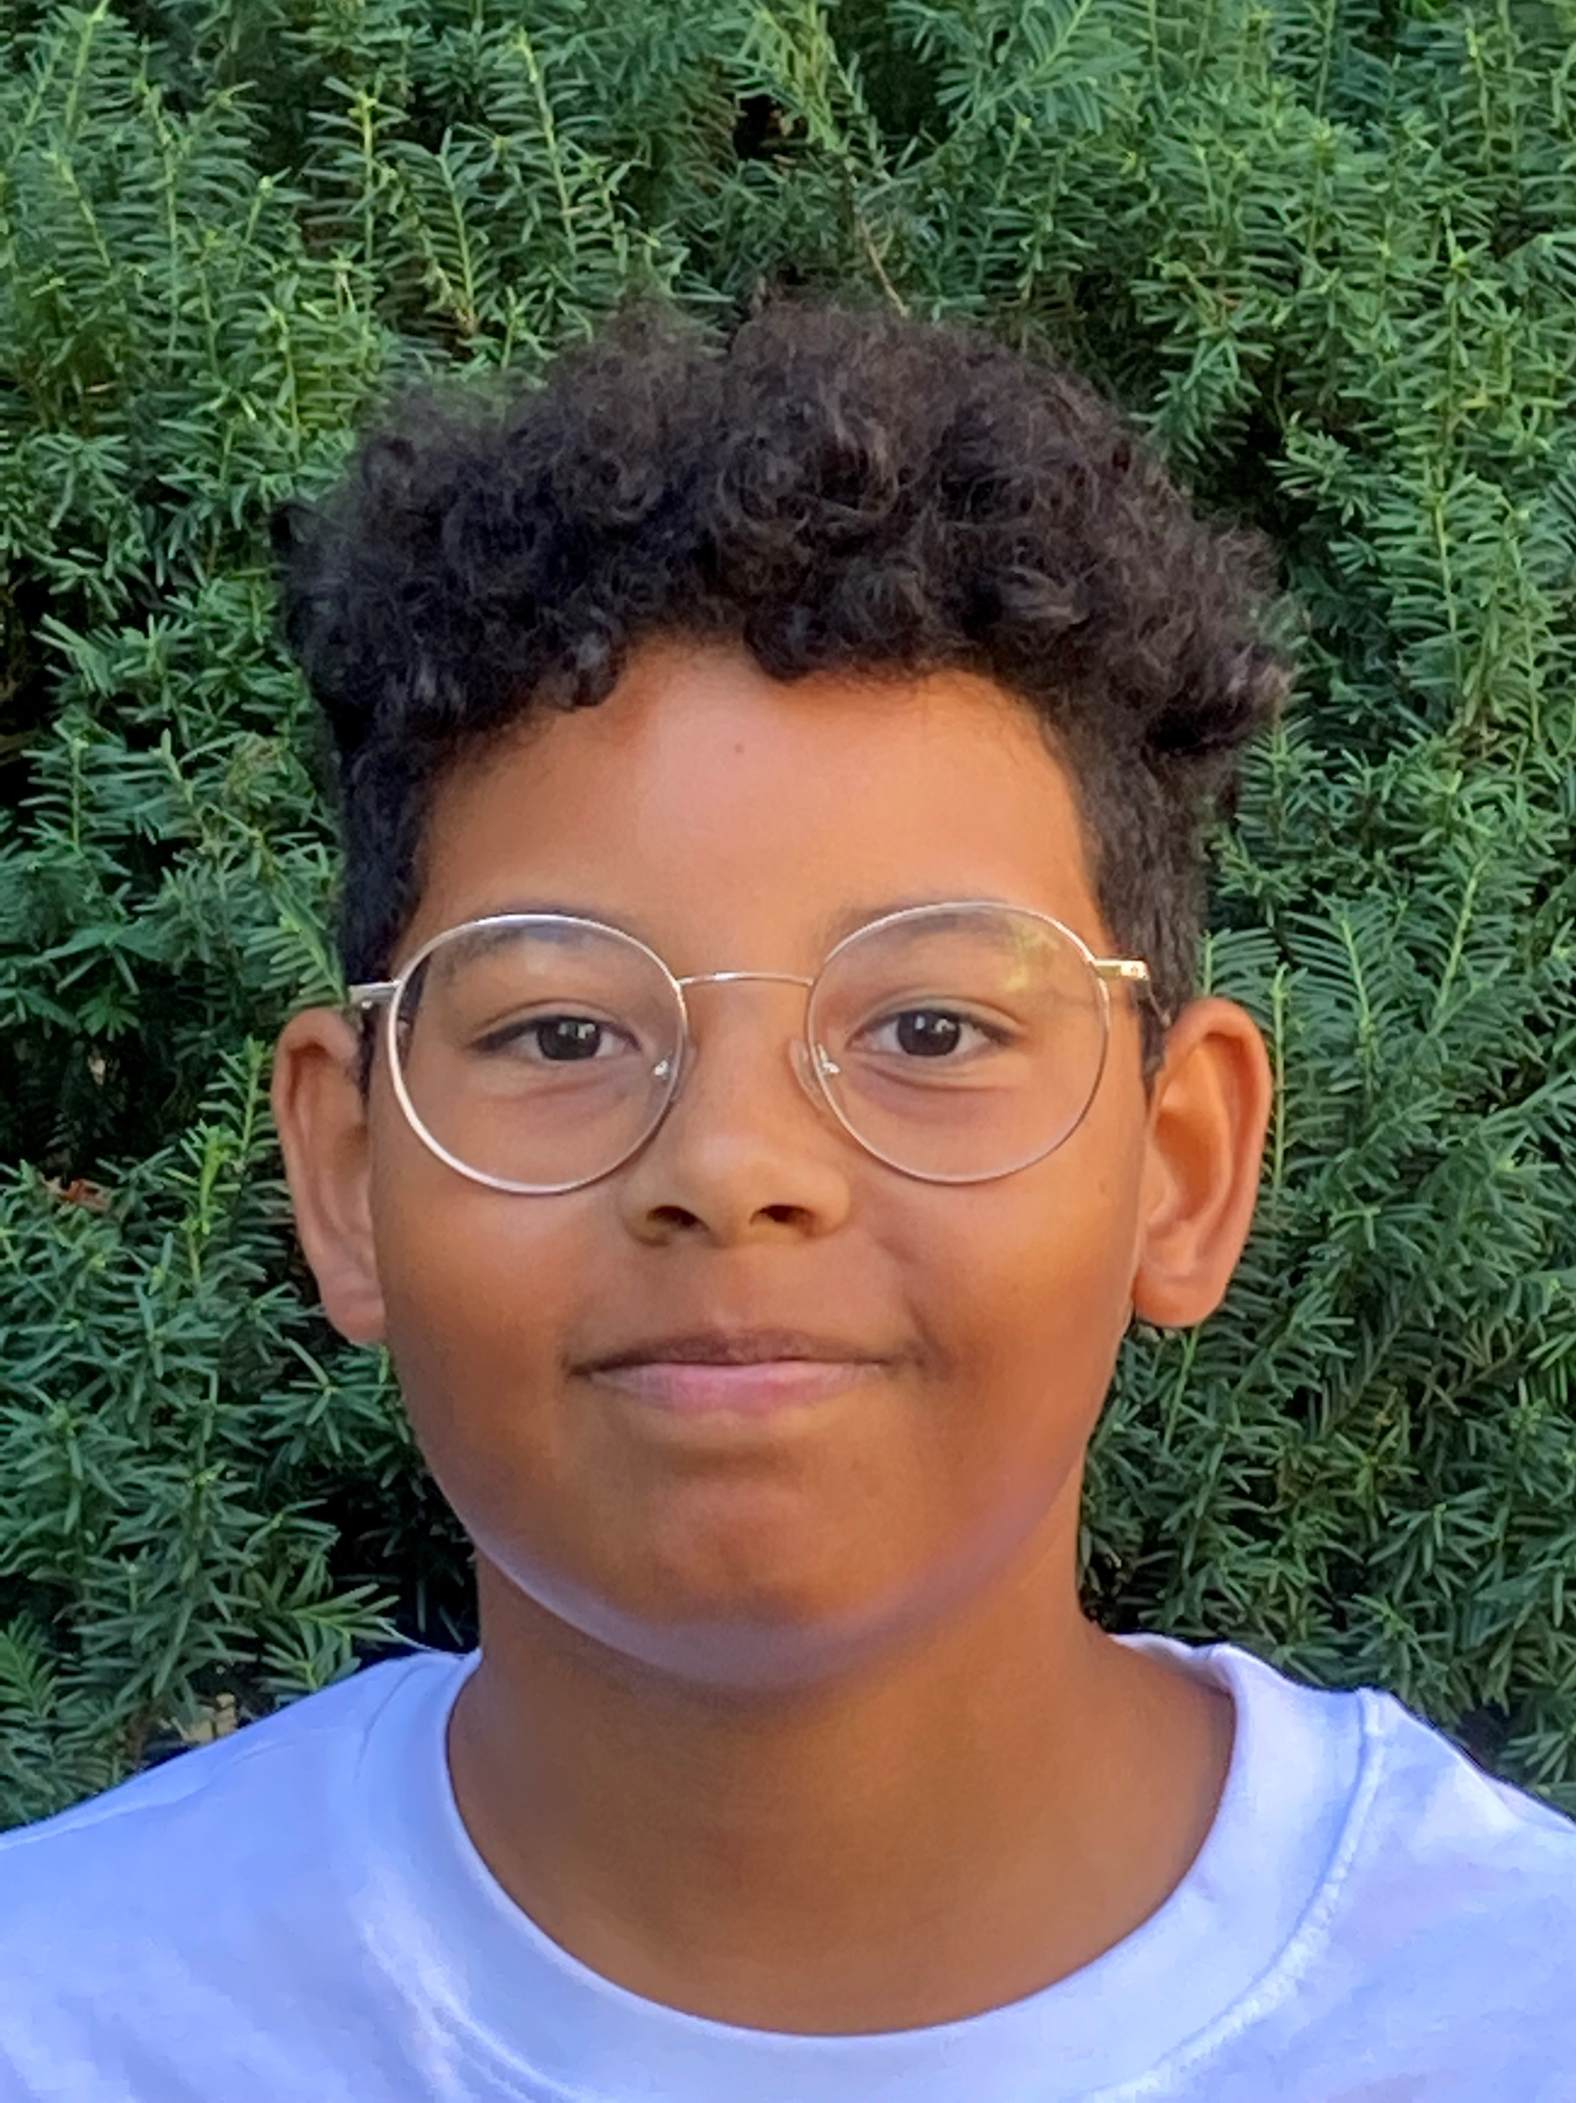
first name:
surname:
age:
country:
city: pets: favourite colour:
hobbies:
languages:
family:

Slide 2
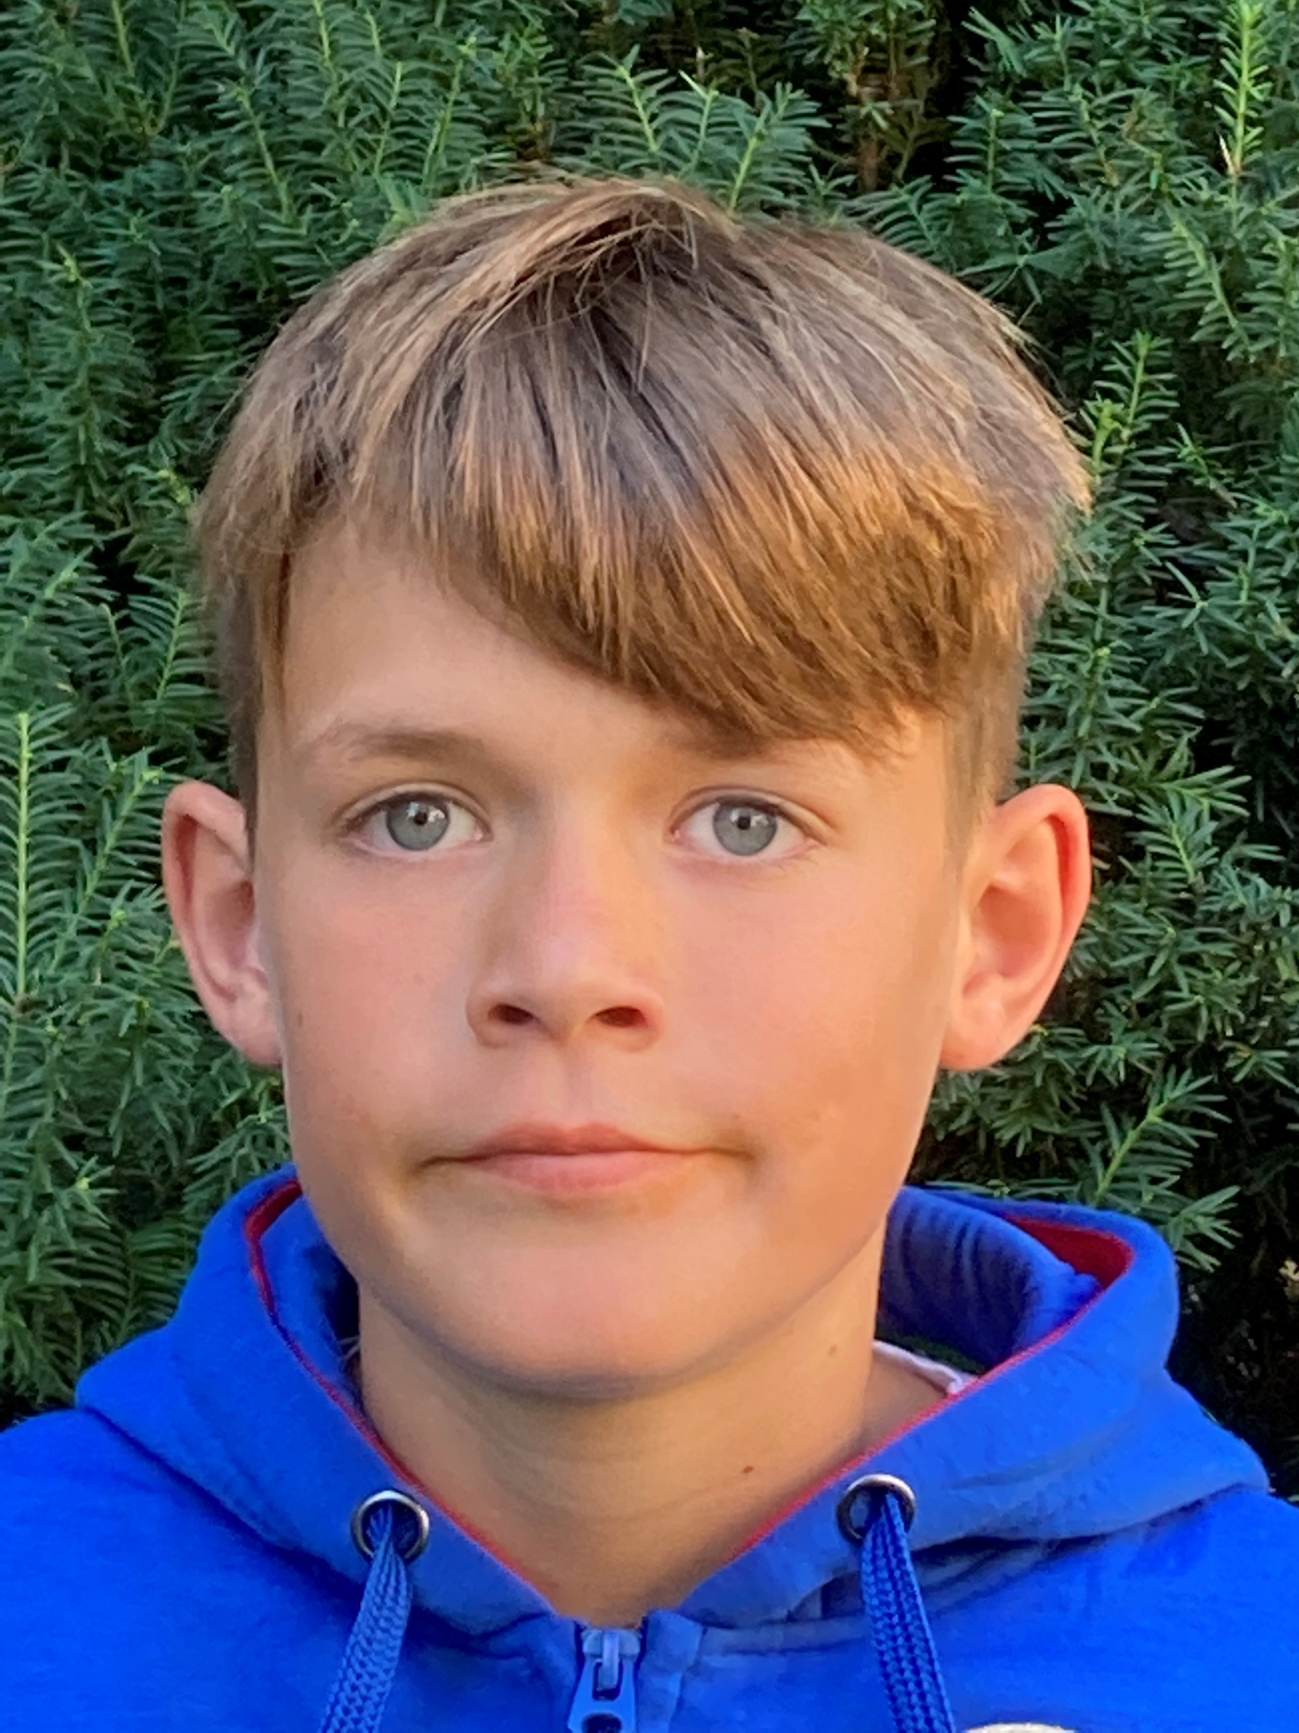
first name:
surname:
age:
country:
city: pets: favourite colour:
hobbies:
languages:
family:

Slide 3
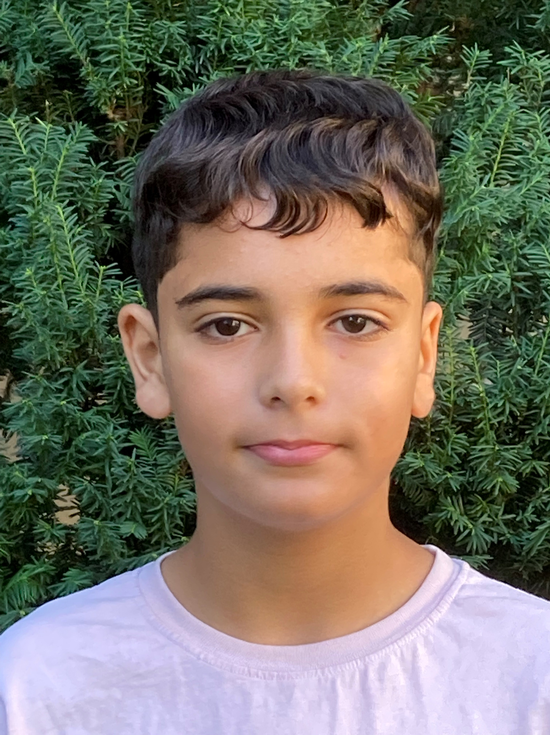
first name:
surname:
age:
country:
city: pets: favourite colour:
hobbies:
languages:
family:

Slide 4
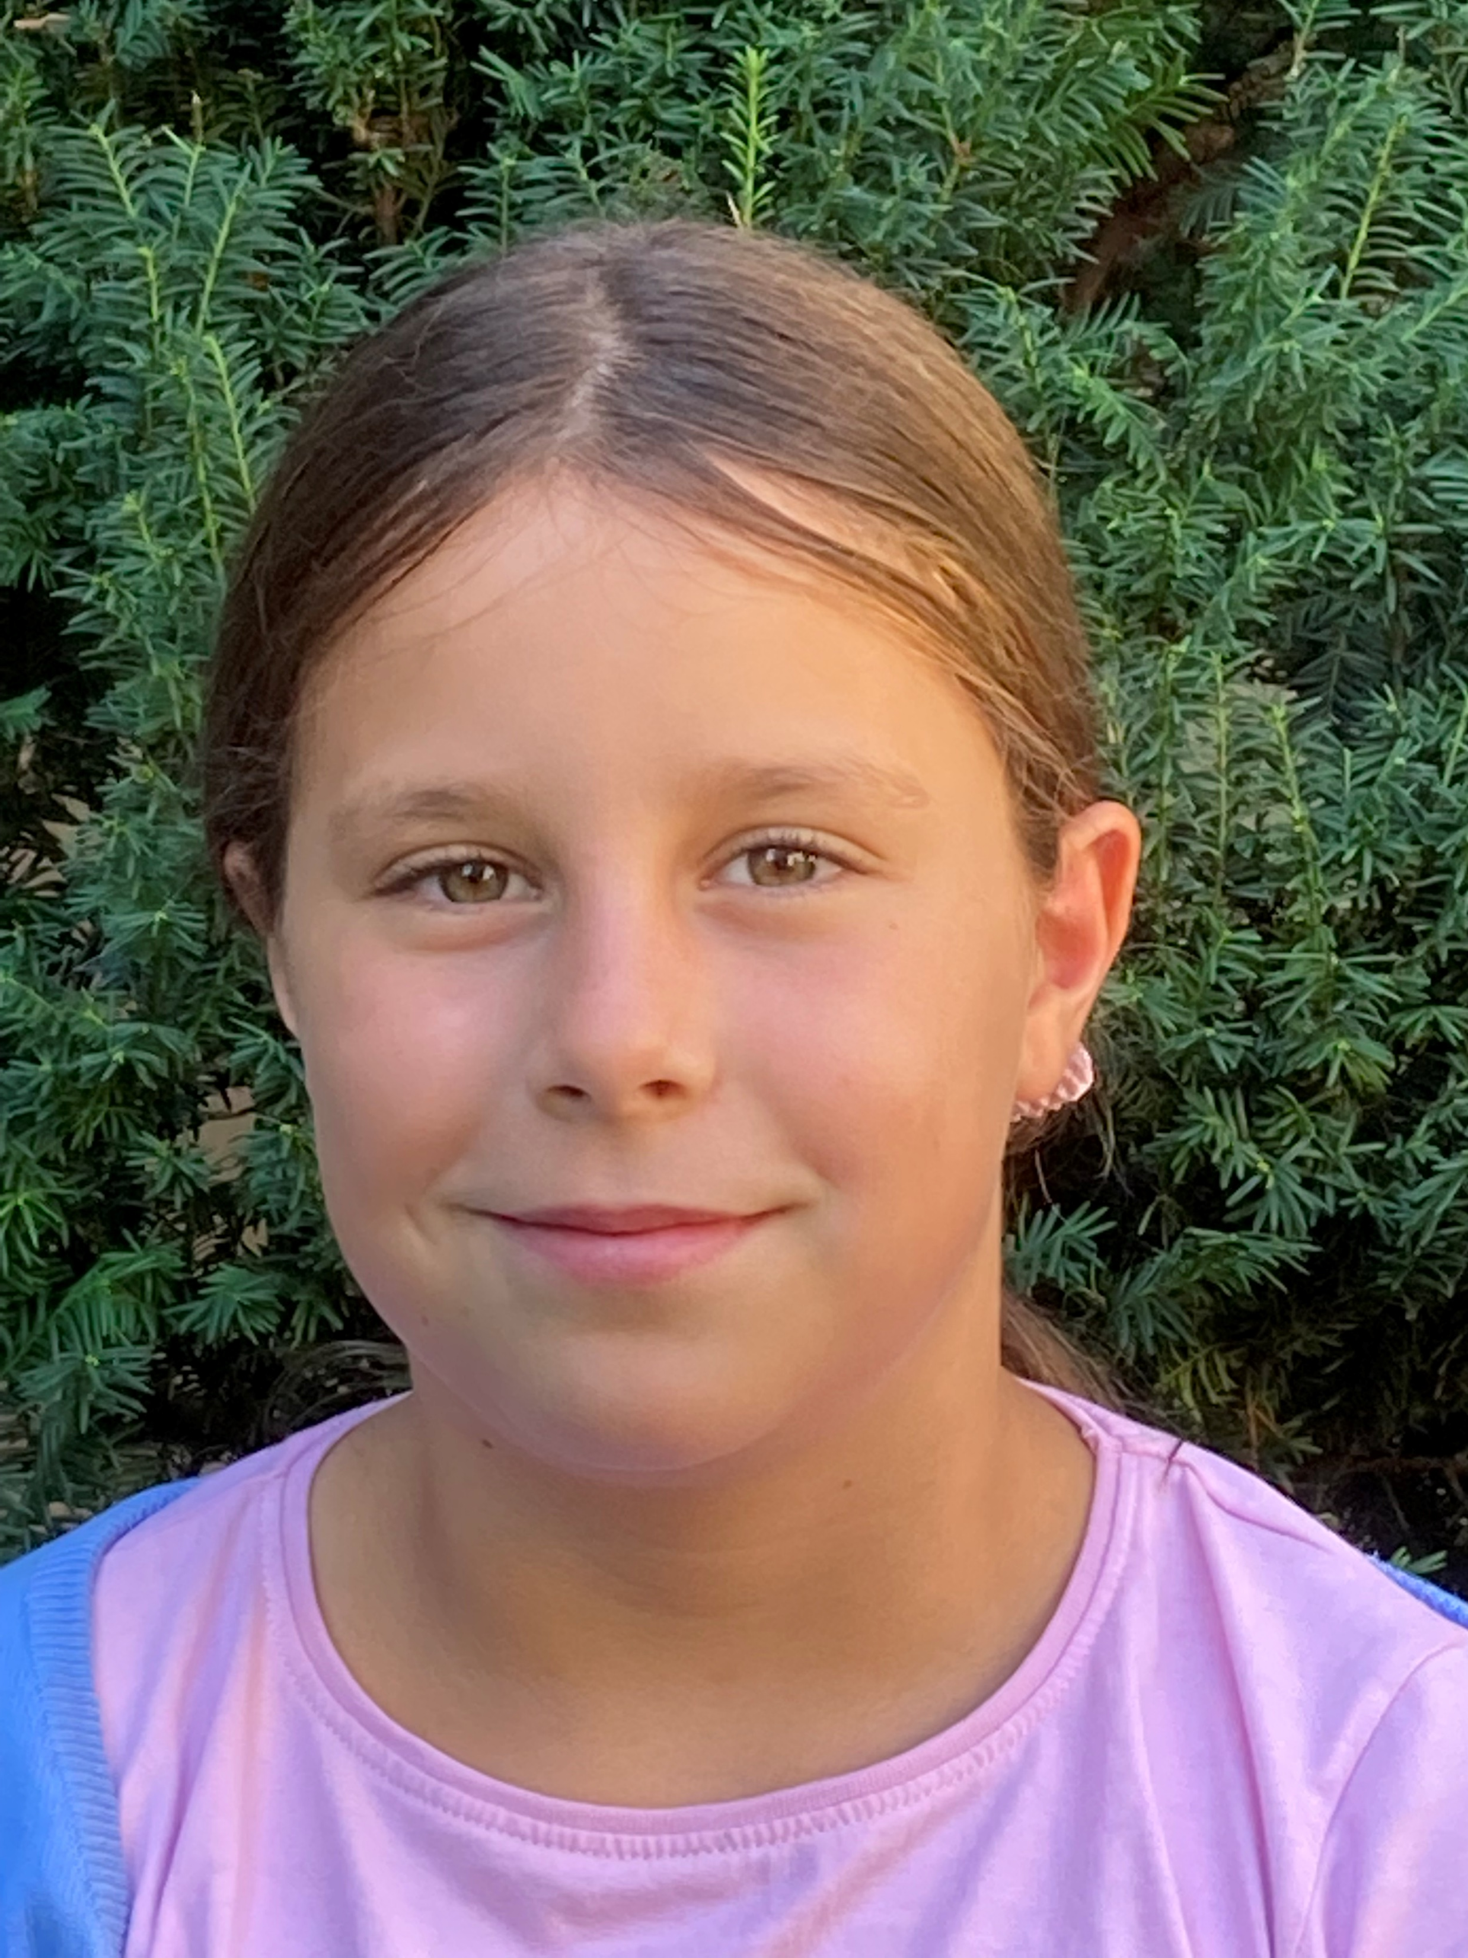
first name:
surname:
age:
country:
city: pets: favourite colour:
hobbies:
languages:
family:

Slide 5
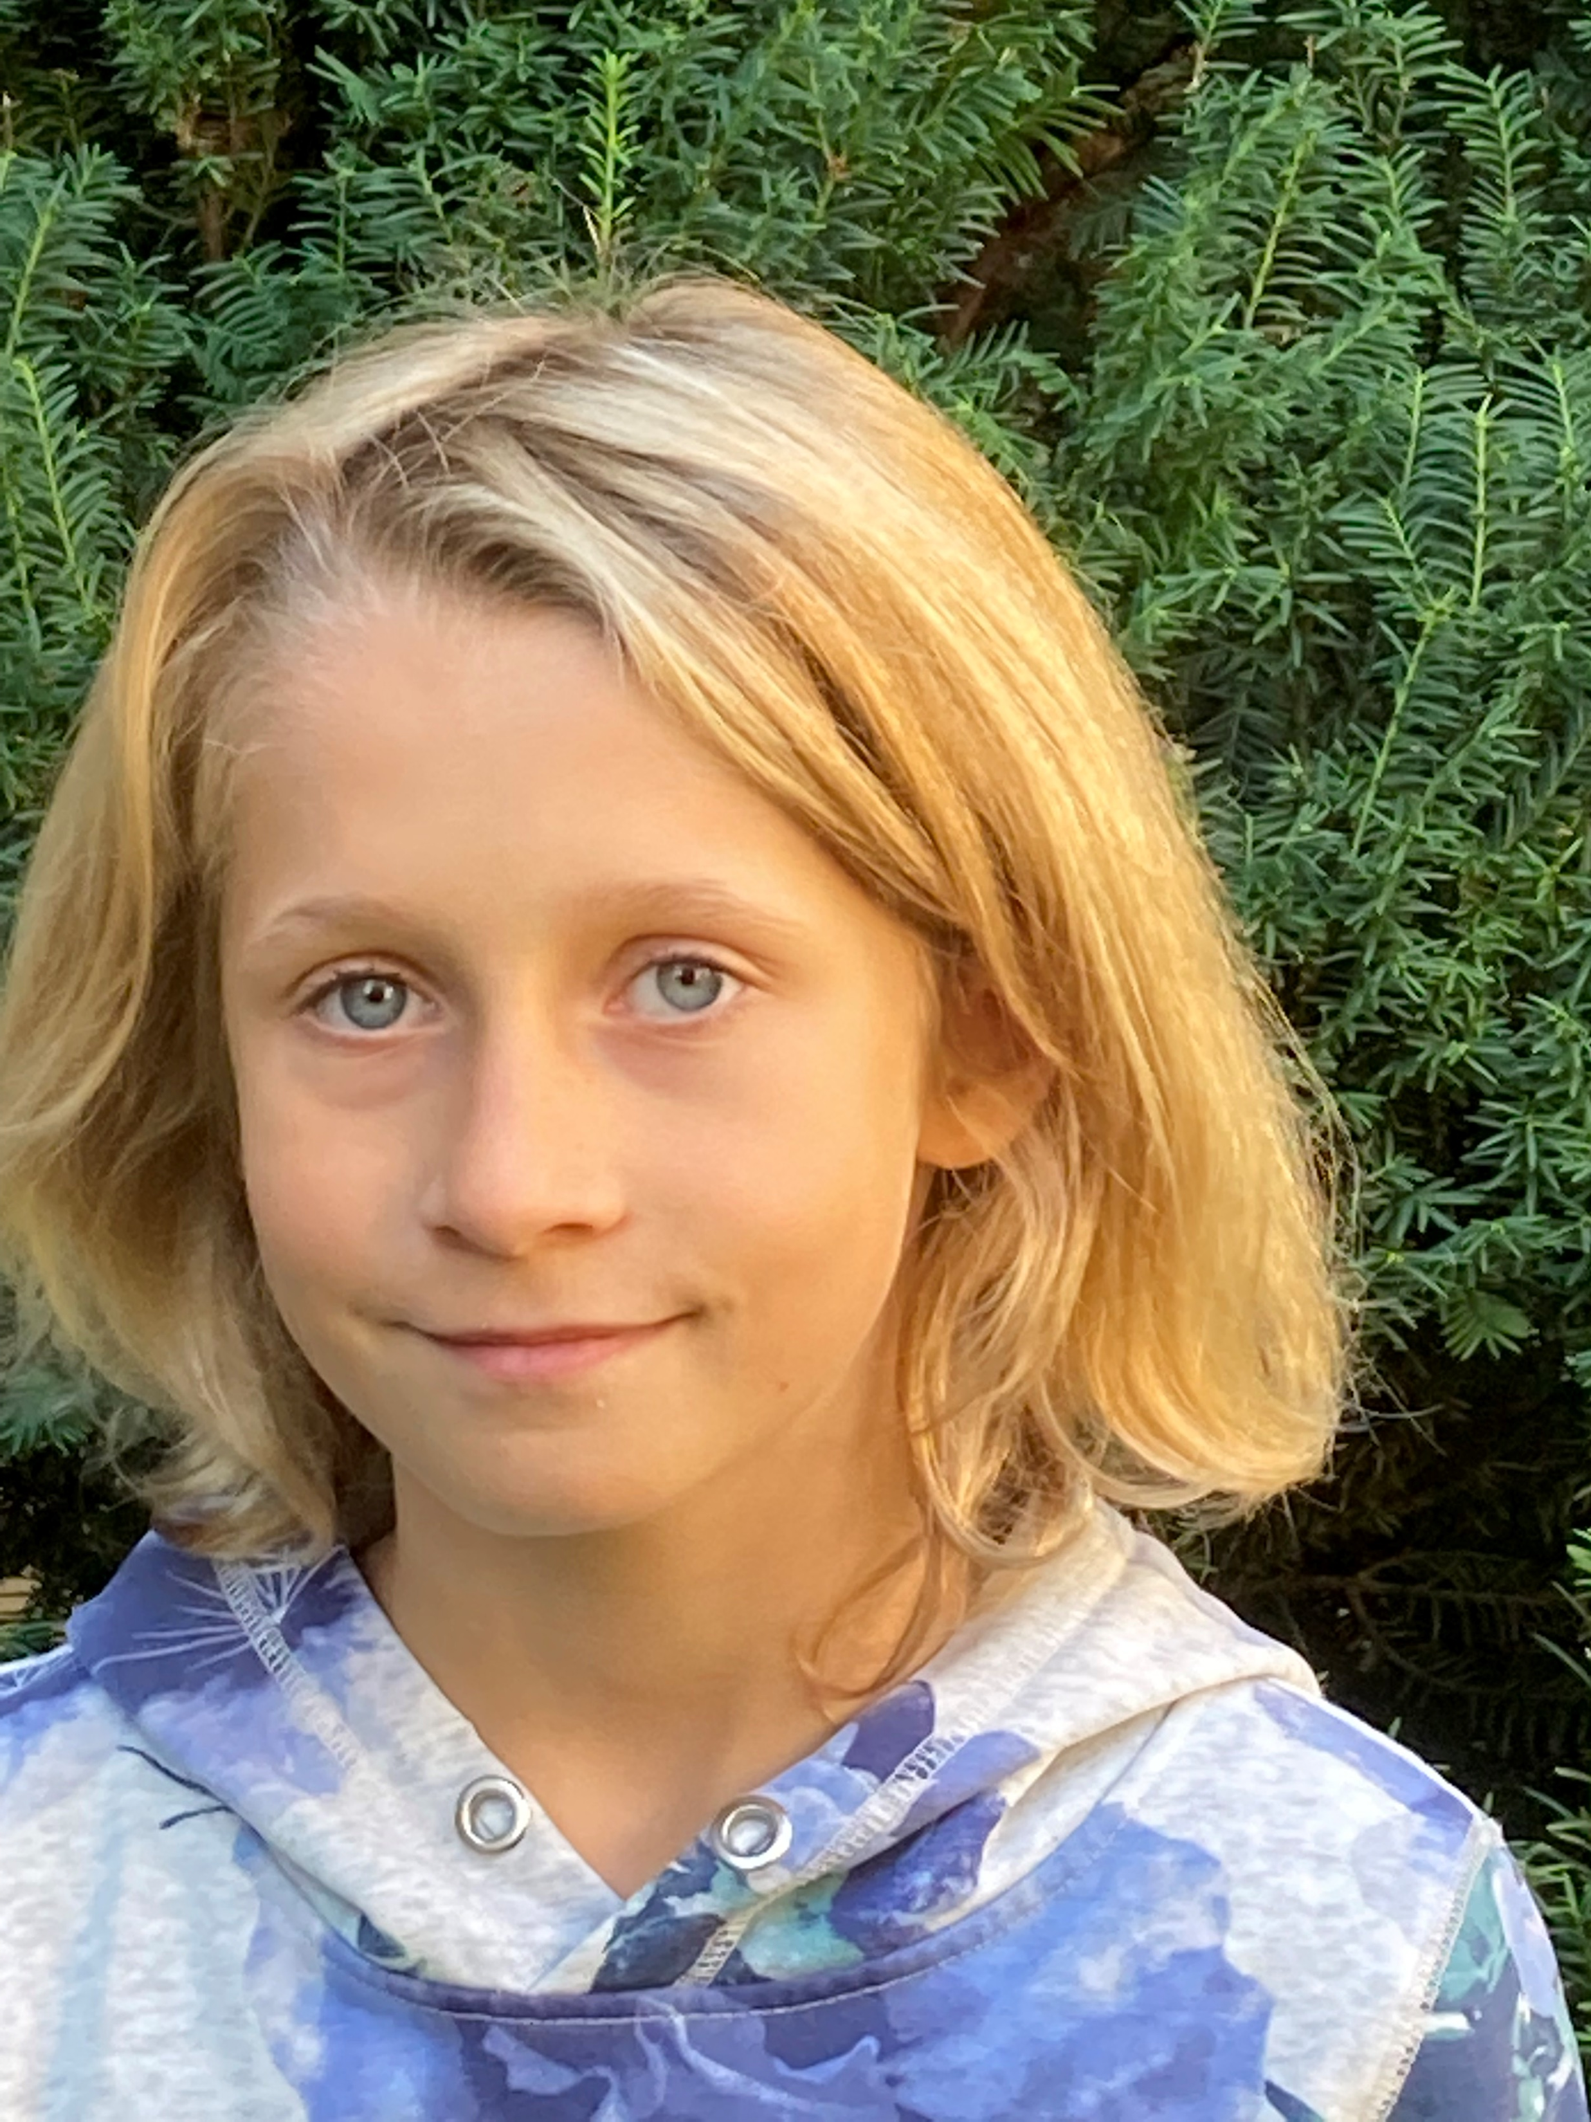
first name:
surname:
age:
country:
city: pets: favourite colour:
hobbies:
languages:
family:

Slide 6
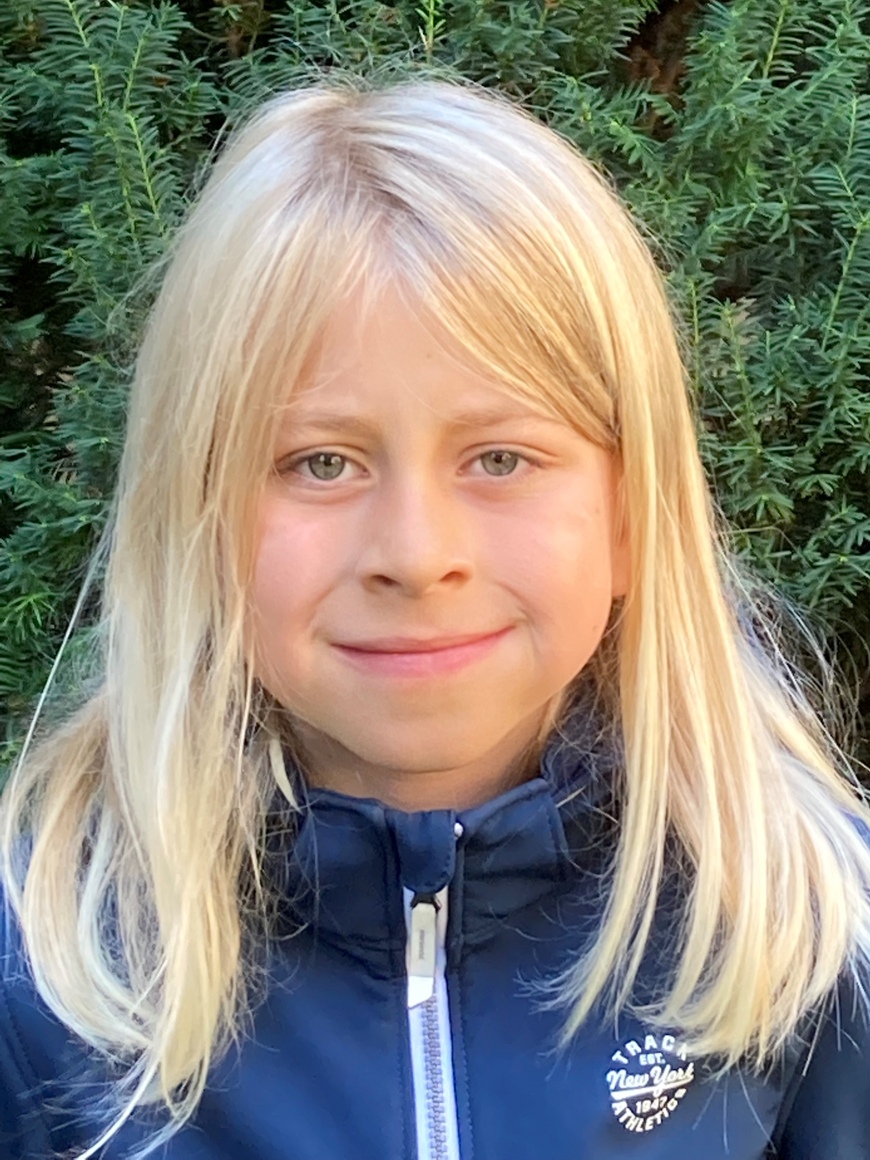
first name:
surname:
age:
country:
city: pets: favourite colour:
hobbies:
languages:
family:

Slide 7
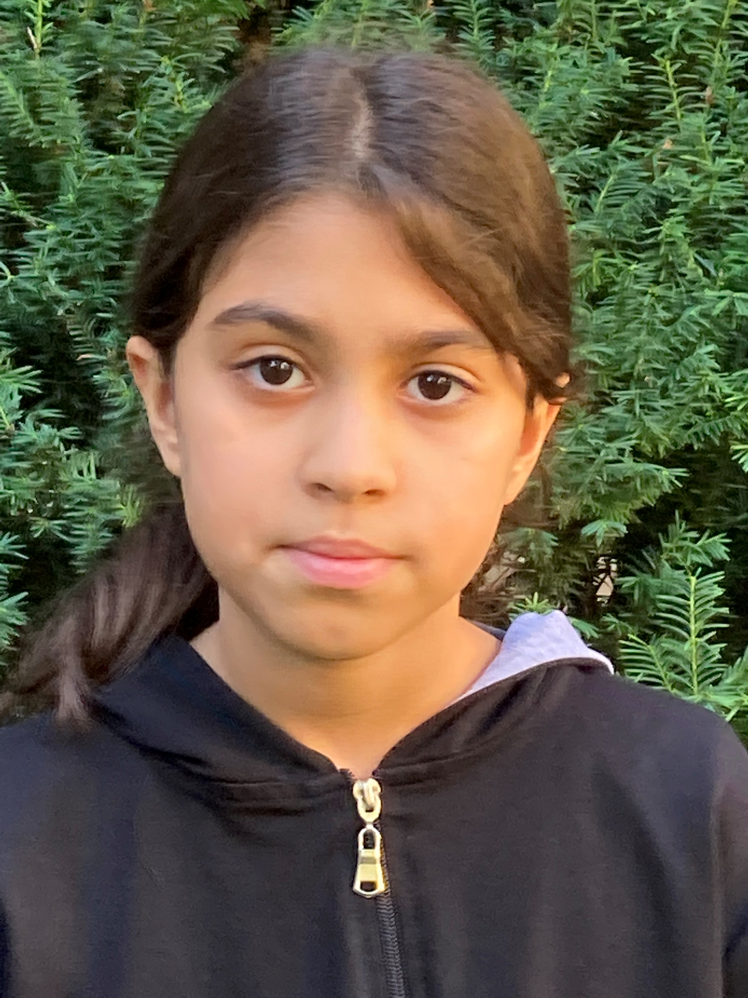
first name:
surname:
age:
country:
city: pets: favourite colour:
hobbies:
languages:
family:

Slide 8
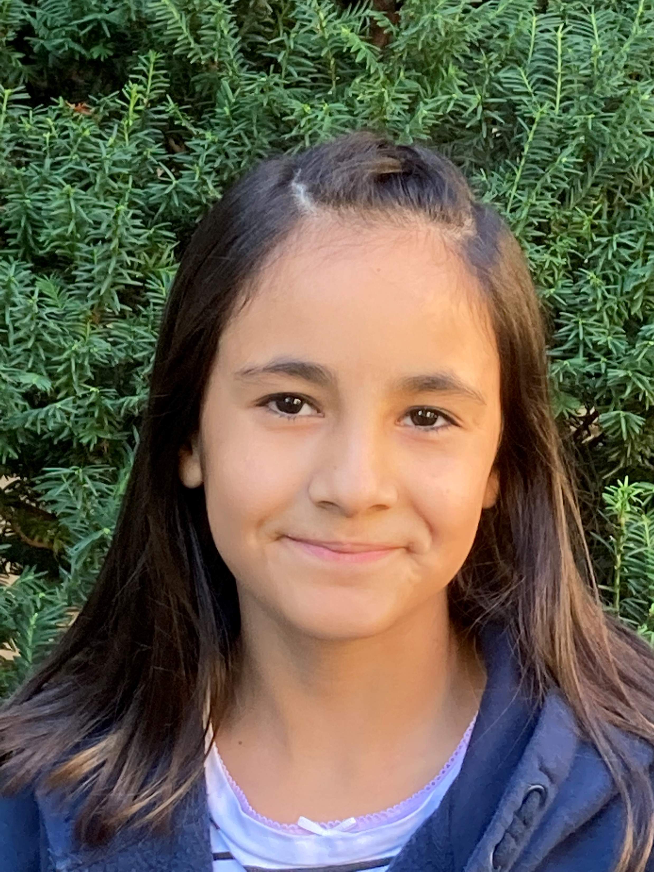
first name:
surname:
age:
country:
city: pets: favourite colour:
hobbies:
languages:
family:

Slide 9
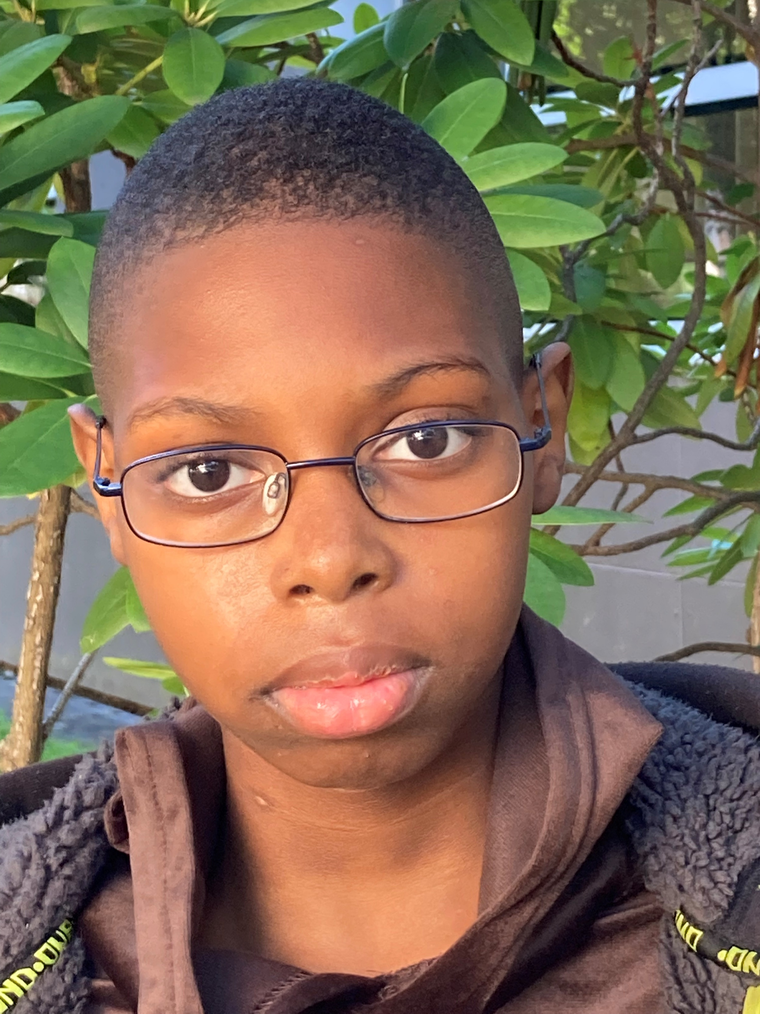
first name:
surname:
age:
country:
city: pets: favourite colour:
hobbies:
languages:
family:

Slide 10
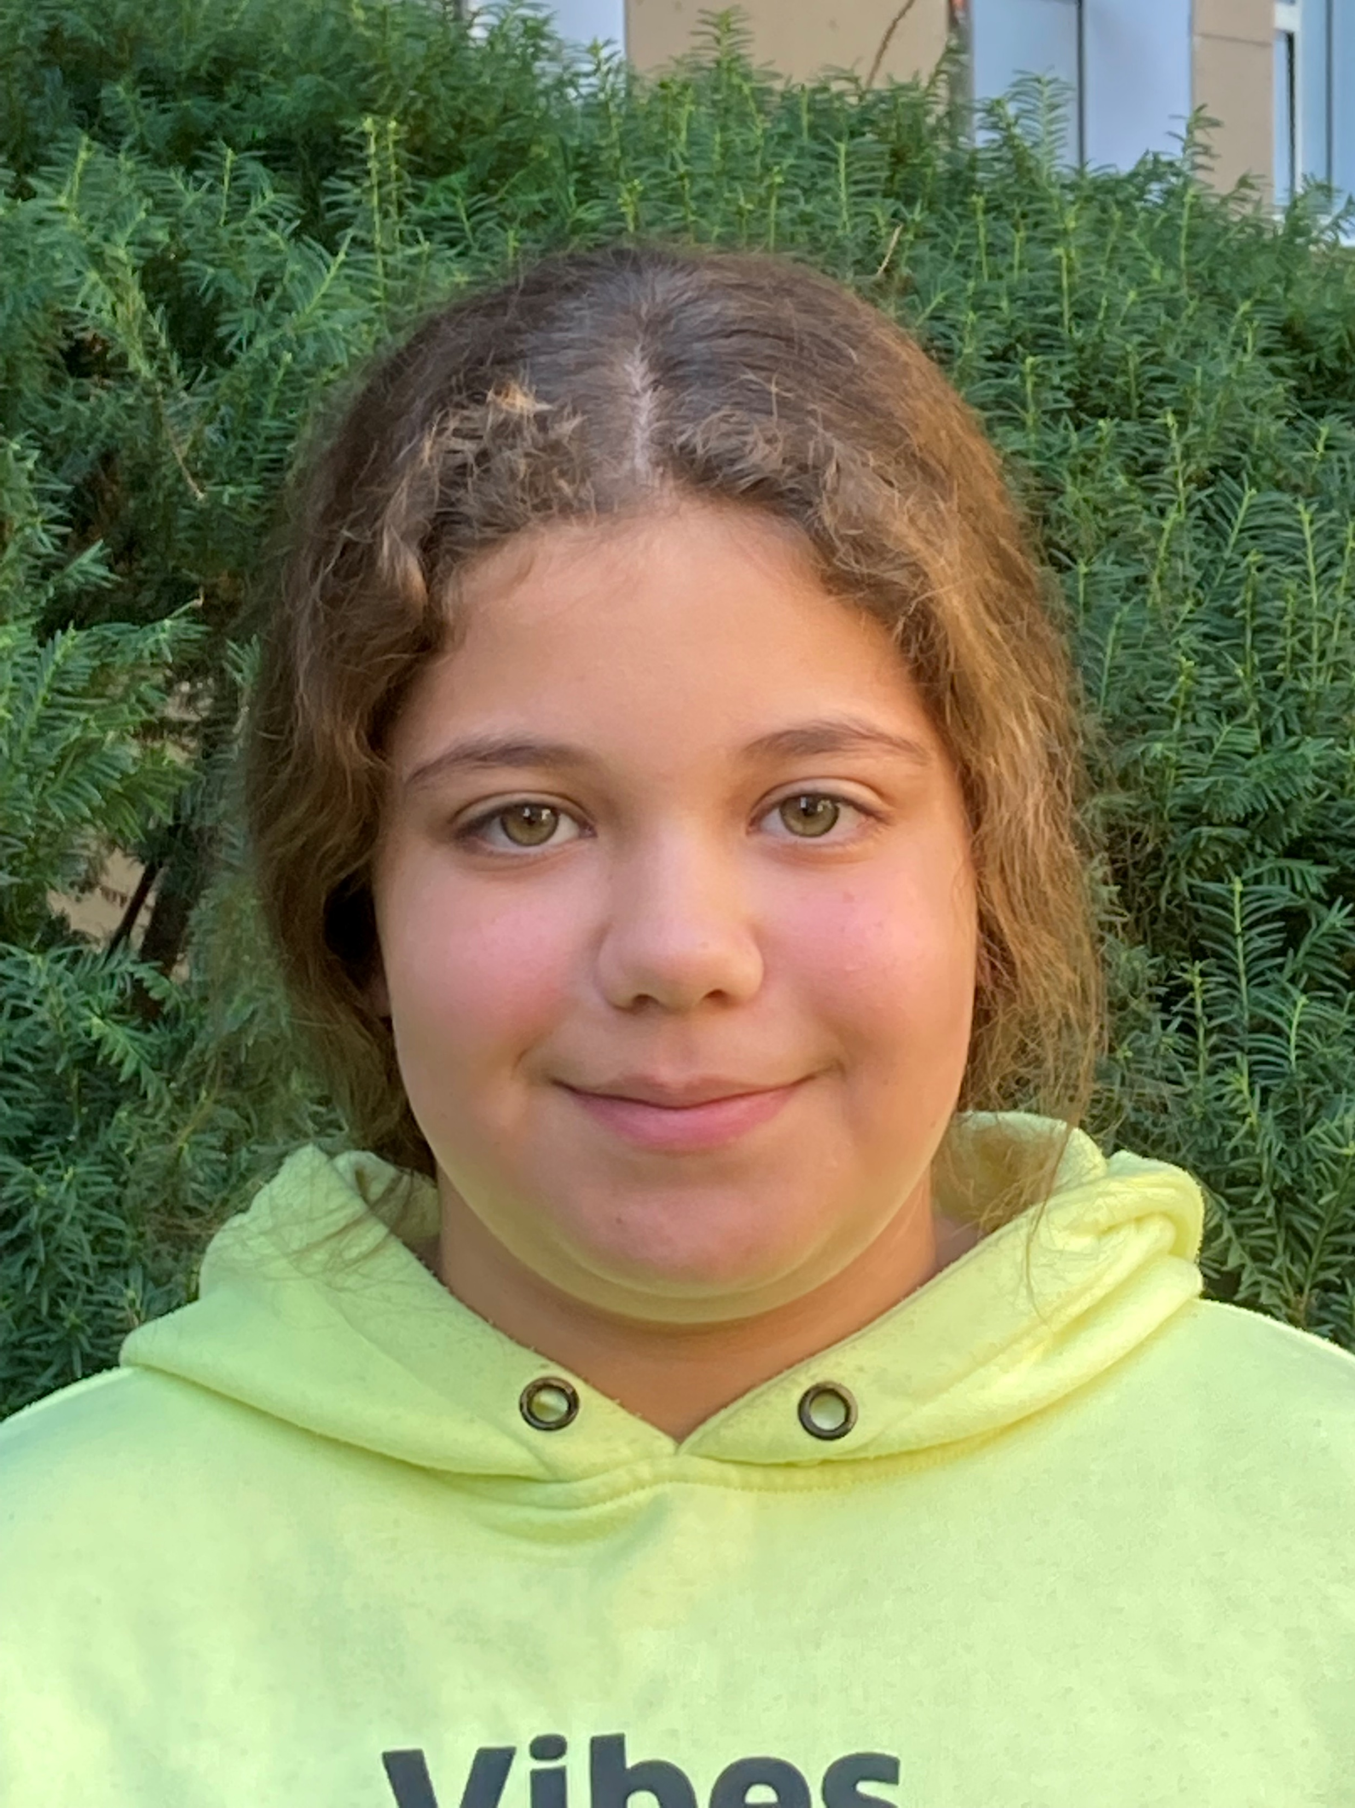
first name:
surname:
age:
country:
city: pets: favourite colour:
hobbies:
languages:
family:

Slide 11
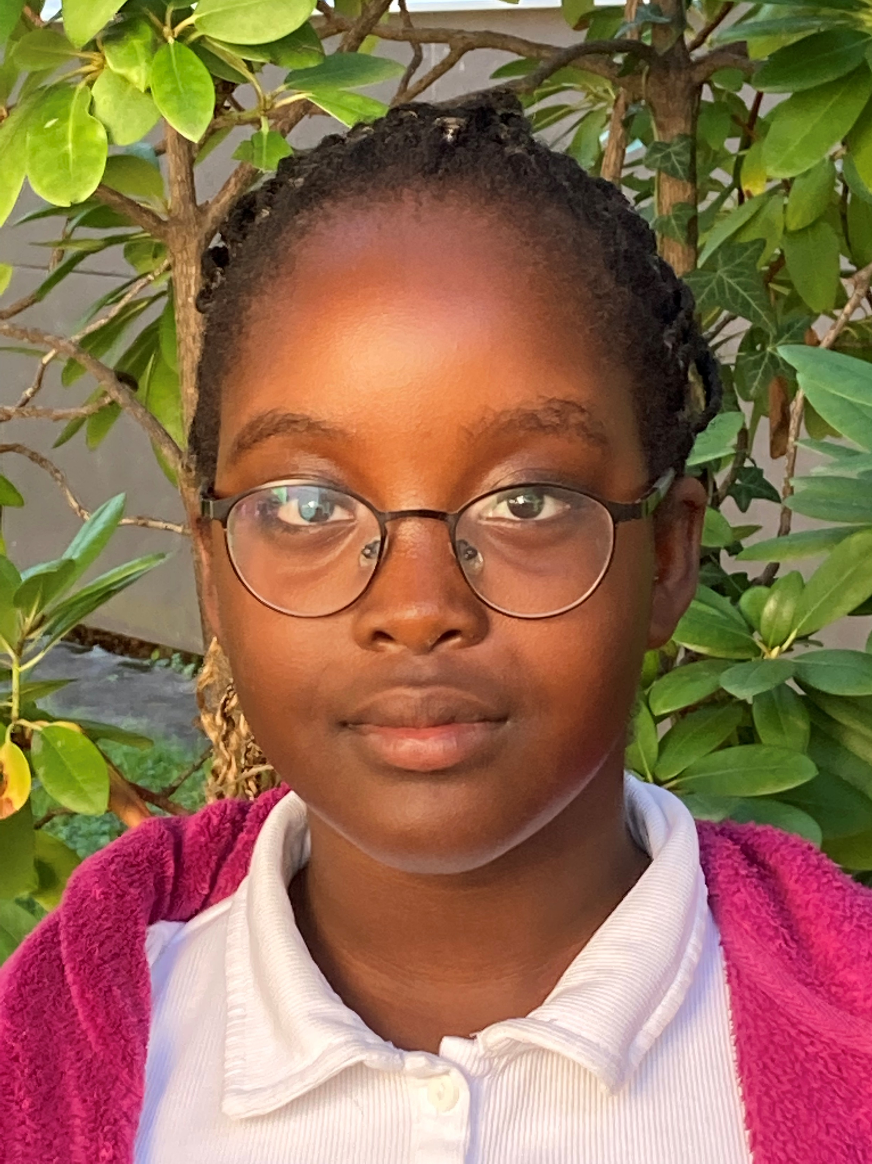
first name:
surname:
age:
country:
city: pets: favourite colour:
hobbies:
languages:
family:

Slide 12
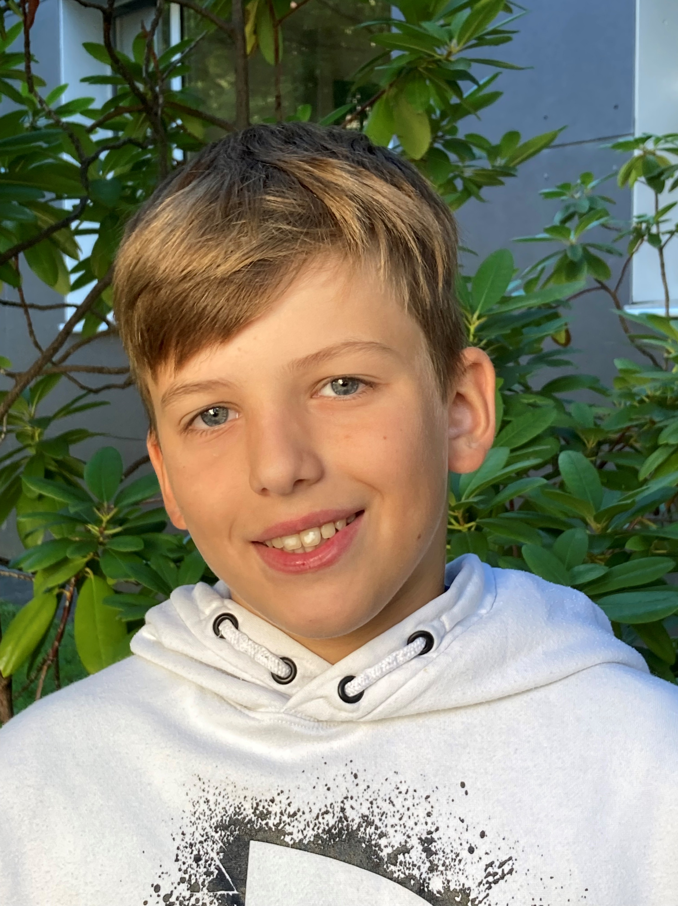
first name:
surname:
age:
country:
city: pets: favourite colour:
hobbies:
languages:
family:

Slide 13
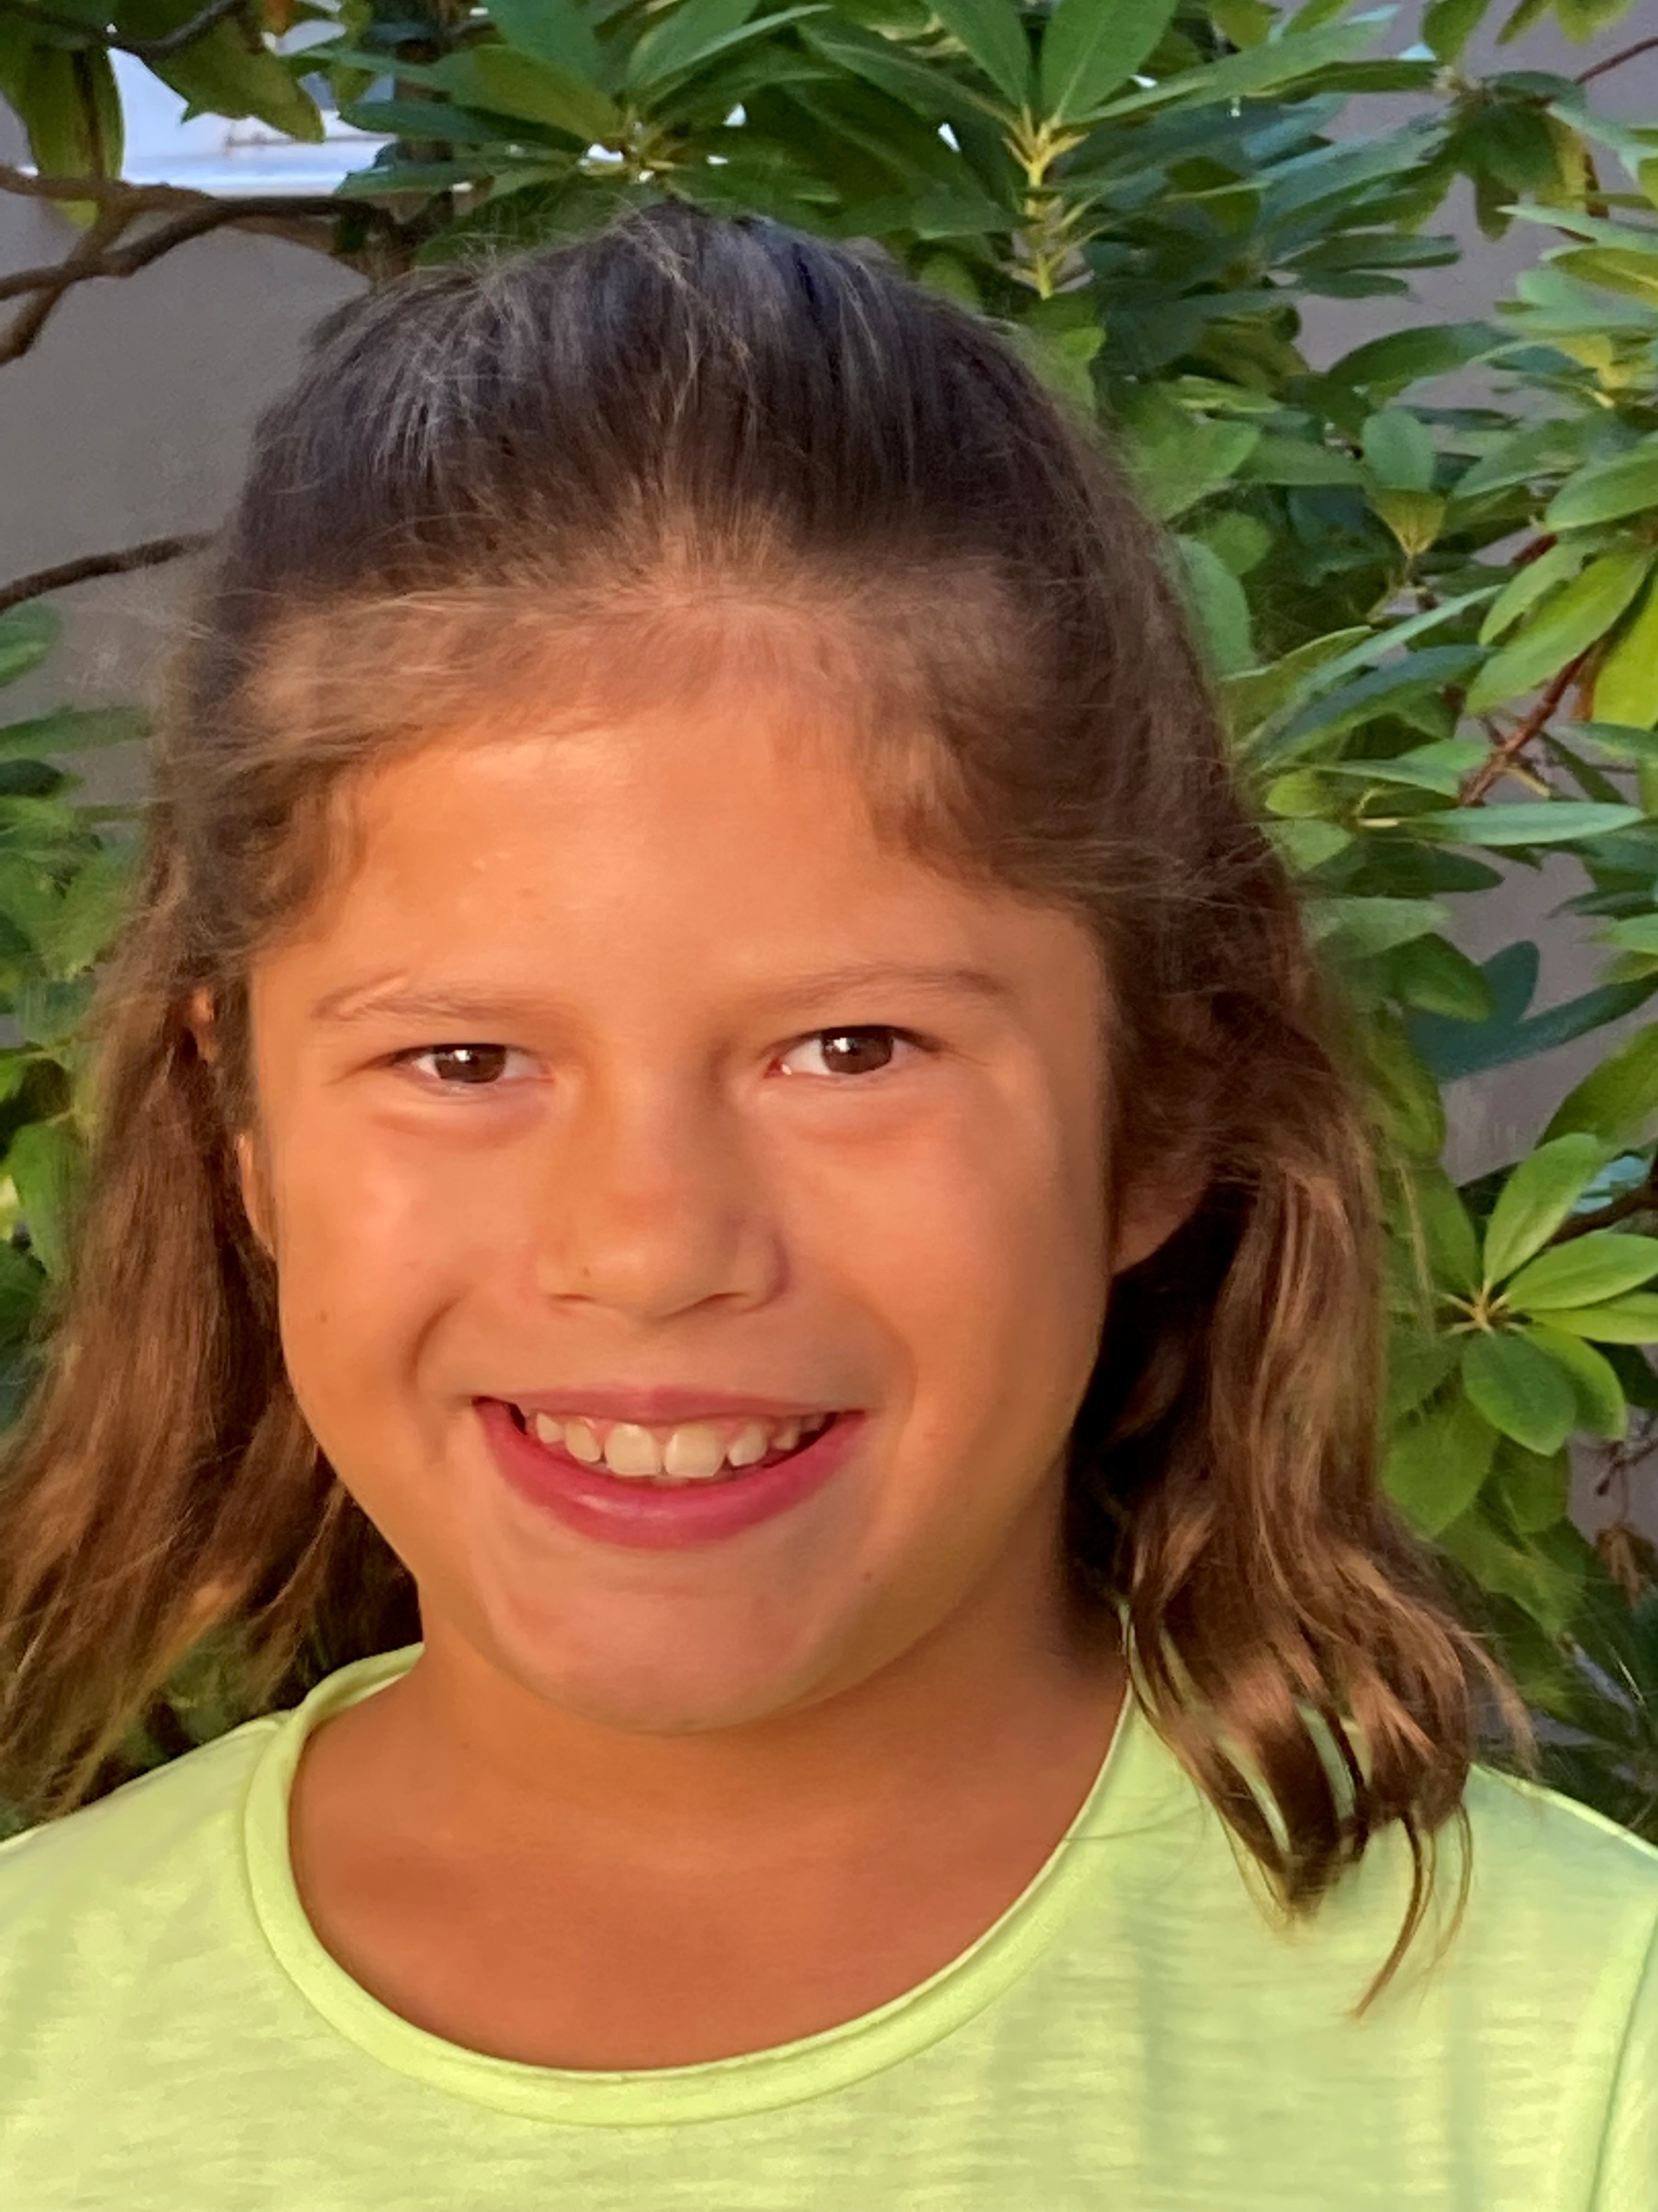
first name:
surname:
age:
country:
city: pets: favourite colour:
hobbies:
languages:
family:

Slide 14
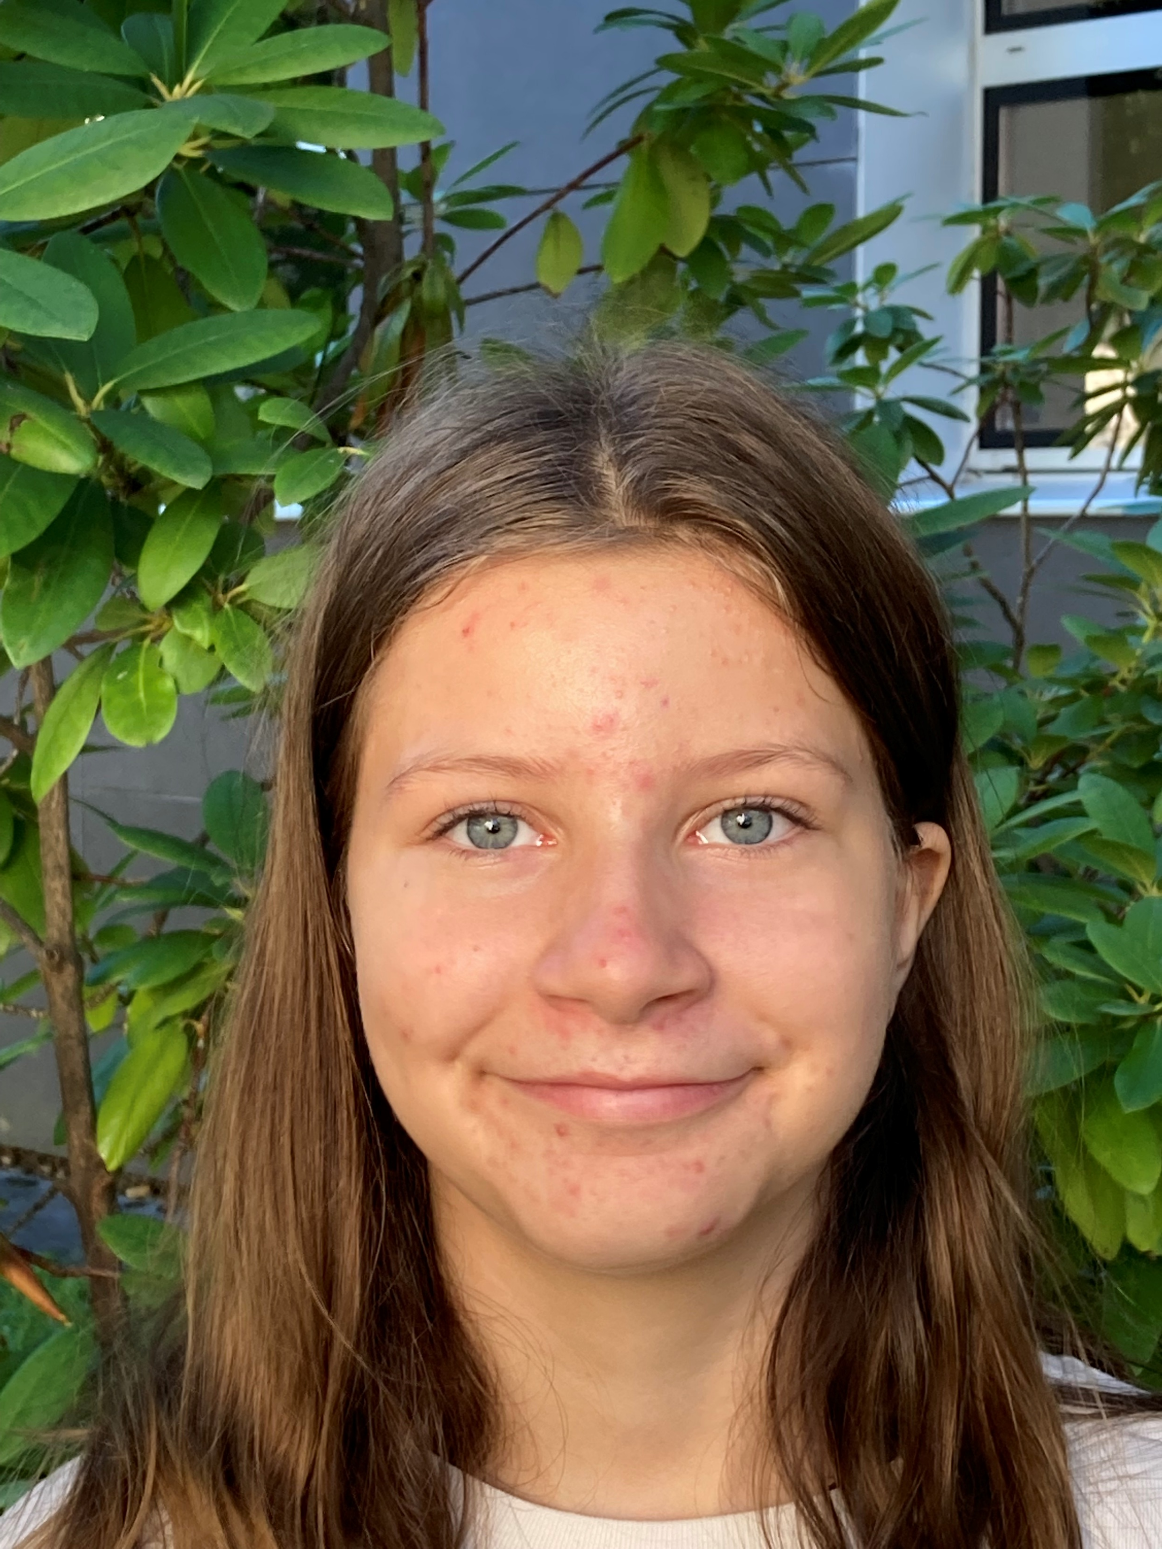
first name:
surname:
age:
country:
city: pets: favourite colour:
hobbies:
languages:
family:

Slide 15
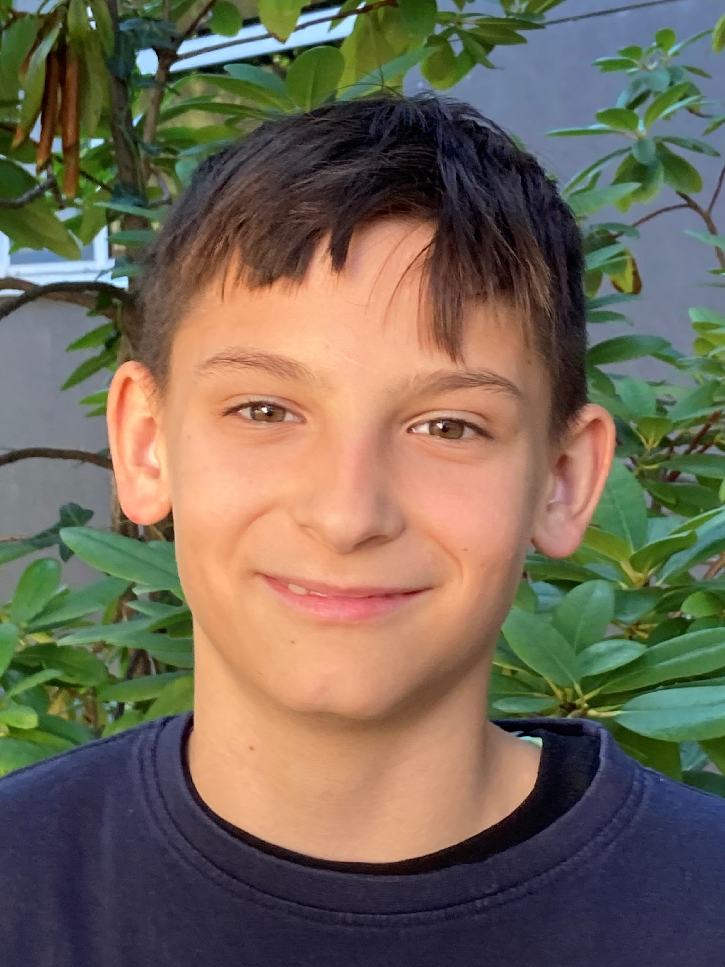
first name:
surname:
age:
country:
city: pets: favourite colour:
hobbies:
languages:
family:

Slide 16
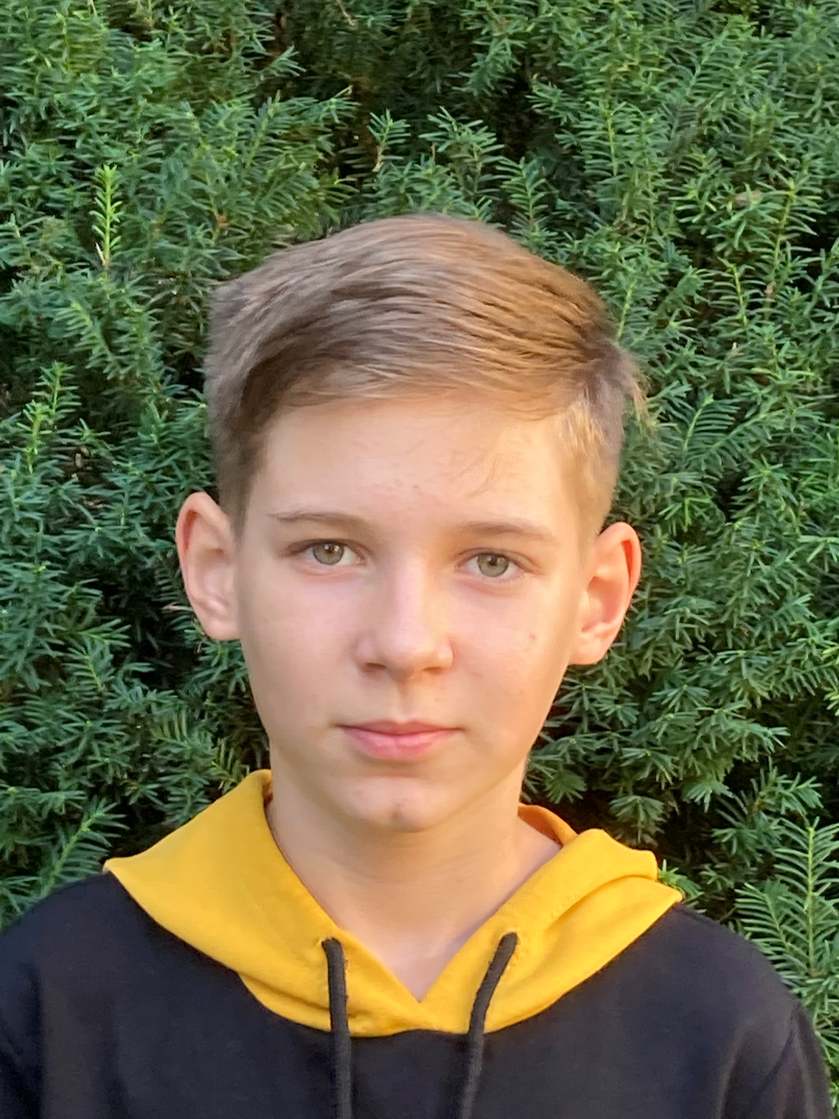
first name:
surname:
age:
country:
city: pets: favourite colour:
hobbies:
languages:
family:

Slide 17
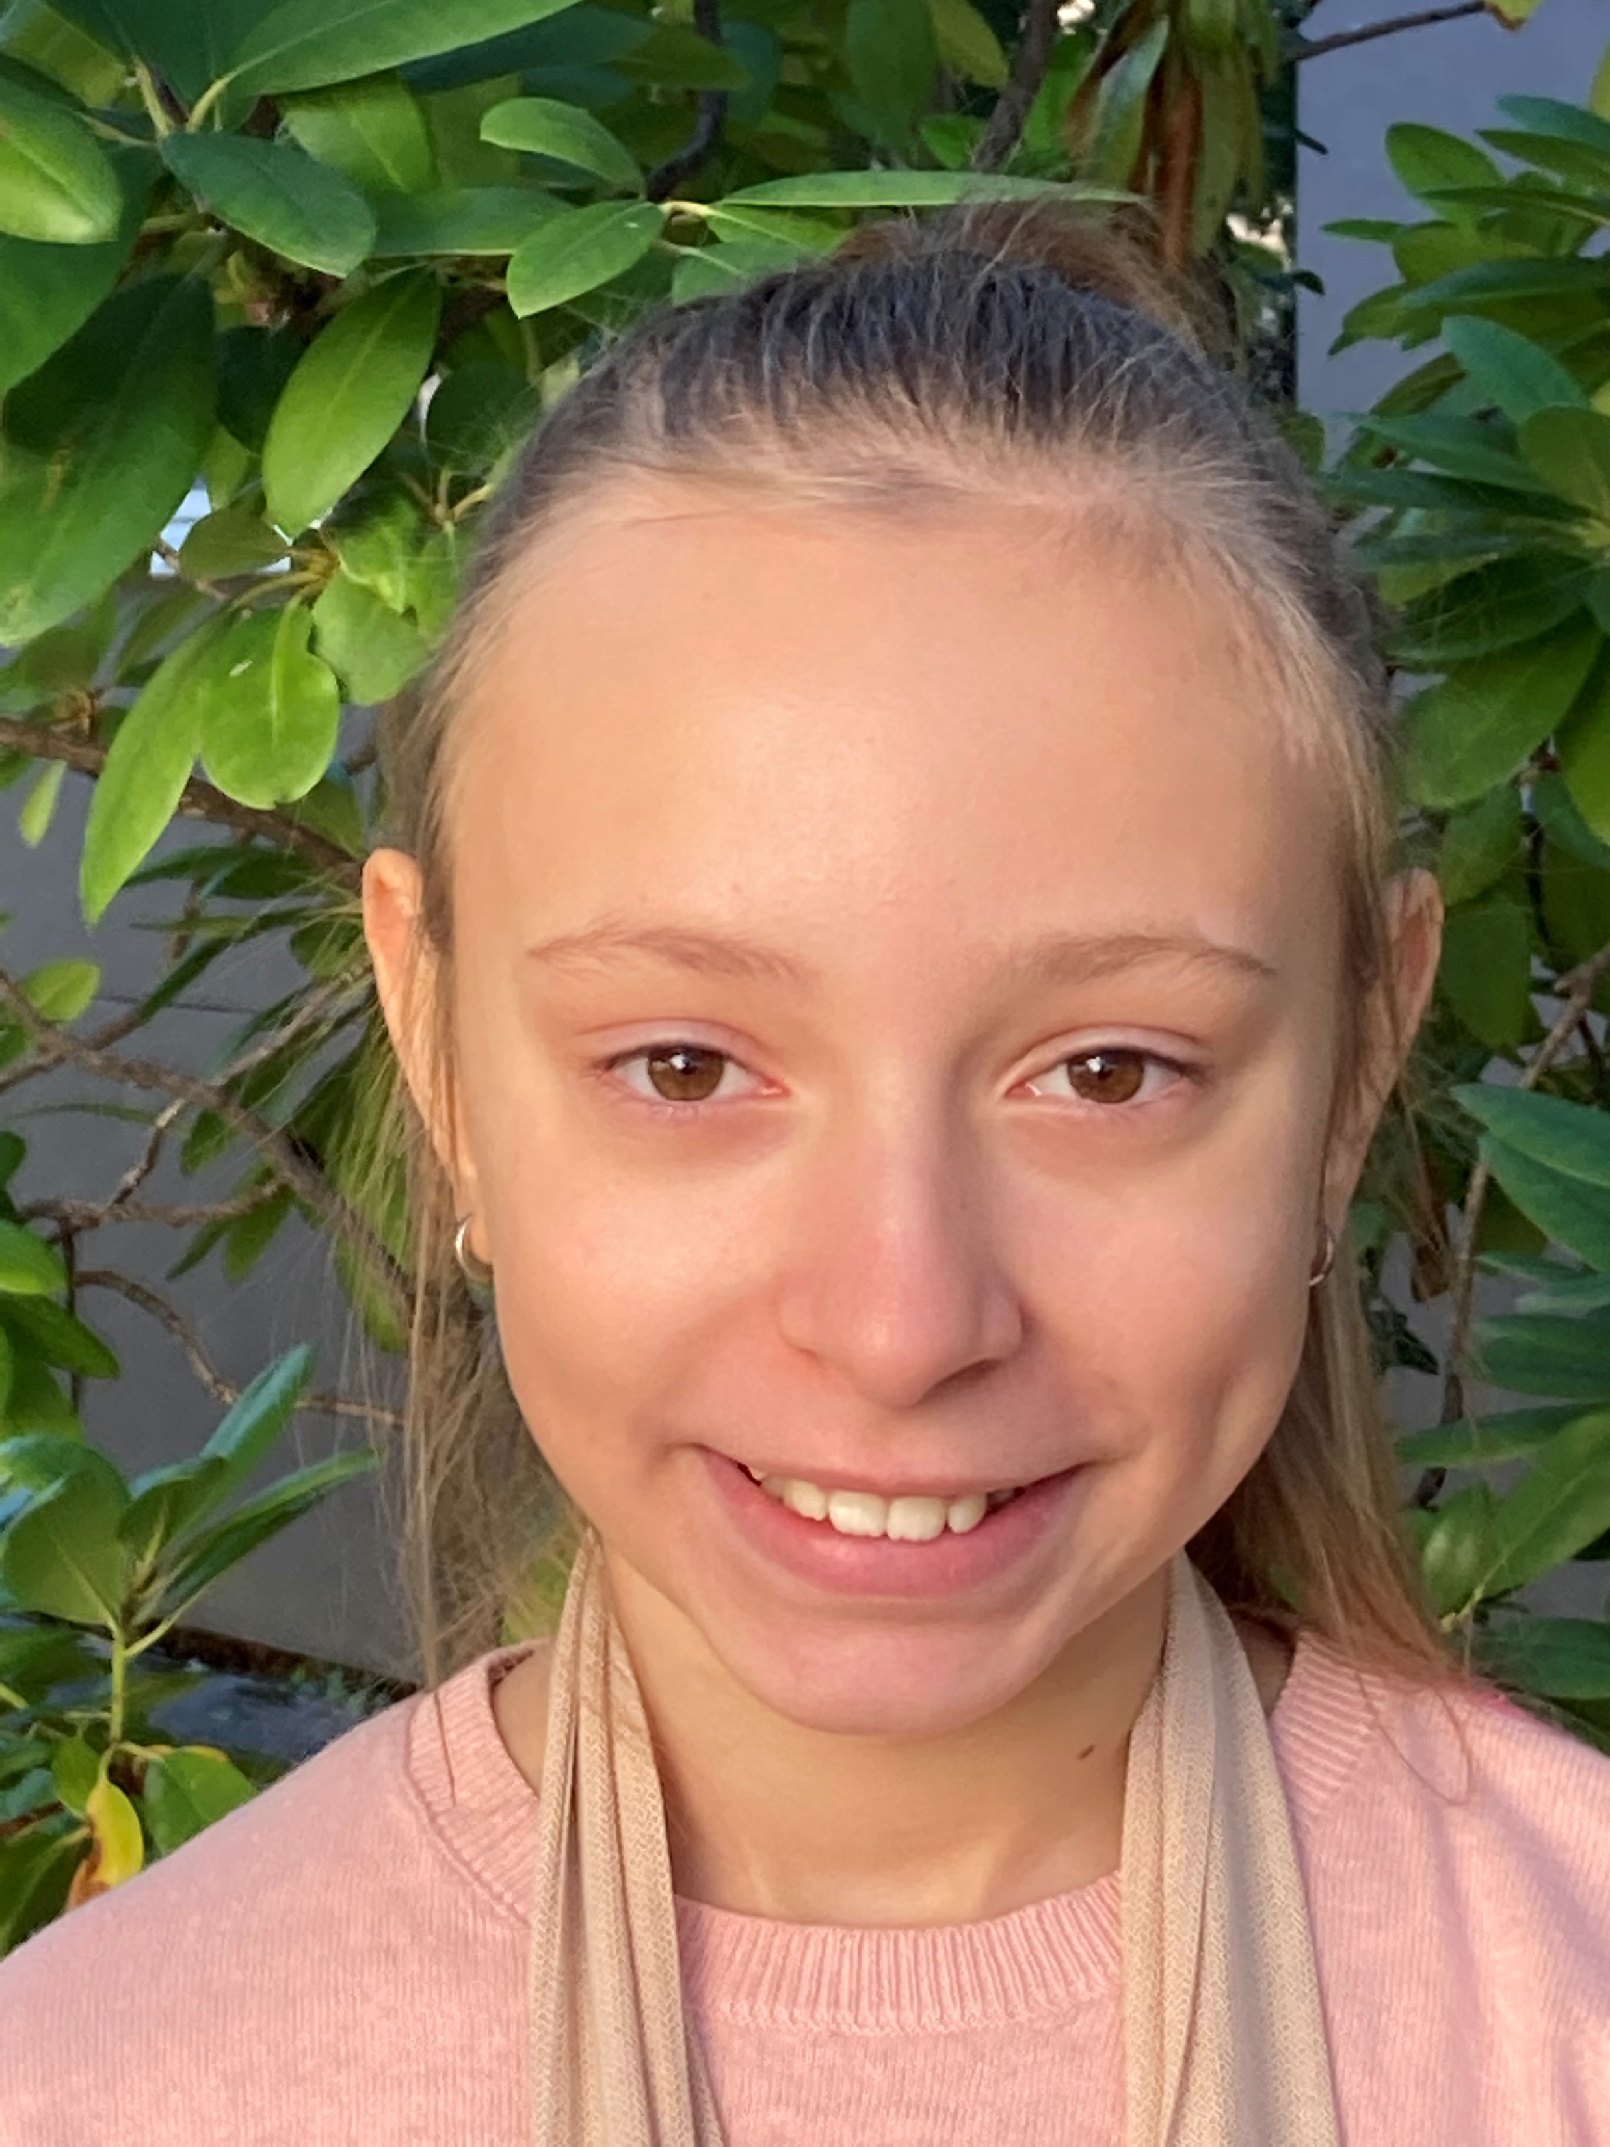
first name:
surname:
age:
country:
city: pets: favourite colour:
hobbies:
languages:
family:

Slide 18
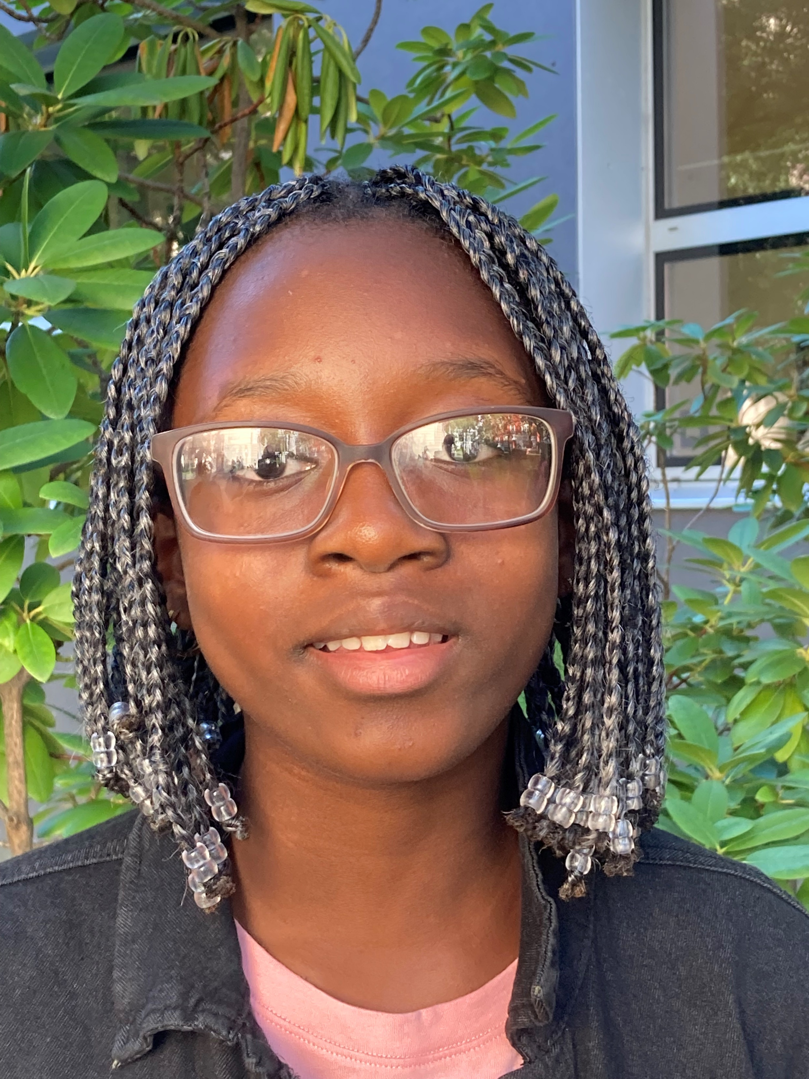
first name:
surname:
age:
country:
city: pets: favourite colour:
hobbies:
languages:
family:

Slide 19
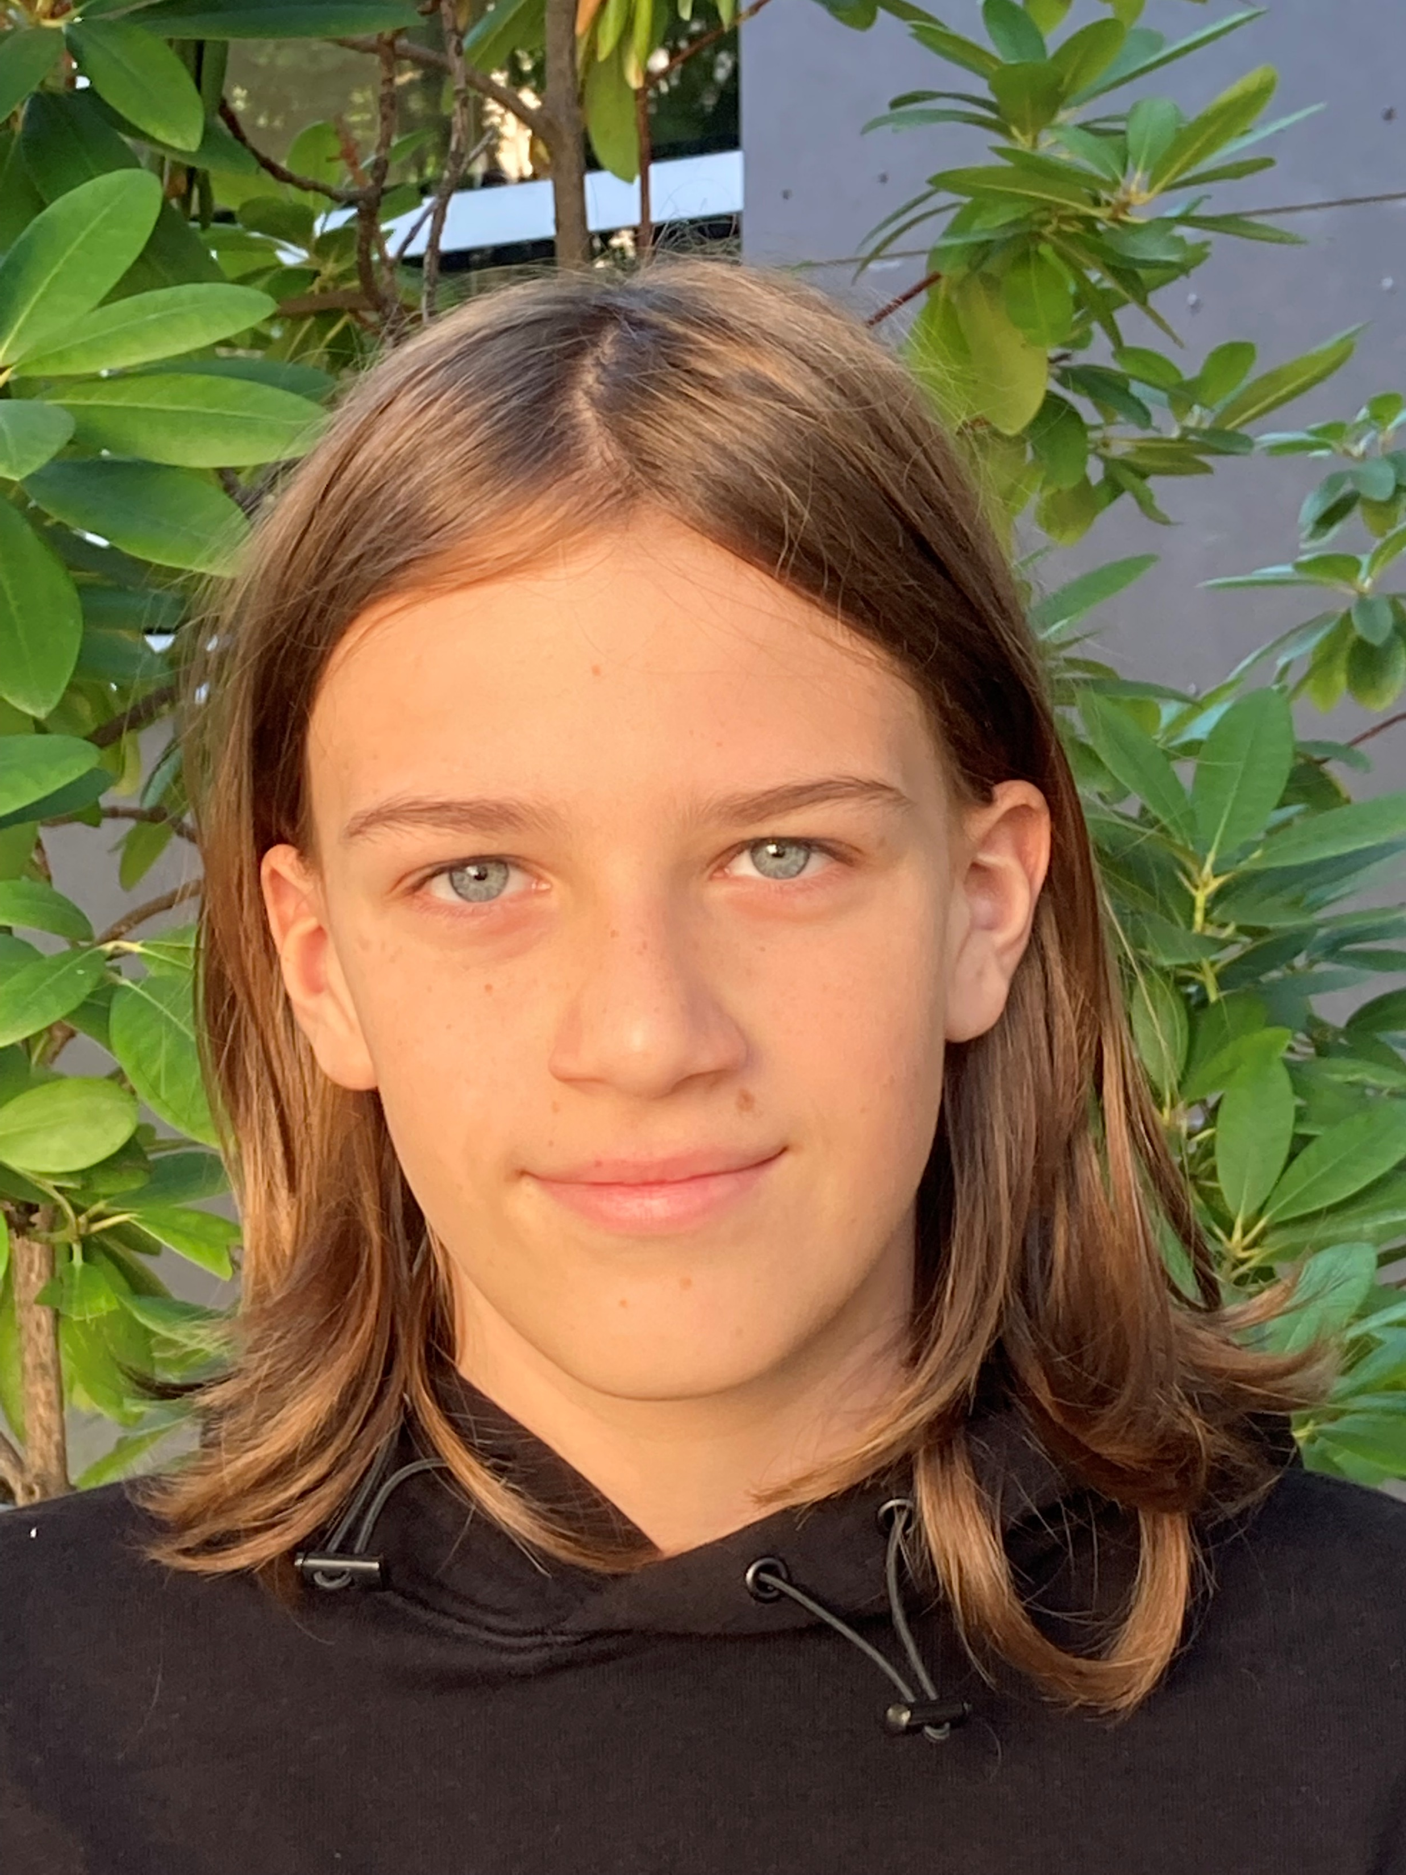
first name:
surname:
age:
country:
city: pets: favourite colour:
hobbies:
languages:
family:

