Slide 1
A beautiful House
Intro to our first Fantasy Trip

Slide 2
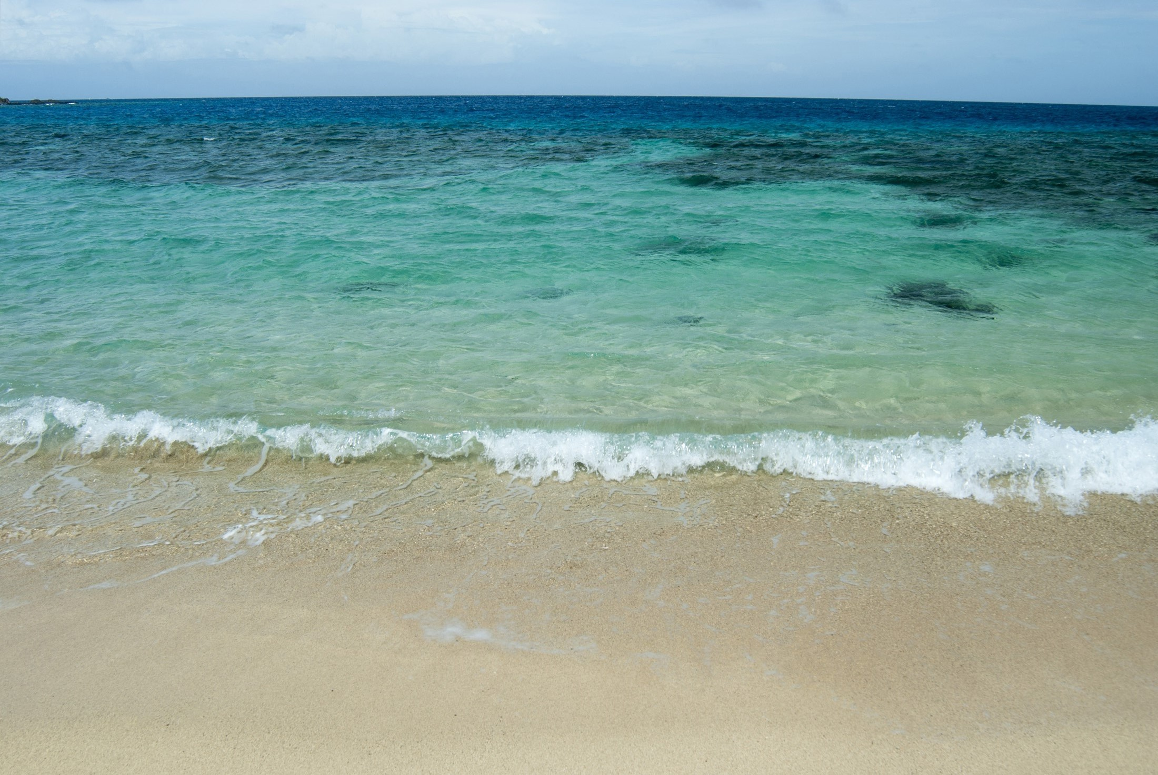
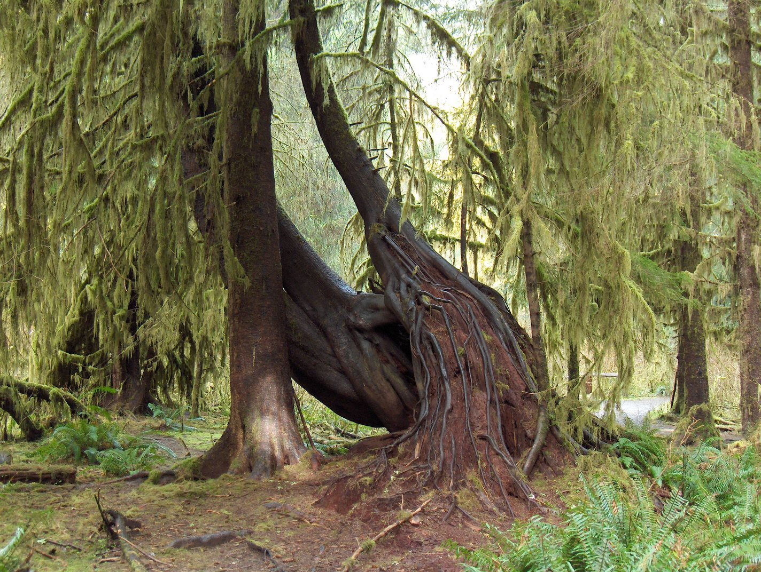

You are walking along the beach.
You can hear the waves
You can feel the sand on your feet
It is nice and warm.
You can see beautiful trees.
You start to run towards the trees and the shady forest.
This Photo by Unknown Author is licensed under CC BY-SA
This Photo by Unknown Author is licensed under CC BY
This Photo by Unknown Author is licensed under CC BY-SA

Slide 3
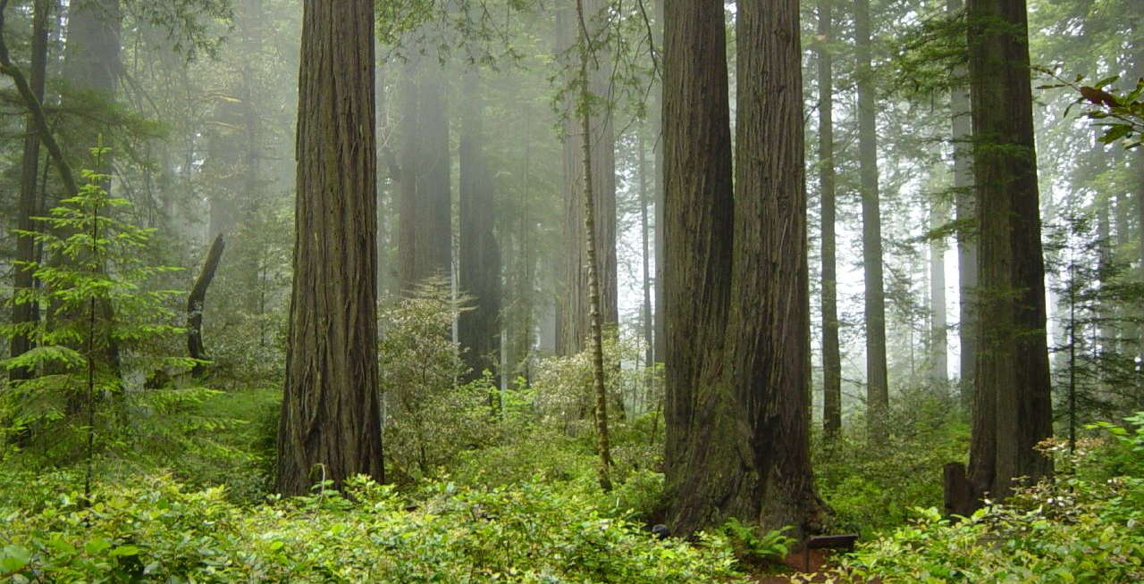

Slide 4
Relaxation music: http://www.orangefreesounds.com/wonder-new-age-ambient-track/ CC By Alexander Blu, NC 4.0
Forest Sounds: http://www.orangefreesounds.com/relaxing-forest-sounds/
CC 4.0 by Alexander
Sea Waves Sound: CC by Alexander – NC 4.0 http://www.orangefreesounds.com/sea-waves-sound/

