Slide 1
The best Day of my Holidays
A Greek Wedding

Slide 2
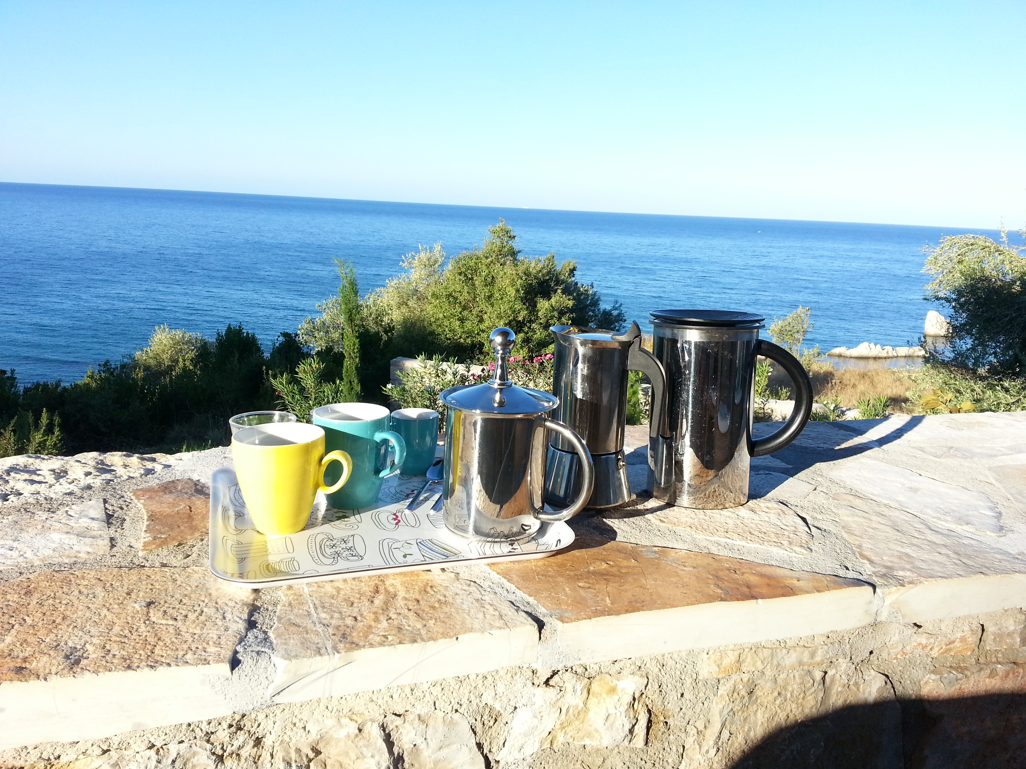
The best day of my holidays…
…was the 25th of August. I was at my friend Thanassis’ wedding. Let me tell you all about this great day.
We got up around 7 o’clock. We went downstairs quietly, because our friends were still sleeping, and we did not want to wake them up. We made breakfast and drank a cup of coffee on the terrace. It was a beautiful day and the sun slowly came up behind the house.

Slide 3
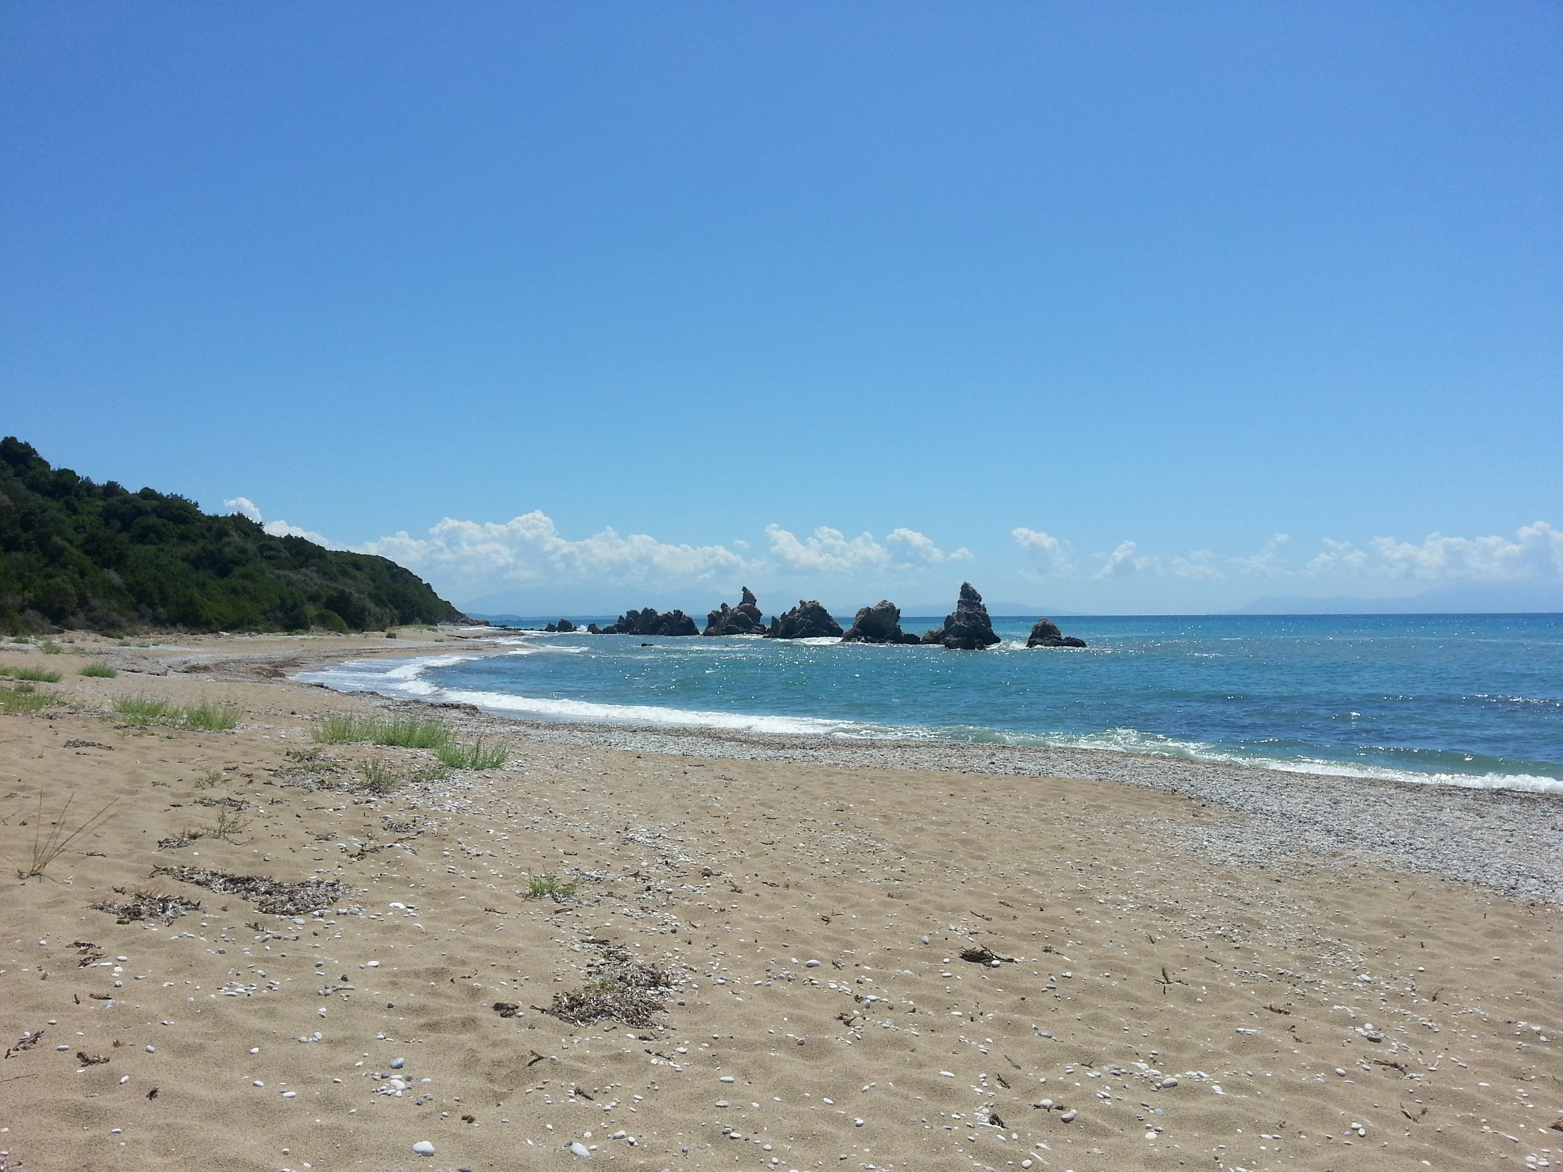
After breakfast…
…we went for a quick swim in the sea. Then we took a shower and got dressed. I put on a pretty summer dress and my husband put on his blue summer suit and a white shirt. We do not normally wear these clothes in Greece, but for a wedding we wanted to be pretty

Slide 4
We left our house…
…around 9 o’clock and drove to Ioannina. There was not much traffic and we got there around 10 o’clock. That was perfect, because the wedding started at 11 o’clock. We found the big church and parked our car. Then we talked to friends and to Thanassis’ parents and went into the church. It was full of beautiful flowers and candles.

Slide 5
We waited for the bride…
… and the bridegroom to arrive. When they came in, everybody stood up. They were really pretty. The bride was wearing a long white dress and she had a little crown made of flowers on her head. The wedding mass was very beautiful but very long and I did not understand everything the priest said in Greek.

Slide 6
After the wedding…
… we had a glass of wine outside the church and talked with the other guests. Then we all went to a big restaurant for the wedding reception. There was soooo much food. It was incredible.

Slide 7
We ate for five or six hours.
… The food was very good and everybody was in a good mood.
The wedding cake was the best. It was huge – the biggest cake I have ever seen, and it was delicious.

Slide 8
In the afternoon…
…and evening there was a band. They played traditional Greek music and all the people danced and had a lot of fun.

Slide 9
We left the wedding…
… in the middle of the night and spent the night in a little hotel. On the next morning we had breakfast at the hotel and then we drove back to our house on the beach.

Slide 10
It was really a very special day, my first Greek wedding.

