Slide 1
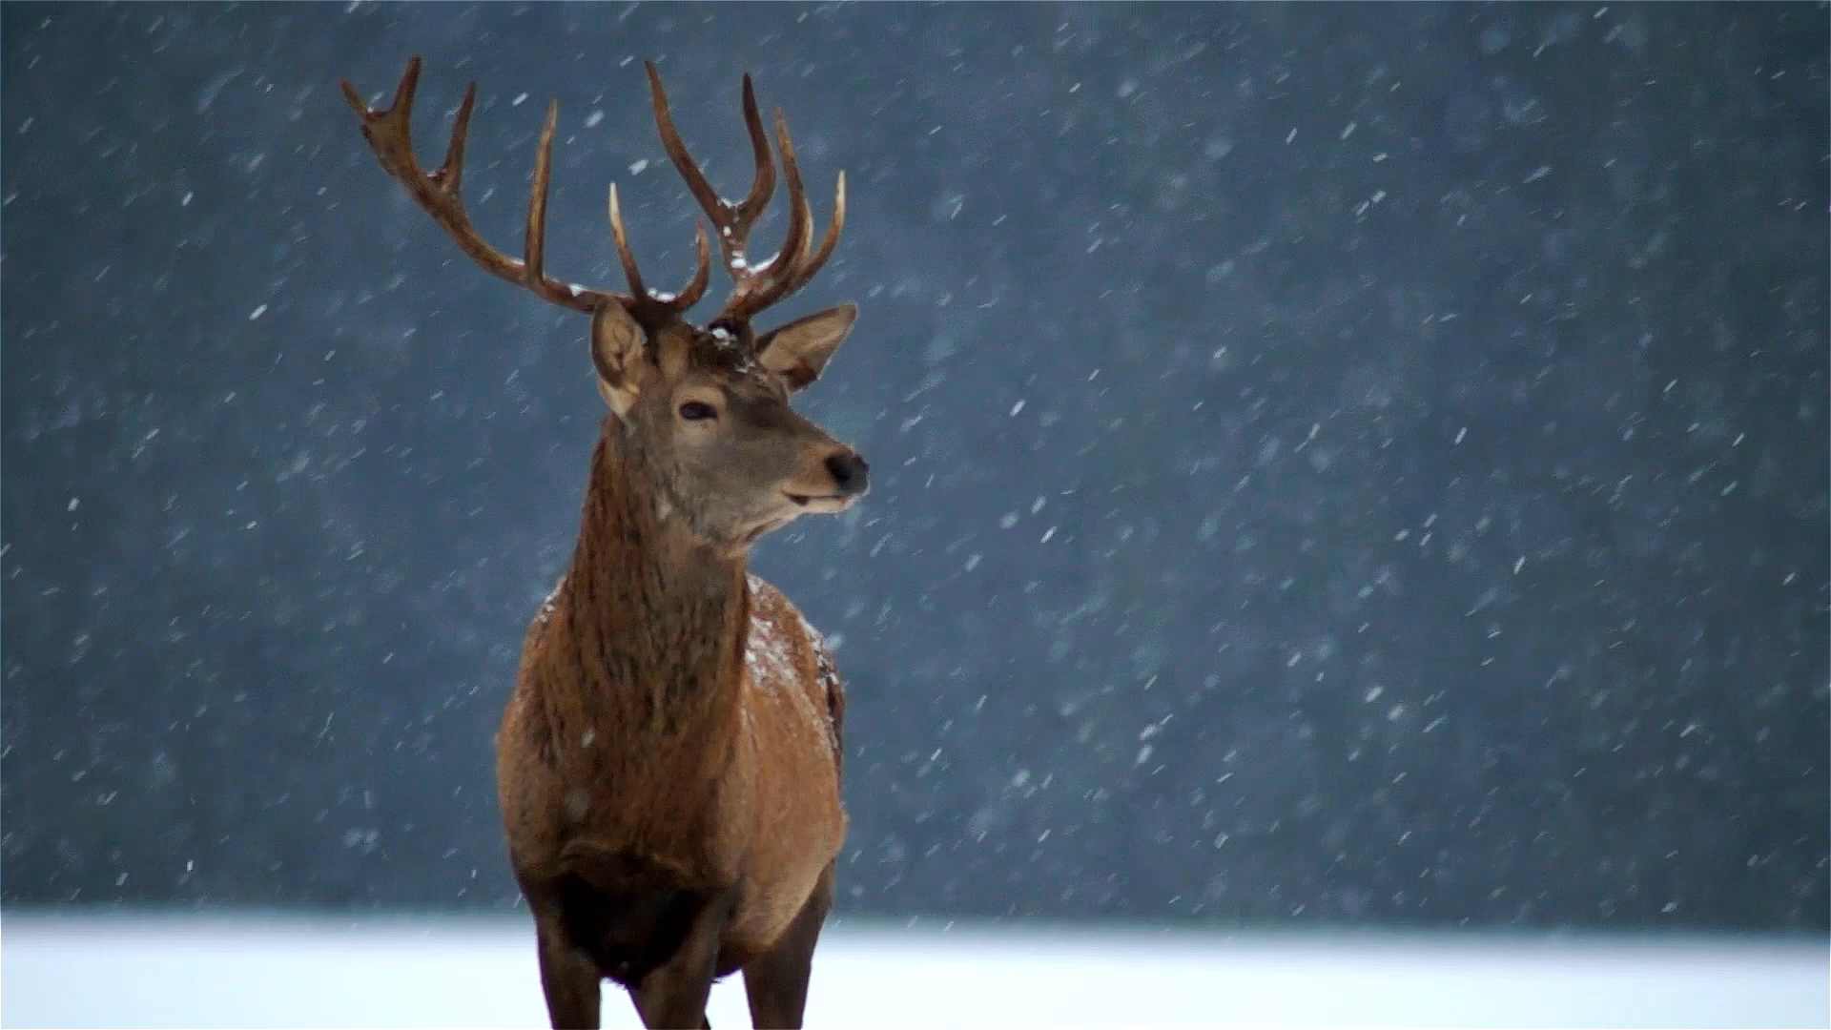
Rudolph’s Revenge

Slide 2
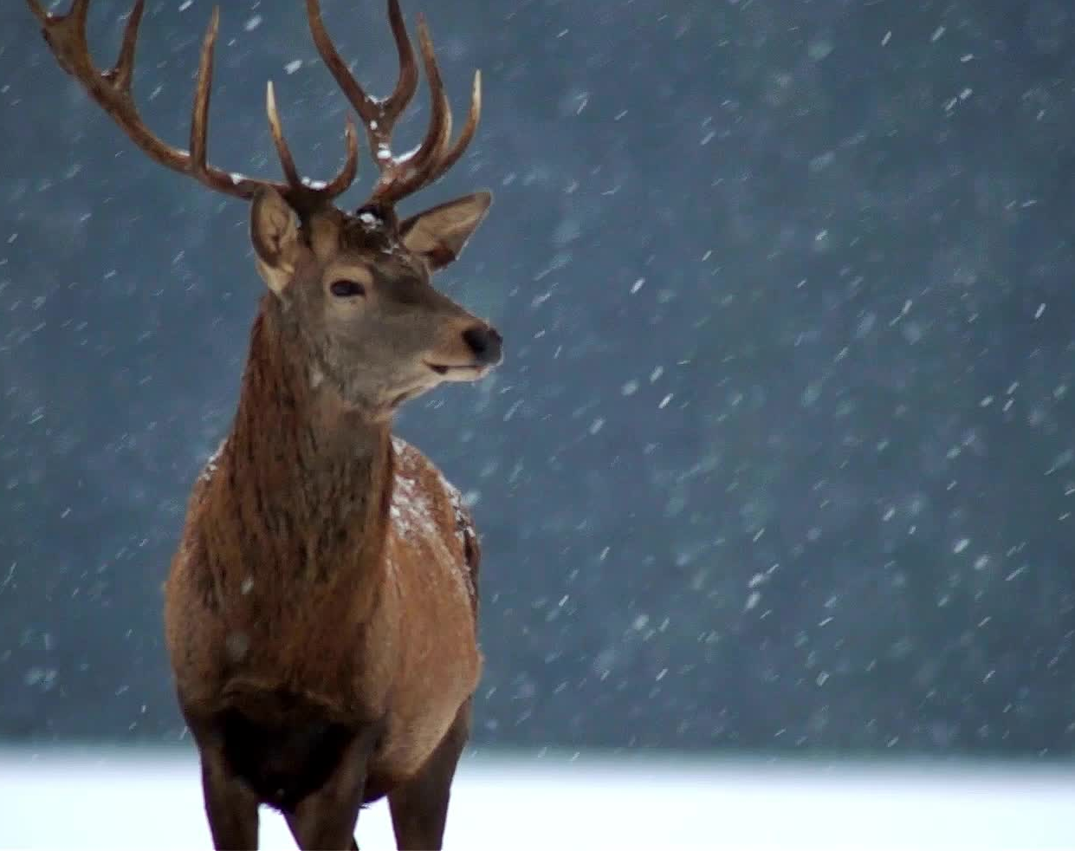
Who was Rudolph?
What do you know about him?

Slide 3
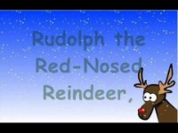
Gene Autry
You know Dasher and Dancer and Prancer and Vixen Comet and Cupid and Donner and Blitzen But do you recall The most famous reindeer of all?
Rudolph the Red-Nosed Reindeer _______ a very shiny nose And if you ever _______ it You would even say it glows
All of the other reindeer Used to laugh and call him names They never _______ poor Rudolph Join in any reindeer games
Then one foggy Christmas Eve Santa __________ to say "Rudolph, with your nose so bright Won't you guide my sleigh tonight?“
Then how the reindeer __________ him As they sh________ out with glee "Rudolph the Red-Nosed Reindeer You'll go down in history"
Songwriters: Johnny Marks
Rudolph, the Red-Nosed Reindeer lyrics © Warner Chappell Music, Inc, Roba Music Verlag GMBH, ST. Nicholas Music Inc.

Slide 4
Rudolph’s Revenge
What could be Rudolph’s REVENGE?
What do you think is happening in the photo that I saw?

Slide 5
Let me describe it:
Rudolph, the red-nosed reindeer, is in the foreground of the photo.
He is flying towards us. His nose is as red and shiny as ever.
He has left all the other reindeer behind. They are lying on the floor in the background of the photo. (Notice: I said FLOOR not GROUND)
Things don’t look good for them. They might even be dead.
… could this be Rudolph’s REVENGE?

Slide 6
Where was this picture taken? What is going on here?

