Slide 1
Colors
Can you name the colors?

Slide 2
Can you name the colors?
blue | red | green | yellow | orange
white | grey or gray | Black | brown | pink
purple

Slide 3
Now write your own list of colors
Use your color pencils or felt tip pens.
blue
red
green…

Slide 4
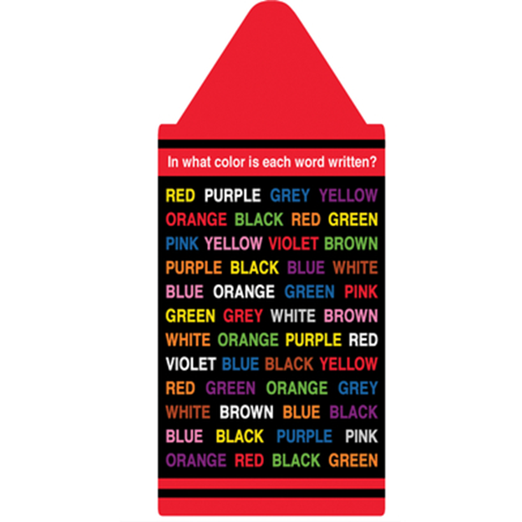
Game: True Colors
Make your own “True colors” card.
Then practice with your partner

