Slide 1
The story of
Thanksgiving

Slide 2
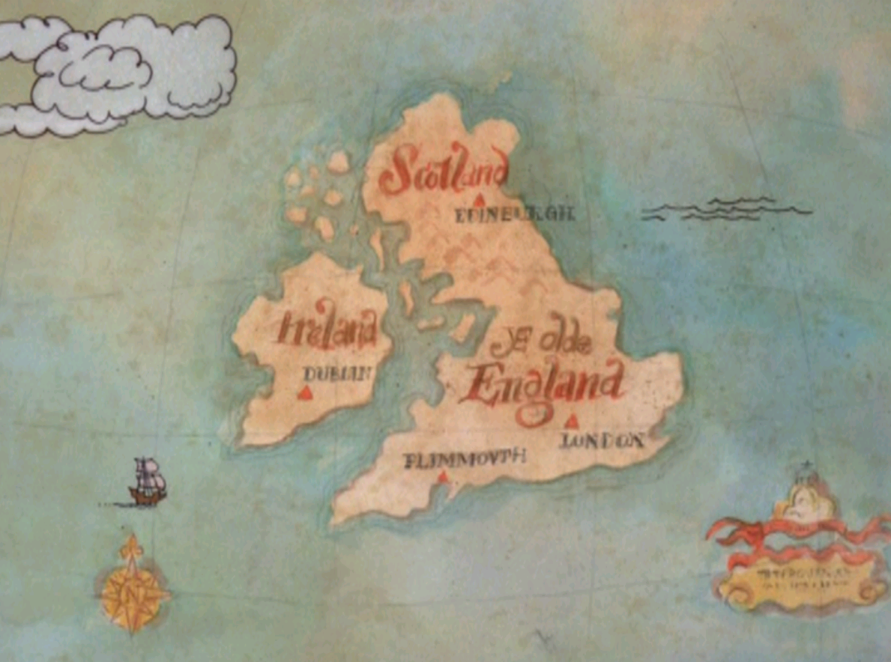
Notes:
Where do you think our story starts? In England
When? In the early 1600s

Slide 3
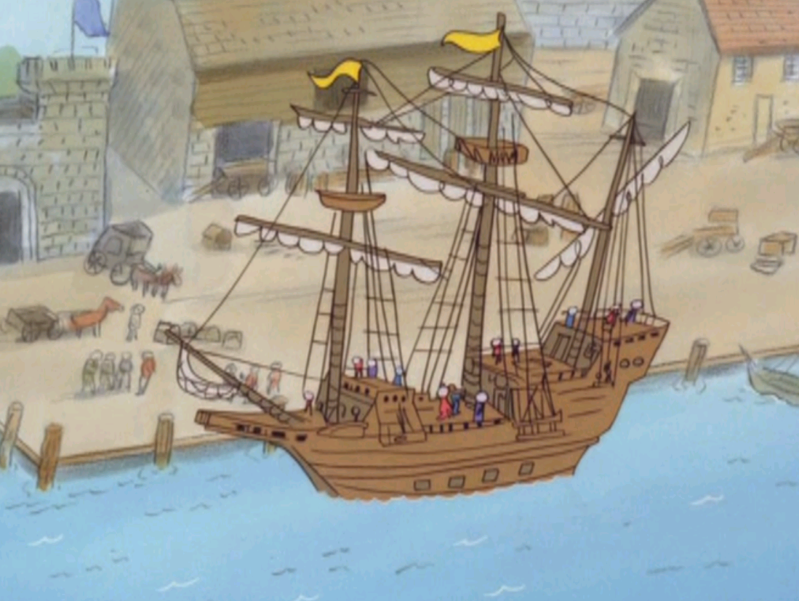
Notes:
On September 6, 1620 a group of 102 people got on a small ship called the Mayflower. Where do you think they wanted to go? America
What was the ship made of? Wood

Slide 4
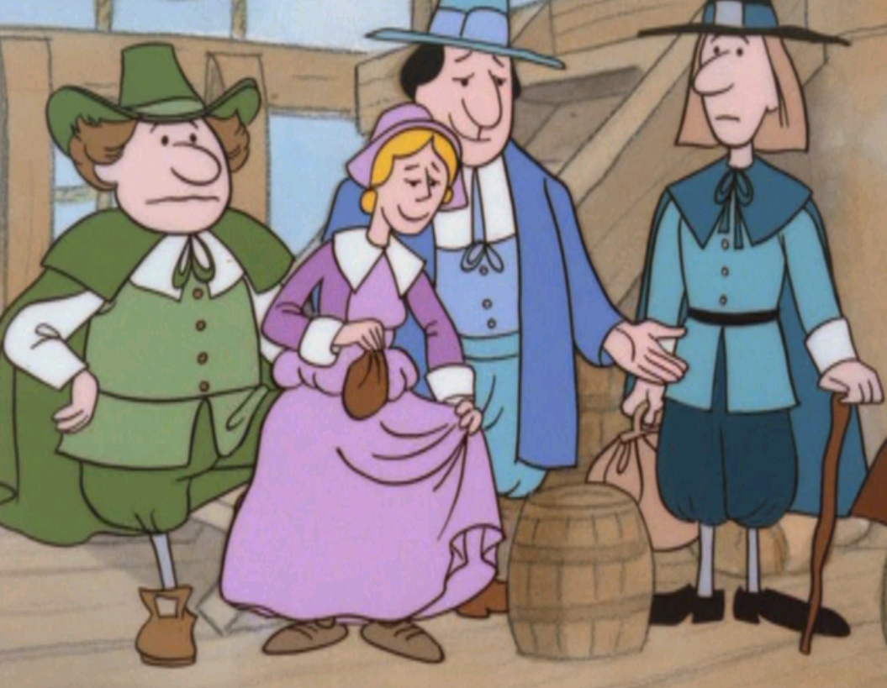
Notes:
Some of these people were called Pilgrims
Why do you think they wanted to go to America? Because in England there was only one church, The Church of England, and they wanted to practice a different religion.
Other passengers were called strangers and they wanted to go to America to find gold and riches and better jobs
The other people on the boat were workers who helped sail the ship

Slide 5
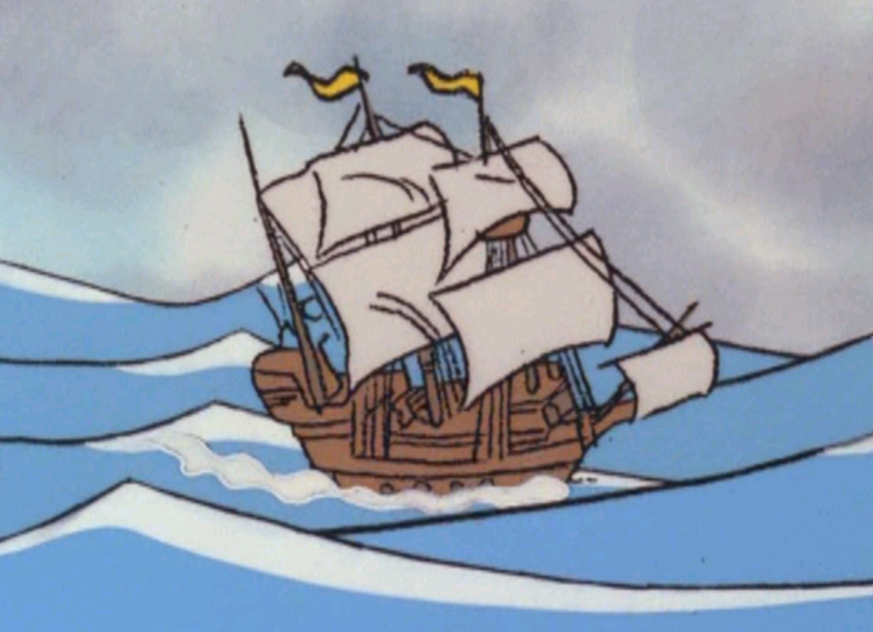
Notes:
Who can show me on the map how they sailed to America from England?
How long do you think it took?
What problems do you think they had?

Slide 6
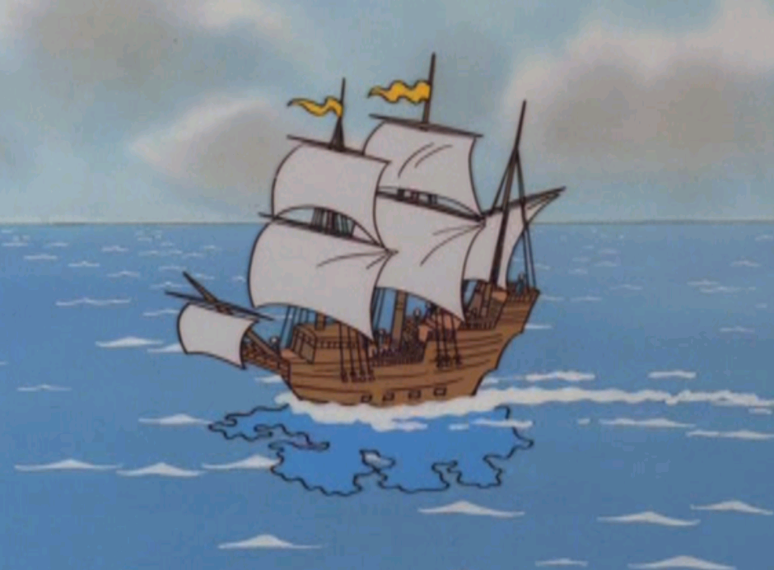
Notes:
For the first weeks the weather was good and they made good progress, but...

Slide 7
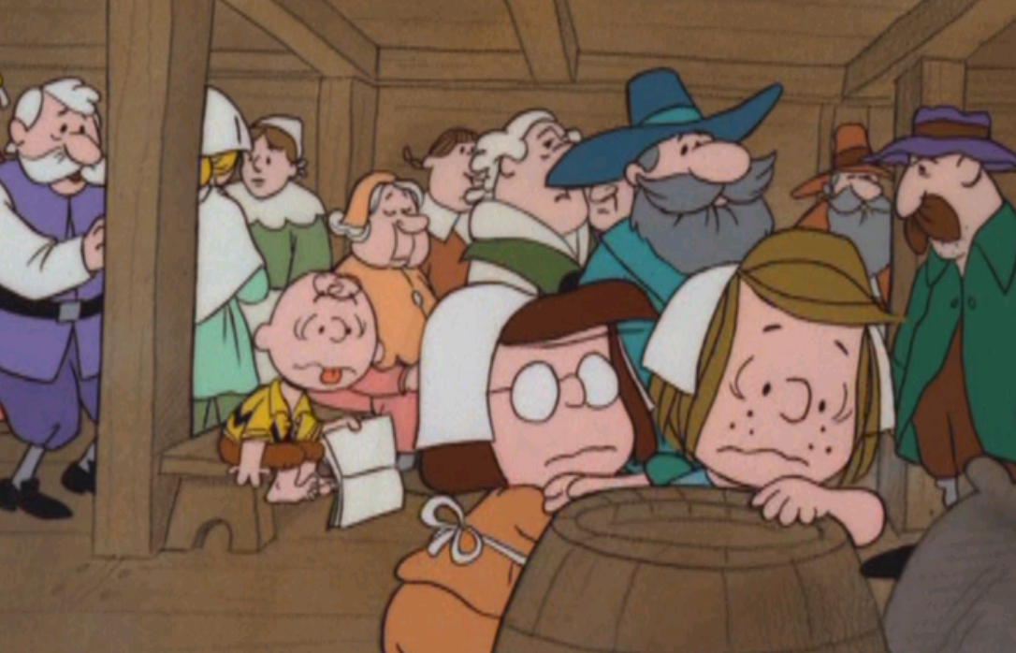
Notes:
It was very crowded, and the boat was rocking back and forth, back and forth which made people feel sick.

Slide 8
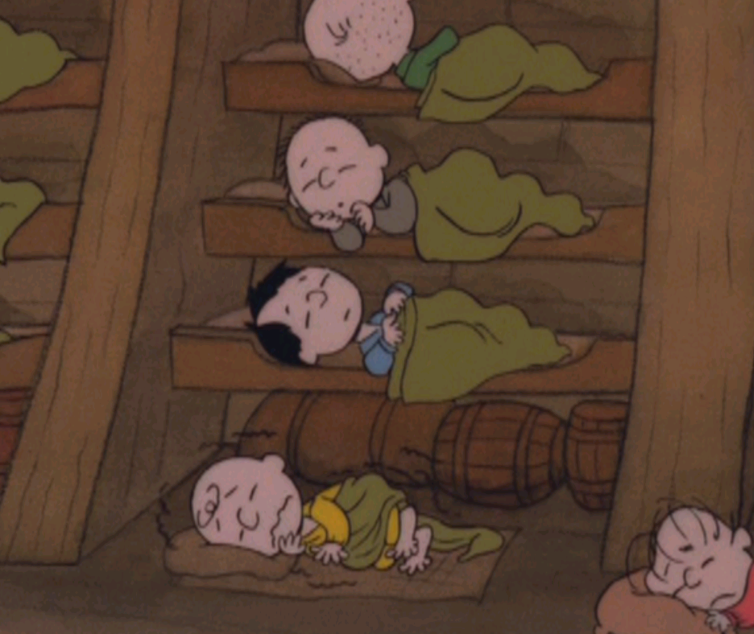
Notes:
Many had to sleep in bunks on on top of the other

Slide 9
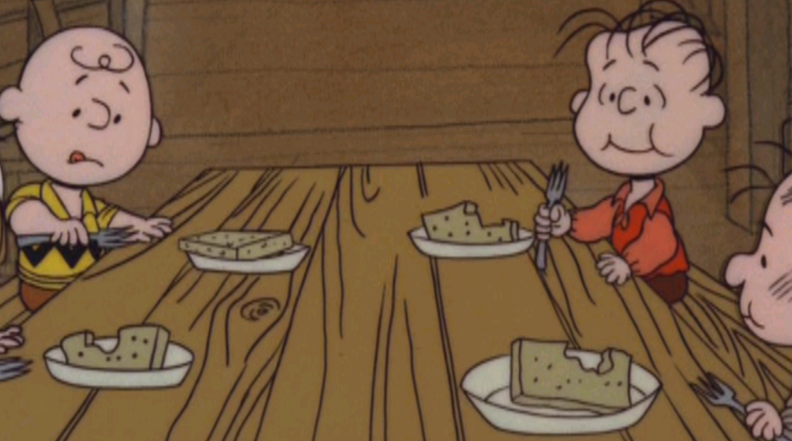
Notes:
And the food was not very good

Slide 10
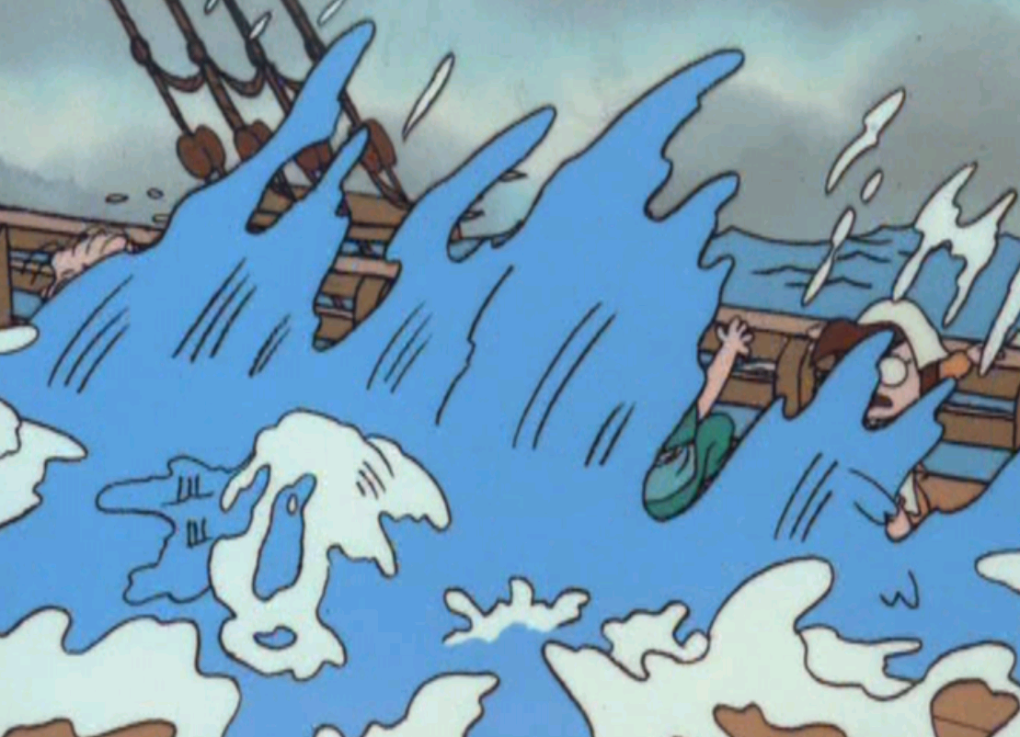
Notes:
What can you see in the picture? What do you think has changed? The weather got much worse about half way through the voyage

Slide 11
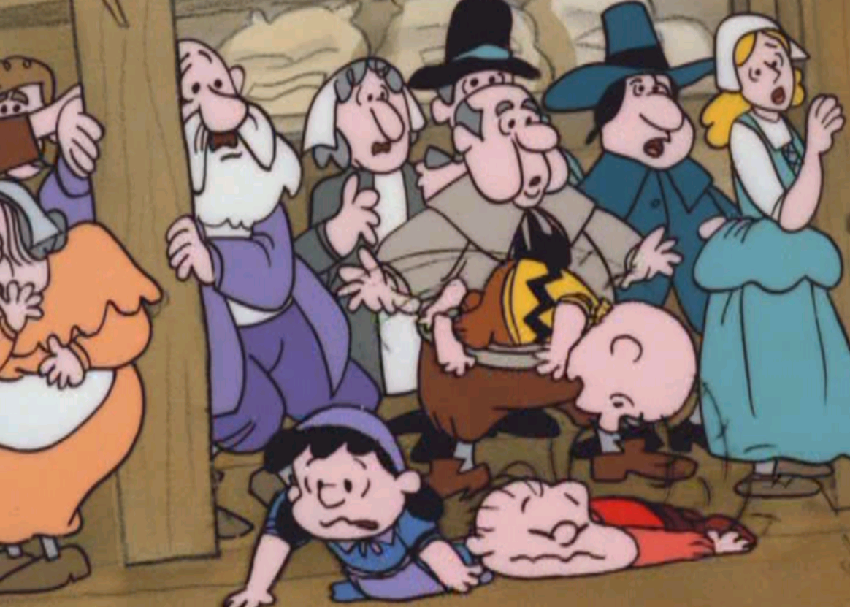
Notes:
The weather got so bad that the passengers had to stay below deck. It was crowded and very smelly

Slide 12
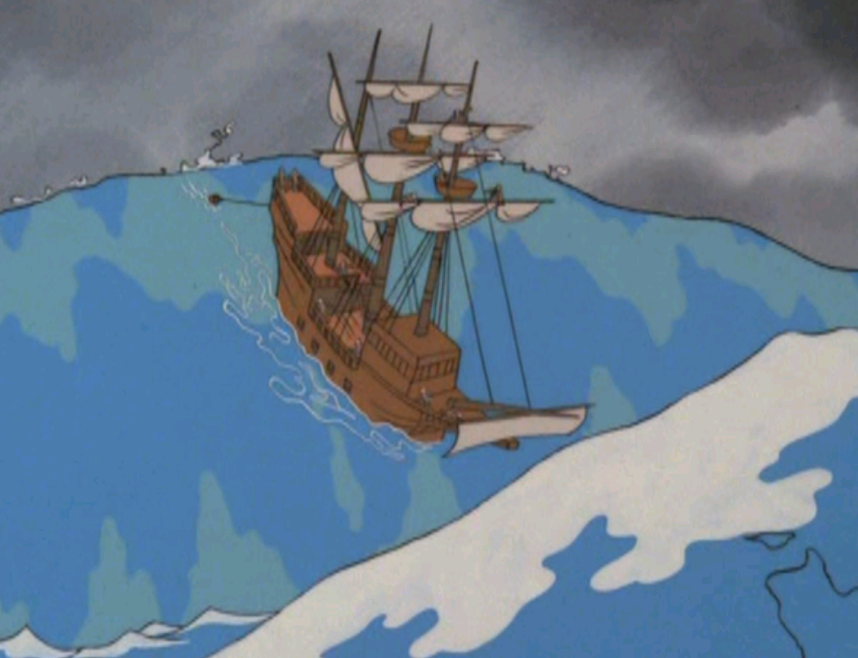
Notes:
The storm got so bad that they had to raise the sails and drop an anchor to slow down the ship and try to keep it in one piece. But even this did not stop the ship from getting damaged

Slide 13
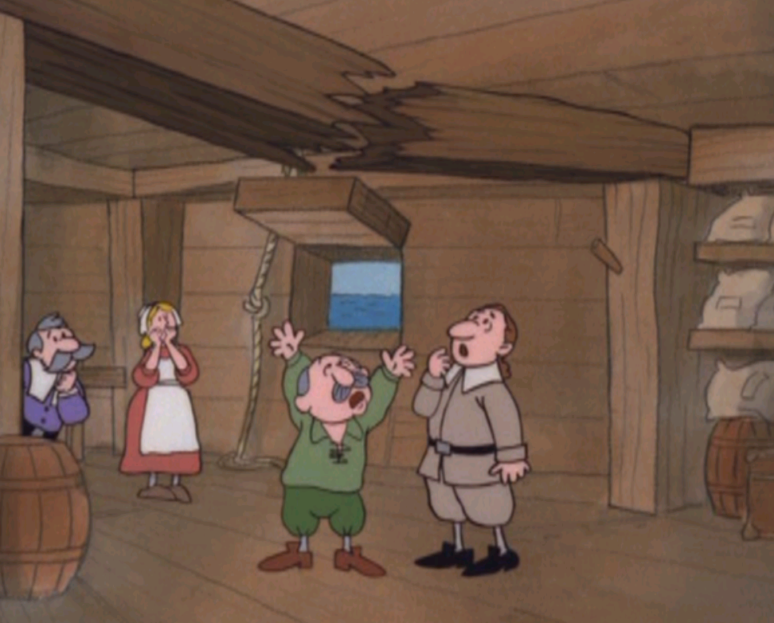
Notes:
One of the wooden beams broke and they thought that they would have to return to England. What do you think they did?

Slide 14
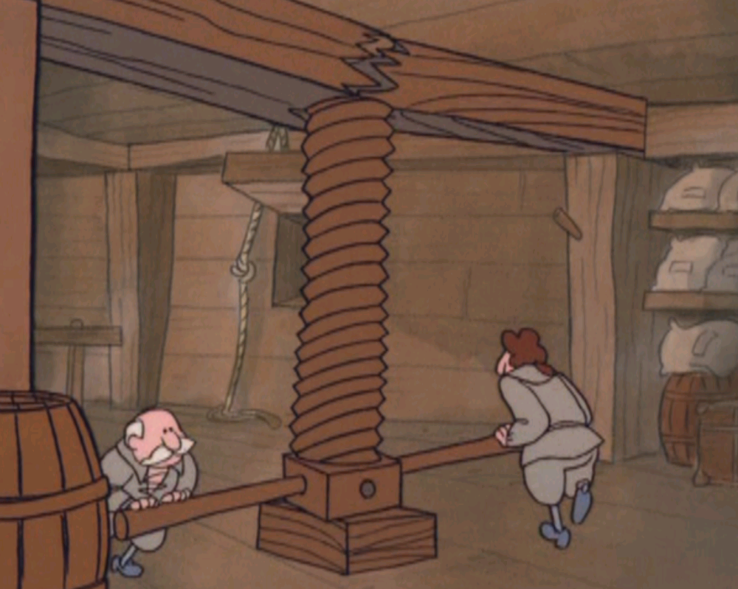
Notes:
They managed to fix it, so luckily they got to continue on to America

Slide 15
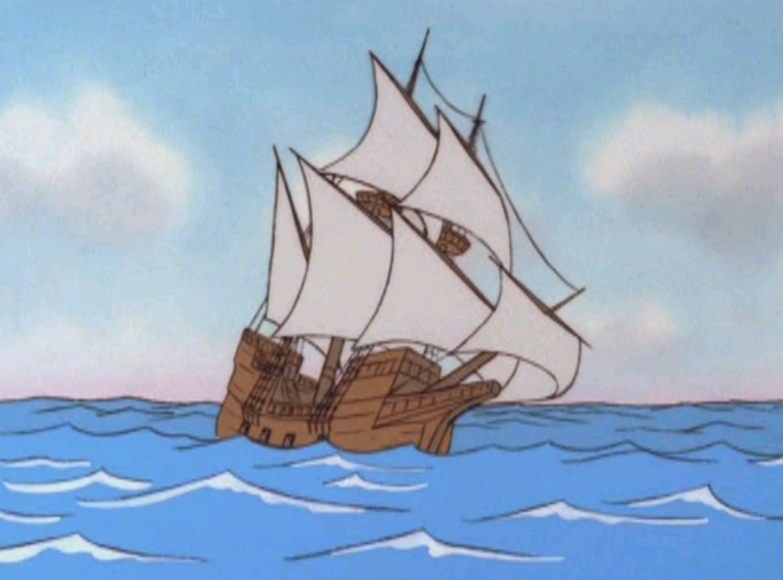
Notes:
The weather got better, but people were very worried. Why? Because they had been at sea for such a long time they started to think that they would never get there.
How long do you think they were at sea? (S make guesses)

Slide 16
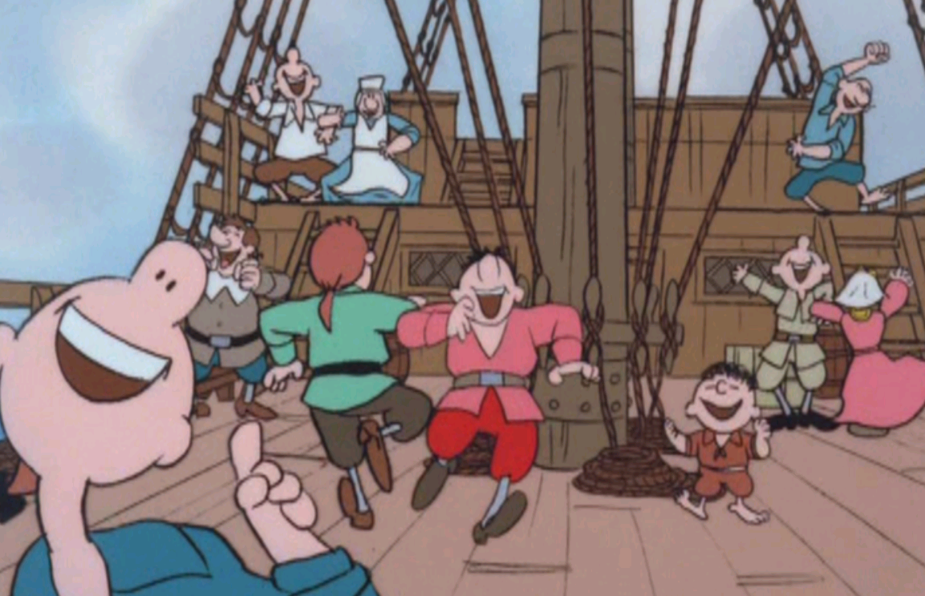
Notes:
On November 9, 1620 they celebrated because they saw land for the first time since leaving England. It had taken them 65 days –9 weeks to travel 2,750 miles (4, 425 kilometers) at an average speed of 3.25 kilometers per hour

Slide 17
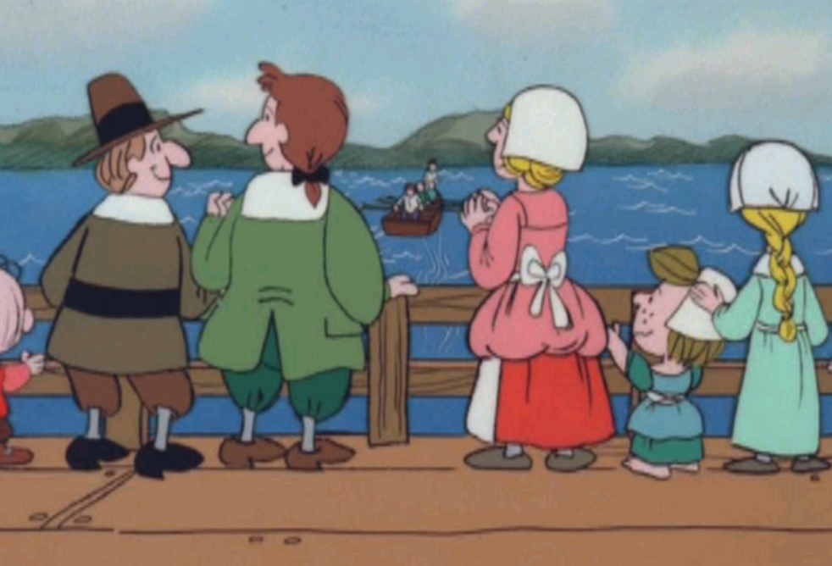
Notes:
101 of passengers made it to America. Do you think that their trouble is over? What other problems might they have? What is the first thing you would do when you got to land?

Slide 18
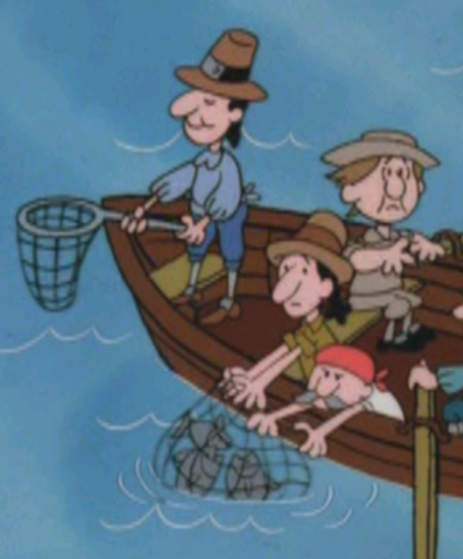
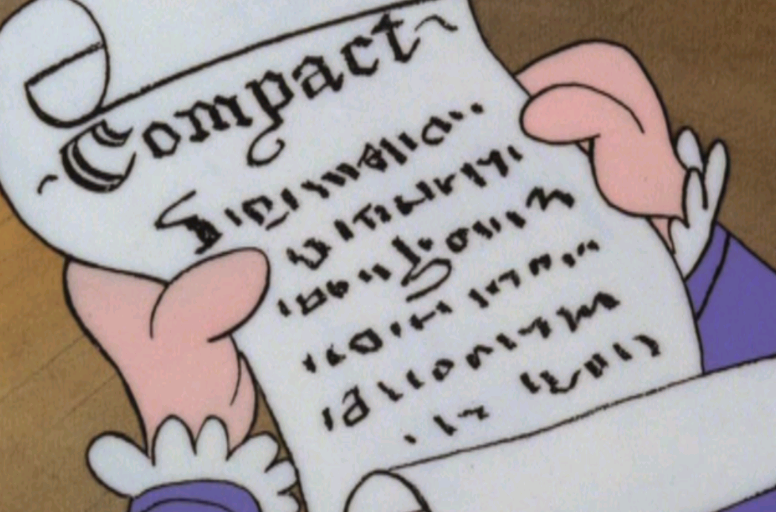
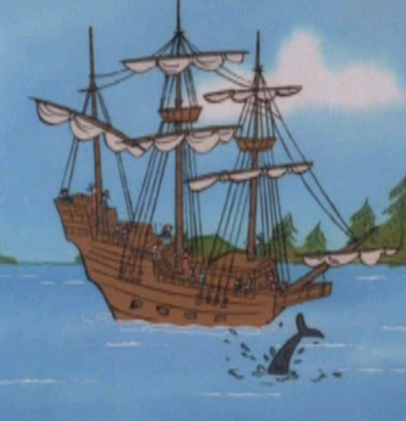
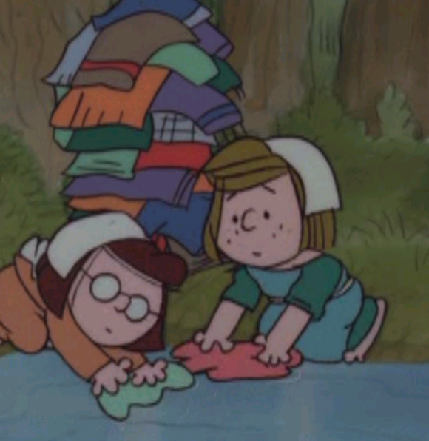
Notes:
They wrote the Mayflower Compact. Stating the rules and joining all of the people together in one group called the Pilgrims.
They could finally wash their clothes and catch fish and birds to eat. It is said that even whales came around the ship as if to welcome the new comers.

Slide 19
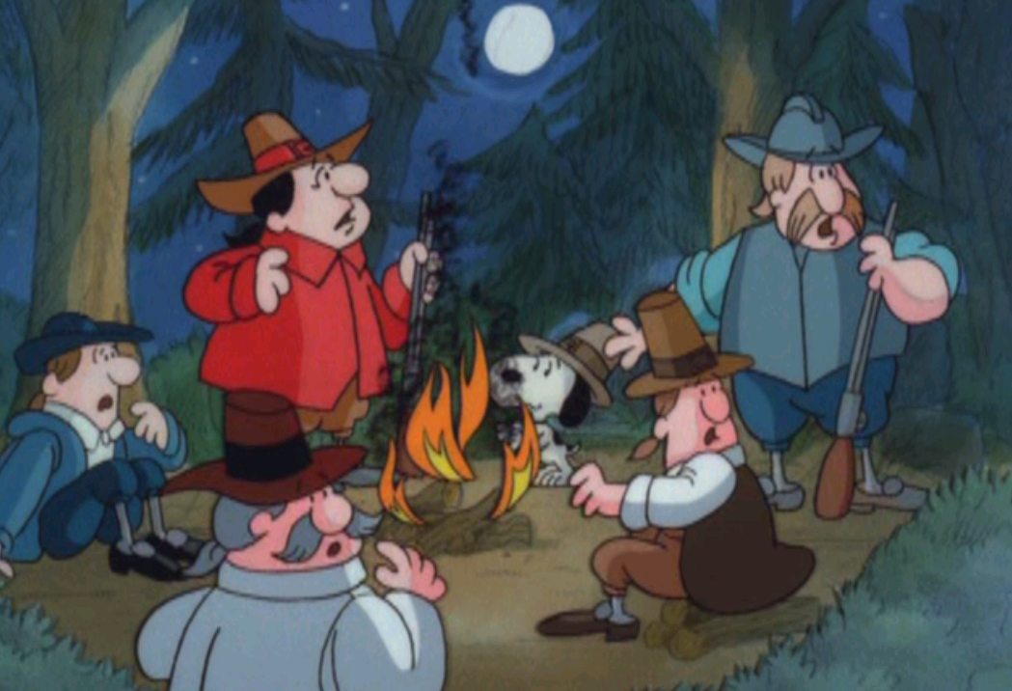
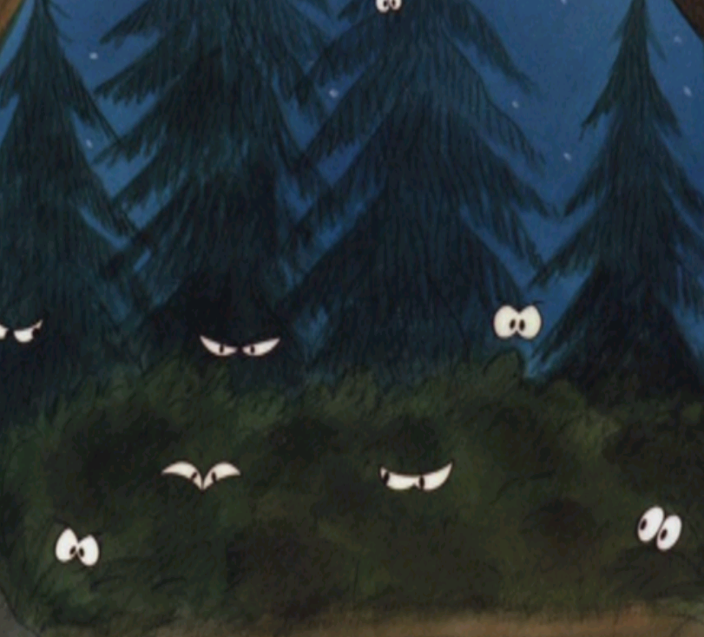
Notes:
But then 4 weeks pass and a small group of men can‘t find a good place to build a town. But what do they find? Wild animals

Slide 20
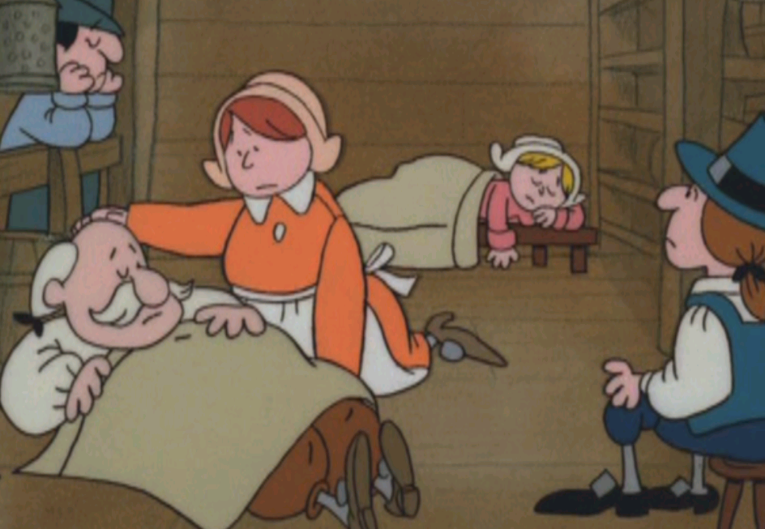
Notes:
Many of the passengers are still living on the Mayflower, and they start getting sick some even die.

Slide 21
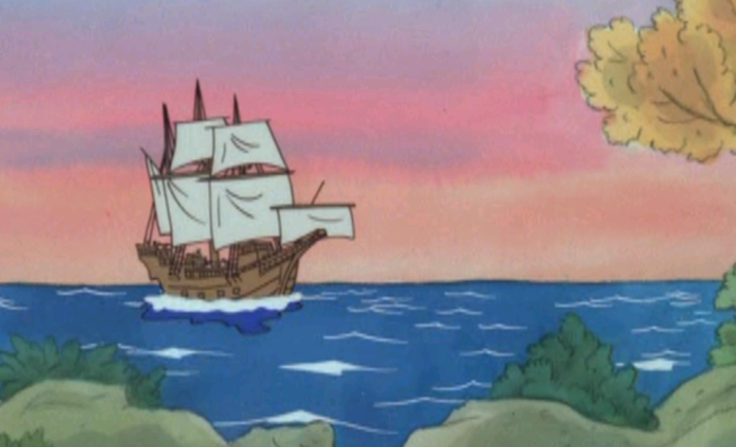
Notes:
So they set sail again for a place that the small group of men had found. A place we now know as Plymouth.

Slide 22
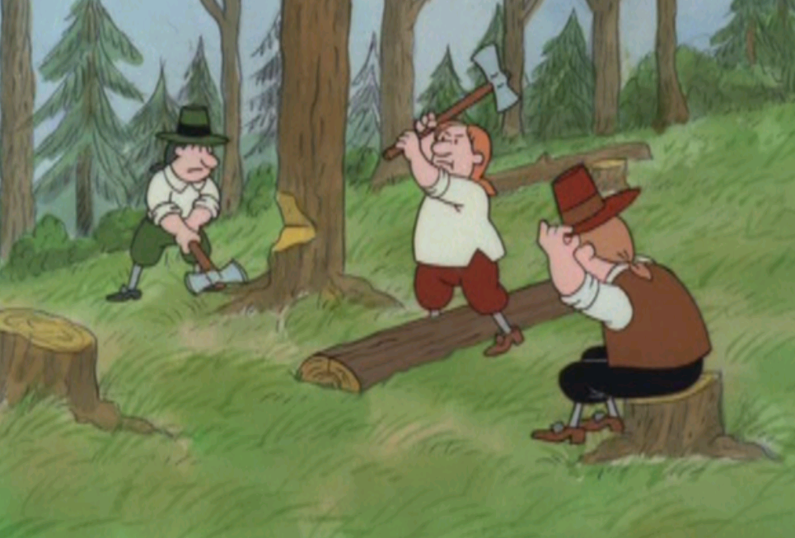
Notes:
What do you think they are doing? Chopping wood to build houses.
What do you think will happen next?

Slide 23
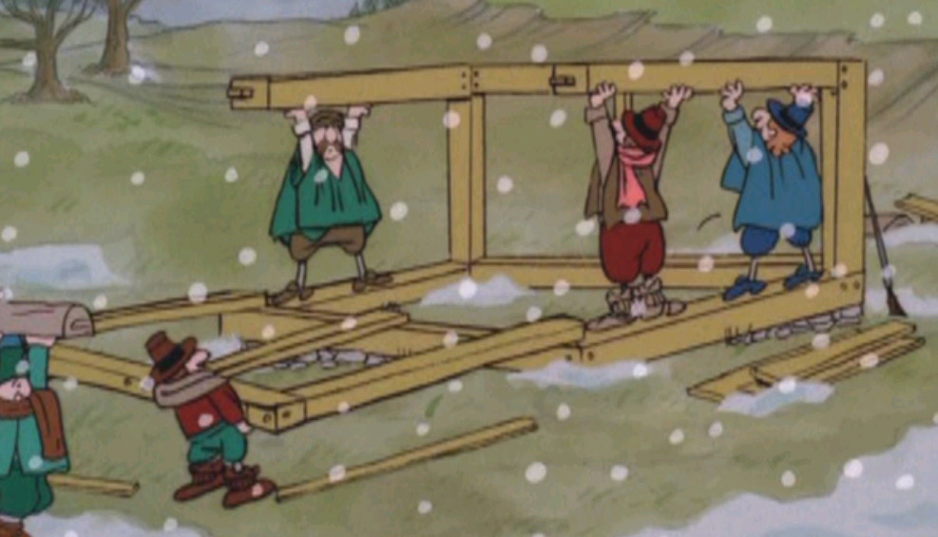
Notes:
Winter comes. Freezing cold storms make life very difficult for the Pilgrims. Half of the adults are too sick to work. The Mayflower becomes a hospital ship.

Slide 24
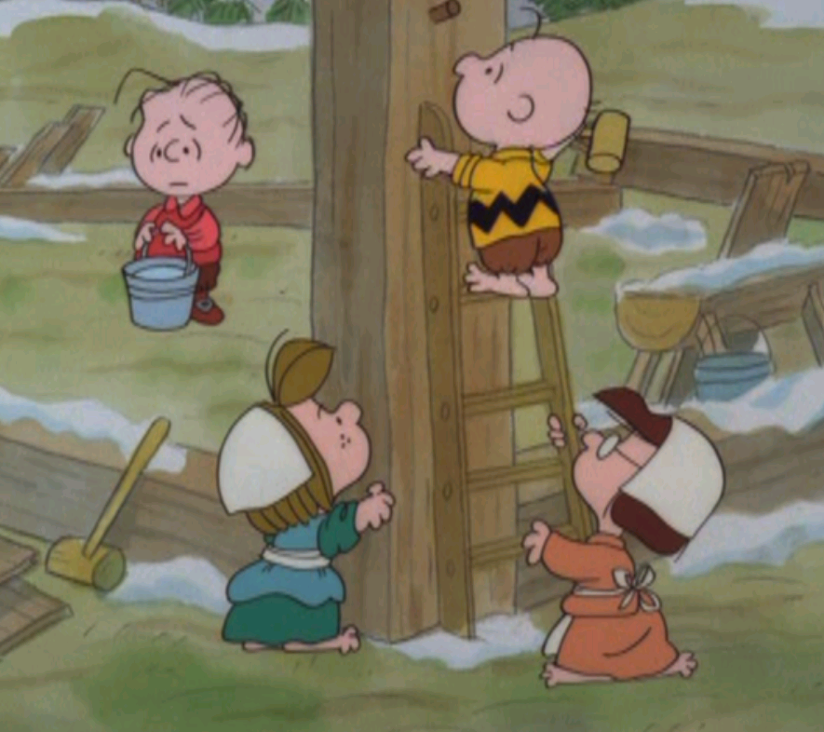
Notes:
Amazingly, the 30 children survive, and many of them must do the work for their parents. What kind of chores do you think they had to do? Building, gathering food/wood/water
, washing, cooking,

Slide 25
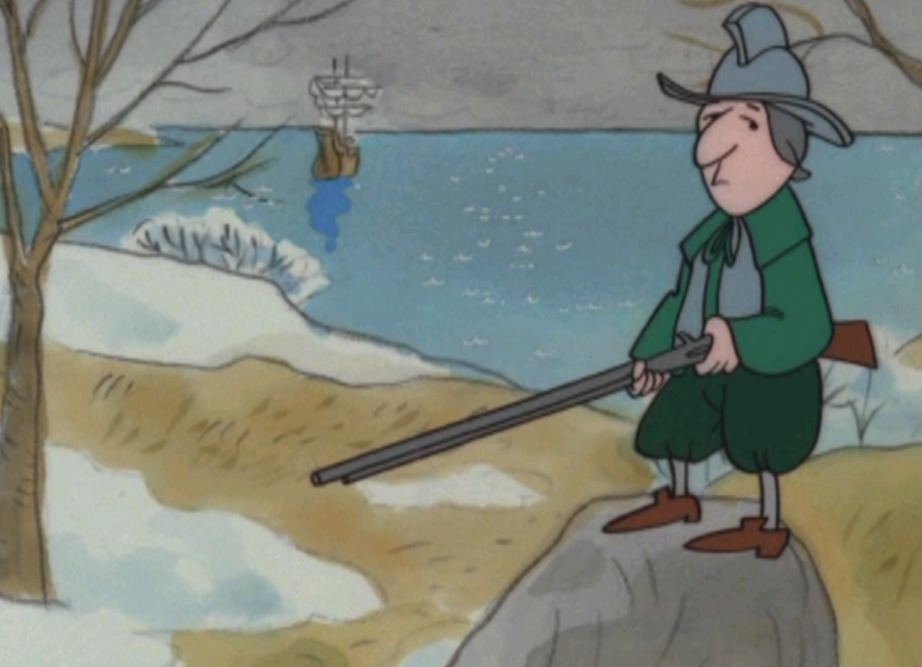
Notes:
By the end of February things weren‘t looking good for the Pilgims. Why? Terrible winter, lack of food, no medicine. ½ of the original passangers had died leaving 20 adults and 30 children.

Slide 26
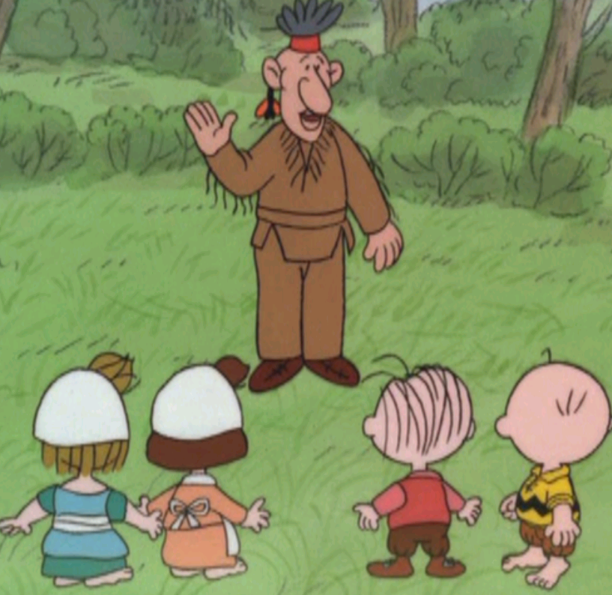
Notes:
Then a miracle happened. An American Indian named Samoset introduced himself to the settlers in English. He learned to speak English from English fishermen in the north. His English was not great, but they communicated and a few days later he returned with another American Indian named Squanto who spoke very good English.

Slide 27
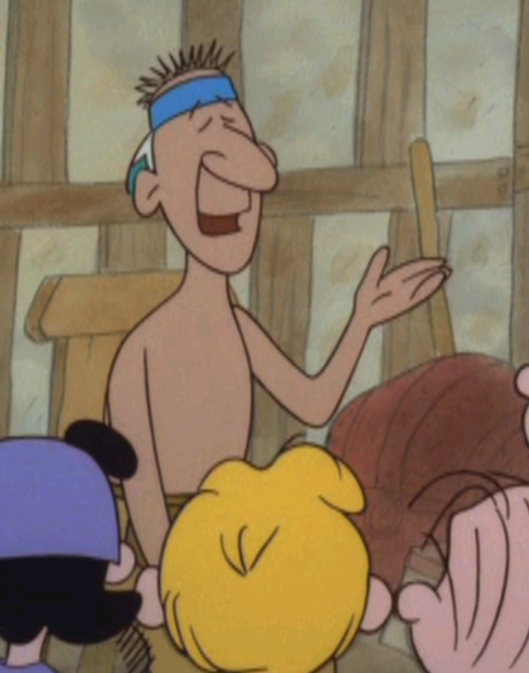
Notes:
How do you think Squanto learned such good English?
He was taken from America by English men and taken to Spain. Then a friendly man took him to England where he learned English. Then he sailed back to America.

Slide 28
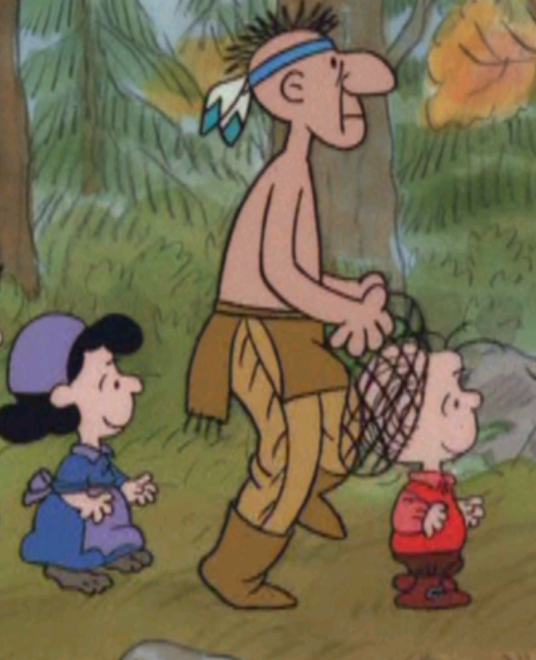
Notes:
Throughout March and April Squanto helped the Pilgrims. How do you think he helped them? Planting crops, hunting, and telling them what new and different foods they could eat

Slide 29
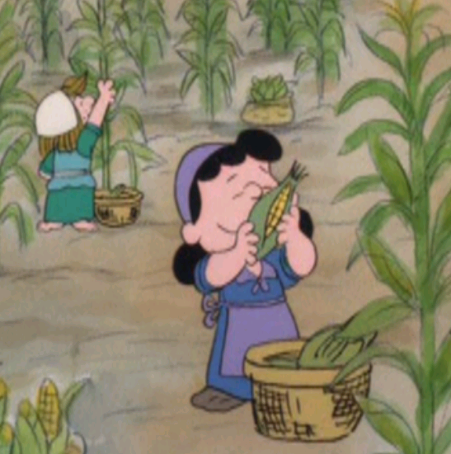
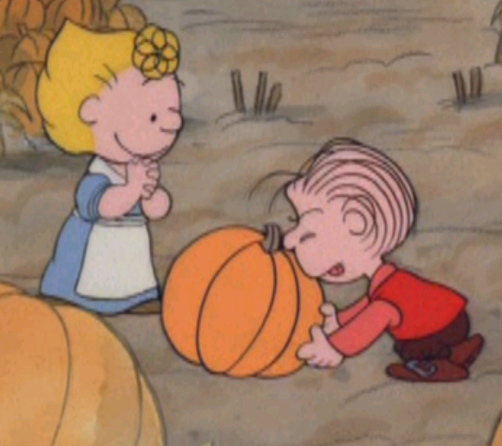
Notes:
Six months passed and thankfully the Pilgims had a great harvest. What did they harvest?

Slide 30
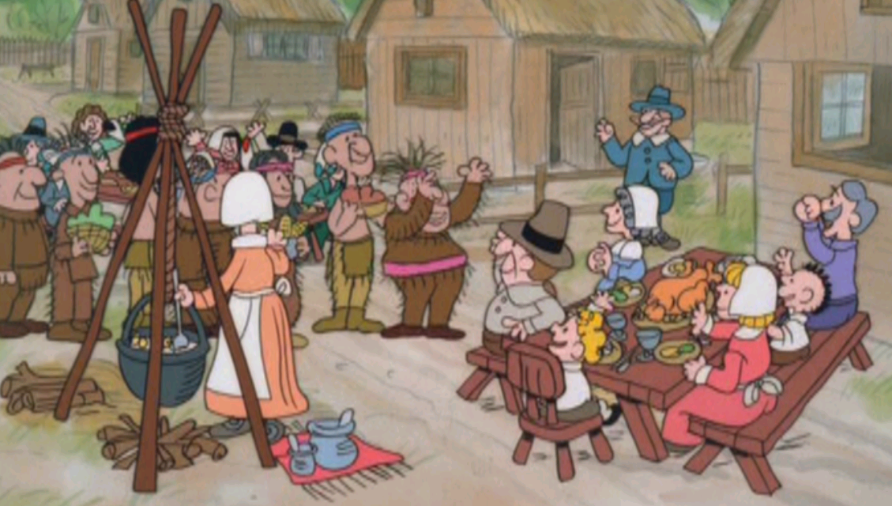
Notes:
90 American Indians and 50 Pilgrims celebrated the harvest together on this first Thanksgiving. Everyone was thankful for the harvest and their new friends.
Today Thanksgiving is celebrated every year in America and Canada in the Fall after the harvests. With family and friends gathering together enjoying a great meal and talking about the things they are thankful for.

