Slide 1
Harlem
What happens to a dream deferred?
Does it dry up
like a raisin in the sun?
Or fester like a sore—
and then run?
Does it stink like rotten meat?
Or crust and sugar over—
like a syrupy sweet?
Maybe it just sags
like a heavy load
Or does it explode?

Slide 2
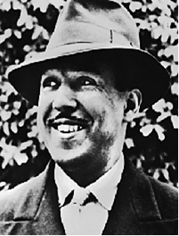
Langston Hughes 1902 - 1967

Slide 3


