Slide 1
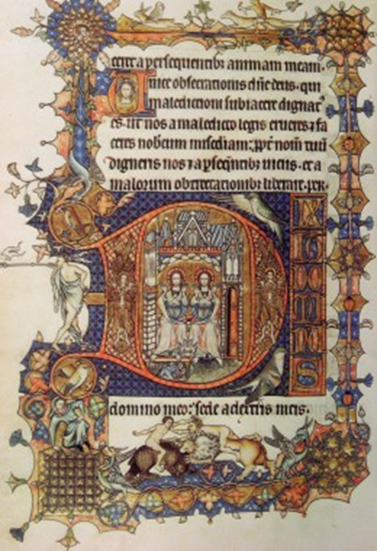
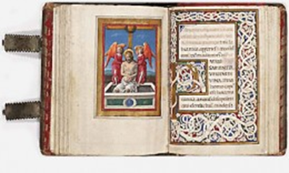
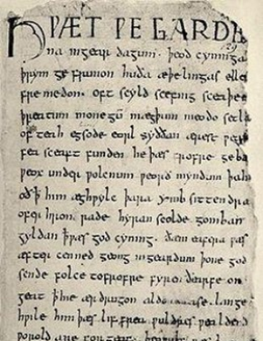
How books were made…

Slide 2
How books were made in the Middle Ages
Watch the video.
Then work with a partner and read the text about bookmaking in the Middle Ages. Highlight the MOST important information and summarize the process of bookmaking in about 10 – 15 sentences.
Compare your versions with another pair. Where did you use the passive? Why?

Slide 3
Bookmaking NOW
Watch this video about modern bookmaking.
Stop the video a few times to take notes of the most important steps.
What are the differences? Write a paragraph comparing the old and the new production processes.

Slide 4
Language focus
Pairwork: How books are made
Choose the best sentence from each pair to build up a continuous text.
Then read out the text to your partner.

