Slide 1
3 things about me

Slide 2
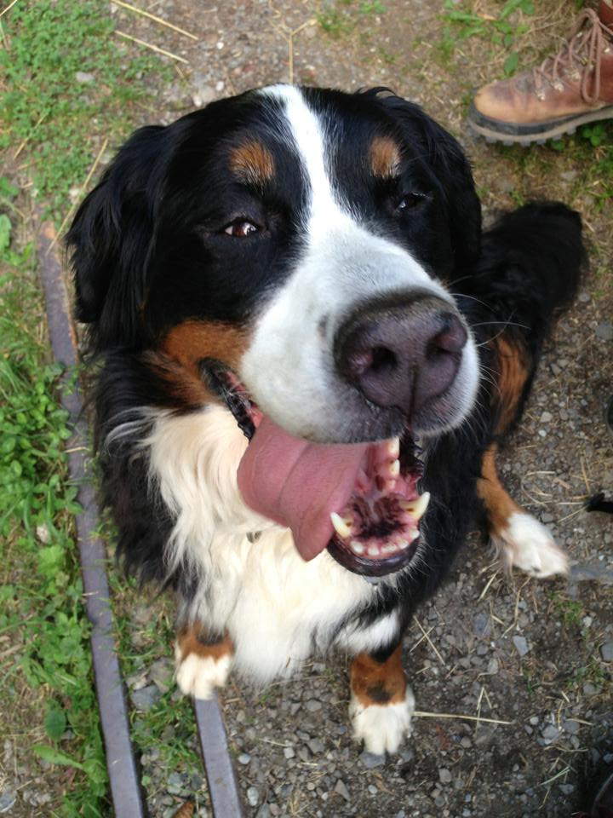

Slide 3


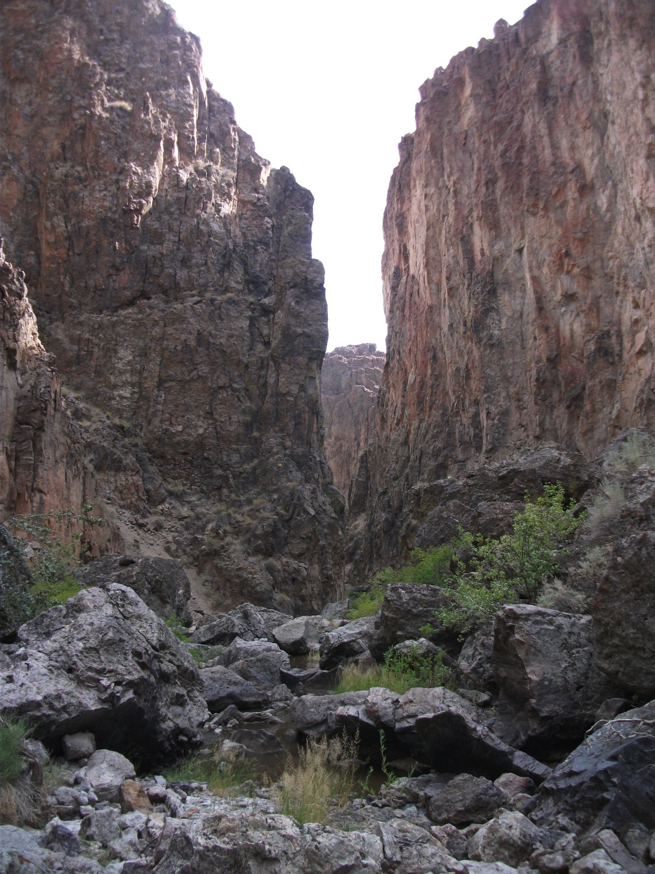

Slide 4
