Slide 1
Mrs. Brown‘s summer vacation
Truth?
or
Lie?

Slide 2
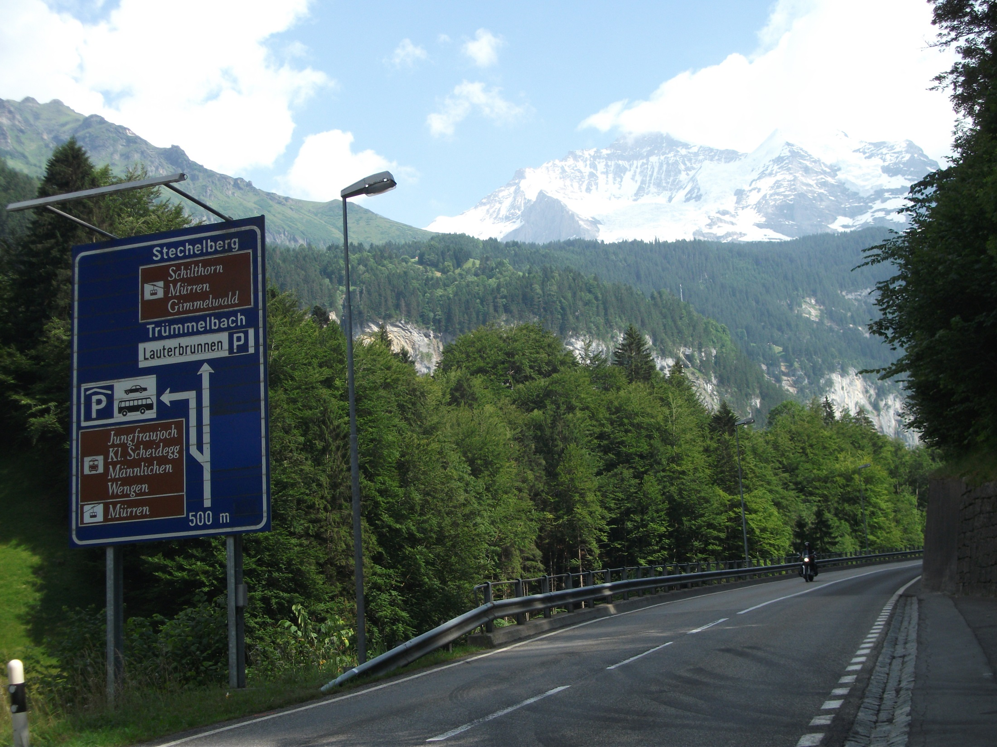

Slide 3
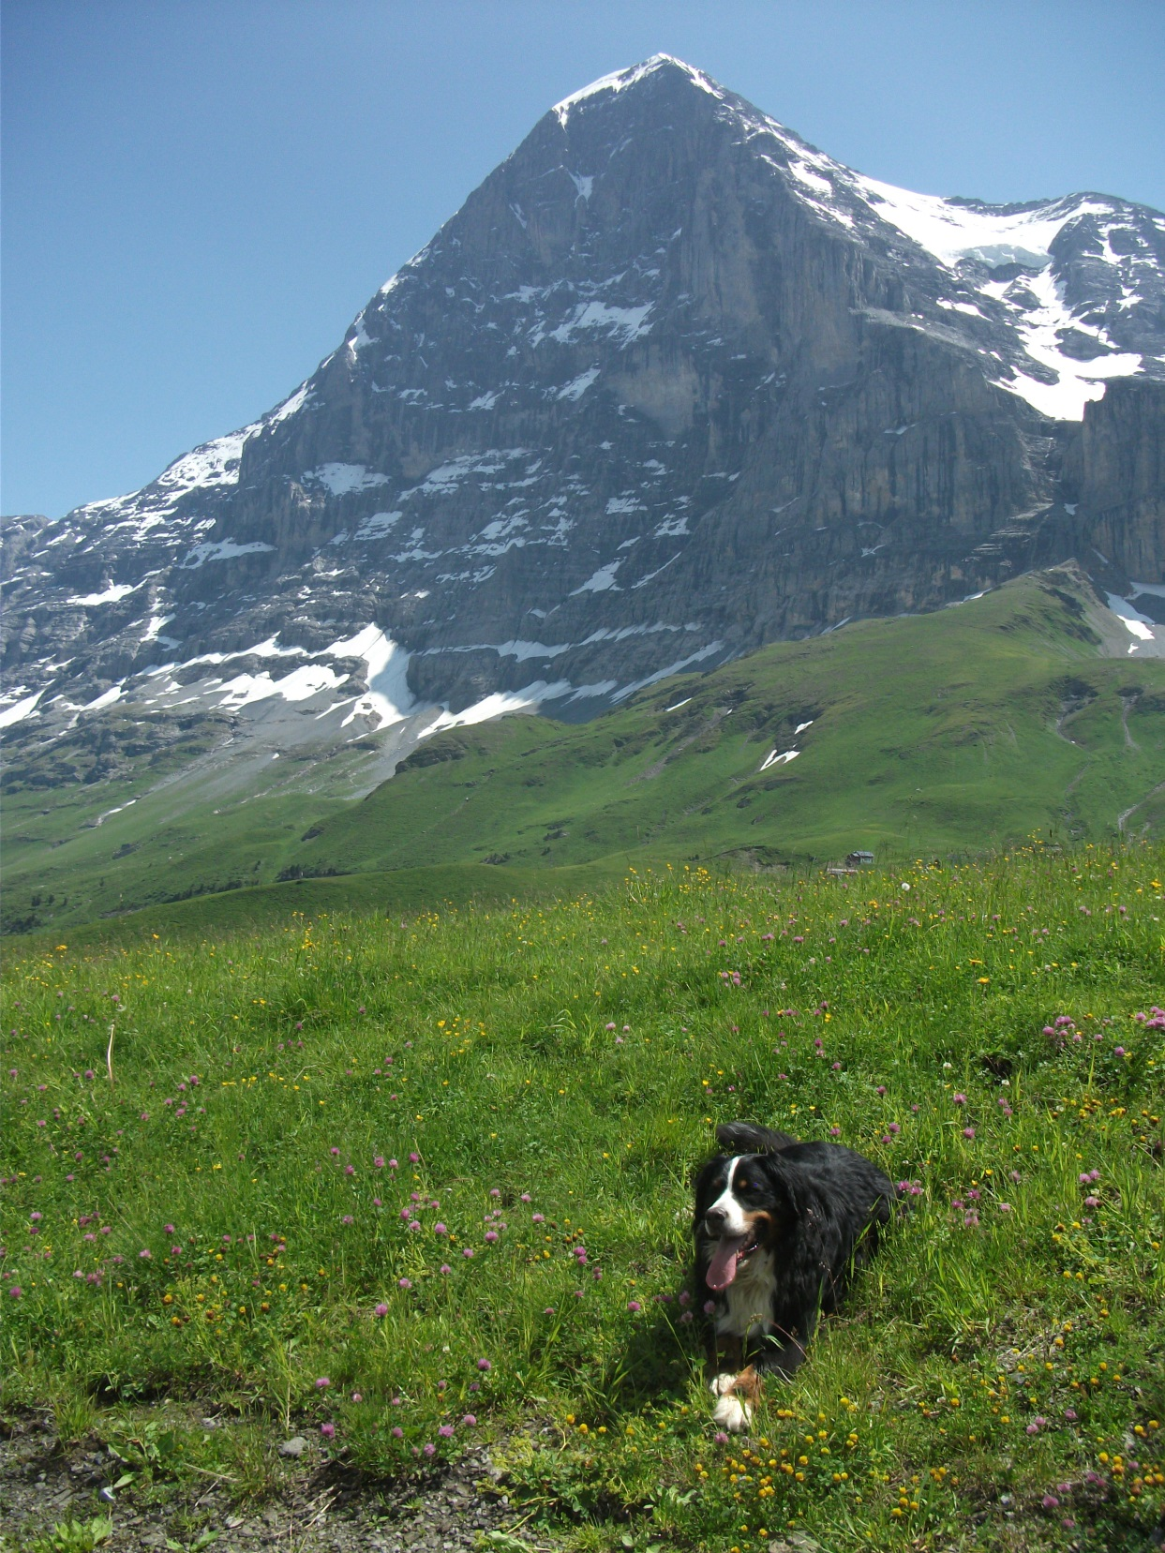

Slide 4
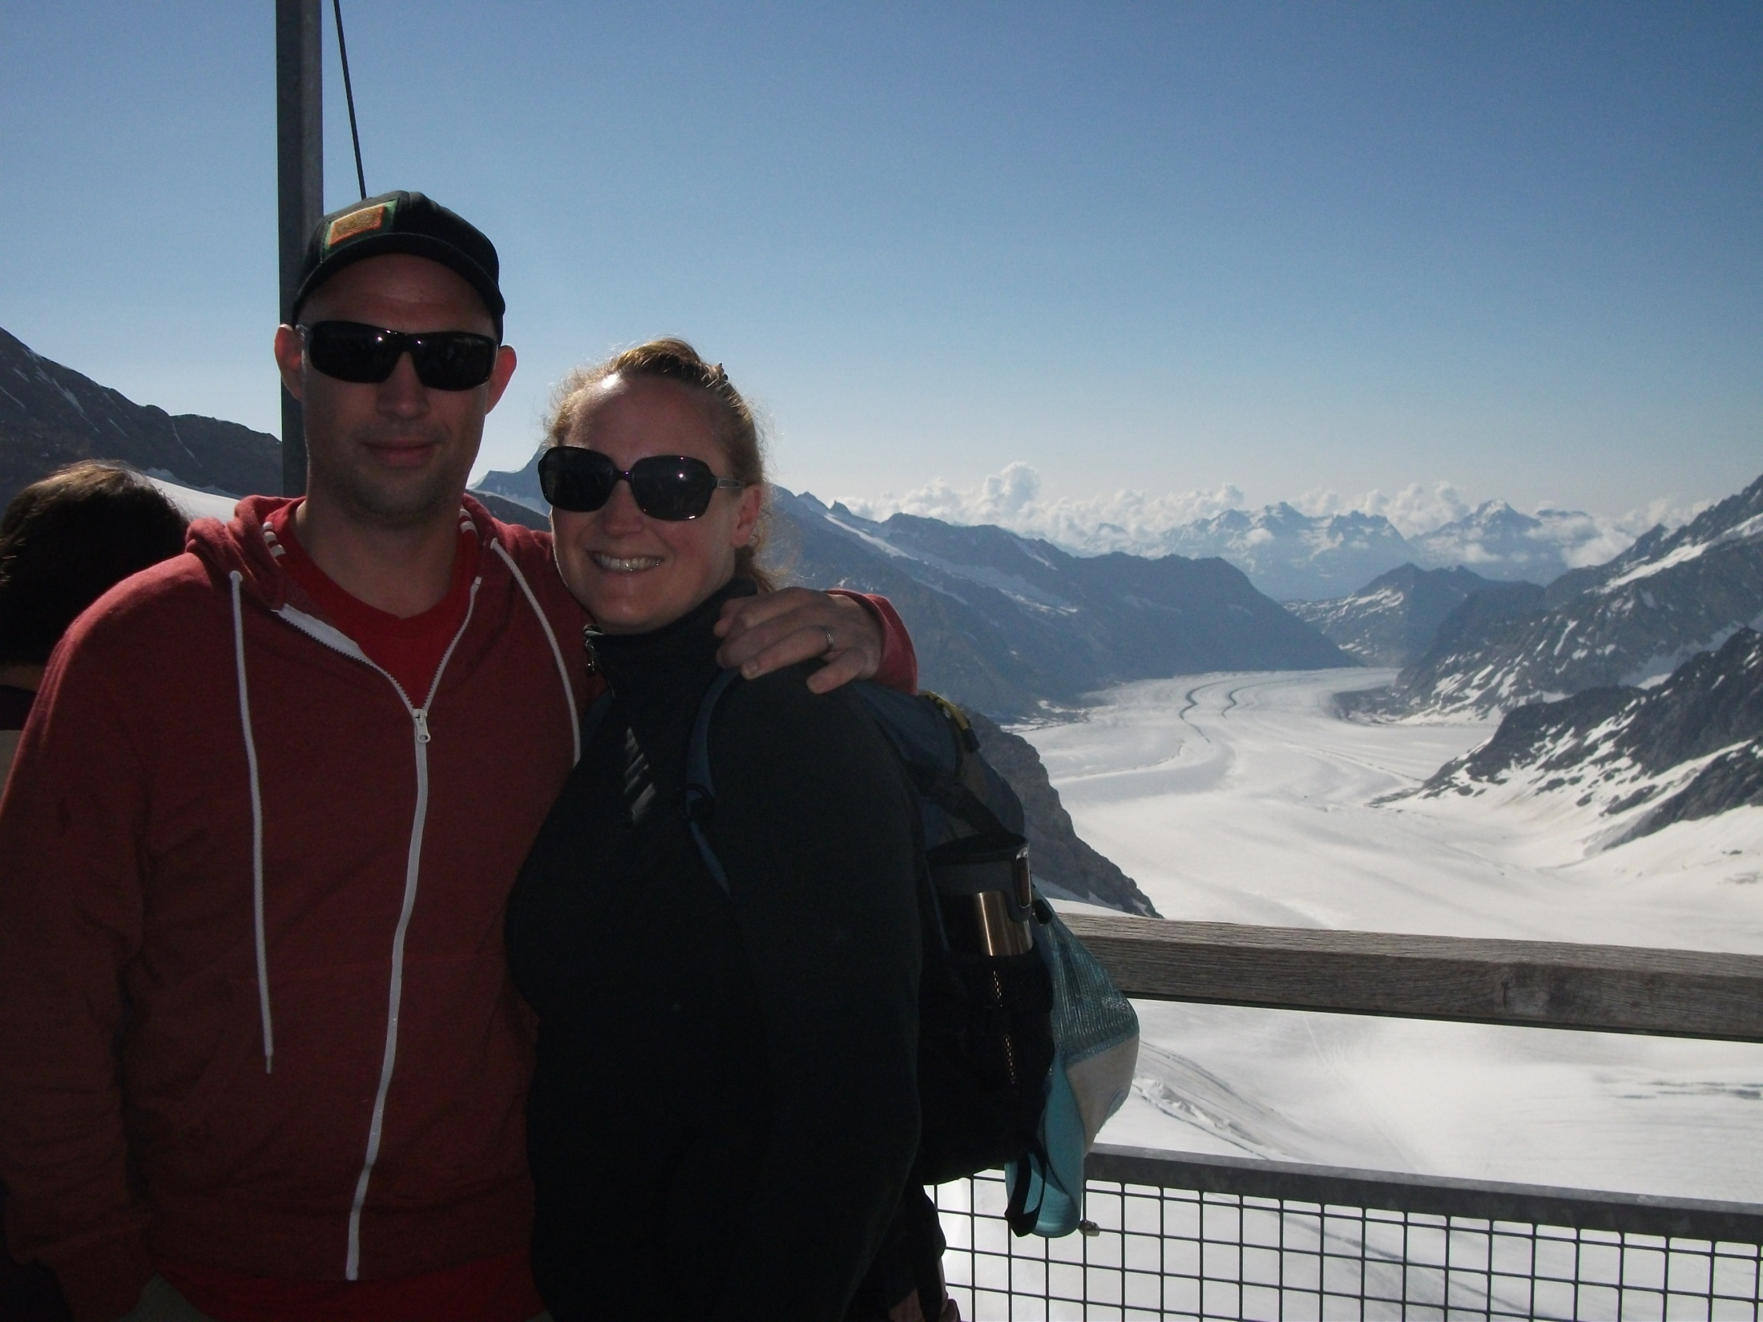

Slide 5
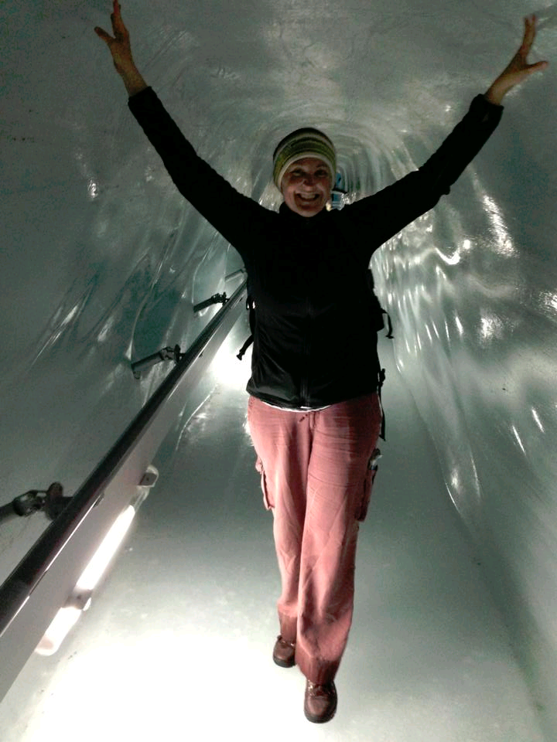

Slide 6
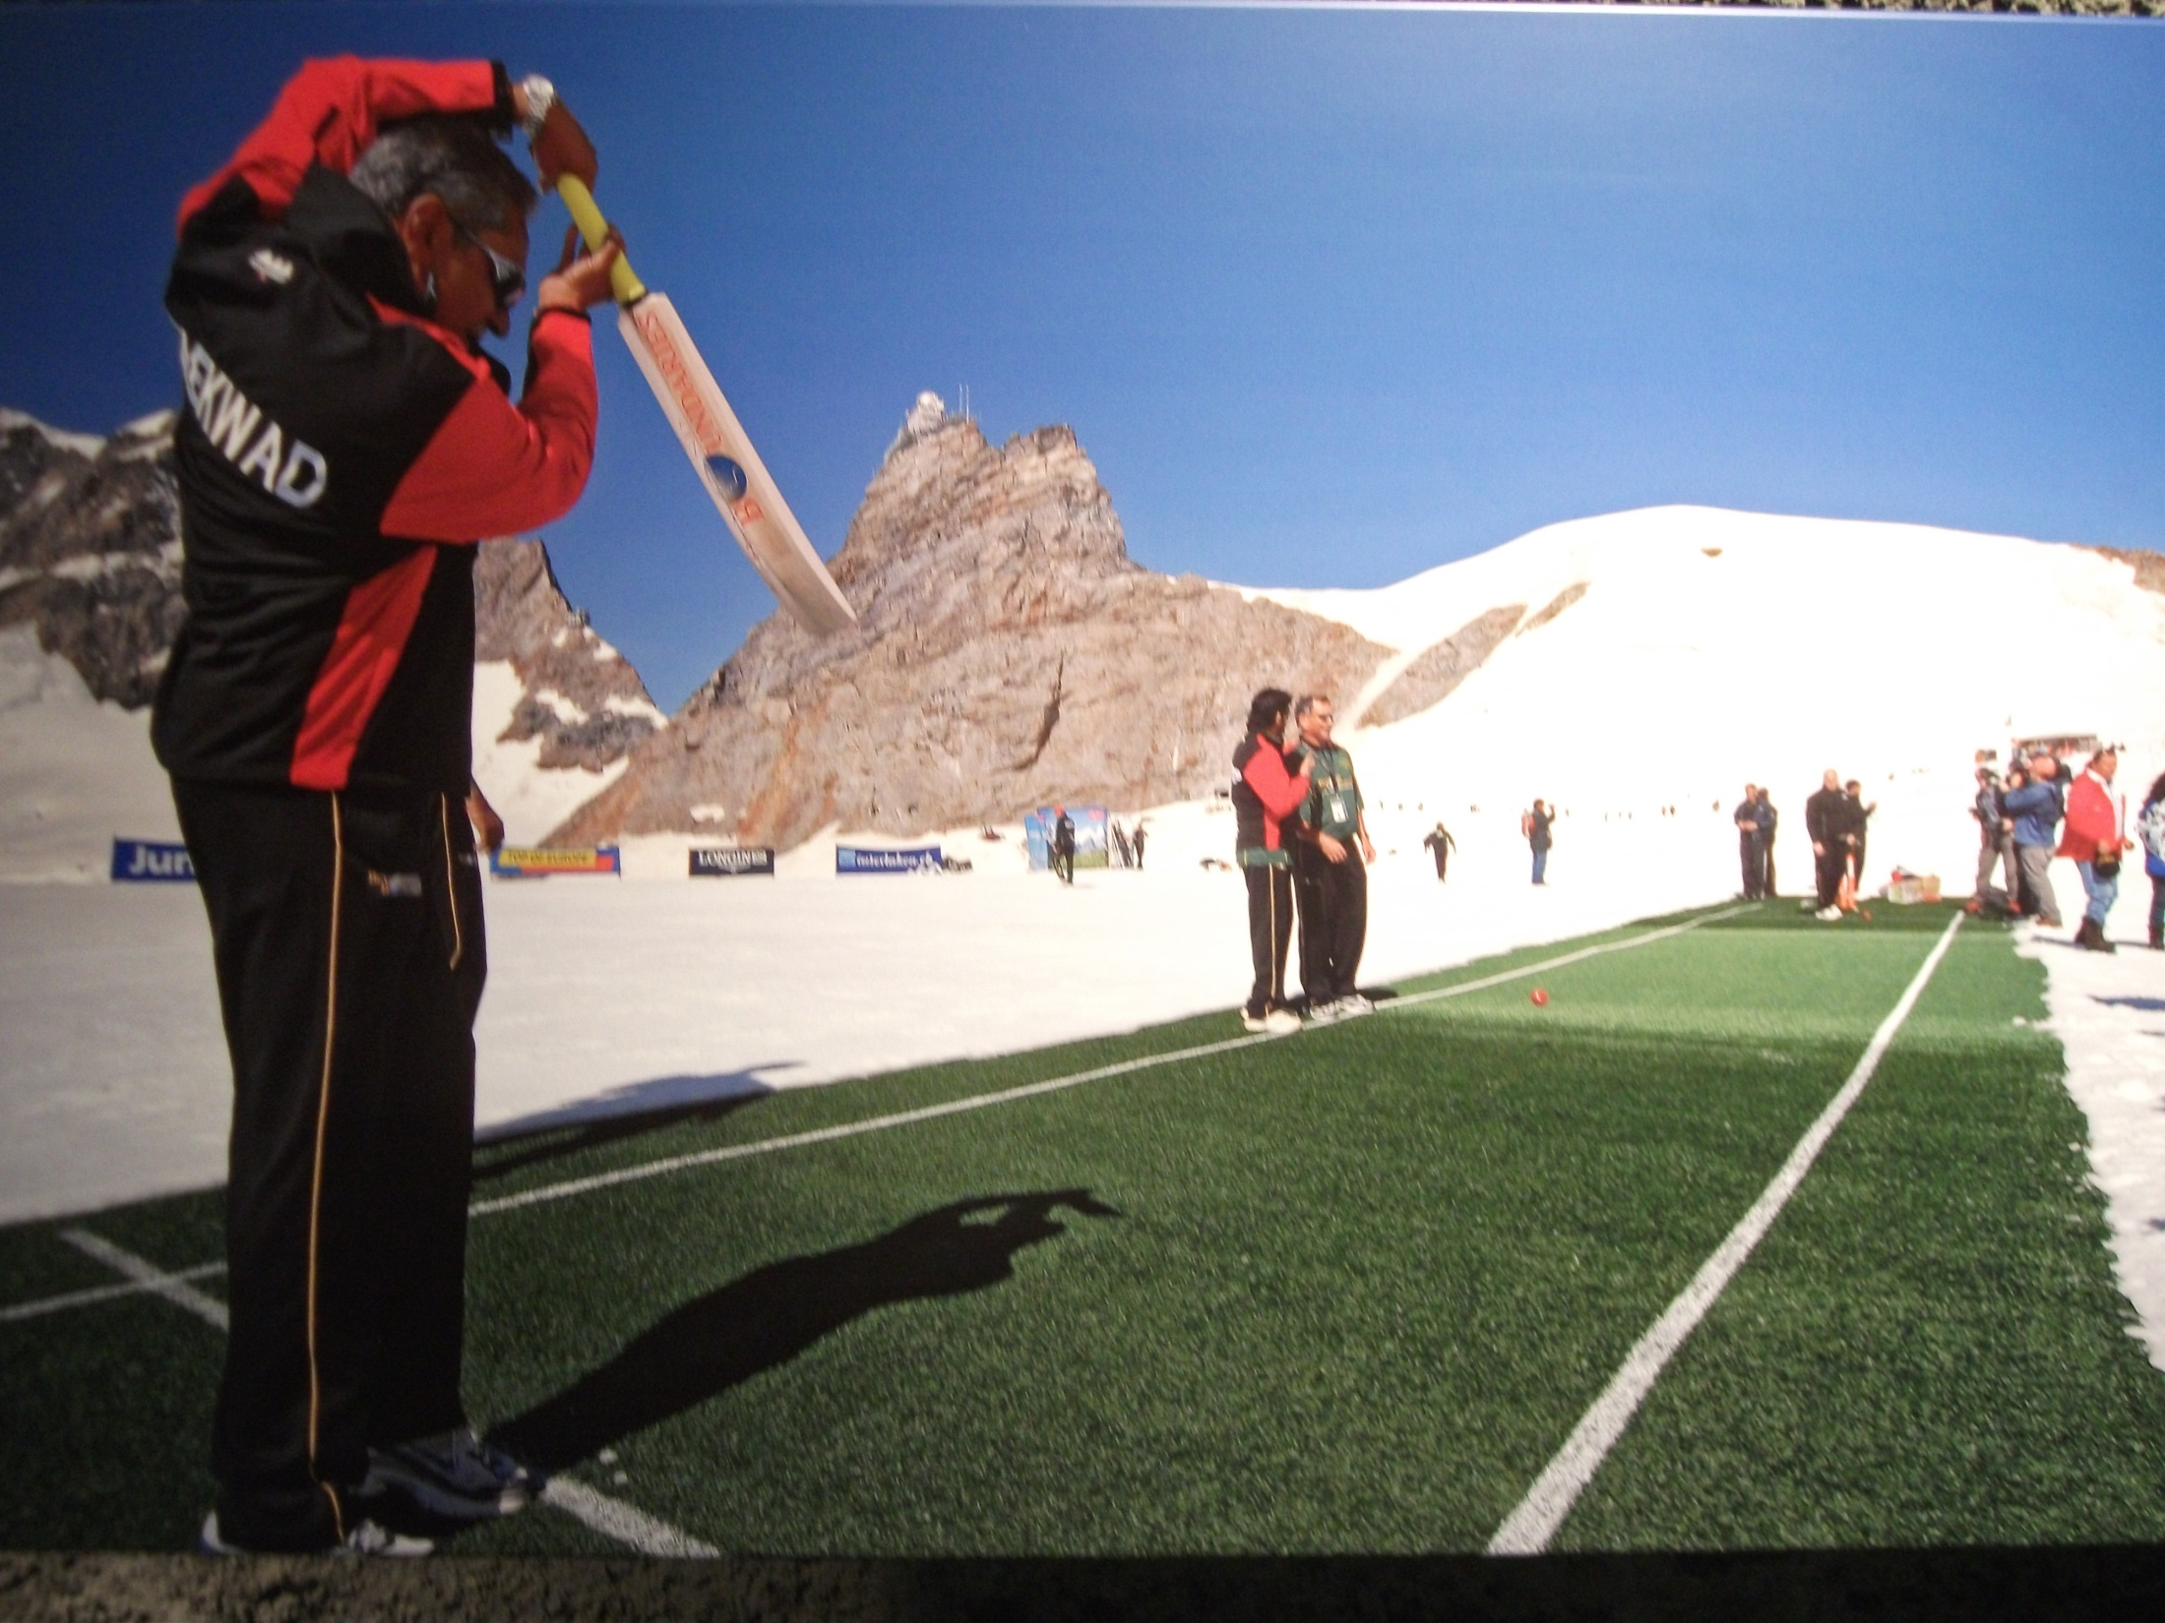

Slide 7


Slide 8
Story 2
The Desert Trail

Slide 9
