Slide 1
The Golden Twenties
The US in the time of
The Great Gatsby

Slide 2
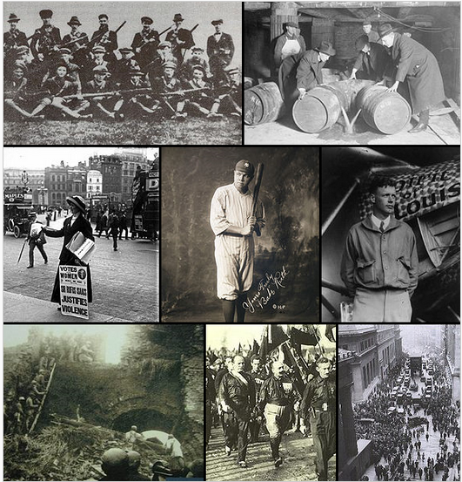
What happened in the 1920s?

Slide 3
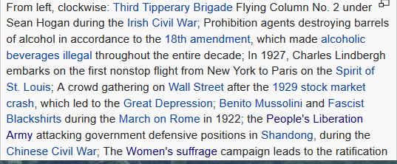

Slide 4
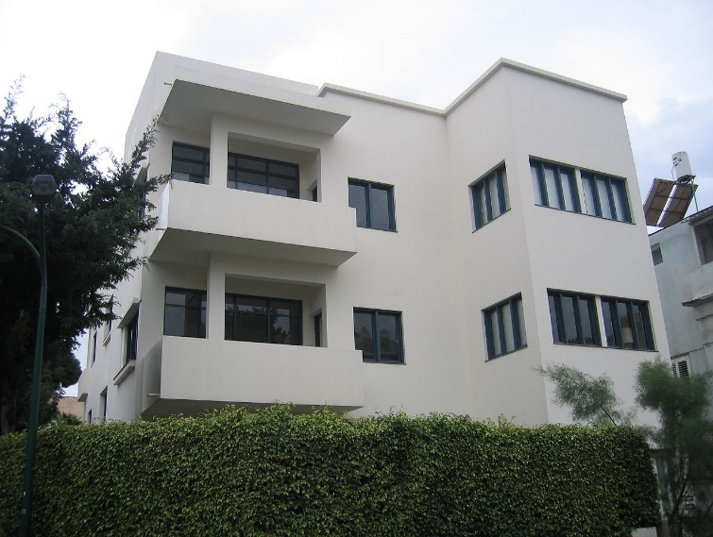
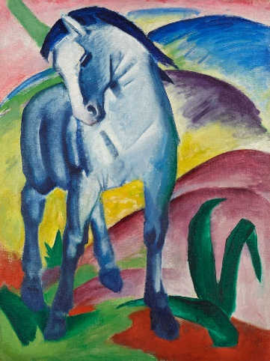
Keywords of the 1920s
Economic prosperity (stock market)
Cultural dynamism (art, architecture, music, dance)
Art: Modernism: Picasso, Cezanne, Salvador Dali, Paul Klee, etc.
Architecture: Bauhaus, Art Deco
New ideas, values and freedoms
Inventions
New urban mass culture and consumerism

Slide 5
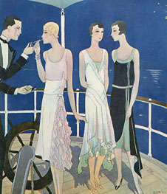
Basic Facts (1)
US: enormous economic potential
Wealthy country with a high standard of living, big cars and large houses, etc.
Stock market expansion
Economy boomed → age of mass consumerism (cars, radios, fridges etc.)
Urbanisation: cities (e.g. New York and Chicago) grow rapidly → skyscrapers
Self-confidence of American society
But also: poverty and racism

Slide 6
Basic Facts (2)
Emphasis on having fun, spending money → parties, music (jazz), new dances (Charleston), movie theatres, sports (baseball) → nickname Roaring Twenties
Also: poverty (African-Americans [especially in the South], women and farmers)
More than 60% of Americans lived below the poverty line.

Slide 7
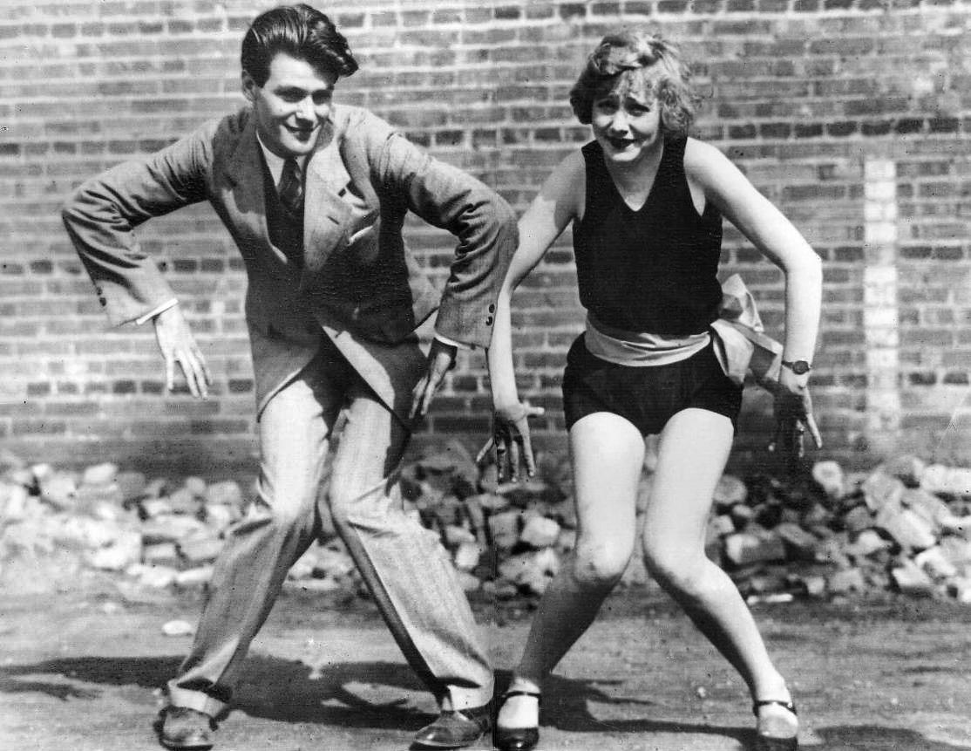
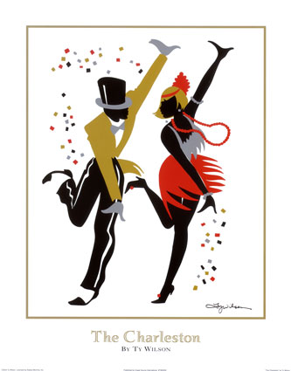
Culture, Literature, Music and Dance
Charleston dance (originally from South Carolina) became the dance of the 20s
https://www.youtube.com/watch?v=yNAOHtmy4j0
https://www.youtube.com/watch?v=G-8kK4J3s2I
Black Bottom dance
https://www.youtube.com/watch?v=jTR6xBeC2xA
https://www.youtube.com/watch?v=kqgLrftfmZo

Slide 8
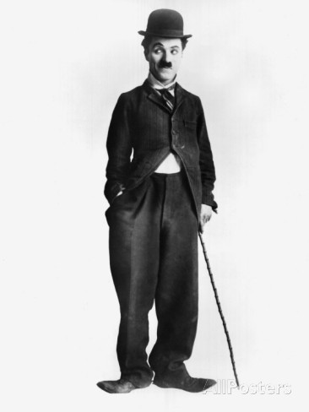
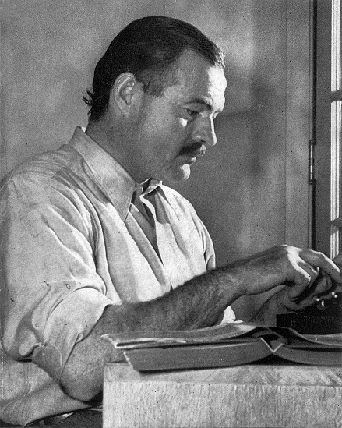
Culture, Literature, Music and Dance
First silent movies: e.g. Charlie Chaplin
https://www.youtube.com/watch?v=tfw0KapQ3qw
Literature: Lost Generation (after WWI, e.g. Hemingway) and Harlem Renaissance (e.g. Hughes)

Slide 9
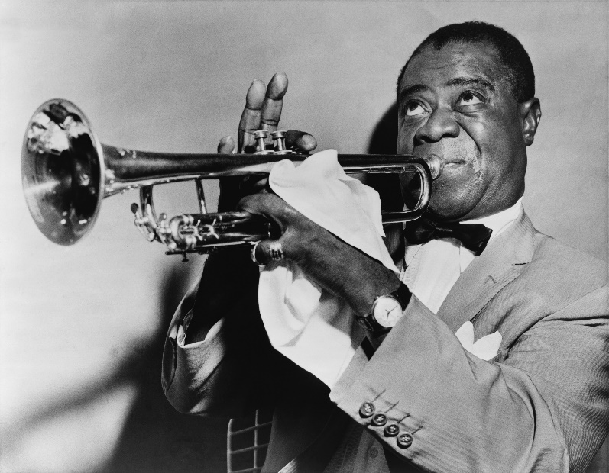
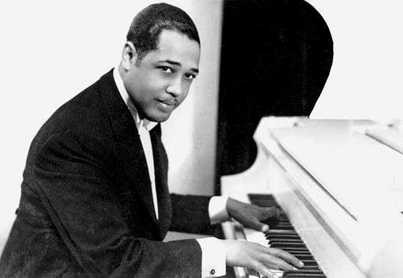
Jazz Music
Originated in New Orleans → north
Became popular in 1920s
High time: big bands (swing movement) in 1930s
Famous Musicians
Louis Armstrong (Stardust: https://www.youtube.com/watch?v=WIE6U6Lrtrc)
Duke Ellington
famous NYC Cotton Club: https://www.youtube.com/watch?v=rLNZdovc3PI
Jubilee Stomp: https://www.youtube.com/watch?v=7atwjmPcxng

Slide 10
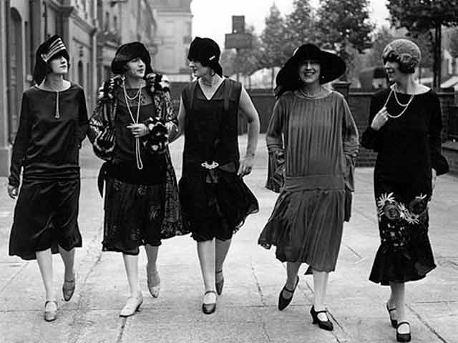
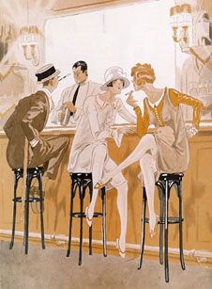
Lifestyle and Fashion
Flapper Girls
New role for women
New freedoms for women
New fashion, hairstyle, make up
Partying culture (after WWI)
Automobiles more widely used
Life in the 1920s:
https://www.youtube.com/watch?v=684n8FO68LU

Slide 11
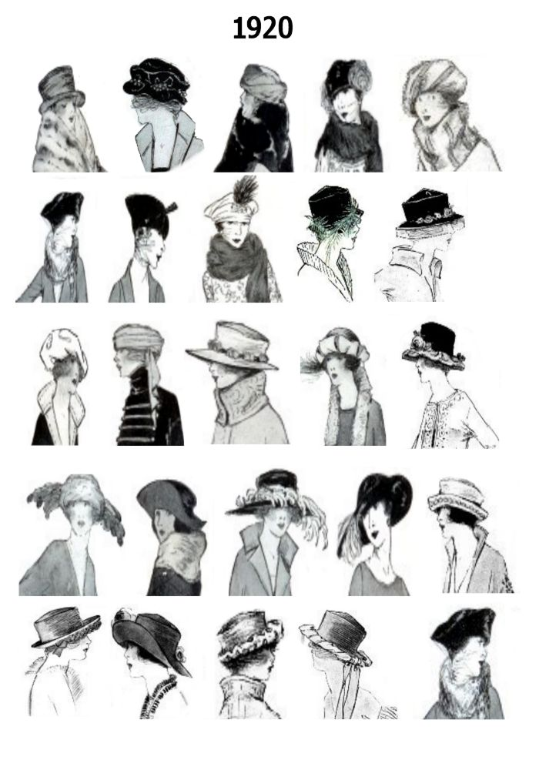
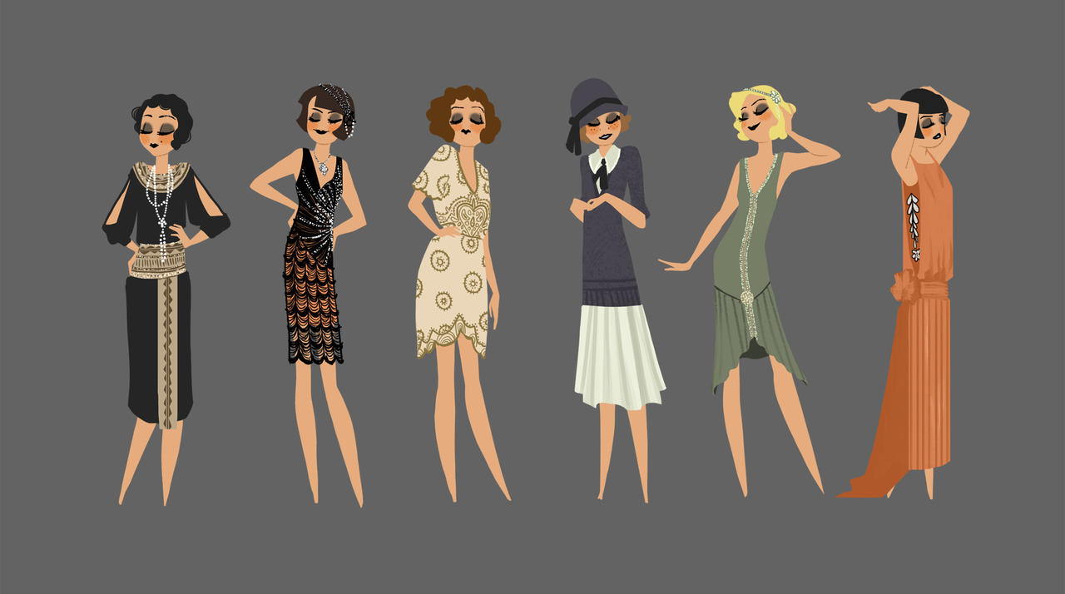

Slide 12
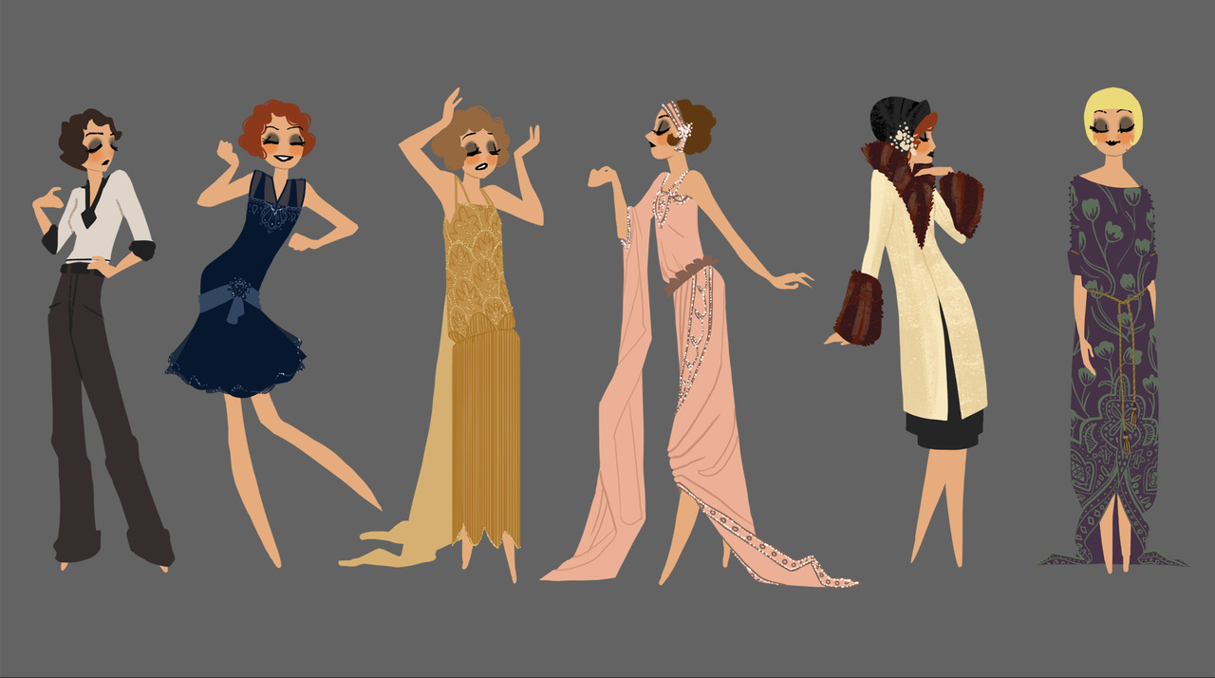

Slide 13
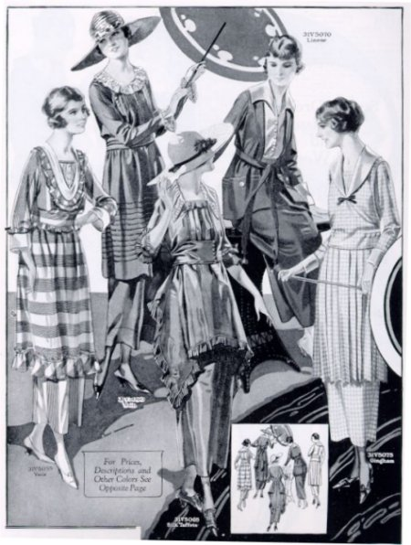
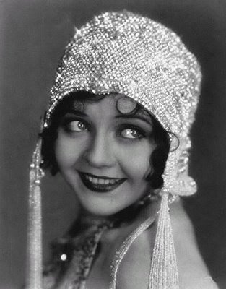
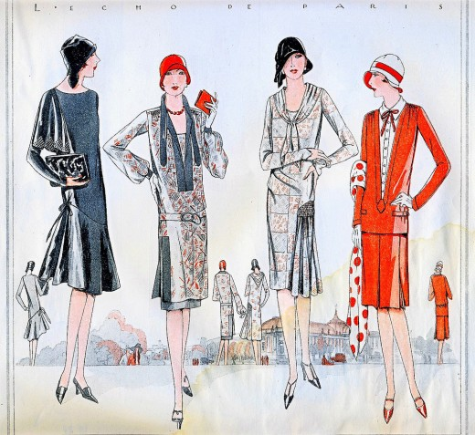

Slide 14
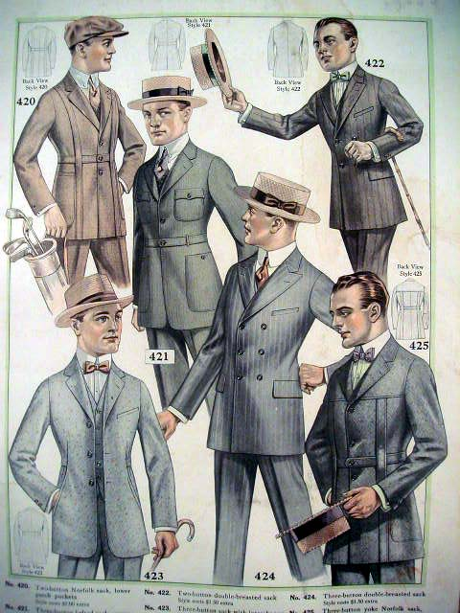
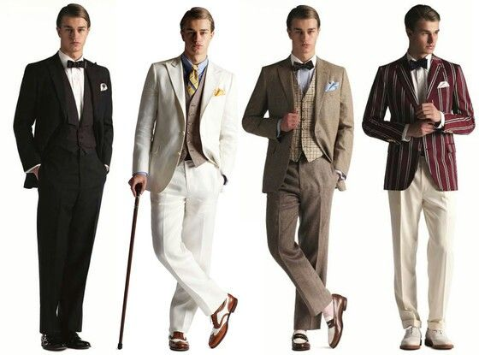

Slide 15
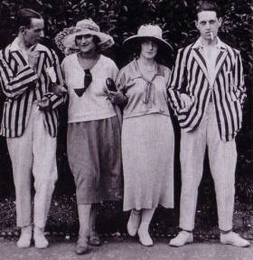
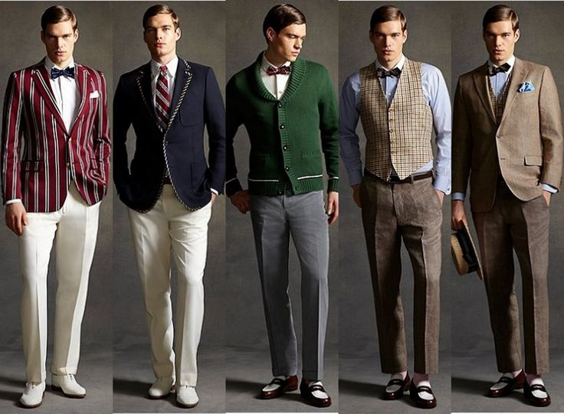
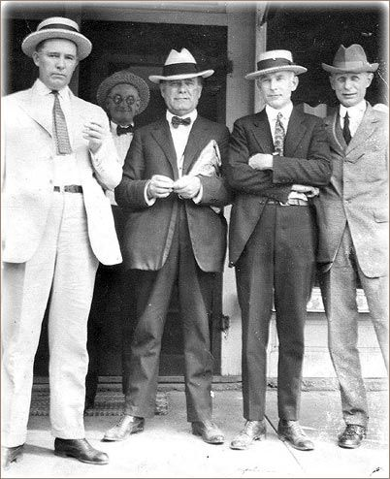

Slide 16
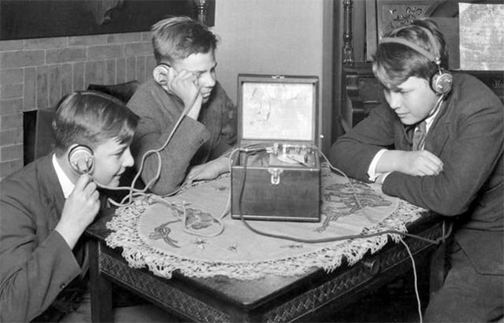
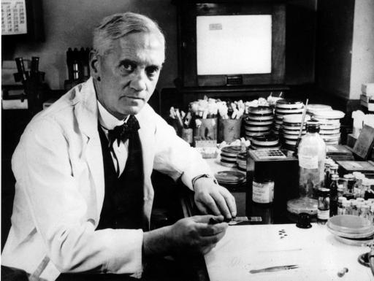
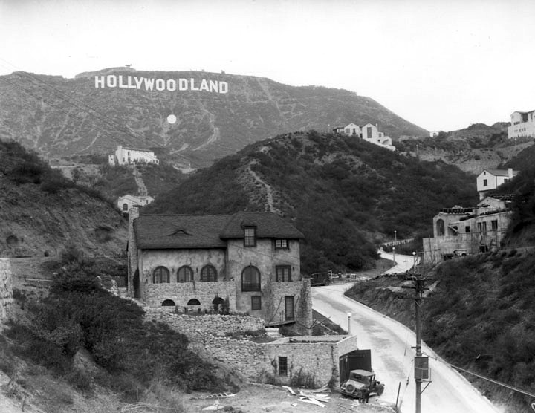
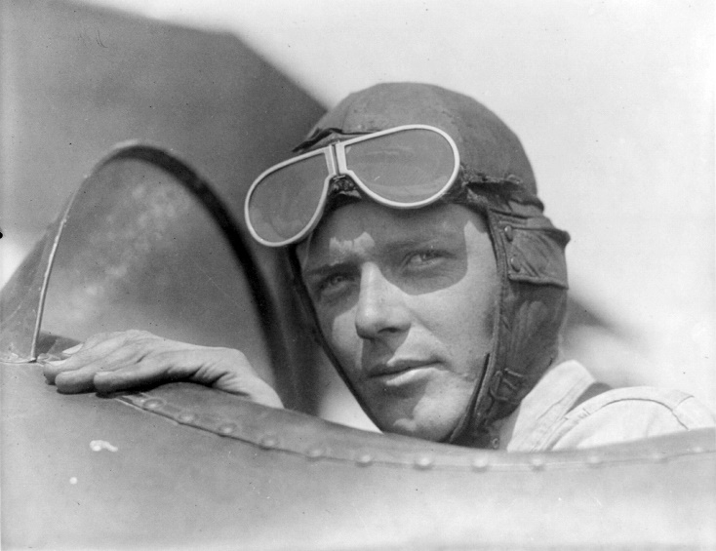
Inventions
Radio
Movies, TV
Medicine (e.g. penicillin)
Fridges, toasters, dish washers, etc.
Charles Lindbergh: flight over the Atlantic
http://www.history.com/topics/roaring-twenties

Slide 17
Women Rights
Changing role of women: result of the work during the war
number of working women increased by 25%
1920: right to vote
'Flappers' smoked in public, new dances, new clothes
Clothing: more convenient for activity, no more long skirts and corsets
Divorce: easier; number doubled
Most women: housewives and not as free as men
Although some women were able to enjoy more independence and wear the latest fashions, the reality was that most women were poorly paid and were employed in roles such as cleaners or waitresses.

Slide 18
Harlem Renaissance
African American cultural movement → idea of rebirth of the African American culture and the celebration of it
Against suppression, racism
Many African Americans move north → new communities in the cities, centre: Harlem
Literature, music, drama, dances
Ends with the Great Depression

Slide 19
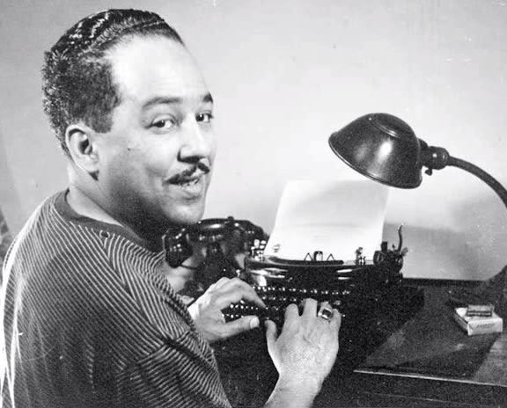
A Dream Deferred by Langston Hughes
What happens to a dream deferred?
Does it dry up like a raisin in the sun? Or fester like a sore-- And then run? Does it stink like rotten meat? Or crust and sugar over-- like a syrupy sweet?
Maybe it just sags like a heavy load.
Or does it explode?

Slide 20
Prohibition
Production and sale of alcohol forbidden from 1919-1933 (not consumption)
https://www.youtube.com/watch?v=_CE4u6jI_rc
Long campaign for it → temperance movements
People tried to find ways around it (speakeasies, personal production, medicinal alcohol) and criminal activity (e.g. Al Capone, bootleggers)

Slide 21
However… (or what we should also know about the 20s)
KuKluxKlan created terror amongst African Americans (lynching, murders, etc)
Widespread poverty and economic problems for the majority of population
Many were worried about keeping traditional (white, Protestant) values alive (→ restrictive, conservative movements against new liberties)
Increase of organised crimes (e.g. Al Capone)
Restriction of immigration

Slide 22
The End: The Great Depression
1929: Wall Street Crash
World wide economic crisis
Unemployment, poverty, famine

Slide 23
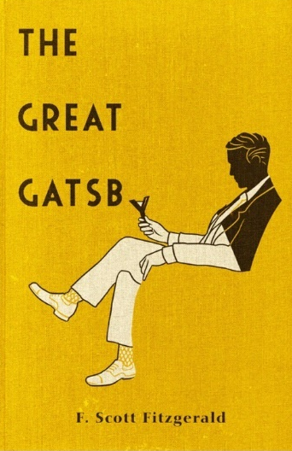
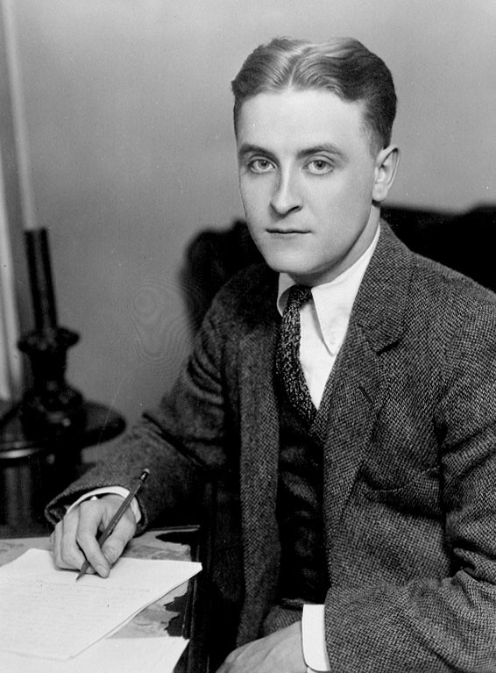
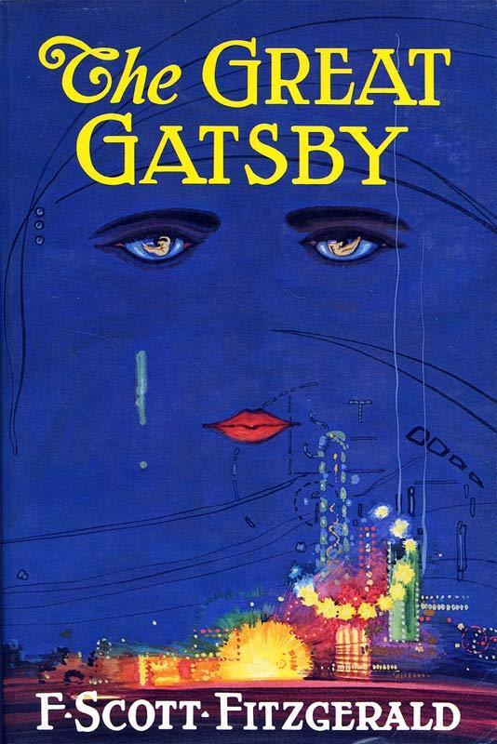
The Connection to The Great Gatsby
Published in 1925
Representing…
Lifestyle of the 1920s
Economic situation (stock market)
Excess of mass-consumerism
Questioning of the American Dream
The Great Gatsby Crash Courses
https://www.youtube.com/watch?v=xw9Au9OoN88
https://www.youtube.com/watch?v=cn0WZ8-0Z1Y

Slide 24
Summary
Crash Course American History: Roaring Twenties
https://www.youtube.com/watch?v=VfOR1XCMf7A

Slide 25
Sources
http://www.history.com/topics/roaring-twenties
http://www.bbc.co.uk/schools/gcsebitesize/history/mwh/usa/1920srev3.shtml
http://www.american-historama.org/1913-1928-ww1-prohibition-era/roaring-twenties.htm

