Slide 1
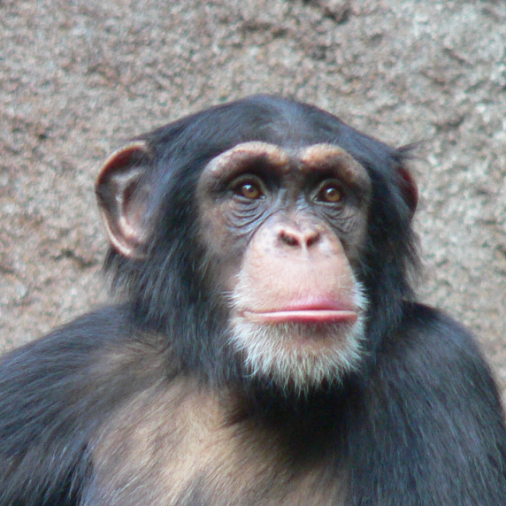
CHIMPANZEE
living habitat
food
natural enemies
special adaptation

Slide 2
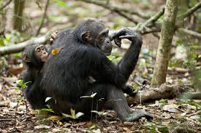
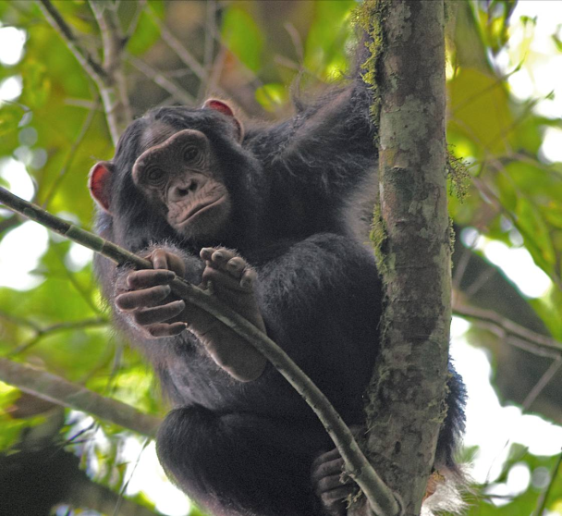
LIVING HABITAT
Central and Western Africa
humid climate > rainforests

Slide 3
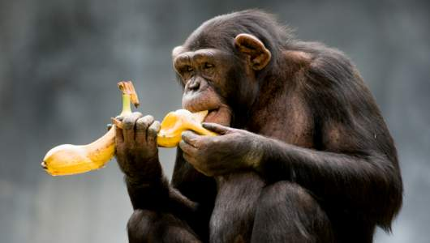
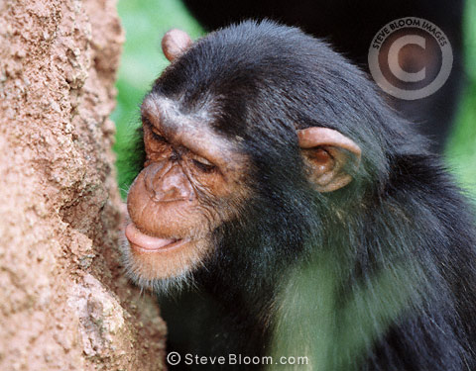
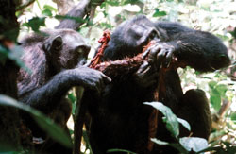
FOOD
Omnivores:
    fruits
    plants
    berries
    insects
    eggs
    meat

Slide 4
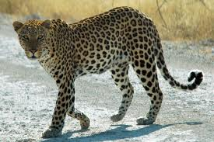
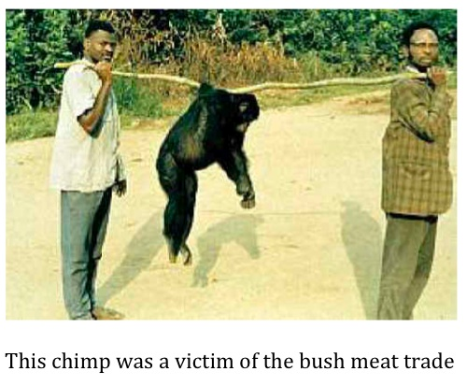
NATURAL ENEMIES
leopard
humans

Slide 5
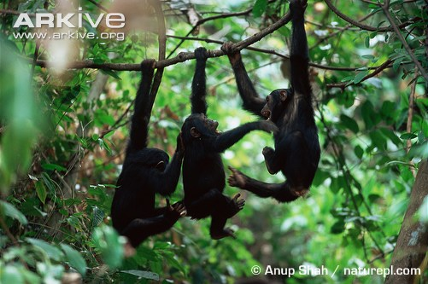
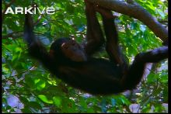
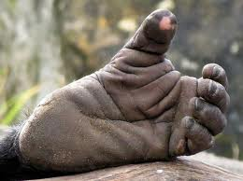
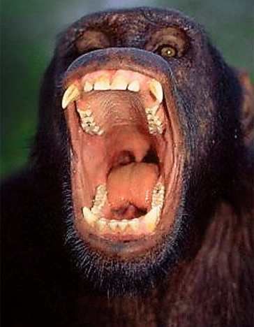
SPECIAL ADAPTATION
long, strong arms
opposable big toe
strong canine teeth

Slide 6
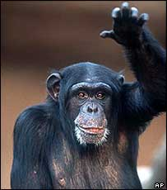
THANK YOU
for your attention!

