Slide 1
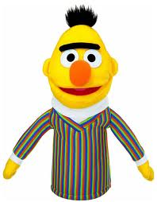
My puppet‘s name is Bluebeard but his friends call him something else and he lives on the moon. His hair is pink. On Mondays he eats coconuts and pears but on Tuesday he only eats pears and on Wednesday and Sunday he eats pears and nuts but no coconuts because he only eats them on Mondays

Slide 2


He didn‘t always live on the moon he was born on Mars but had to leave when his friend Sam left his house his pet is called Fruggle. He is a worm. Fruggle eats coconuts like Bluebeard but only on Sundays. His hobby is bowling.

Slide 3
Beside his bedroom is a TV room and a closet where he keeps all his jackets and boots and stuff he needs for walking on Mars or on the Moon. He plays football with Fruggle and Piffy. Piffy is an orange bear.

Slide 4

His mum always wakes him up too early. On Mars. They live on a moon tree with Fruggle. Piffy lives close to their place. Sometimes they go swimming. When Bluebeard eats ice-cream his left ear starts to grow and only stops when he eats a coconut. But only on Thursdays.

Slide 5
ThAnK yOu FoR lIsTeNiNg

