Slide 1
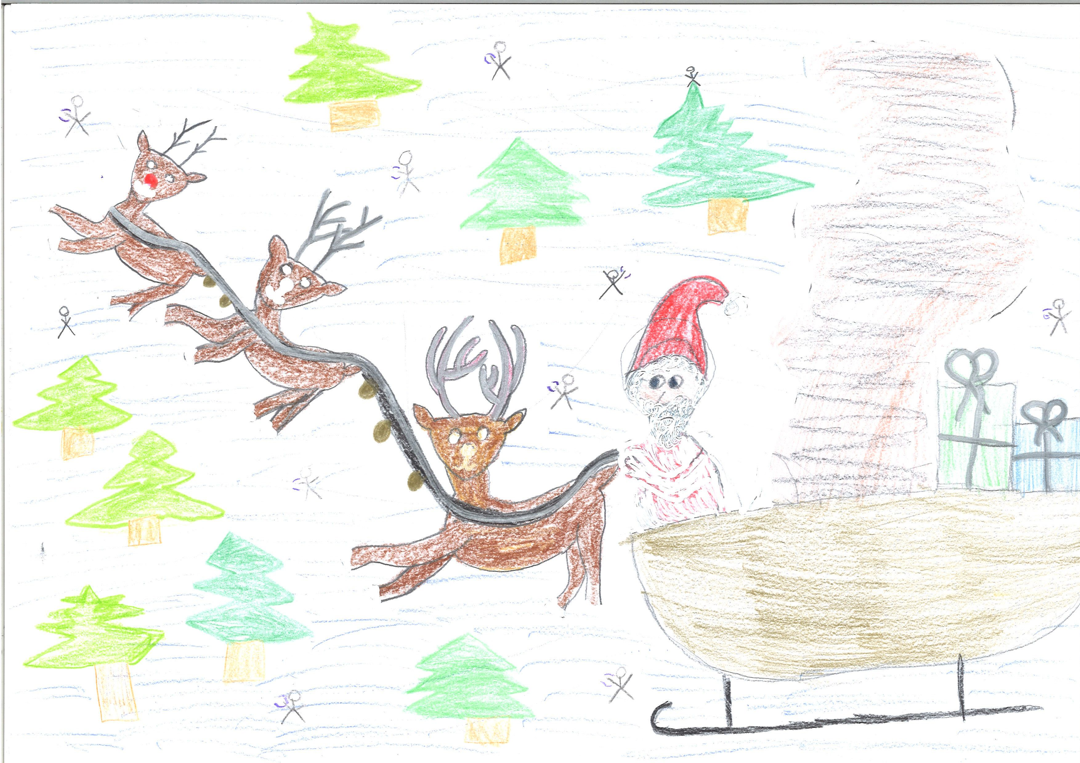
Santa’s Garden
By 1a GIBS and The Beatles

Slide 2

I'd like to be… far in the North
In Santa’s magic garden in the snow

Slide 3
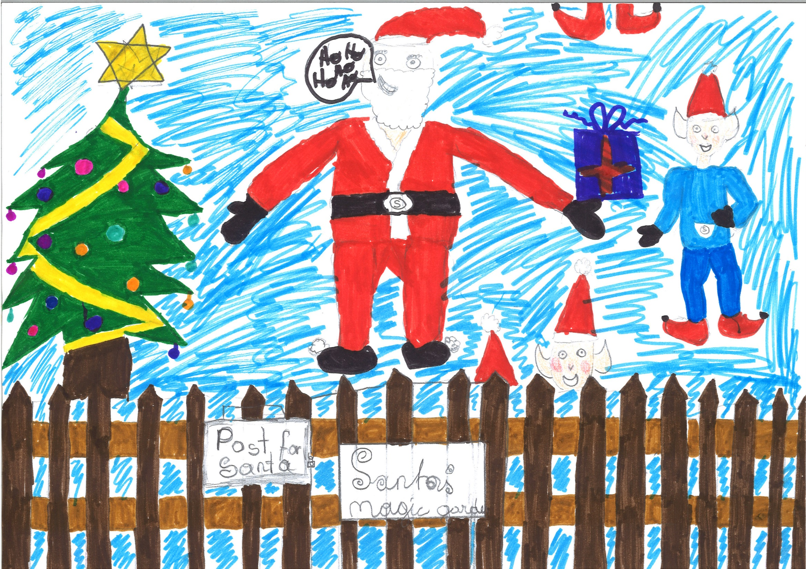
He'd let us in,…knows where we've been
In Santa’s magic garden in the snow

Slide 4
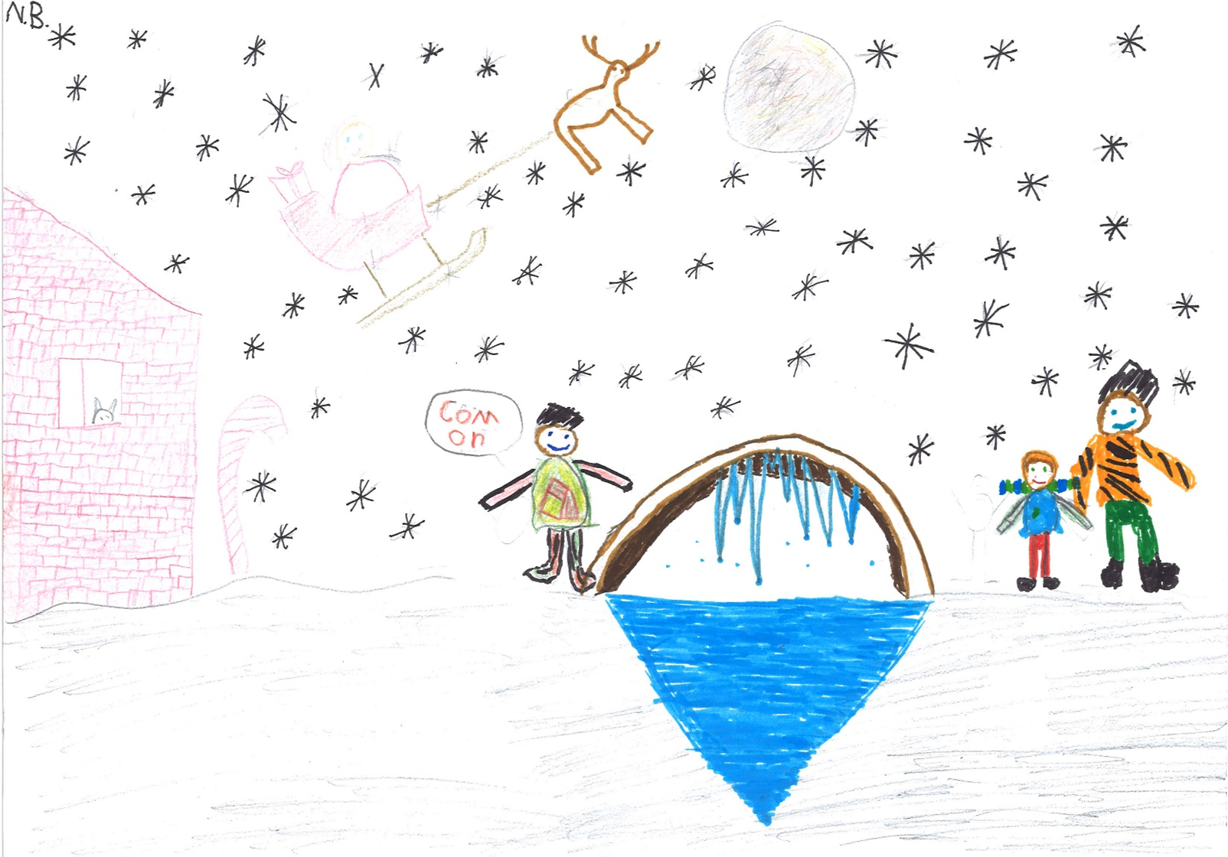
  I'd ask my friends … to come and see
  Santa’s magic garden with me

Slide 5
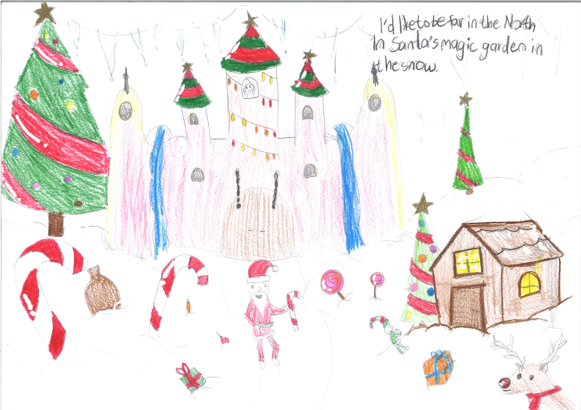
  I'd like to be …far in the North
  In Santa’s magic garden in the snow

Slide 6
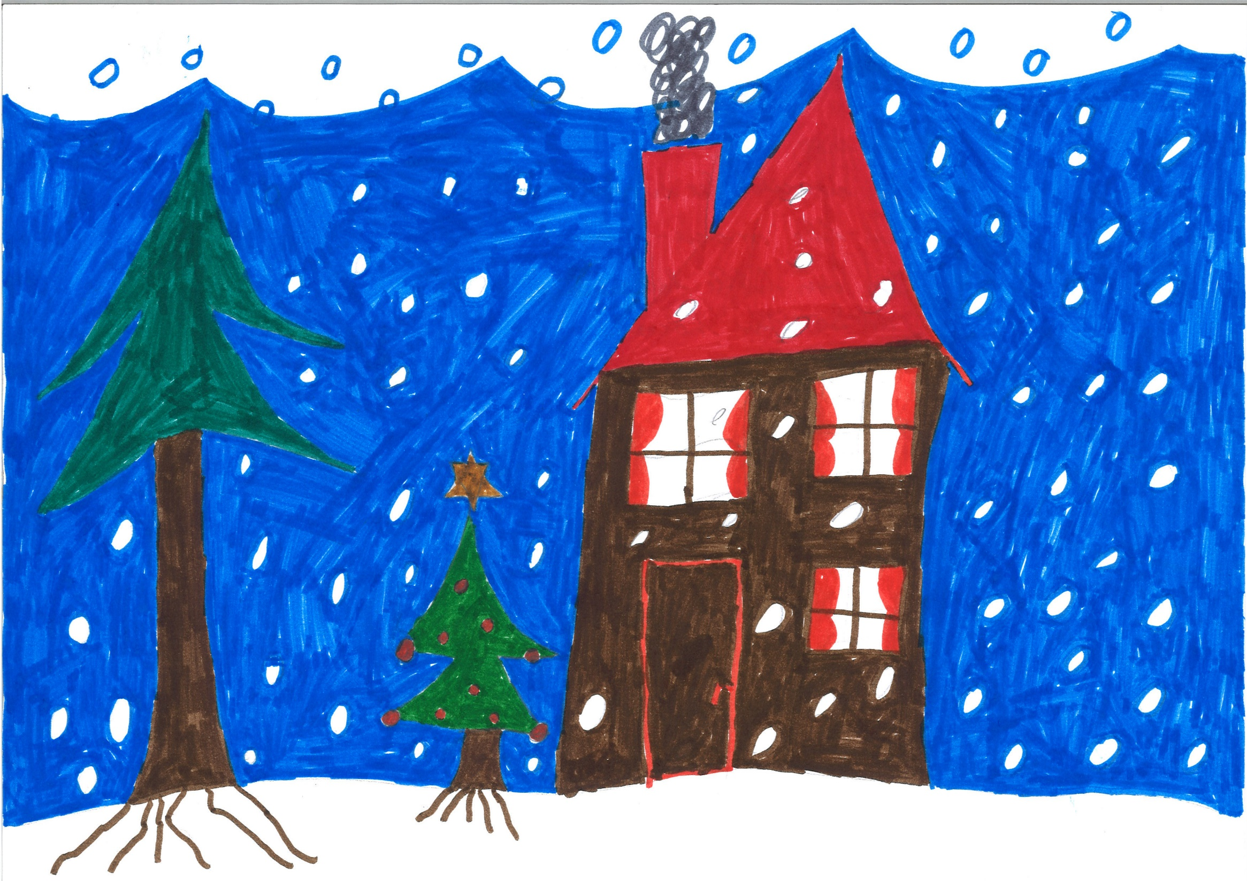
We would be warm … in the snow-storm
In our little hideaway in Santa’s house

Slide 7
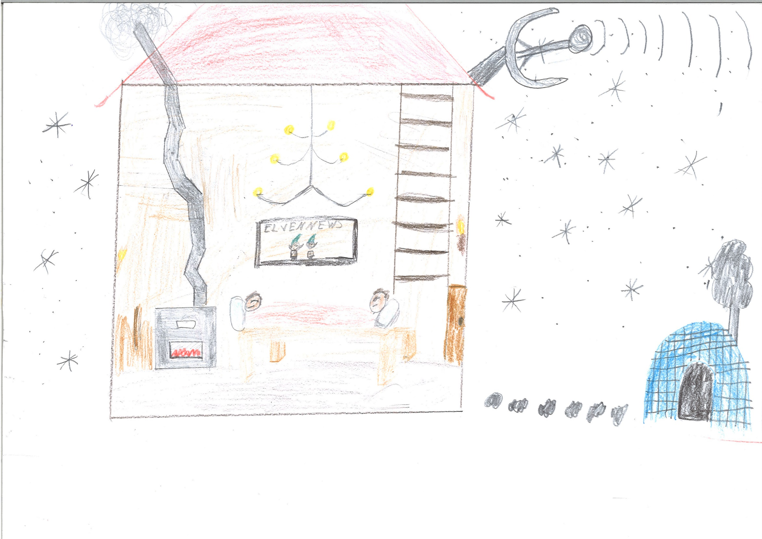
Resting our head … on his warm bed
In Santa’s magic garden in the snow.

Slide 8
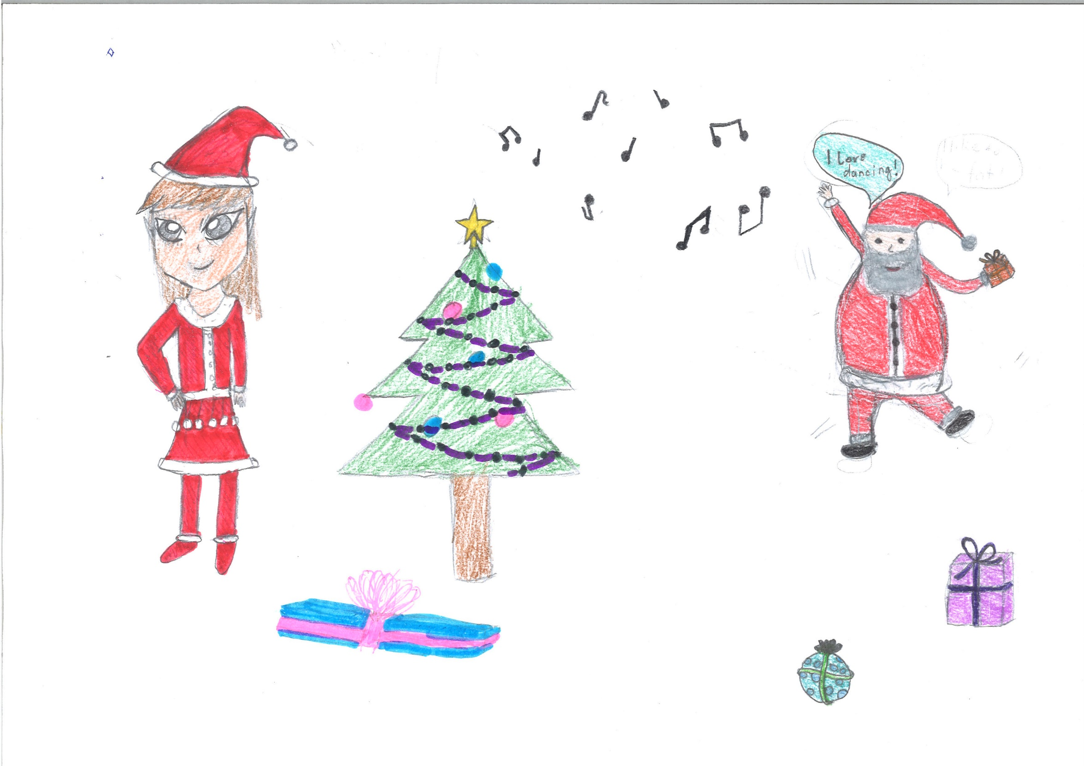
We would sing … and dance around
Because we know we can't be found

Slide 9
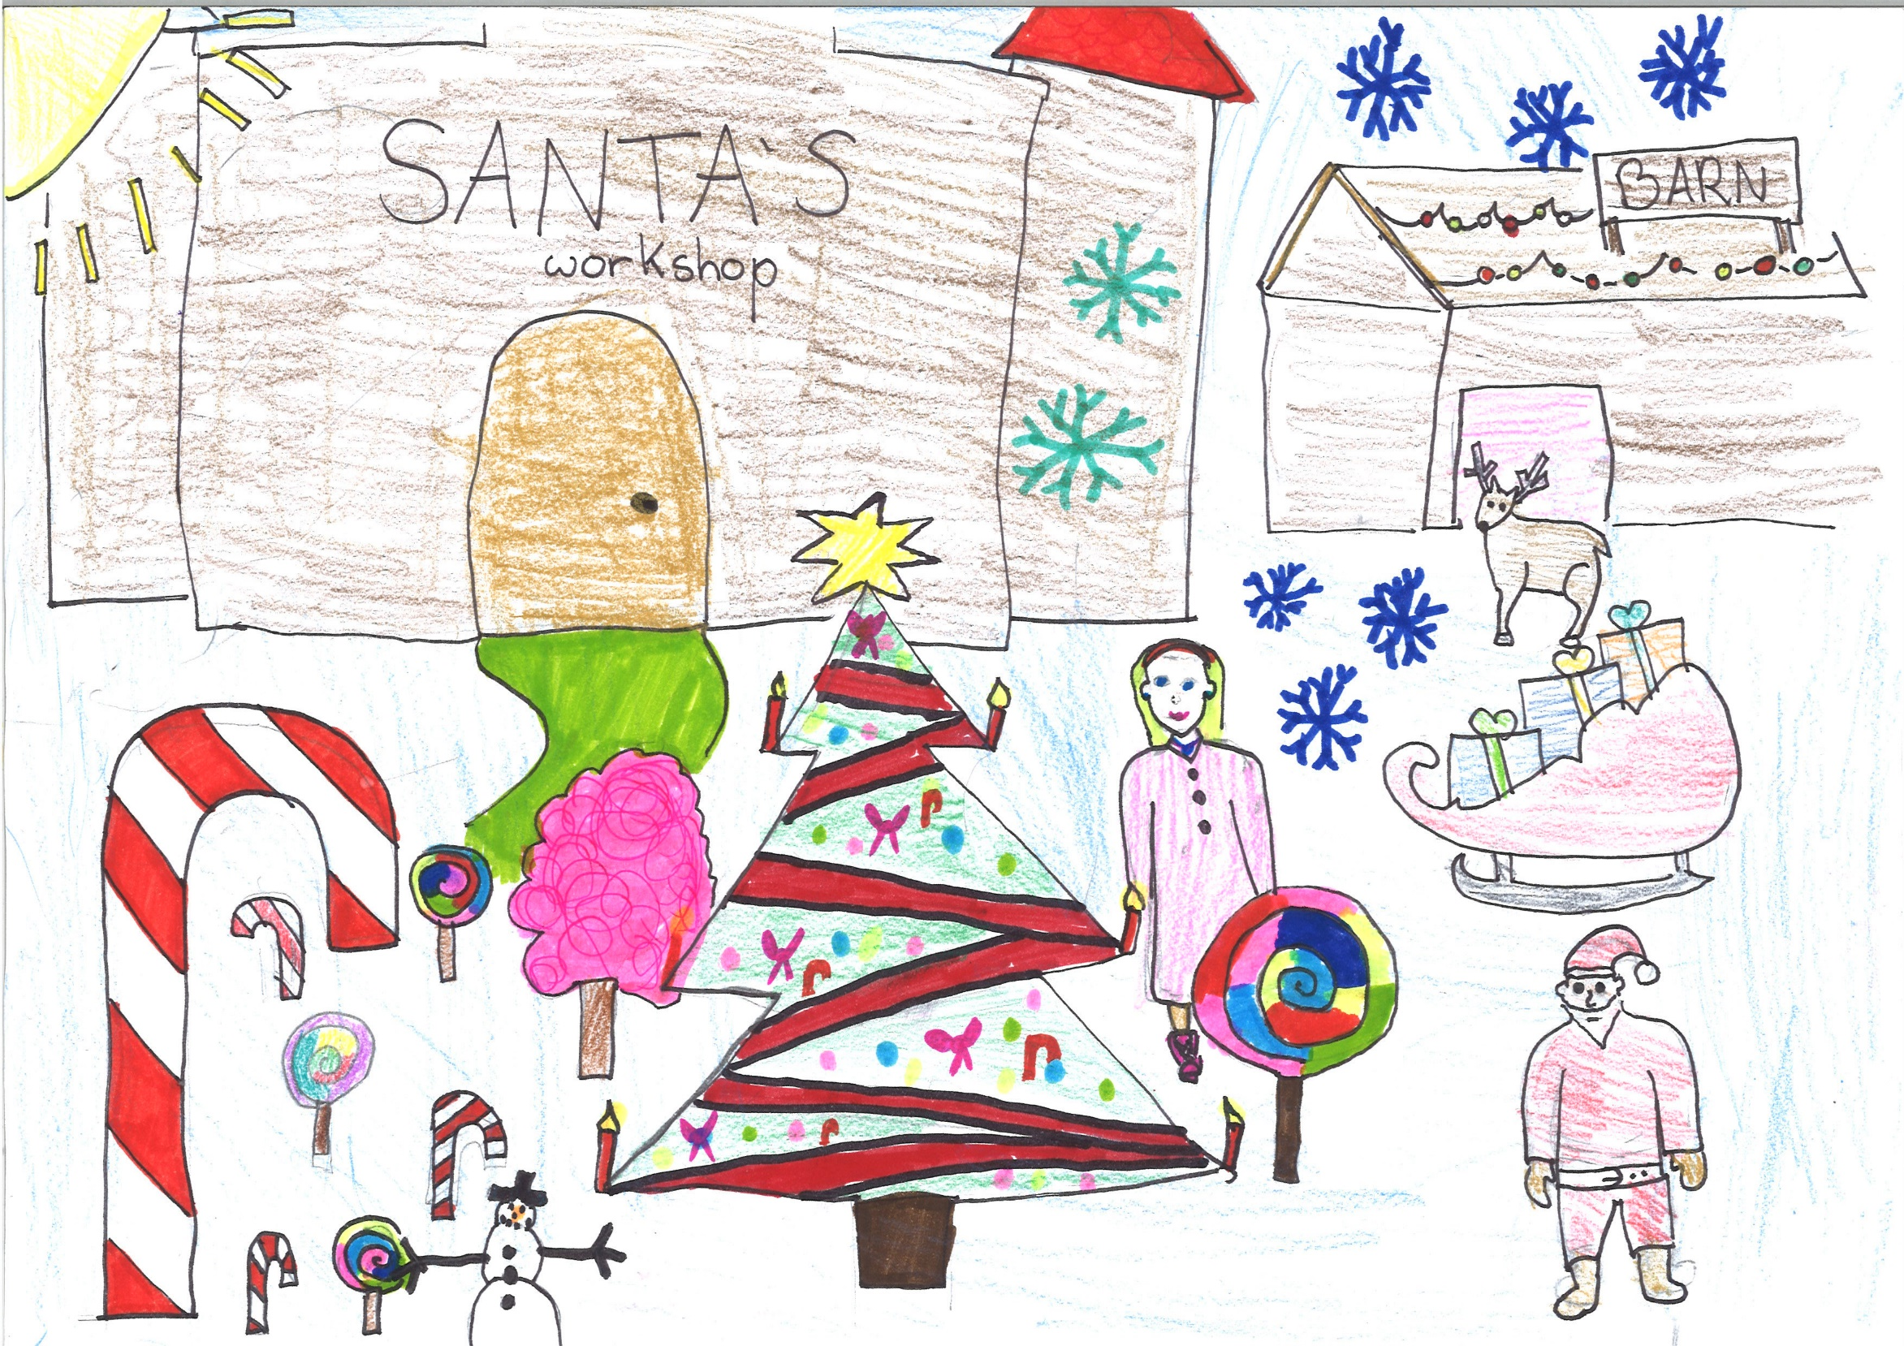
I'd like to be … far in the North
In Santa’s magic garden in the snow

Slide 10
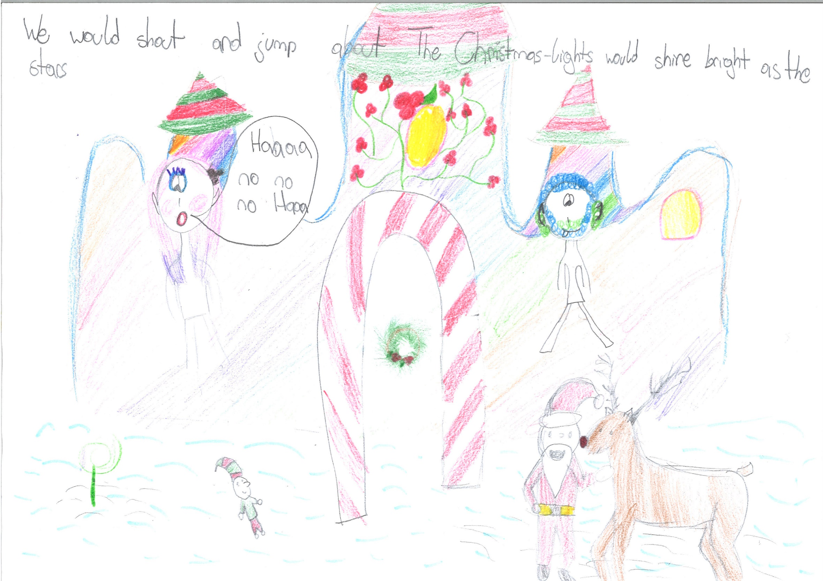
We would shout … and jump about
The Christmas-lights would shine bright as the stars

Slide 11
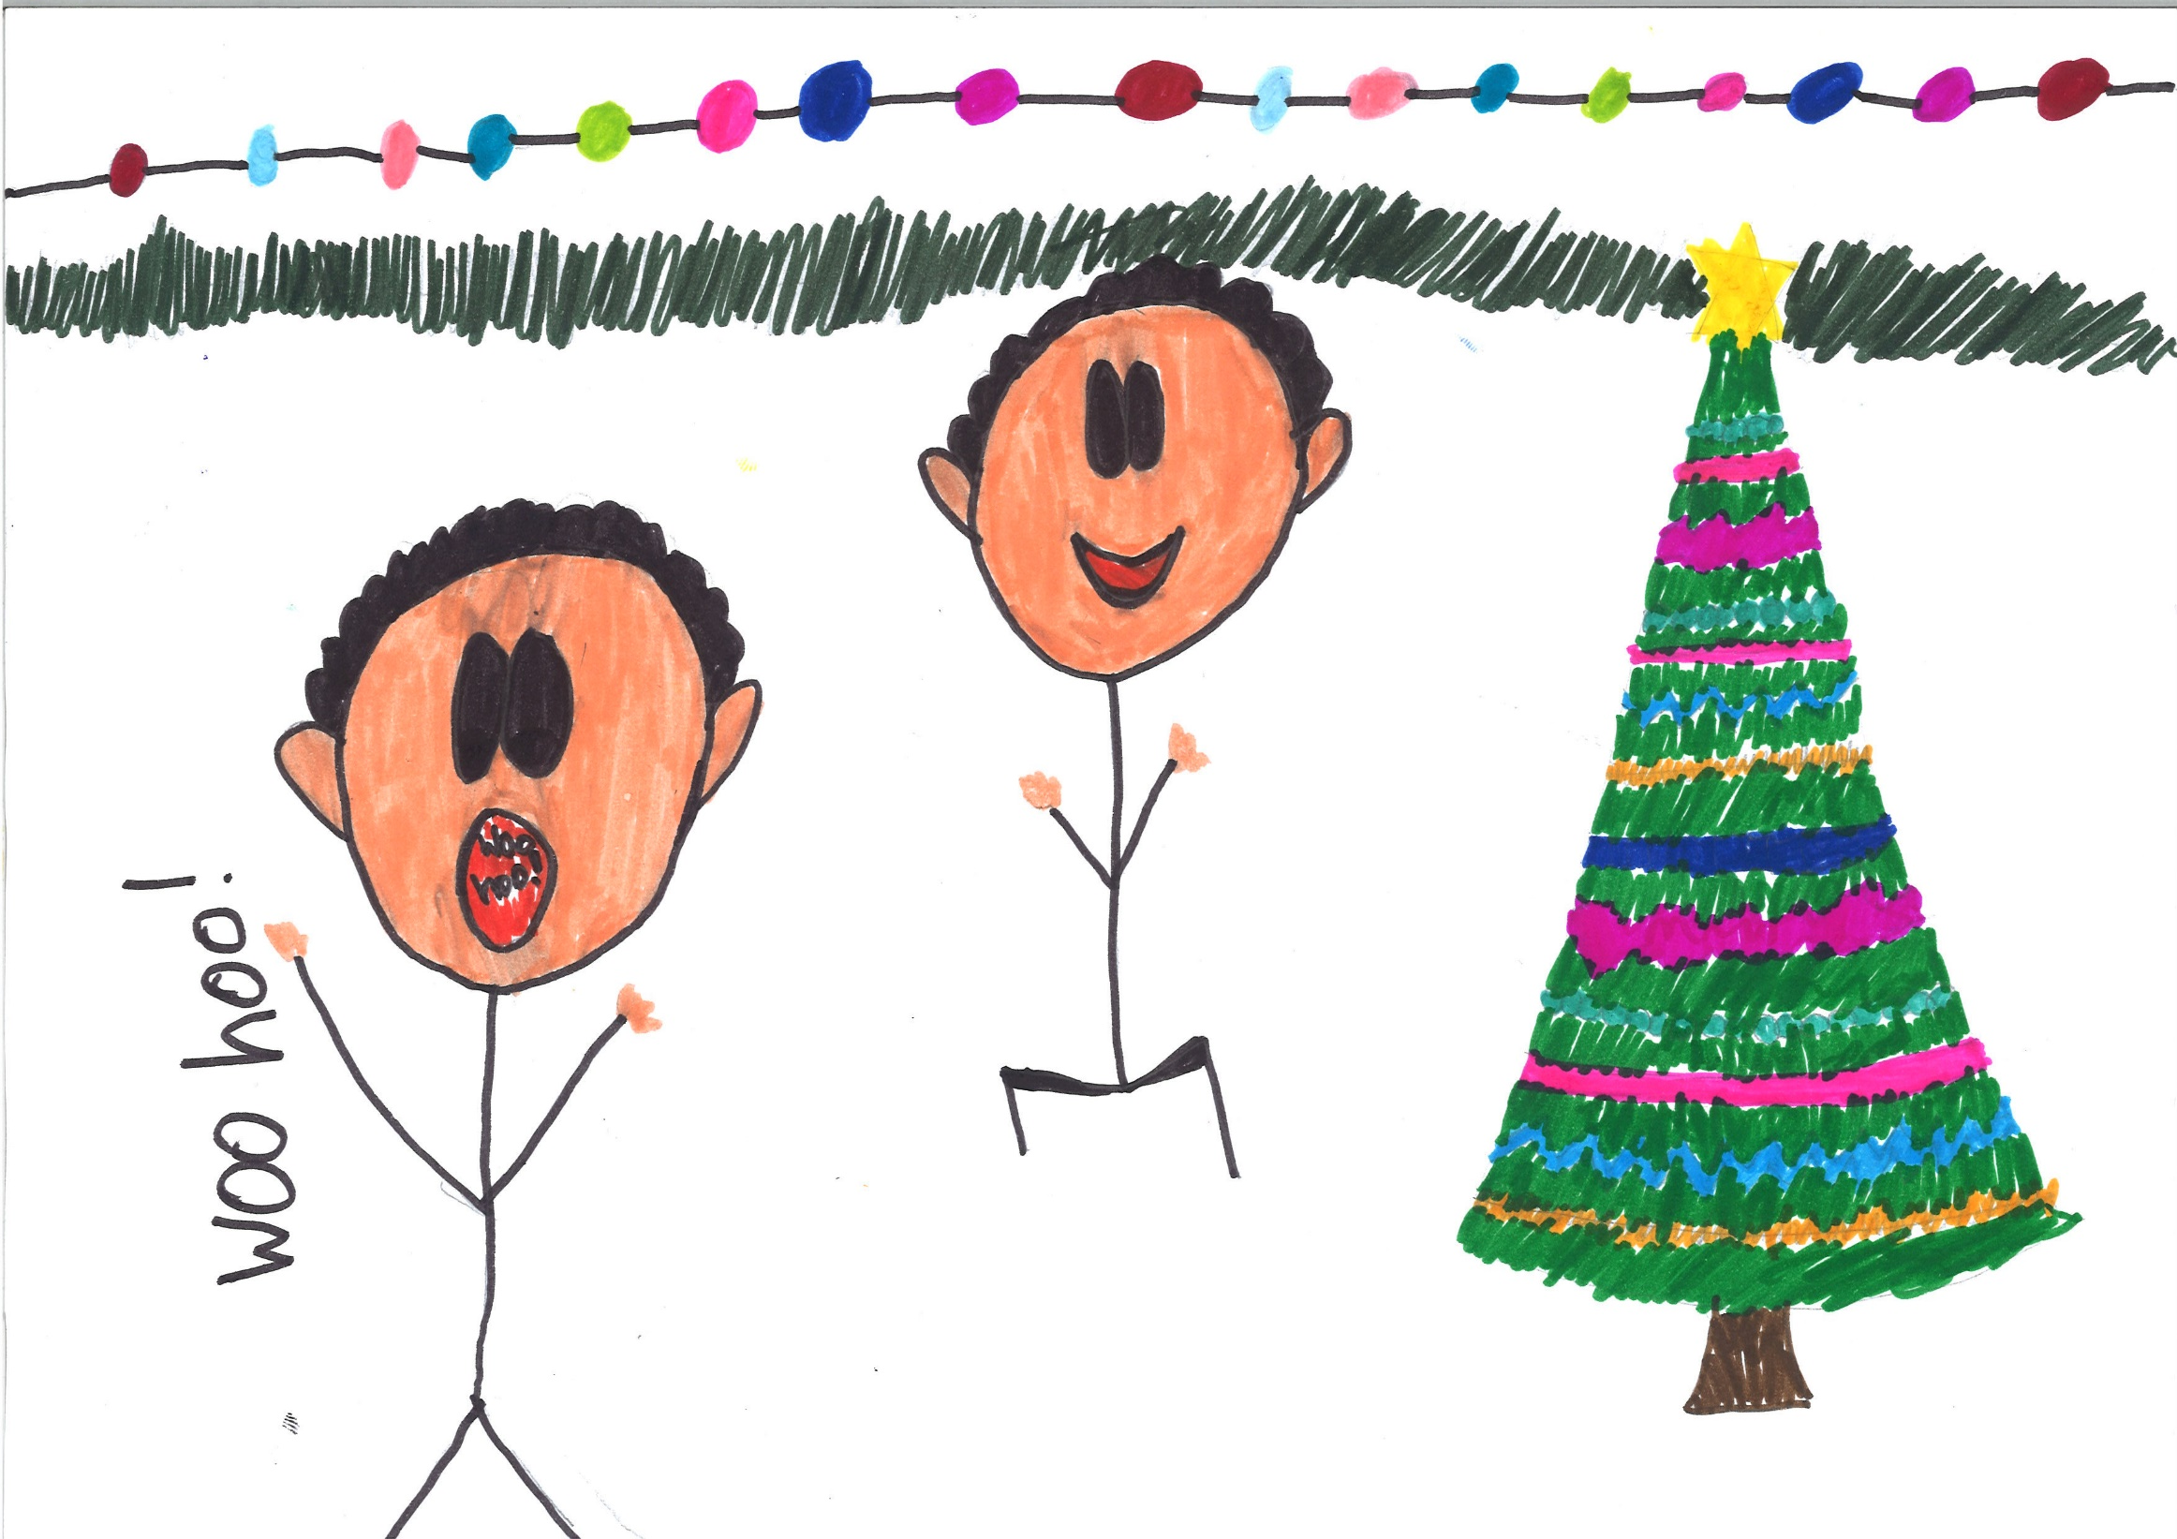
Oh what joy… for every girl and boy
Knowing they are happy and they're safe

Slide 12
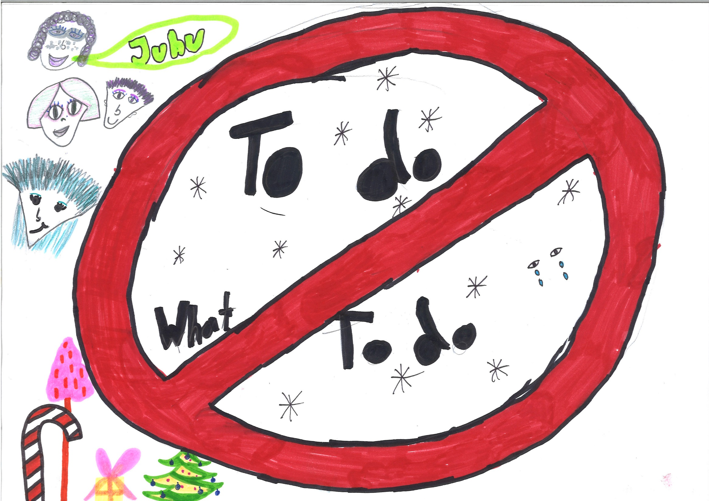
We would be …so happy you and me
No one there to tell us what to do

Slide 13
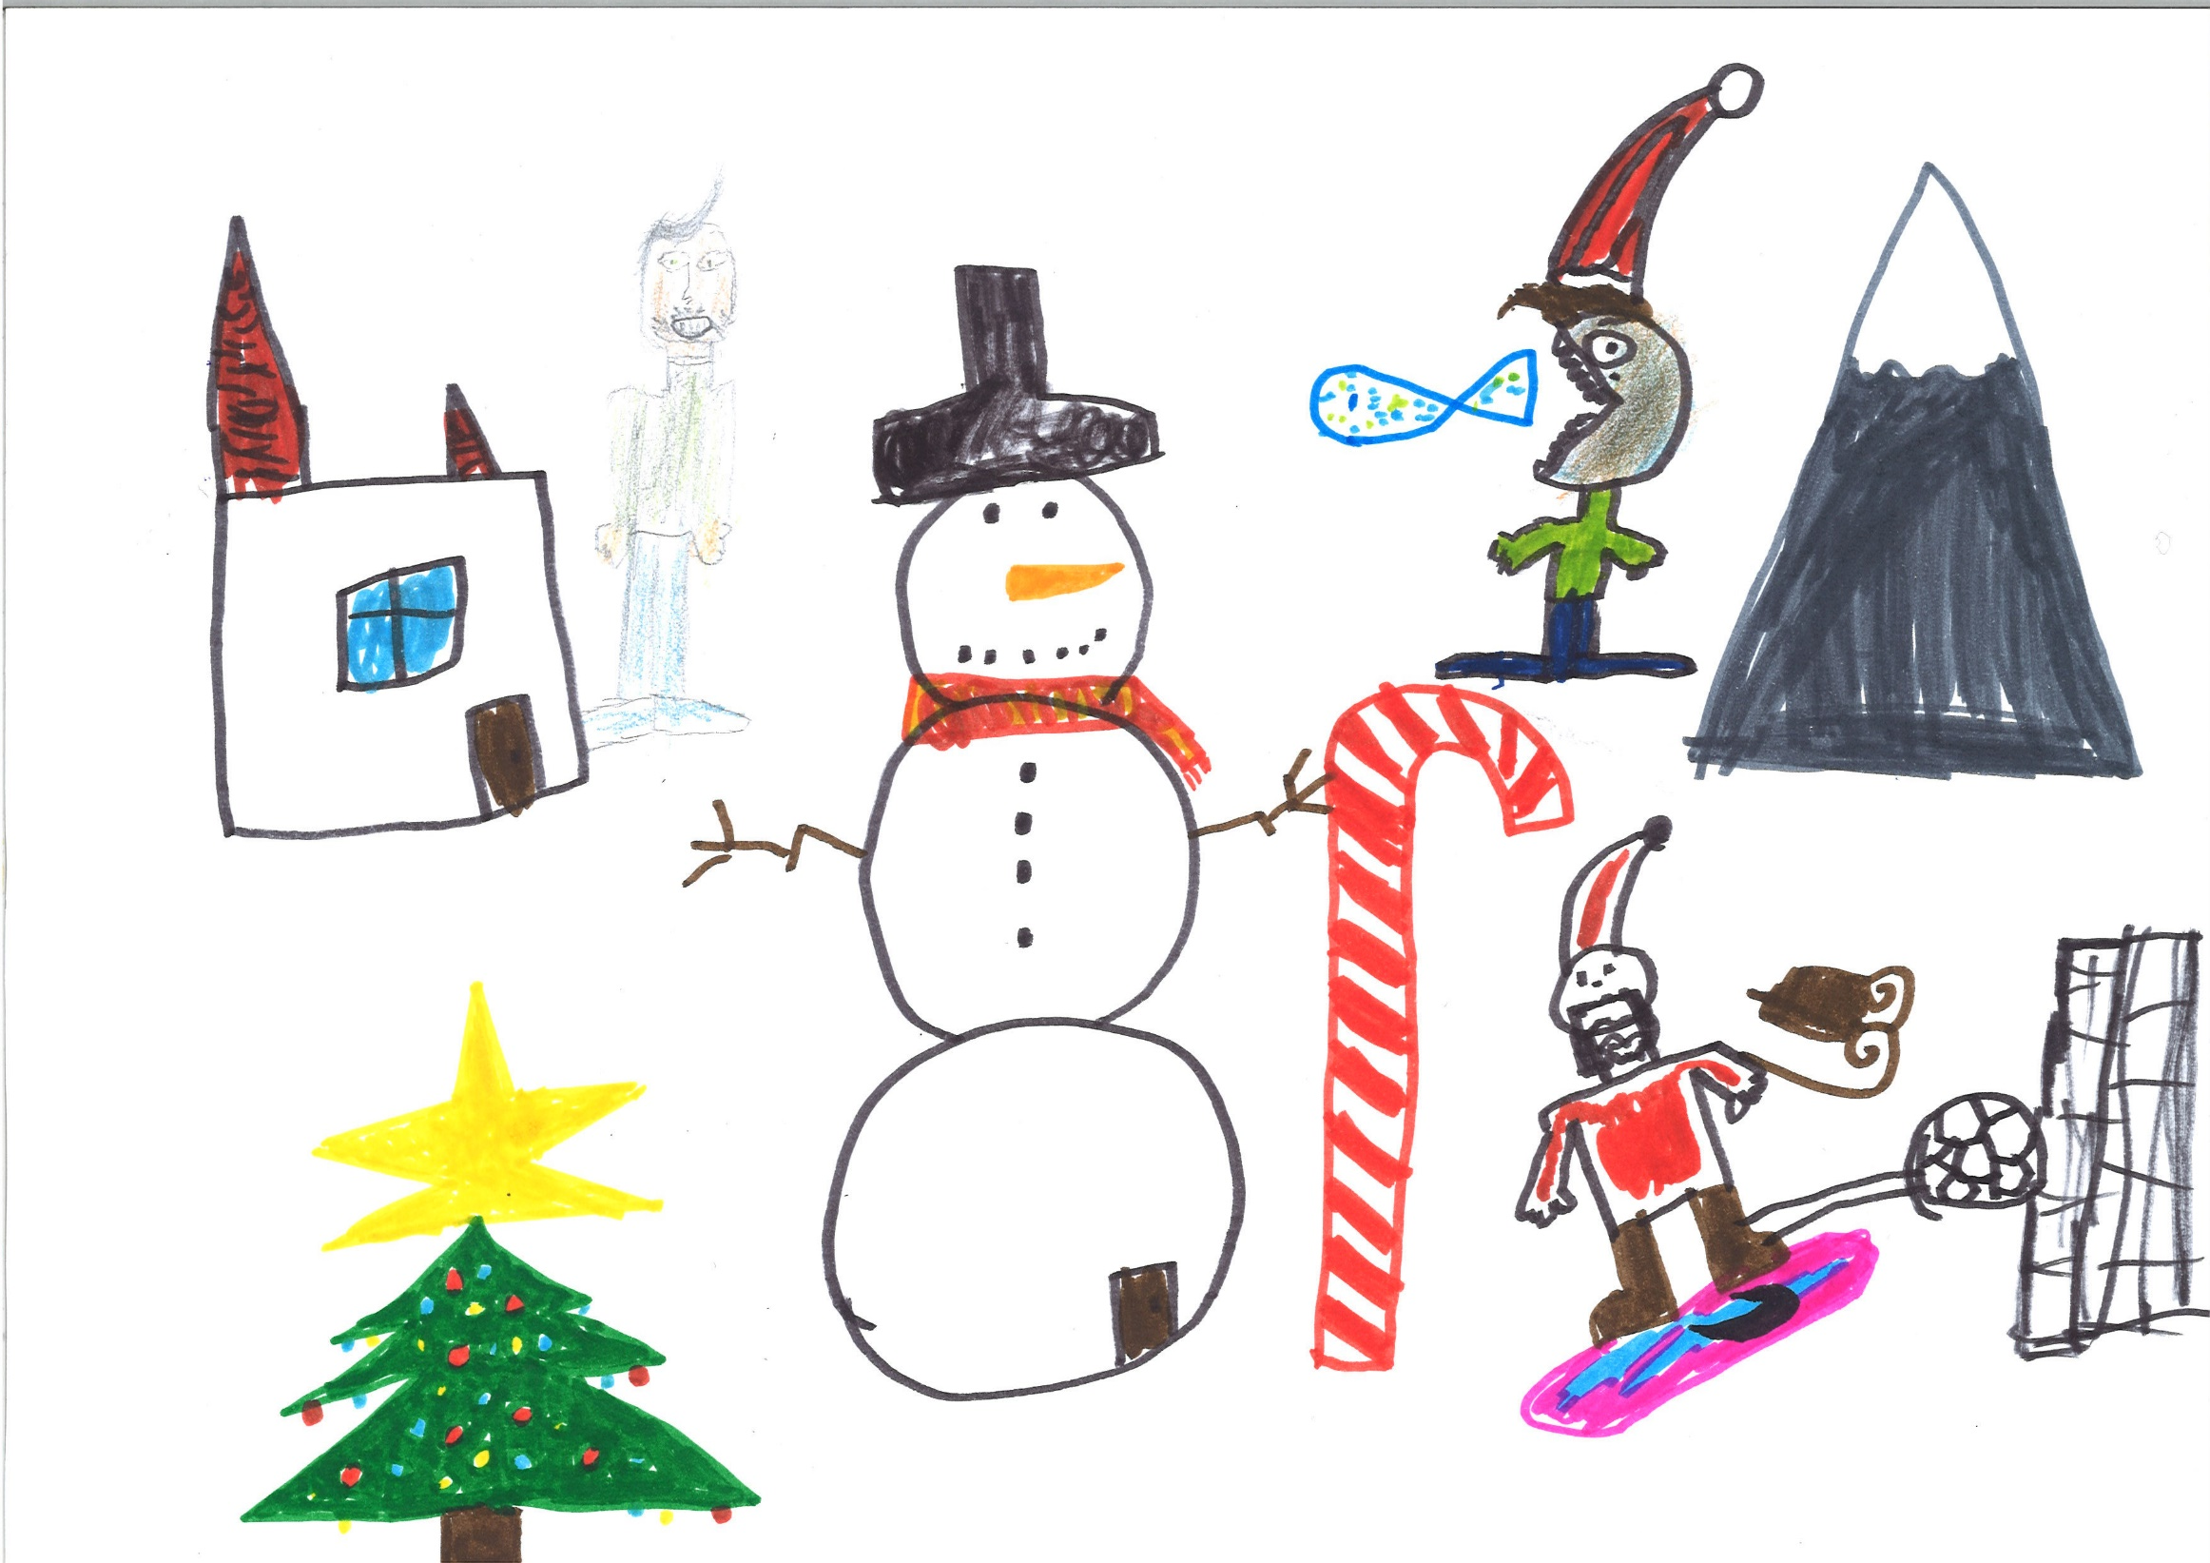
I'd like to be … far in the North
In Santa’s magic garden in with you…

Slide 14
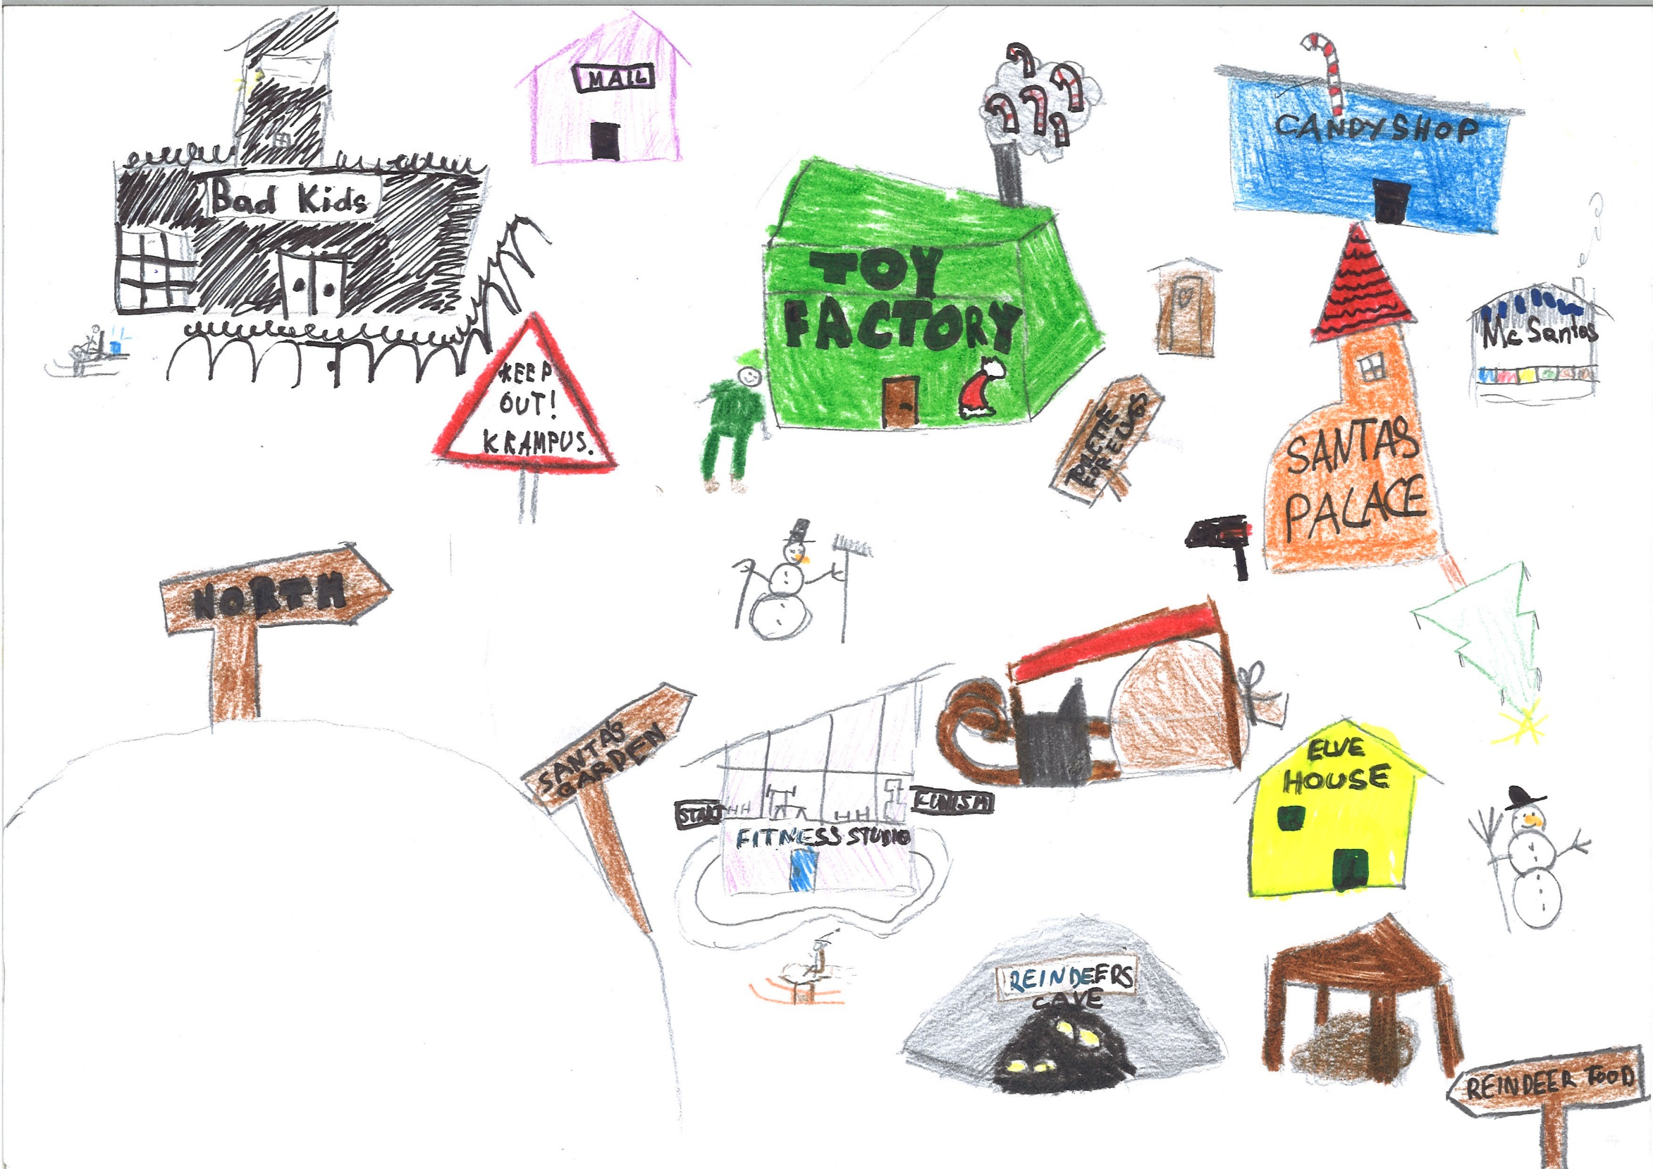
In Santa’s magic garden with you…
In Santa’s magic garden with you…

Slide 15
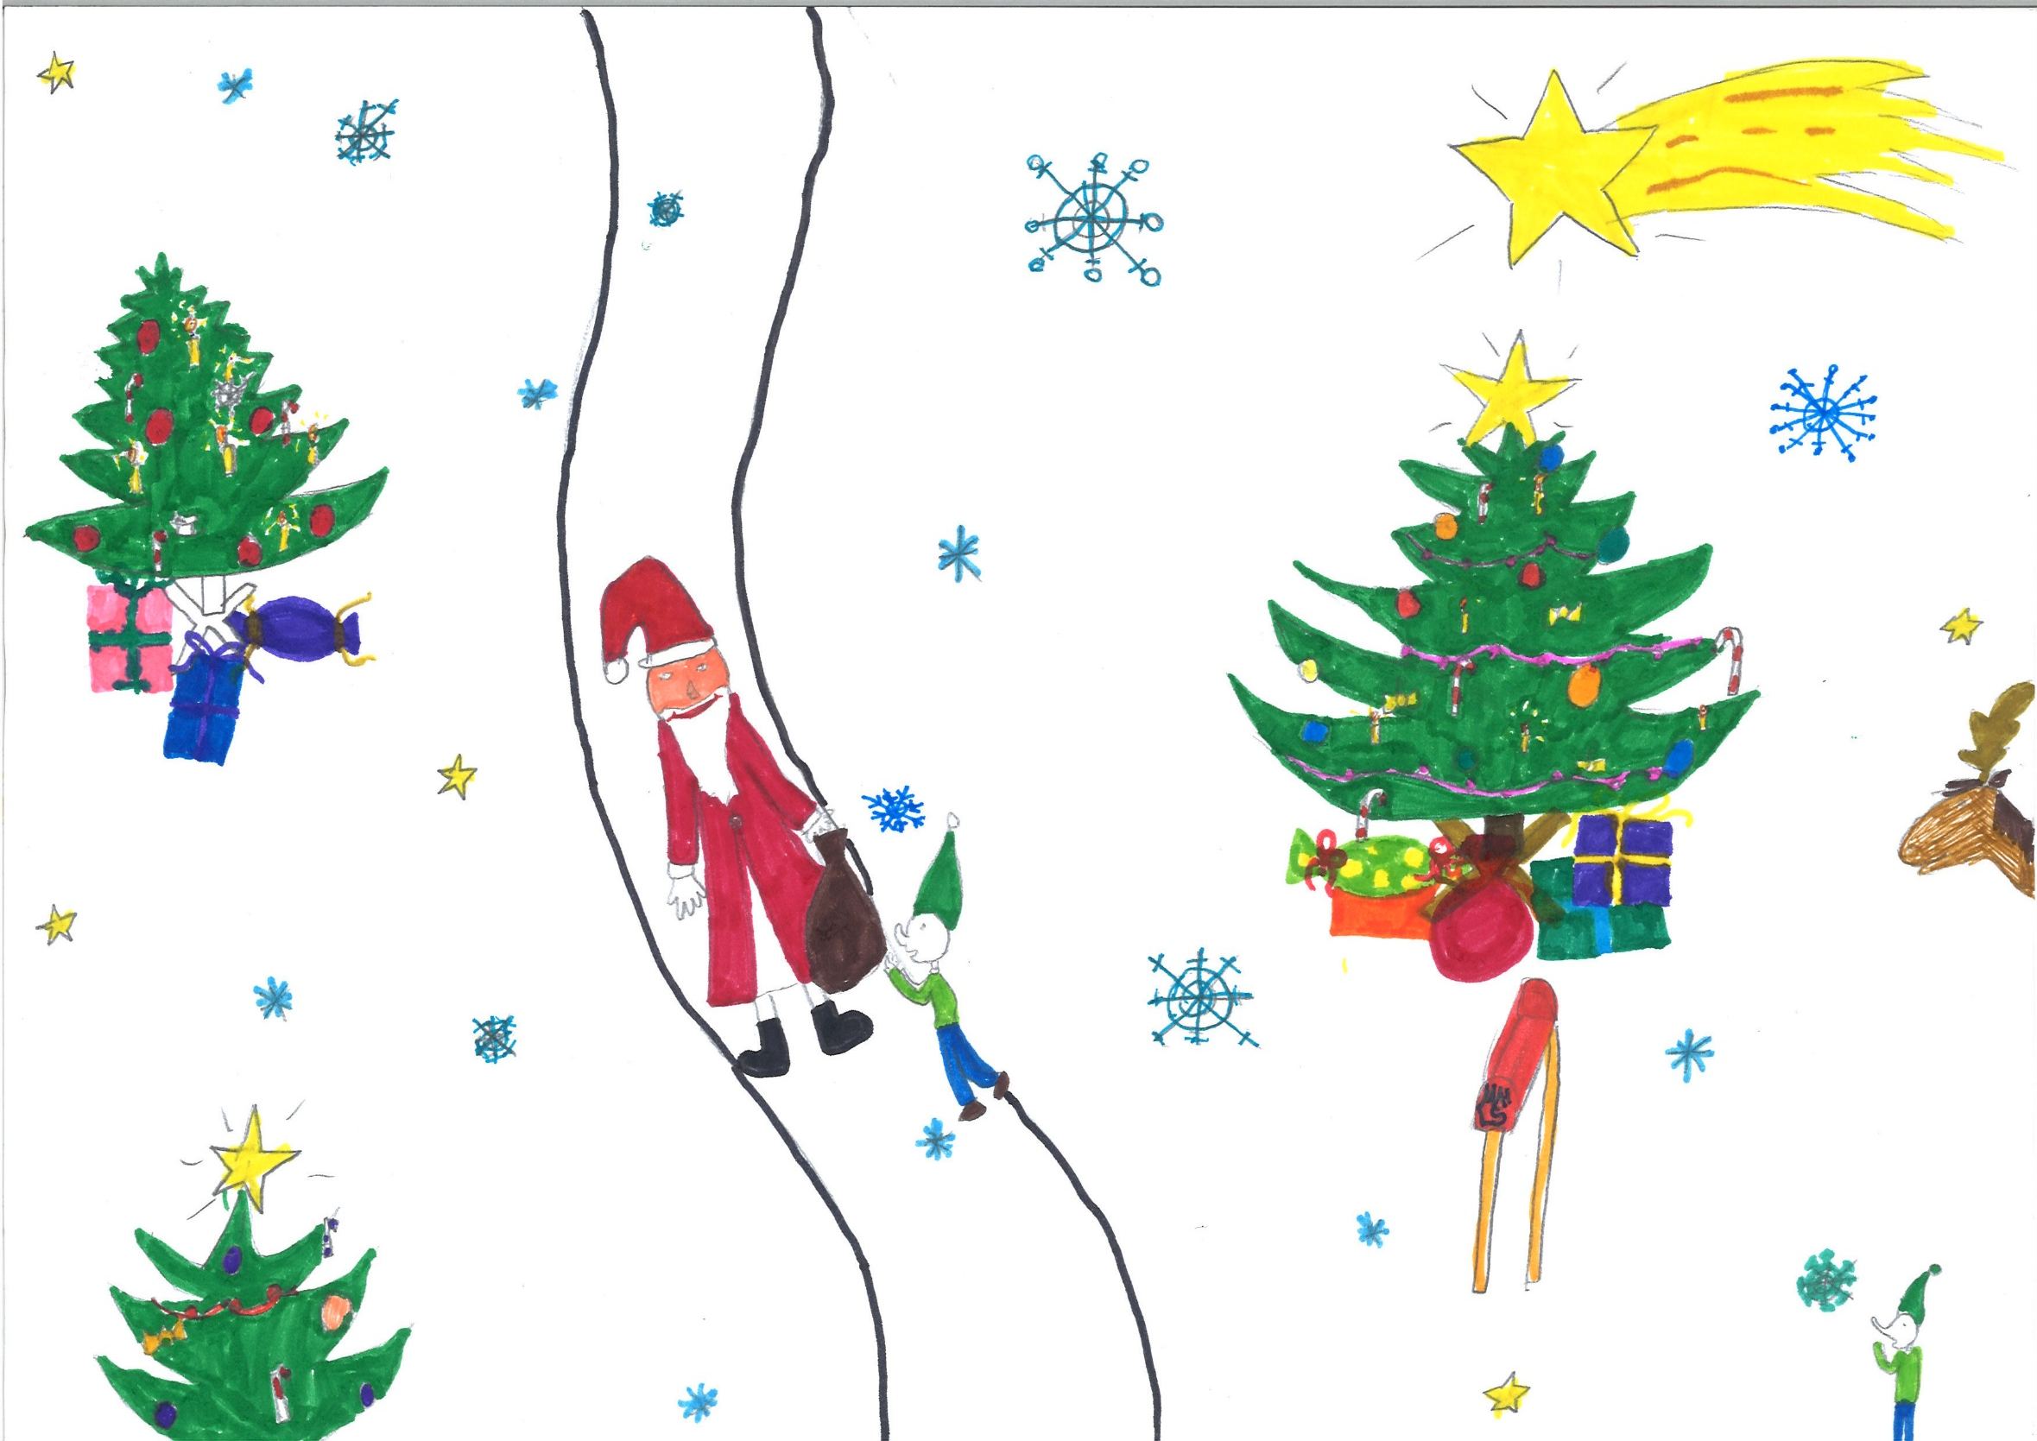
Merry Christmas to you all…

