Slide 1
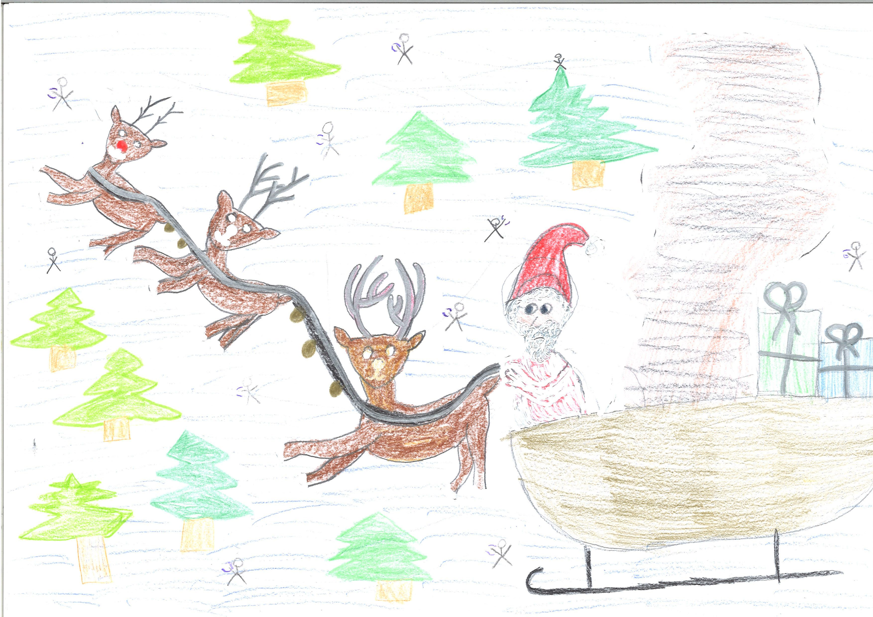
Santa’s Magic Garden
1a and the Beatles

Slide 2
