Slide 1


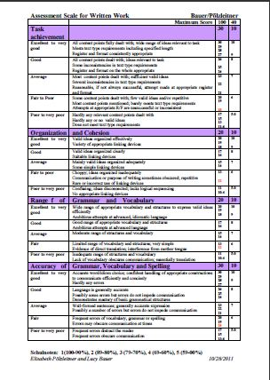
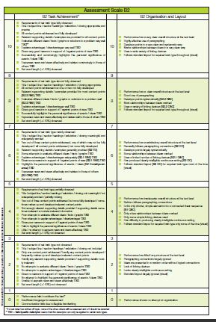
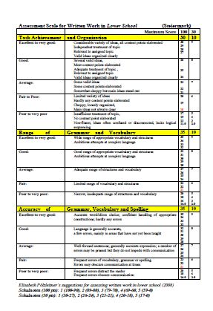
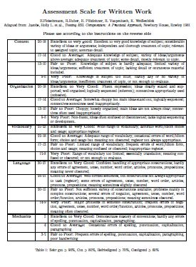
Using the new Assessment Scales

Slide 2
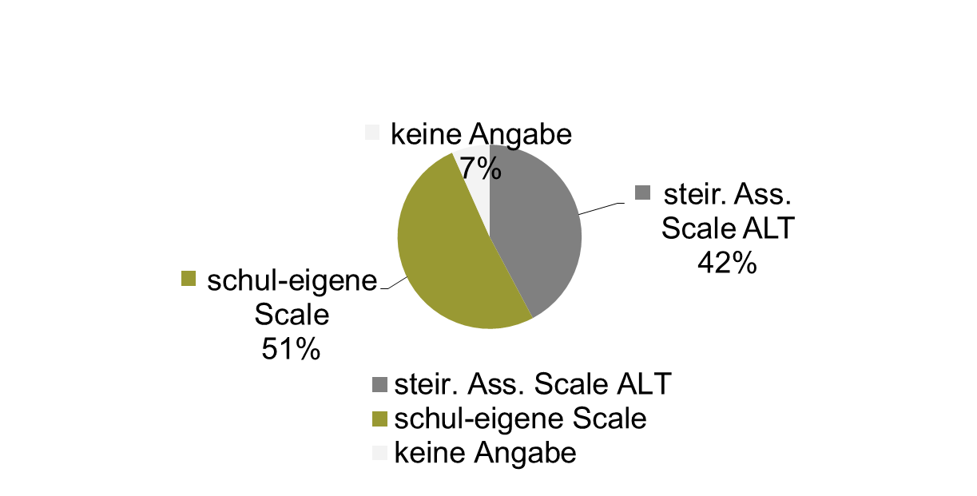
Assessment Matura Old

Slide 3
New Matura – New Needs
First joint tasks for written exam in Styria (2007/08)
ARGE group suggested criteria for a new assessment scale
Better suited for new text types
B2 level, according to CEFR
5 grades/marks, should also be used throughout upper-school
Should be user friendly for the teachers
transparent for students, should give clear feedback of strenths and weaknesses

Slide 4
Our Models
Old Styrian assessment scale for written work, (1991)
ESL Composition Profile, Jacobs et al. (1981)
Hungarian Assessment Scale, Tankó (2005)
FCE General Marking Scheme, British Council.Org
CEFR descriptors, B2
NÖ Assessment Scale for Writing, Friedl & Auer (2008)

