Slide 1
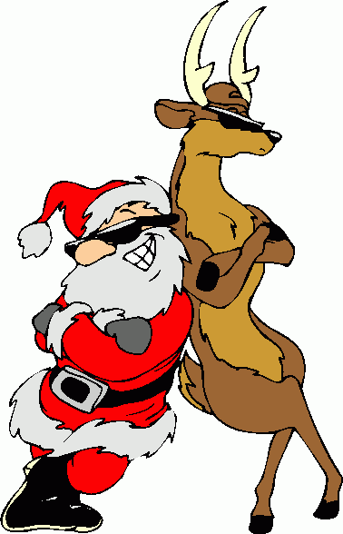
1A Active English SOAR

Slide 2
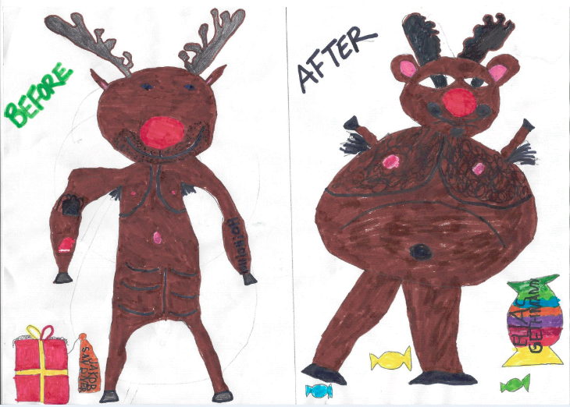
I used to train a lot and have a six pack Then I got TV and UPC

Slide 3
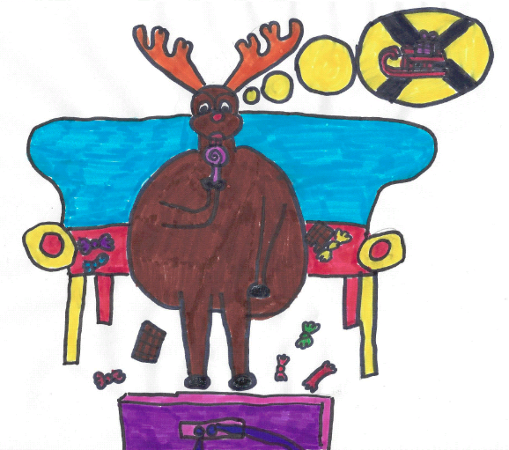
So I sat quietly, eating candy I guess that I forgot I had a job

Slide 4
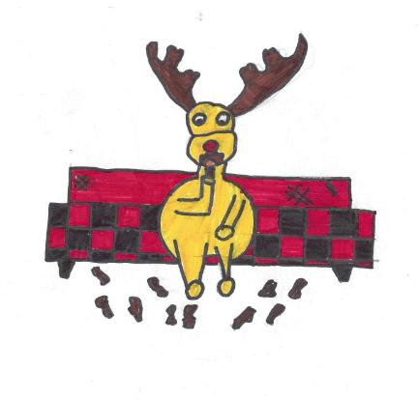
The Snickers pushed me to the bursting point I stood for nothing, so I ate through everything

Slide 5
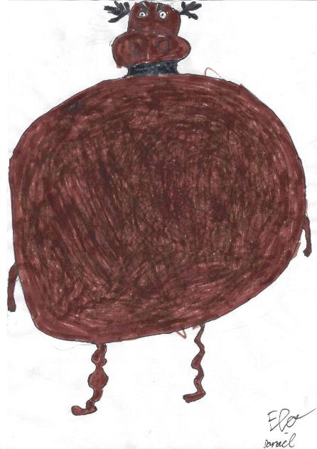
It held me down,
but I got up (WEIGH!) Already brushing off
the crumbs
You see my waist,
you see how round No longer gonna
shake the ground It held me down,
but I got up (WEIGH!) Get ready cause
I’ve had enough I see it all, I see it now

Slide 6
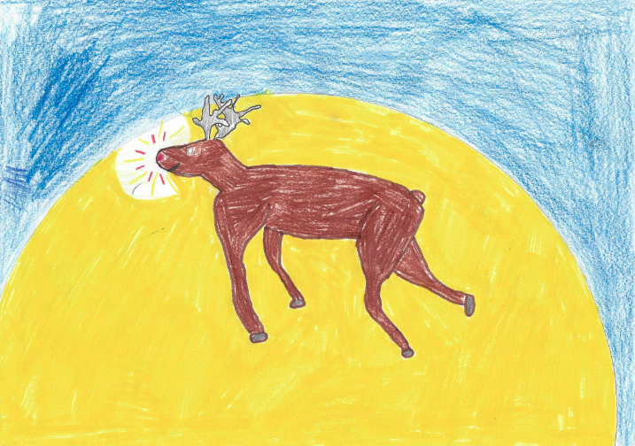
My nose shines bright like a fire,
a flier
Raising through the sky-a
Cause I am a champion
And you’re gonna see me soar
Higher, higher than an eagle Cause I am a champion
And you’re gonna see me soar

Slide 7
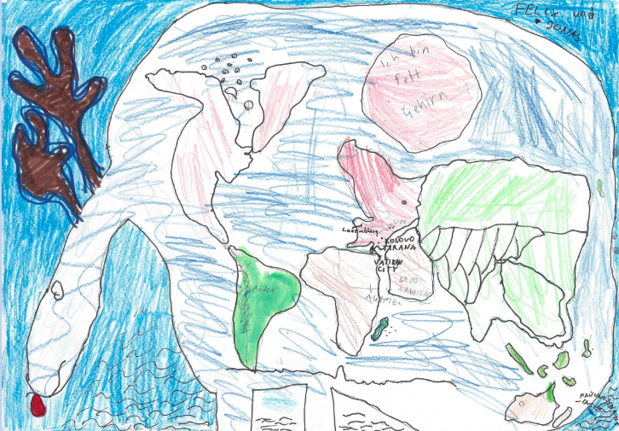
Oh oh oh oh oh oh Oh oh oh oh oh oh Oh oh oh oh oh oh You’re gonna see me soar

Slide 8
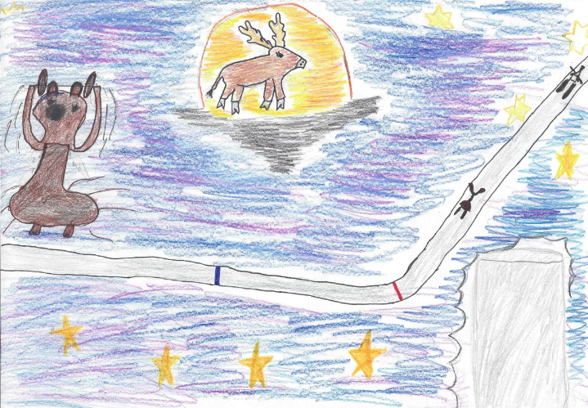
Now I’m training like Tom Morgenstern Dropping the weight and getting back in shape I went from Cee-Lo to Santa’s hero

Slide 9
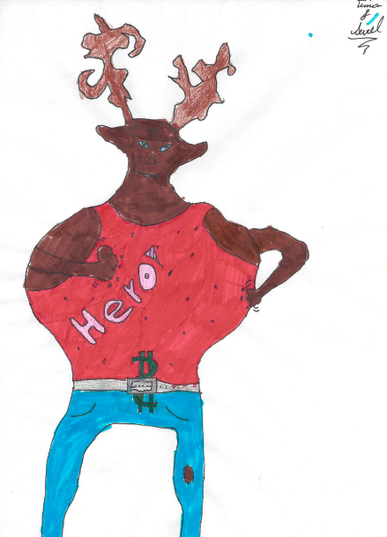
It held me down,
but I got up (WEIGH!) Already brushing off
the crumbs
You see my waist,
you see how round No longer gonna
shake the ground It held me down,
but I got up (WEIGH!) Get ready cause
I’ve had enough I see it all, I see it now

Slide 10
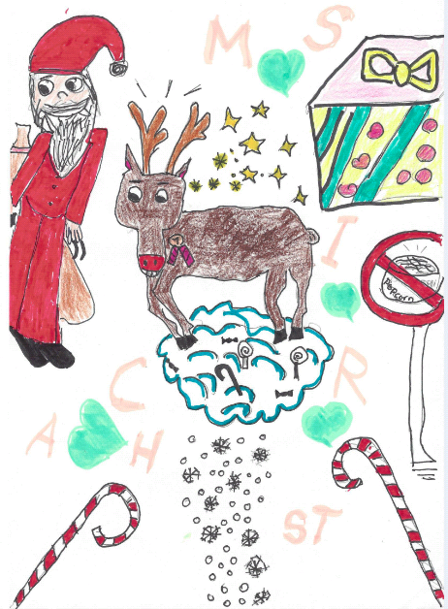
My nose shines bright like a fire, a flier Raising through the sky-a Cause I am a champion And you’re gonna see me soar Higher, higher than an eagle Cause I am a champion And you’re gonna see me soar

Slide 11
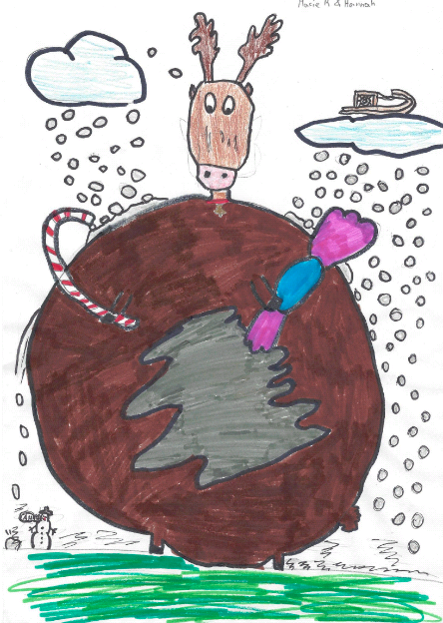
Oh oh oh oh oh oh Oh oh oh oh oh oh Oh oh oh oh oh oh You’re gonna see me soar Oh oh oh oh oh oh Oh oh oh oh oh oh Oh oh oh oh oh oh You’re gonna see me soar So-oar, so-oar, so-oar, so-oar, so-oar

Slide 12
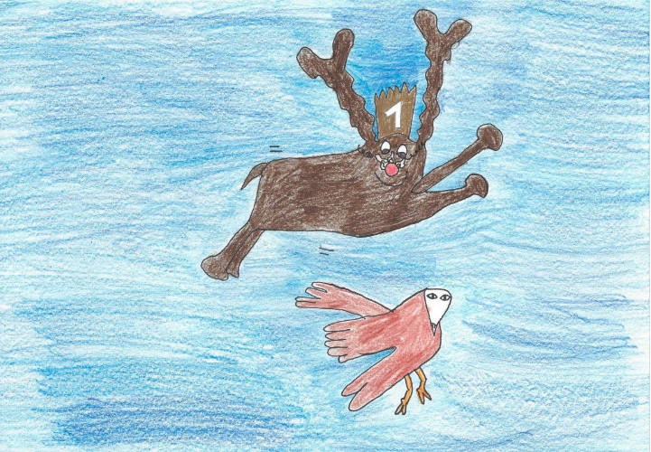
My nose shines bright like a fire, a flier
Raising through the sky-a Cause I am a champion
And you’re gonna see me soar
Higher, higher than an eagle Cause I am a champion
And you’re gonna see me soar

Slide 13
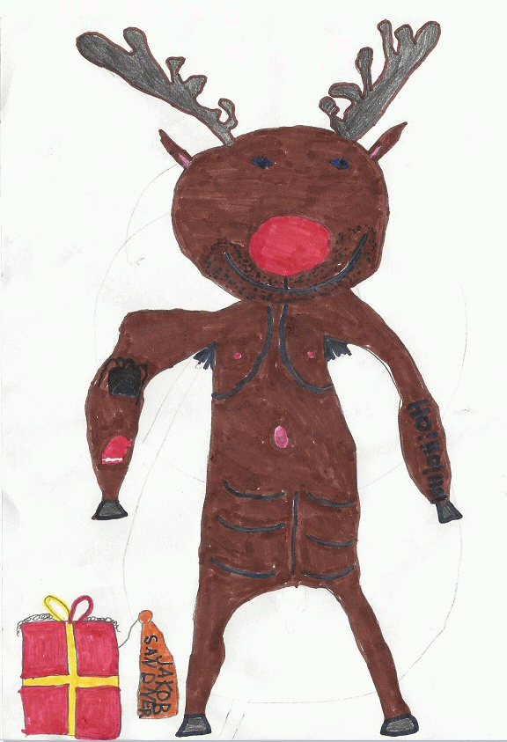
Oh oh oh oh oh oh Oh oh oh oh oh oh Oh oh oh oh oh oh You’re gonna see me soar
Oh oh oh oh oh oh Oh oh oh oh oh oh Oh oh oh oh oh oh You’re gonna see me soar

