Slide 1
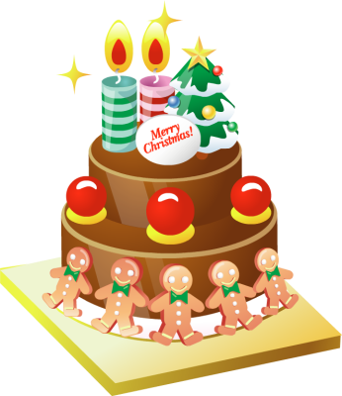
1B Active English All about that Cake

Slide 2
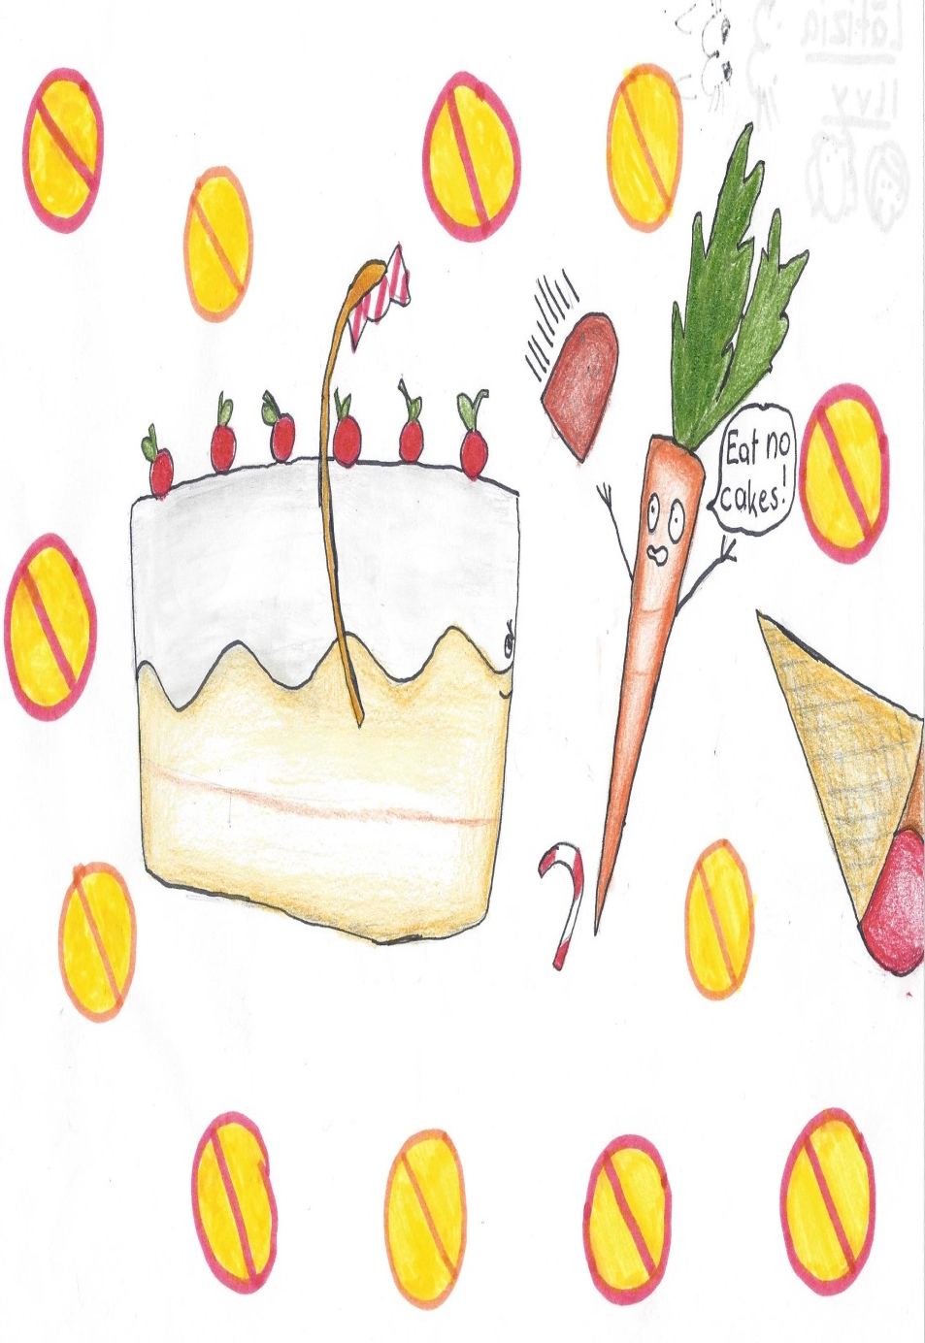
Because you know
I'm all about that cake
'Bout that cake, no carrots
I'm all about that cake
'Bout that cake, no carrots
I'm all about that cake
'Bout that cake, no carrots
I'm all about that cake
'Bout that cake

Slide 3
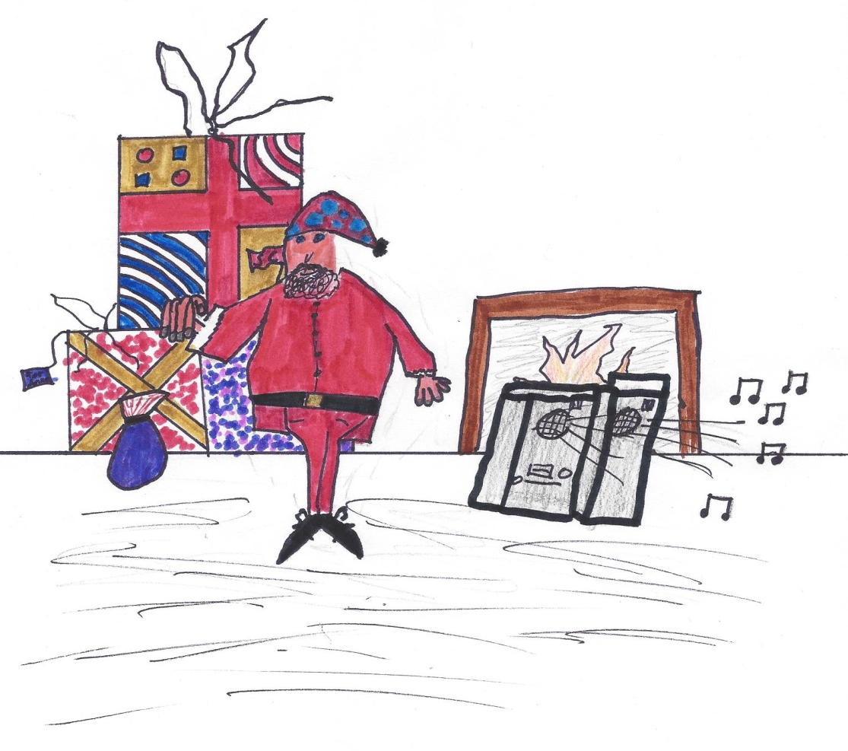
Yeah, it's pretty clear, I ain't no size two But I can shake it, shake it
Like I'm supposed to do I got that belly like a bowl full o’ jelly
And all the right jiggle, with the right wiggle

Slide 4
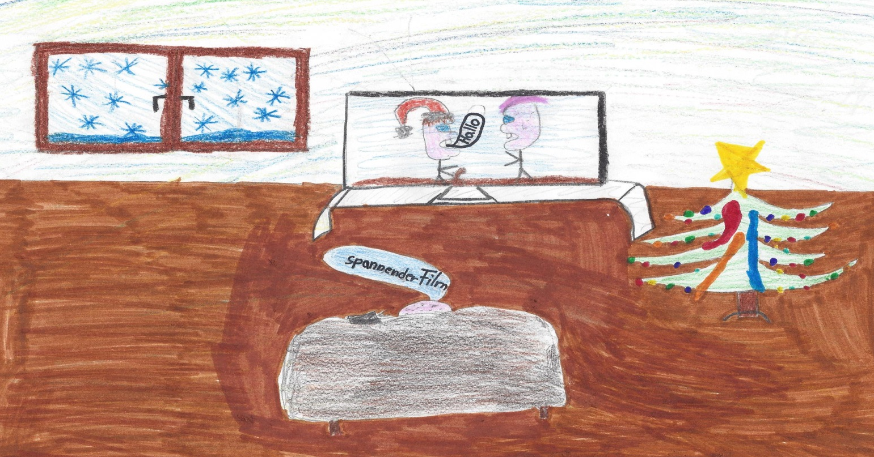
I see pictures of skinny me on TV
We know the pics ain’t real
C’mon now, make it stop
If you got tummy, tummy, just raise ‘em up
‘cause every inch of me is perfect from the bottom to the top

Slide 5
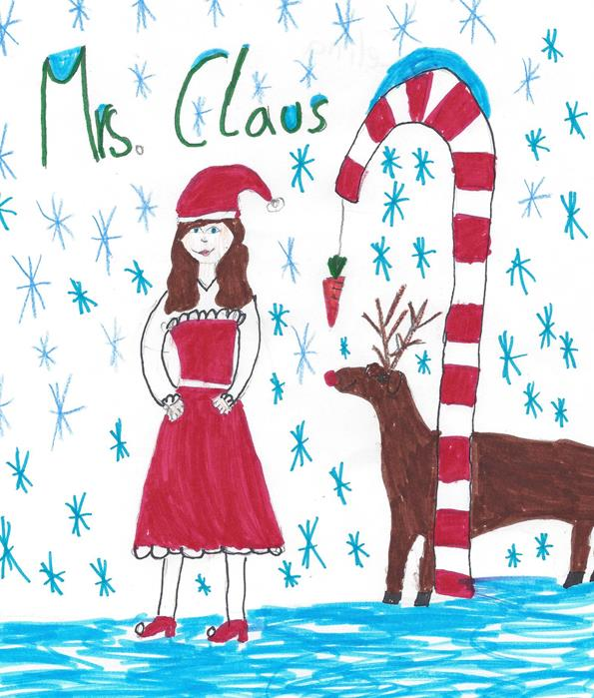
Yeah, Mrs. Claus told me don’t worry about your size
She says, “Kids like a little more cushion to sit on, right.”

Slide 6
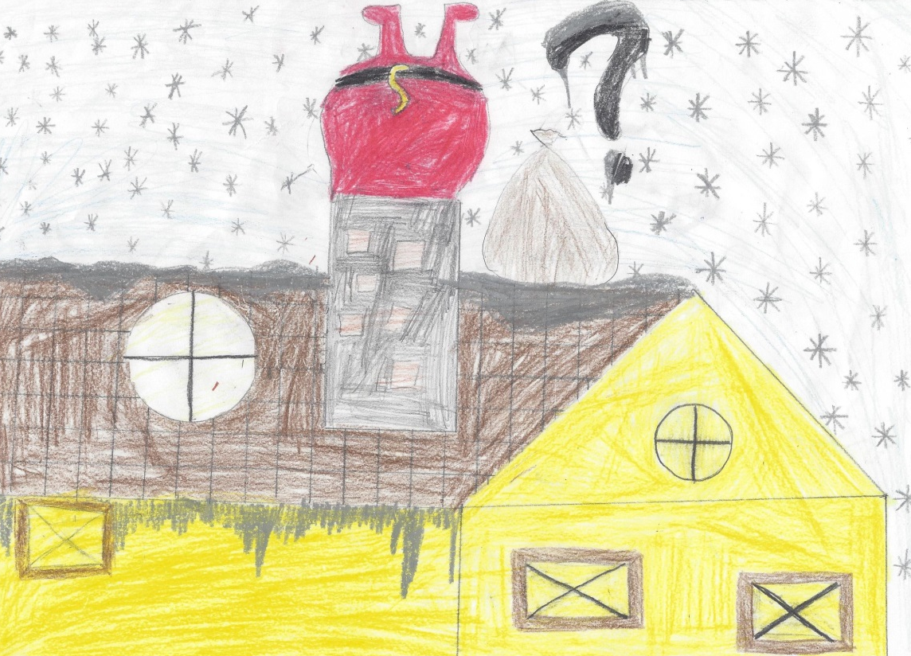
You know as long as I can fit down the chimney I’m happy
And if the reindeer can still pull the sleigh we’ll be more than okay

Slide 7
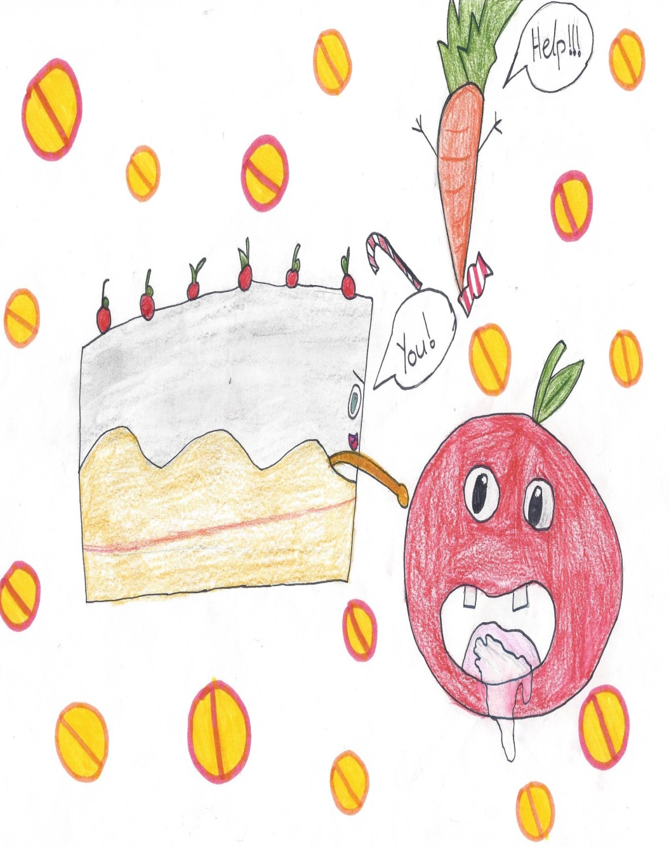
Because you know
I'm all about that cake
'Bout that cake, no apples
I'm all about that cake
'Bout that cake, no apples
I'm all about that cake
'Bout that cake, no apples
I'm all about that cake
'Bout that cake
Hey!

Slide 8
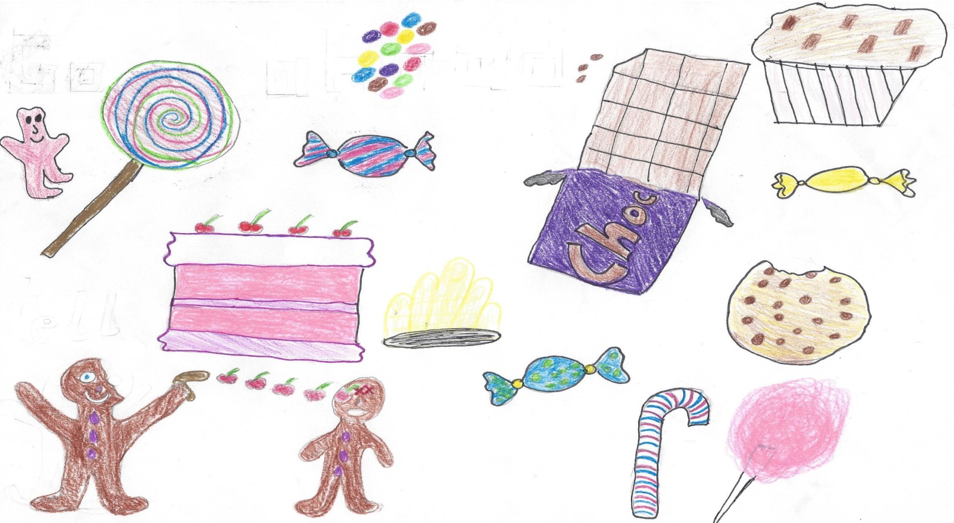
I’m bringing Christmas back
Go ahead and tell the kids to put out sweets
Now, I know you agree with me

Slide 9
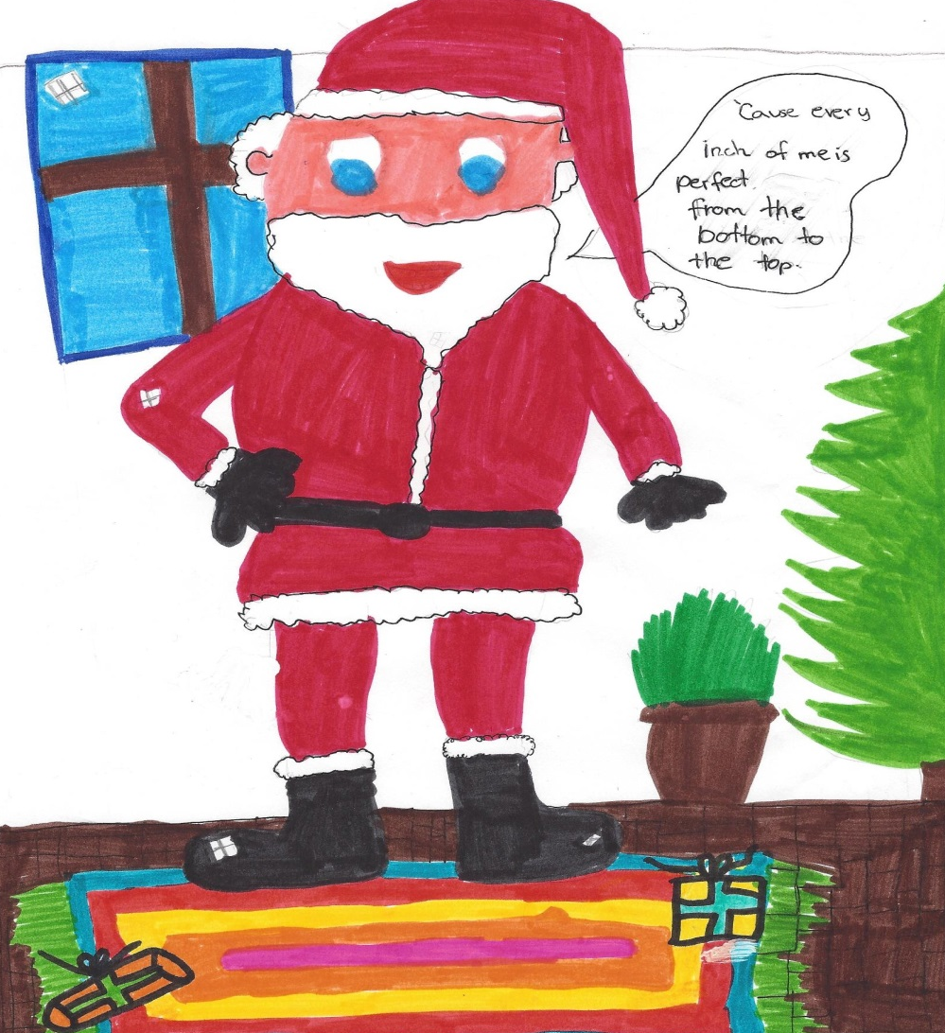
But I'm here to tell ya
Every inch of me is perfect from the bottom to the top

Slide 10
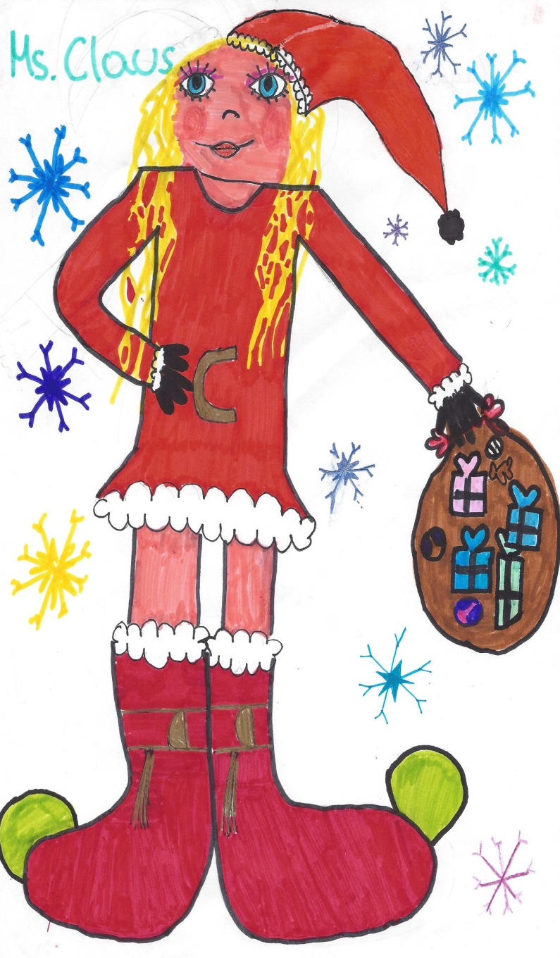
Yeah, Mrs. Claus told me don’t worry about your size
She says, “Kids like a little more cushion to sit on, right.”

Slide 11
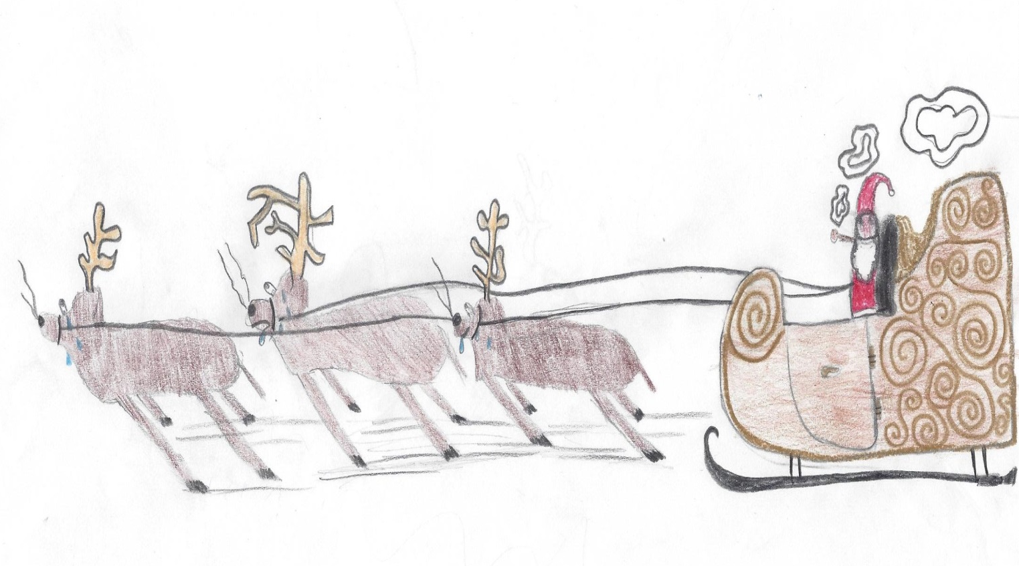
You know as long as I can fit down the chimney I am happy
And if the reindeer can still pull the sleigh we’ll be more than okay

Slide 12
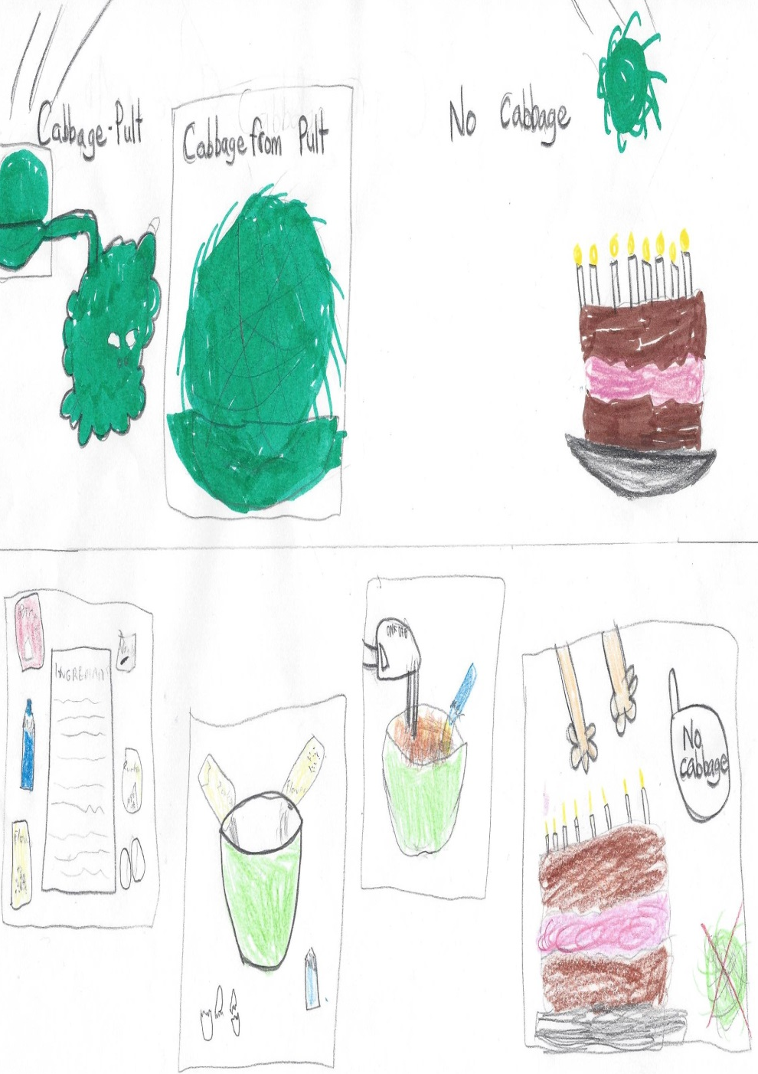
Because you know
I'm all about that cake
'Bout that cake, no cabbage
I'm all about that cake
'Bout that cake, no cabbage
I'm all about that cake
'Bout that cake, no cabbage
I'm all about that cake
'Bout that cake

Slide 13
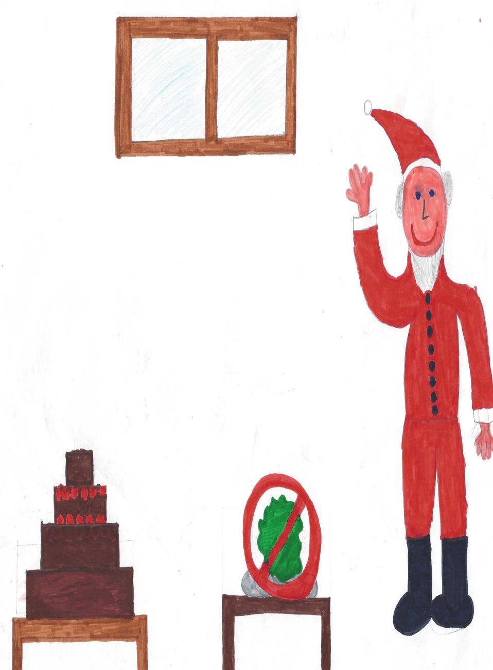
Because you know
I'm all about that cake
'Bout that cake, no spinach
I'm all about that cake
'Bout that cake, no spinach
I'm all about that cake
'Bout that cake, no spinach
I'm all about that cake
'Bout that cake

Slide 14
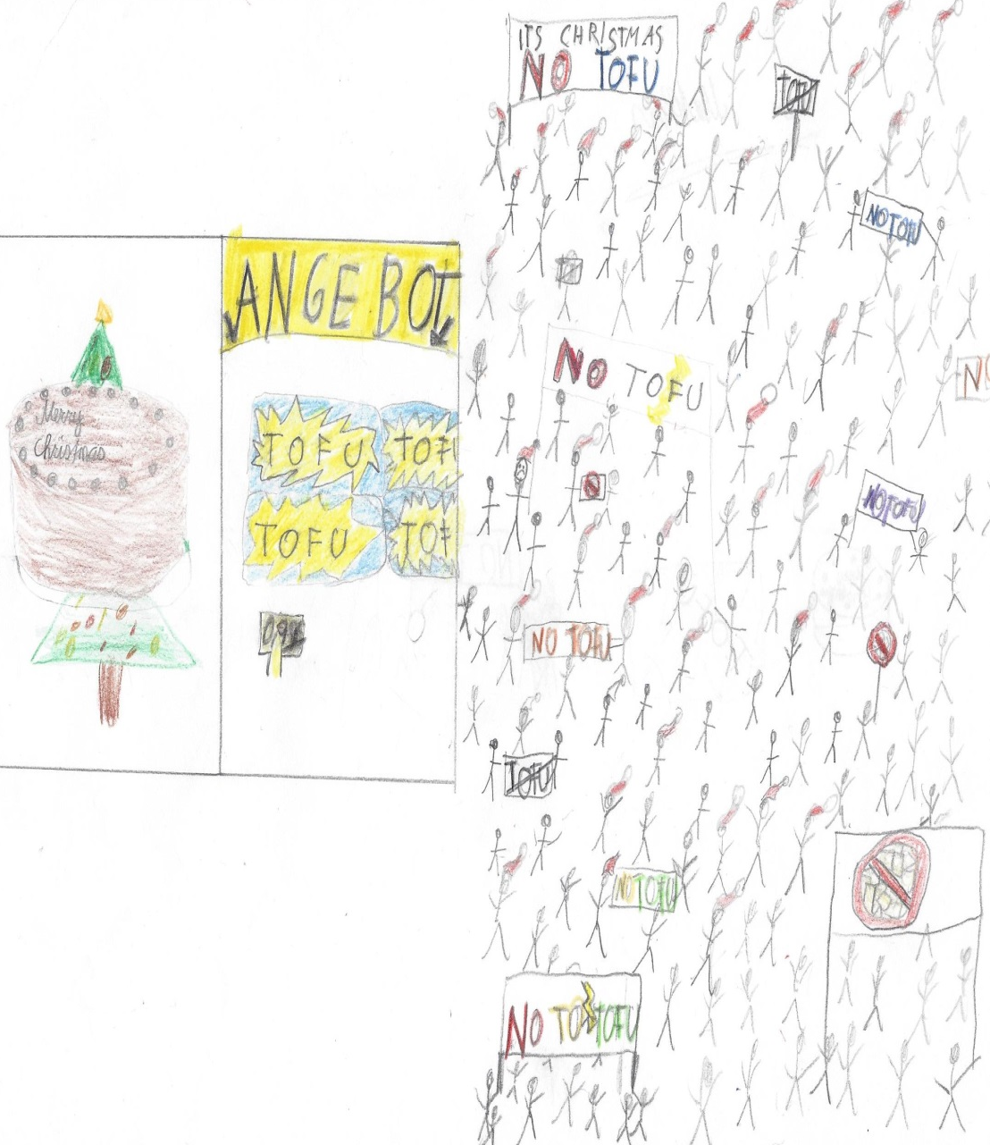
Because you know
I'm all about that cake
'Bout that cake, no tofu
I'm all about that cake
'Bout that cake, no tofu
I'm all about that cake
'Bout that cake, no tofu
I'm all about that cake
'Bout that cake

Slide 15
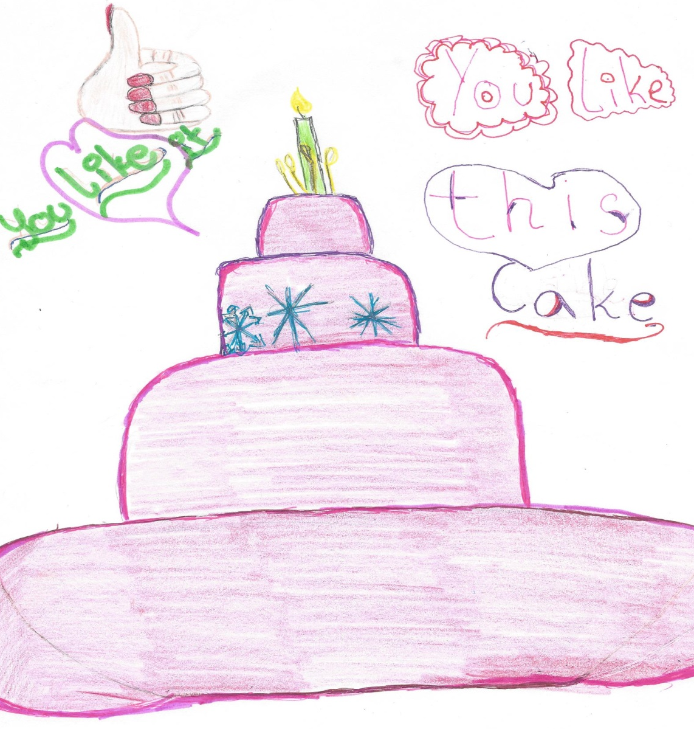
‘Bout that cake, ‘bout that cake
Hey, hey, ho, ho
You know you like this cake

