Slide 1
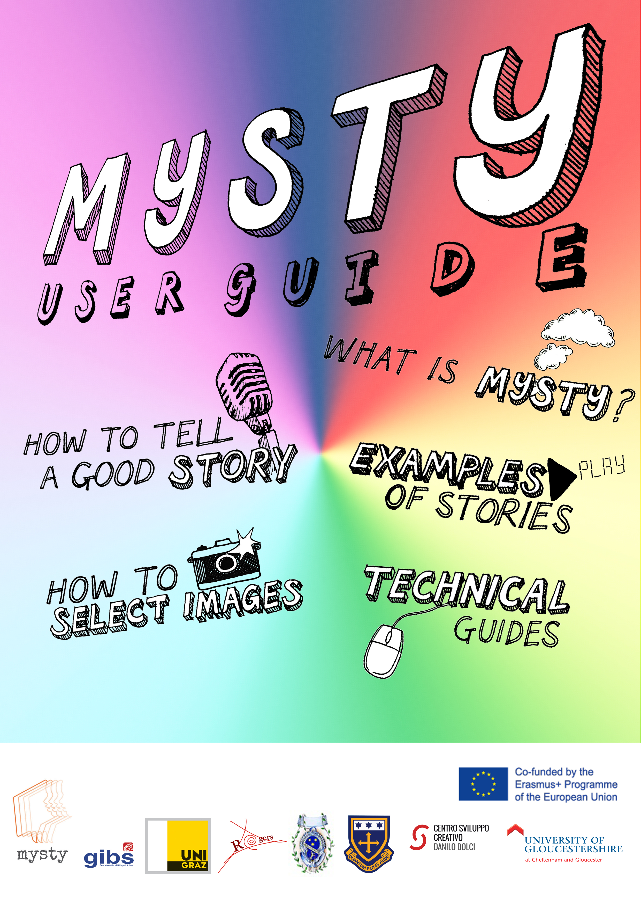
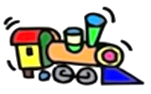

Slide 2

https://mysty.eu/

Slide 3
Goal of MYSTY Project
To encourage teachers and pupils to use digital technology and storytelling as fun educational tools, with the aim to increase everyone’s awareness of cultural diversity within society.

Slide 4
Pedagogical benefits 1/2
Language skills – e.g. writing and speaking
Media literacy/IT skills
e.g. recording audio, editing video
Internet literacy
e.g. publishing and sharing a video, copyright laws
Awareness raising (cultural, historical, … diversity)
e.g. other classmates‘ stories

Slide 5
Pedagogical benefits 2/2
Own (family) history/intergenerational aspect e.g. photo album, grandparents
Social skills
e.g. collaborating with others
Final product – being proud of end result
…and probably more

Slide 6
Example videos
Theme: Family, Food, Festivals
“A Special present” by Anna
“My aunt: a brave woman” by Kalkidan

Slide 7
Goal for today
Produce a story
Showcase some of them at the end
Important: share sth. you feel comfortable sharing

Slide 8
Technical showcase https://www.knovio.com

Slide 9
Recording devices
Mobile device (phone, tablet, …)
Laptop
External USB microphones
  e.g. Blue Nessie: https://www.amazon.de/dp/B00BUIA362

Slide 10
Have you got internet access?
EDUROAM instructions:
https://it.uni-graz.at/en/instructions/?tx_news_pi1%5BoverwriteDemand%5D%5Bcategories%5D%5B%5D=422,436

Slide 11
Next steps…
Brainstorm some ideas (handout)
Develop 2-3 story ideas (index cards)
Choose the best story, write a script
Select (personal) images, record voice-over
Edit video and finalize it
Show to friends and family!

Slide 12
Materials
Pupil‘s guide on USB
Consent forms (copyright) on USB
https://mysty.eu/

