Slide 1

MyStory: Digital Storytelling Toolbox for Diversity Training in Schools
Elisabeth Pölzleitner, Andreas Schuch, Robert Kozak
GIBS Graz
Hermine Penz and Roberta Maierhofer
University of Graz
Erasmus+ Project

Slide 2
MyStory’ (MYSTY)
MyStory’ (MYSTY): Erasmus+ funded Digital Storytelling project focused on migration and minority experiences.
  8 partners:
  2 universities, 4 secondary schools and 2 NGOs across 4 countries (Austria, Italy, Hungary and the UK)
  It involves the collection, editing and uploading of digital stories to a Digital Storytelling Toolbox website
  The stories focus on ‘food’, ‘family’ and ‘festival’ and act as a platform for diversity awareness and digital upskilling.
Links:
  http://ec.europa.eu/programmes/erasmus-plus/projects/eplus-project-details/#project/cadc5b24-3421-47d8-b028-7ac554763a81
  Website (will be launched officially in June 2018): http://mysty.eu/

Slide 3
MYSTY seeks to bring the participating organizations together to develop and share practice, in order to produce resources that other schools can use.
This will enable teachers across the EU to develop a shared understanding of the key issues, which will help them in their practice.
With a network of teachers, media and education academics, and technicians, the main objective of MYSTY project is to create an online resource called the MYSTY Digital Storytelling Toolbox.

Slide 4
The MYSTY Project
Objectives:
The MYSTY project aims to create digital storytelling as an innovative tool for pupils and teachers
to share and introduce this teaching practice to enhance awareness on diversity within the school environment
Subgoals:
  1) Develop Curriculum Integration Methodologies to support school use of a Digital Story Toolbox (developed in the project)
  2) Create a Pupil Guide for Digital Storytelling to facilitate the creation of digital stories
  3) Produce a Collection of Themed Digital Stories for use in school and community settings

Slide 5
What is digital storytelling?
Combines storytelling with digital media, including text, pictures, audio recordings of narration, music and video
Small-scale and easy to produce, i.e. simple technology (2-5 minutes length)
Focus on both producing and sharing the story with others
Types of digital stories (Robin 2016):
  1) personal narratives (relating incident in one’s life)
  2) historical documentaries (stories that examine dramatic event to help us understand the past)
  3) instructional stories (inform or instruct on a particular concept or practice)

Slide 6
Development of digital storytelling (see Lundby 2008)
New media practice of digital storytelling was taken up by the BBS in Wales in 2001: ‘Capture Wales’ (http://www.bbc.co.uk/wales/audiovideo/sites/galleries/pages/capturewales_memory.shtml)
This small-scale media movement spread to England, Scandinavia, Australia, etc.
Center for Digital Storytelling in California – ‘Capture Wales’ is used as background to founders’ own domestic experiences in
Australia (Hartley and McWilliam 2009).
‘London Voices’ Project of the Museum of London (oral-history project; ordinary people’s stories)

Slide 7
Method
1. Brainstorm story ideas
2. Develop two or three story ideas (e.g. on index cards)
3. Choose best story & present to peers/teacher for feedback
4. Write full story script
5. Select (personal) images and create story board
6. Record voice-over
7. Create and edit video and put on any finishing touches
8. Watch digital story with friends, family, in class

Slide 8
Digital Stories - GIBS

Slide 9
Digital Stories
My aunt – a brave woman (GIBS)
  https://www.youtube.com/watch?v=0D8-XMXiXc4
Acapulco Family (GIBS)
  https://www.youtube.com/watch?v=h8AF0z2Dzgc&feature=youtu.be
A castle in Misilmeri
  https://www.youtube.com/watch?v=ff4wJt2d7VY&index=18&list=UUn3JyTy6LQXKfFfU0Pn5DUg
My mum’s travels as a child (St. Edwards School)
  https://www.youtube.com/watch?v=y-aKyk5dPgs
Sicillian Panelle
  https://www.youtube.com/watch?v=zeOhLRwh1W0

Slide 10
Outcomes/Pedagogical benefits
• Improving language skills
• Developing media literacy, internet literacy and IT skills
• Raising awareness about cultural, historical, … diversity
• Intergenerational aspects (e.g. story about grandparent)
• Developing social skills (collaboration)
• Engaging in a subject matter, e.g. environment
• Feeling proud of final product
Etc.

Slide 11
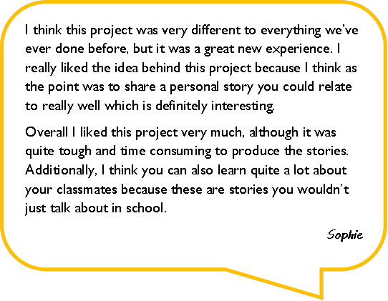
Pupils’ comments
I personally really liked this project. Coming up with a good story idea was like exploring my memories and going through all these awesome moments I have spent with my family.
Here’s what I loved about this very project: not only thinking about it, or giving it small thoughts all the time, speaking loud and clearly while recording and then editing my story, but also the memories that came to my mind while producing it.
Matteo

Slide 12
References
Hartley, John and Kelly McWilliam (2009). Story Circle: Digital Storytelling Around the World. Malden, MA/Oxford: Blackwell.
Lambert, Joe (2002). Digital storytelling cookbook. Retrieved from: https://wrd.as.uky.edu/sites/default/files/cookbook.pdf .
Lundby, Knut, ed. (2008). Digital Storytelling, Mediatized Stories. Self-representation in New Media. New York, etc.: Peter Lang.
Robin, Bernhard R. (2006). “The educational uses of digital storytelling.” In: Crawford, C. et al., eds. Proceedings of Society for Information Technology and Teacher Education International Conference 2006. Chesapeake, VA: AACE, 709-716.
Robin, Bernhard R. (2016). “The Power of Digital Storytelling to Support Teaching and Learning.” Digital Education Review 30 (December 2016). http://greav.ub.edu/der/ .

