Slide 1
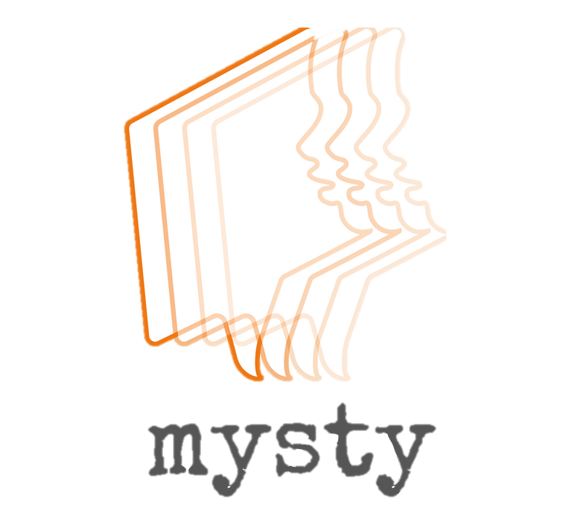
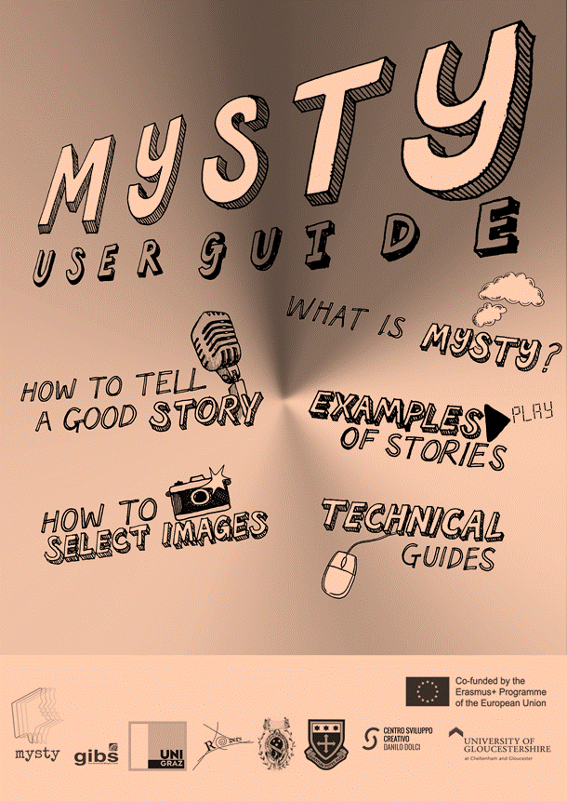
https://mysty.eu/

Slide 2
Goal of the MYSTY Project
To encourage teachers and pupils to use digital technology and storytelling as fun educational tools, with the aim to increase everyone’s awareness of cultural diversity within society.

Slide 3
Pedagogical benefits 1/2
Language skills – story writing, speaking, register
Awareness raising (cultural, historical, … diversity)
e.g. other classmates‘ stories – stories of the other project partners
Personal (family) history/intergenerational aspect e.g. photo album, grandparents
Social skills and confidence as active participants in society
e.g. collaborating with others, sharing the stories with a wider audience
Sense of ownership (being proud of the result)

Slide 4
Pedagogical benefits 2/2
Media literacy/IT skills
e.g. recording audio, editing video
Internet literacy
e.g. publishing and sharing a video, copyright laws

Slide 5
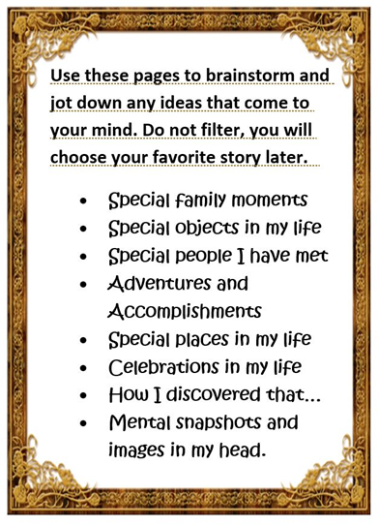
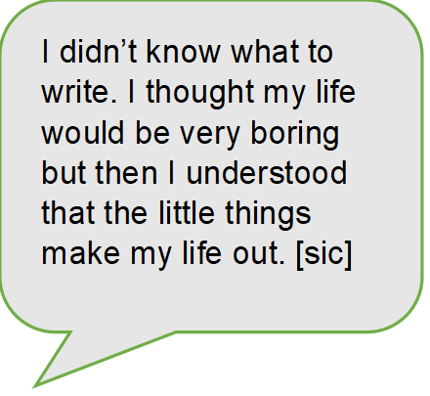
Project steps
Brainstorm some ideas (handout)
1
Develop 2-3 story ideas (index cards)
2
Choose the best story, write a script
3
Select (personal) images, record voice-over
4
Edit video and finalize it
5
Show to friends and family!
6

Slide 6
Recording devices
Mobile devices: (phone, tablet)
Laptop
optional:
External USB microphones
e.g. Blue Nessie: https://www.amazon.de/dp/B00BUIA362

Slide 7
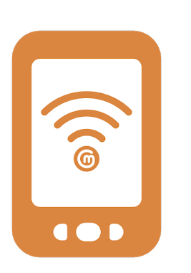
Some software options
Knovio.com
https://www.knovio.com
Com phone (Android app)
Shotcut (PC)

Slide 8
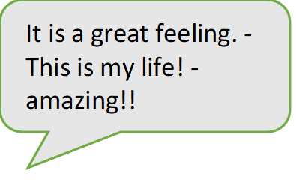
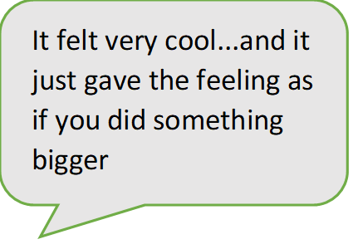
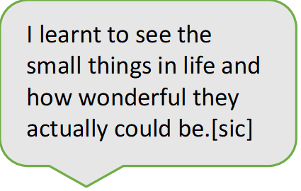
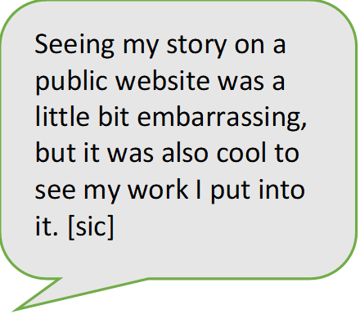
Pupil user guides and personal thoughts about the project

Slide 9
I personally really liked this project, and the fact that I like telling stories is not the only reason for that. Coming up with a good story idea was like exploring my memories and going through all these awesome moments I have spent with my family. This was probably the part of the project that took up the most time for me. However, when I finally had some ideas it was quite obvious which of the ideas I would choose to make a good story. I took the story that had most to do with my relation to my family. The story that is very important for me in my life.
I specifically liked this project, because it really had to do with one’s personal opinions and stories, but also because I could choose the story I would later work on, on my own. And this was actually the hardest part of the whole project: Finding a personal story which is interesting and still not too personal. As a matter of fact, for me this wasn’t very easy, but as soon as I had an idea that fit, the project became quite simple and also fun, except for a few technical issues you’ll read about later…
For me it was pretty hard to come up with a good idea for my story. When I first started thinking about what would fit to the topic “family” I thought to write about my grandfather in World War II because it is a very important aspect in my family and I wasn’t sure if I had anything else to tell which would be really interesting. Then I realized that it wasn’t about a great plot but about something that I could really tell others because I can identify with the story. So I asked my parents for advice and together we came up with an idea for my final story. Finding the right pictures for my story was hard as well and I’m still not quite satisfied with my choice. Mainly I took my own photos of objects that have something to do with my story, because it makes the story more personal if you have your own pictures.

Slide 10
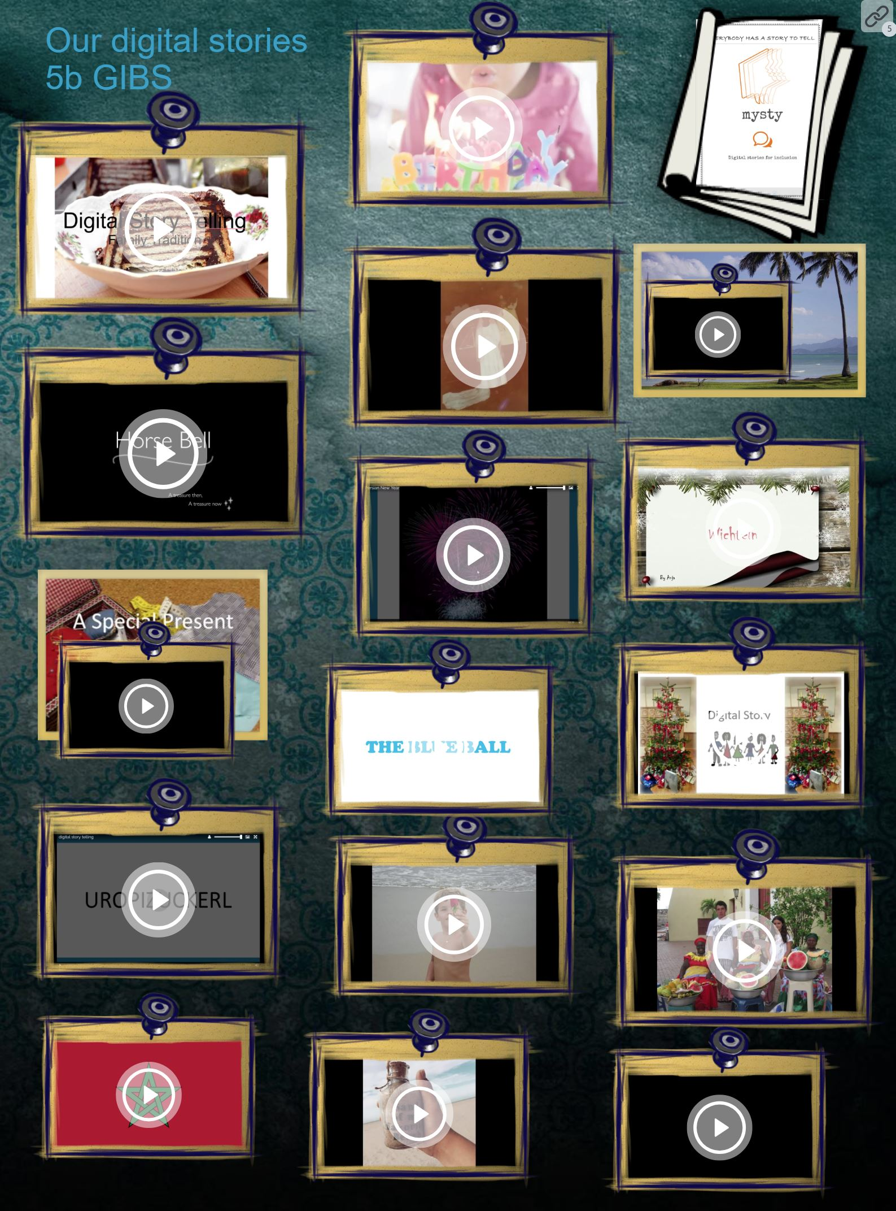
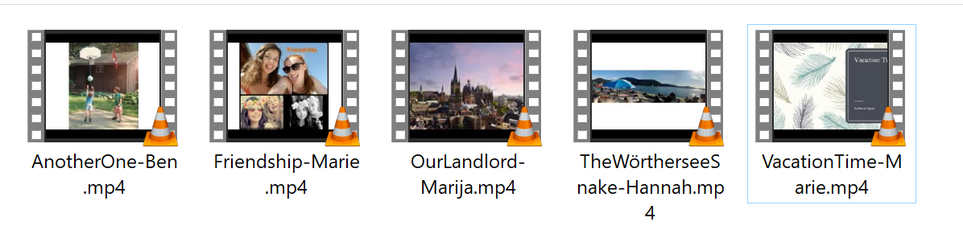
Some of the stories…

Slide 11
For more info read our USER GUIDE or explore the project website
https://mysty.eu/

Slide 12
