Slide 1

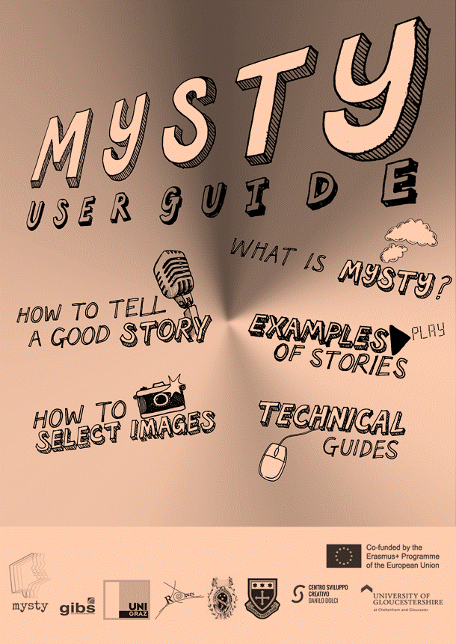
https://mysty.eu/

Slide 2
Overview: What to expect…
Concepts and theoretical aspects of DS in education
Project goals
Methods used in class
Step-by-step
Student reactions and
Conclusions
Screening of sample videos

Slide 3
Development of digital storytelling
(see Lundby 2008)
New media practice of digital storytelling was taken up by the BBC in Wales in 2001: ‘Capture Wales’ (http://www.bbc.co.uk/wales/audiovideo/sites/galleries/pages/capturewales_memory.shtml)
This small-scale media movement spread to England, Scandinavia, Australia, US, etc.
Center for Digital Storytelling in California – ‘Capture Wales’ is used as background to founders’ own domestic experiences in
Australia (Hartley and McWilliam 2009).
‘London Voices’ Project of the Museum of London (oral-history project; ordinary people’s stories)

Slide 4
My Story: MYSTY
In this presentation we will focus on the project that was done in a secondary school in Austria.
MyStory’ (MYSTY): Erasmus+ funded Digital Storytelling project focused on migration and minority experiences.
  8 partners:
  2 universities, 4 secondary schools and 2 NGOs across 4 countries (Austria, Italy, Hungary and the UK)
  It involves the collection, editing and uploading of digital stories to a Digital Storytelling Toolbox website
  The stories focus on ‘food’, ‘family’ and ‘festival’ and act as a platform for diversity awareness and digital upskilling.

Slide 5
MYSTY: Objectives
To encourage teachers and pupils to use digital technology and storytelling as fun educational tools, with the aim to increase everyone’s awareness of cultural diversity within society.
The MYSTY project aims to create digital storytelling as an innovative tool for pupils and teachers
to share and introduce this teaching practice to enhance awareness on diversity within the school environment
Subgoals:
  Develop Curriculum Integration Methodologies to support school use of a Digital Story Toolbox (developed in the project)
  Create a Pupil Guide for Digital Storytelling to facilitate the creation of digital stories
  Produce a Collection of Themed Digital Stories for use in school and community settings

Slide 6
DS in Education: types of stories
DS produced in the California tradition:
short, focused, 2-5 min
still visuals
producer‘s own voiceover
personal point of view
often emotional account
simple digital technology
published online
Other types of DS:
historical documentaries examining dramatic events
stories that inform or instruct
creative stories, illustrated and read by the writers
Notes:
der zweite Pfeil bei „creative stories…“ bedeutet: das hat die Klasse vorher schon gemacht – in einem anderen Projekt. (Vorerfahrung)

Slide 7
DST in Education
Application at all levels of education (primary, secondary, tertiary, further education)
Instructional tool and/or creative production of students‘ own stories
Pedagocial uses:
  Media literacy
  Other literacy skills: writing, speakig and listenting, presentation skills, research skills, composition
  Teaching groups of diverse learners
  Diversity education/intercultural awareness

Slide 8
Intercultural Competence
CEFR about intercultural competence
Byram‘s Model of assessing intercultural competence
Attitudes: curiosity and openness, readiness to suspend disbelief about other cultures and belief about one’s own;
Knowledge: of social groups and their products and practices in one’s own and in one’s interlocutor’s country, and of the general processes of societal and individual interaction;
Skills of interpreting and relating: ability to interpret a document or event from another culture, to explain it and relate it to documents or events from one’s own;
Skills of discovery and interaction: ability to acquire new knowledge of a culture and cultural practices, and the ability to operate knowledge, attitudes and skills under the constraints of real-time communication and interaction;
Critical cultural awareness/political education: an ability to evaluate critically and on the basis of explicit criteria perspectives, practices and products in one’s own and other cultures and countries (Byram, 2000)
…in an intercultural approach, it is a central objective of language education to promote the favourable development of the learner‘s whole personality and sense of identity in response to the enriching experience of otherness in language and culture.
(Council of Europe, 2001, 1)

Slide 9
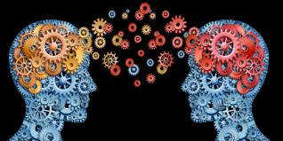
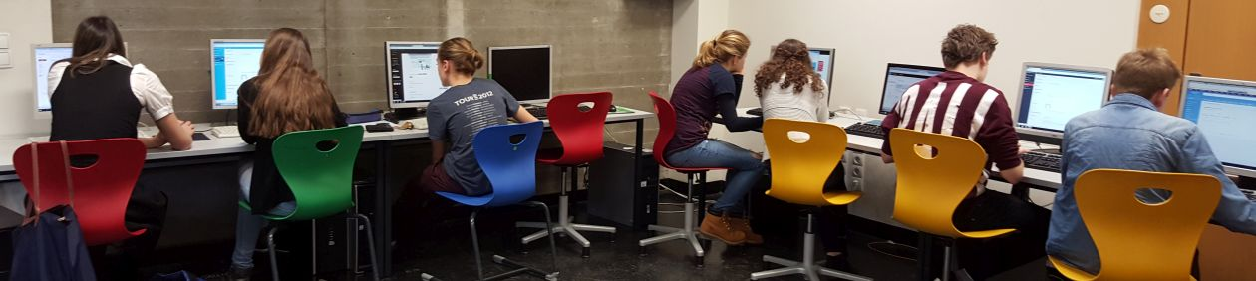

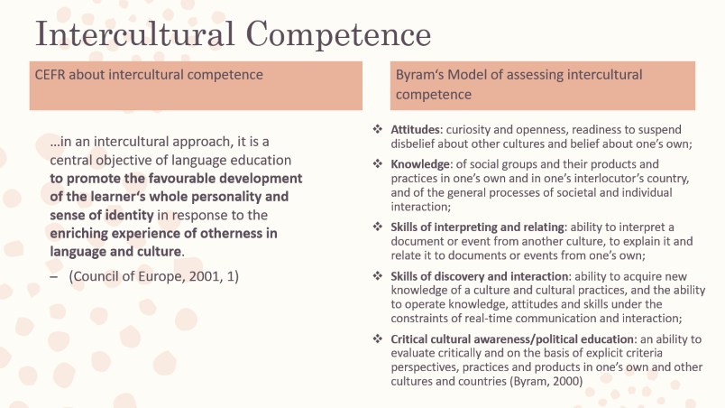
Main project goals in school
Engagement happens when a lesson captures students‘ imaginations, snares their curiosity, ignites their opinions, or taps into theirsould. Engagement is the magnet that attracts learners‘ meandering attention and holds it so that enduring learning can occur. (Tomlinson, 2014)
to raise the learners’ awareness of cultural aspects of their everyday lives and the people around them
to improve the learners’ interpersonal and social skills (ToM, Kidd and Castano, 2018)
to develop the learners’ sense of ownership and engagement with their work (Tomlinson, 2014) (Zull, 2002)
to increase the learners’ confidence as active participants in society (in the real and virtual world)
to improve the learners’ story-writing skills and speaking skills in English (L2)
to further develop the learners’ digital skills
Engagement
Acetylcholine
Durable synapse connections

Slide 10
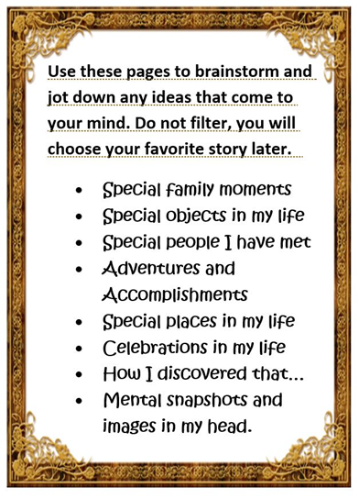
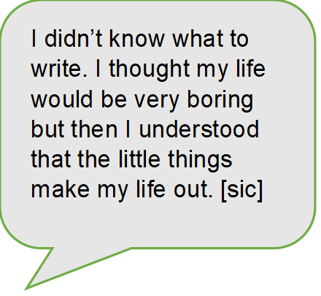
Project steps
Brainstorm some ideas (handout)
1
Develop 2-3 story ideas (index cards)
2
Choose the best story, write a script
3
Select (personal) images, record voice-over
4
Edit video and finalize it
5
Show to friends and family!
6

Slide 11
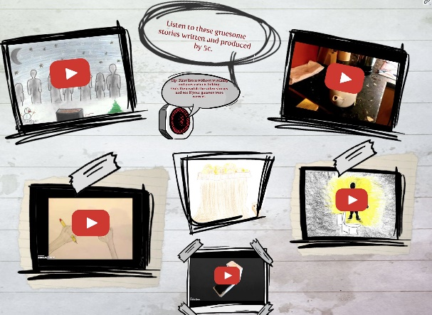
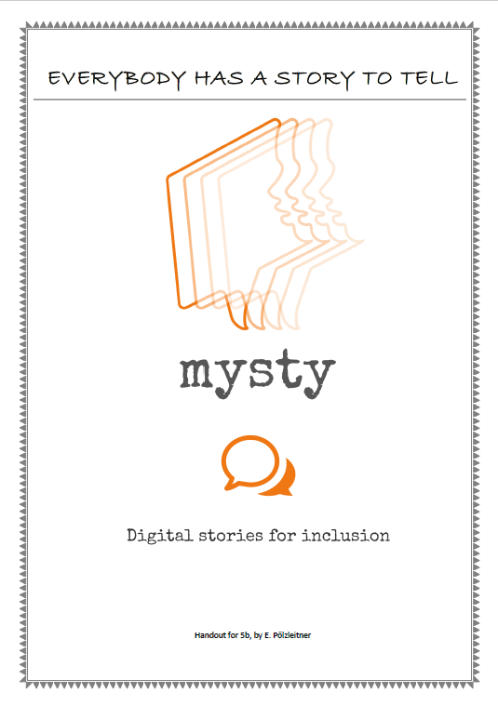
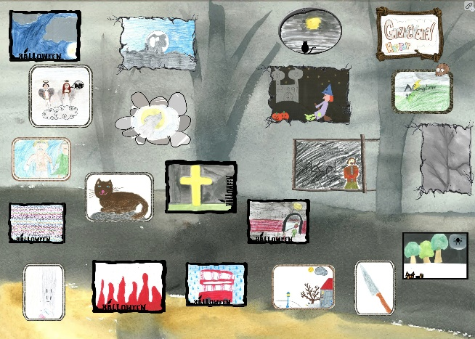
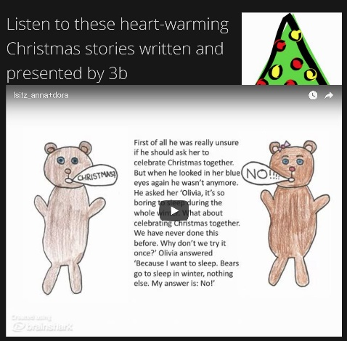
Step 1: What makes a good story?
„The Ship“, Joseph Bruchac
[T]he boat was full of mothers and children. […] All around were children my age, younger, older, in varying degrees of happiness and sorrow, good clothing and bad, clean faces and dirty. And each of them was waving, thinking the returned wave from the shore was for themselves alone.” (Bruchac, 1983, 60)

Slide 12
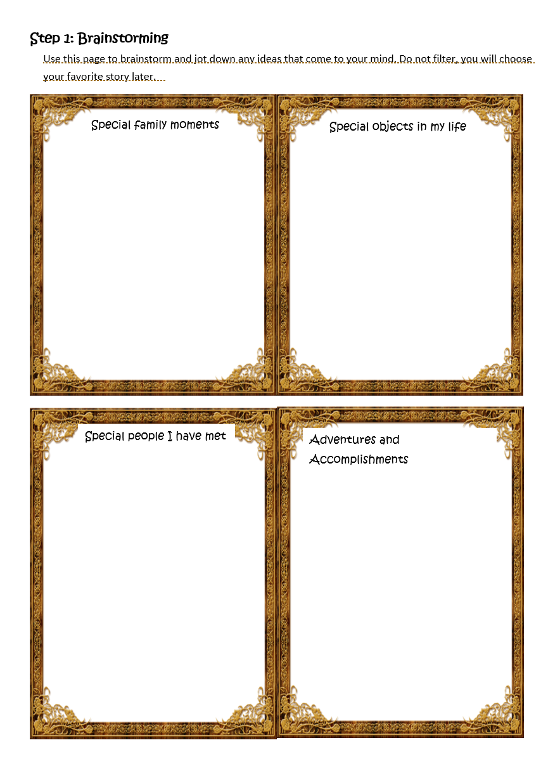
Step 2: Finding your stories
Brainstorming special moments
Finding memory props
Writing story seeds on index cards

Slide 13

Step 3: Choosing the best stories
First, I didn‘t know what to write. I thought my life would be very boring but then I understood that the little things make my life out. [sic]
What do you think the story means? What is it really about?
What is the most important moment in the story? What is this moment about? Did anything change? Did you learn or realize anything new? Can you describe the moment in more detail?
What emotions are connected to this story?

Slide 14
Step 4: Writing the stories
Questions for revising the stories
Challenges
Have I managed to get my emotions across?
Am I focusing on the right things?
Is anything unclear or confusing?
How could I restructure my story in order to make it more interesting and effective?
tone and register (writing for oral delivery)
expressing emotions (showing rather than telling)

Slide 15
Step 5: Producing the stories
Storyboarding
Voicerecording
Mobile devices: (phone, tablet)
Laptop
optional:
External USB microphones
e.g. Blue Nessie: https://www.amazon.de/dp/B00BUIA362

Slide 16

Some software options
Knovio.com
https://www.knovio.com
Com phone (Android app)
Shotcut (PC)

Slide 17
Step 6: Writing the pupil user guides
How to come up with a good story idea
How to find the right pictures
Choosing the right software (pros and cons of the programs they had used)
Personal thoughts about the project

Slide 18
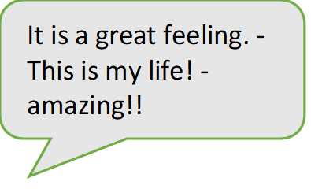
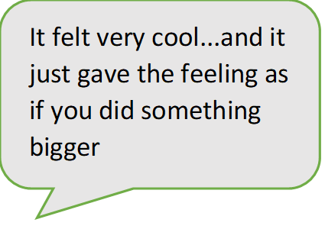
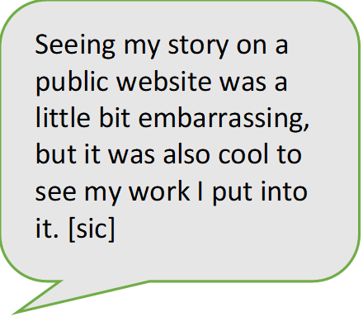
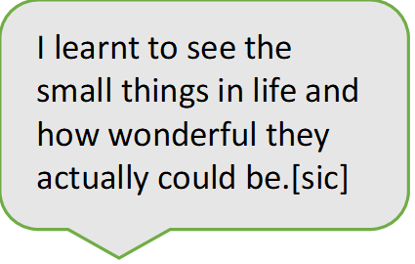
… personal thoughts about the project

Slide 19
I personally really liked this project, and the fact that I like telling stories is not the only reason for that. Coming up with a good story idea was like exploring my memories and going through all these awesome moments I have spent with my family. This was probably the part of the project that took up the most time for me. However, when I finally had some ideas it was quite obvious which of the ideas I would choose to make a good story. I took the story that had most to do with my relation to my family. The story that is very important for me in my life.
I specifically liked this project, because it really had to do with one’s personal opinions and stories, but also because I could choose the story I would later work on, on my own. And this was actually the hardest part of the whole project: Finding a personal story which is interesting and still not too personal. As a matter of fact, for me this wasn’t very easy, but as soon as I had an idea that fit, the project became quite simple and also fun, except for a few technical issues you’ll read about later…
For me it was pretty hard to come up with a good idea for my story. When I first started thinking about what would fit to the topic “family” I thought to write about my grandfather in World War II because it is a very important aspect in my family and I wasn’t sure if I had anything else to tell which would be really interesting. Then I realized that it wasn’t about a great plot but about something that I could really tell others because I can identify with the story. So I asked my parents for advice and together we came up with an idea for my final story. Finding the right pictures for my story was hard as well and I’m still not quite satisfied with my choice. Mainly I took my own photos of objects that have something to do with my story, because it makes the story more personal if you have your own pictures.

Slide 20
I personally really liked this project. Coming up with a good story idea was like exploring my memories and going through all these awesome moments I have spent with my family.
I think this project was very different to everything we‘ve ever done before, but it was a great new experience. I really liked the idea behind htis project because I think as the point was to share a personal story you could relate to really well which is definitely interesting.
Overall, I liked this project very much, although it was quite tough and time consuming to produce the stories. Additionally, I think you can also learn quite a lot about your classmates because these are stories you wouldn‘t just talk about in school.
Here’s what I loved about this very project: not only thinking about it, or giving it small thoughts all the time, speaking loud and clearly while recording and then editing my story, but also the memories that came to my mind while producing it.
Matteo

Slide 21
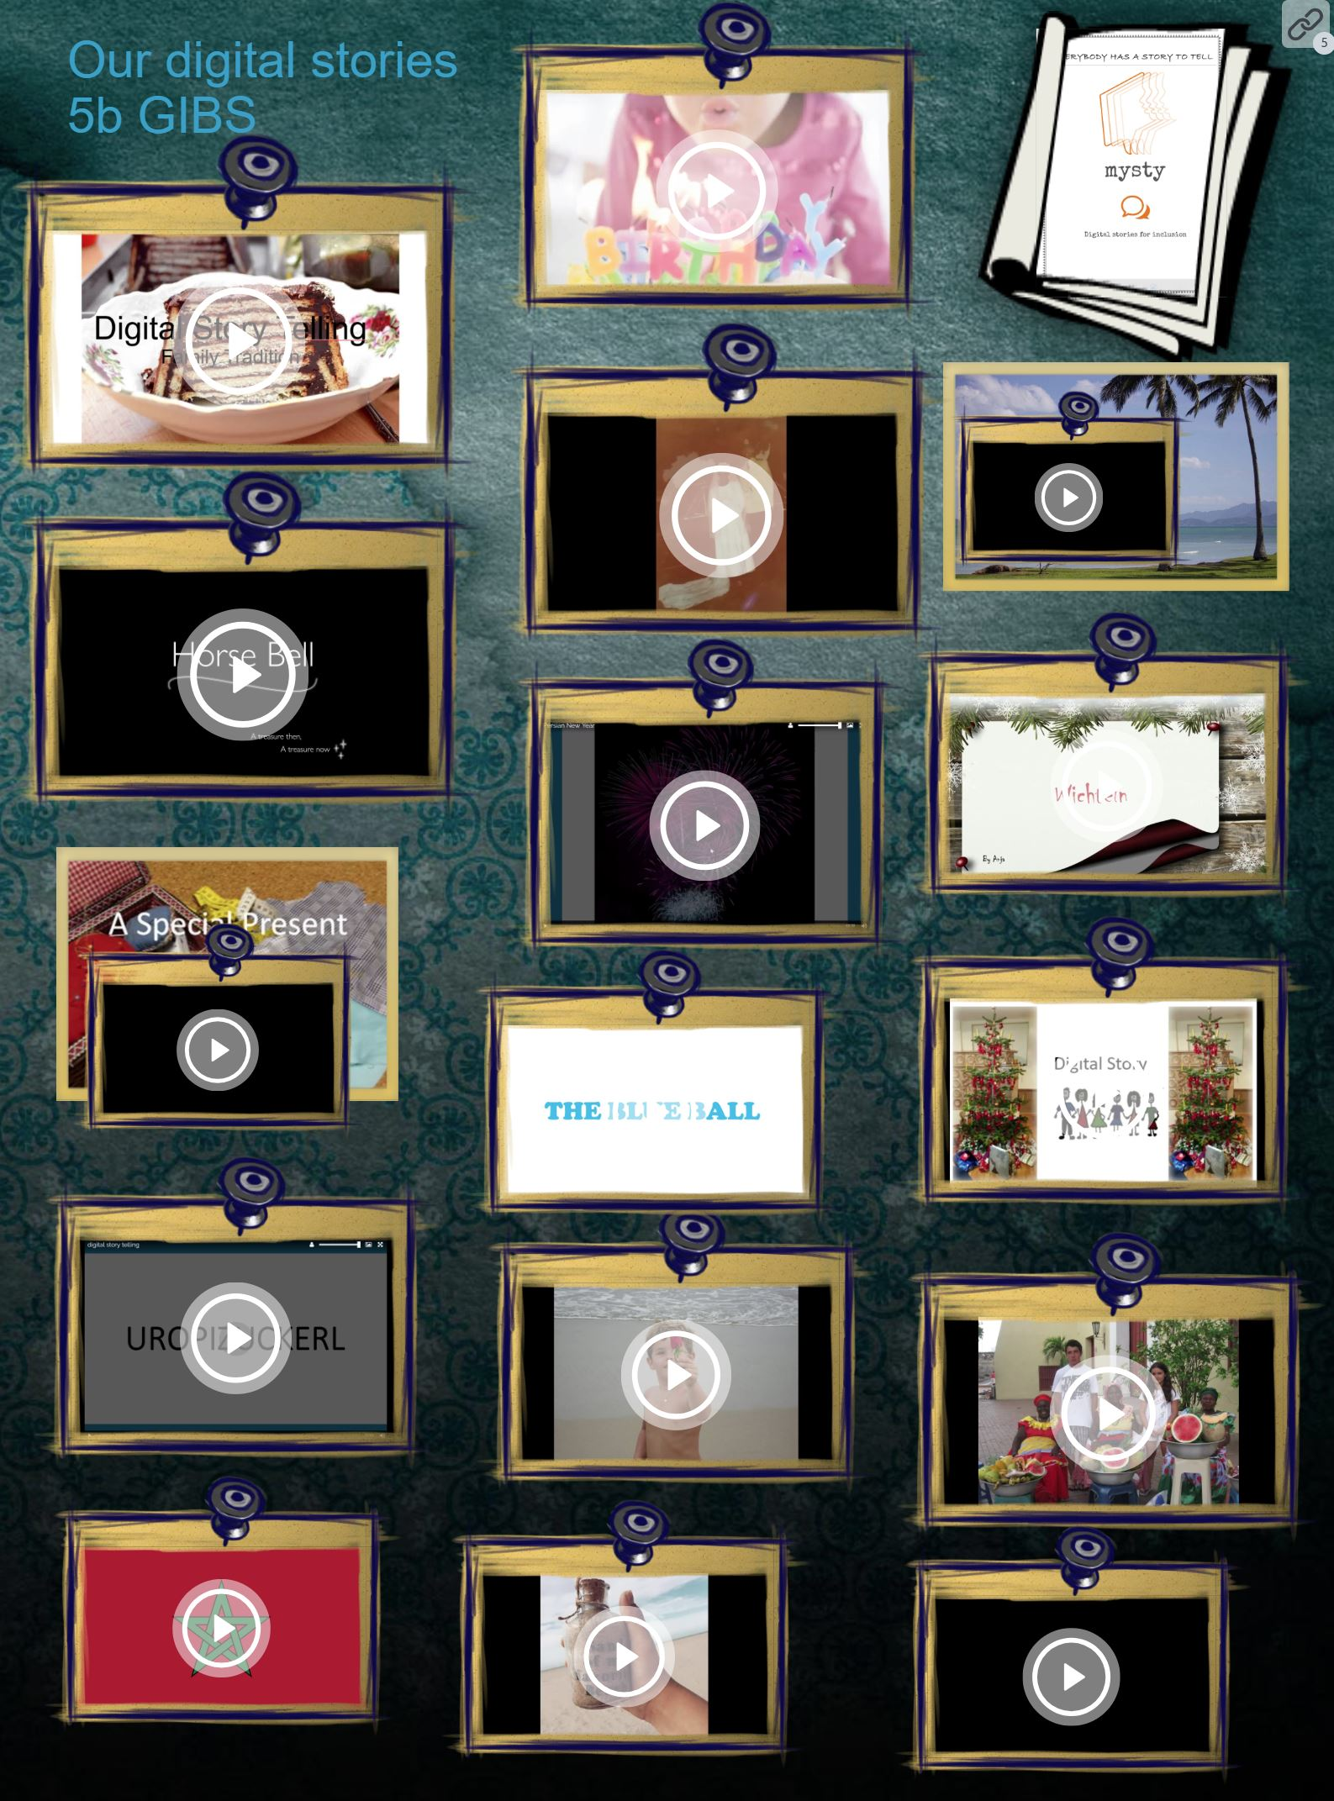
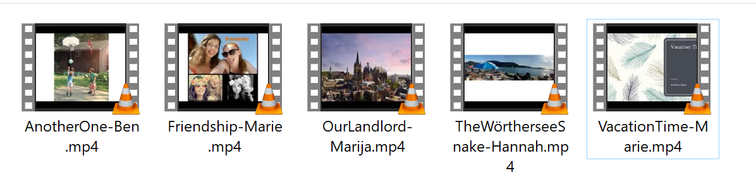
Some of the stories…

Slide 22
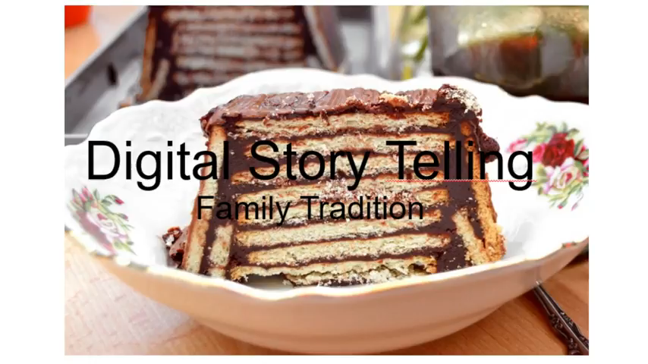
Schwarzer Peter

Slide 23
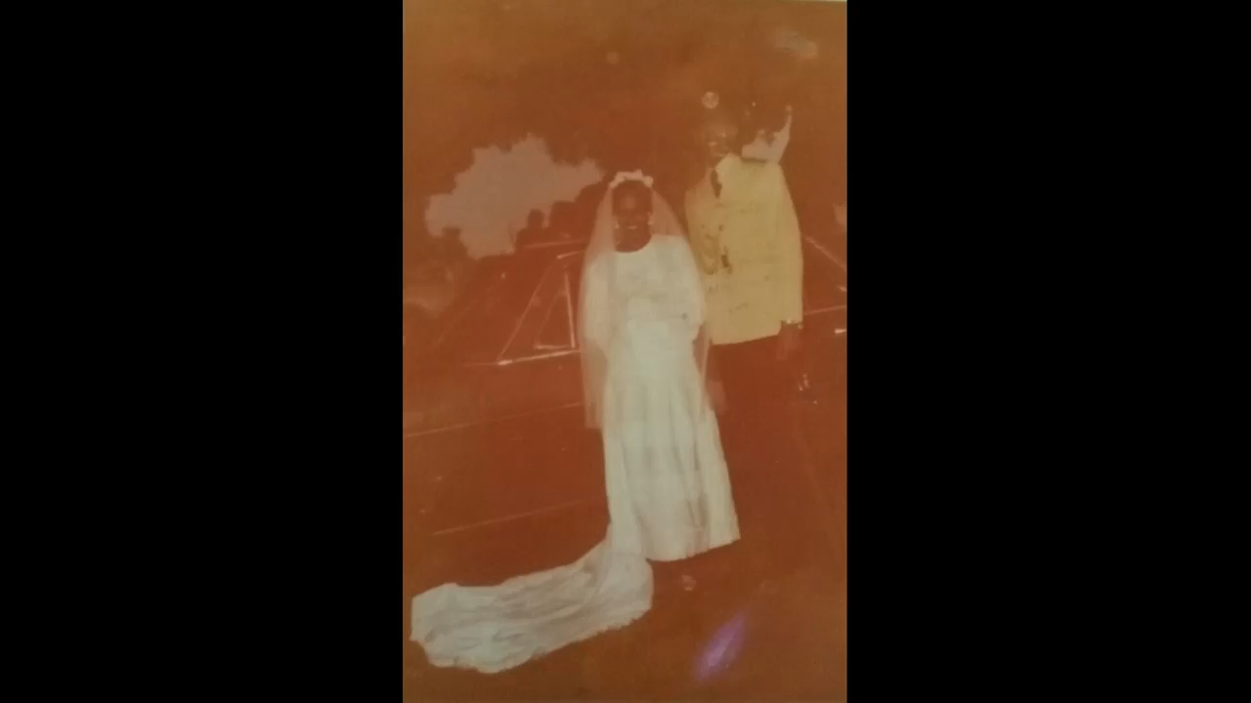
My aunt

Slide 24
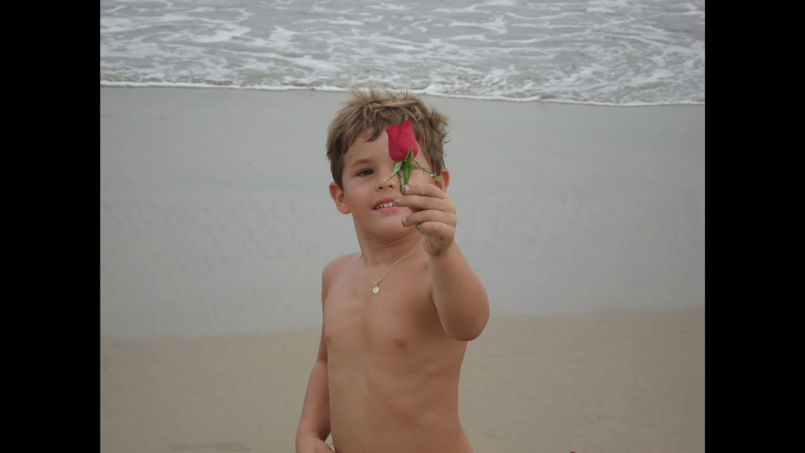
Soccer

Slide 25
For more info read our USER GUIDE or explore the project website
Any questions?
https://mysty.eu/

Slide 26
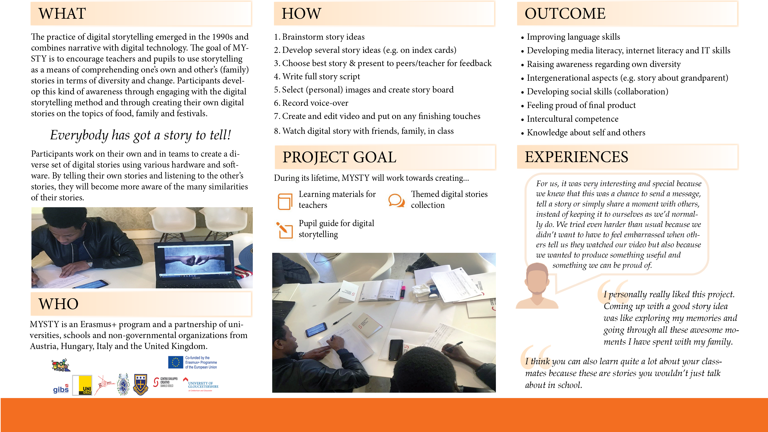

Slide 27
References
Bruchac, J. (1983). The Ship. In E. Nischik Reingard, Short Short Stories (pp. 59-60). Paderborn: Schöninghbuch.
Byram, M. (1997). Teaching and Assessing Intercultural Communicative Competence. Clevedon: Multilingual Matters.
Byram, M. (2000). Assessing Intercultural Competence in Language Teaching. Sprogforum, 8-13. Retrieved 04 13, 2011, from Retrieved from: http://library.au.dk/fileadmin/www.bibliotek.au.dk/Campus_Emdrup/Sprogforum_arkiv/SPROGFORUM_NO._18_Interkulturel_kompetence.pdf
Council of Europe. (2001). Common European Framework of Reference for Languages. Retrieved Juli 19, 2011, from Council of Europe: https://www.coe.int/en/web/common-european-framework-reference-languages/?
Gardner, A., Maierhofer R., & Penz, H. (in print). MyStory: The tale of an Erasmus+ storytelling project. Arbeiten aus Anglistik und Amerikanistik 43(2).
Hartley, J., & McWilliam, K. (2009). Computational Power Meets Human contact. In J. Hartley, & K. McWilliam, (Eds.). Story Circle. Digital Storytelling Around the World (pp. 3-15). Oxford-Wiley Blackwell.
Kidd, D. C. (2018, October 18). Reading Literary Fiction Improves Theory of Mind. Science, 344(6156), 377-380.
Lambert, J. (2010). Digital Storytelling Cookbook. (J. Lambert, Ed.) Retrieved 05 11, 2018, from https://www.storycenter.org/inventory/digital-storytelling-cookbook
Lambert, J. (2013). Digital storytelling: Capturing lives, creating community. New York: Routledge.
Lundby, K. (Ed.) (2008). Digital Storytelling, Mediatized Stories. Self-representation in New Media. New York, etc.: Peter Lang.
McWilliam, K. (2009). The Global diffusion of a Community Media Practice. Digital Storytelling Online. In J. Hartley, & K. McWilliam, (Eds.). Story Circle. Digital Storytelling Around the World (pp. 37-75). Oxford-Wiley Blackwell.
MYSTY. (2018). mysty.eu. Retrieved from mysty.eu: http://mysty.eu
Poelzleitner, E. (2013, January 8). Spooky Stories. Retrieved from epep: Elisabeth Poelzleitner's English Pool: http://epep.at/?page_id=2490
Poelzleitner, E. (2014). Christmas Stories. Retrieved from Reading is Cool: http://readingiscool.xyz/rc/?page_id=380
Pölzleitner, E. (2018). Everybody has a story to tell. Graz, Austria. Retrieved from http://www.polzleitner.com/epep/Gibs/Erasmus-mysty/digital-storytelling-5b/DigitalStorytelling.pdf
Robin, Bernhard R. (2011). The Educational Uses of Digital Storytelling. Retrieved from: http://digitalstorytelling.coe.uh.edu/articles/Educ-Uses-DS.pdf
Robin, Bernhard R. (2016). The Power of Digital Storytelling to Support Teaching and Learning. Digital Education Review 30 (December 2016). http://greav.ub.edu/der/
Tomlinson, C. A. (2014). The Differentiated Classroom. ASCD.
Zull, J. (2002). The Art of Changing the Brain. Sterling: Stylus Publishing.

