Slide 1
Reported Speech
Is it really so Difficult?

Slide 2
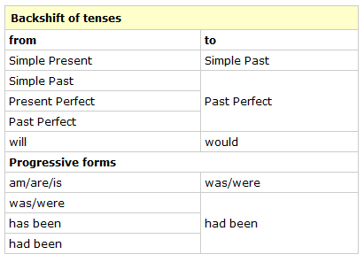
Is this rule valid?
Reported speech:

Slide 3
Let’s look at a few examples
Obama: « I am going to introduce a new health care system for all Americans. »
Queen Elisabeth: « I will not retire – I regard being queen as a job for life. »
But commentators quickly noted that Elizabeth — who seems to be in excellent health — has said in the past that she regards being queen as a "job for life.“ (Daily Herald)
Where do you come from?
She said that ….she comes from… or
She said that …. she came from….
What are you going to do in the semester break?
She said that she is going to…
She said that she ways going to…
« I work at GIBS and at Graz university. «
« I love Greece. I go there every summer. »
Maxi, aged 3: « I have stroked an aligator and I have ridden on a tiger.
Why does the shifting rule not always work?
Notes:
Questions: ask individual participants to whisper their answers into my ear. I will then report what they have said.
Why does shifting not work? Because English speakers do not shift!!! They express their ideas… The process is totally different. (deixis points the way)

Slide 4



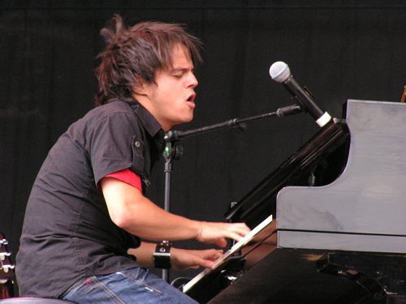



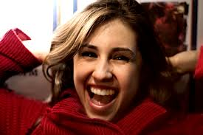
Last week you met your new co-teacher. What did Daniel tell you about himself?

Slide 5
Daniel told us that…
He told us that he owned a candy-apple-red car.
He said that he had eight siblings.
He told us that he had studied at the film academy of New York.
He told us that he loved jazz.
He claimed to have met Jamie Cullum in a cafe in NY and
He told us that he had a dog called Walter because he had loved the picture book when he was a child.
He told us that he had a girlfriend called Danny who was waiting for him back home in America.

