Slide 1
The winners are…
Present Tenses: Grammar Rules Contest 1b

Slide 2
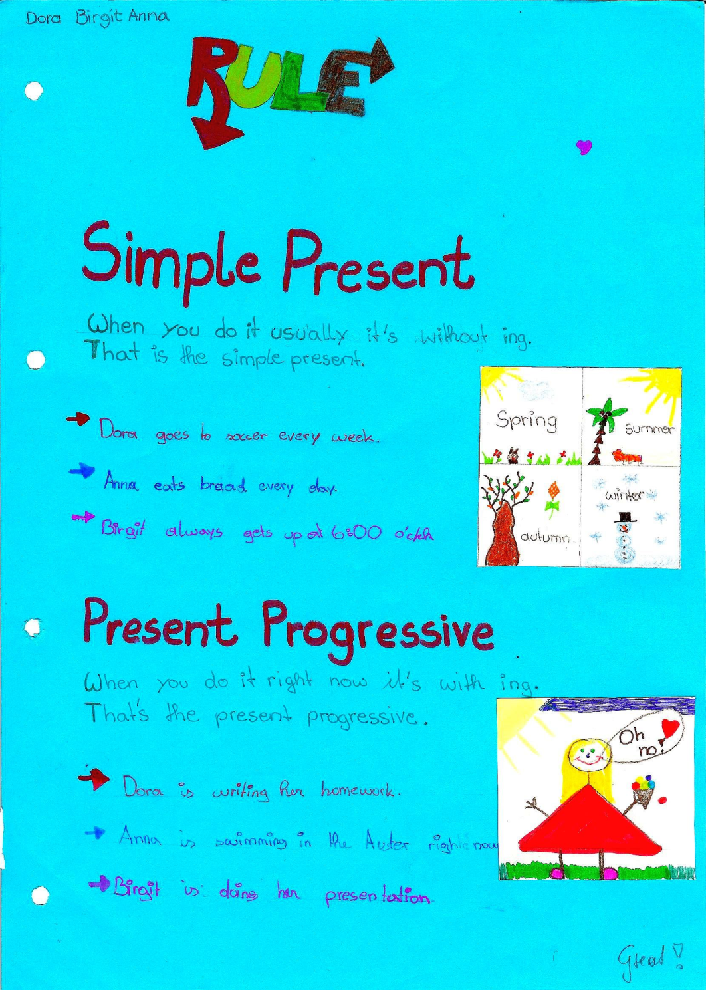
3

Slide 3
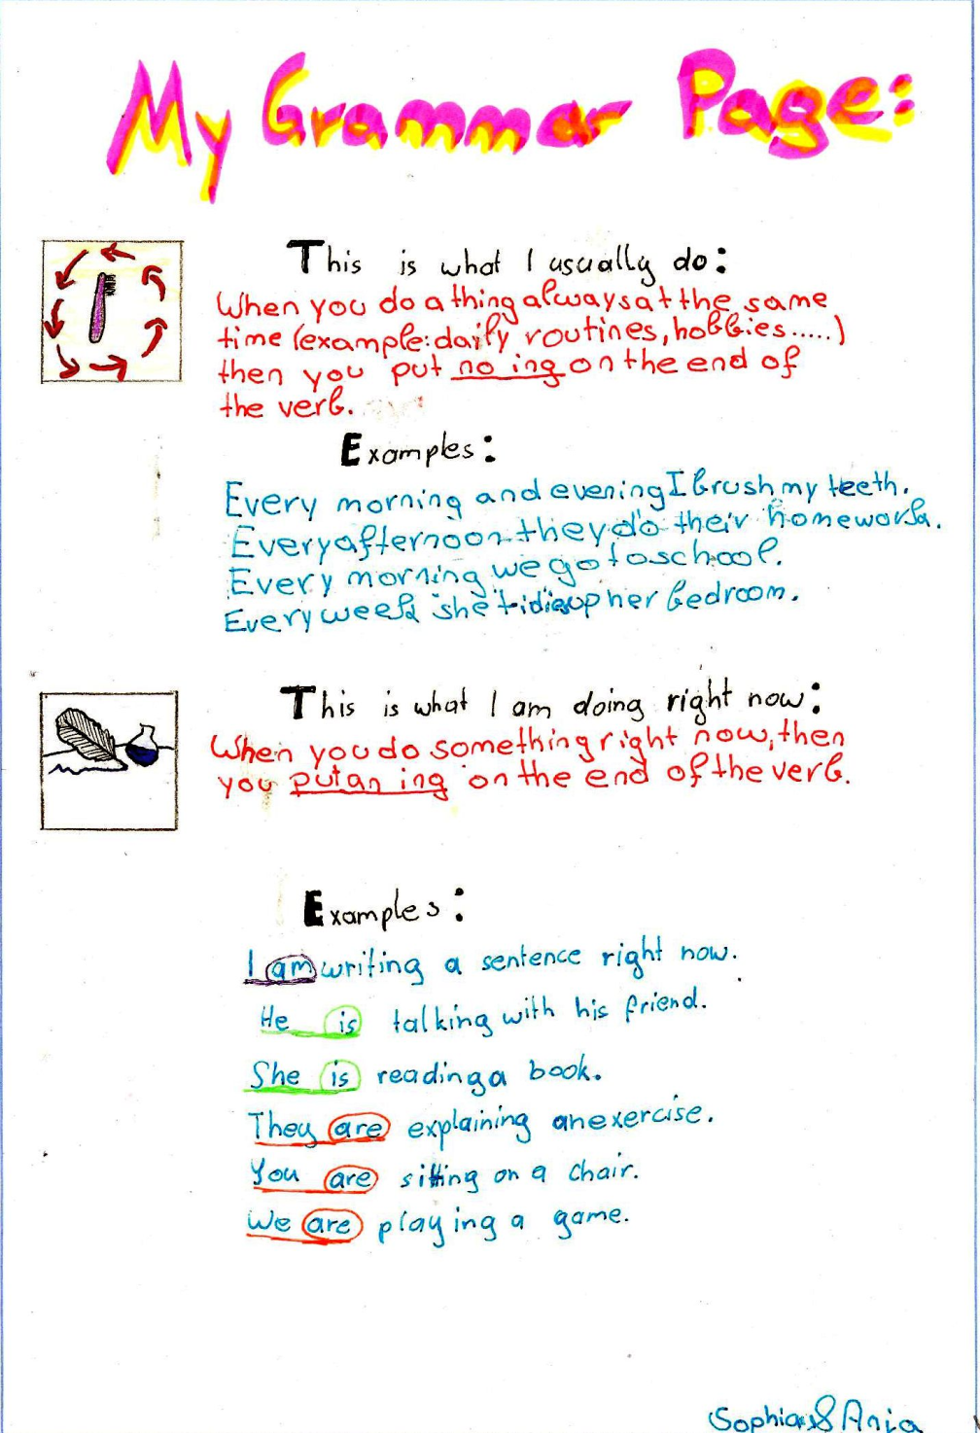
2

Slide 4
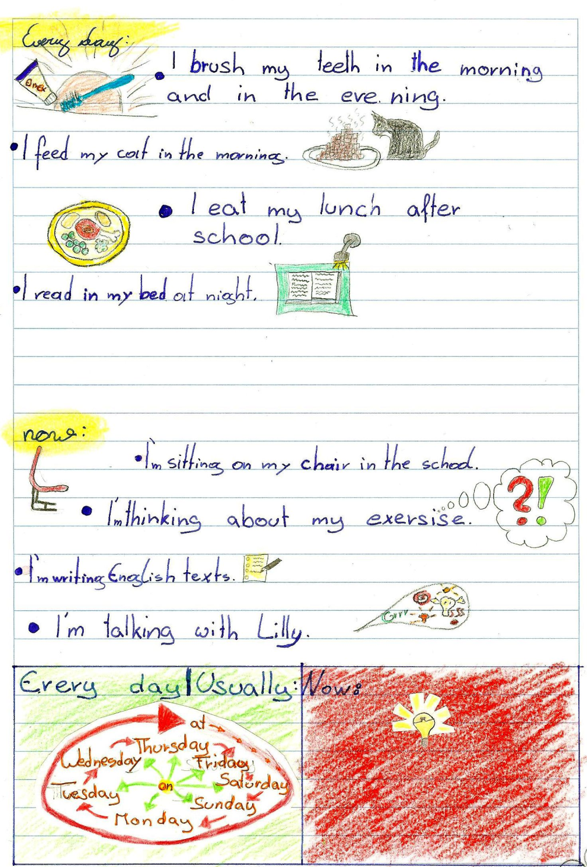
1

