Slide 1
Our new co-teacher
What Did Daniel tell you…?

Slide 2
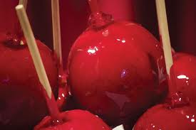
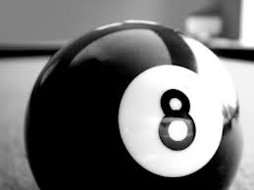

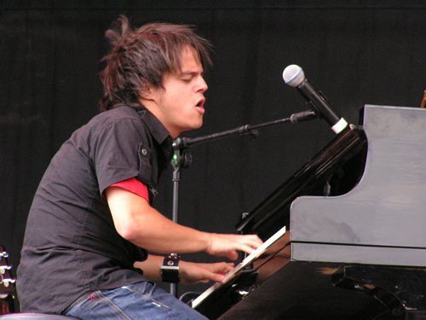



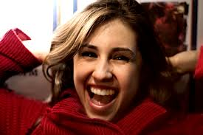
Last week you met your new co-teacher.
What did Daniel tell you about himself?

Slide 3
Daniel told us that…
He told us that he owned a candy-apple-red car.
He said that he had eight siblings.
He told us that he had studied at the film academy of New York.
He told us that he loved jazz.
He claimed to have met Jamie Cullum in a cafe in NY and
He told us that he had a dog called Walter because he had loved the picture book when he was a child.
He told us that he had a girlfriend called Danny who was waiting for him back home in America.

