Slide 1
What might this be?
Speculating about pictures

Slide 2
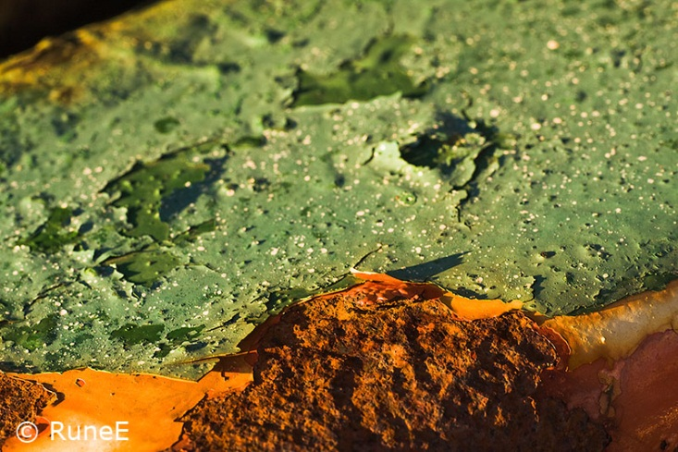
What might this be?
Notes:
What might this be? A shot of the moon - cheese, horizon, craters and all? No, just a piece of rusty junk found on a quay by a hobby photographer who was looking for something suitable for a shot by a macro lens.
http://visualnorway.blogspot.com/2008_12_01_archive.html

Slide 3

What might this be?
Notes:
Brain scan: http://www.psychologicalscience.com/physiology/

Slide 4
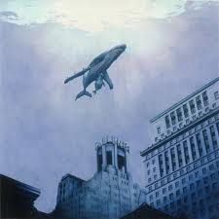
What might this be?
Notes:
A painting by Don Simon warning of the rising sea levels due to global warming: http://www.treehugger.com/galleries/2009/02/the-unnaturalism-of-human-habitat.php

Slide 5
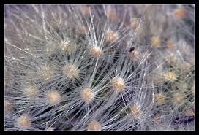
What might this be?
Notes:
Cactus spines: http://forum.auscactiforum.net/t1056-what-might-this-be

Slide 6
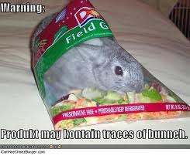
What might this be?

Slide 7
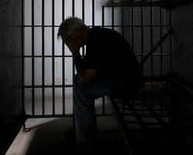
What might have happened?

Slide 8
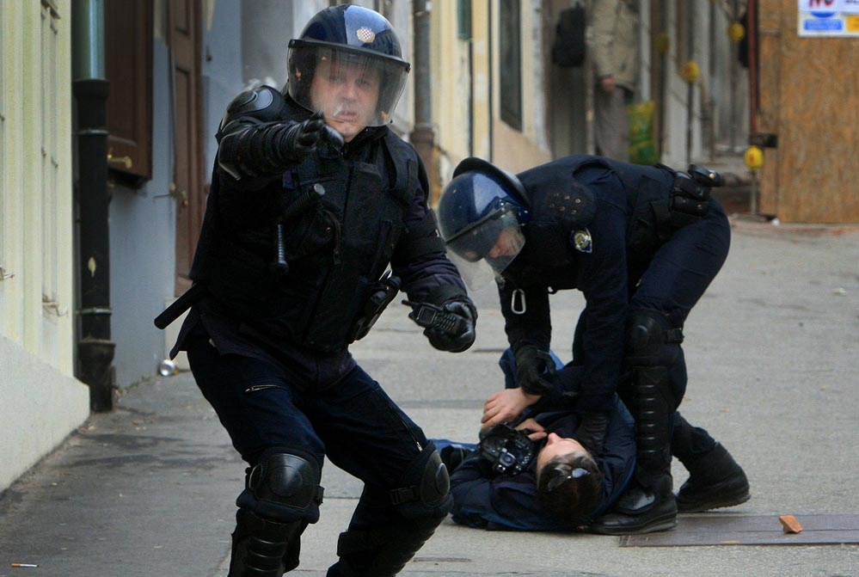
What might have happened?

Slide 9

What might he be doing?
Notes:
Playing baseball: http://www.natsnq.com/?tag=john-lannan

Slide 10
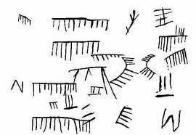
What might this be?
Notes:
Stone Age counting: What might they be counting? http://nrich.maths.org/2472

Slide 11

What might this be?
Notes:
Poster raising awareness about high school dropouts

Slide 12
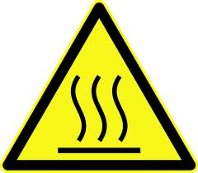
What might this sign mean?
Notes:
Hot surface: http://chemistry.about.com/od/PrintableQuizzes/tp/Printable-Lab-Safety-Sign-Quiz.htm

Slide 13
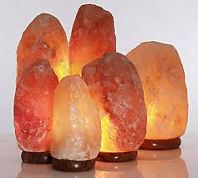
What might this sign mean?
Notes:
Rock salt lamps: http://www.thenakedscientists.com/forum/index.php?topic=11526.msg354401%3Bboardseen

