Slide 1


How to make a video story with Powerpoint

Slide 2

Prepare your presentation
Upload your drawings.
Put them into the correct order
Write your text for each slide.
This Photo by Unknown Author is licensed under CC BY

Slide 3

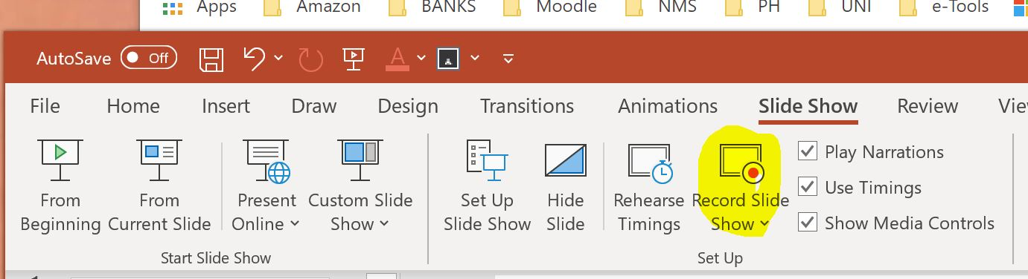
Record your presentation
Add page-flip transitions so your presentation looks like a book.
Click Slide Show – then click Record Slide Show and record your presentation for each slide.
Save your presentation
This Photo by Unknown Author is licensed under CC BY-SA

Slide 4

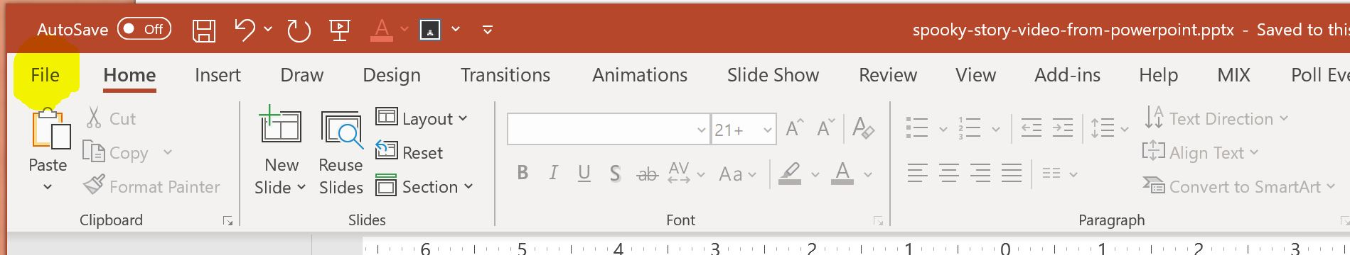
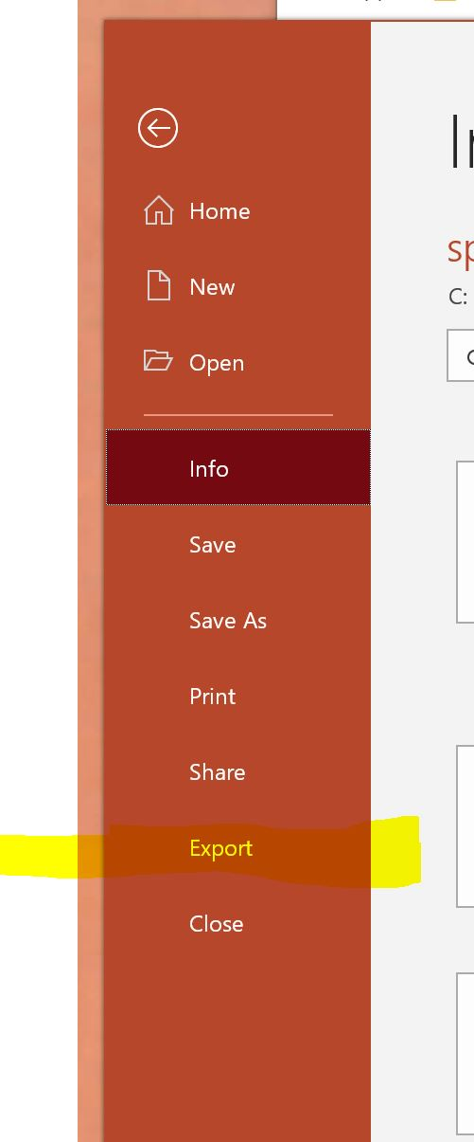
Save your presentation as a video
Click: FILE
Click: Export

Slide 5

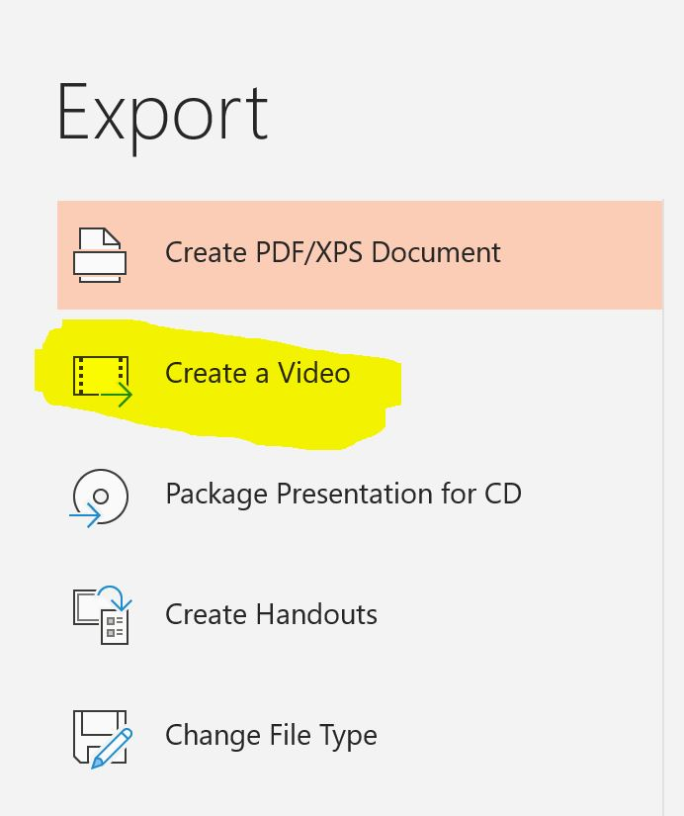
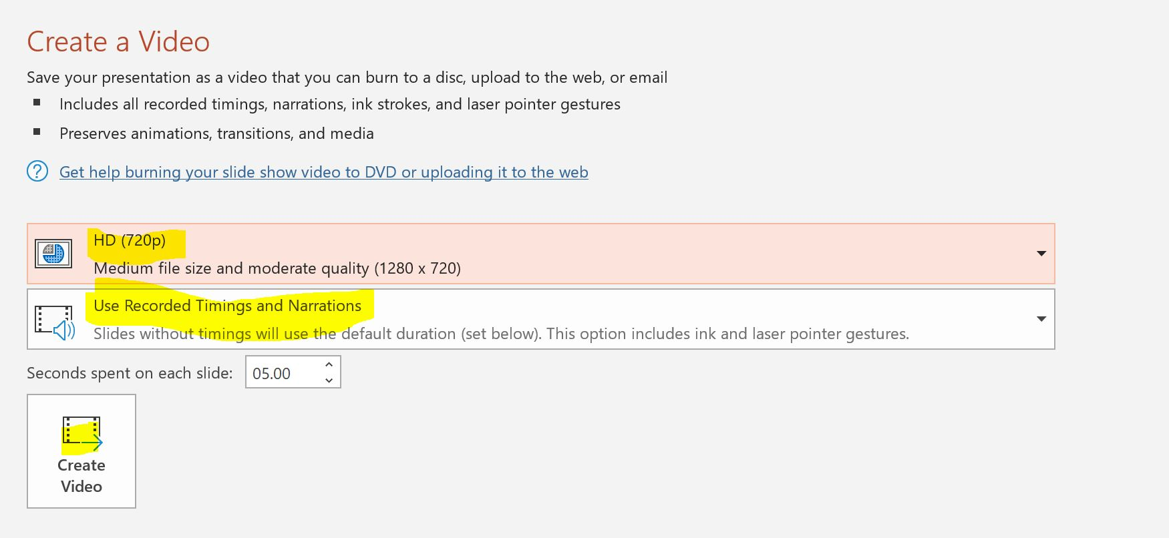
Save your presentation as a video
Save your file in a place where you can find it !!!
Click: Create a Video
Choose:
HD (720p)
Use Recorded Timings…
Then click: Create video
This Photo by Unknown Author is licensed under CC BY-NC-ND

