Slide 1

How to record your Presentation on Powerpoint

Slide 2


Prepare a nice presentation
Prepare your presentation:
Tips:
Pictures are better than words.
Write keywords, but avoid long sentences

Slide 3
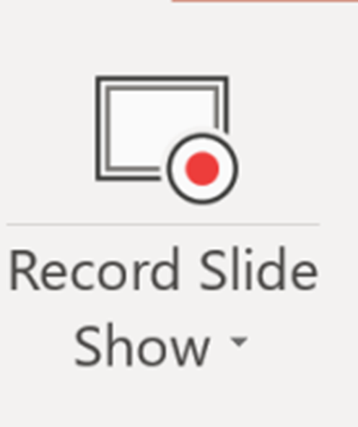
Record your presentation
2. Add simple transitions (fancy transitions distract the attention of your audience)
3. Click Slide Show – then click Record Slide Show and record your presentation for each slide.
4. Save your presentation
5. Click FILE --- EXPORT – and
choose the video format and size that you prefer.
choose: Use recorded timings and narrations.

Slide 4
Save your presentation as a video
click FILE – EXPORT –and
click CREATE a VIDEO
and choose the size and format that you prefer
choose: use timings and recordings

